Slide 1
Future trends of precipitation extremes in the eastern Mediterranean
George Zittis, Adriana Bruggeman, Panos Hadjinicolaou & Jos Lelieveld

Slide 2
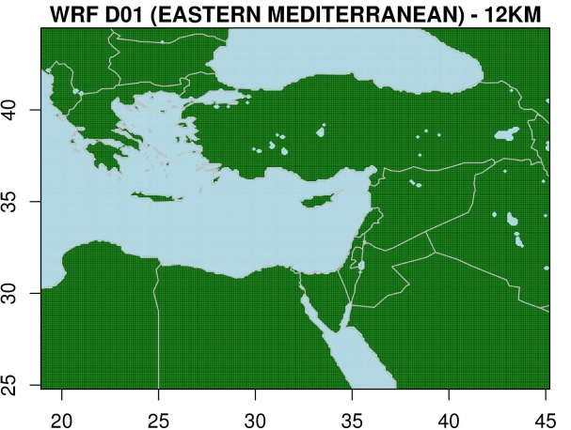
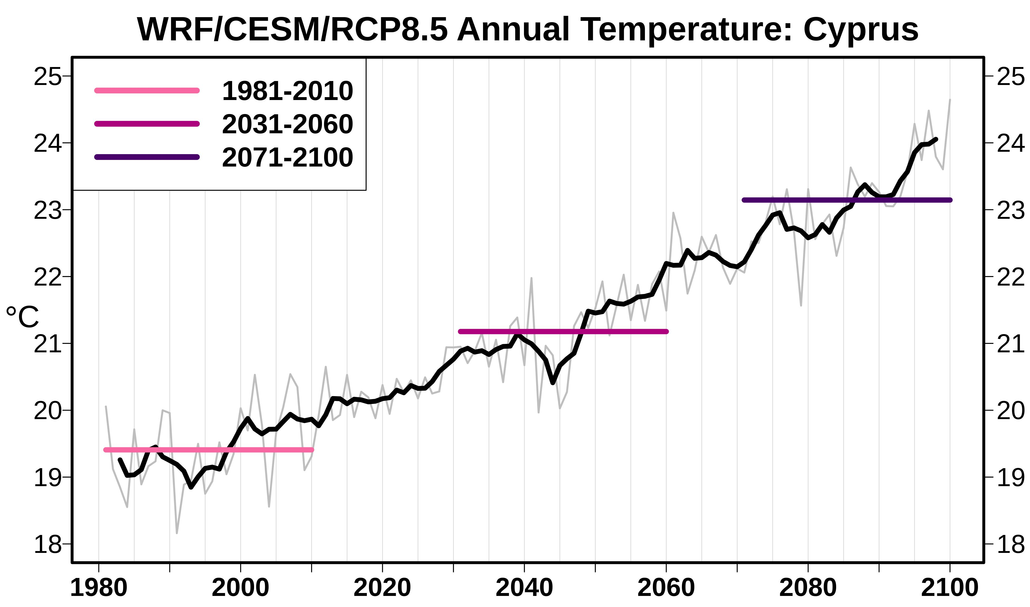
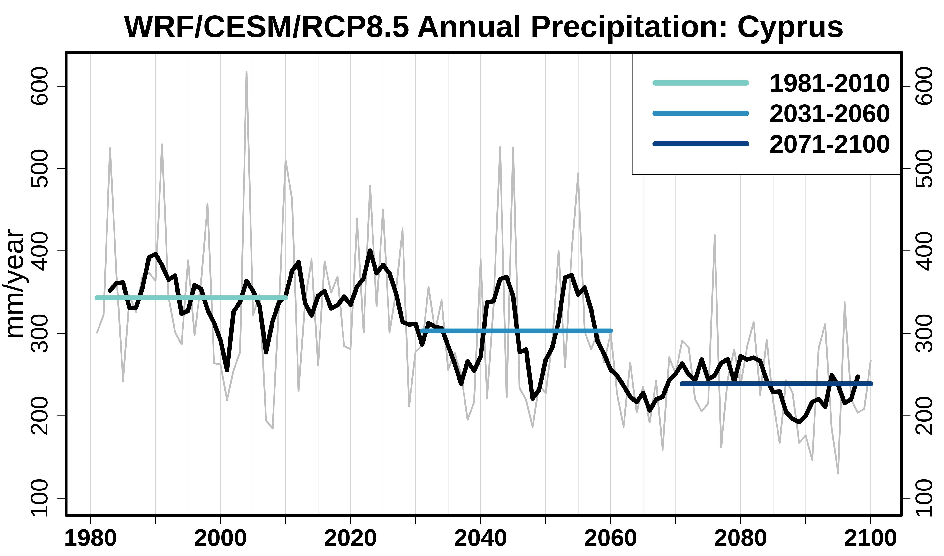
Description of Simulation
CESM/WRF/RCP8.5
One-way nesting
Resolution: 12km/6h
40 vertical levels (20 hPa)
Optimised physics options for the EMME environment

Slide 3
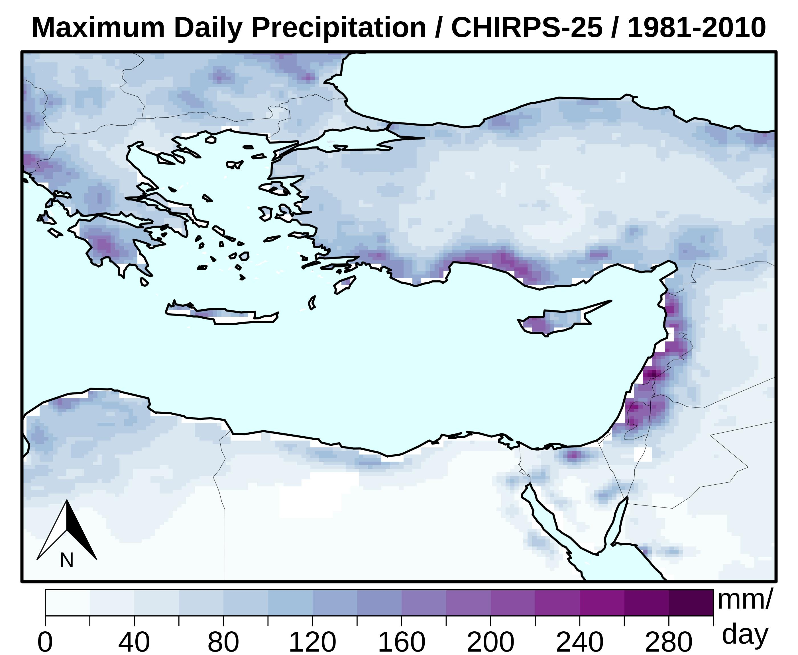
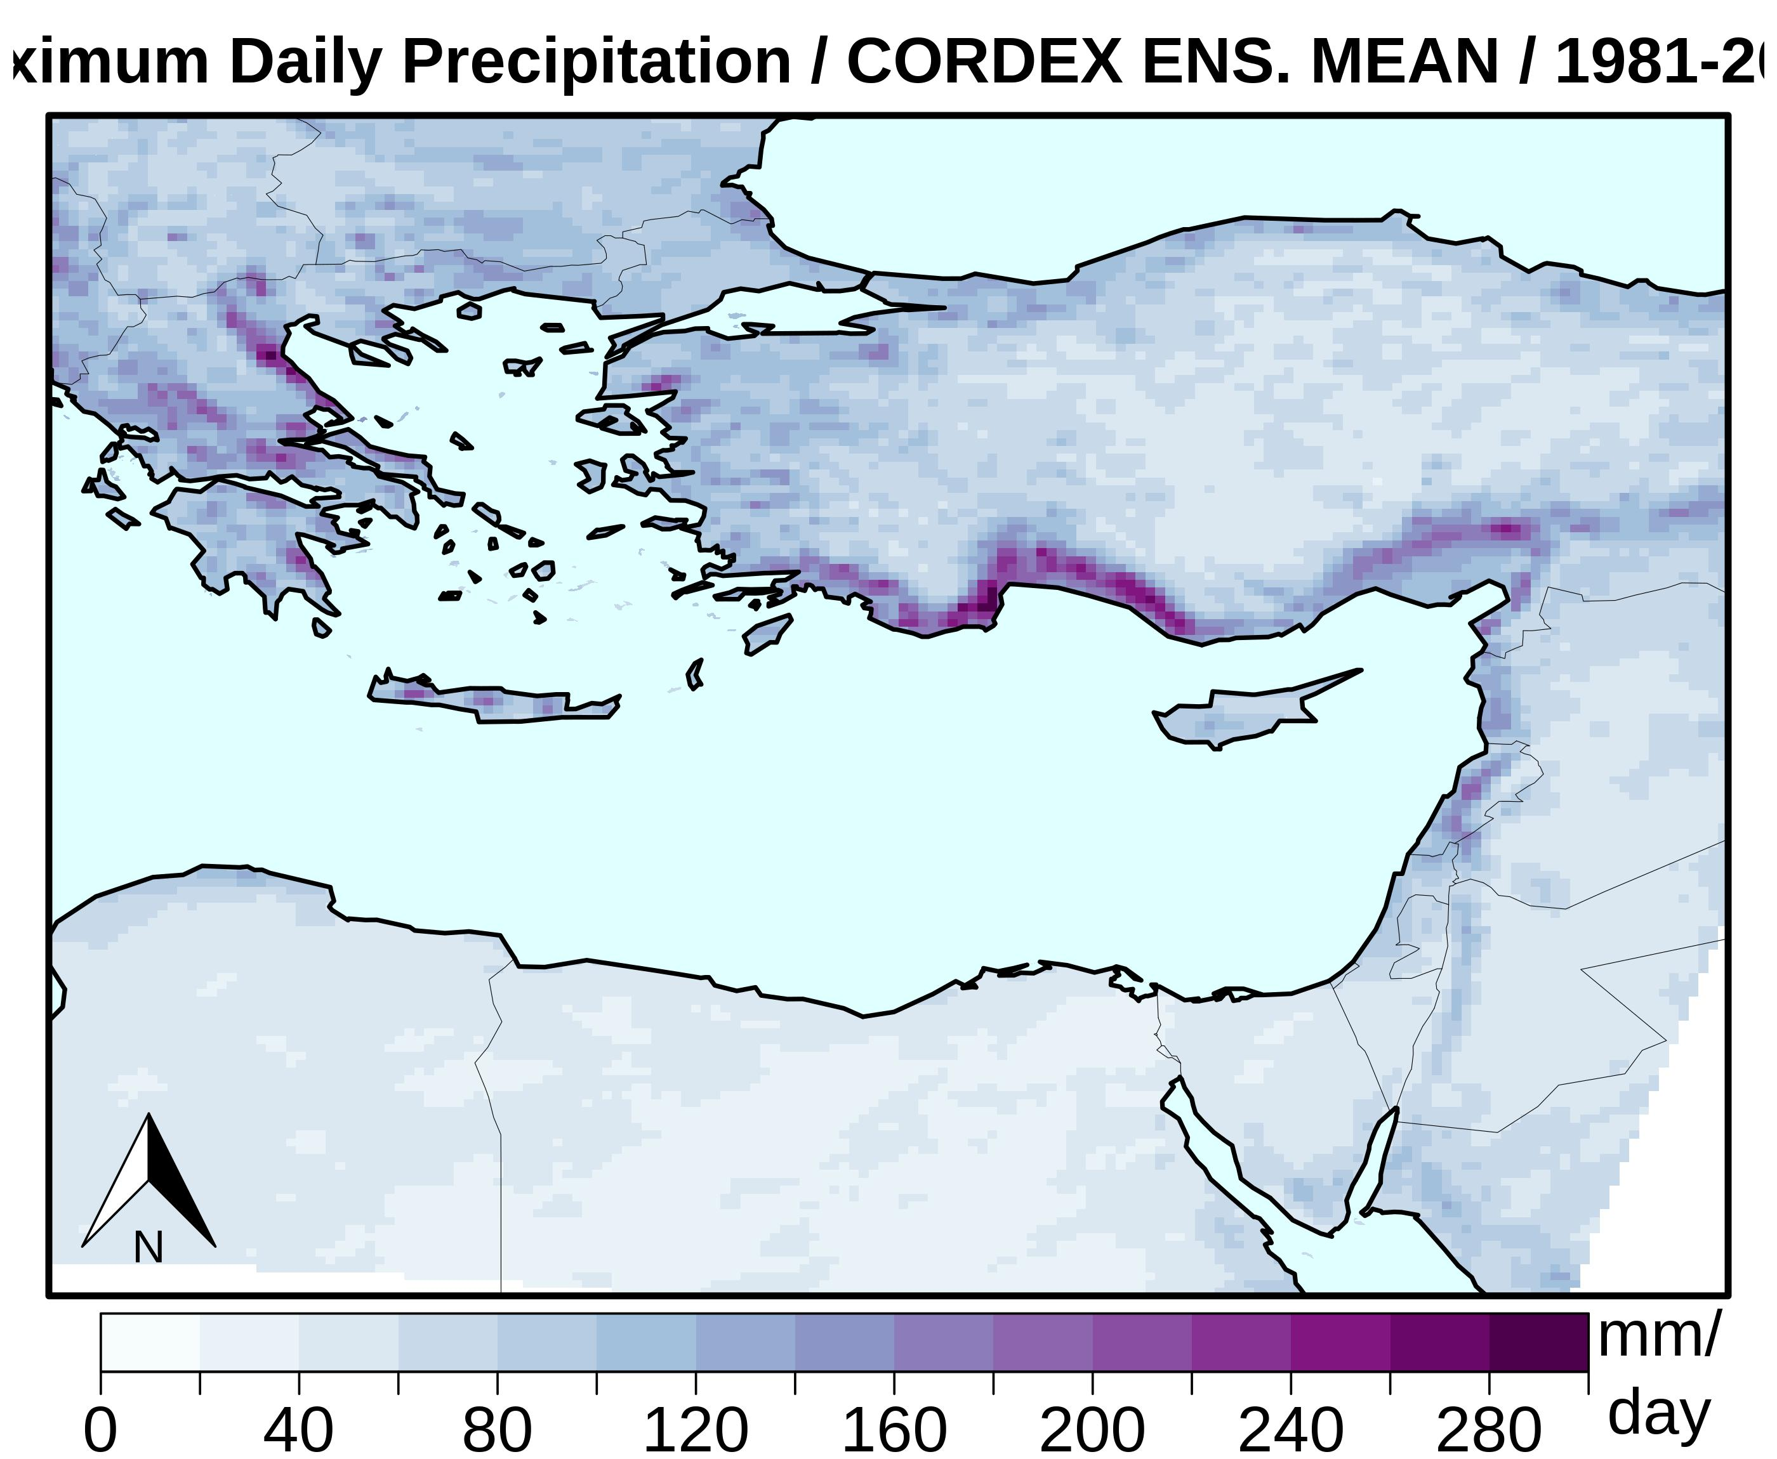
Comparison with Obs. & EURO-CORDEX
Validation for recent past
Maximum daily precipitation per year (Rx1day)
1981-2010
CHIRPS (25×25 km)
Ens. mean of 25 EURO-CORDEX simulations
(12×12 km)
CYI-WRF
(12×12 km)

Slide 4
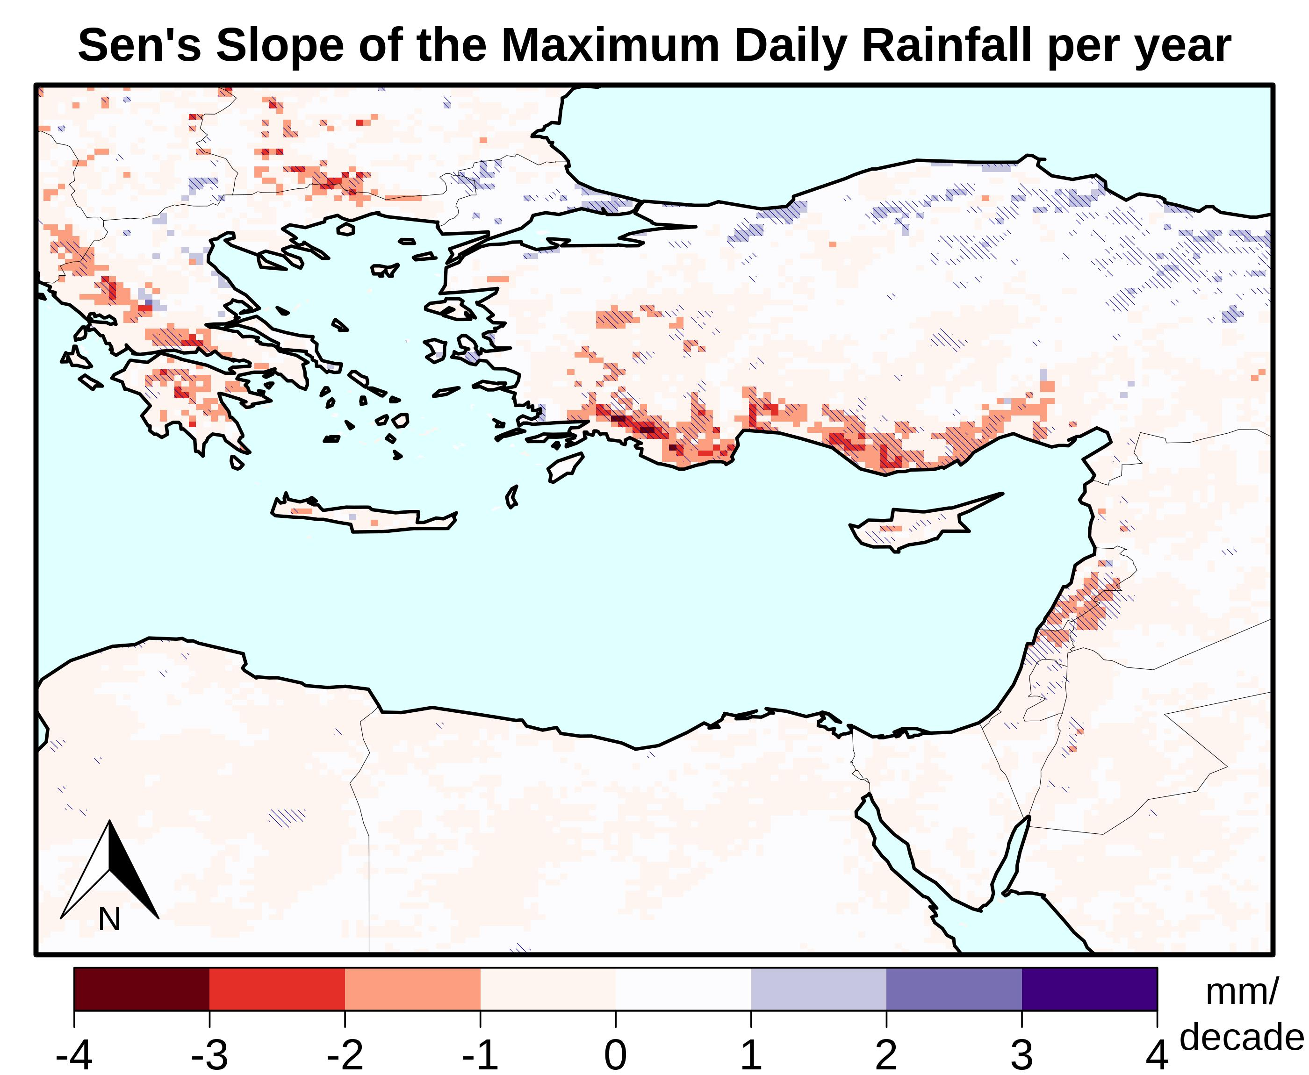
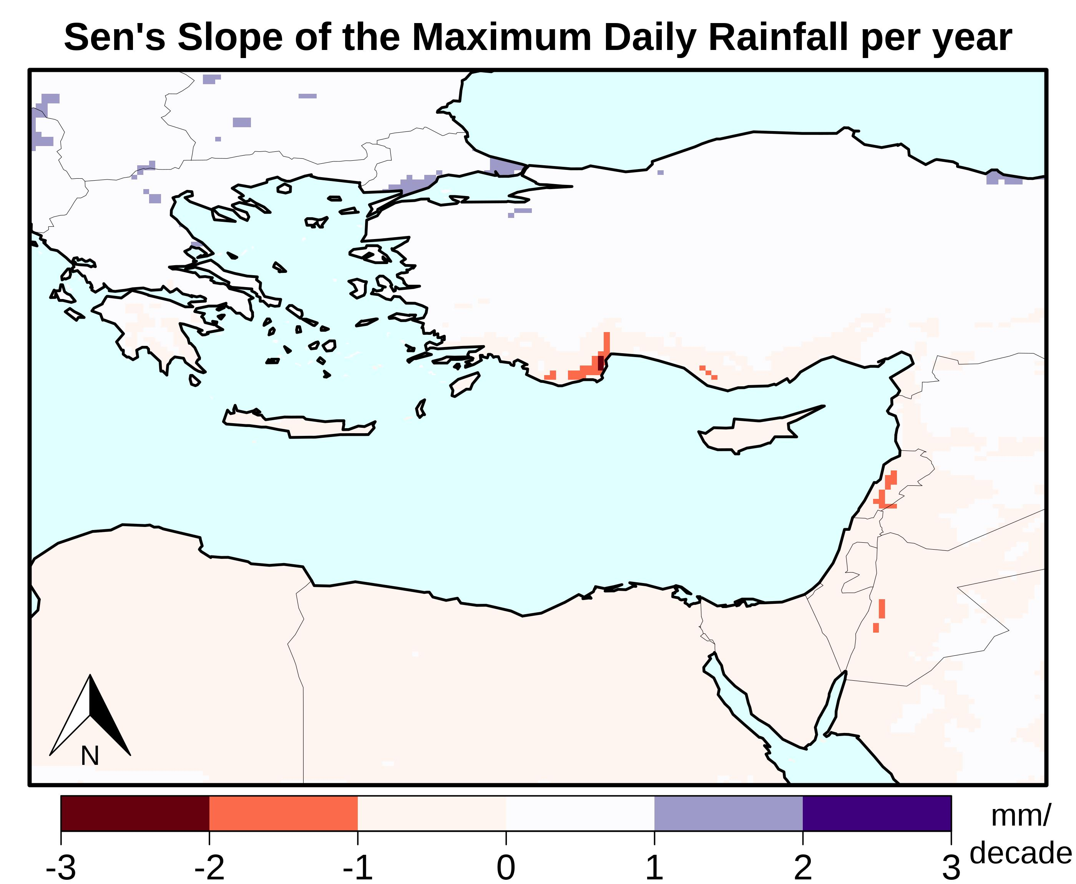
Trends of future precipitation extremes
CYI-CESM/WRF
ENS. MEAN (25 EURO-CORDEX SIMS)
Maximum daily precipitation / year
2001 – 2100
Mann-Kendall test for trends (significance)
Sen’s Slope Estimator for direction of trends

Slide 5
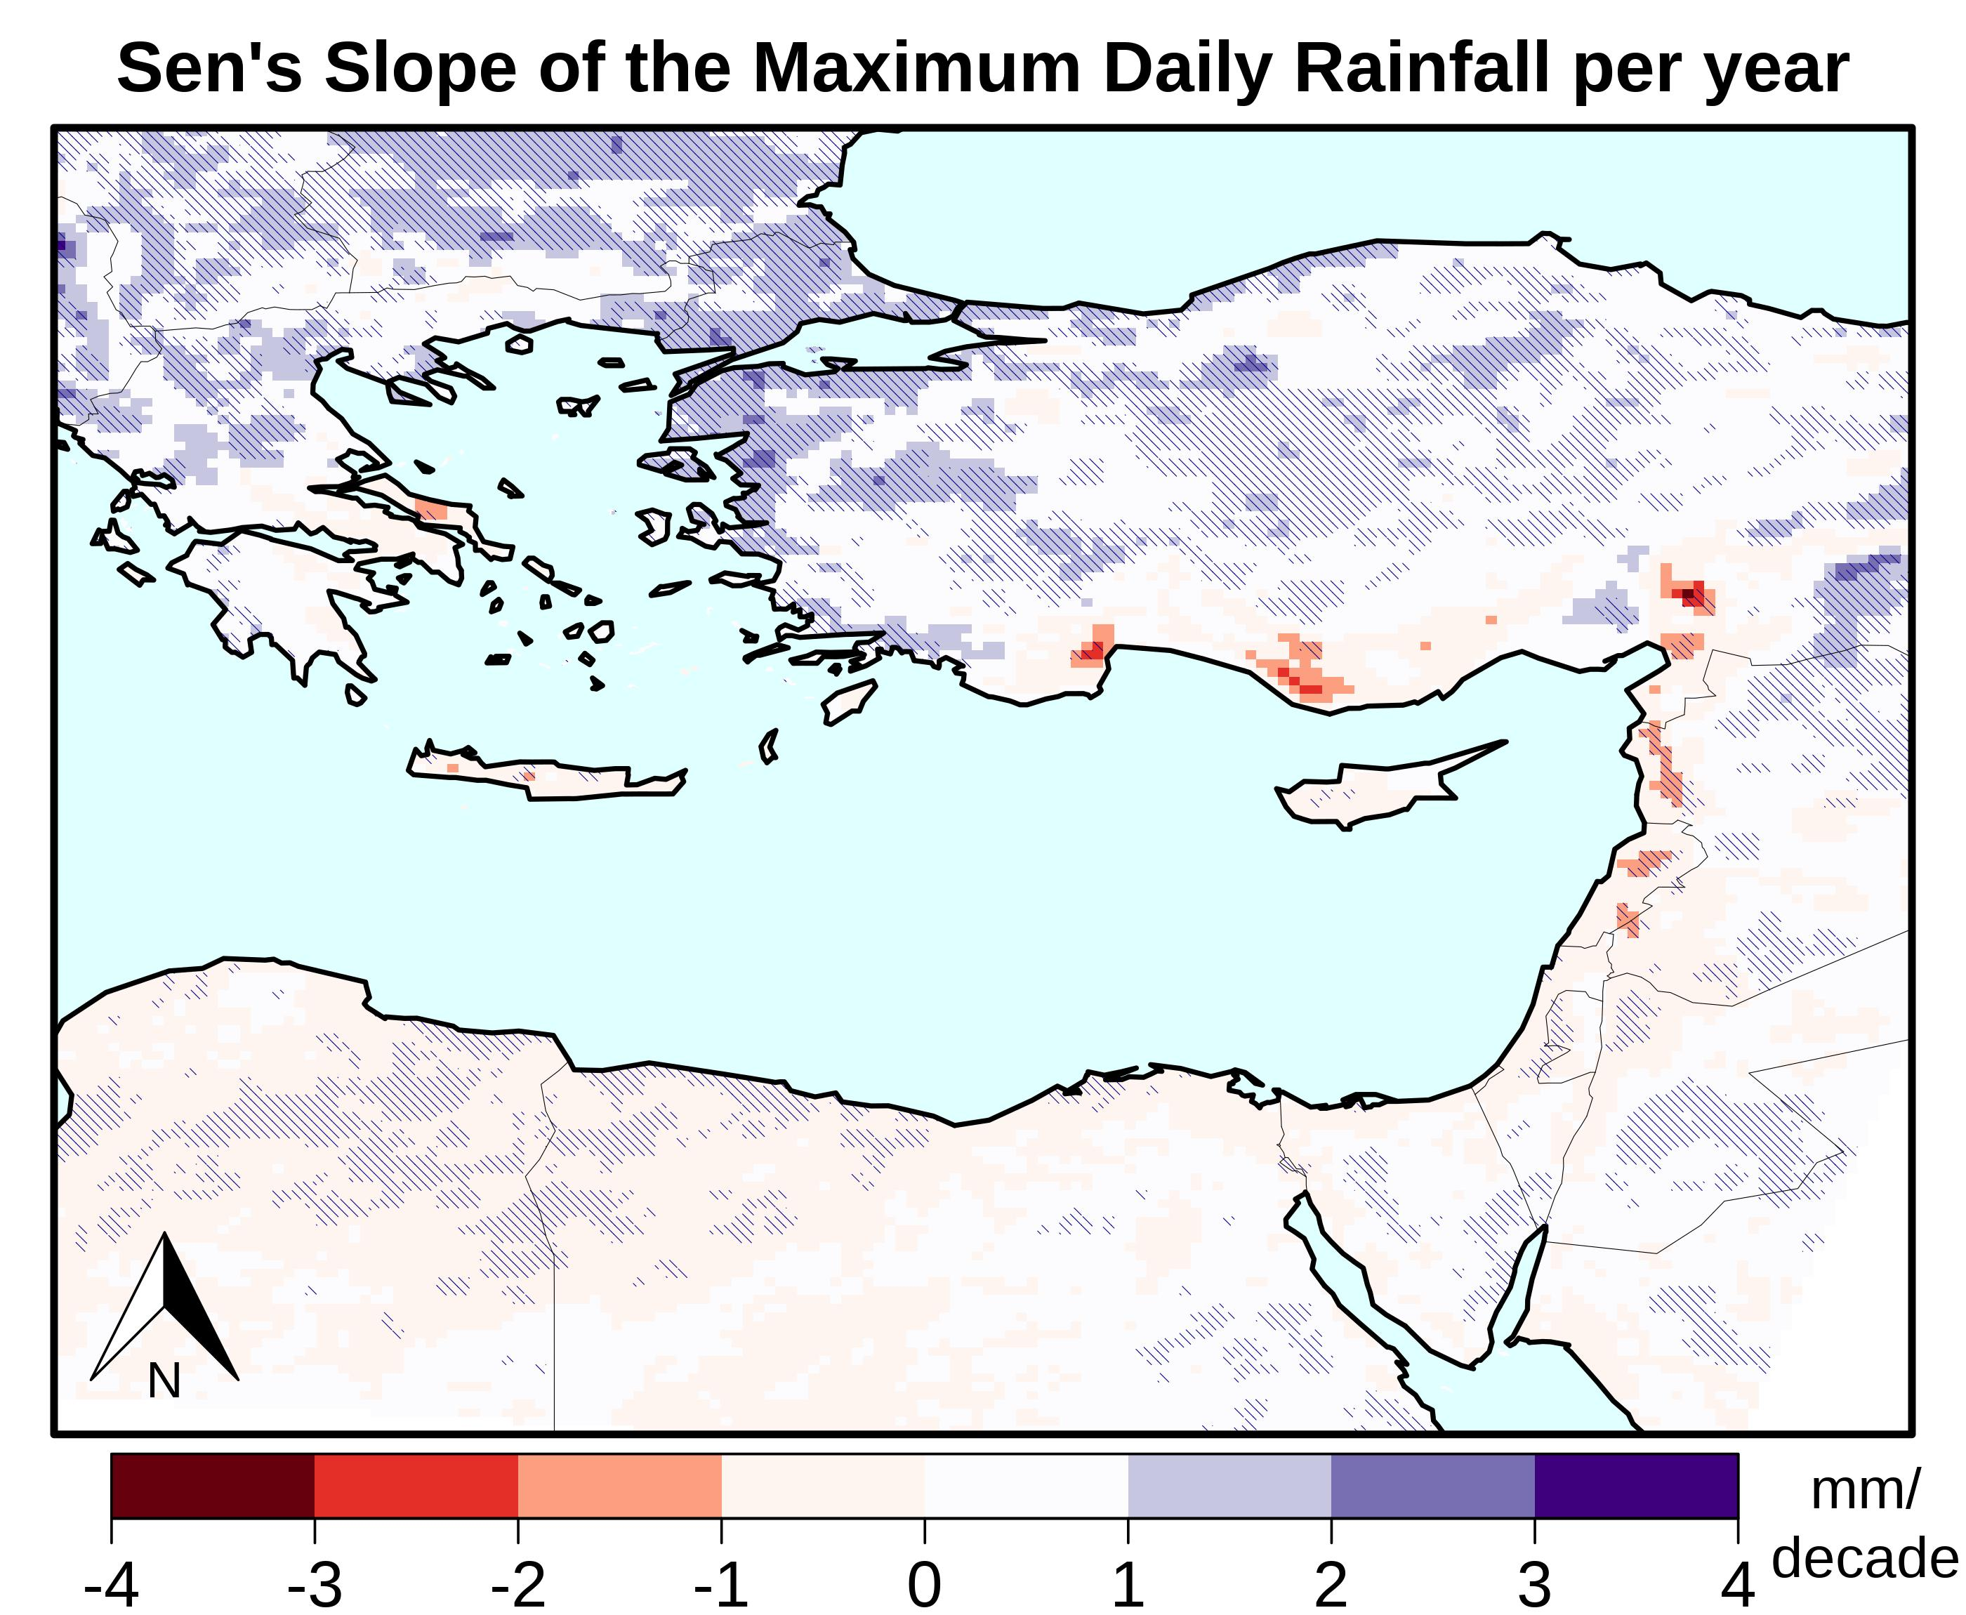
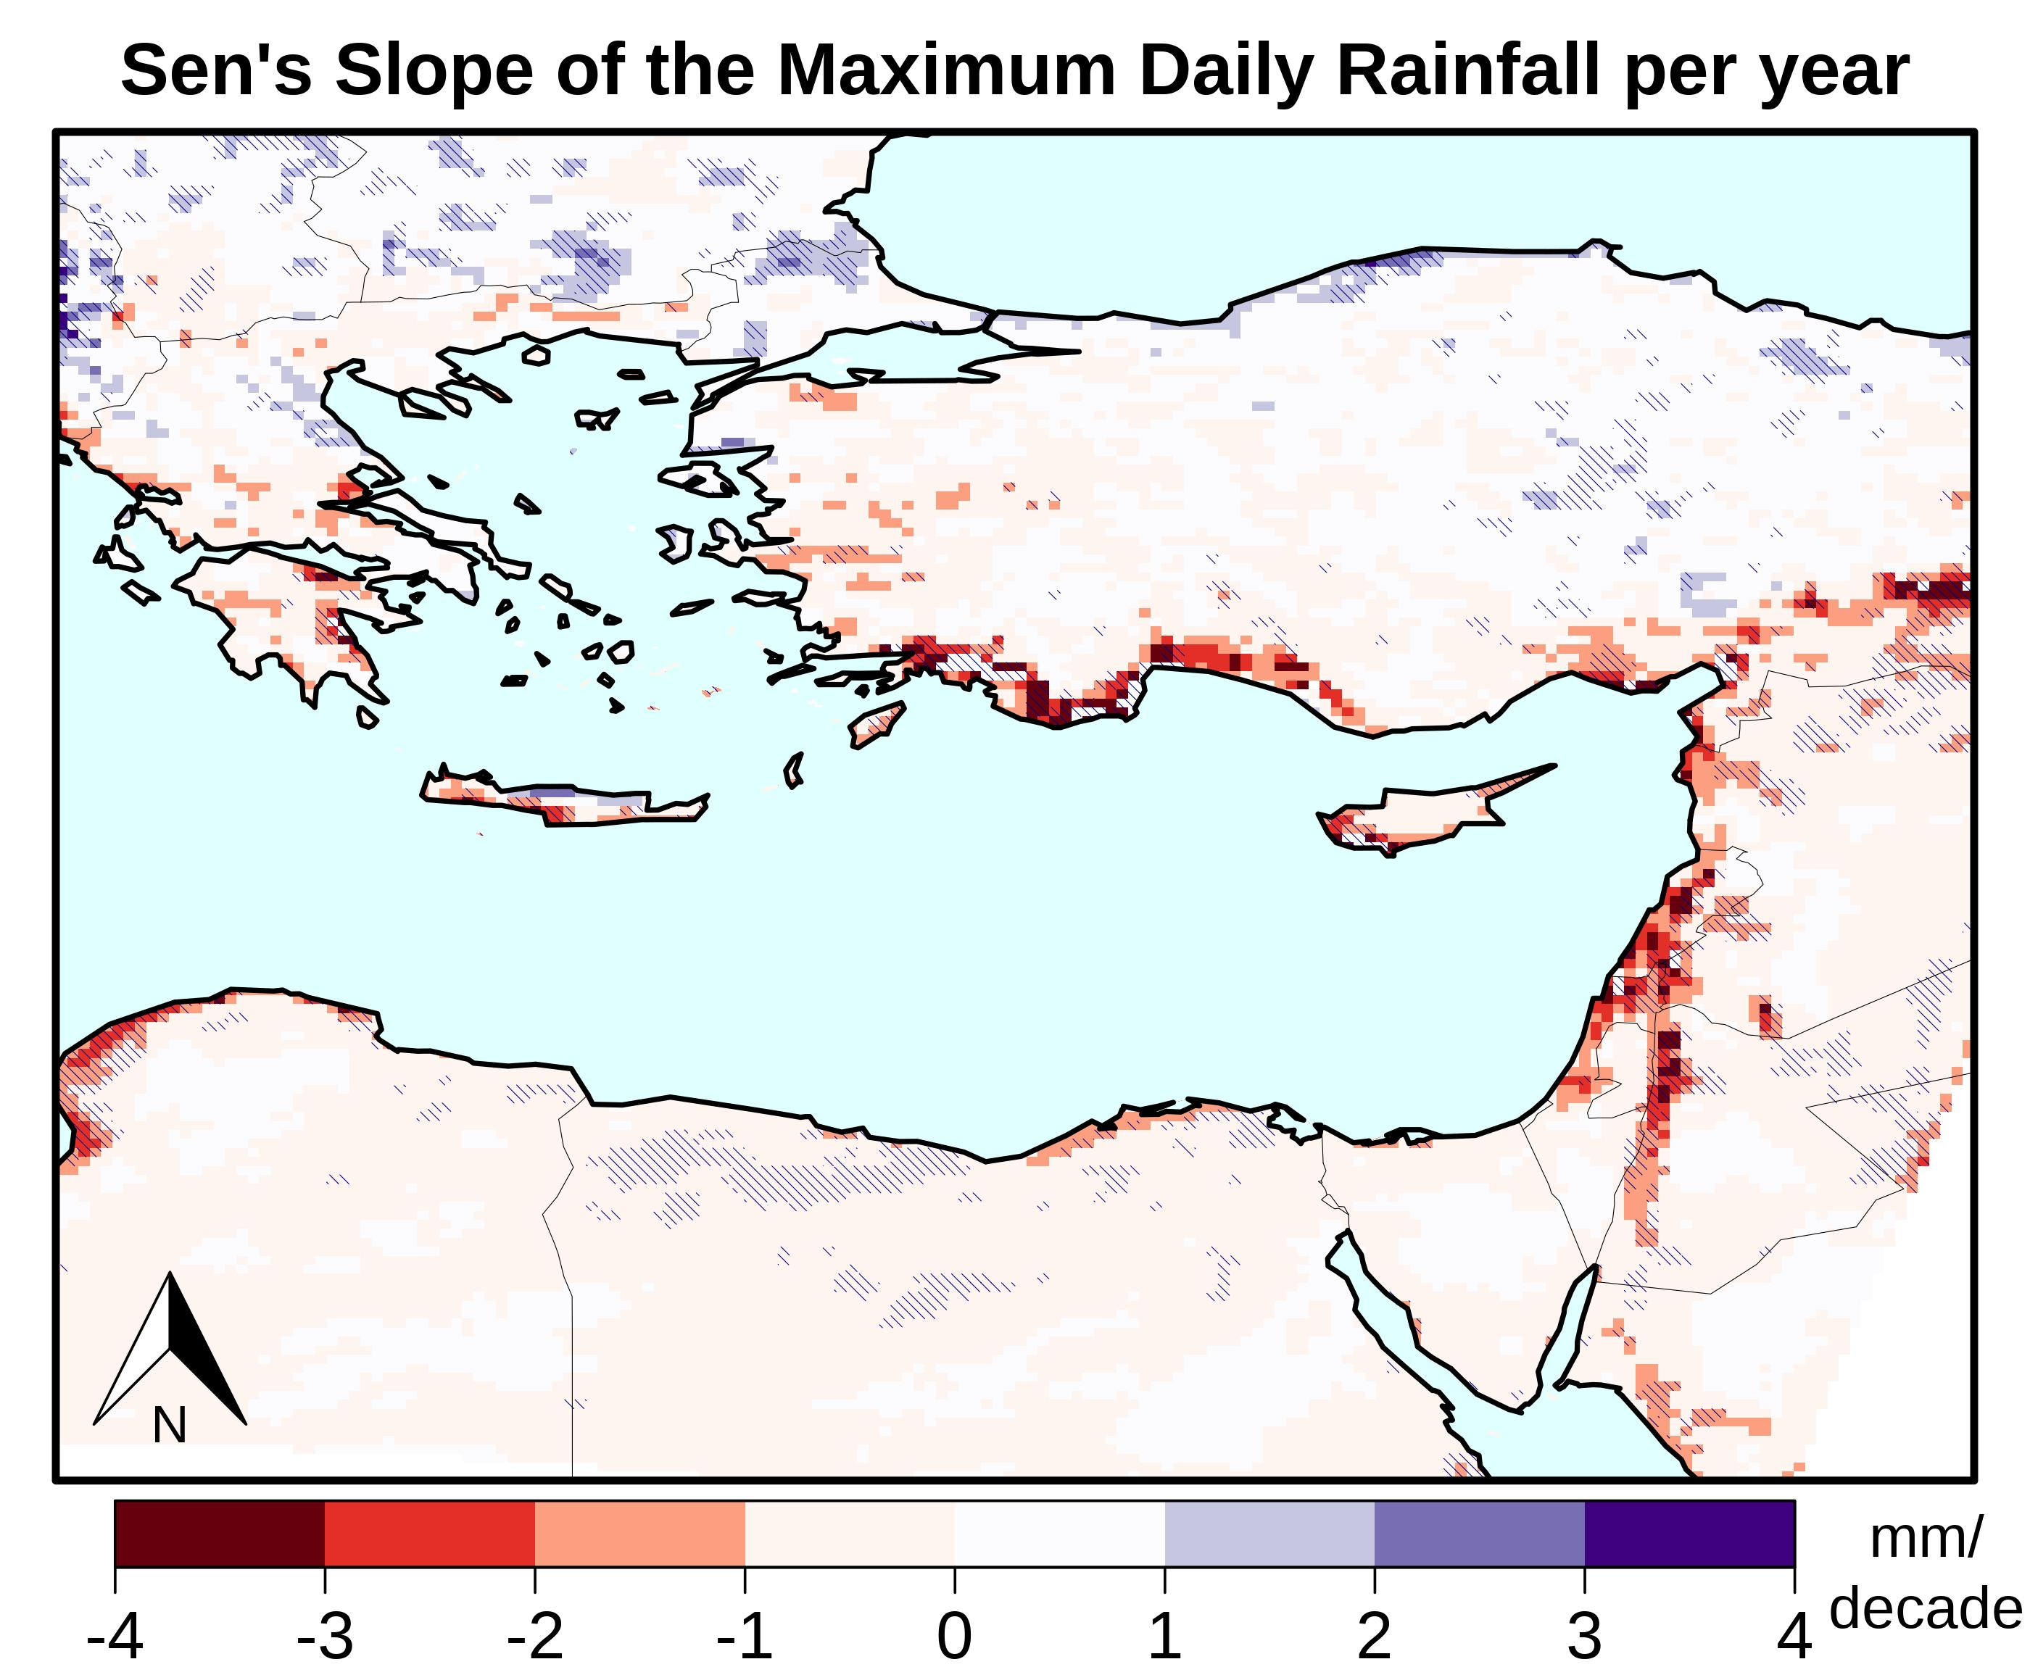
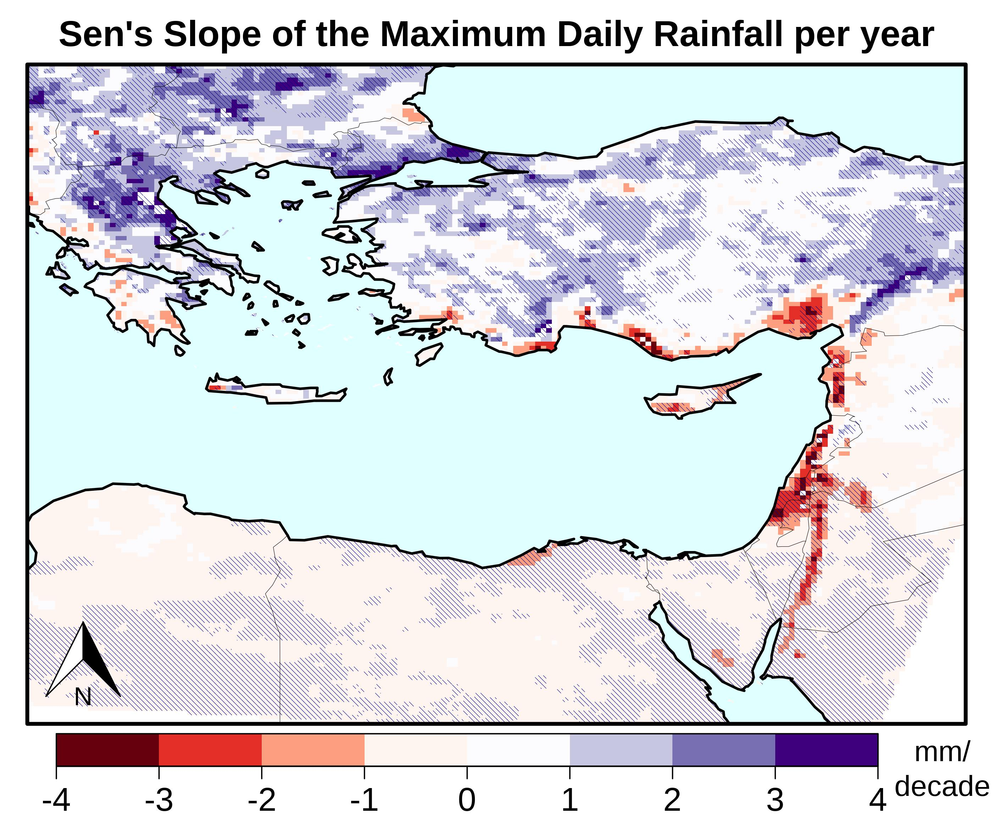
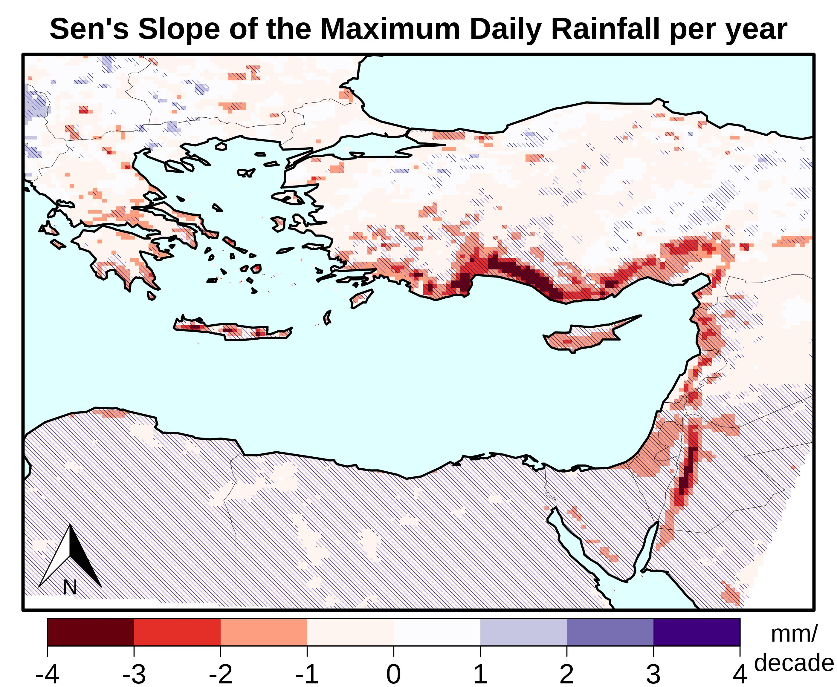
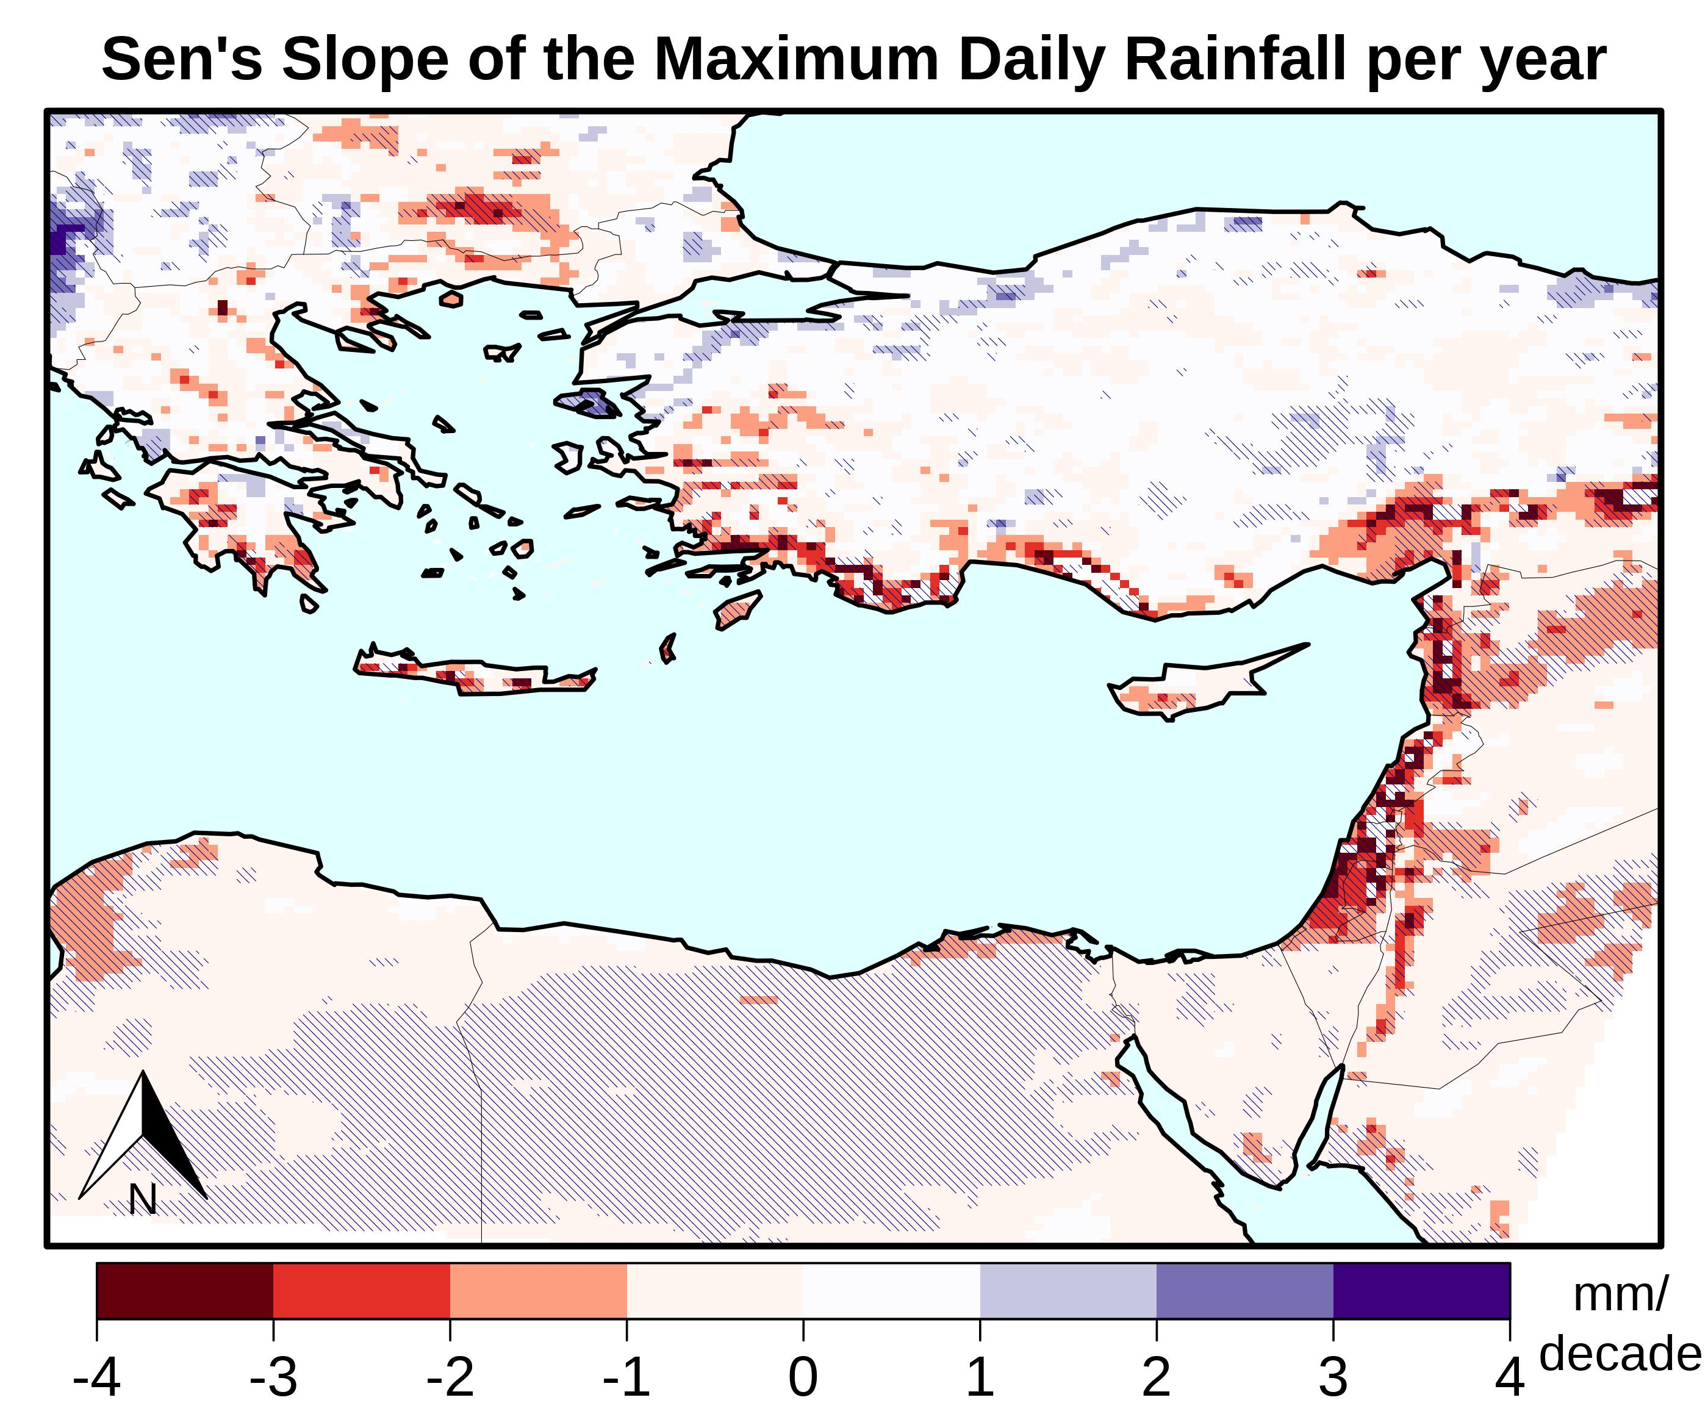
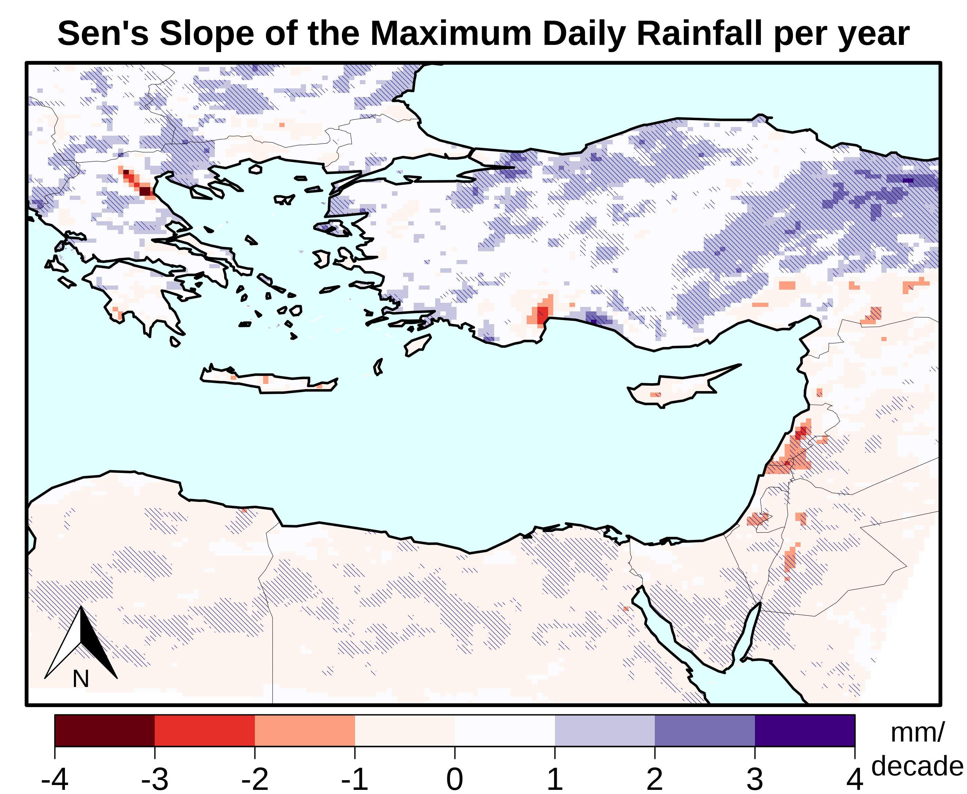
Trends of future precipitation extremes
Rx1day Sen’s Slopes (2001-2100) for 6 random EURO-CORDEX models
Strong variability within the EURO-CORDEX ensemble!!

Slide 6
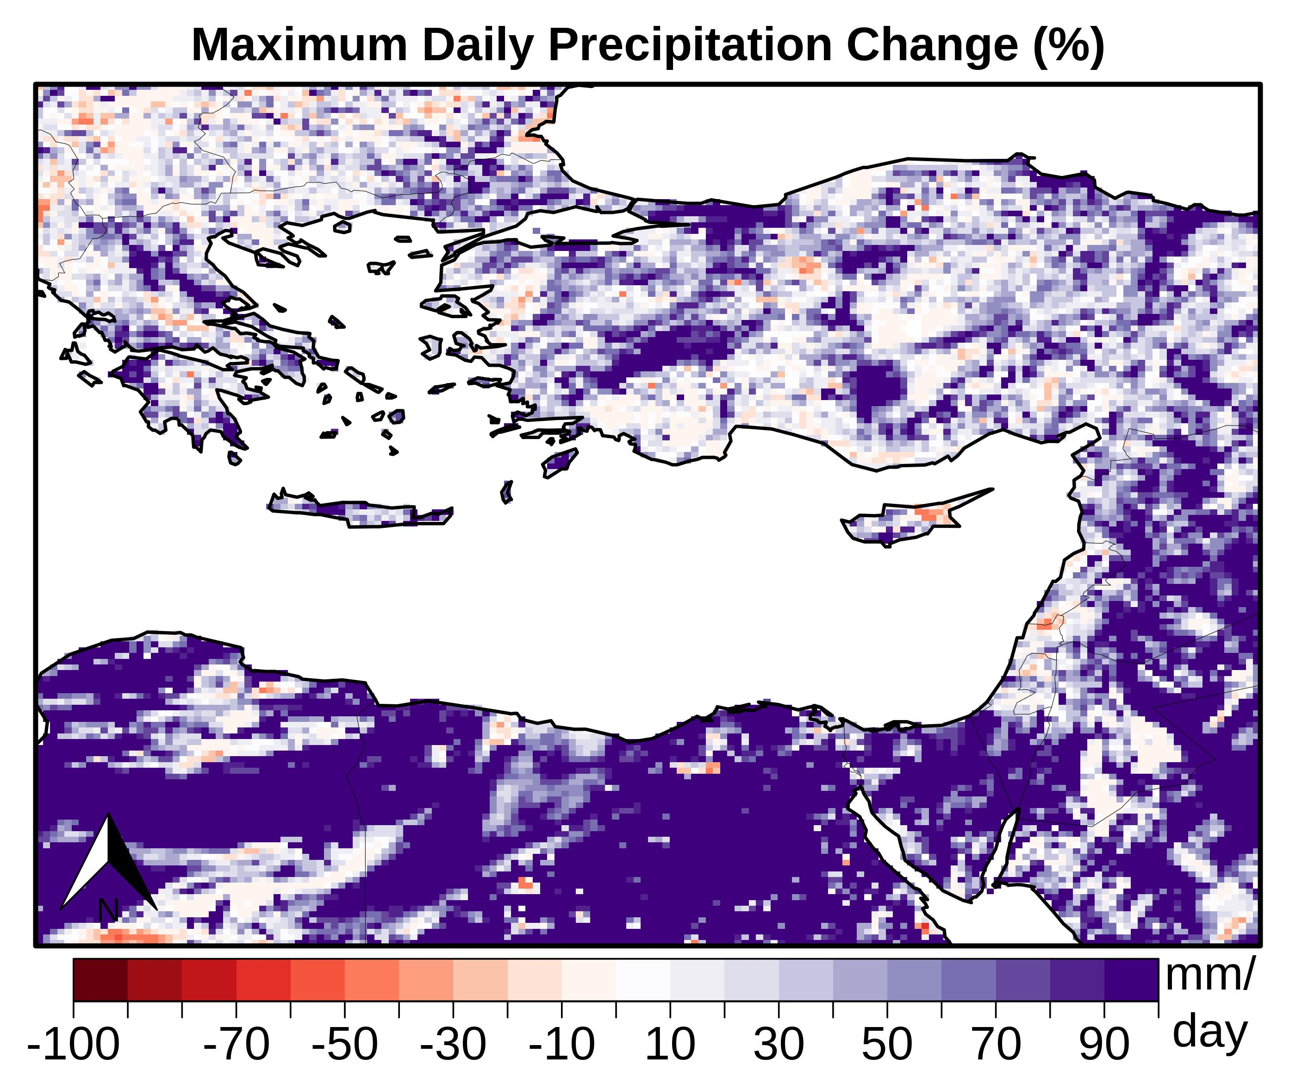
Projected Differences in Abs. Precipitation Maxima
CYI-CESM/WRF
ENS. MEAN (25 EURO-CORDEX SIMS)
Projected differences in the absolute maximum daily rainfall
(2001-2100) – (1981-2010)

Slide 7
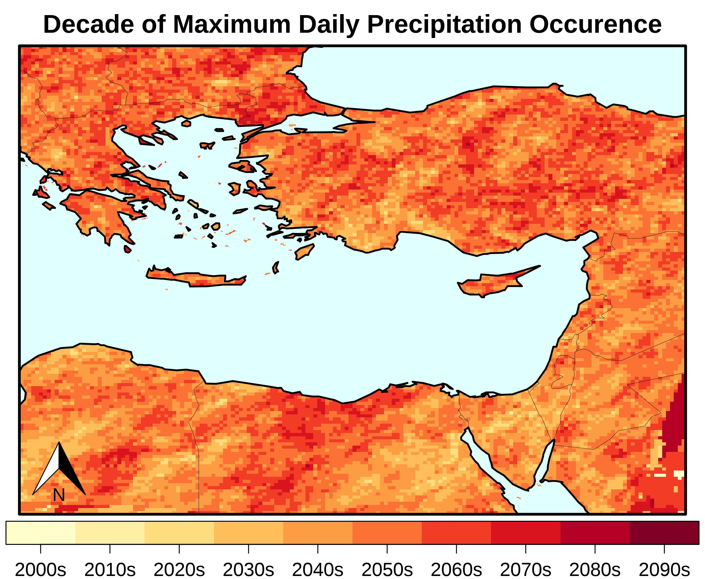
Expected decade of occurrence of Absolute Precipitation Maxima
ENSEMBLE MEAN of 25 EURO-CORDEX SIMULATIONS

Slide 8
Summary
Mean precipitation is expected to decrease throughout the eastern Mediterranean.
According to CYI-WRF, trends of annual extremes will likely be negative for most of the eastern Mediterranean (few exceptions in the north).
Absolute rainfall amounts during future extreme events are projected to increase throughout the domain.
Absolut maxima expected to occur in 2050s.

