Slide 1
Human-landscape Interactions along the Danube from the Neolithic to the Present in Budapest, Hungary
István Viczián, Gábor Szilas, Farkas Márton Tóth, György Sípos, Dávid Gergely Páll, and József Szeberényi
István Viczián, contact: viczian.istvan@csfk.mta.hu
ITS2.2/GM12.5 Geoarchaeological records of human-landscape interaction: from a nature-dominated world to the Anthropocene
EGU2020: Sharing Geoscience Online, 4 May 2020

Slide 2
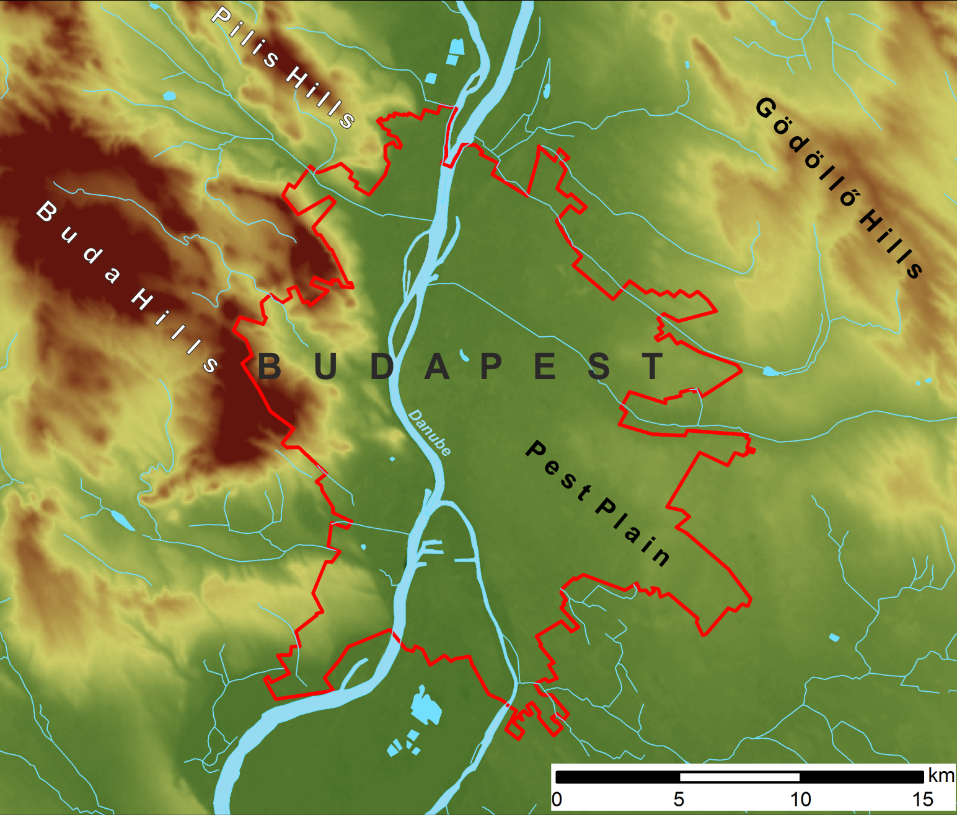
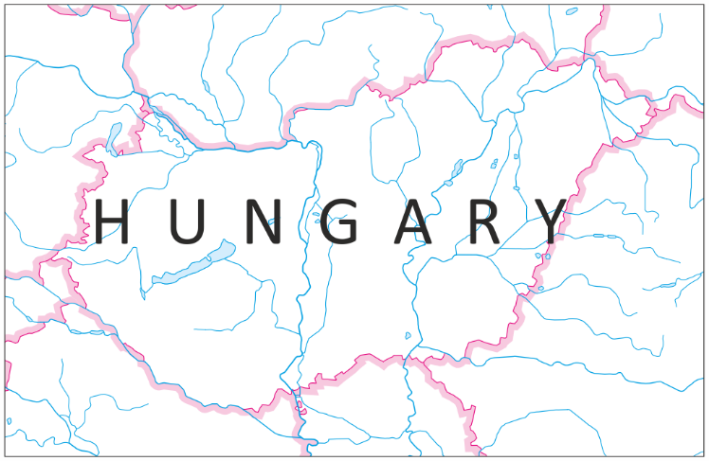
Study area
Methods
Archaeological excavations
Geomorphology
Environmental history
GIS, georeferencing old maps
Sedimentological analysis (grain size, TOC, AL-P, CaCO₃, etc.)
XRD mineralogical analysis
OSL and radiocarbon dating
Malacology

Slide 3
Aims and objectives
Reconstruct late Quaternary landscape evolution that affected the human-landscape interactions from the Neolithic to the present times.
Reconstruct the abandonment and the aggradation processes of an anabranch channel of the Danube. Reveal the alluvial plain's natural and human-induced environmental and fluvial changes.
Interpret the concentrations or pattern of archaeological sites or individual sites in the context of the environmental conditions.
Reveal the history of floodplain development and the conditions that affected human occupation along the river. Study the environmental conditions and the feasibility of human occupation separately at lower and higher parts of the floodplain.

Slide 4
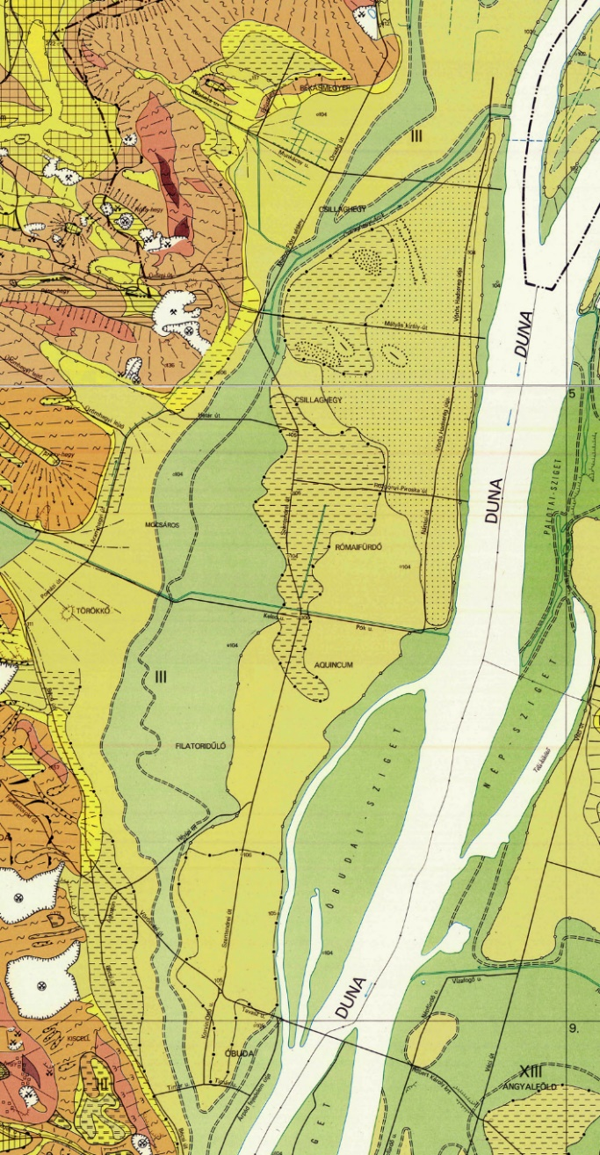
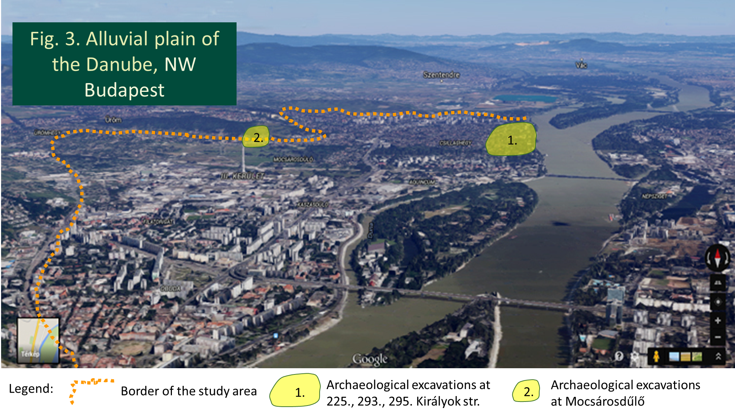
According to earlier knowledge, an Early Holocene anabranch channel of the Danube existed in the Óbuda Bay as it is shown in Fig. 2. quite inaccurate (green area = floodplain). Our goal was to reveal the processes of channel abandonment and aggradation and reconstruct the environment along with it in each successive archaeological period.
The excavations subject to geoarchaeological study are situated along this channel in and around the junction (to the north, Fig. 2-3.) and in the area of the Mocsárosdűlő which is a moderate-sized swampy, waterlogged area refer to the existence of this former river channel (to the south).
Fig. 2. Geomorphological map (Pécsi et al. 1980)
the studied archaeological excavations
at Mocsárosdűlő swamp
the studied archaeological excavations
at the junction area

Slide 5
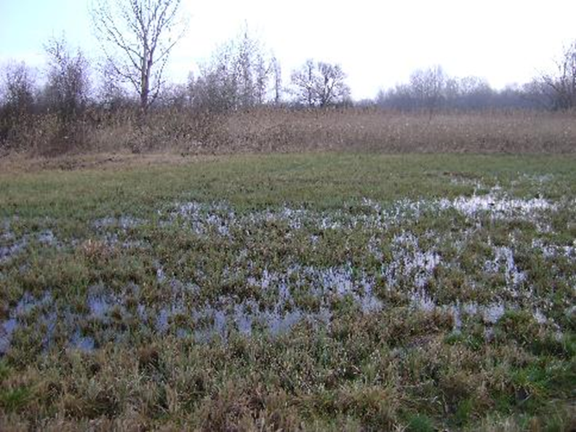
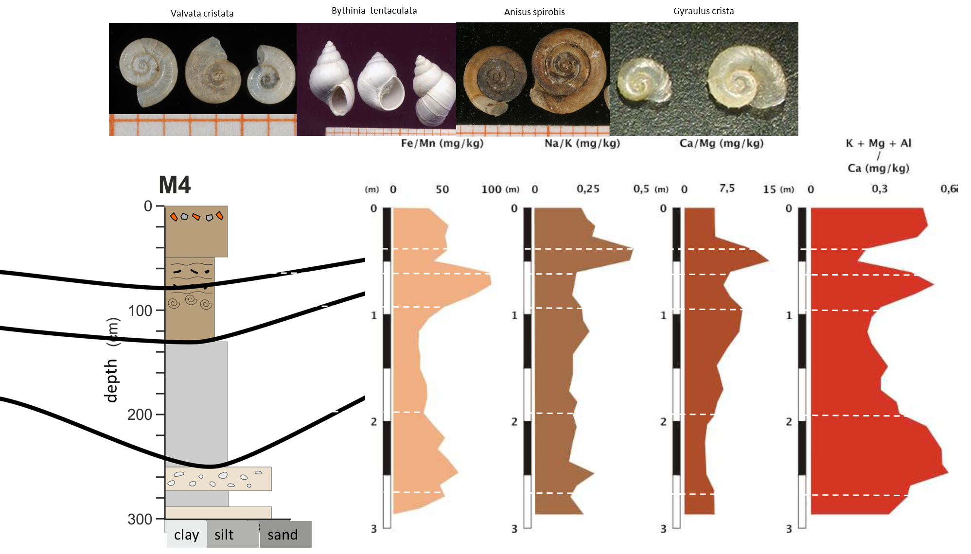
Results. Mocsárosdűlő area
Mocsárosdűlő swamp
Archive maps, aerial photos, etc.
georeferenced in ArcMap

Slide 6
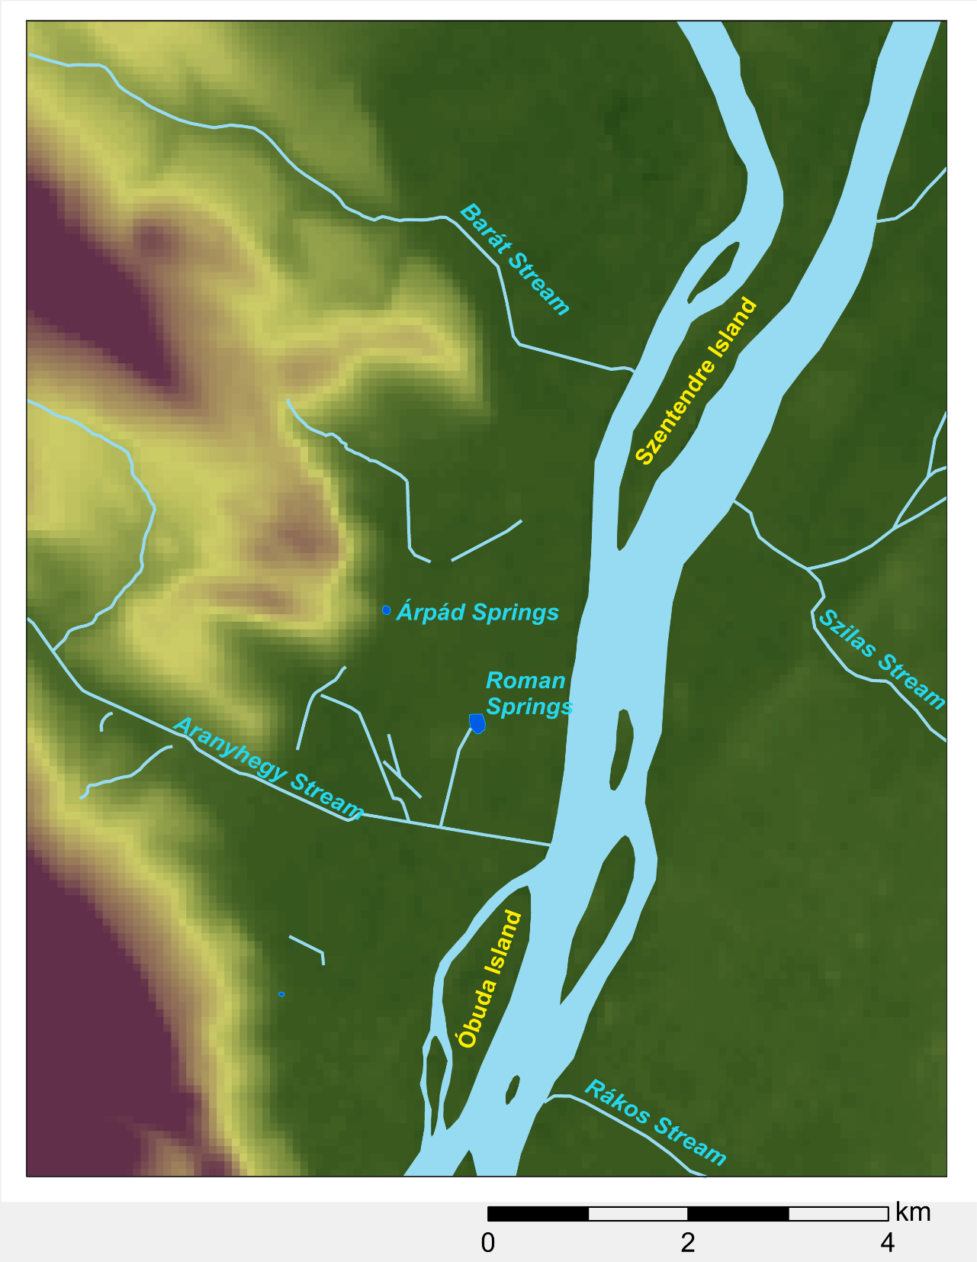
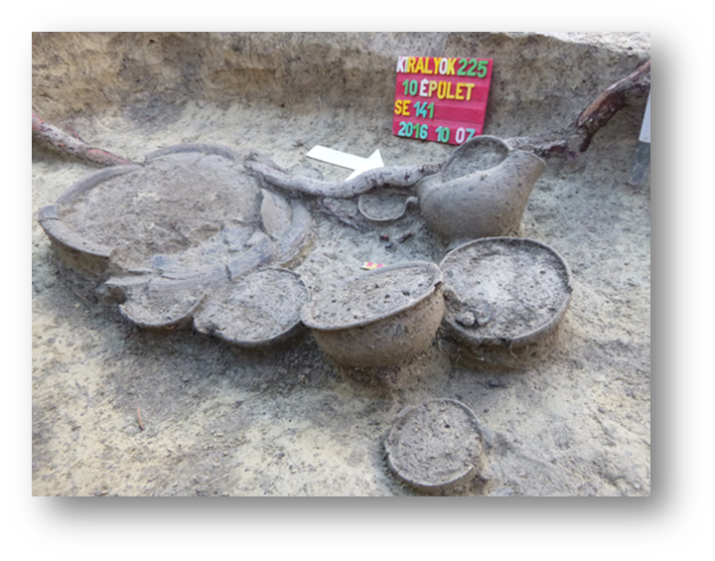
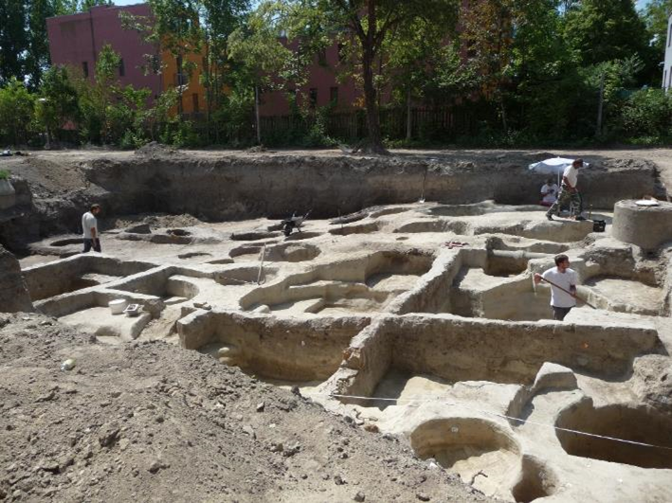
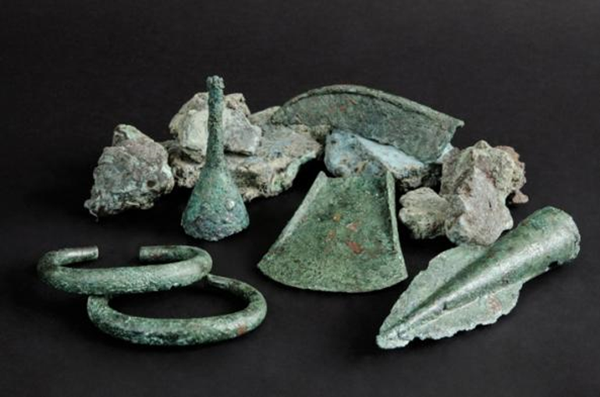
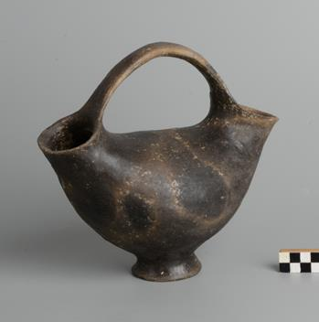
The most intense concentrations of prehistoric archaeological sites in the Óbuda-Békásmegyer area
Legend
area of settlements
(Neolithic – Late Iron Age)
separately located cemeteries
(Early Copper Age – Late Bronze Age)

Slide 7
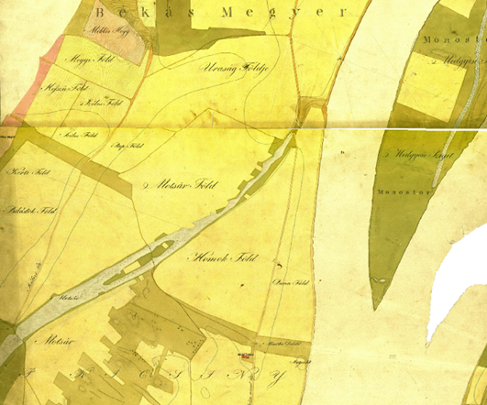
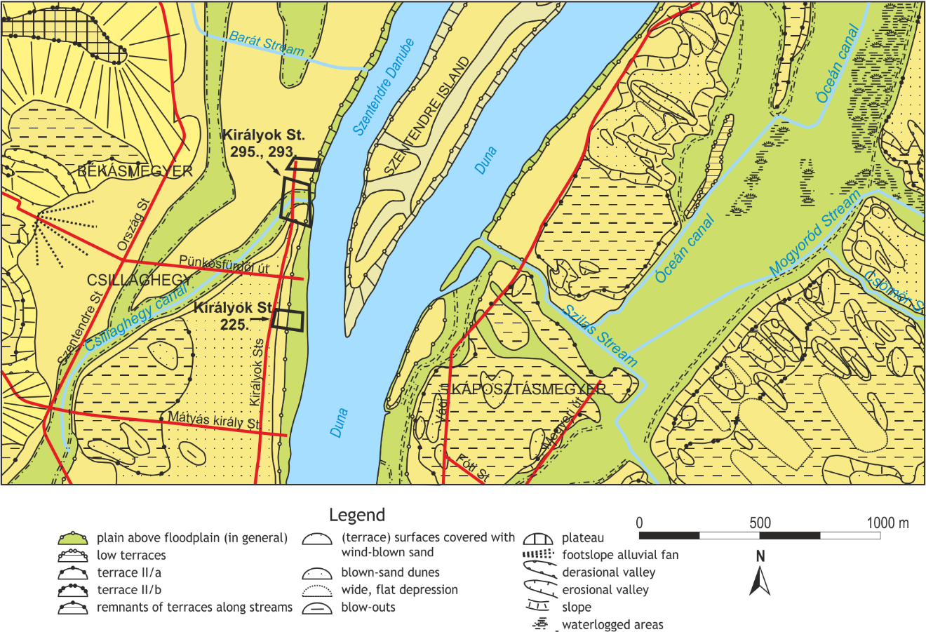
Results. Junction area
Fragment of sheets of the Danube Mappation (1830-1840) showing the Csillaghegy stream
Duna. - No. 126/1-1757. Duna-mappáció
[S 80 - Duna. - No. 126/1018-1019.]
Fragment of the geomorphological map of Budapest depicting the studied excavations. Pécsi et al. 1980
Through time the relict form of the Danube’s paleochannel was occupied by streams, draining surface water, groundwater and abundant karstic springs. Today the Csillaghegy stream which flows into the Danube to the northeast is mainly canalised into a subsurface pipeline.
the studied archaeological excavations

Slide 8
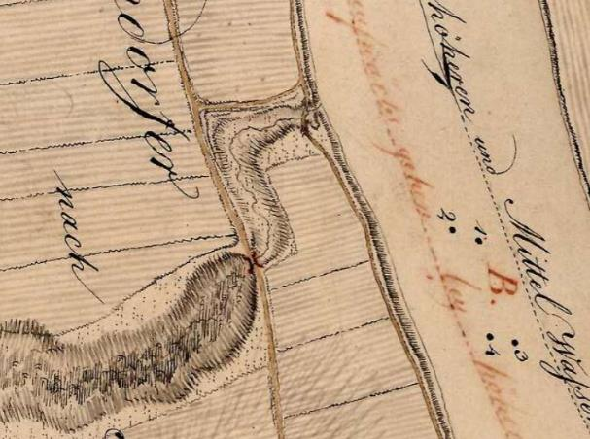
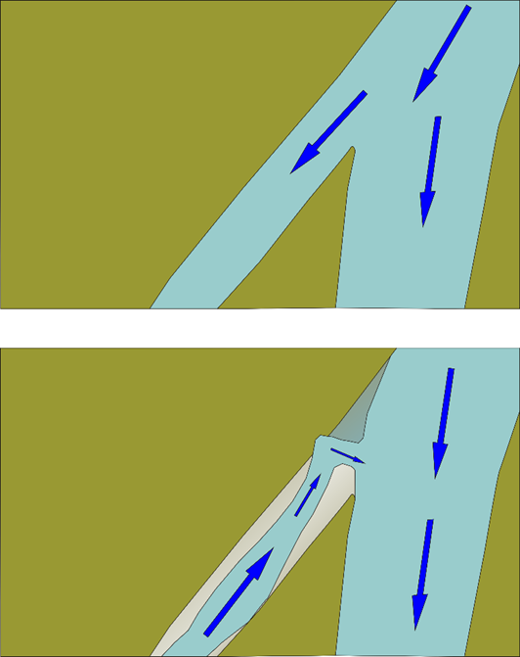
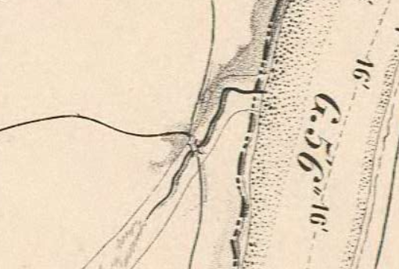
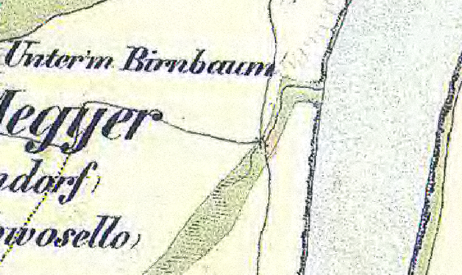
Results. Junction area
year 1835
Archive maps show a bend where the Csillaghegy stream joins into the Danube. When did the river bifurcation of the Danube transform into a bend at the confluence of the stream and the river? When did the abandonment of the anabranch channel of the Danube occur?
1825
Bifurcation of the river
1857
1841
Confluence
the stream joins
to the river

Slide 9
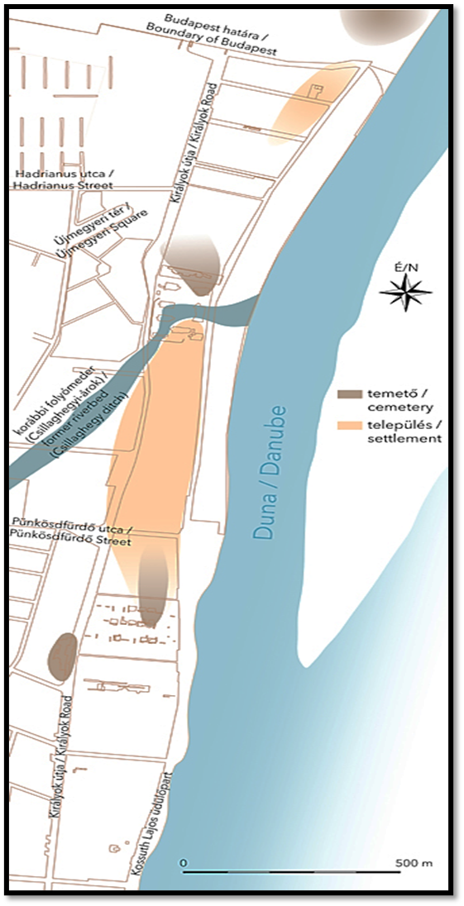
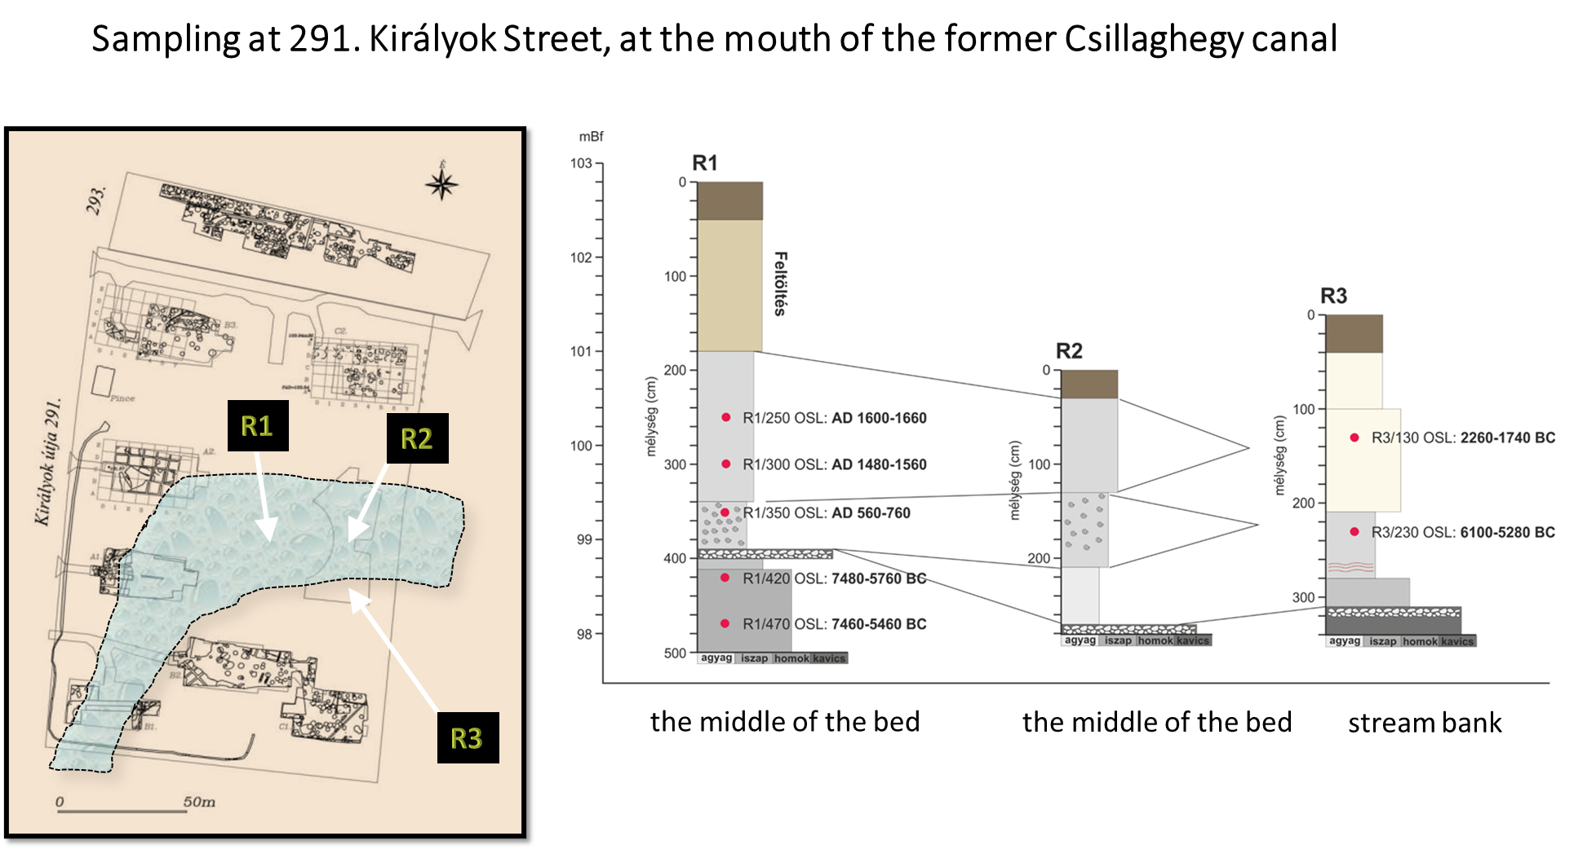
Results. Junction area
Archaeological sites from the Middle Neolithic to the Late Iron Age have been unearthed along both banks of the bend. Sites confirm the age of the river channel abondment and the stream channel’s formation. The bend of the stream already existed in the Middle Neolithic.

Slide 10
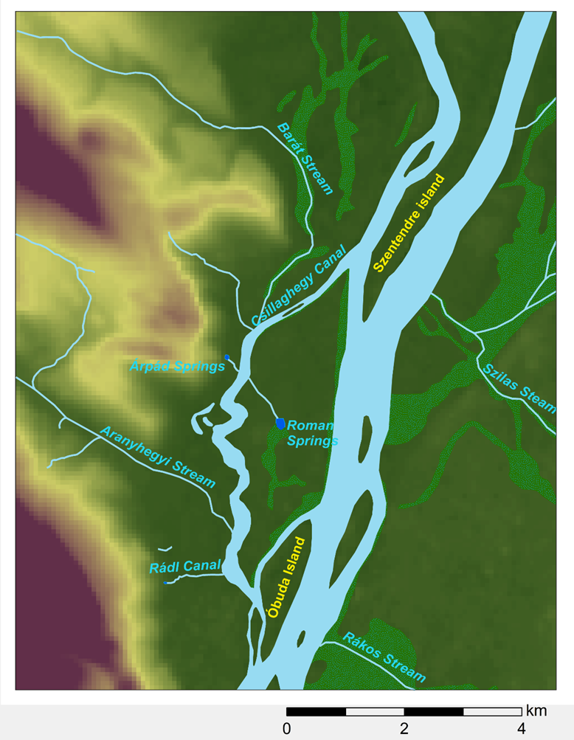
Results. Environmental reconstruction
As a result of sedimentological examinations and OSL dating: an active river channel existed across the Mocsárosdűlő swamp area in the Early Neolithic. Later the channel has been transformed into a shallow lake.
The Middle Neolithic sites next to the bend confirm that by that time the former river channel has already been abandoned and a stream drained the lake to the Danube.
The hydrographical changes must have occured in the transition period from Early to Middle Neolithic some 7400 years ago.
Sediment analysis of the studied excavations shows that the long and dry Boreal is characterised by floodplain accumulation, channel aggradation, aeolian sand movement on floodplains and terrace surfaces. In the beginning of the Atlantic, during the Early Neolithic humidity increased. The studied channel has already been acting as an anabranch channel for a while.
Environmental reconstruction
Early Holocene till the end of the Early Neolithic (7.400 BP)

Slide 11
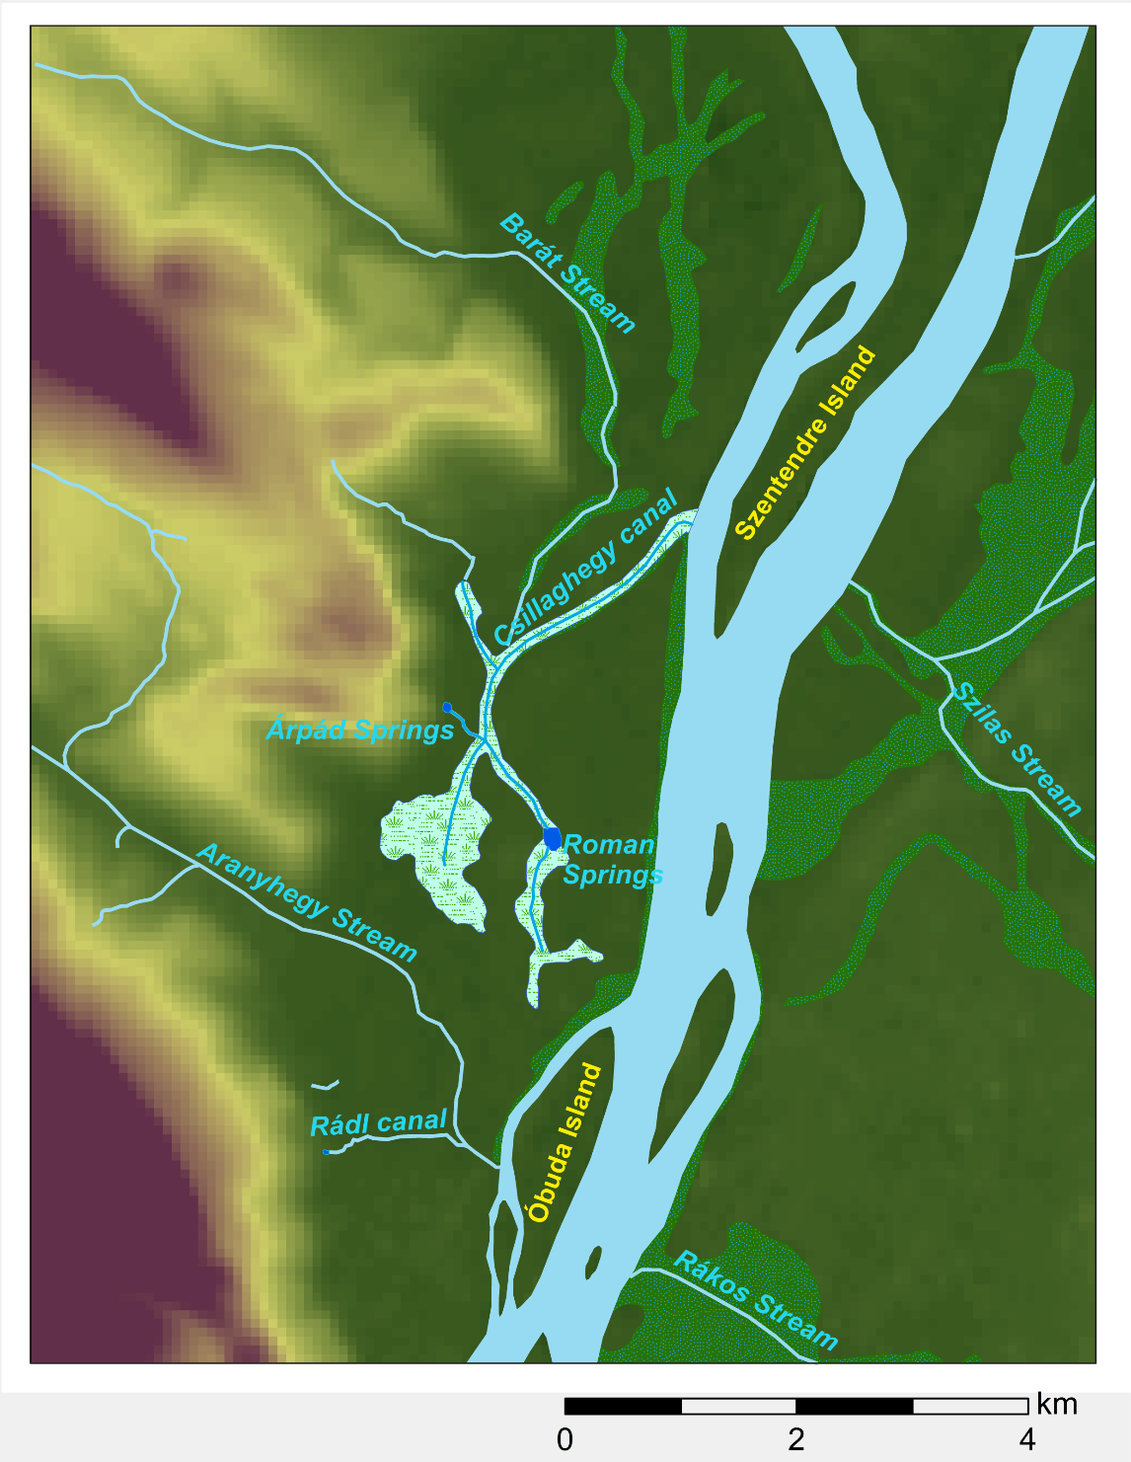
Results. Environmental reconstruction
During the humid transition period of Boreal and Atlantic and the first third of the Atlantic (Early Neolithic) the discharge increased and the main channel gradually incised, while the minor anabranch channels gradually became abandoned.
The studied paleochannel became abandoned at this time too. Its south part was occupied by the Aranyhegy stream which built an alluvial fan there. North of the fan, the paleochannel transformed into a shallow lake. The lake sucession reached the stage of swamp only by the Middle Ages (C14 result: 1355-1389 cal AD).
By the Middle Neolithic (7.400-6.900 BP), the river channel had already incised. The climate grew dry and warm, flood risk decreased, the environmental condition enabled human occupation on the higher parts of the floodplain. Since then the area along the river has been repeatedly occupied, mostly during the periods with favourable fluvial, climatic and geomorphological conditions and lower flood risks.
Environmental reconstruction
Middle Neolithic - Middle Ages

Slide 12
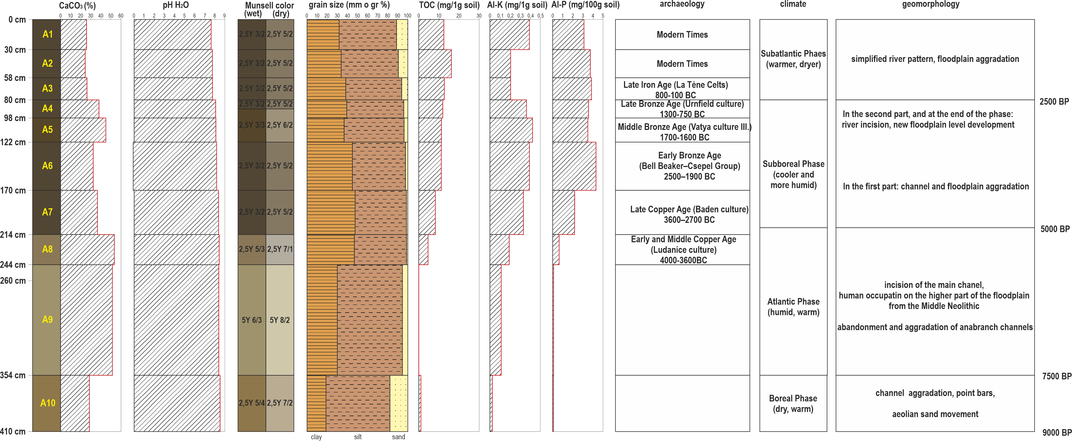
Results. Environmental reconstruction
The higher parts of the floodplain were suitable (albeit limited) for human occupation from the Middle Neolithic -- while the lower parts were still inappropriate for thousands of years.
The aggradation of the lower parts was much definite. For example, at the 295 Királyok St. excavation 30-50 cm of sediment deposited on the higher part of the floodplain, while it was about 3 meters from the same period (from the Neolithic to the Late Iron Age) on the lower part. The difference in elevation between the two areas decreased to 1,5 metres by now.
Sequence in the lower part of the floodplain at the 295. Királyok St (100 m north to the band of Csillaghegy stream discussed above)

Slide 13
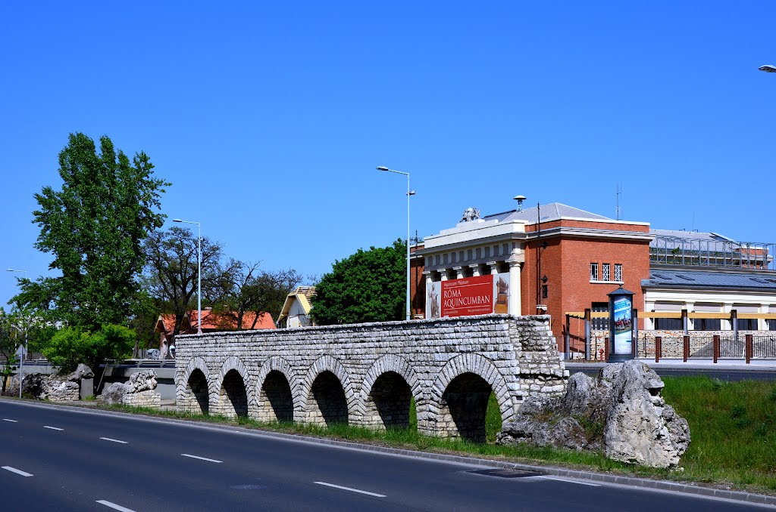
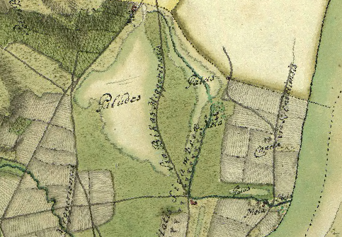
Results. Environmental reconstruction
The environmental and hydrographical conditions have changed due to drainage works.
In the Roman Times water of abundant karst springs was collected and led through the aqueduct to provide running water for the Civil and Military Town of the provincial seat Aquincum.
In the 18-19th century springs were drained and used to drive dozens of water mills. The Mocsárosdűlő swamp was also drained to gain arable lands.
Map from 1778 showing canals and water mills
Environmental reconstruction
18-19th century

Slide 14
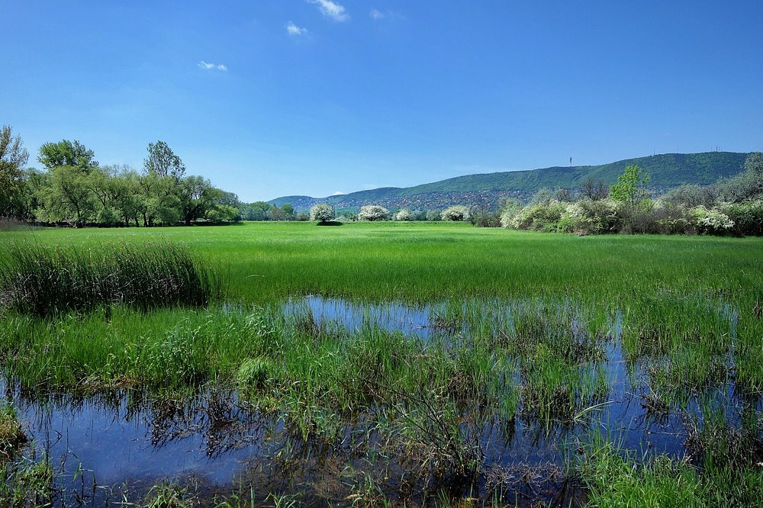
Results. Environmental reconstruction
Today's hydrographic conditions, the drainage of streams and springs into waterways and subsurface drainage tubes have principally been developed due to flood protection considerations.
The studied area is a densely built-up urban environment, except for the protected 25-acre area of Mocsárosdűlő, which is the last residual of the wetlands on the Buda side.
Mocsárosdűlő protected area
Environmental reconstruction
20-21th century

Slide 15
Results. Concentrations of archaeological sites and their environment
Maps represent the concentration of archaeological sites from Neolithic to Late Iron Age along the river.
If we look at the map on the left, it is apparent that the settlement concentrations are not related to the present courses of the Danube’s tributaries.
If we look at the map on the right, it becomes evident that the settlement concentrations are located around the mouth of Danube’s former natural tributaries.
Base map: Environmental condition today
Base map: Reconstructed environment,
Middle Neolithic - Middle Ages
Legend:
area of settlements
(Neolithic – Late Iron Age)
separately located cemeteries
(Early Copper Age – Late Bronze Age)

Slide 16
Conclusions
The anabranching pattern of the Danube formed until the Early Holocene had a decisive effect on the later fluvial processes. The main tendency in floodplain development in the Holocene was the abandonment and aggradation of minor anabranch channels, bars and islands attached to each other or merged into the floodplain. The location and pattern of archaeological sites confirm that lateral migration of channel barely occurred. The floodplain evolution was predominantly affected by climate-induced fluvial processes (incision, aggradation) on the main channels.
The abandonment of the studied anabranch channel occurred in the Early Neolithic. Later the relict landform of the paleochannel was occupied by a shallow lake and streams.
The human occupation of the higher parts of the floodplain was a given since the Middle Neolithic. Occupation was mostly restricted to the periods with favourable fluvial, climatic, geomorphological conditions and lower flood risk. The environmental conditions and the feasibility of human occupation have to be studied separately at lower and higher parts of the floodplain.
The prehistoric settlement concentrations are located around the mouth of Danube’s natural tributaries.
Human impacts greatly affected the hydrographical and environmental conditions.
A detailed reconstruction was made and mapped for the Holocene floodplain development and the alluvial plain’s evolution.

Slide 17
Thank you for your attention!
contact: viczian.istvan@csfk.mta.hu

