Slide 1


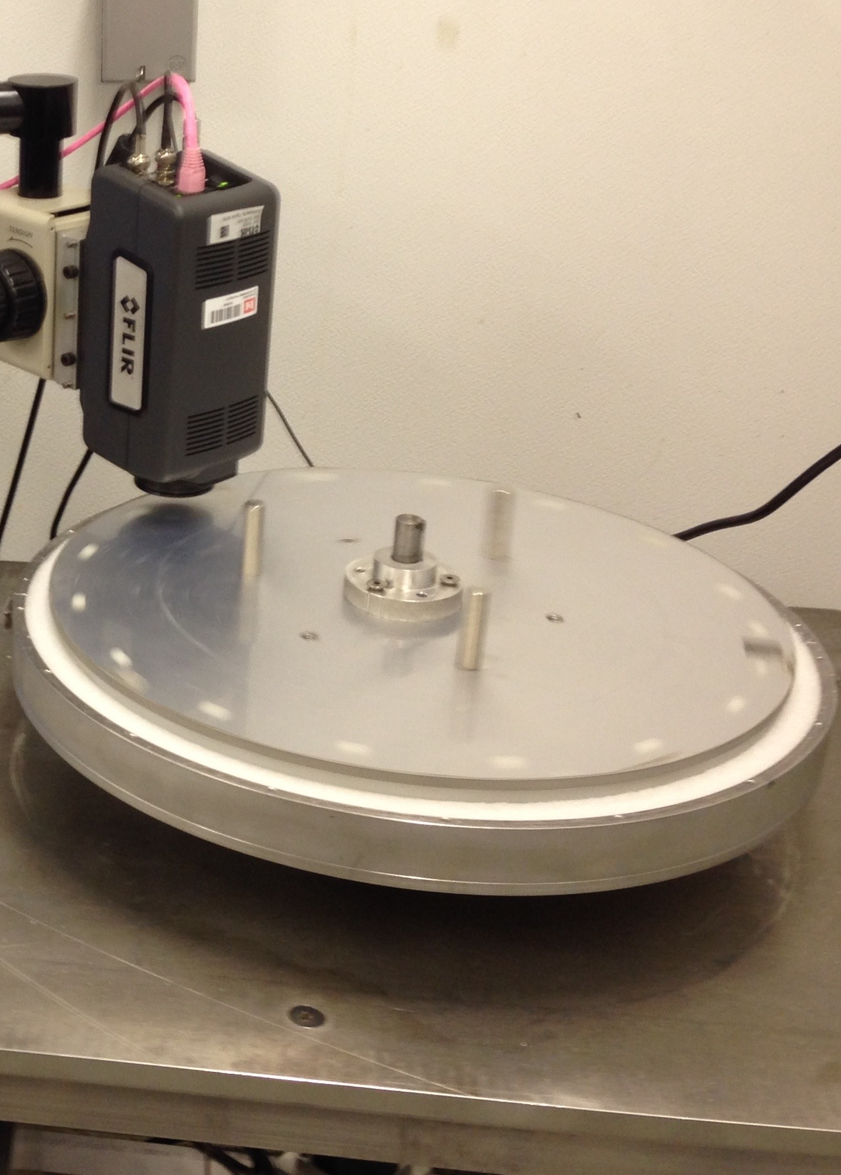
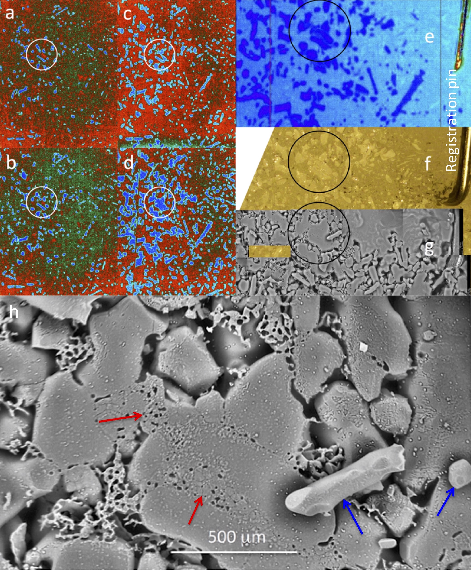
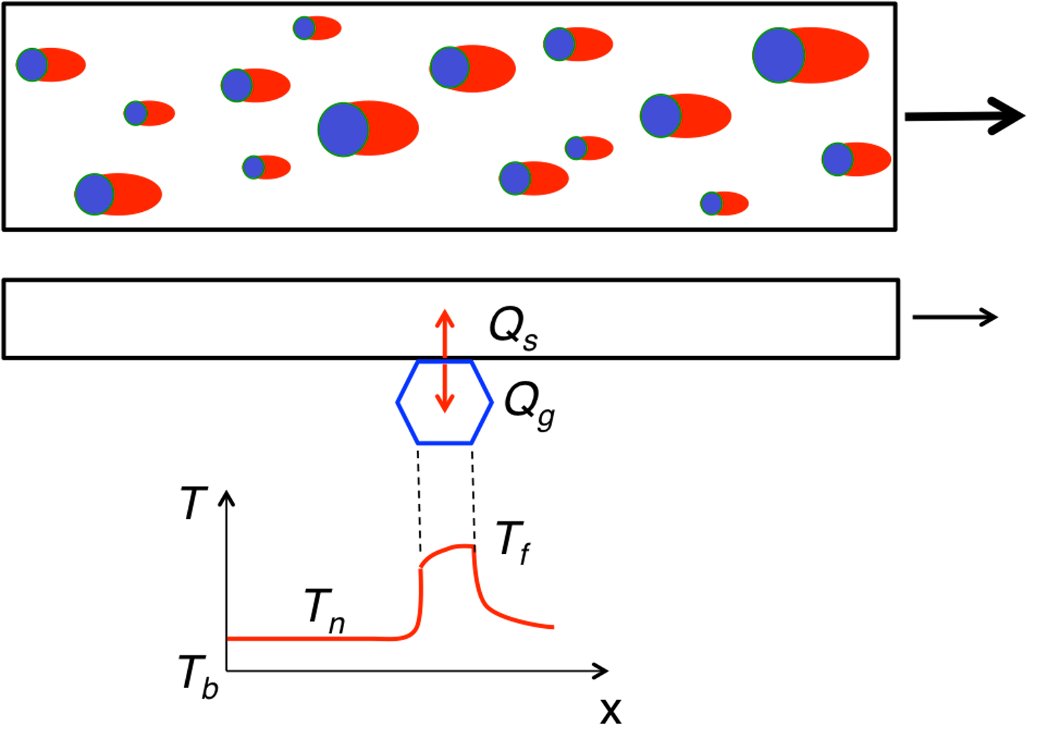
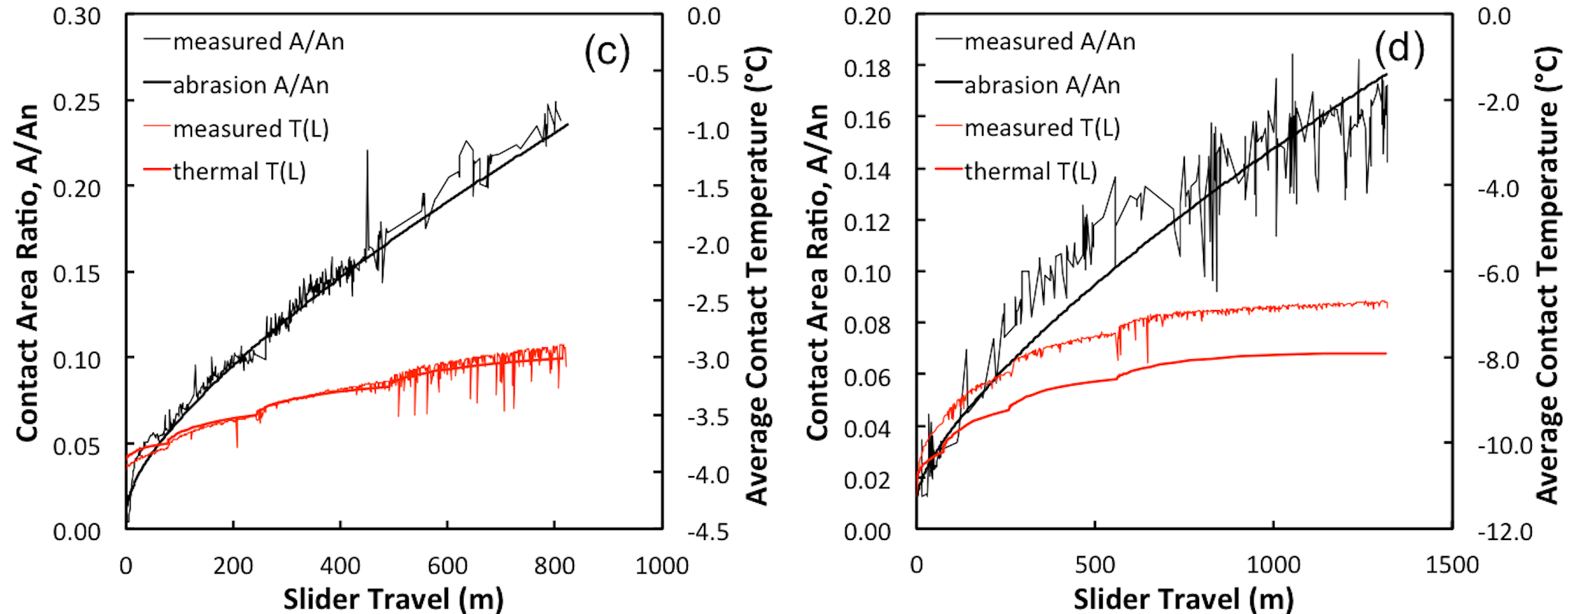
Why is Snow Slippery? The Role of Abrasion in Snow Kinetic Friction
James H. Lever, Susan Taylor, Garrett R. Hoch, Emily Asenath-Smith
Engineer Research and Development Center (ERDC - CRREL)
Lever et al. (2018) The mechanics of snow friction as revealed by micro-scale interface observations.
J. Glaciology, 64(243) 27 – 36.
Lever et al. (2019) Evidence that abrasion can govern snow kinetic friction. J. Glaciology, 65(249) 68–84.
US Army ERDC 6.1 basic research, military engineering

Slide 2
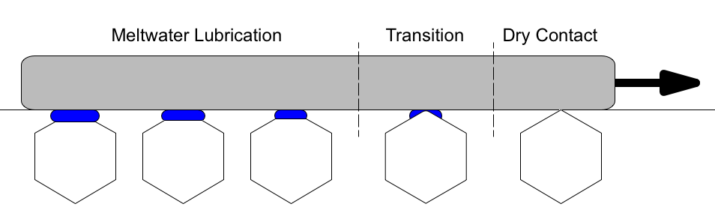
Why is snow slippery?
Reynolds (1899) – water lubrication from pressure melting
Bowden & Hughes (1939) – water lubrication from frictional heating
Issues to implement theory
Mixed friction modes along a slider
μ is average value – must separately measure & scale each mode
Persistent contacts are required
Snow is weak – easy to deform or fail grains
Many studies used ice as a surrogate
No micro-scale observations of self-lubrication
Unknown evolution of contact area
How does transition occur from dry to lubricated contact?
What is fate of melt-water (squeezing, shearing, plowing by asperities)?
Predicted water layers are thinner than slider roughness
How does water layer support slider?

Slide 3
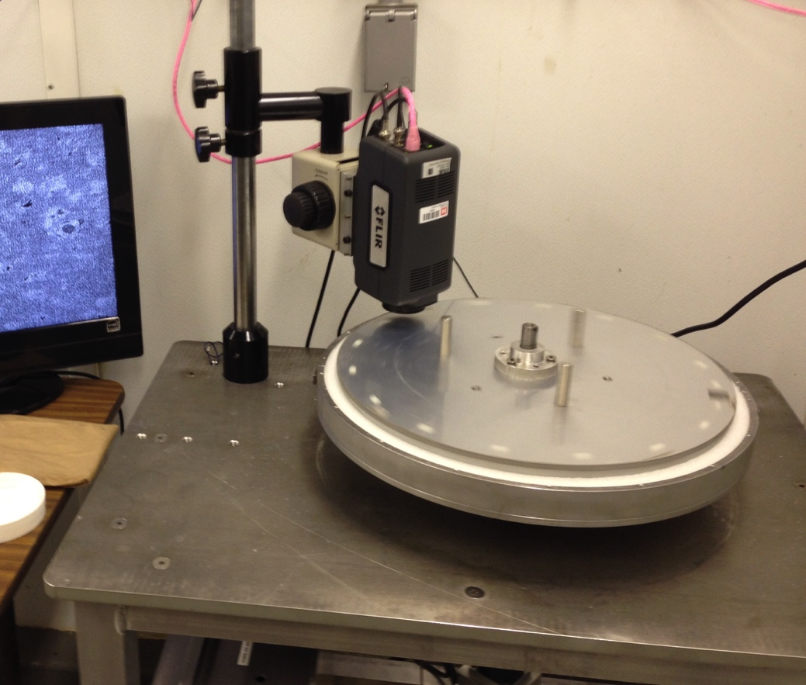
Original Objectives
Confirm self-lubrication
Map dry-to-lubricated transition
Quantify evolution of real contact area
Quantify production & loss of melt water
Approach
Ring tribometer – single friction mode
High-res IR camera to measure temperature & area evolution
Optical, SEM and micro-CT to track melt water and changes in snow structure
Tribometer
Polyethylene ring rotated on stationary snow
Snow Samples
Compacted & sintered “strong” snow
Test parameters
0.3 – 1.3 m/s, 0.8 – 4.5 kPa, -4 – -19°C
IR Camera
15-μm pixels, A_{c}/A_{n} = 3 x 10⁻⁶
10 x 8 mm snow patch imaged each slider revolution
Accuracy ± 0.1°C near 0°C

Slide 4


Key Result: No Melting
Mode 1 – Cascading grain-bond failure at low friction
μ < 0.03
No persistent contacts to melt
Snow warmed very little, T_{max} < 0°C
Mode 2 – Dry-contact abrasion at low friction
μ < 0.05
Slider abraded persistent contacts
Grains warmed but didn’t melt, T_{max} < 0°C
Polished flat-top grains yielded glazed macro-surface
IR movies: evolving snow-grain contacts are closed contours

Slide 5
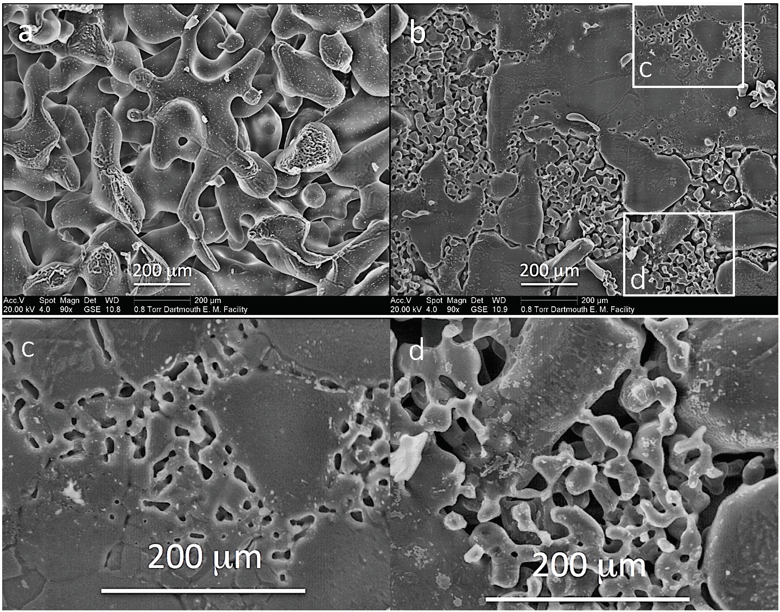

Coordinated IR, Optical and SEM Images Reveal Structure
Undisturbed
snow
Abraded grains
& infilled pores
IR
Optical
SEM
Abrasion polishes snow-grain contacts
Abraded wear particles deposit & sinter in pore spaces – ”lacy” structures
Sintered deposits can fill pores & flatten with further sliding
Infilled pores
Post-test
debris

Slide 6
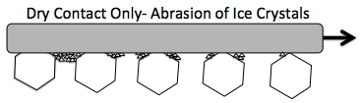
Towards a New Theory: Dry-Contact Abrasion
Abrasive wear – Archard (1953) W ∝ P/H
W is volumetric wear rate, P is load
H(T) is indentation hardness of snow grains (ice), H(0°C) → 0
Abrasion accelerates as T → 0°C
Sliding Heat Source – Tian & Kennedy (1993, 1994)
T_{contact} = T_{flash} + T_{nominal} + T_{background}
Match temperature across contact to determine heat-flux split
Q_{slider} + Q_{grain} = Q_{friction}
Uniform temperatures measured across contacting grains, A_{c}/A_{n} ~ 0.01 – 0.3
Predicts T_{flash} << T_{nominal}
Most of heat initially flows into slider

Slide 7
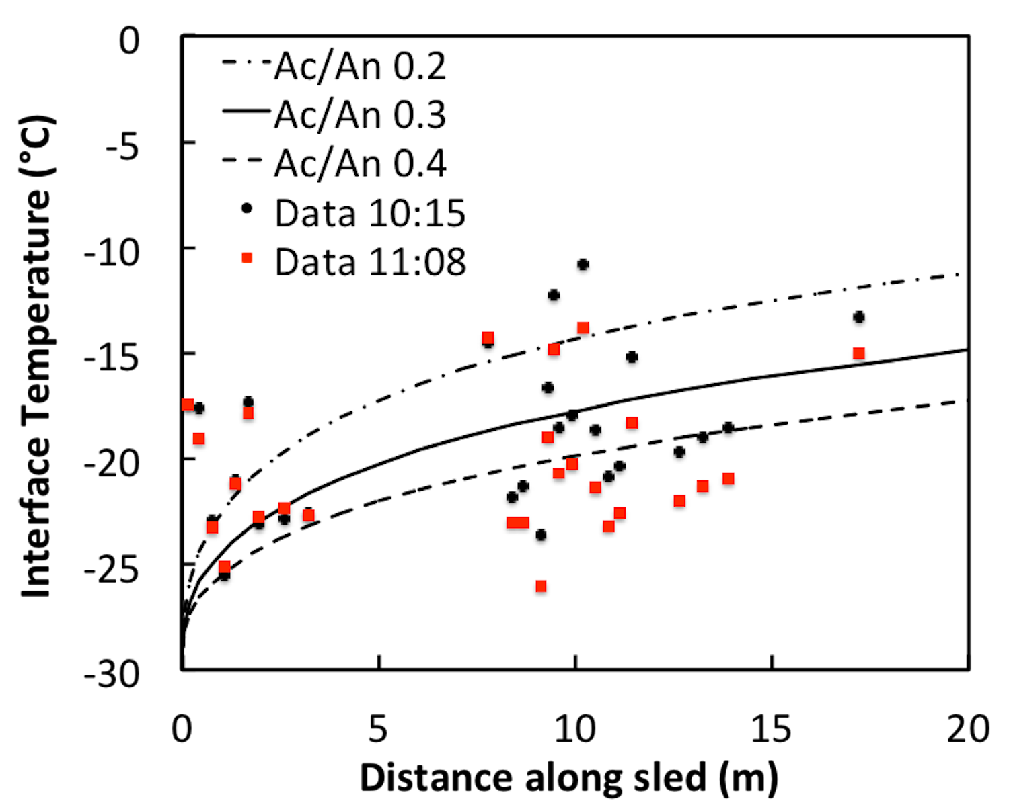
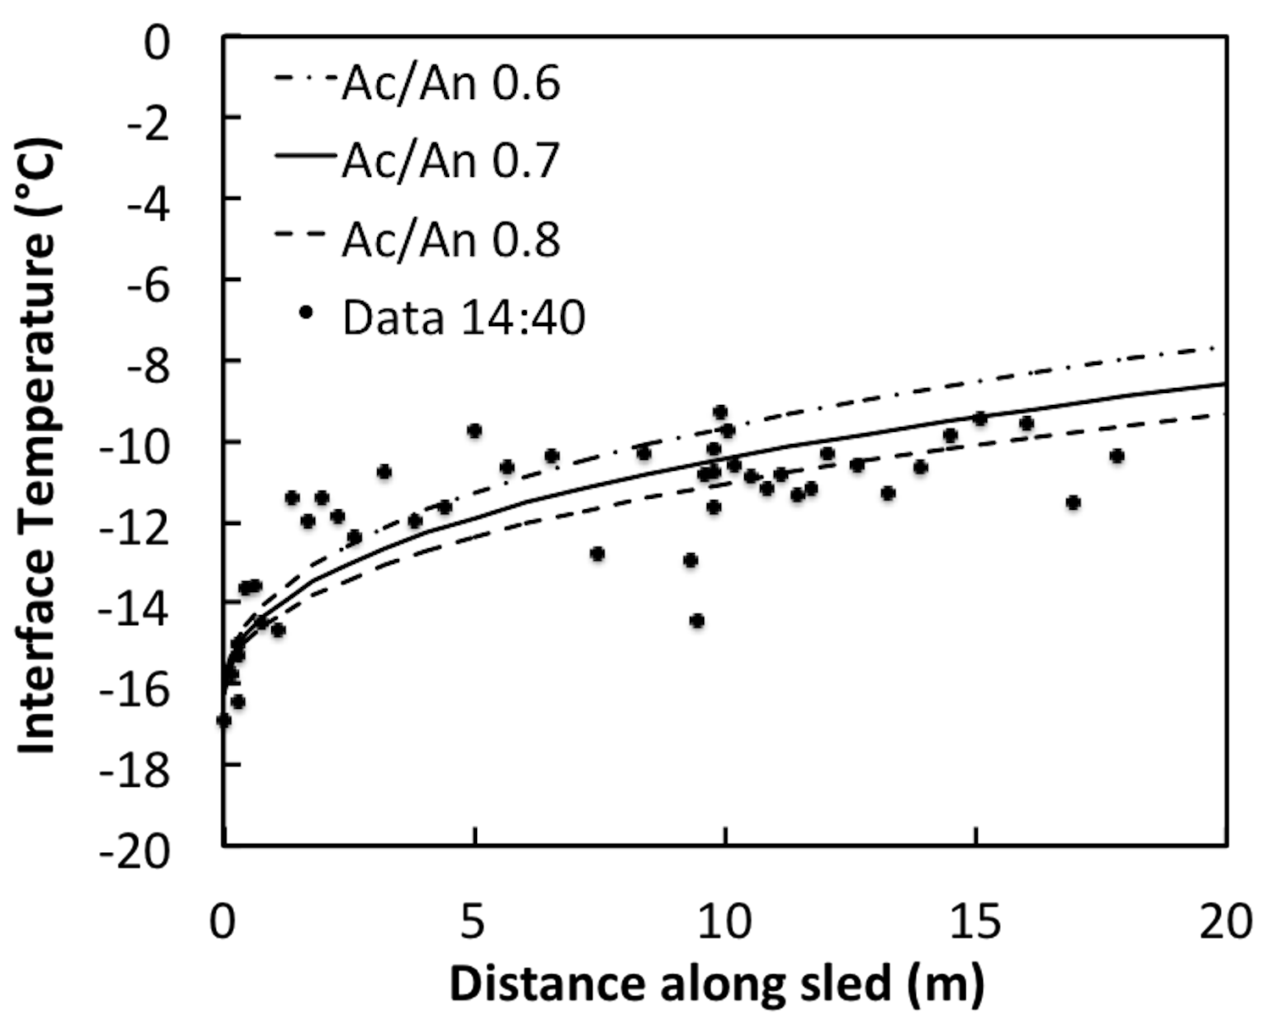
Model Predictions: Contact Area & Temperature
Tribometer Tests
Use measured μ
Good agreement with measured area (black) and temperature (red) evolution
Model predicts no melting
Antarctica
Greenland
Field Data – Sleds
Use measured μ
Predict steady-state temperature profiles along sled-snow interface
T_{nominal} ≈ T_{contact} for small T_{flash}
Data confirm contact temperatures < 0°C

Slide 8
Why is Snow Slippery?
  Intergranular bonds may initially break
  Abrasion gets easier as contacting grains warm up
  Layer of abraded particles might act as dry lubricant
On-Going Work
  Apply dry-lubricant theory to snow friction
    Need to measure rheological properties of wear particles
    One mechanism postulates fluid-like behavior
  Observe single snow-grain/slider contact at high-res
    Continuous IR and microscope video of evolving contact
  Does self-lubrication occur on ice?
    Abraded particles trapped under skate could melt
Thanks!

