Slide 1
Integrated monitoring of soil gases, plume SO₂ and volcanic tremor to detect impulsive magma transfer at Mt. Etna volcano (Italy)
Susanna Falsaperla¹, Tommaso Caltabiano¹, Alessia Donatucci¹, Salvatore Giammanco¹, Horst Langer¹, Alfio Messina², Giuseppe Salerno¹, Francesco Sortino³, Salvatore Spampinato¹, and Carmelo Ferlito⁴
¹Istituto Nazionale di Geofisica e Vulcanologia, sezione di Catania, Osservatorio Etneo, Italy
²Istituto Nazionale di Geofisica e Vulcanologia, sezione di Roma2, Italy
³Istituto Nazionale di Geofisica e Vulcanologia, sezione di Palermo, Italy
⁴Università di Catania, Italy

Slide 2
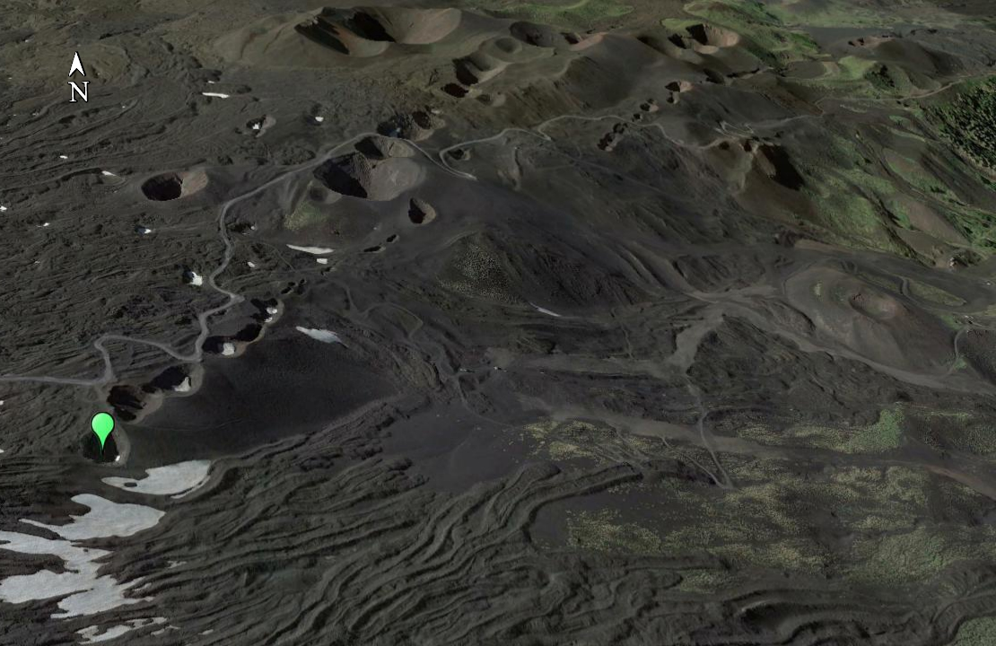
A permanent station for continuous monitoring of the concentration of H₂ was installed in a steaming, low-temperature fumarole (T∼ 90°C) inside the uppermost crater formed during the 2002 flank eruption, on the upper north side of Mt. Etna at 2400 m a.s.l.
North-East Rift
In this site there is a continuous producing of gaseous emissions since the end of the 2002 eruption and this gas emissions have been found to be directly linked to the degassing of the summit area.
Its relative low altitude (∼2400 m a.s.l.) allows us to access the site almost continuously and in total safety, compared to the summit area.
Permanent station

Slide 3
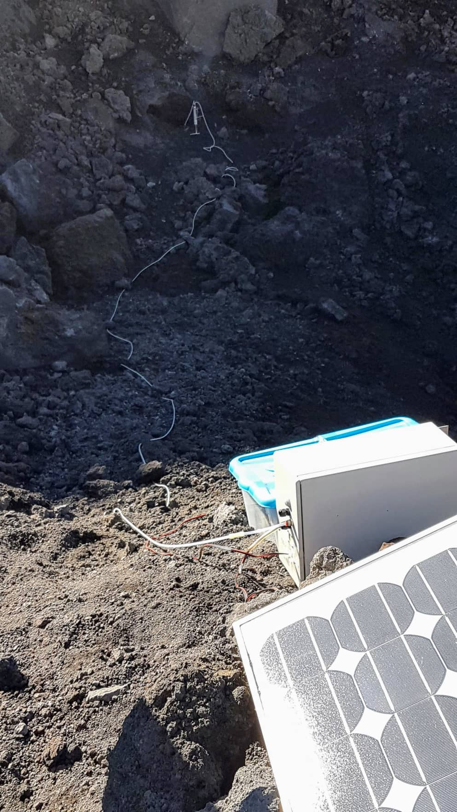
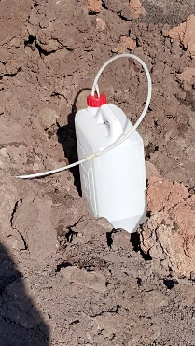
The station is formed by a probe inserted at ∼50 cm depth in soil, linked with a condensation system that allows us to analyze only dry gas. The condensation system has two pipes: the first is connected with a tank where the condensate is stored; the second pipe reaches the station located on the crater rim. The station is formed by three detectors: two of these for the detection of H₂ concentration and the other one to detect CO₂ concentration. Two batteries fed the station which in turn are powered by a 12 V solar panel. The station analyzes the gas every 5 minutes; data are stored in a SD-card and then converted into concentration values for comparison with a previously performed calibration curve.
Low-temperature fumarole
Condensation system
Tank for condensate
Batteries
Station
Solar panel

Slide 4
The station can be produced at low cost and it is also easy to install; moreover, it has low consumption. This station was developed both because we want see if changes in Etna’s volcanic activity can also be found through the emission of gas in the short term, and because this type of monitoring is still poor widespread on Etna. Furthermore, the sampling of gases in a very short time makes these data comparable with those of other geochemical and geophysical parameters acquired in real time, such as volcanic tremor or plume SO₂ concentration.

Slide 5
H₂ concentration
A strong positive increase of H2 concentration was recognized at the onset of Strombolian activity at NE crater during the night between 8 and 9 September 2019.

Slide 6
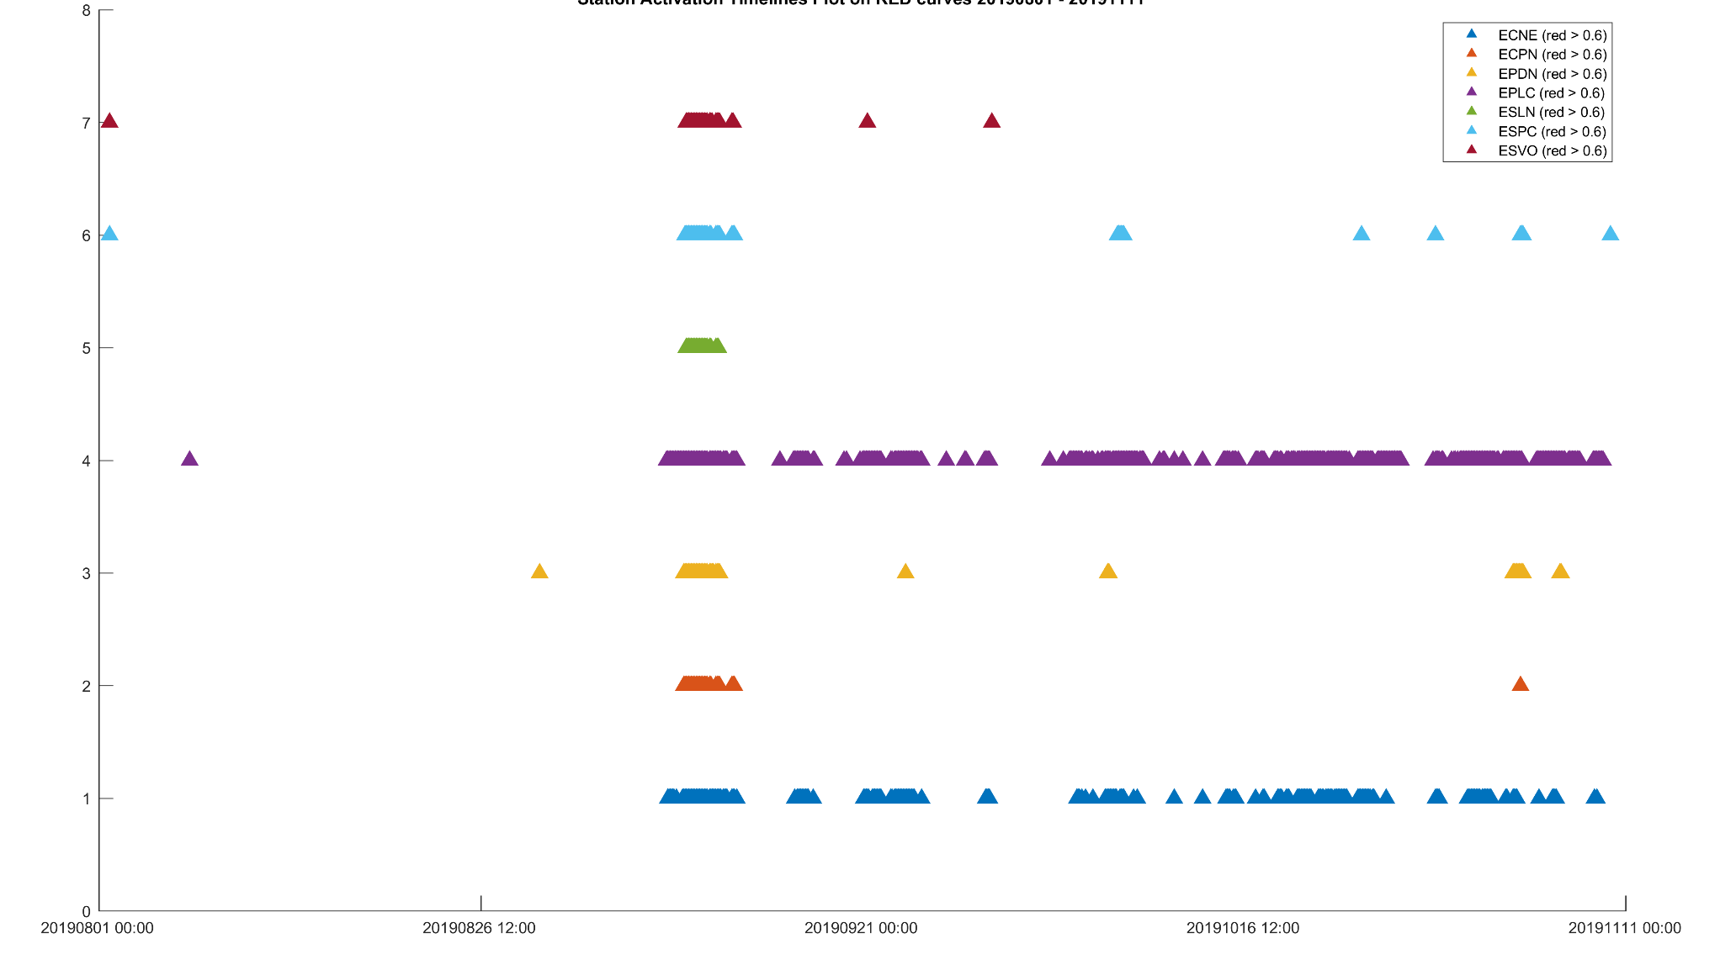
Seismic alert
8
7
6
5
Activation of the alert
4
3
2
1
0
01/08/19 00:00
26/08/19 12:00
21/09/19 00:00
16/10/19 12:00
11/11/19 00:00
time (min)
The activation of the alert system is based on the spectral analysis of volcanic tremor (Spampinato et al., 2019). Each colored triangle corresponds to a seismic station according to the legend on the upper right-hand side of the figure.

Slide 7
References
Spampinato, S., H. Langer, A. Messina, S. Falsaperla (2019), Short-term detection of volcanic unrest at Mt. Etna by means of a multi-station warning system. Scientific Reports, (2019) 9:6506 | https://doi.org/10.1038/s41598-019-42930-3; http://hdl.handle.net/2122/12914

