Slide 1
High precision Quantum Cascade Laser Absorption Spectroscopy (QCLAS) for selective NO₂ measurement
Nicolas Sobanski¹, Beat Schwarzenbach¹, Béla Tuzson¹, Lukas Emmenegger¹, David R. Worton²,
Naomi Farren³, Tatiana Mace⁴, and Christophe Sutour⁴
¹Empa, Swiss Federal Laboratories for Materials Science and Technology, Dübendorf, Switzerland
²National Physical Laboratory, Teddington, United Kingdom
³University of York, York, United Kingdom
⁴Laboratoire national de métrologie et d'essais, Paris, France
Contact : nicolas.sobanski@empa.ch
EGU 2020 - AS5.11

Slide 2
Introduction
The MetNO2 project aims at improving NO₂ monitoring in Europe. It focuses on:
Characterization of existing and new calibration methods
Improvement of calibration protocols
Charaterization of various NO₂ measurement techniques in lab. conditions
Instruments comparison in controlled environments and field conditions
A Quantum Cascade Laser Absorption Spectrometer has been developed at Empa to evaluate the potential and limitations of this measurement technique for NO₂.
The performances of this instrument and various comparison results with other techniques are presented.

Slide 3
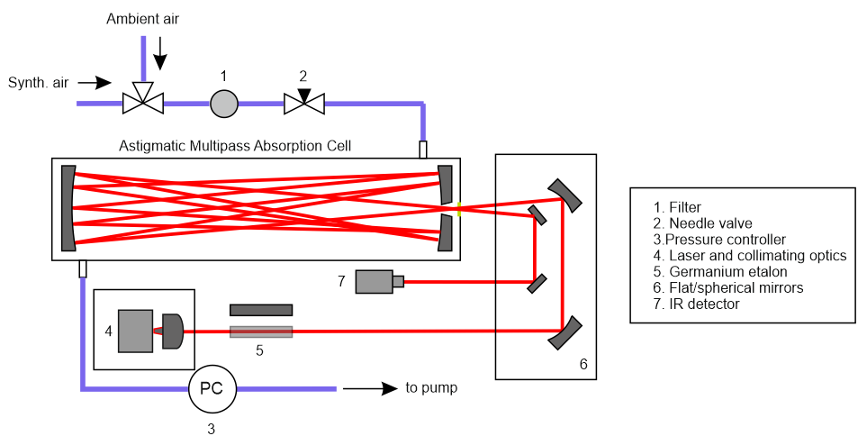
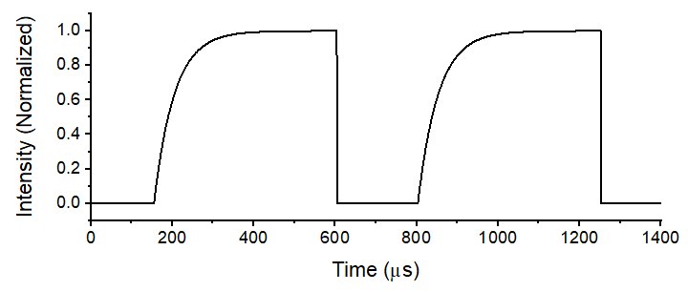
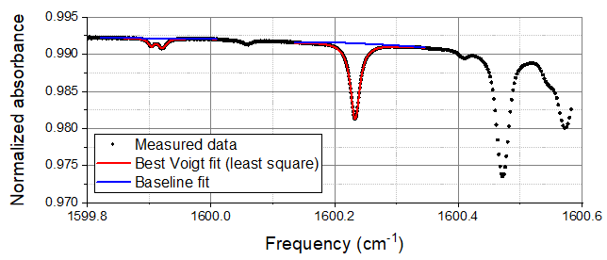
Instrument setup
Laser driving scheme
The QCL runs in iCW mode¹, with a pulse width of 400 μs which results in a laser emission frequency sweep of 1 cm⁻¹ during each individual pulse.
NO₂
_{(10 ppbv)}
Setup design
- Quantum Cascade Laser (QCL) emitting at 1600 cm⁻¹
- Optical path length in the multipass cell (MPC): 110 m
- MPC length: 50 cm, number of reflections: 274
- Sample flows through the multipass cell at 1 slm and 50 mbar
- The blank is obtained by measuring the absorption of synth. air
H₂O
_{(0.1%)}
Observed and fitted spectra
The absorption spectrum (1 s average) is fitted with a Voigt profile using HITRAN database parameters.

Slide 4
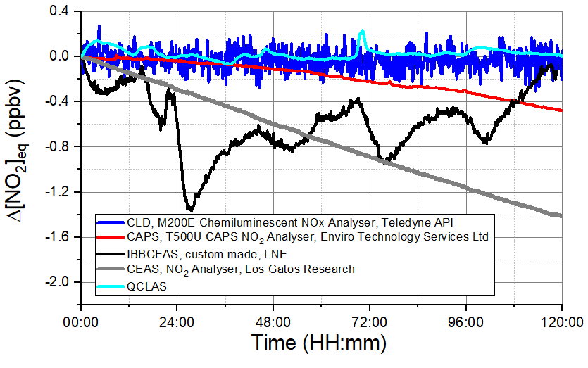
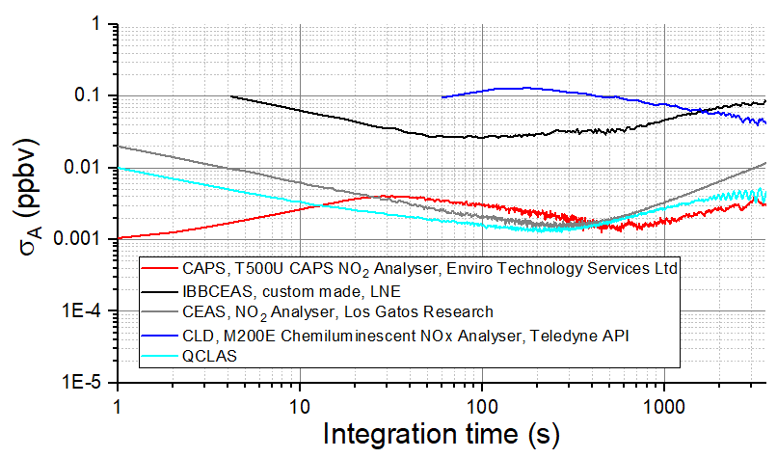
Precision and stability
The precision of the instrument was determined by sampling synthetic air for a period of 12 h, the Allan-deviation plot of this dataset is shown below, together with the datasets of several other instruments involved in the MetNO2 project.
The long-term stability of the instrument during 5 days measurement of a synthetic air sample. The data are offset corrected.
Allan deviation plot
Long term stability
QCLAS: Precision in 1 s: 10 pptv (1σ)
Best precision: 1.5 pptv in 250 s (1σ)
QCLAS:
Maximum deviation within 5 days: 200 pptv
Average drift: 2 pptv/day
The trends in the signal are strongly correlated with ambient temperature (not shown)

Slide 5
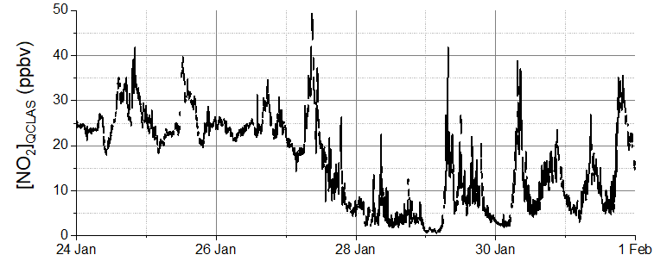
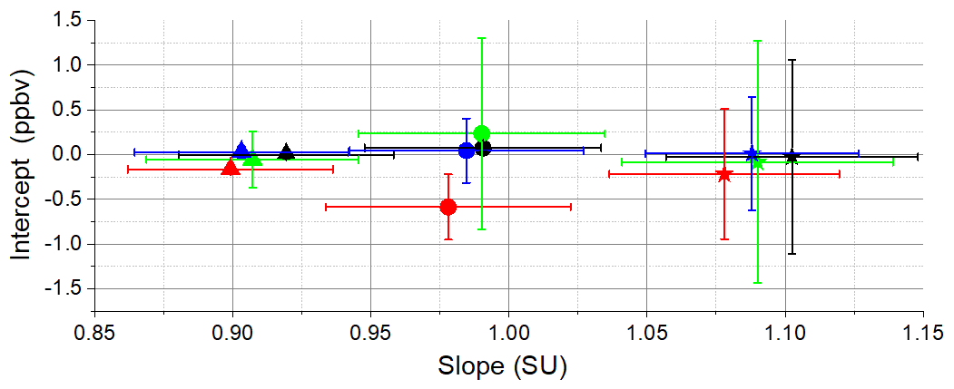
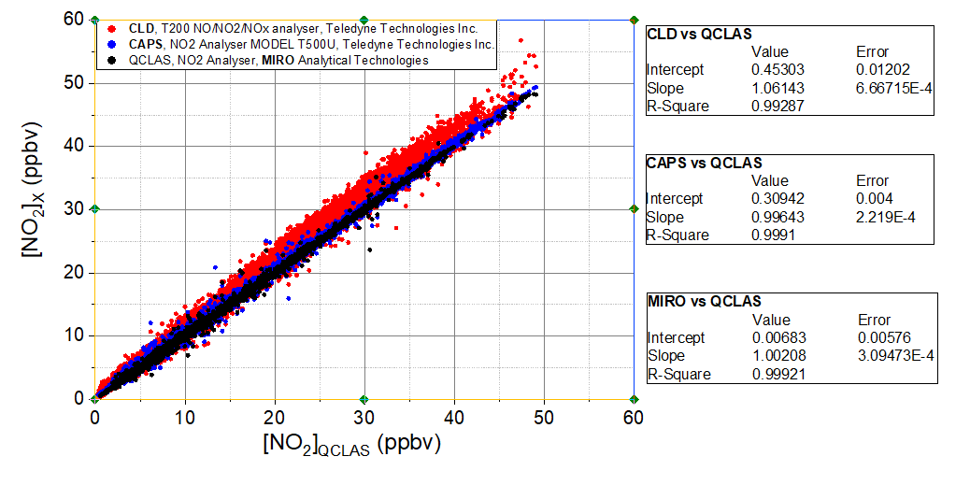
Ambient measurement
B) Two weeks of ambient measurements at a urban site
A) Calibration using direct and indirect methods
A) The calibration factors using 3 different calibration techniques were compared with 3 commercial devices (CLD, CAPS and another QCLAS) and show very good agreement for each given method.
B) The 4 instruments were deployed for 2 weeks at a urban station of the Swiss Air Quality Monitoring Network (NABEL). The NO₂ mixing ratios obtained with the prototype QCLAS are shown.
C) Correlation between the prototype QCLAS and the commercial instruments.
C) Correlation of ambient air datasets

Slide 6
Conclusion and Outlook
The newly developed QCLAS instrument shows excellent precision and stability
A very good agreement was found with other selective NO₂ instruments
Futher improvements will focus on optimizing fitting procedure and on temperature stability
Further extension towards other species (e.g. HNO₃) is planned

Slide 7
References
[1] M. Fischer, B. Tuzson, A. Hugi, R. Brönnimann, A. Kunz, S. Blaser, M. Rochat, O. Landry, A. Müller, and L. Emmenegger, "Intermittent operation of QC-lasers for mid-IR spectroscopy with low heat dissipation: tuning characteristics and driving electronics," Opt. Express 22, 7014-7027 (2014)

