Slide 1
Which method should we use to draw empirical rainfall thresholds for landslide early warning?
© Copyright by the Authors
David J. Peres
Antonino Cancelliere
Department of Civil Engineering and Architecture University of Catania

Slide 2
Empirical rainfall thresholds for landslide early warning
Rainfall is the main cause of landslides
Early warning of landslides can save lives
Rainfall thresholds linked to landslide occurrence are an important component of landslide early warning systems
Thresholds are commonly expressed in terms of a power-law linking rainfall event duration and intensity

Slide 3
After collecting the data on landslide events…
Triggering events
Rainfall event intensity
Rainfall event duration

Slide 4
After collecting the data on landslide events…
Triggering events
Rainfall event intensity
Lower limit by eye
Rainfall event duration

Slide 5
After collecting the data on landslide events…
Triggering events
Frequentist P:
More objective
than “by eye”
Regression
5 % non-exceedance thresholds

Slide 6
After collecting the data on landslide events…
Triggering events
Frequentist P:
More objective
than “by eye”
5 % non exceedance thresholds

Slide 7
After collecting the data on landslide events…
Non-triggering events

Slide 8
After collecting the data on landslide events…
Non-triggering events
Frequentist N
Regression

Slide 9
After collecting the data on landslide events…
Non-triggering events
Frequentist N
This method is rarely used
5 % exceedance threshold

Slide 10
After collecting the data on landslide events…
Triggering and
Non-triggering
Optimize
a given objective
in terms of the
ROC matrix

Slide 11
After collecting the data on landslide events…
Triggering and
Non-triggering
Optimize
a given objective
in terms of the
ROC matrix
Frequentist N
ROC
Frequentist P

Slide 12
Which methods we test
Frequentist on triggering (Frequentist P)
Frequentist on non-triggering (Frequentist N)
ROC Analysis of triggering and non-triggering (max TSS)
Landslide occurred
Landslide not occured
Threshold exceeded
TP
FP
Threshold not exceeded
FN
TN
max TSS = TP/(TP+FN) – FP/(FP+TN)

Slide 13
Which methods we test
Indeed the other methods have an objective that can be framed in terms of the ROC matrix too
Landslide occurred
Landslide not occured
Threshold exceeded
TP
FP
Threshold not exceeded
FN
TN
Frequentist P
TPR = TP/(TP+FN) = 5 % (e.g.)

Slide 14
Which methods we test
Indeed the other methods have an objective that can be framed in terms of the ROC matrix too
Landslide occurred
Landslide not occured
Threshold exceeded
TP
FP
Threshold not exceeded
FN
TN
Frequentist N
FPR = FP/(FP+TN) = 5 % (e.g.)

Slide 15
What we test
Sampling variability
How large is the statistical uncertainty in the estimation of the threshold, due to limited size of the available data set
For example:
Method 1
MSE of threshod parameter
Method 2
Sample size
Method 2 is better than method 1

Slide 16
What we test
Robustness
Robustness measures how "the outcome of a statistical procedure is affected by the presence of a small number of unusual or incorrect values".
Oxford dictionary of Statistics

Slide 17
Method
Monte Carlo simulations are used (see Peres and Cancelliere, 2018)
For a given sample size (number of rainfall events) N = 30 repetitions are carried out
For each sample, to test robustness, a separate set with errors is generated:
p% of the triggering rainfall events are randomly assigned to non-triggering events and vice-versa
In this way we try to mimic the effect of missing landslide events in inventories, and of rainfall events erroneously being attributed to a landslide (for instance: far rain gauge/landslide triggered by other causes)

Slide 18
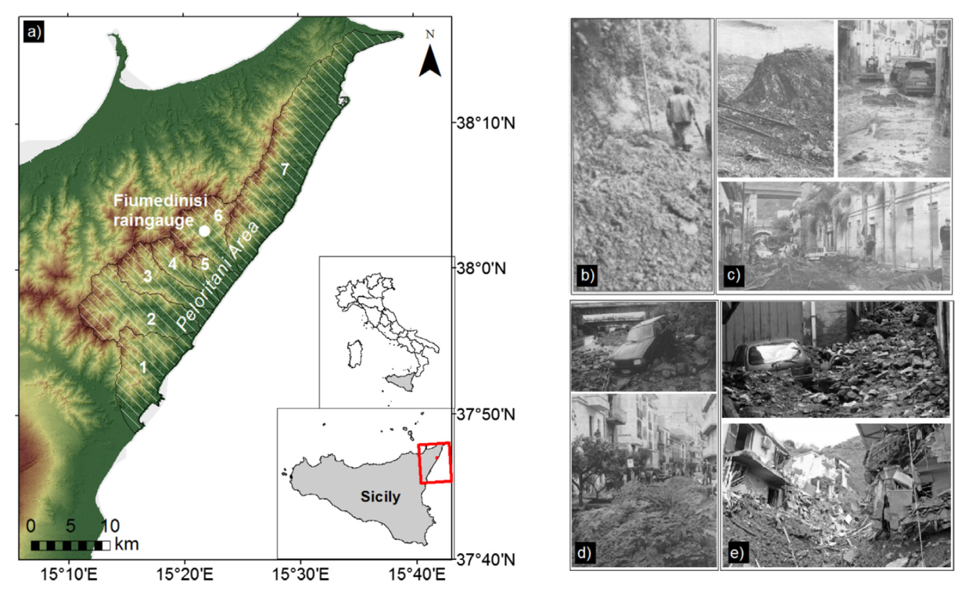
Data
Climate and hydro-geomorphological characteristics of the Peloritani Mountains area (see Peres and Cancelliere, 2018)

Slide 19
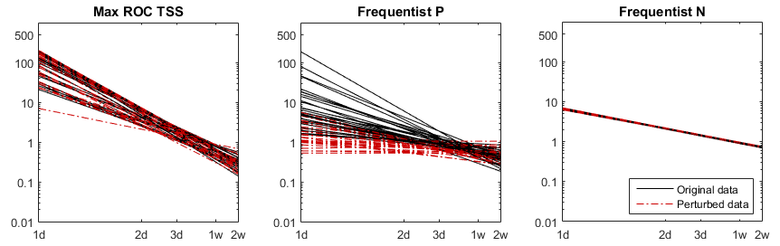
Results: Robustness (p = 10%)
These plots show thresholds derived from a “perfect” rainfall-landslide data set vs. a “polluted” data set, where the 10 % of triggering events are exchanged with non-triggering events and vice-versa
Number of rainfall events = 5’000

Slide 20
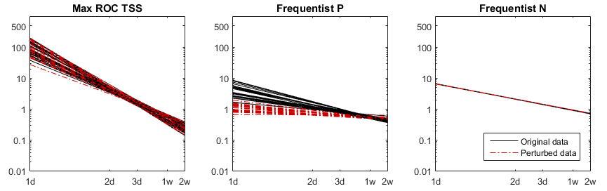
Results: Robustness (p = 10%)
These plots show thresholds derived from a “perfect” rainfall-landslide data set vs. a “polluted” data set, where the 10 % of triggering events are exchanged with non-triggering events and vice-versa
Number of rainfall events = 50’000

Slide 21
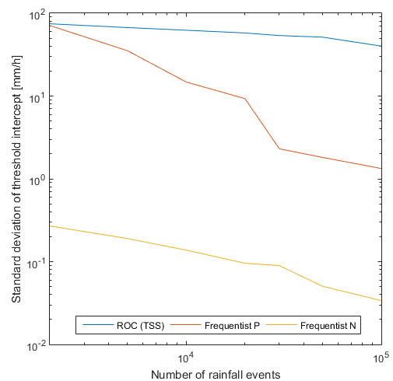
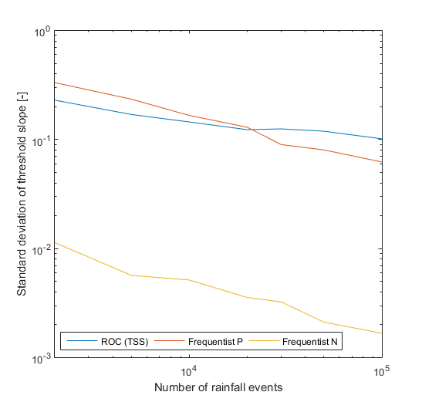
Results: Sampling variability
These plots show the uncertainty in determination of the I-D threshold parameters (intercept and slope), for varying sample-size

Slide 22
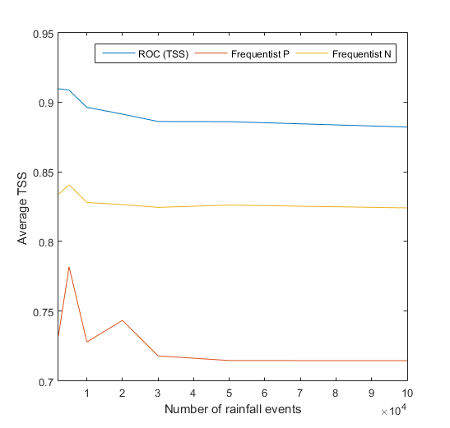
Results: Performance (calibration)
This plot shows the average calibration performance of thresholds with the 3 methods, in terms of the ROC TSS

Slide 23
Conclusions
Method based on maximization of TSS are the most robust and performing (best trade-off between false positives and false negatives)
At the same time max TSS method has the highest sampling variability
“Frequentist P” method is the least robust and leads to a high number of false positives. Errors in inventories exacerbate this issue
“Frequentist N” method deserves higher attention by the scientific community, as it is more robust, less variable and more performing than widely-used “Frequentist P”
Even if other considerations may constrain the choice of the method, the statistical features illustrated may be useful when taking the decision

Slide 24
Questions?
Chat with me:
don’t‘ be shy!
Write me a comment

