Slide 1
Temperature and precipitation projections for Poland based on downscaled EuroCORDEX ensemble
Joanna Struzewska
Maciej Jefimow
Paulina Jagiełło
Maria Kłeczek
Anahita Sattari
Aneta Gienibor
Aleksander Norowski
Pawel Durka
Barłomiej Walczak
Piotr Drzewiecki
Department of Atmospheric and Climate Modelling
Institute of Environmental Protection – National Research Institute

Slide 2
Outline
Motivation
Methodology and data
Ensemble spread
Temperature projections
Precipitation projections
Summary

Slide 3
Motivation
Climate change scenarios prepared in the scope of a project - Knowledgebase on climate change and adaptation strategies (Klimada2.0)
Coherent information for all administrative regions in Poland
Results publicly available
Diverse applications:
Adaptation plans
Environmental impact assessment
Sectoral development plans
Climate protection
Research
Education

Slide 4
Climate change service
Stage-1 Temperature and precipitation (2019)
Stage-2 Irradiance and wind + potential
energy for solar and wind farms (2020)
Stage-3 Humidity and snow cover (2021)

Slide 5
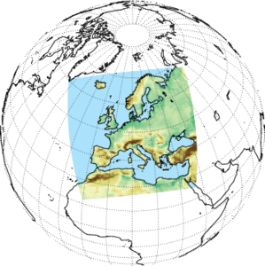
Climate projections - EuroCORDEX
EUR11 at 0.11deg x 0.11deg
All available models for the analysed parameters
RCP4.5 and RCP8.5
2006 - 2100
Institution | RCM | Driving model | RCP Scenario | Period
CCLMCOM | CCLM4 | CNRM-CM5 | RCP4.5 / RCP8.5 | 2006-2100
 |  | EC-EARTH
 |  | MPI-ESM-LR
KNMI | RACM022 | EC-EARTH | RCP4.5 / RCP8.5 | 2006-2100
SMHI | RCA4 | CNRM-CM5 | RCP4.5 / RCP8.5 | 2006-2100
 |  | EC-EARTH
 |  | MPI-ESM-LR
IPSL | WRF331F | IPSL-CM5A-MR | RCP4.5 / RCP8.5 | 2006-2100
DMI | HIRHAM5 | EC-EARTH
 |  | NCC-NorESM | RCP4.5 / RCP8.5 | 2006-2100
CNRM | ALADIN53 | CNRM-CM5 | RCP4.5 / RCP8.5 | 2006-2100
CSC | REMO2009 | MPI-ESM-LR | RCP4.5 / RCP8.5 | 2006-2100

Slide 6
Methods and data
RCM results statistically downscaled using different sets of gridded observation-based meteorological fields to reduce systematic biases
Observation-based fields were interpolated to EuroCordex grid
Analysis were limited to the area of Poland
Observations
Reference period 2006 - 2017
Main meteorological parameters | Historical data
 | IMGW | ERA5 | EOBS | UERRA
Annual average temperature | × | × | × | ×
Maximum average temperature | × | × | ×
Minimum average temperature | × | × | ×
Precipitation sum | × | ×

Slide 7
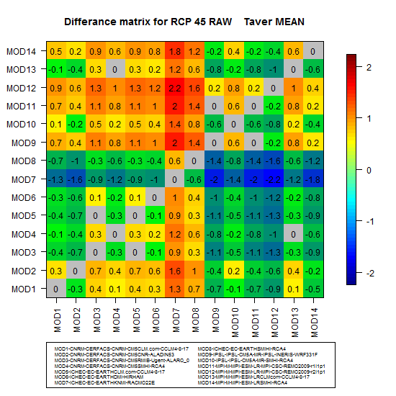
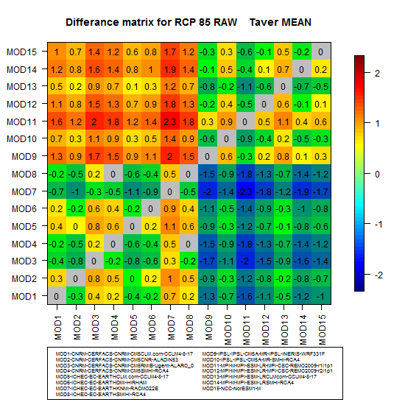
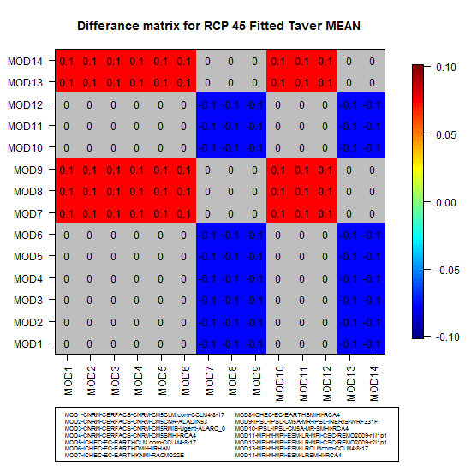
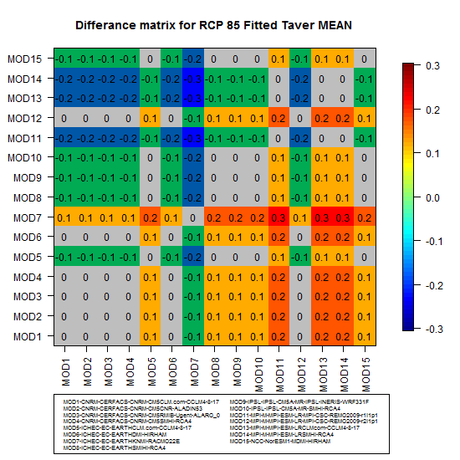
Downscaling
As a result of statistical downscaling, the bias was reduced, the spread of extreme values was improved, and the probability distribution was better approximated

Slide 8
Ensemble spread (example for average temperature)
Ensemble spread was calculated separately for each „partial ensemble”. Statistical analysis was performed for individual ensemble members
2021 - 2030
2051 - 2060

Slide 9
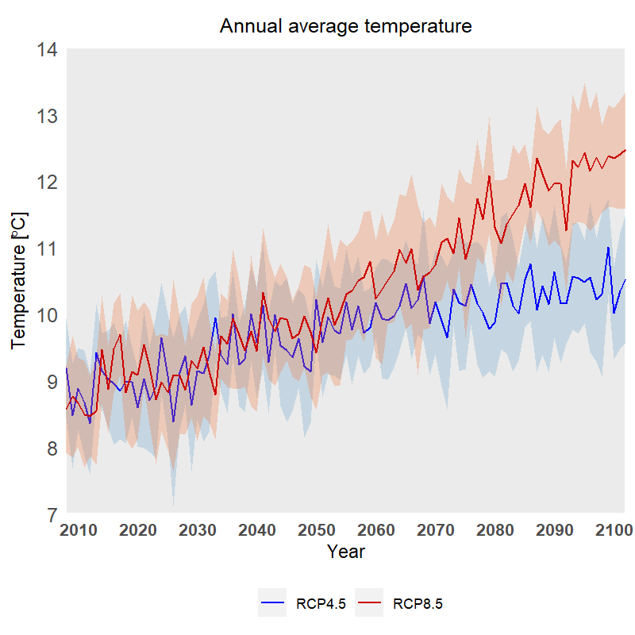
“Multi-ensemble” and uncertainty (𝞼)
Since partial ensembles showed similar pattern we have decided to a calculated final projection based on all available ensemble members (muti-ensemble comprised with downscaling results will all datasets).

Slide 10
Processing chain
Historical data:
IMWM
E-OBS
EAR5
UERRA
Final scenario was calculated as the mean of all ensemble members
Statististical downscaling
Ensemble analysis
Climate indices
Averaging and post-processing
EURO-CORDEX scenarios RCP4.5 i RCP8.5
WEB
PORTAL

Slide 11
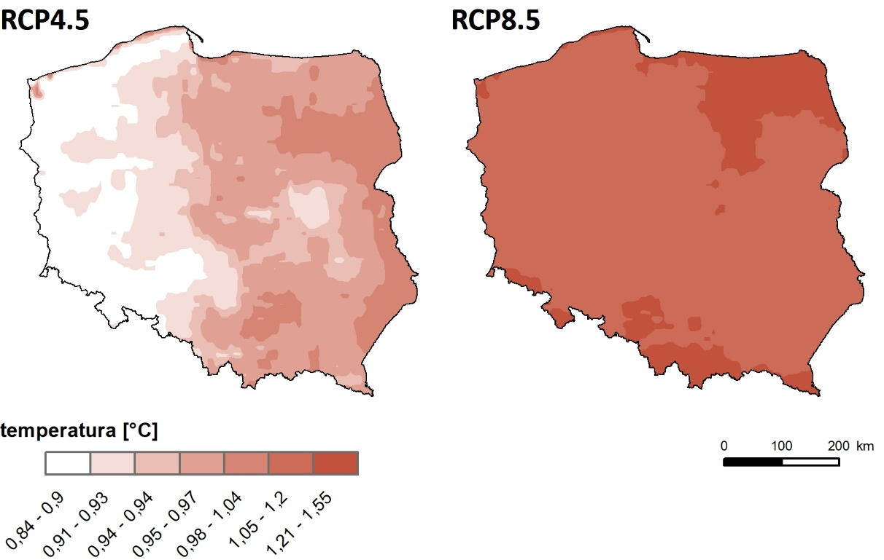
Average temperature
The absolute difference between the modelled decades:
2051-2060 | 2020-2011

Slide 12
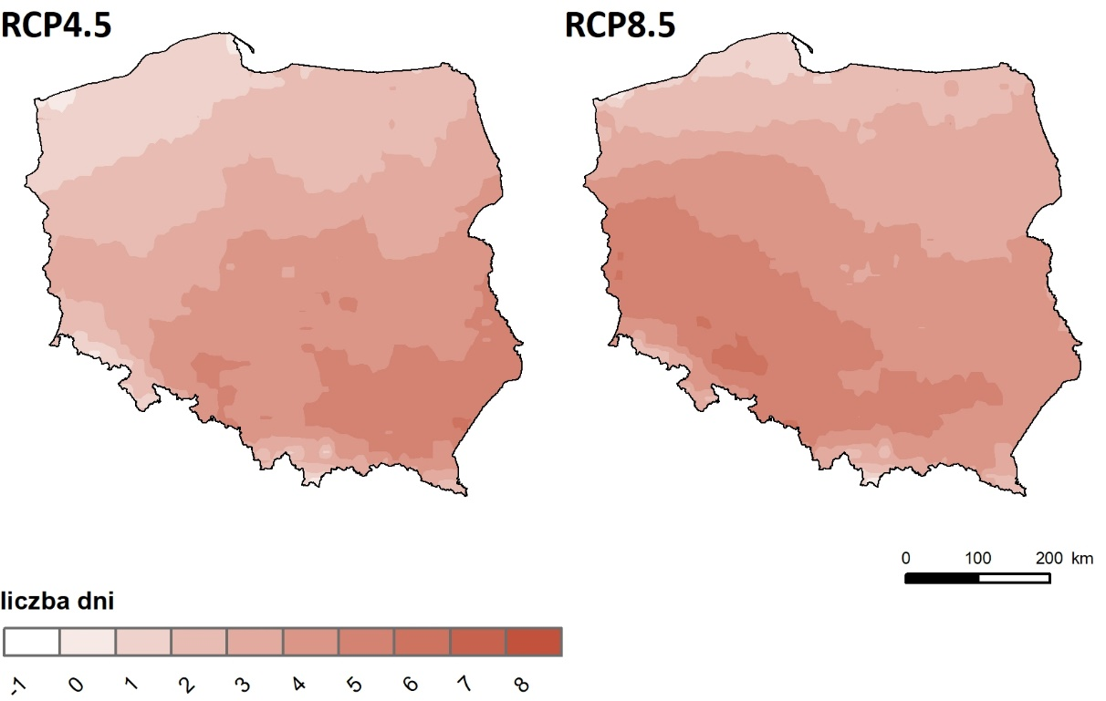
Hot spells
The absolute difference between the modelled decades:
2051-2060 | 2020-2011

Slide 13
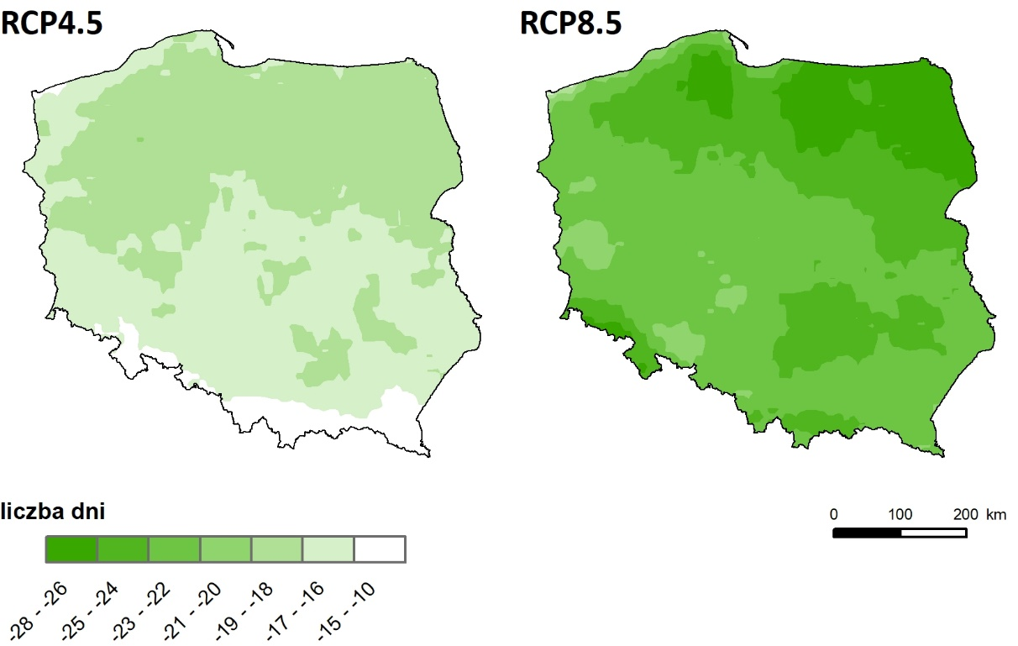
Cold spells
The absolute difference between the modelled decades:
2051-2060 | 2020-2011

Slide 14
Temperature trends
More summer days
Less cold days
More hot days

Slide 15
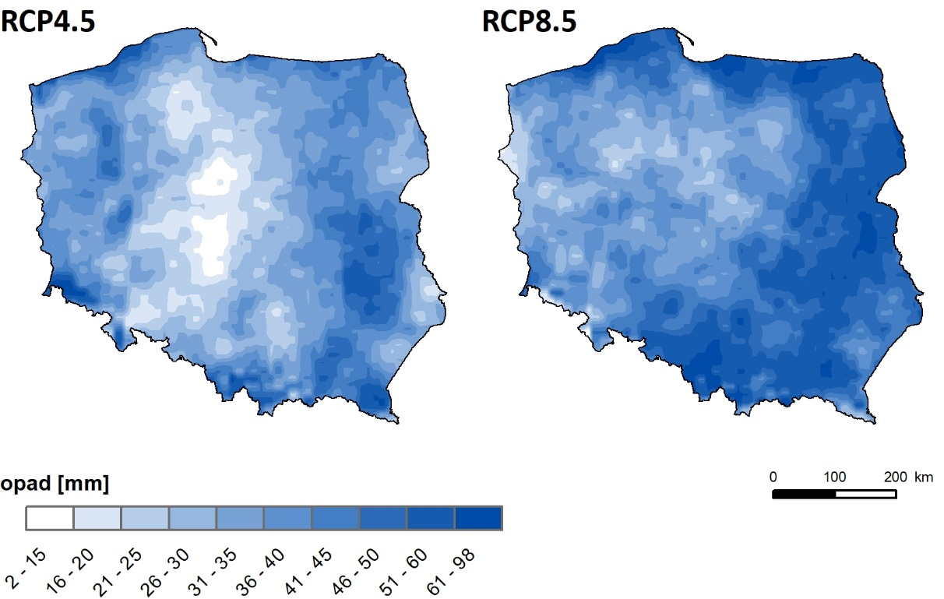
Annual precipitation
The absolute difference between the modelled decades:
2051-2060 | 2020-2011

Slide 16
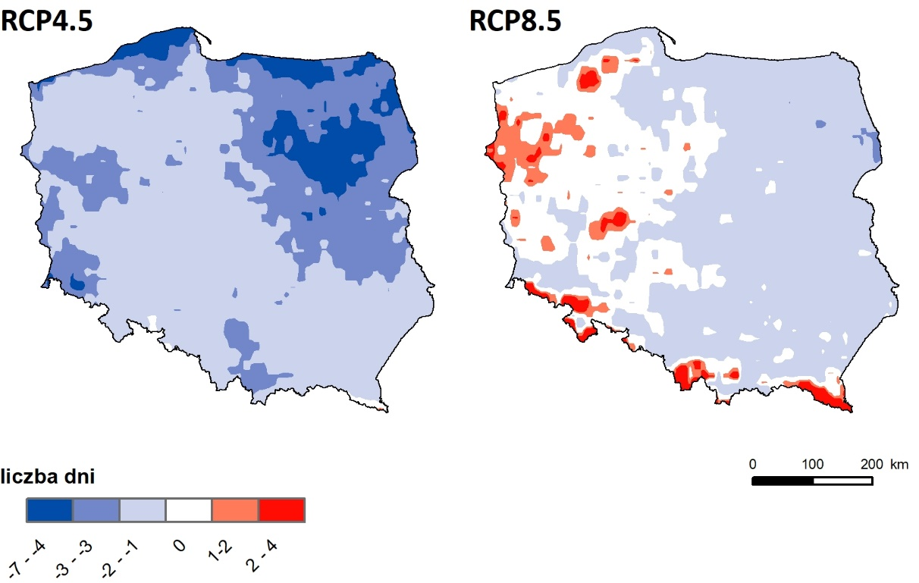
Dry spells – number of days without precipitation
The absolute difference between the modelled decades:
2051-2060 | 2020-2011

Slide 17
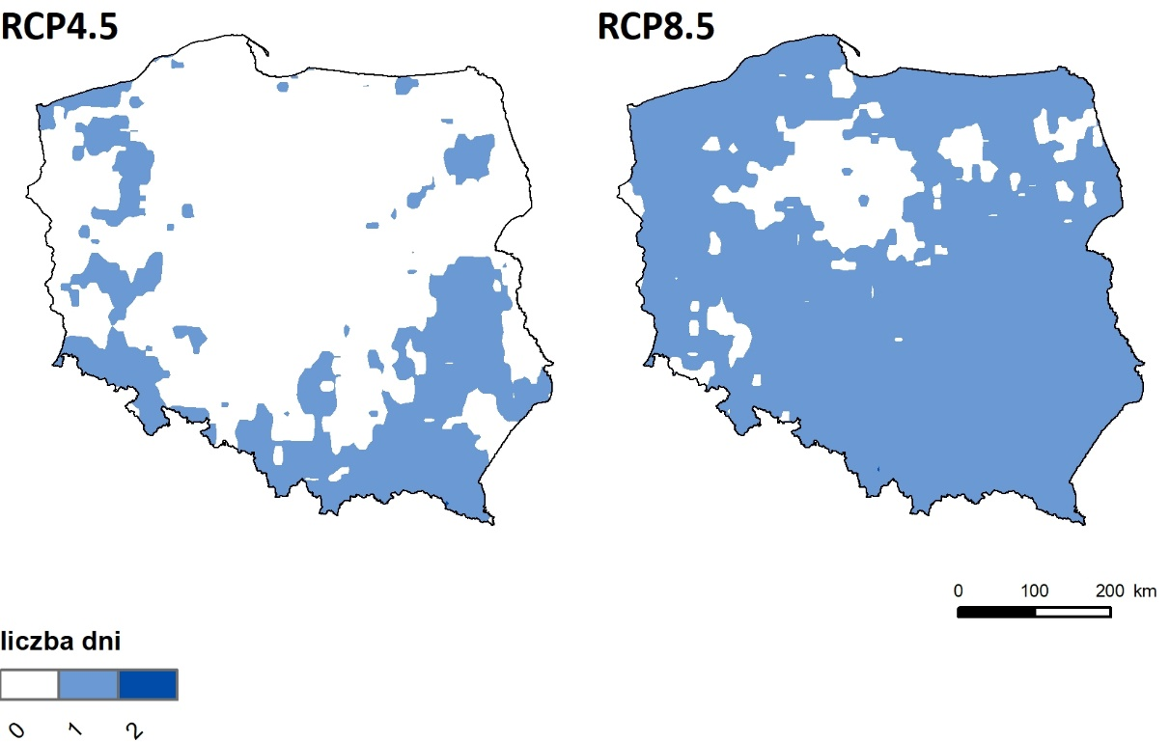
Extreme precipitation – number of days
The absolute difference between the modelled decades:
2051-2060 | 2020-2011

Slide 18
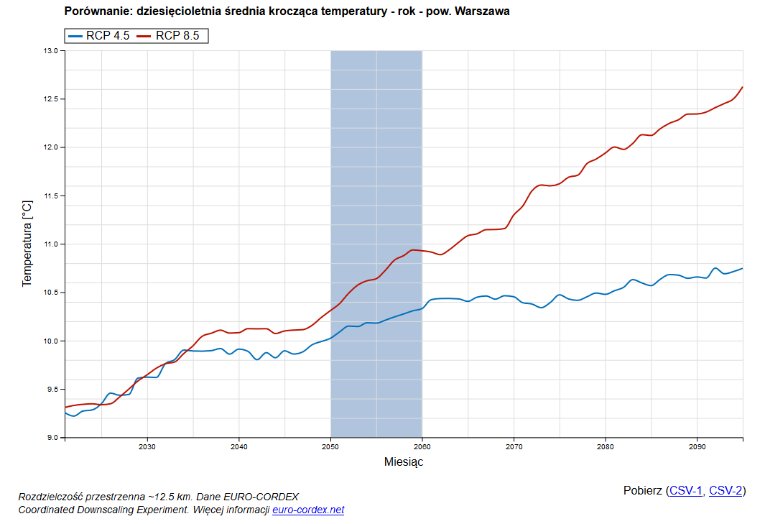
Climate change for Poland - web portal
https://projekcje.ios.gov.pl/
https://klimada2.ios.gov.pl/klimat-scenariusze/

Slide 19
Summary
Climate projections based on EuroCORDEX were prepared for temperature and precipitation for Poland for the period 2020 - 2100
The “multi-ensemble” approach was used with all available downscaling result
The increase in the average annual temperature results from the increase in the number of hot days and the reduction in the number of frost days. The number of frost days will also decrease.
The most pronounced changes in the frequency and amount of precipitation occur in the north-east of Poland.
The total number of days with precipitation increases slightly.
The increase in the annual rainfall is mainly due to the increase in the number of days with extreme precipitation.
The forecasted changes in precipitation are the least significant in the western part of the country.

Slide 20
Future work
Projections for wind speed, irradiance, humidity and snow cover will be prepared
Future climate potential energy for solar and wind farms will be assessed
Data are publicly available via web-portal (trends, seasonal patterns and histograms averaged for administrative regions)

Slide 21
THANK YOU! contact e-mail: joanna.struzewska@ios.edu.pl
Department of Atmospheric and Climate Modelling
Institute of Environmental Protection – National Research Institute
www.klimada2.ios.gov.pl

