Slide 1






Influence of crop residues on weed emergence
Nebojša Nikolić¹, Donato Loddo², and Roberta Masin¹
¹Department of Agronomy, Food, Natural resources, Animals and Environment - DAFNAE, University of Padova, Italy
²Institute for Sustainable Plant Protection - IPSP, National Research Council of Italy - CNR, Italy
Corresponding author: nebojsa.nikolic@phd.unipd.it

Slide 2

Introduction
Weeds are one of the major problems in agriculture
Reduce yield
Interfere with harvest
Serve as hosts to possibly harmful organisms
In order to prevent this, control operations should be performed during the germination-emergence phase

Slide 3
Introduction
Different management systems = Different field conditions = Weed seed bank exposed to different conditions
May promote or obstruct germination
One of these conditions is the presence or the absence of crop residues on the soil surface, very common in the newer agricultural practices, such as
Conservation Agriculture

Slide 4
Introduction
The presence of crop residues on the soil surface can have two opposite effects on weed seed germination on the base of the quantity of residues and weed species
Inhibits germination since residues impede light to reach the soil surface and decrease daily fluctuation of soil temperature, reducing consequently the environmental stimulus for germination.
Promotes germination since residues reduce soil water evaporation and increase soil moisture, facilitating seed imbibition.

Slide 5
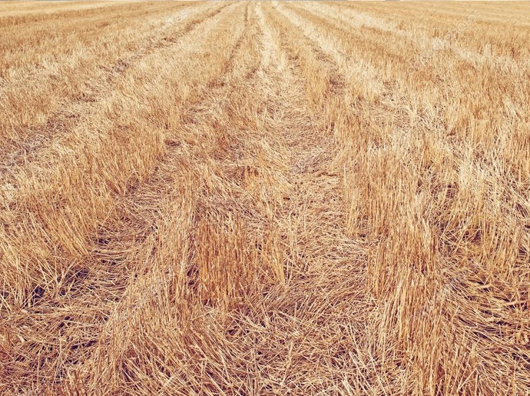
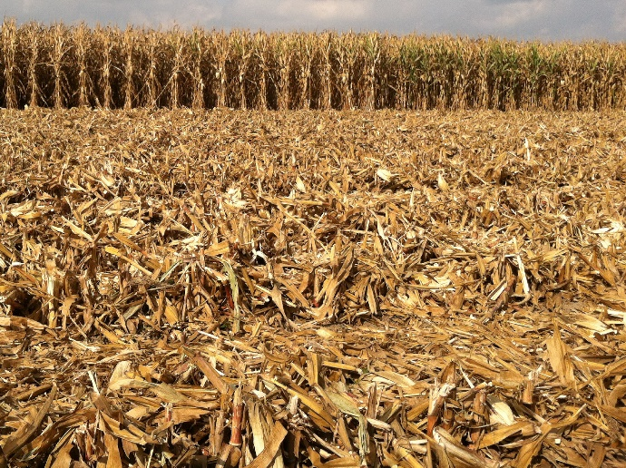
Aim of the study
Understand the influence of crop residues on weed seed germination
Influence of the quantity of residues
Influence of the type of residues
Uncover if different weed species respond differently to coverage by residues

Slide 6
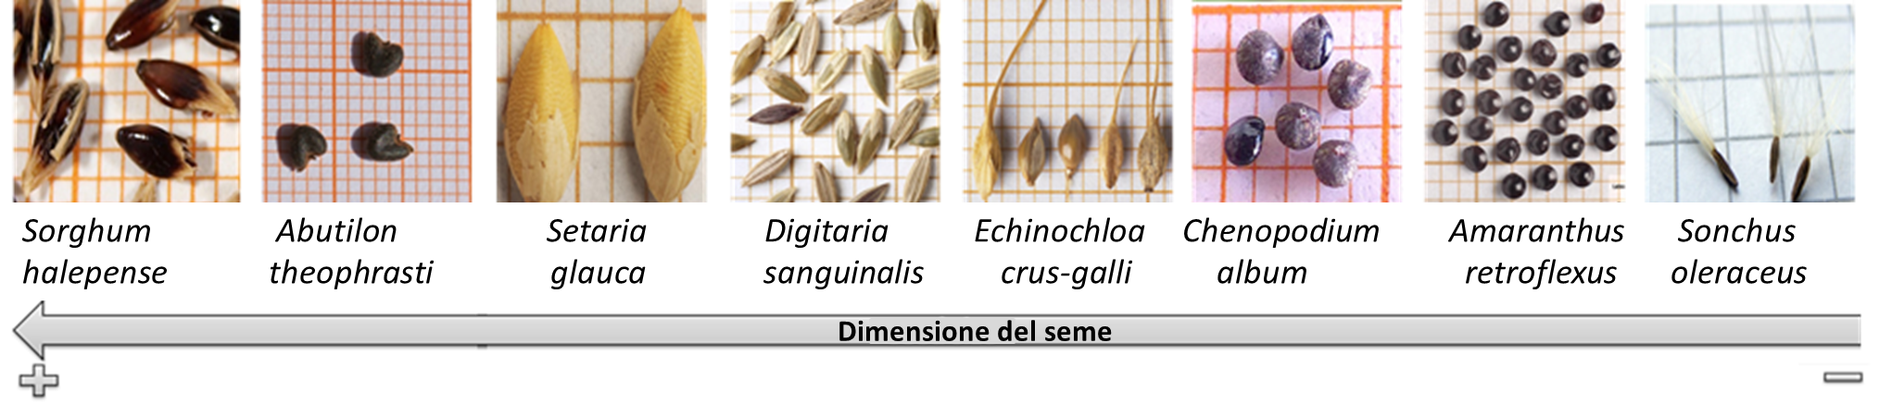
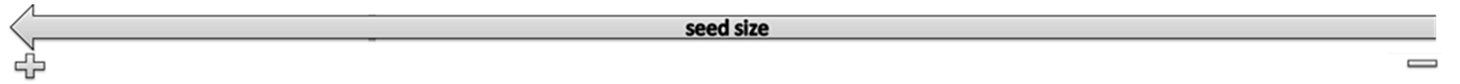
Materials and Methods
In this work the germination of eight weed species
was examined under the residues of two crop species
Maize (Zea mays)
Wheat (Triticum sp.)

Slide 7
Materials and Methods
200 seeds
Maize (Zea mays)
3 quantities
Wheat (Triticum sp.)
0.5
1
1.5
The quantity (in kg) of residues measured in 1 m²
0 control with no residues

Slide 8
Materials and Methods
Scheme of the experimental plan
200 cm
20x20 cm
The experiment was conducted at the experimental farm of the University of Padova in Legnaro (PD)
8x2x3 factorial design with three blocks, plus three control repetitions was used
520 cm
Seeds of each weed species were sown in an area of 20 x 20 cm

Slide 9
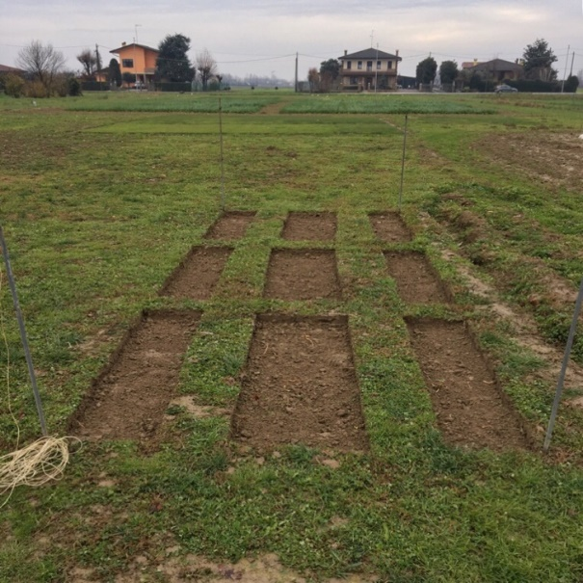
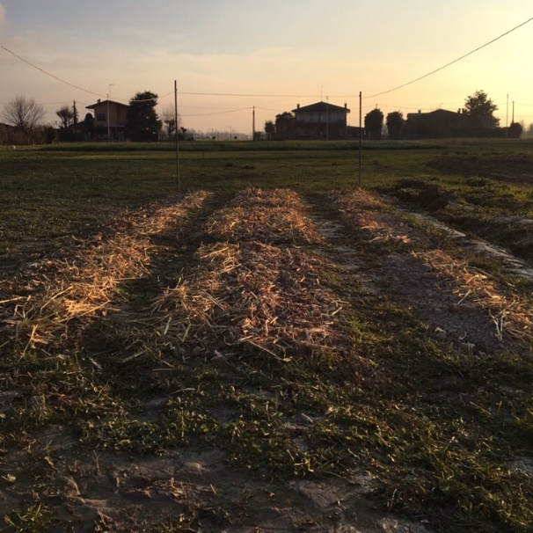
Materials and Methods
Soil from the designated areas was removed, sterilized at 105°C and restored to the field.
The seeds were sown on the surface of the soil and covered with the different quantity of the respective crop residue or left uncovered in the case of control.
Experimental area before and after sowing
The experiment started in December 2018
Seed germination started in March 2019 and was controlled twice a week

Slide 10
Results
ANOVA and LSD analysis were performed on cumulated germination data.
Quantity of residues and weed species resulted significant as factors
(p-value < 0.000).
Efficacy of residue quantity to reduce germination for both maize and wheat residues
Field quantity (1) – Medium efficacy
Quantity superior than the one present in the field (1.5) – Good efficacy
Quantity smaller than the one present in the field (0.5) – Ineffective
a
b
Emergence without residues
c
Quantity (0.5)
+15%
Quantity (1)
-10%
Quantity (1.5)
-30%

Slide 11
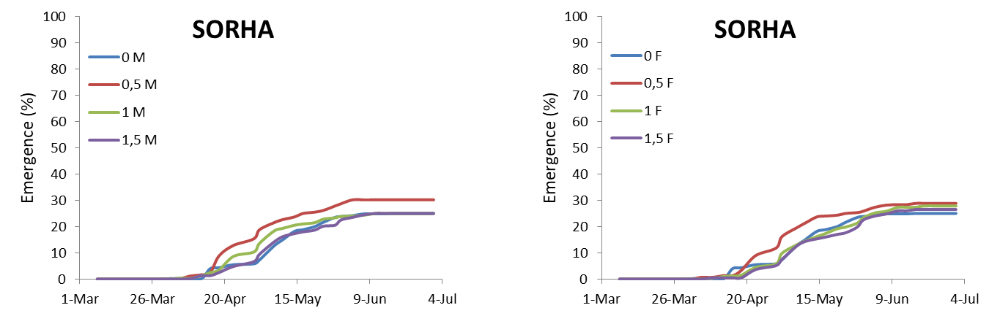
Results
Weed species were all more inhibited by the higher concentrations of residues
Maize residues
Wheat residues
0
0,5
1
1,5
0
0,5
1
1,5
Sorghum halepense

Slide 12
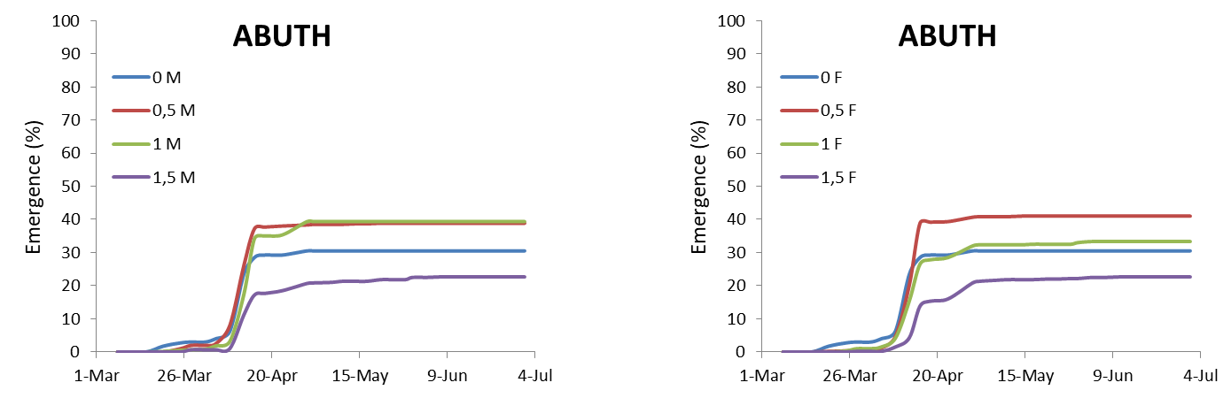
Results
Weed species were all more inhibited by the higher concentrations of residues
Maize residues
Wheat residues
0
0,5
1
1,5
0
0,5
1
1,5
Abutilon theophrasti

Slide 13
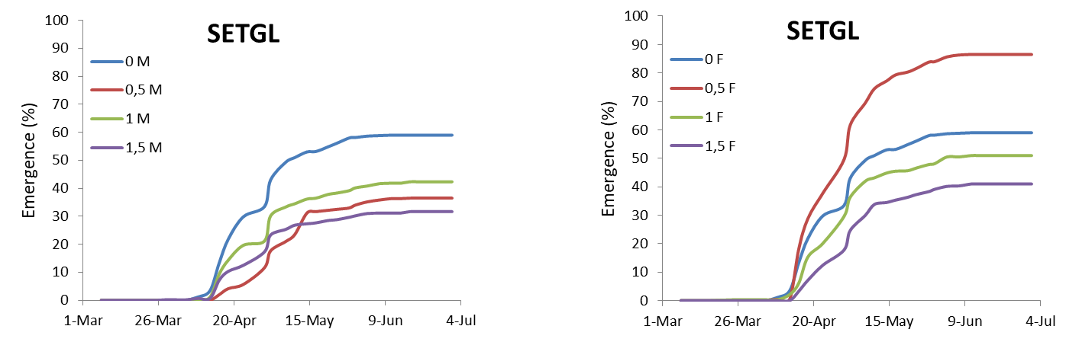
Results
Weed species were all more inhibited by the higher concentrations of residues
Maize residues
Wheat residues
0
0,5
1
1,5
0
0,5
1
1,5
Setaria glauca

Slide 14
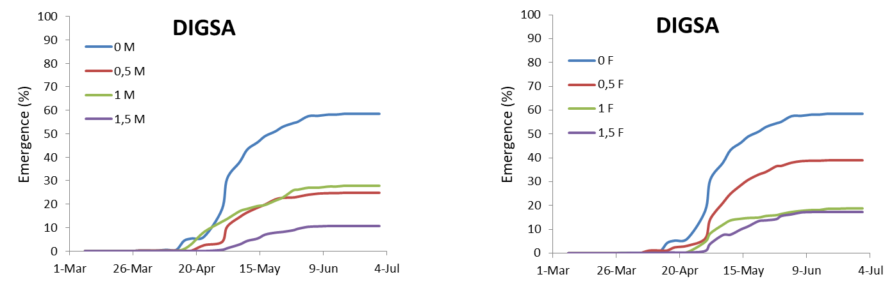
Results
Weed species were all more inhibited by the higher concentrations of residues
Maize residues
Wheat residues
0
0,5
1
1,5
0
0,5
1
1,5
Digitaria sanguinalis

Slide 15
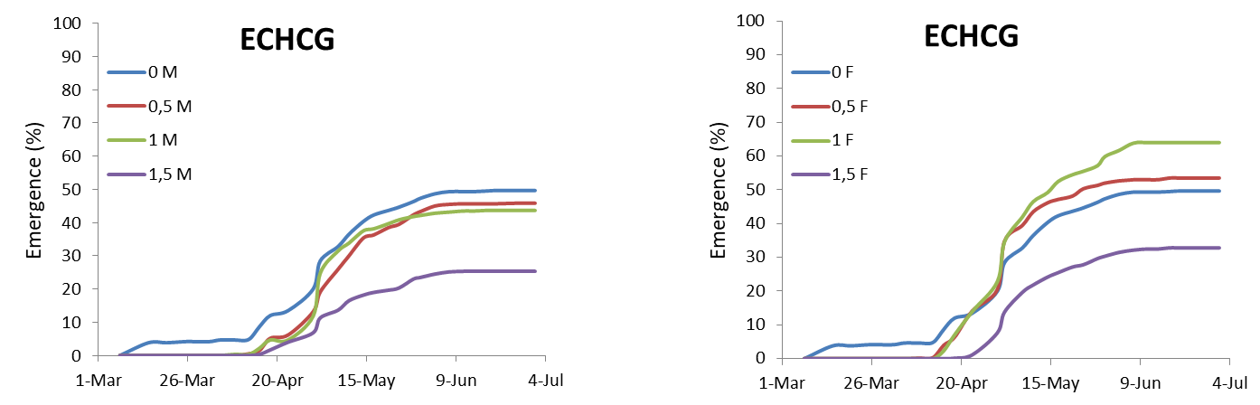
Results
Weed species were all more inhibited by the higher concentrations of residues
Maize residues
Wheat residues
0
0,5
1
1,5
0
0,5
1
1,5
Echinochloa crus-galli

Slide 16
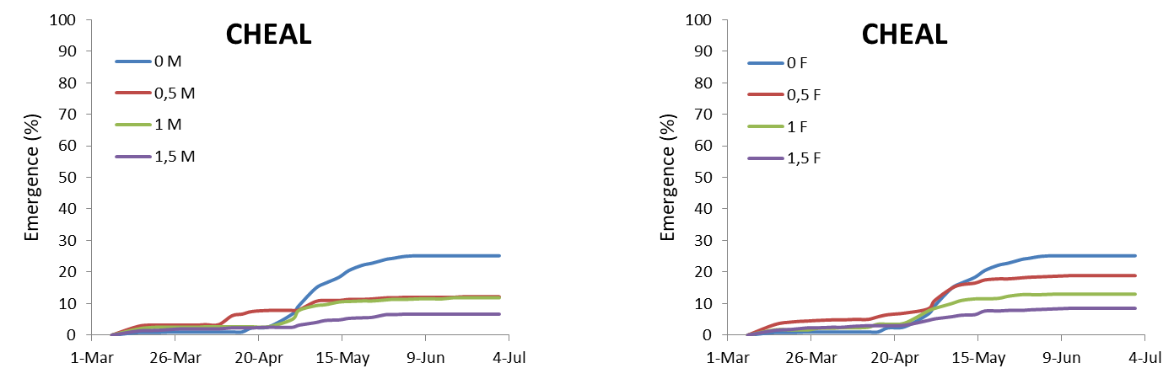
Results
Weed species were all more inhibited by the higher concentrations of residues
Maize residues
Wheat residues
0
0,5
1
1,5
0
0,5
1
1,5
Chenopodium album

Slide 17
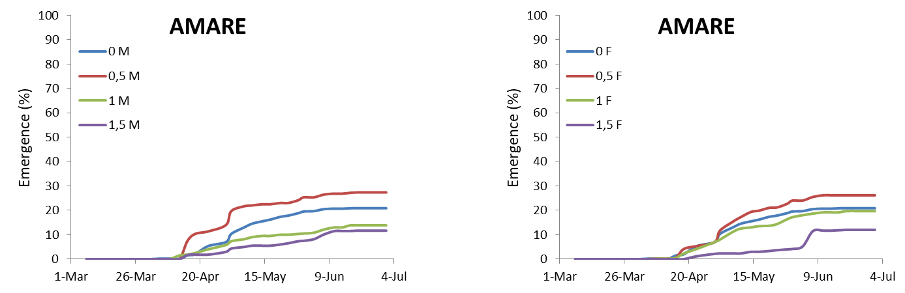
Results
Weed species were all more inhibited by the higher concentrations of residues
Maize residues
Wheat residues
0
0,5
1
1,5
0
0,5
1
1,5
Amaranthus retroflexus

Slide 18
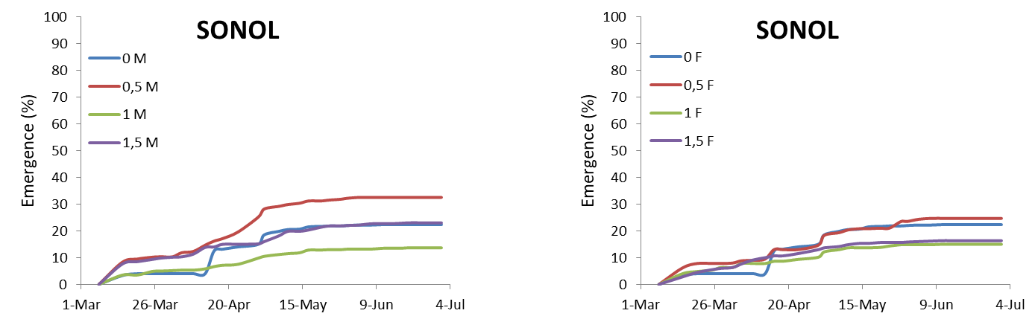
Results
Weed species were all more inhibited by the higher concentrations of residues
Maize residues
Wheat residues
0
0,5
1
1,5
0
0,5
1
1,5
Sonchus oleraceus

Slide 19
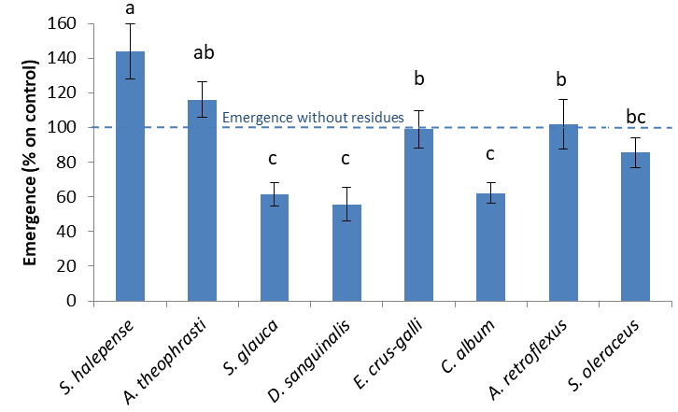
Results
Differences in emergence between the species in the presence of crop residues. Emergence is expressed in % on control. Different letters indicate significant differences (p<0.05)
Mean values of 2 different types of residues and 3 quantities

Slide 20
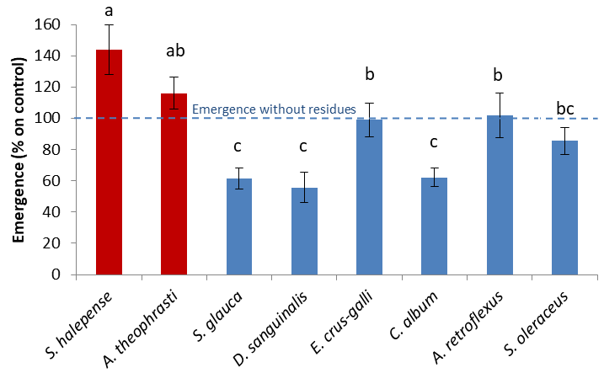
Results
It was observed that some of them seemed to be favored by the low presence of residues S. halepense and A. theophrasti

Slide 21
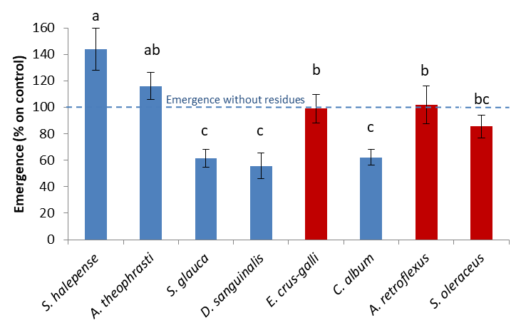
Results
Some seemed not particularly influenced by the presence of residues
E. crus-galli, A.retroflexus and S. oleraceus

Slide 22
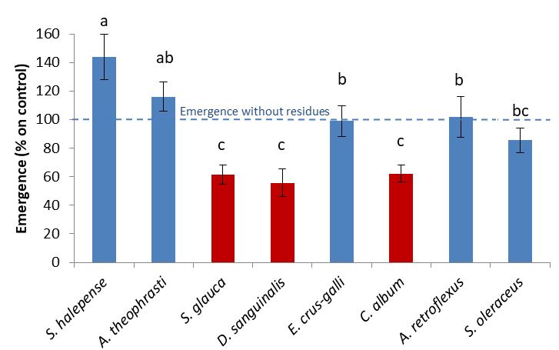
Results
While S. glauca, D. sanguinalis and C. album showed major germination rate reduction

Slide 23
Conclusions
Crop residues and weeds
Only the quantity of residues influences the emergence with higher quantities having an inhibitory effect, while low quantities may even promote emergence
Seed size might have an important role in overcoming the obstacles created by residue coverage

Slide 24
Conclusions
To obtain the weed inhibitory effect
Residues should be distributed the most homogeneously possible
Higher quantities that offer greater coverage results in grater germination reduction
Low residue density areas could favour weed emergence

Slide 25


Thank you for Your attention!

