Slide 1



LOFAR4SpaceWeather (LOFAR4SW) – Increasing European Space-Weather Capability with Europe’s Largest Radio Telescope: Beyond the Detailed Design Review (DDR)
Note that this work is as of December 2019 – pre-DDR – no updates made due to the COVID-19 Pandemic.
***All rights reserved – NOT for reproduction, use, or further distribution…
Mario M. Bisi (1), Mark Ruiter (2), Richard A. Fallows (2), René Vermeulen (2), Stuart C. Robertson (1), Nicole Vilmer (3), Hanna Rothkaehl (4), Barbara Matyjasiak (4), Joris Verbiest (5), Peter T. Gallagher (6), Michael Olberg (7), Tobia Carozzi (7), Michael Lindqvist (7), Eoin Carley (6), Paulus Krüger (2), Maaijke Mevius (2), Carla Baldovin (2), and David Barnes (1).
(1) RAL Space, UK Research and Innovation – Science & Technology Facilities Council – Rutherford Appleton Laboratory, Harwell Campus, Oxfordshire, OX11 0QX, UK. (2) ASTRON, the Netherlands Institute for Radio Astronomy, Postbus 2, 7990 AA Dwingeloo, The Netherlands. (3) Observatoire de Paris, Paris, France.
(4) Space Research Centre Polish Academy of Sciences, Warsaw, Poland. (5) Bielefeld University, Bielefeld, Germany. (6) Dublin Institute for Advanced Studies (DIAS), Dublin, Ireland. (7) Onsala Space Observatory (OSO), Onsala, Sweden.

Slide 2
Funding…
The LOFAR4SW research infrastructure project is made possible from funding from the European Community’s Horizon 2020 Programme H2020 INFRADEV-2017-1 – under grant agreement 777442.

Slide 3
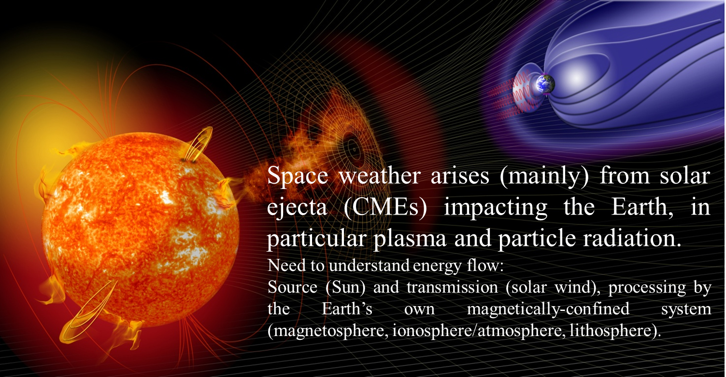
Motivation…
Because space weather is the entire Sun-Earth system!

Slide 4
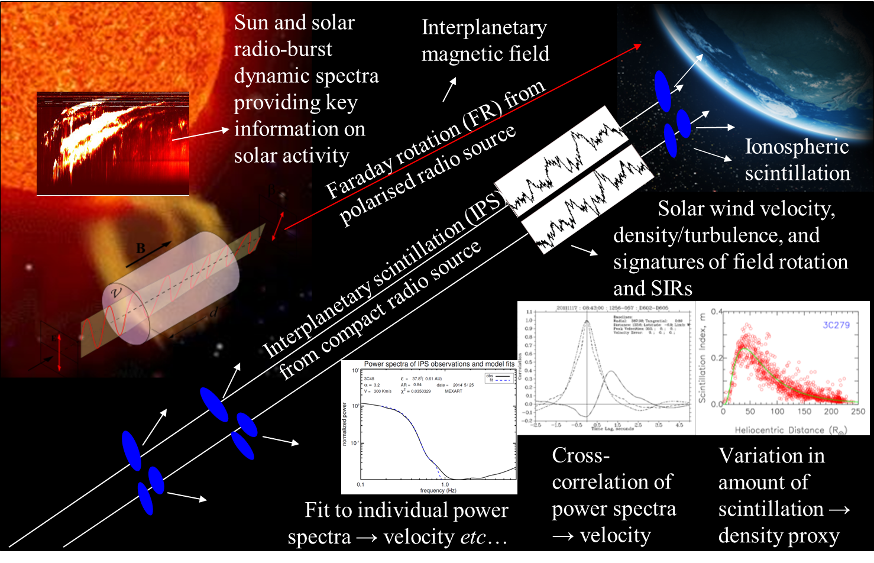
Radio Techniques (Plus Imaging)

Slide 5
LOFAR4SW WP Structure…

Slide 6
LOFAR4SW Science Use Cases… (1)
Solar:
  Continuous solar monitoring when the Sun is above the horizon and within the LOFAR field of view on the sky will provide detailed information on solar activity as well as imaging.
Heliosphere:
  Interplanetary Scintillation: IPS is used for various coronal/inner-heliospheric studies including determining the plasma velocity of structures flowing out from the Sun, estimates of plasma density variation/turbulence, assessments of flow directions, and when incorporated into the University of California, San Diego (UCSD) 3-D tomography, the ability to produce inner-heliospheric reconstructions in both velocity and density structure out to at least 3 AU (as per the previous talk) plus IPS imaging.

Slide 7
LOFAR4SW Science Use Cases… (2)
Heliosphere:
  Faraday rotation: FR is a result of the rotation of the plane of polarisation of a radio source as it traverses an magneto-ionic medium and is affected by both the density and the magnetic field of the medium; a potential breakthrough in the all-important magnetic-field determinations between the Sun and Earth; Test studies are already underway to assess its viability.
Ionosphere:
  LOFAR is revolutionising the way in which we can look at mid-latitude ionospheric structure across all scales through ionospheric scintillation, and the wide-band dynamic spectra, including potential use for riometric techniques and other ionospheric studies will be examined here (plus imaging).

Slide 8
LOFAR4SW Science Use Cases… (3)
Planetary:
  The Jovian magnetosphere is a complex electro-magneto-dynamic system with internal and external sources emitting very-intense radio waves from decametre (auroras) to centimetre (radiation belts) wavelength bands; these radio waves are used as a proxy for the observation of the energy levels and the dynamics of charged particles in the system and is also influenced by the solar wind.
Science Use Cases Summary:
  LOFAR4SW has nearly 30 detailed science use cases, all of which out many constraints on a 24/7 LOFAR4SW observing system with many requirements which have been formally addressed through systems engineering processes.

Slide 9
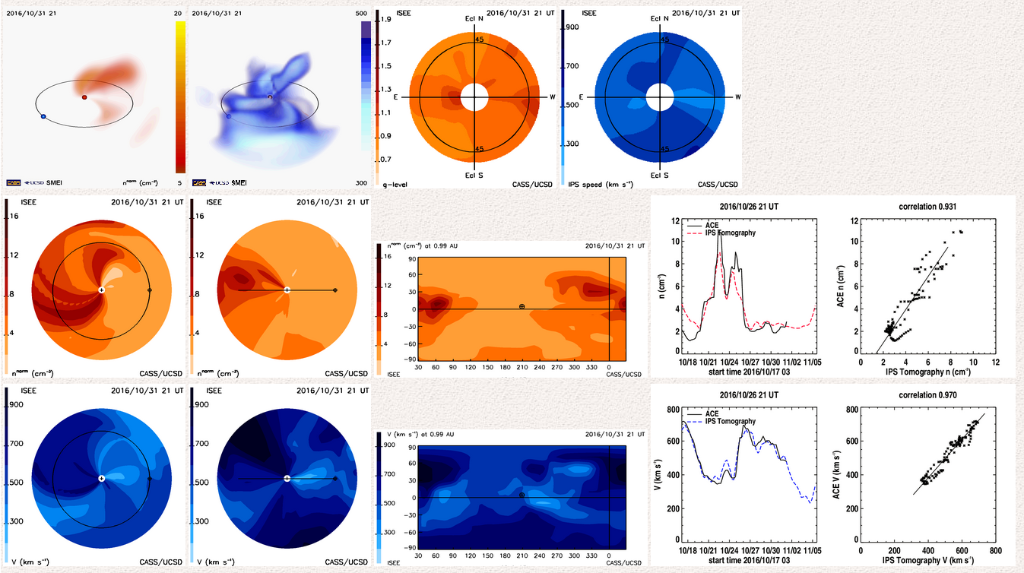
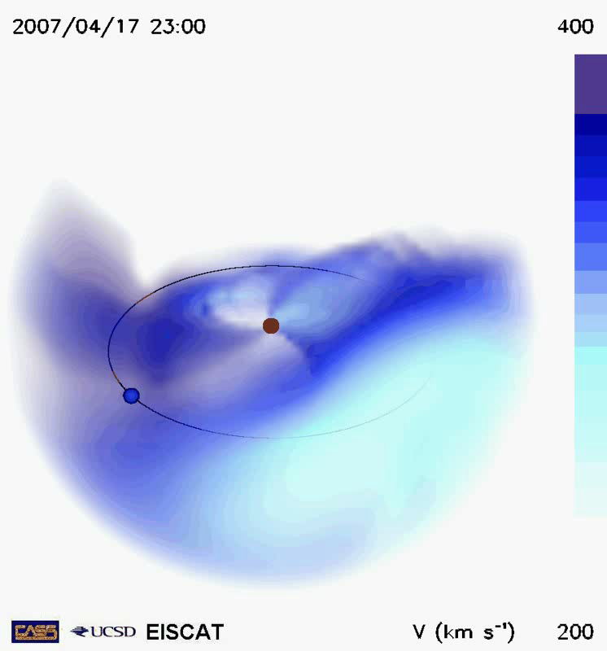
Heliosphere Use Cases (1)
Case 1 – Multi-station Interplanetary Scintillation (IPS) data for space weather measurements.
Case 2 – Using g-levels from Observations of IPS to Characterise Solar Wind Density.
Case 4 – Space Weather g-levels and Cross Correlations for Space-Weather Monitoring and Operational Forecasting.
Case 5 – All-Sky Snapshots of IPS g-level and Single-Site Velocities.
Case 6 – Exploring Spatial and Temporal Solar Wind Turbulence Scales.
Individual observations of point-like, distant, astronomical radio sources:
  Considers each international station as an individual telescope/receiver site.
  Feeds directly into Worldwide IPS Stations (WIPSS) Network.
  Critical for Sun-to-Earth space-weather science and forecasting/modelling.

Slide 10
Heliosphere Use Cases (2)
Heliosphere Use Case 7 – Exploration of Solar Wind Density in the Inner Heliosphere.
Heliosphere Use Case 8 – Provision of Faraday Rotation using Pulsars.
Individual observations of polarised astronomical radio sources:
  Used to determine the plasma density (and potentially the heliospheric magnetic field).
  Remote sensing of the magnetic field of a CME has rarely, if ever, been successfully demonstrated, particularly in the heliosphere (potential case study with LOFAR currently being written up by Bisi et al., 2019/2020).
  If successful, this would be a ground-breaking step in space-weather science and forecasting: B_{z} is the Holy Grail for Space Weather!

Slide 11
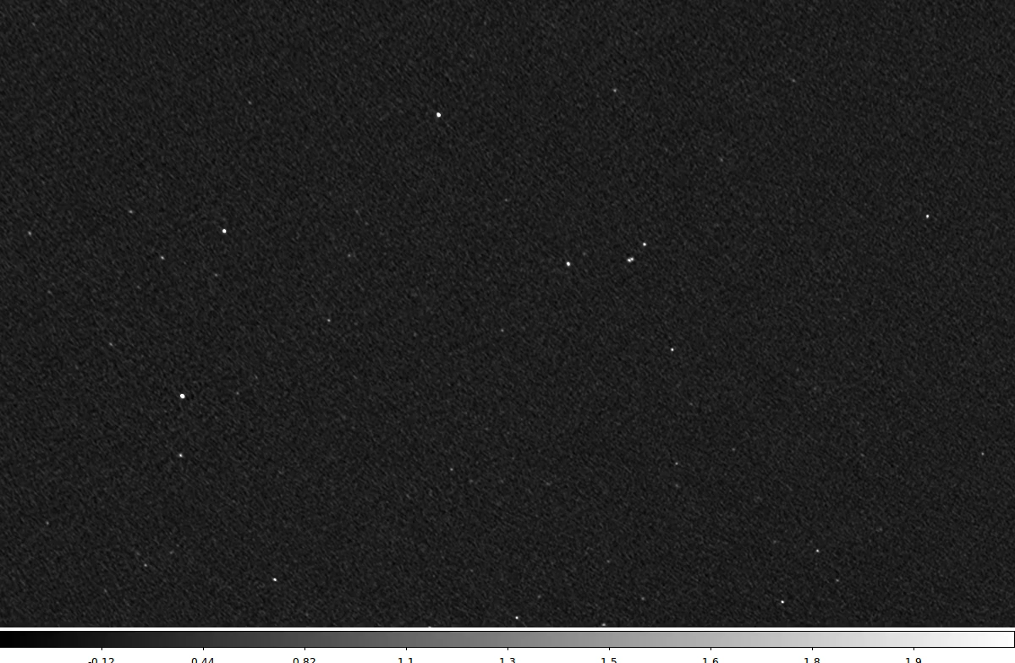
Heliosphere Use Cases (3)
Heliosphere Use Case 3 – Observations of IPS via Interferometric Imaging.
Heliosphere Use Case 9 – Faraday Rotation Measurements of CMEs using diffuse Galactic Emission.
Imaging of radio sources to maximise all-sky observational coverage:
  IPS via imaging has been pioneered by the MWA (https://www.icrar.org/ips).
  Imaging is by far the most-effective way to conduct a sky survey sources.
  The uv coverage is important; additional <100m baselines are needed to fill in the gaps LOFAR currently has in its uv plane.
  Potential for orders of magnitude more sources to be observed simultaneously!

Slide 12
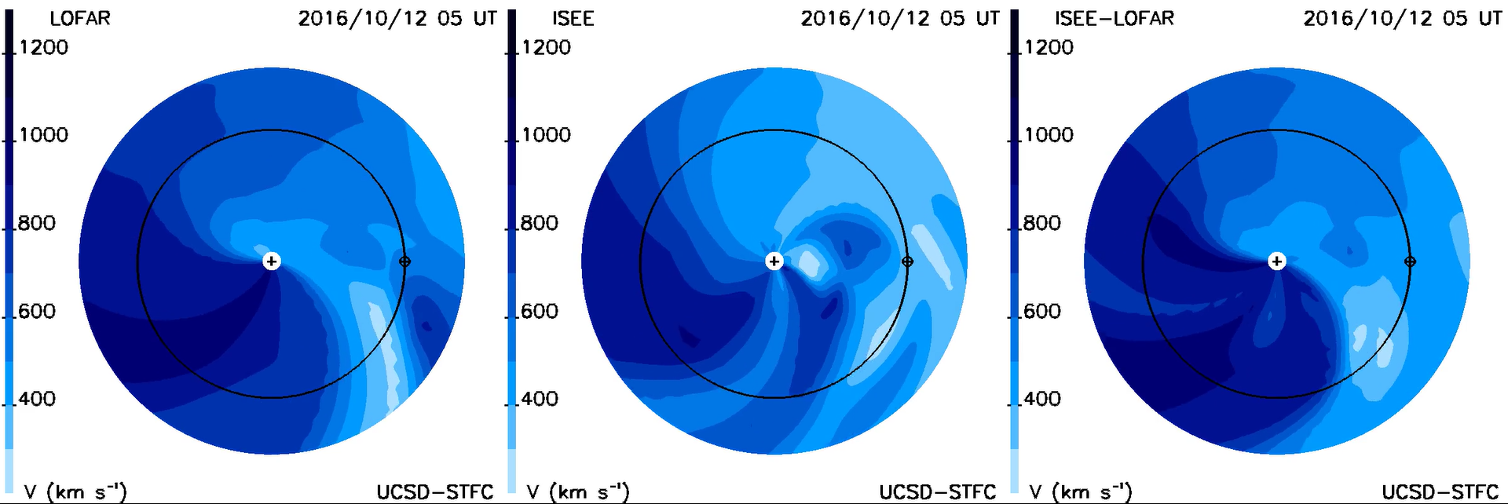
Heliosphere Use Cases (4)
Use of multiple observing modes maximises the science and forecasting potential across all existing and requested frequency bands up to 390MHz.
Imaging (and likely Faraday rotation) observations require the use of the full core (and extras in some cases) – ground-breaking space-weather science!
>80MHz bandwidth without the loss of any sensitivity is a driving factor.
Increased uv coverage is required for maximum capability realisation.
Additional stations/sites would be very beneficial to maximise both spatial and temporal observational coverage.
CME reconstructed using LOFAR, ISEE, and ISEE-LOFAR combined data inputs to the UCSD tomography…

Slide 13
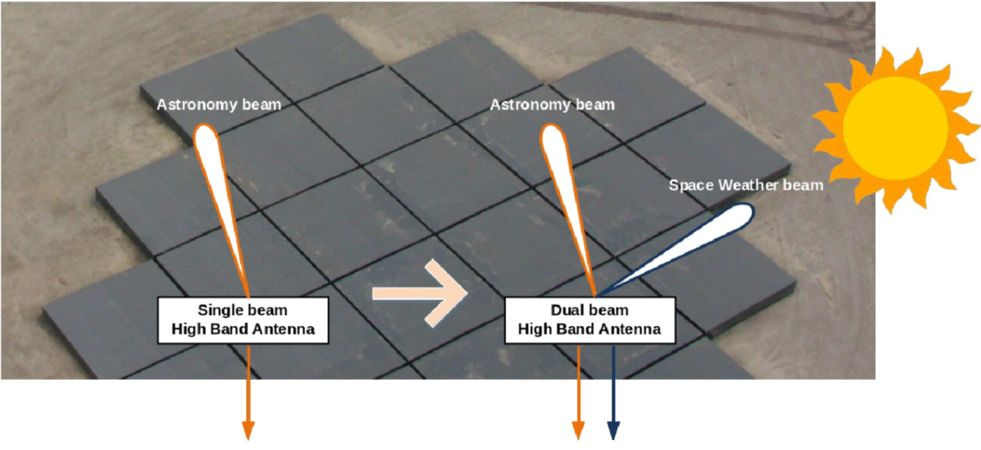
LOFAR4SW Ultimate Goal/Challenge
Make one telescope into two:
  With NO effect on normal astronomy operations!

Slide 14
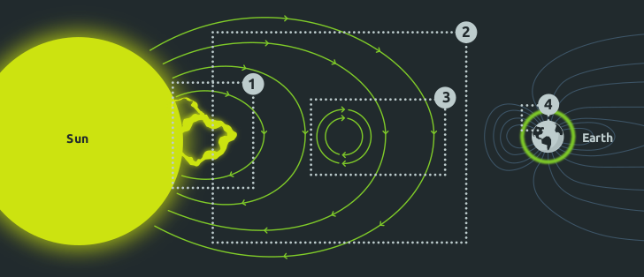
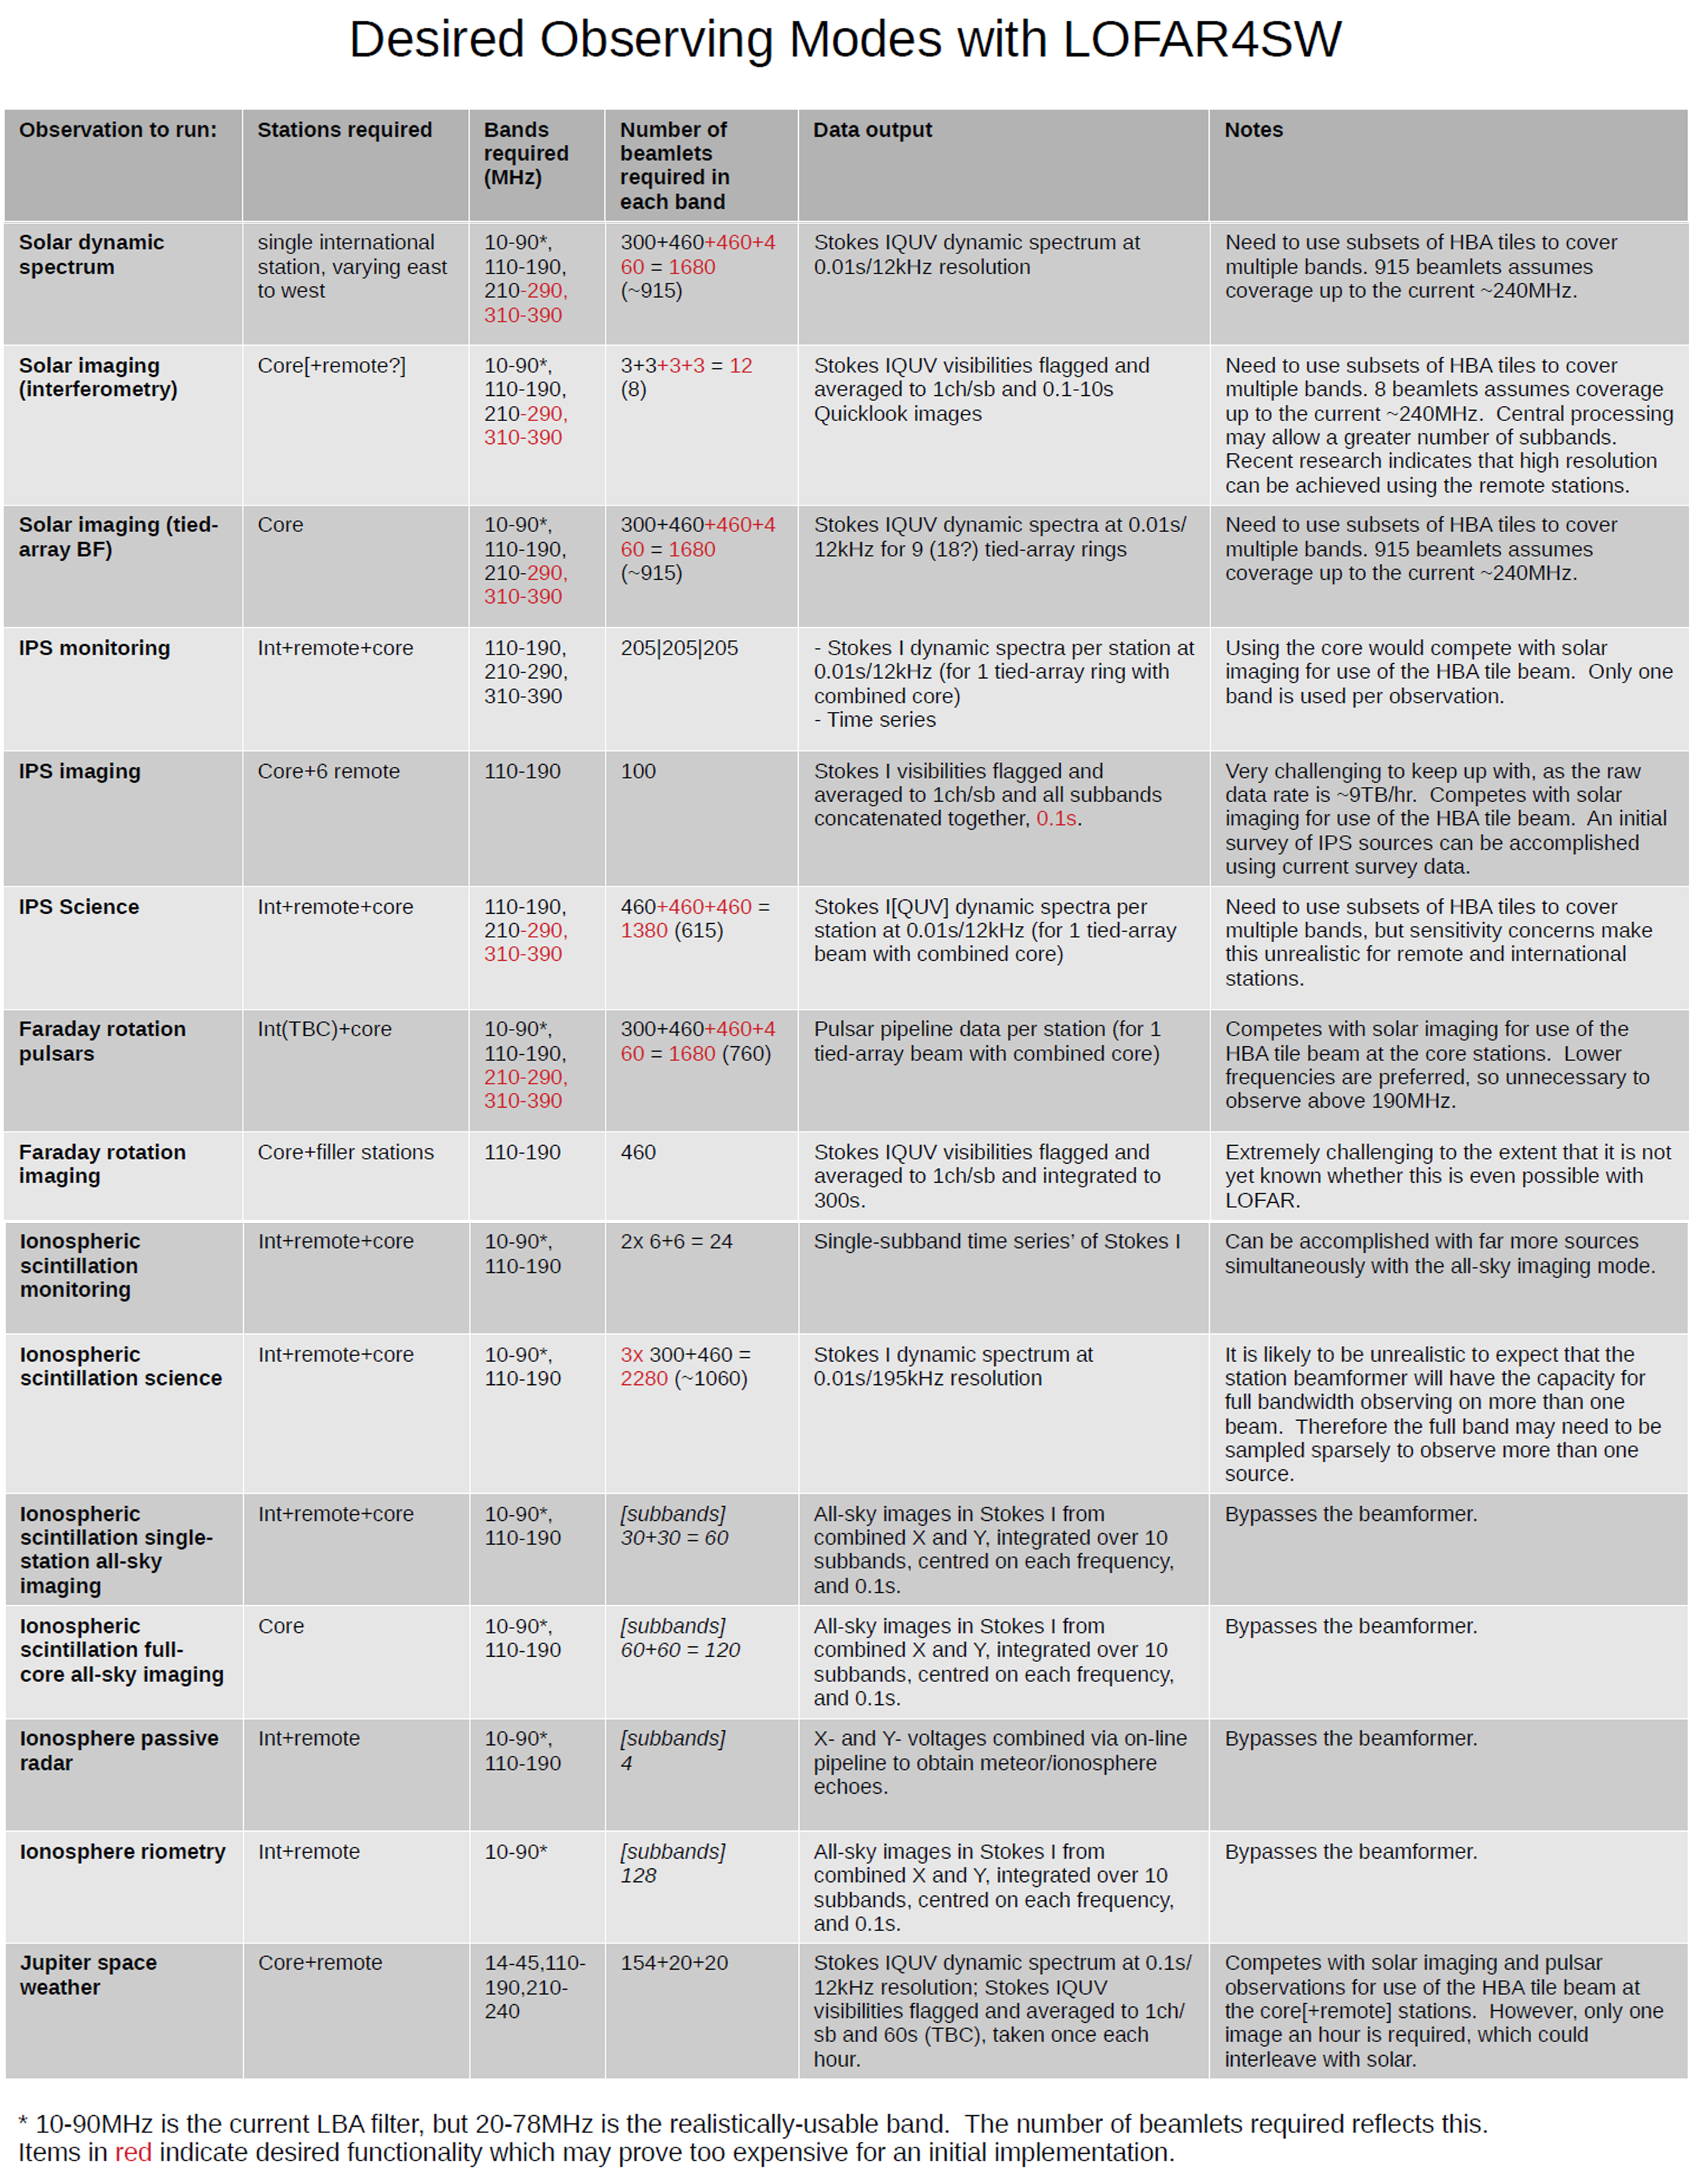
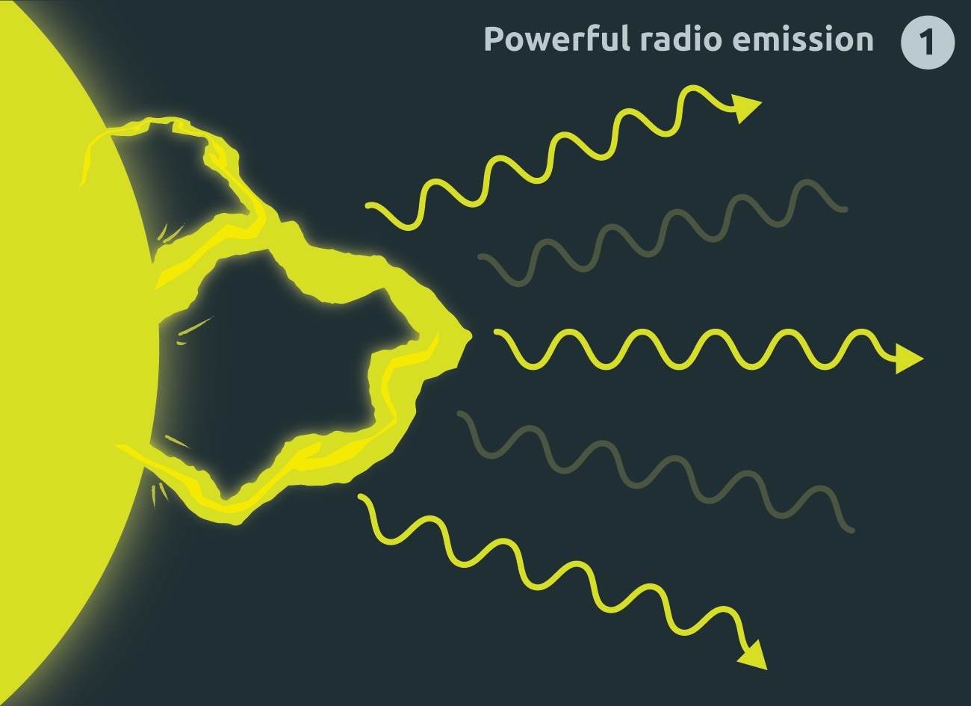
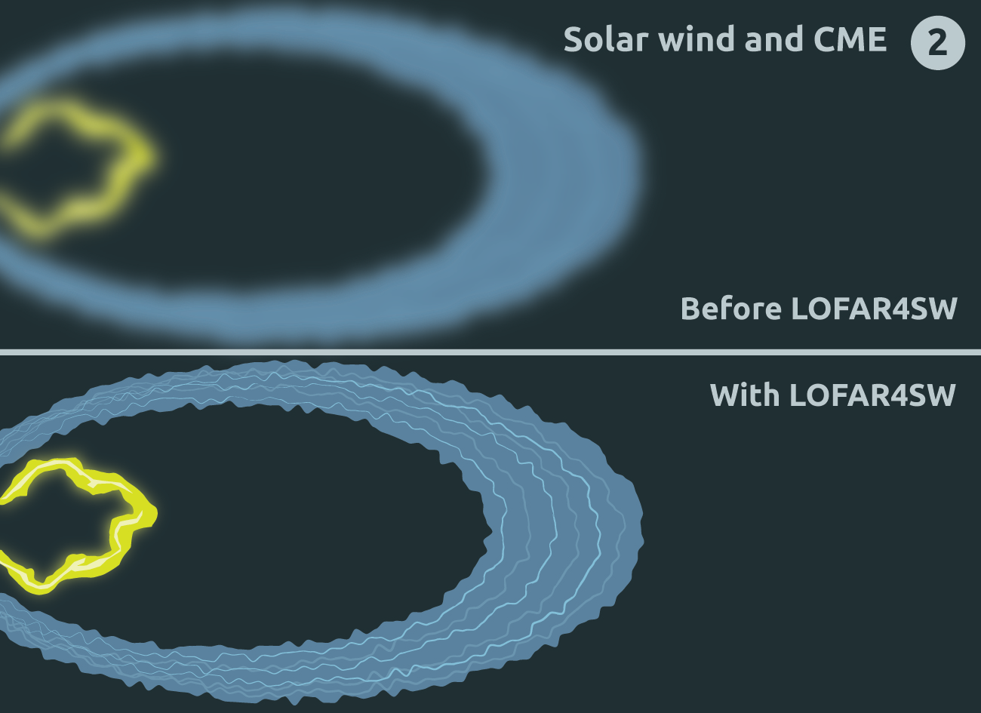
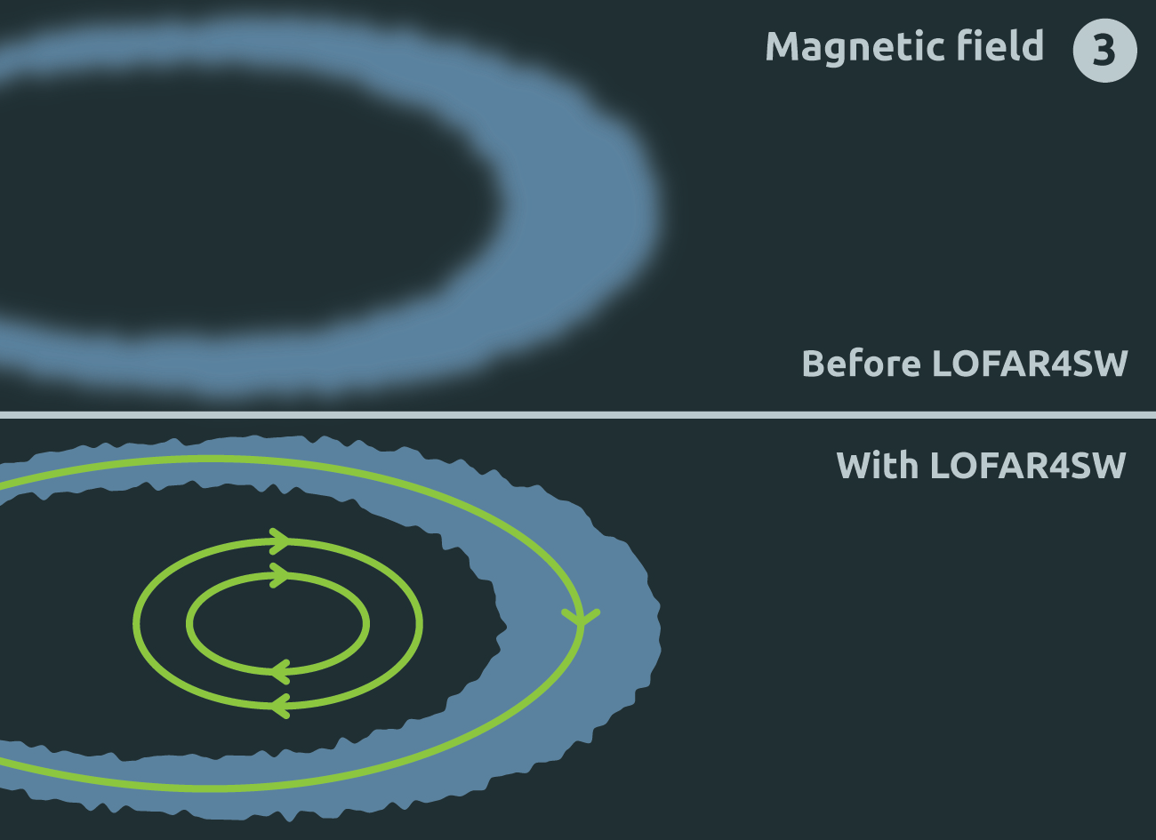
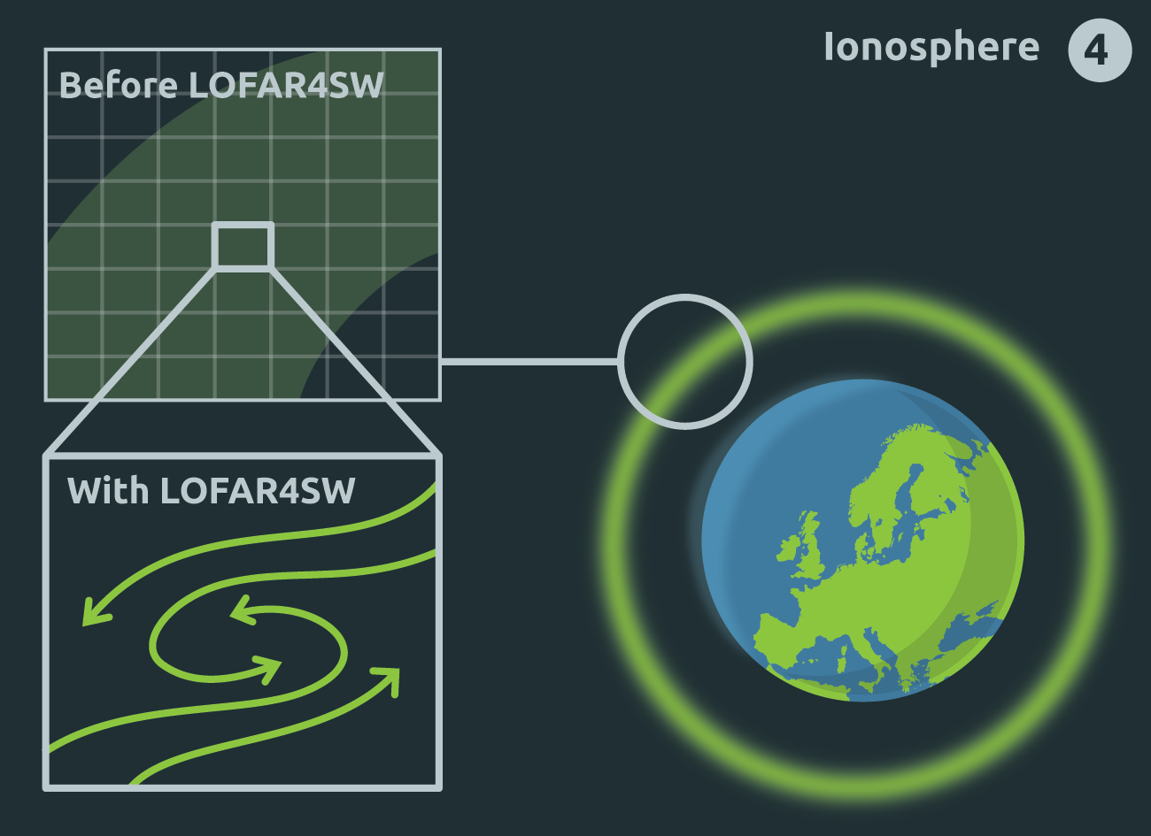
Space-Weather Science Advancement

Slide 15
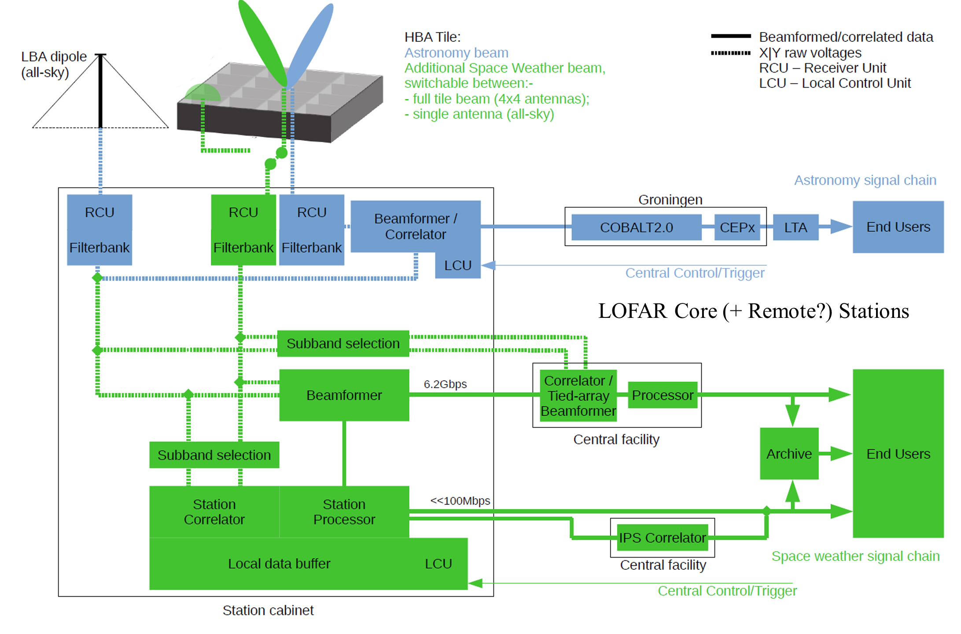
Simplified Architectural Design (1)

Slide 16
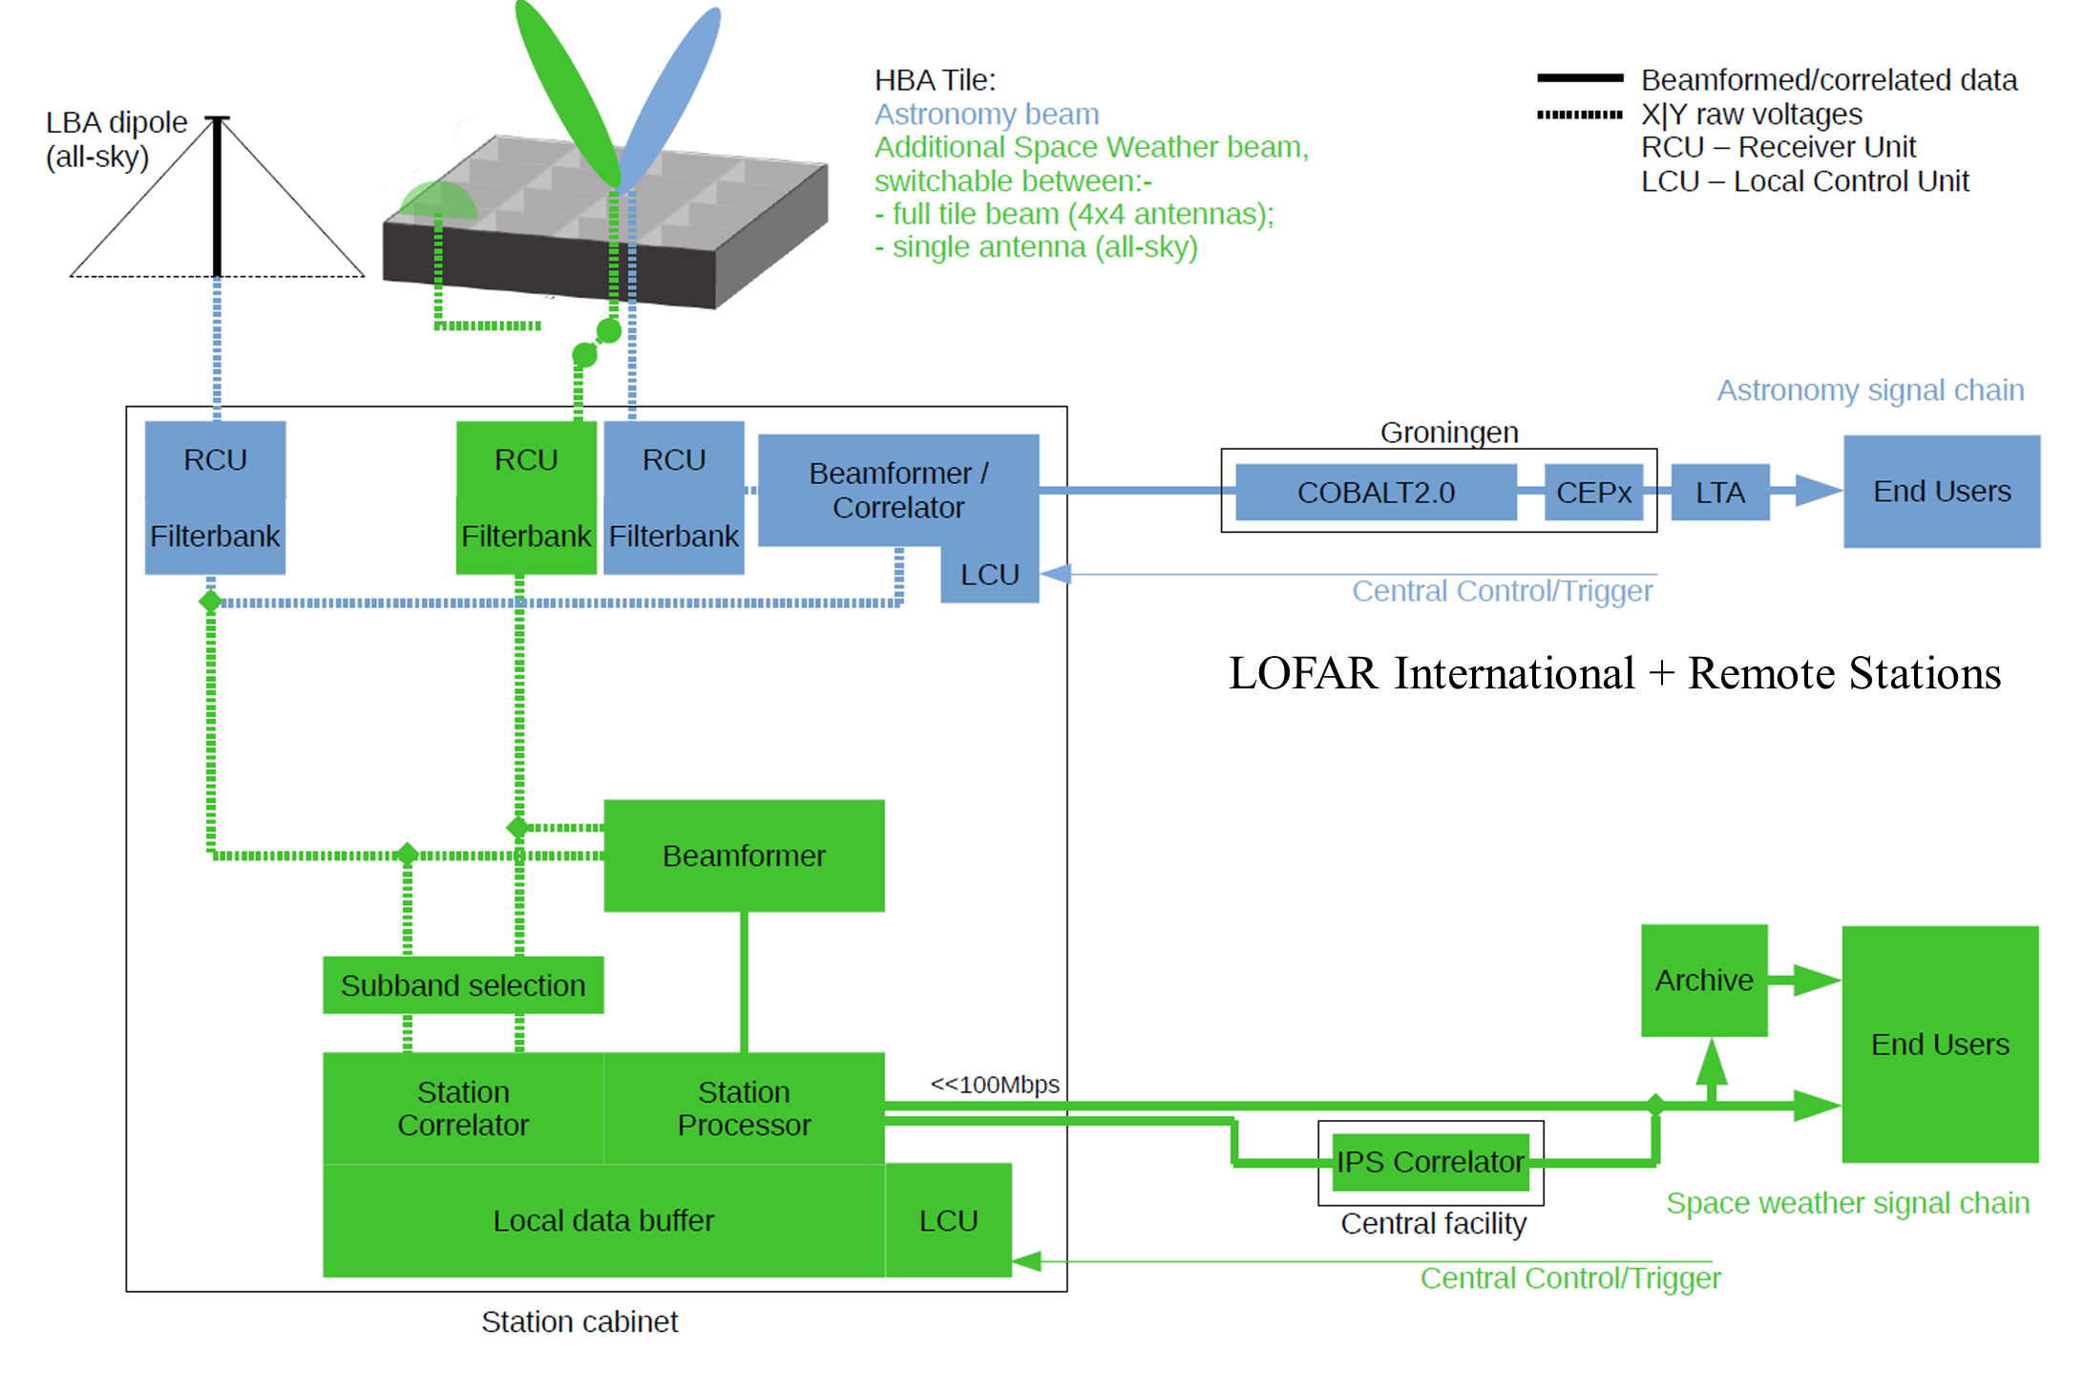
Simplified Architectural Design (2)

Slide 17
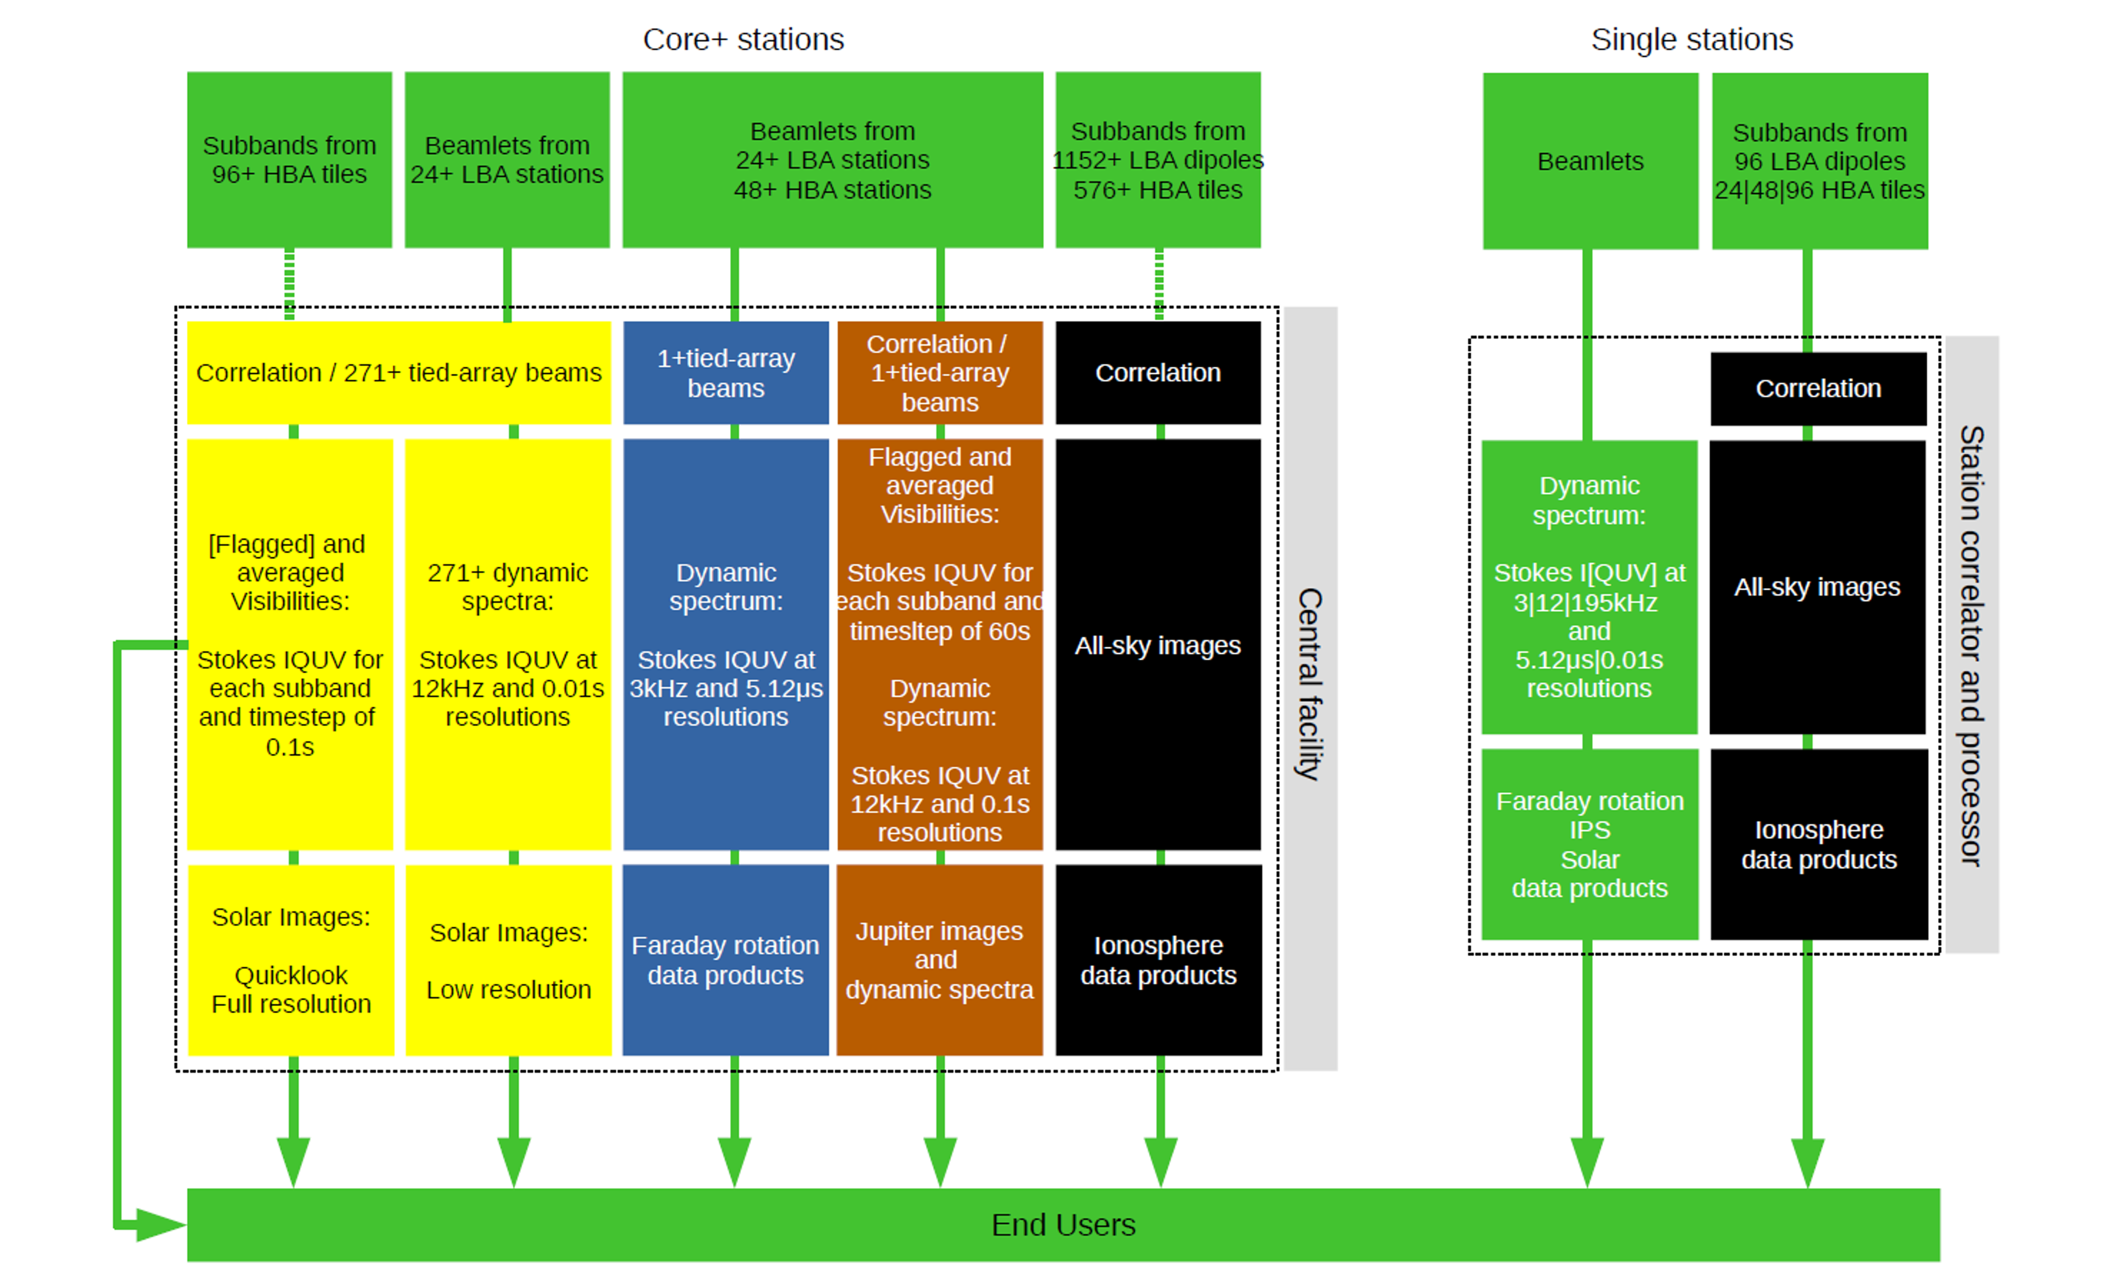
Simplified Architectural Design (3)

Slide 18
Integration into LOFAR2.0

Slide 19
Successful PDR and MTR
Very constructive and positive feedback from both the Preliminary Design Review (PDR) and the EC Mid-Term Review (MTR).
  Included a formal review of the initial design documents at PDR.
  Included a formal review of all deliverables to date at the MTR.
Prepartions are underway for the Detailed Design Review (DDR) in the first quarter of 2020.
  Focus on hardware design/characteristics.
Users Workshop 13-14 May 2020 in Warsaw, Poland.
The Critical Design Review (CDR) is planned for February 2021 in Cardiff, Wales, UK.
  Here we will agree the final design and commence the final documents write-ups...

Slide 20
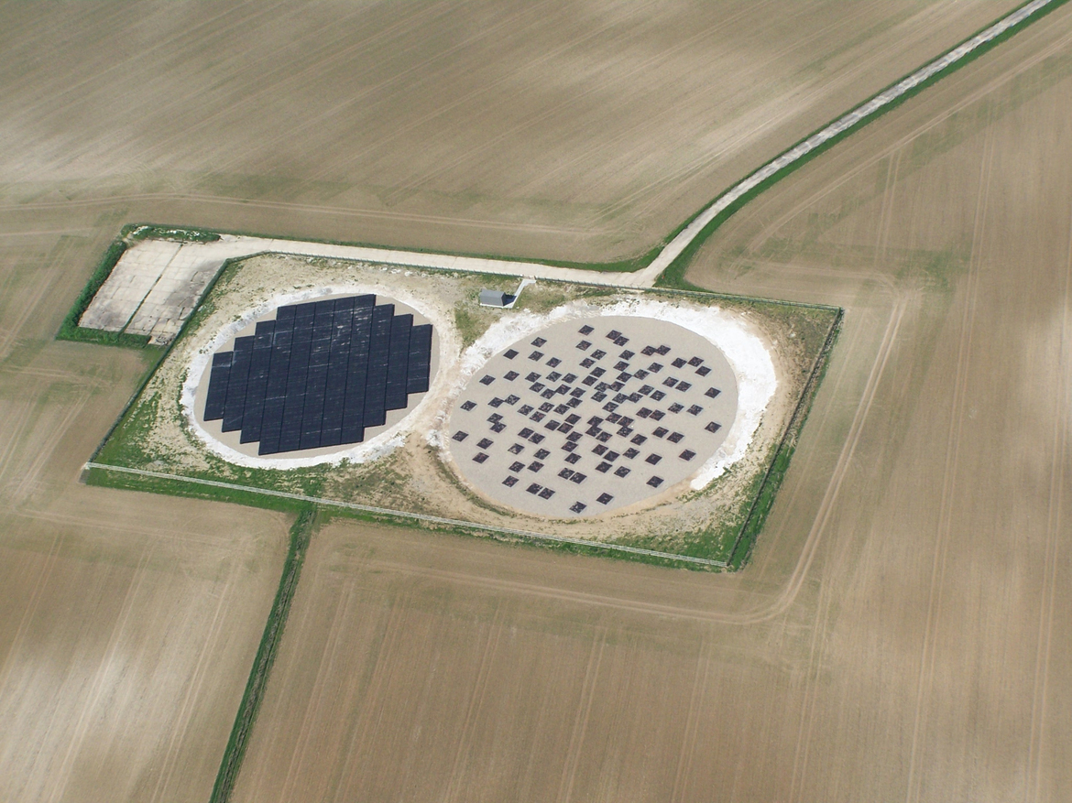
UK608 LOFAR Station
LOFAR4SW Prototype Location…

Slide 21
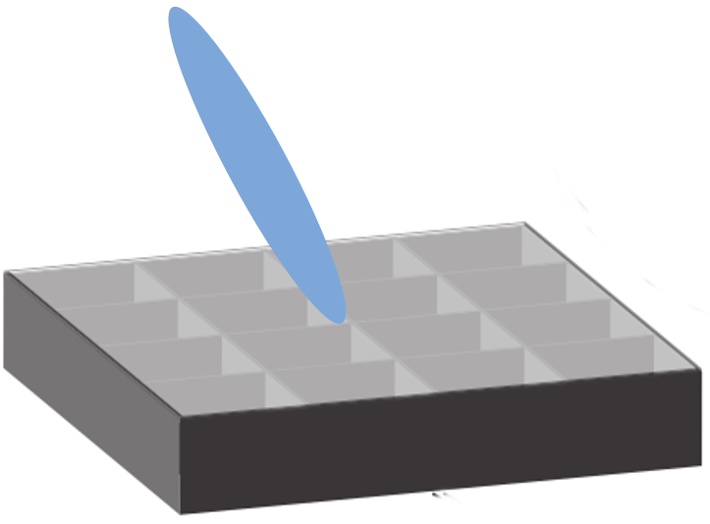
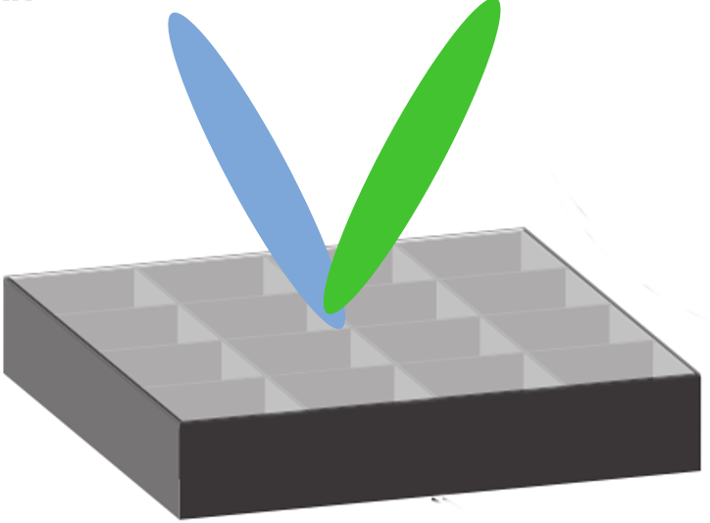
LOFAR4SW Prototype
4 normal HBA Tiles
Wired for a second beam
Full Independent Backend
  16 RCU
  2 RSP
  Switch

Slide 22
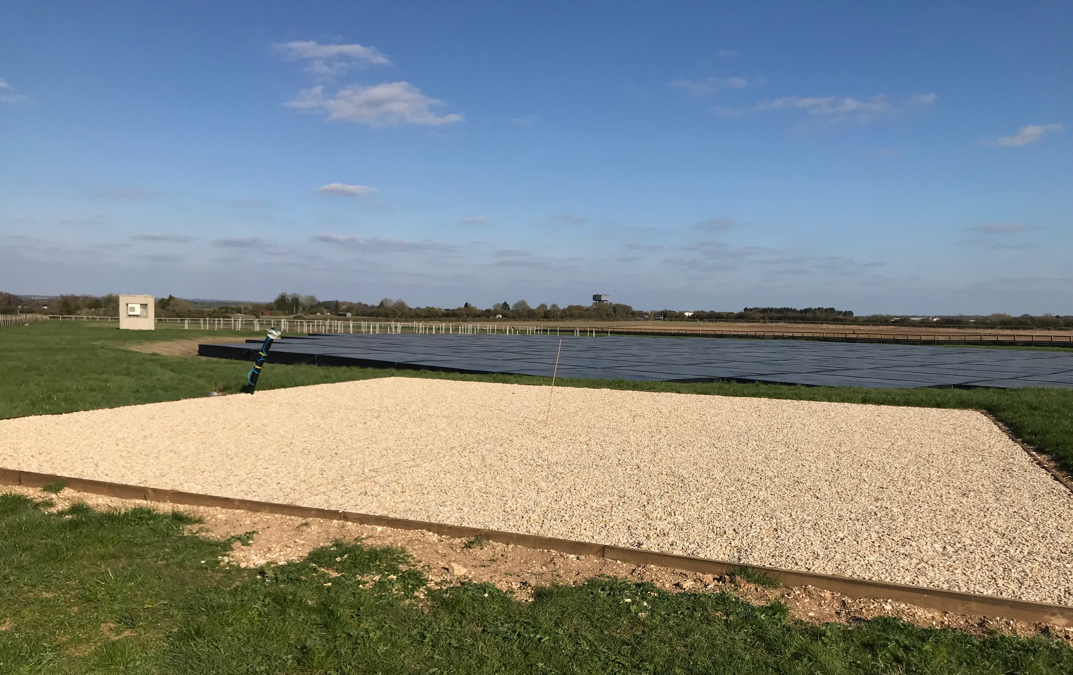
LOFAR4SW Earth Works

Slide 23
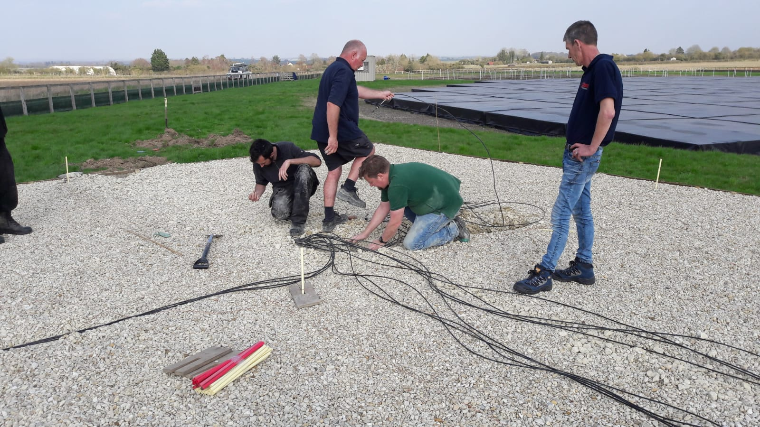
L4SW PROTOTYPE BUILD

Slide 24
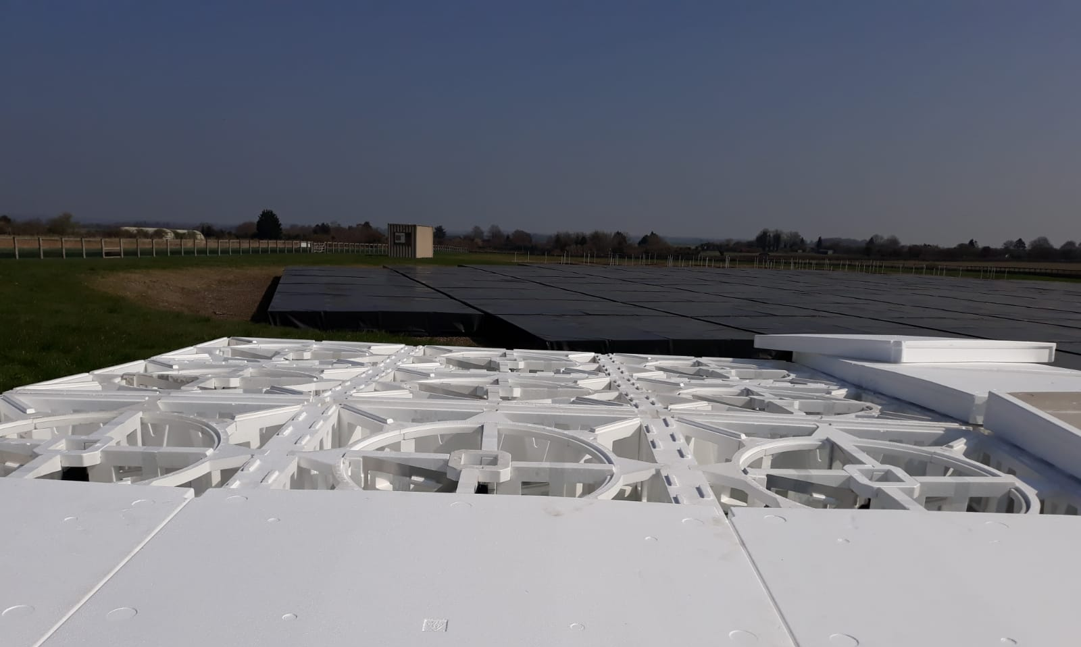
L4SW PROTOTYPE BUILD

Slide 25
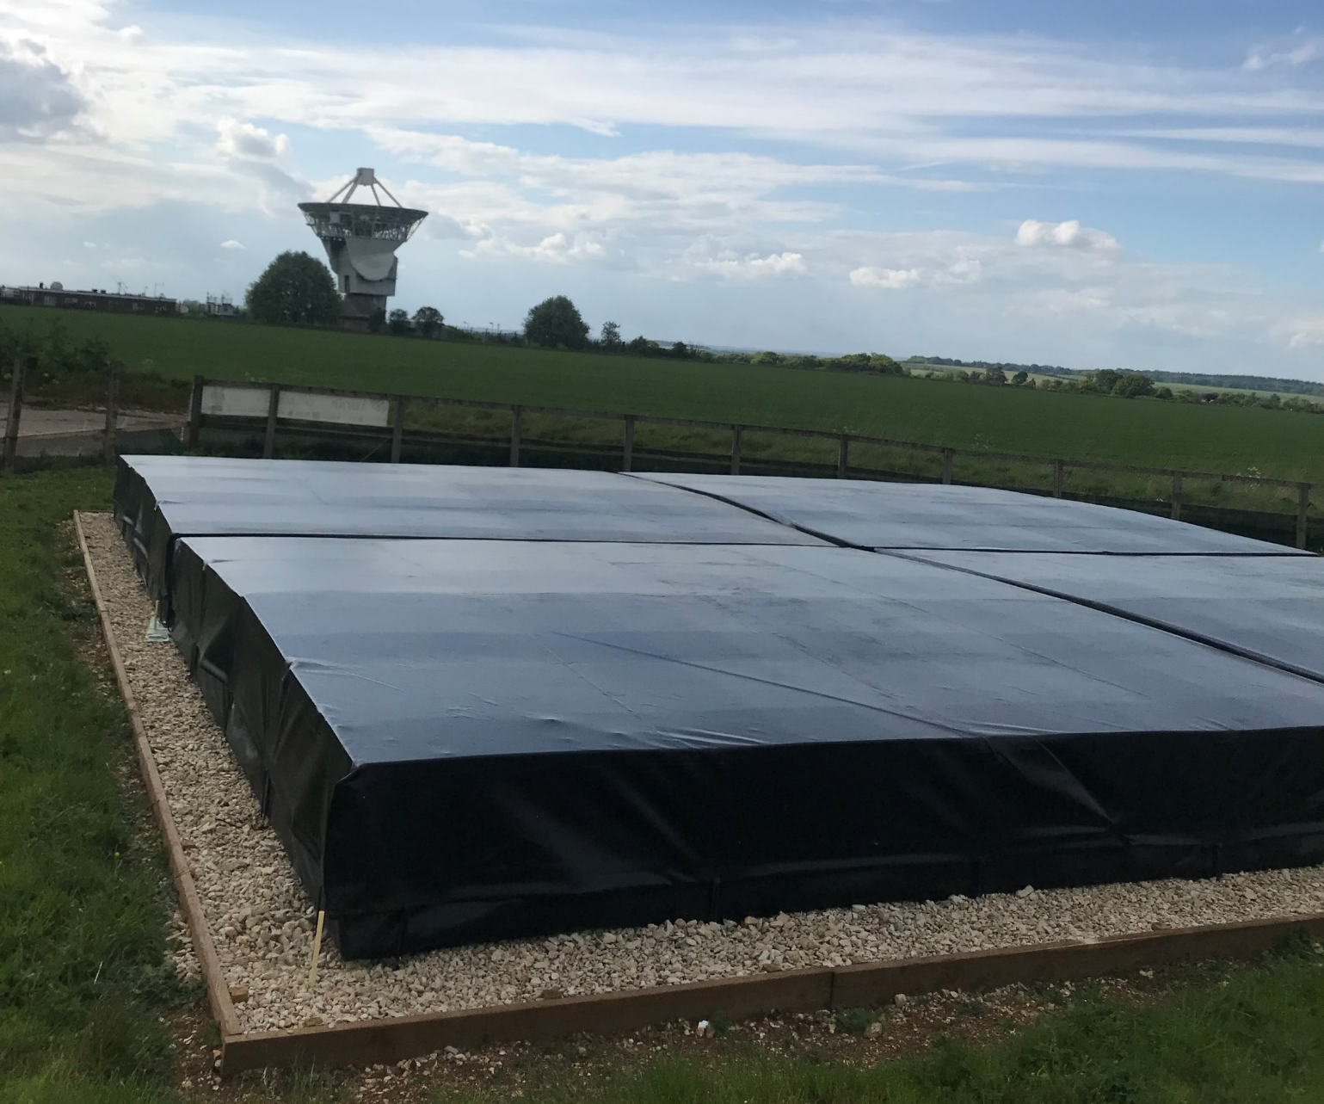
LOFAR4SW PROTOTYPE

Slide 26
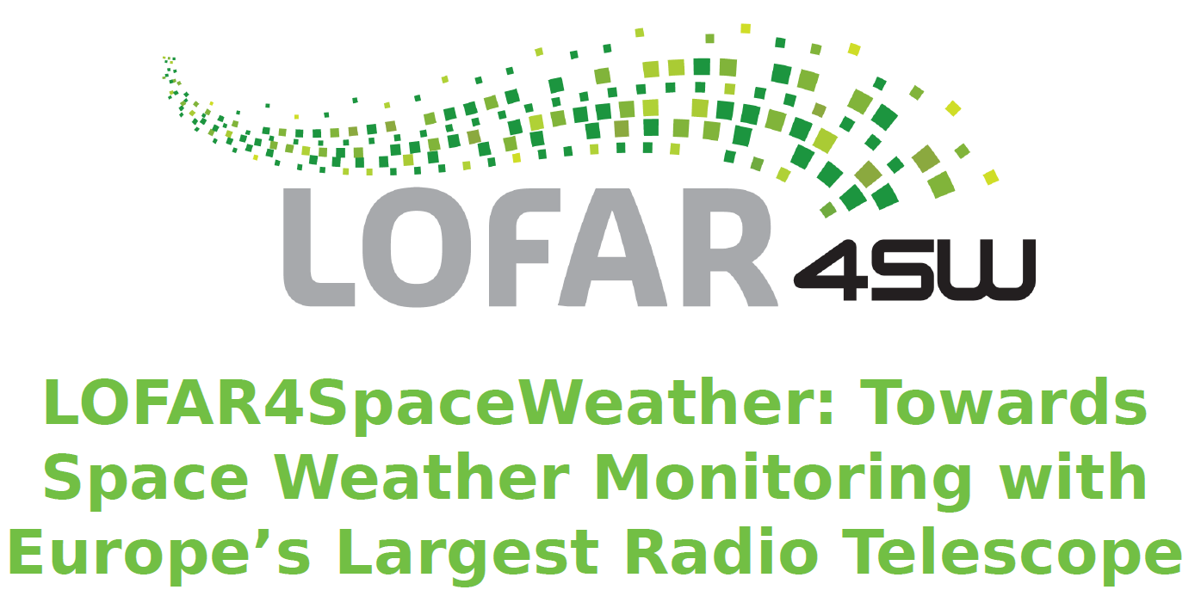
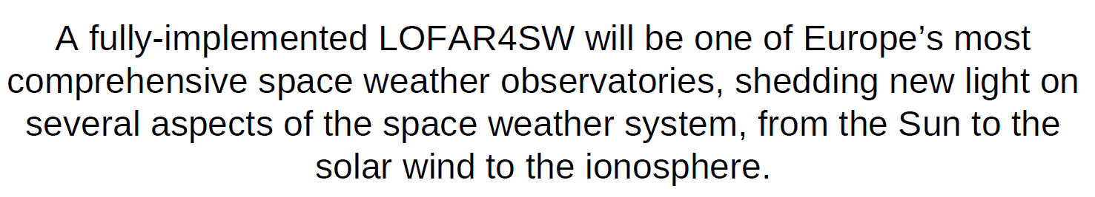
Overall Summary
We have an ambitious set of Science Use cases for the LOFAR4SW project.
  Covers space-weather monitoring and inputs to forecast models.
  Covers a diverse set of space-weather science investigations across solar, corona, heliosphere, ionosphere, and planetary domains.
  We still need to prioritise the use cases/data products properly…
The LOFAR4SW project will provide prototype processing pipelines for most both IPS and heliospheric FR.
  It will also provide a detailed science study on heliosphere FR.
The LOFAR4SW project will provide a detailed upgrade path/documentation for the upgrade of the LOFAR radio telescope into a dedicated space-weather instrument alongside normal astronomy operations.

