Slide 1

The Mechanism and Dynamics of N-S trends normal faults in Tibetan Plateau: Insight From Thermochronology, Magnetotellurics, Magmatism and GPS Measurements
Han-Ao Li^{a,b}, Jin-Gen Dai^{a,b,*}, Le-Tian Zhang^{c}, Ya-Lin Li^{a,b}, Guang-Hao Ha^{d}, Cheng-Shan Wang^{a,b}
ª School of Earth Science and Resources, and Research Center for Tibetan Plateau Geology, China University of Geosciences, Beijing 100083, China
^{b} State Key Laboratory of Biogeology and Environmental Geology, China University of Geosciences, Beijing 100083, China
^{c} School of Geophysics and Information Technology, China University of Geosciences, Beijing 100083, China
d State Key Laboratory of Earthquake Dynamics, Institute of Geology, China Earthquake Administration, Beijing, China
*Corresponding author: Jin-Gen Dai (djgtibet@163.com)

Slide 2
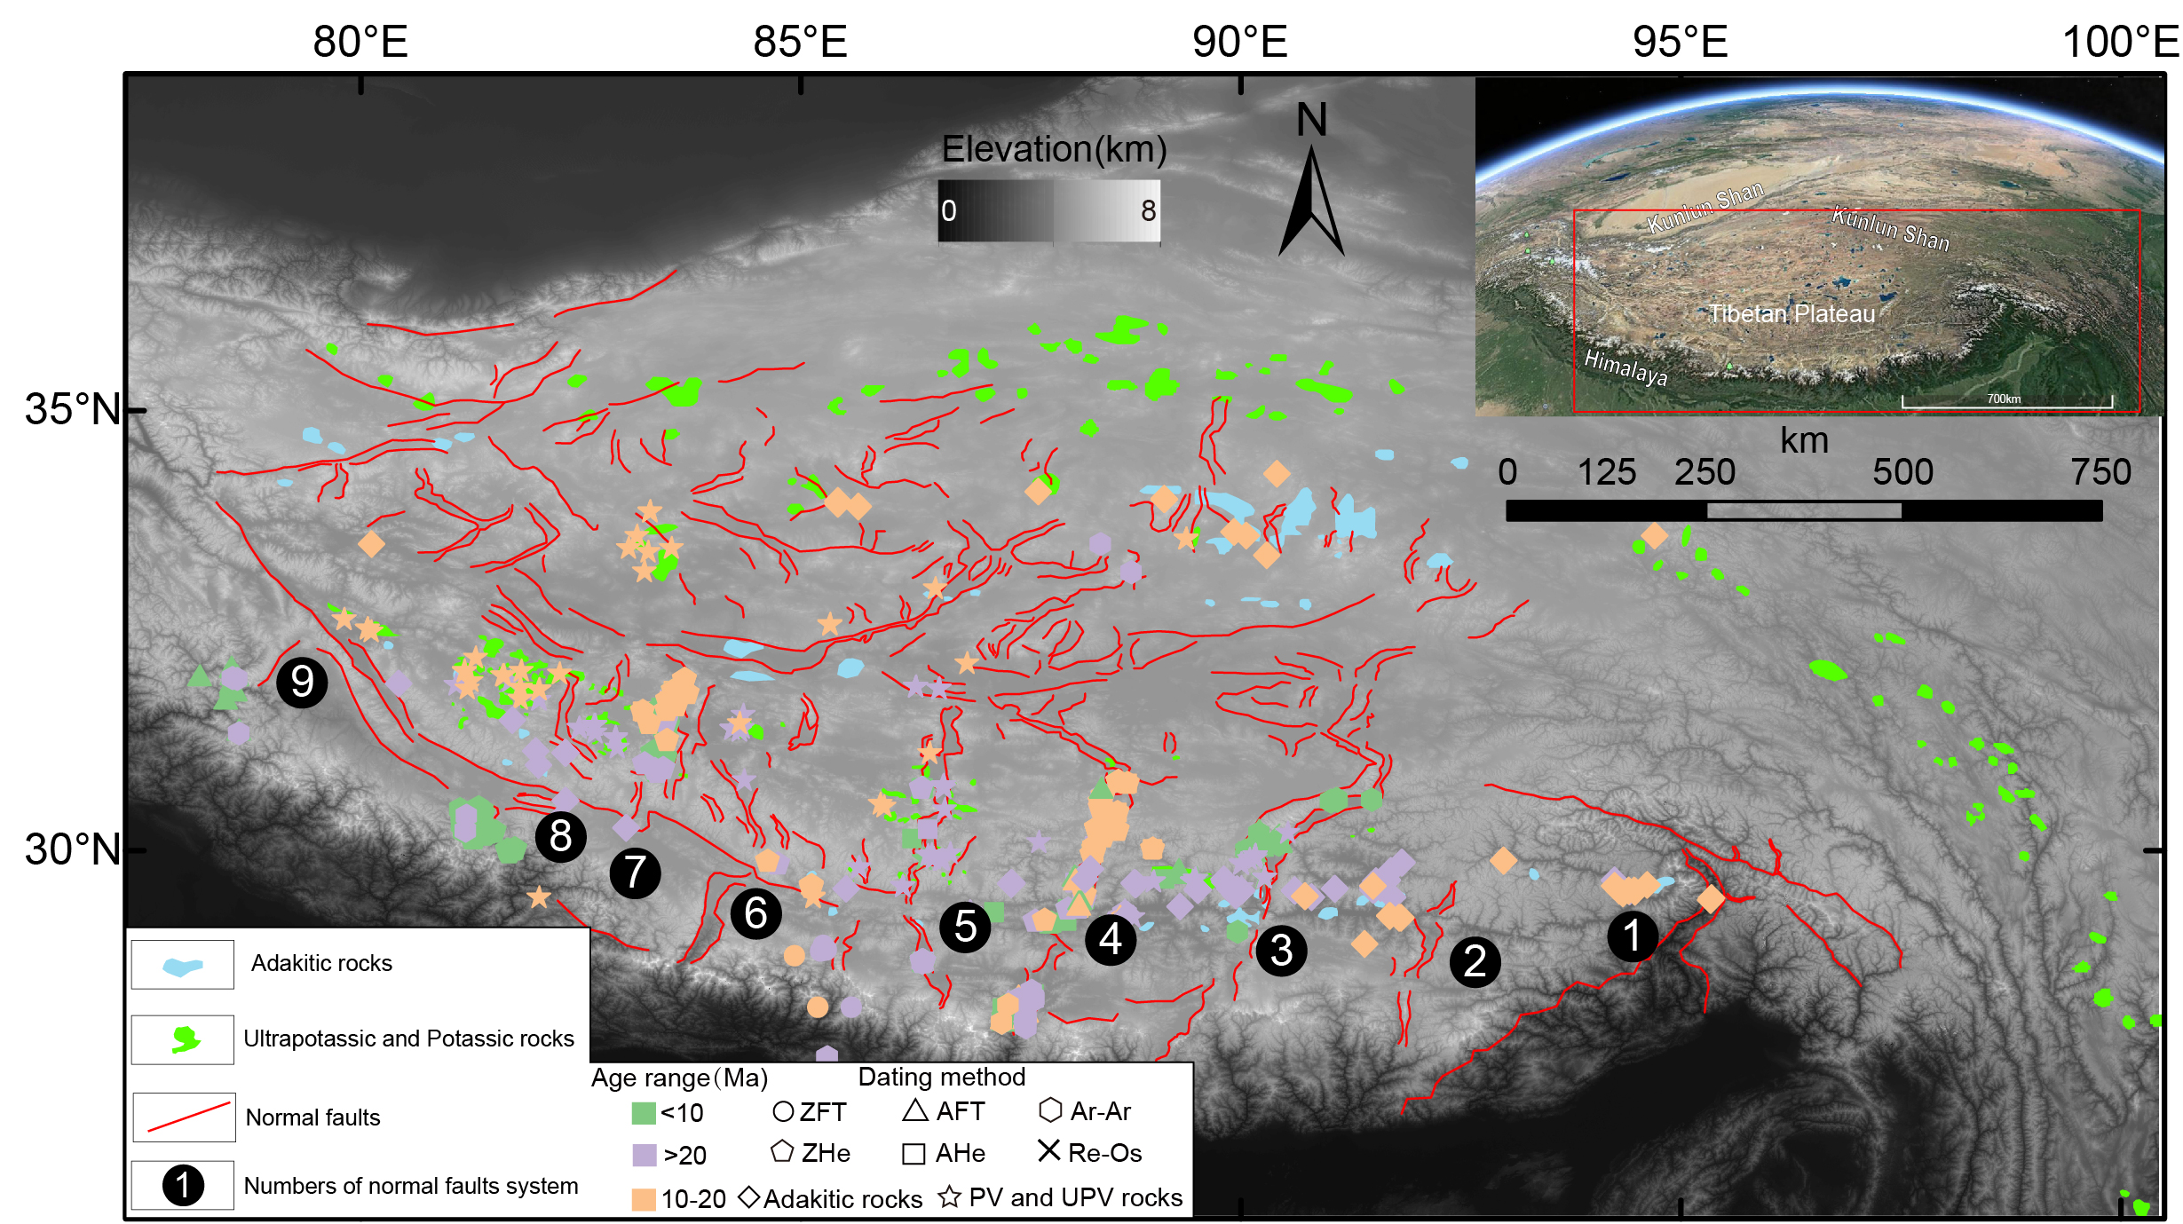
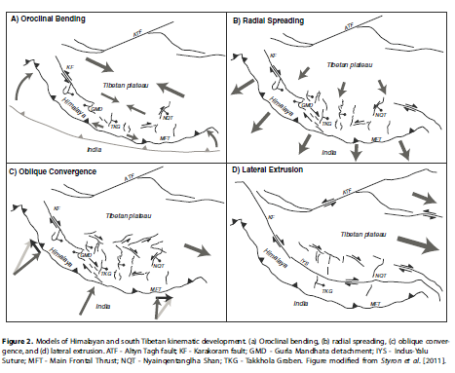
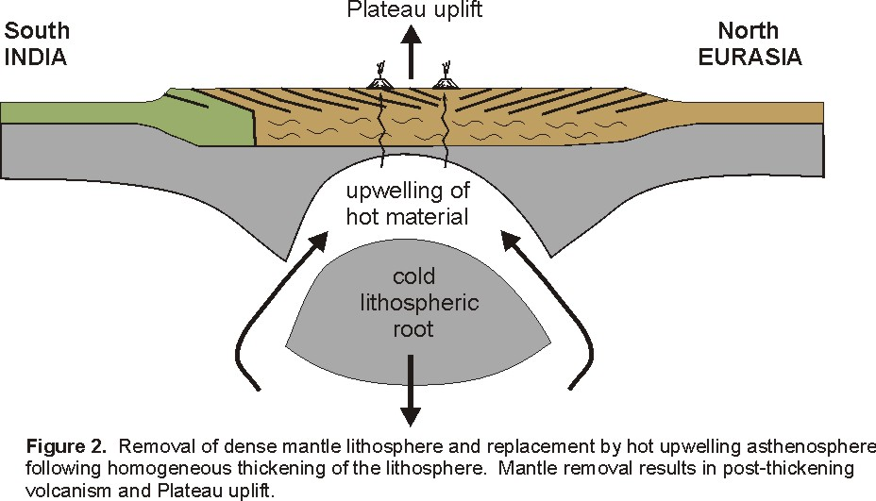
The N-S normal faults：
are widespread through the whole TP
record key information for the growth and uplift of the Tibetan Plateau
The Mechanism and Dynamics are remain controversial
Two end members:
Regional stress fields and boundary conditions
Gravitational collapse
The N-S normal faults
Convective removal
McCallister et al.,2014,Tectonics
Molnar et al.,1993,RG

Slide 3
Methods
Thermochronology
Magnetotellurics
Magmatism
Potassic and ultra Potassic rocks
Adakitic rocks
GPS Measurements

Slide 4
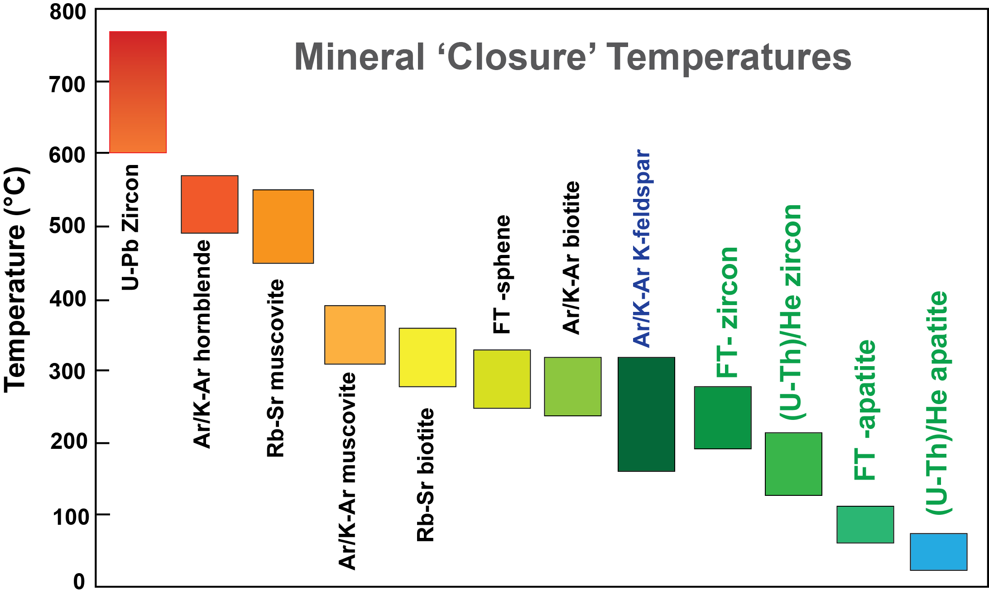
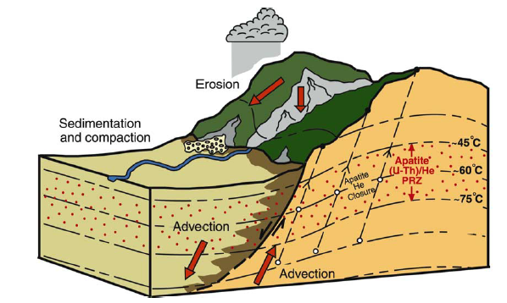
The thermochronology provide a direct way to record the initial activity timing of the normal faults
Thermochronology：
(U-Th)/He
FT
Ar-Ar
Re-Os
The footwall of the normal faults is in a relative high topographic relief.
Rocks in the footwall experience enhanced and recent cooling.
The enhanced cooling can be recorded by the thermochronology data.
Ehlers et al, 2003,2005, EPSL
The thermochronology data show that the initial activity timing ranges from the Miocene to Pliocene（20-4 Ma）

Slide 5
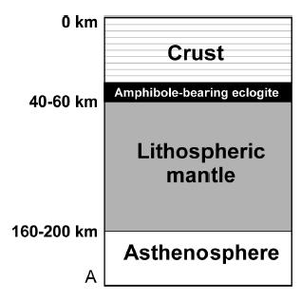
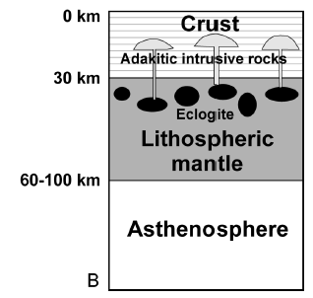
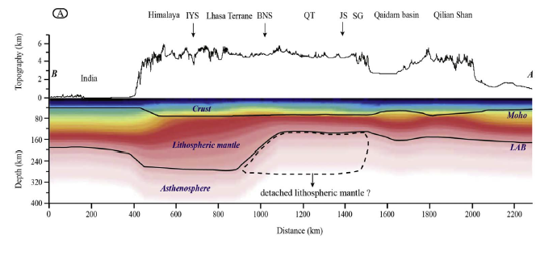
Conditions:
The Delamination and partial melting of the thickened lower crust
Xu et al, 2002, Geology
Xiong et al.,2005,2006 constrain the conditions of the produce of the adakitic rocks by high-temperature-high-pressure expriments
depth>50km
Thickened lower crust
The morden TP crust：
70-80 km √
Delamination & Partial melting √
The produce of the adakitic rocks indicates the extension environments
Lu et al, 2018, Teconophysics
Notes:
Xu et al.,2002研究区域位于南京

Slide 6
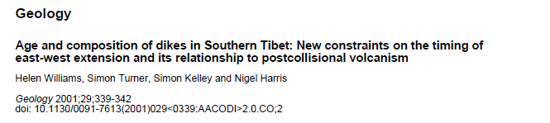
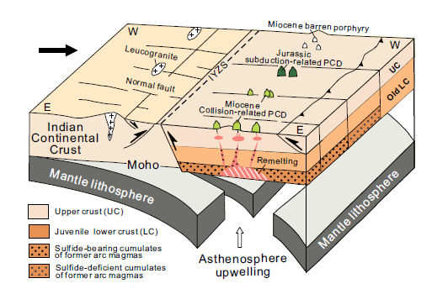
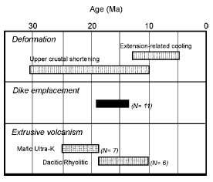
The N-S normal faults and potassic/ultra potassic rocks is temporally and spatially linked.
Williams et al, 2001, Geology
Hou et al, 2015, Geology
Underplating and collision induced the thickening of the juvenile lower crust.
Upwelling of asthenosphere related to Slab tearing/breaking off triggered the melting of the lower crust.
The adakitic melts of the lower crust and potassic/ultra potassic asthenosphere upwelling along the coupling normal faults.
The potassic/ultra potassic and adakitic rocks is directly related to the N-S normal faults

Slide 7
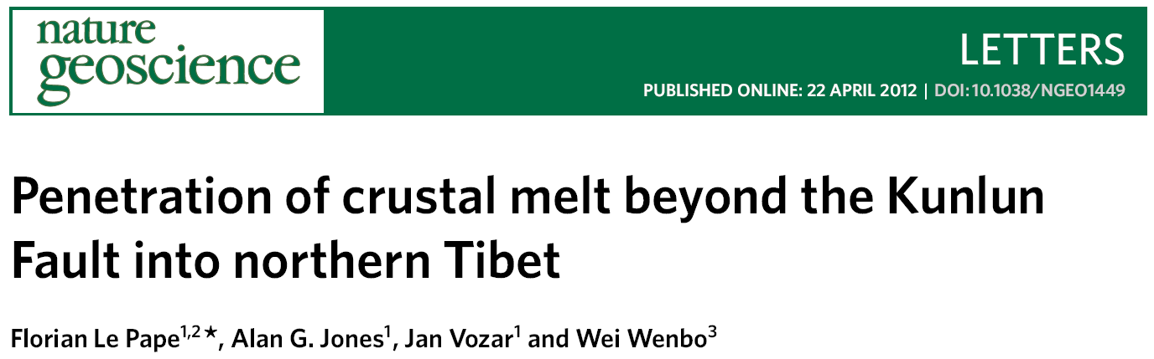
Significant advances of the geophysical observation: Discovery of the low-velocity and high-conductivity of the weak curst layer in TP
(16-30 km)
(Pham et al., 1986, Nature)
South Tibetan Plateau
Liu et al., 2014, Nature Geoscience
Eastern Tibetan Plateau
Le Pape et al., 2012, Nature Geoscience
North Tibetan Plateau
Notes:
近30度年地球物理探测的中要进展：发现青藏高原地壳低速高导层，并可能与部分熔融有关。

Slide 8
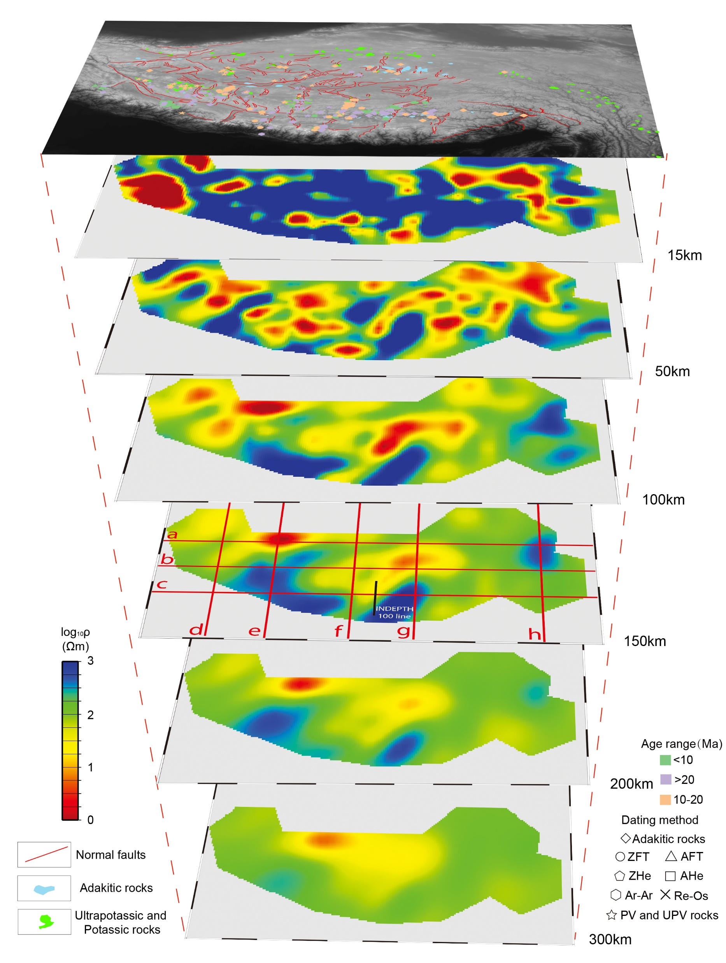
The relationship of the thermochronology, magnetotellurics and magmatism of the N-S normal faults
Upper crust
Lower crust
Mantle
The Theoretical basis of the crustal flow model of the Tibetan Plateau
Supposing that the 16-50 km depth is partially melting
Modified from:
Zhang et al.,2017,Surveys in Geophysics

Slide 9
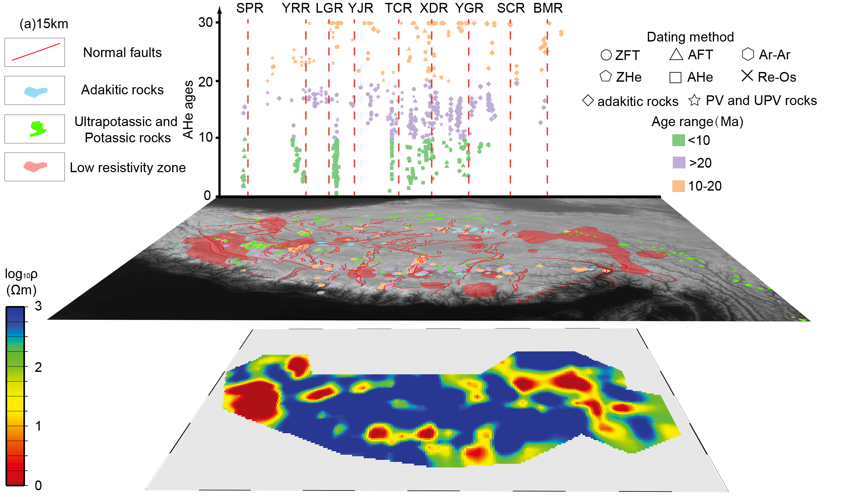
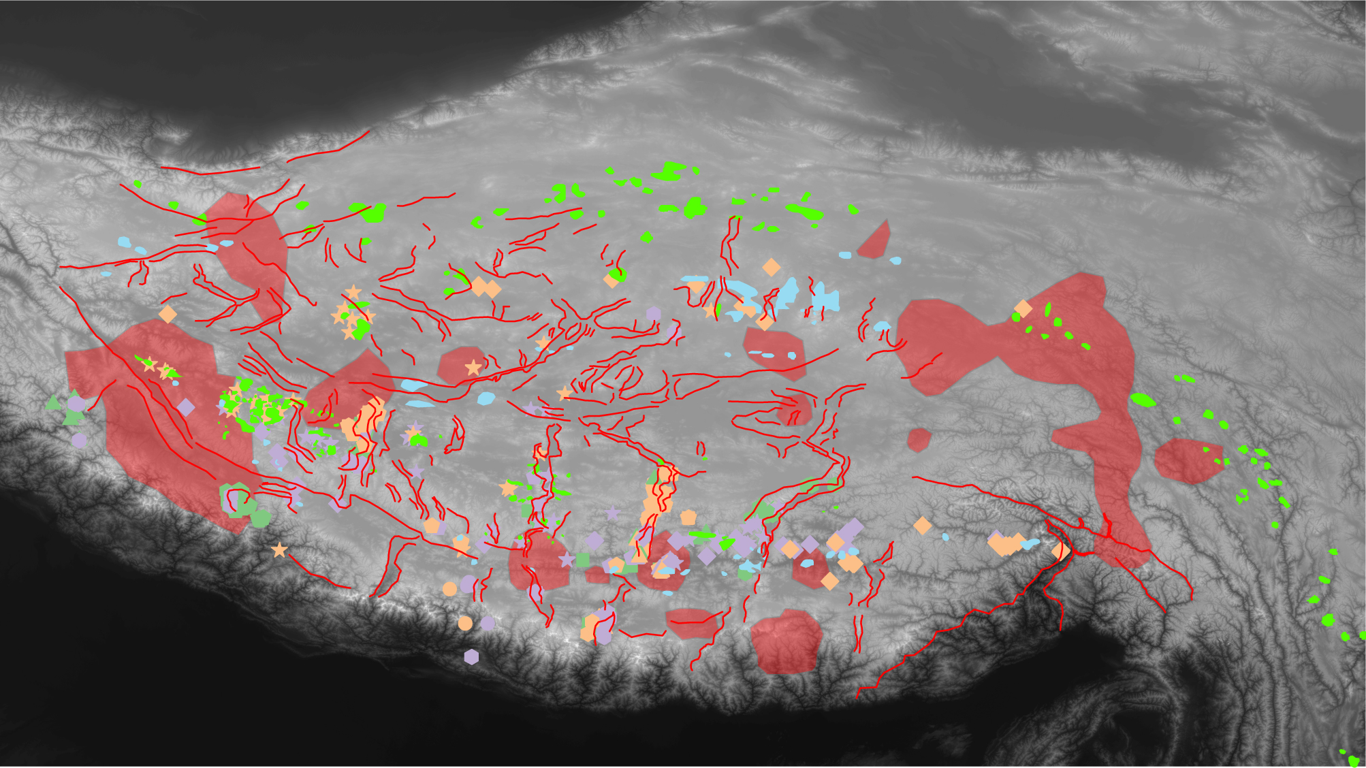
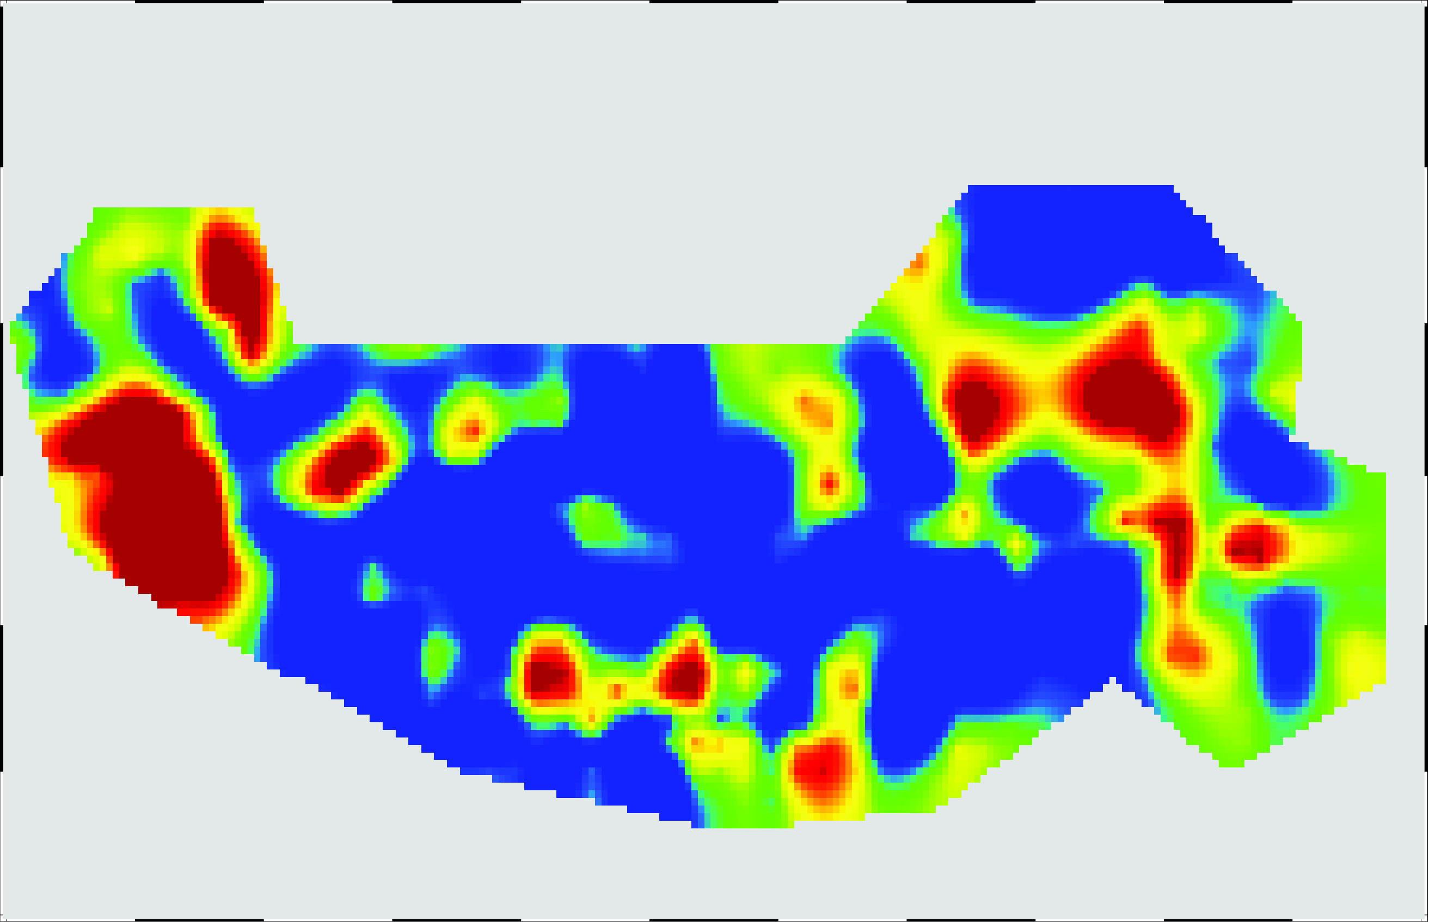
15km

Slide 10
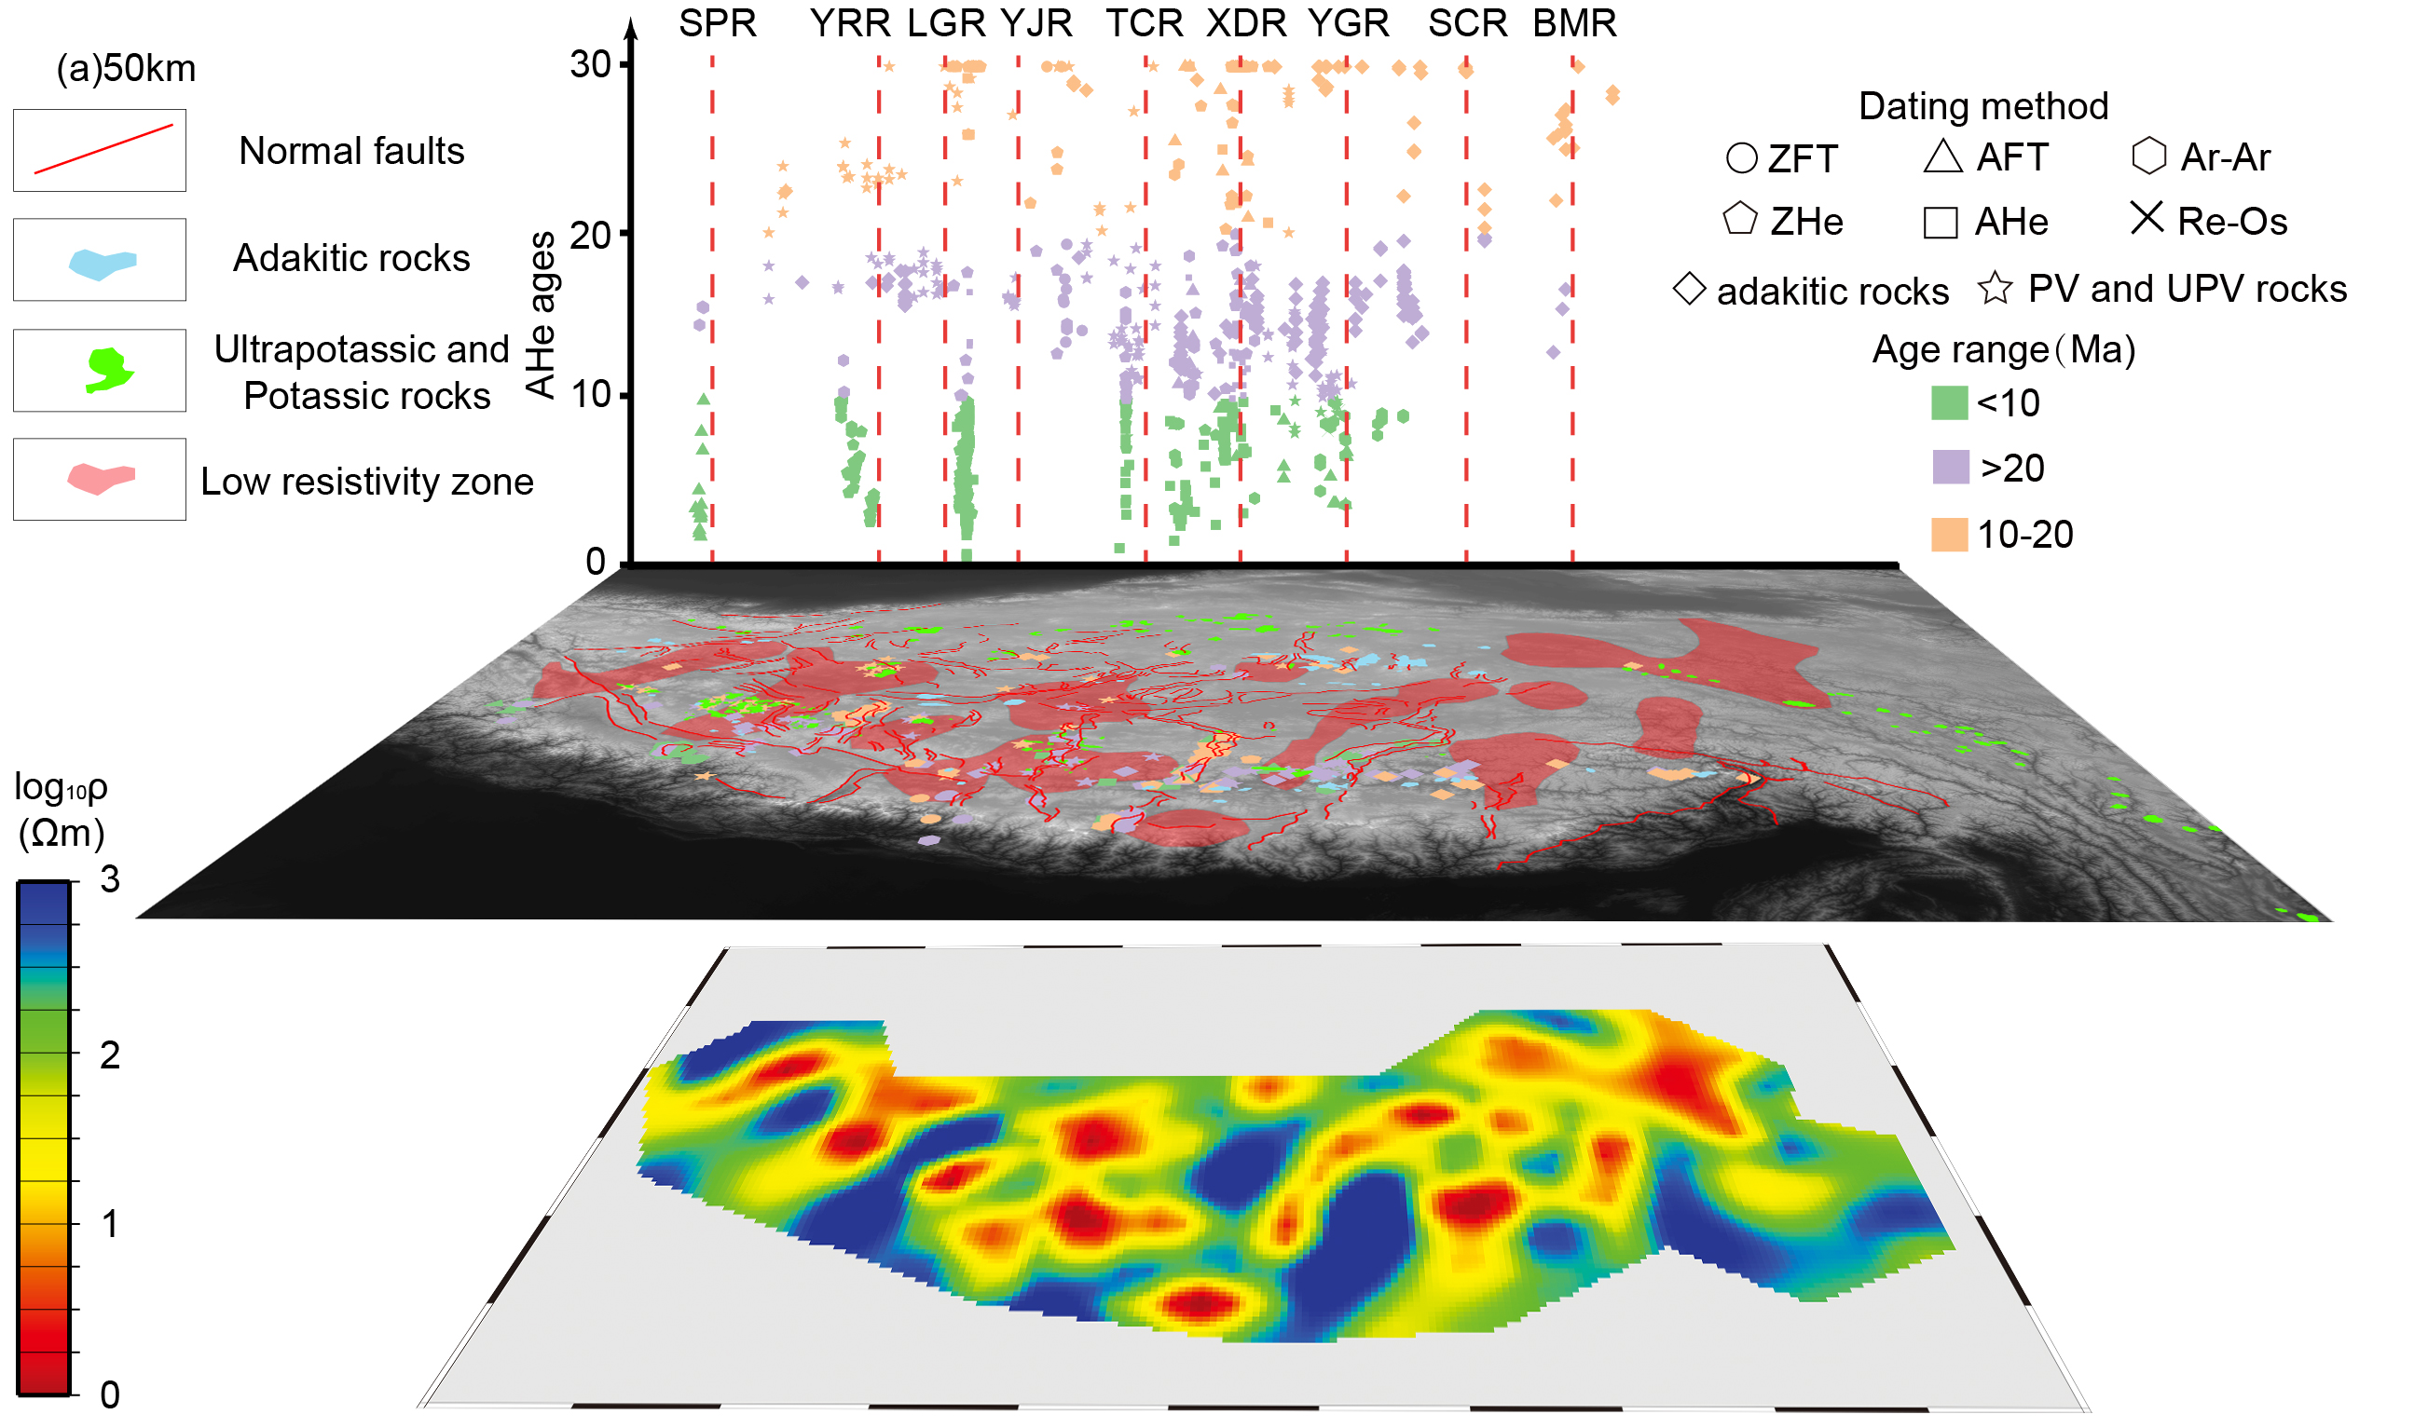
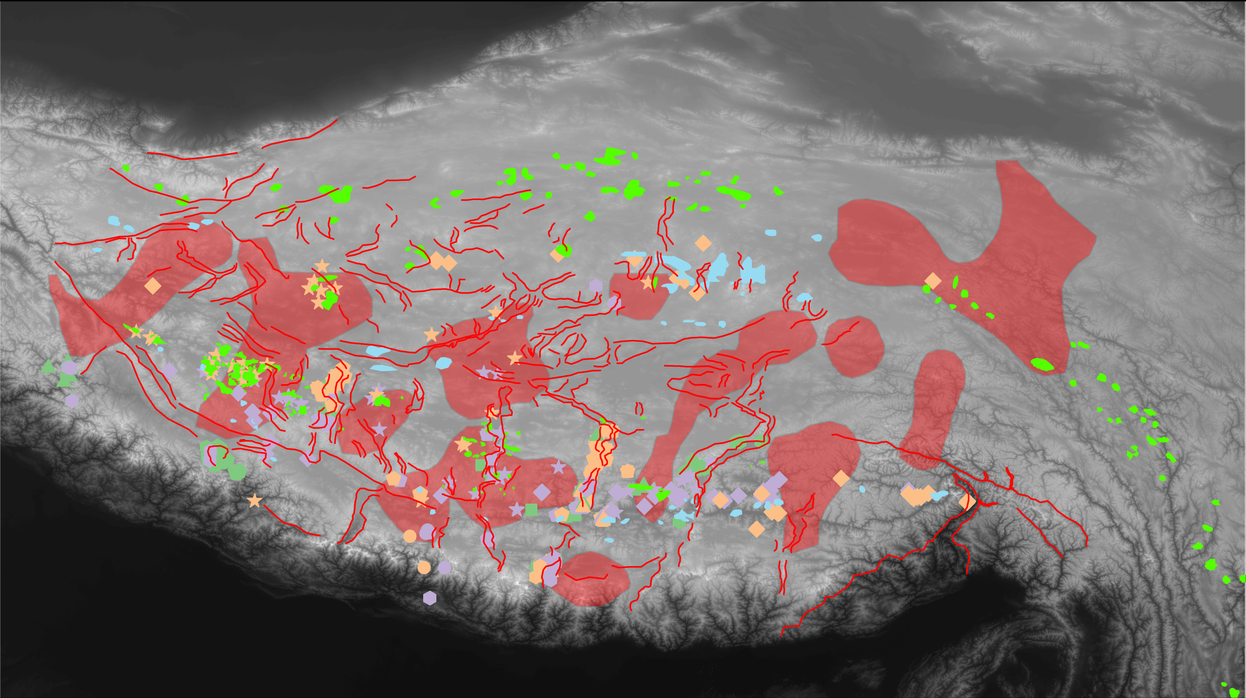
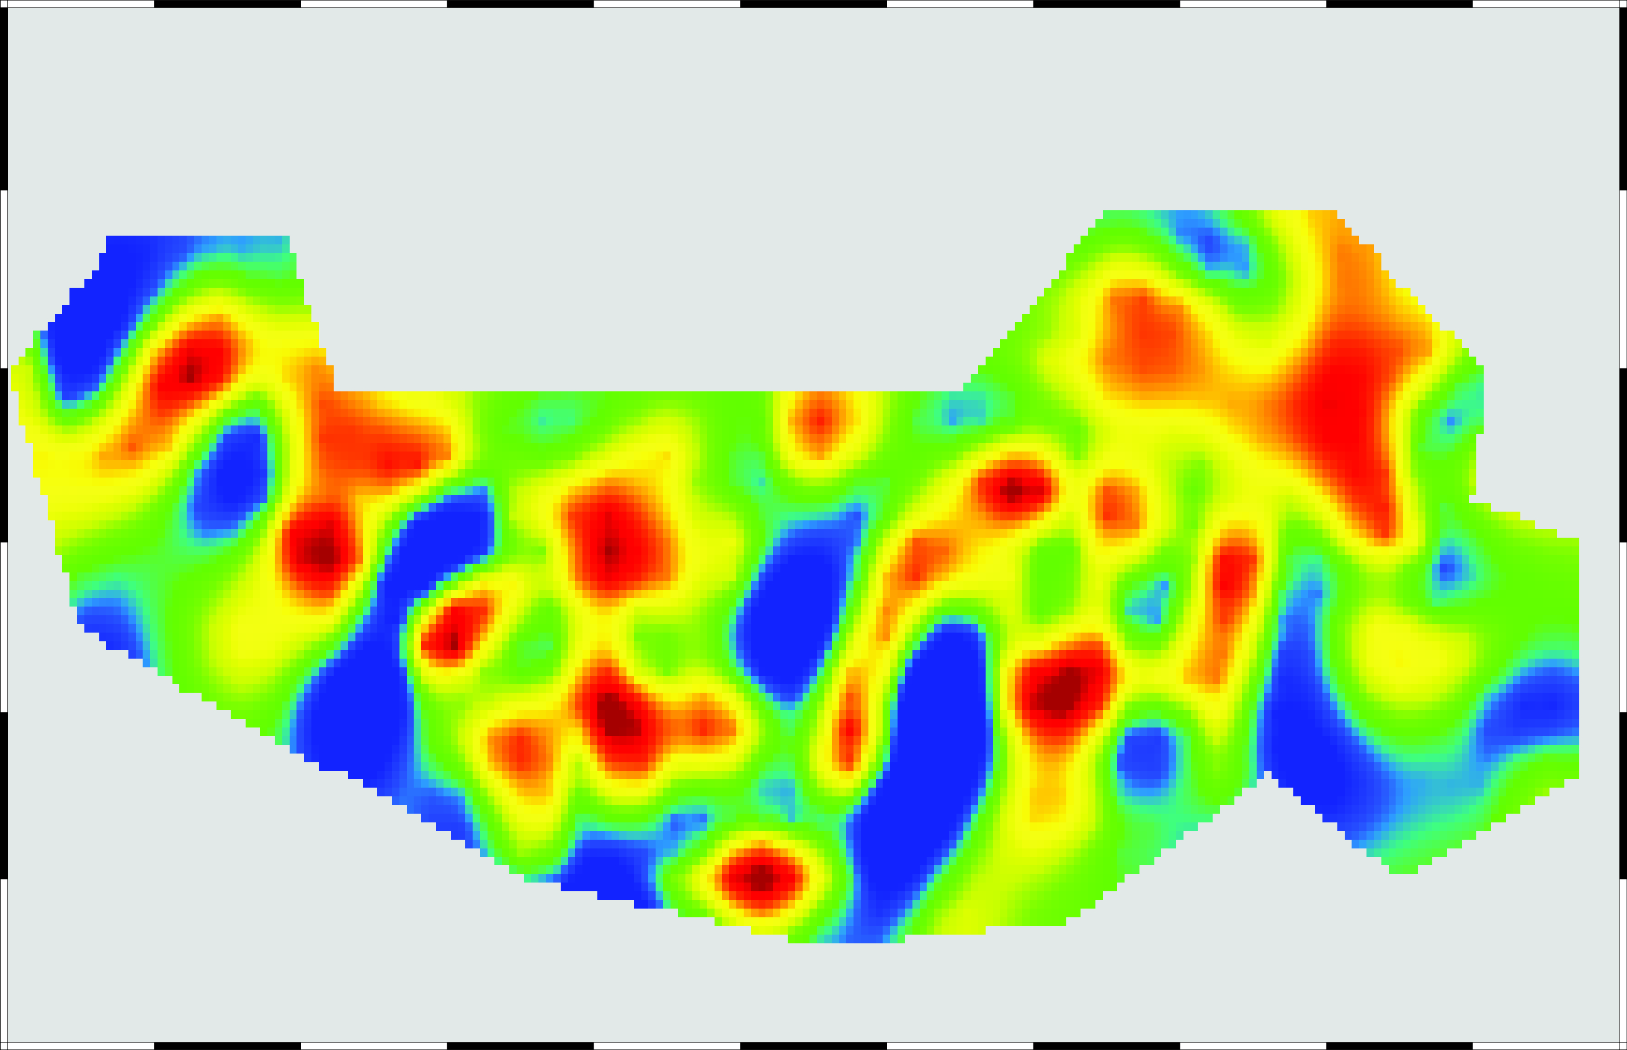
50km

Slide 11
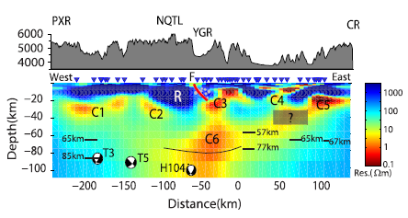
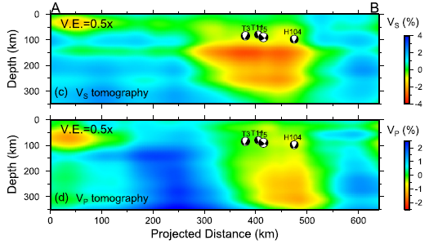
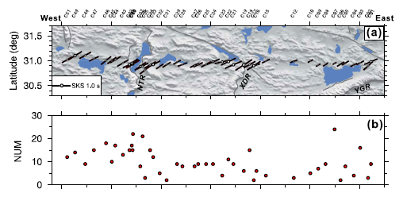
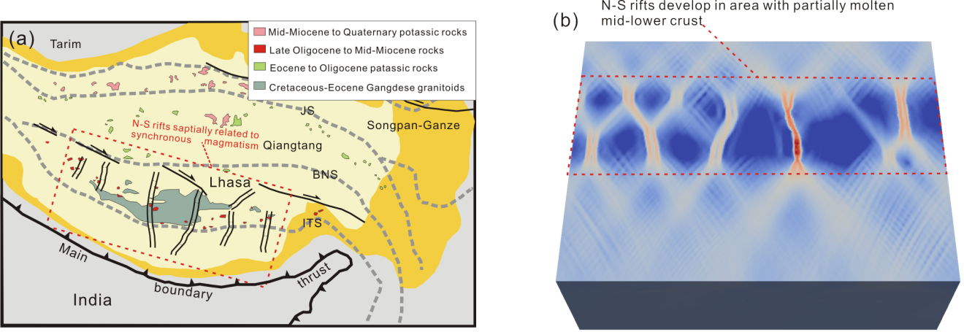
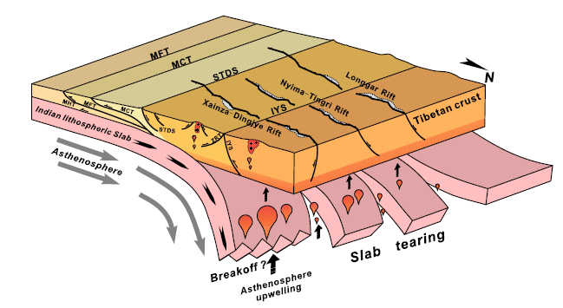
Tian et al, 2015, EPSL
Chen et al, 2015, EPSL
Wang et al, 2017, EPSL
The geophysical observation show：
geophysical anomalies exists in the lower crust
The moho depth is different from west to the east
Pang et al, 2018, JGR
Slab tearing model
Pang et al(2018) conclude that：
The normal faults and related rocks are temporally and spatially linked.
The hot and weak layer exists shown by the geophysical observation beneath the N-S normal faults.
The weak middle crust enhanced the formation of the N-S normal faults.
Chen et al, 2015, EPSL

Slide 12
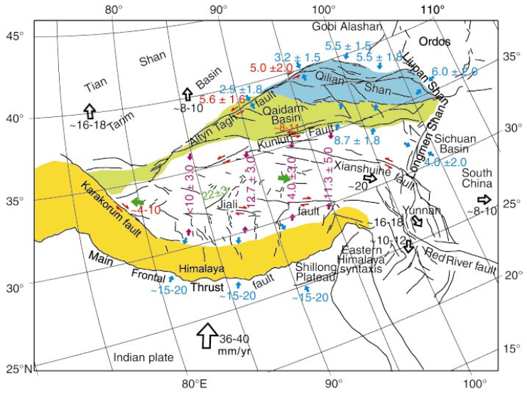
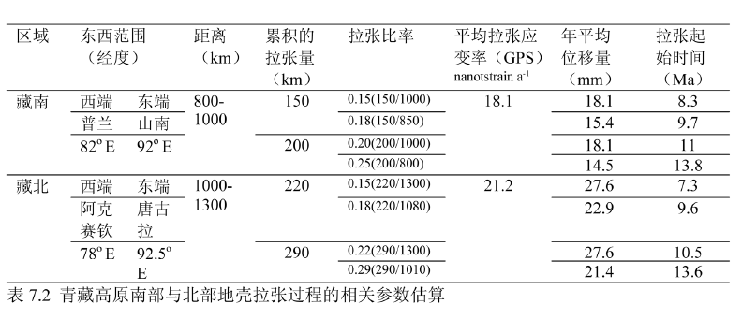
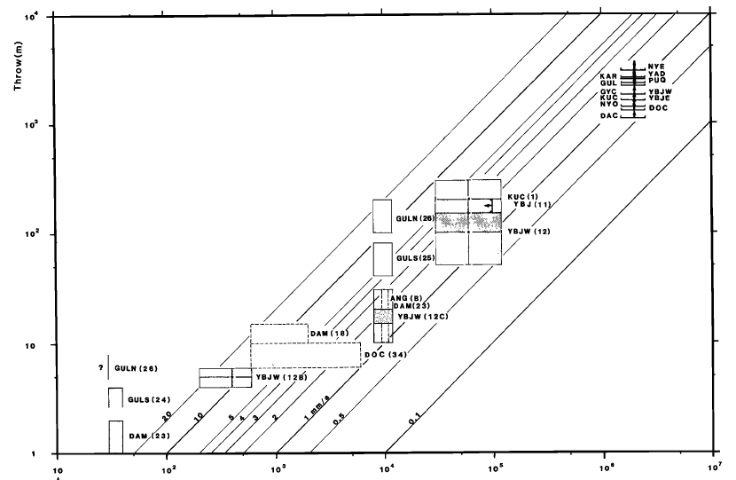
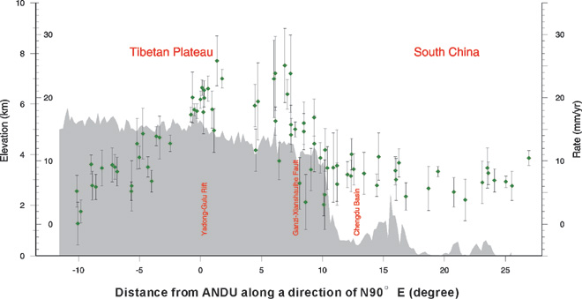
GPS:22±3mm/yr
The extension rates:14-27mm/yr
Ge, 2016, thesis(Supervisor：Shen)
Zhang et al, 2004, Geology
¹⁰Be:18±9mm/yr
GPS:20±3mm/yr
Armjo et al, 1986, JGR
The present-day extension rates:~20mm/yr
Wang et al, 2001, Science

Slide 13
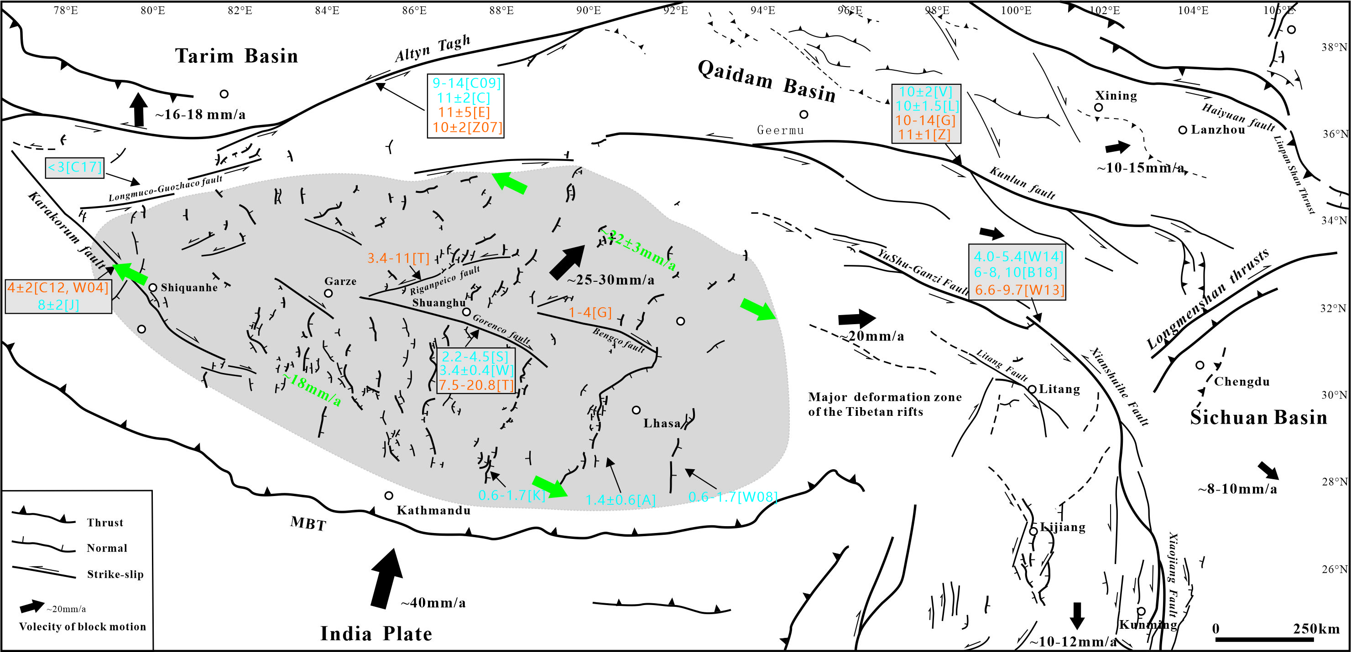
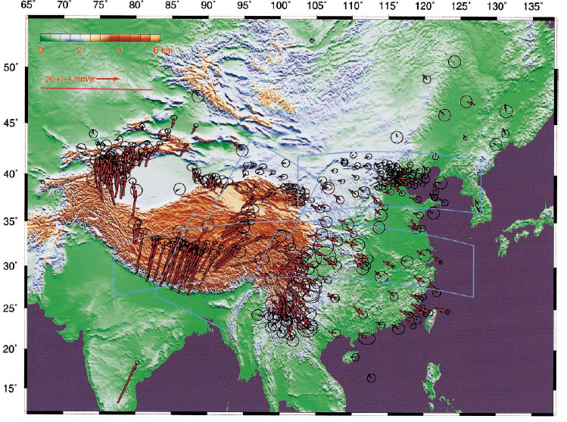
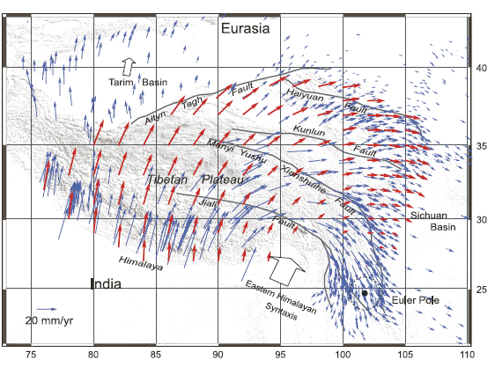
Modified from:
Ha, 2019, thesis(Supervisor：Wu)
Wang et al, 2001, Science
Conclusions:
The present-day extension rates is 20mm/yr.
The extension rates are consistent with the eastward flow rates.
Our GPS data support the eastward flow model.
Gan et al, 2007, JGR

Slide 14

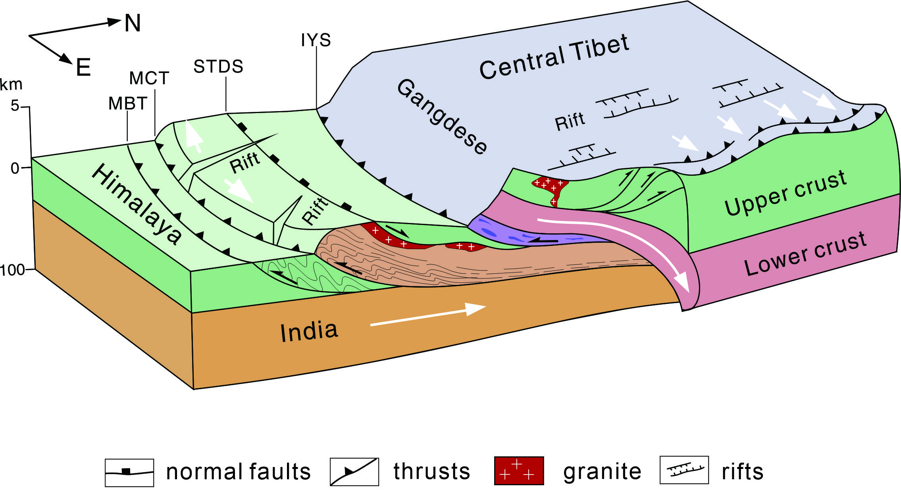
Implications：
The weak zone in the middle to lower crust influence the developments and evolution of the N-S trends normal faults.
The material eastward flow enhance the N-S normal faults developments.
The timing of the middle to lower crustal flow may begin in the Miocene.
Modified from:
Li et al.,2015,ESR

Slide 15
Thanks to all
Sorry for not attending the meeting

