Slide 1
High-speed UV imaging of elves
and lightning from space
First simultaneous detections by the Mini-EUSO and ASIM instruments
Università di Torino - INFN Torino
Matteo Battisti - matteo.battisti@edu.unito.it
Enrico Arnone, Mario Bertaina, Francesca Bisconti for the Mini-EUSO collaboration
Mini-EUSO collaboration
E. Arnone, M. Battisti, A. Belov , M. Bertaina, F. Bisconti, C. Blaksley, S. Blin-Bondil, F. Cafagna, G. Cambiè, F. Capel, M. Casolino,
I. Churilo, G. Cotto, A. Djakonow, T. Ebisuzaki, F. Fausti, F. Fenu, C. Fornaro, A. Franceschi, C. Fuglesang, P. Gorodetzky, A. Haungs,
F. Kajino, P. Klimov , L. Marcelli, W. Marszał, M.Mignone, H. Miyamoto, A. Murashov, T. Napolitano, G. Osteria, M. Panasyuk,
A. Poroshin, E. Parizot, P. Picozza, L.W. Piotrowski, Z. Plebaniak, G. Prévôt, M. Przybylak, E. Reali, M. Ricci, N. Sakaki, K. Shinozaki,
J. Szabelski, Y. Takizawa, M. Traïche, S. Turriziani for the JEM-EUSO collaboration
for the ASIM collaboration
O. Chanrion, T. Neubert
© Copyright authors, all rights reserved

Slide 2
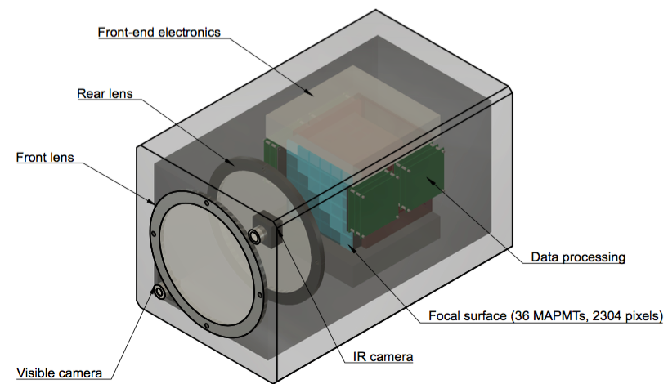
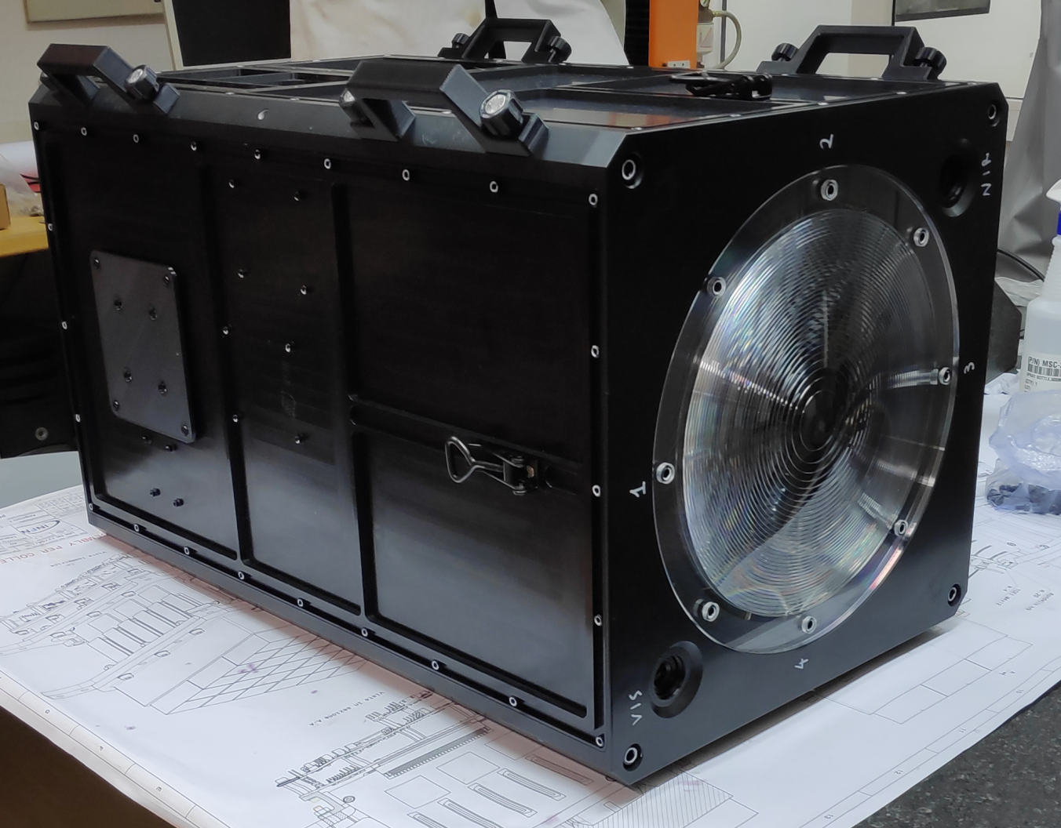
Mini-EUSO instrument
Mini-EUSO conceptual design
Mini-EUSO detector
Mini-EUSO is a compact telescope (dimension 37×37×62cm³) with a large field of view (44°), based on an optical system employing two Fresnel lenses for light collection (25 cm in diameter). The light is focused onto an array of 36 multi-anode photomultiplier tubes (MAPMT), for a total of 2304 pixels. In addition to the main detector, Mini-EUSO contains two ancillary cameras for complementary measurements in the near infrared (1500-1600 nm) and visible (400-780 nm) range. Mini-EUSO was launched on the ISS on August 2019, collecting so far data in 14 different 1-night-long sessions from October 2019, looking down in the nadir direction at the Earth from a UV-transparent window located in the Zvezda module. The detector is scheduled to keep working at least for the entire 2020 and beyond.
For details see Mini-EUSO: A high resolution detector for the study of terrestrial and cosmic UV emission from the International Space Station, Advances in Space Research, 62, (2018) 2954-2965.

Slide 3
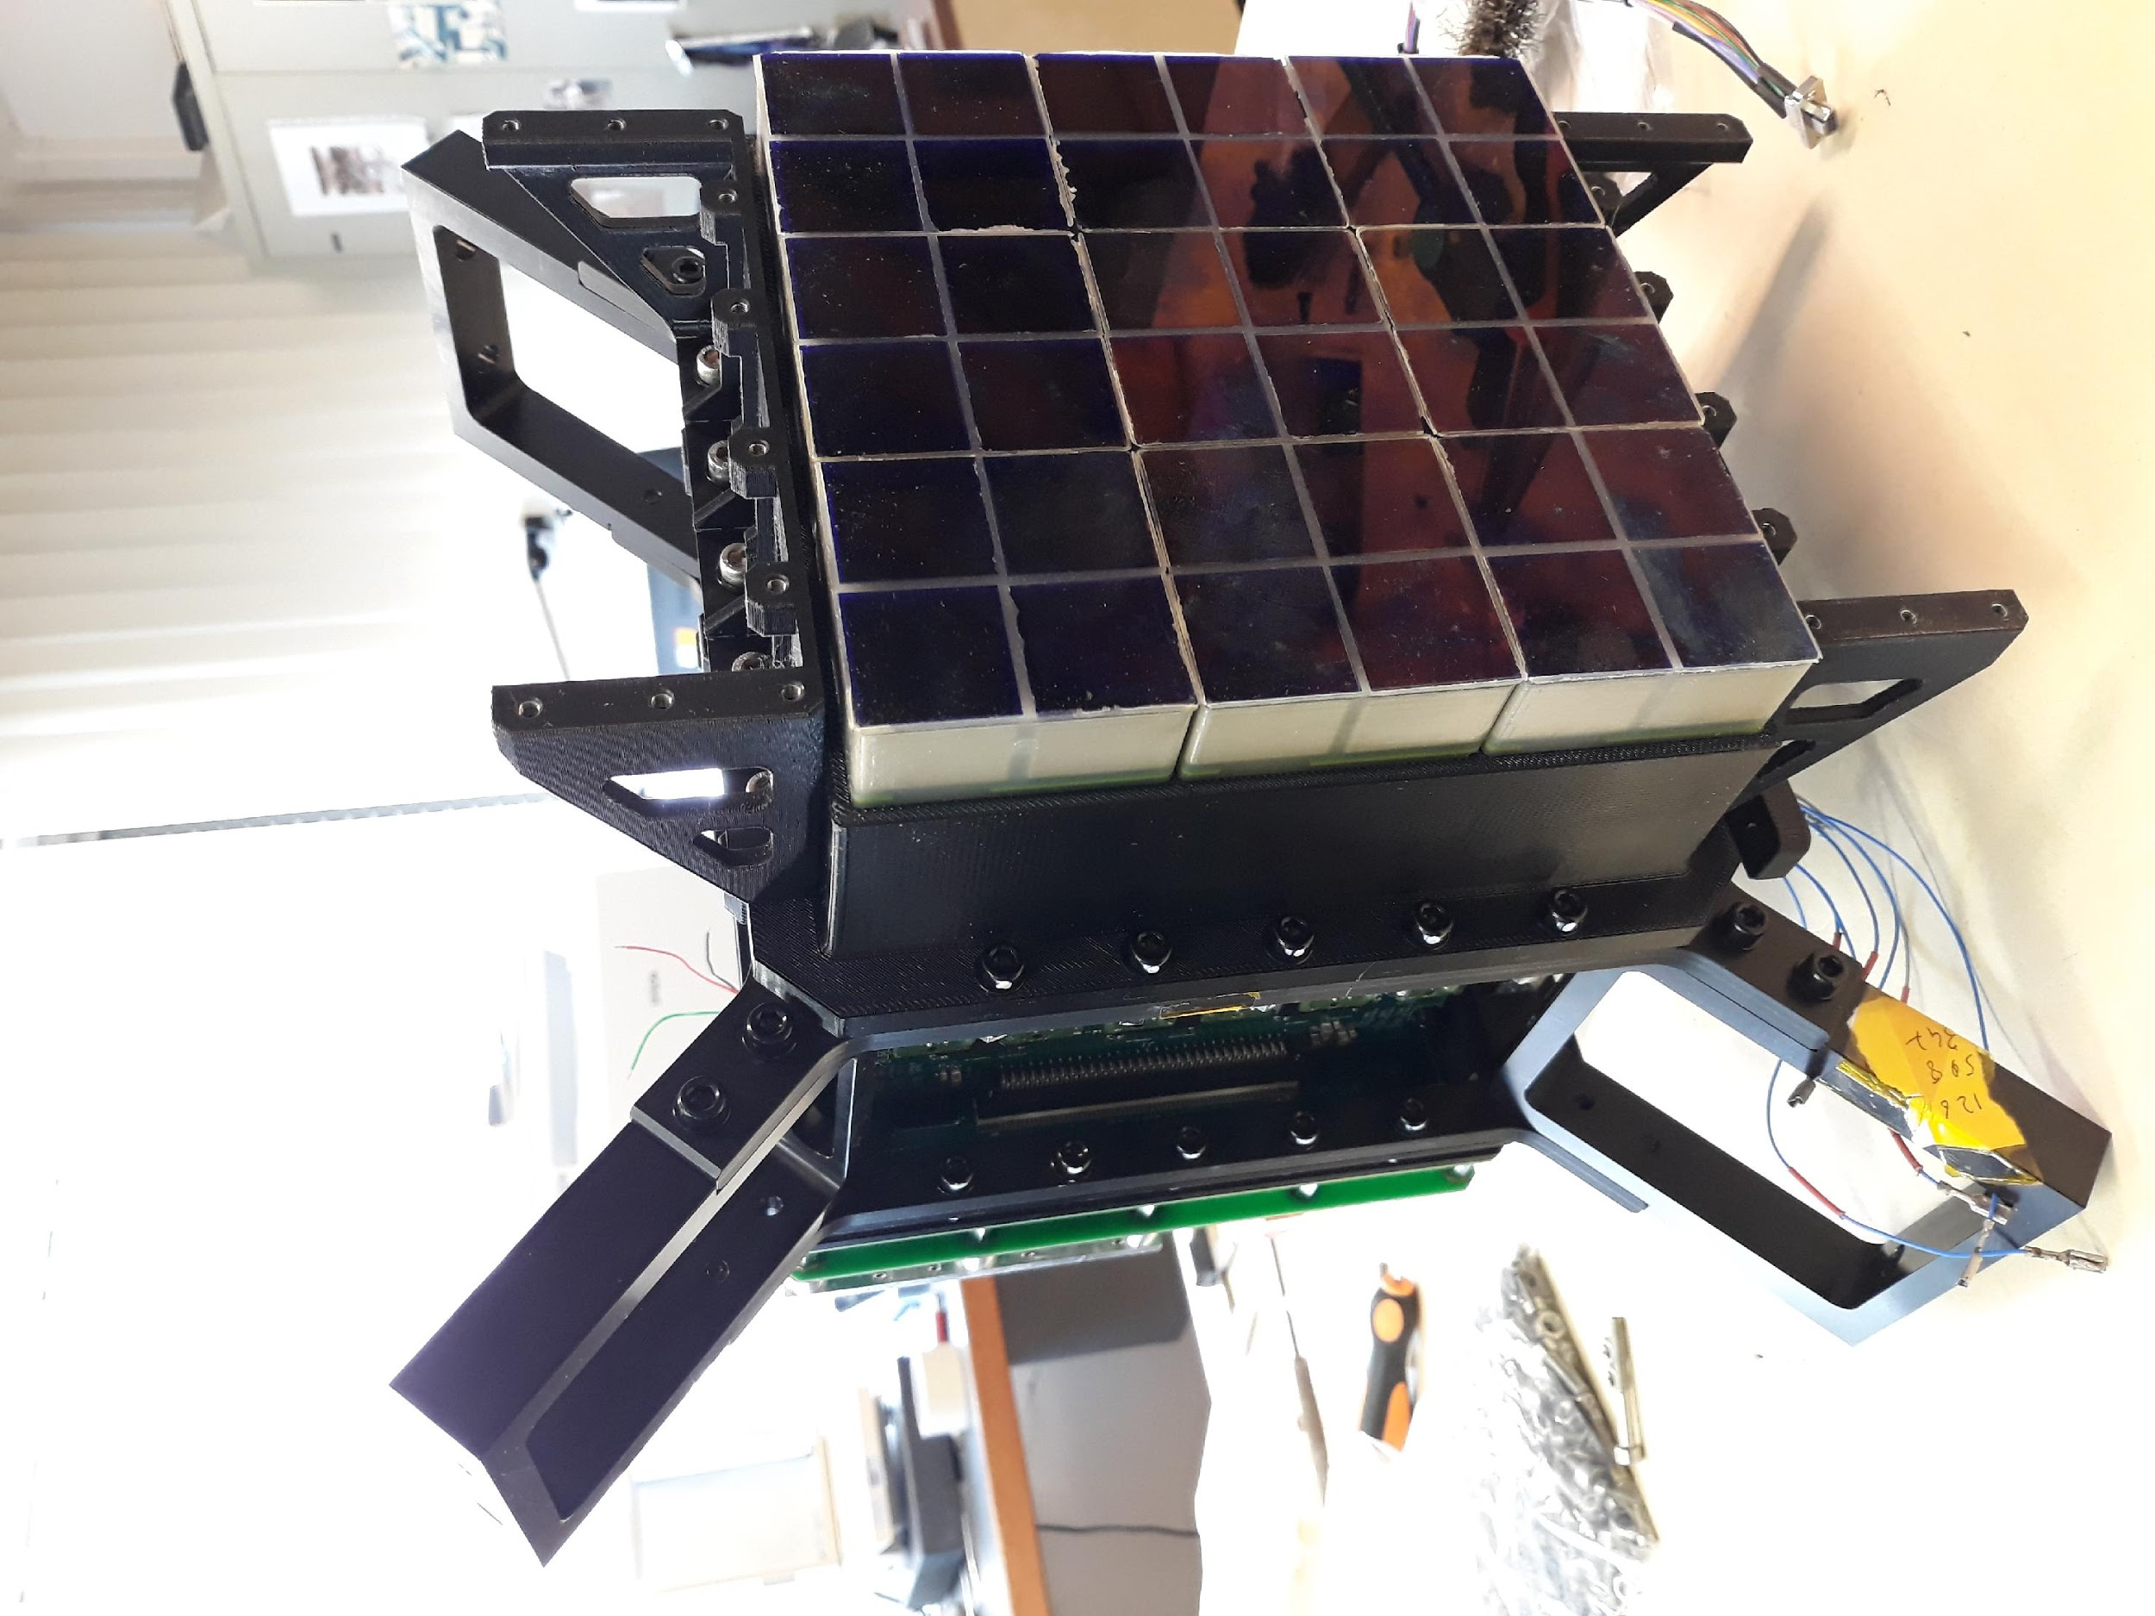
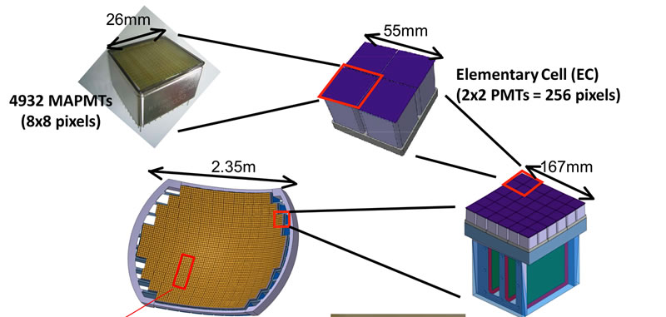
Mini-EUSO focal surface
The focal surface is an array of 36 MAPMTs, arranged in a square structure called Photo-Detection Module (PDM), for a total of 2304 pixels (48x48 pixels). A UV filter (2 mm thickness of BG3 filter) are applied to the MAPMTs to select mostly wavelengths between 300 nm and 400 nm.
Mini-EUSO is capable of single photon counting. Data are collected on three different timescales at the same time: a 2.5 𝝁s (D1) and a 320 𝝁s (D2) timescale with dedicated trigger systems, and a 40.96 ms timescale (D3) used to produce a continuous monitoring of the UV emission from the Earth. Data on D1 and D2 levels are available only when a trigger is issued, while D3 data are continuously stored.

Slide 4
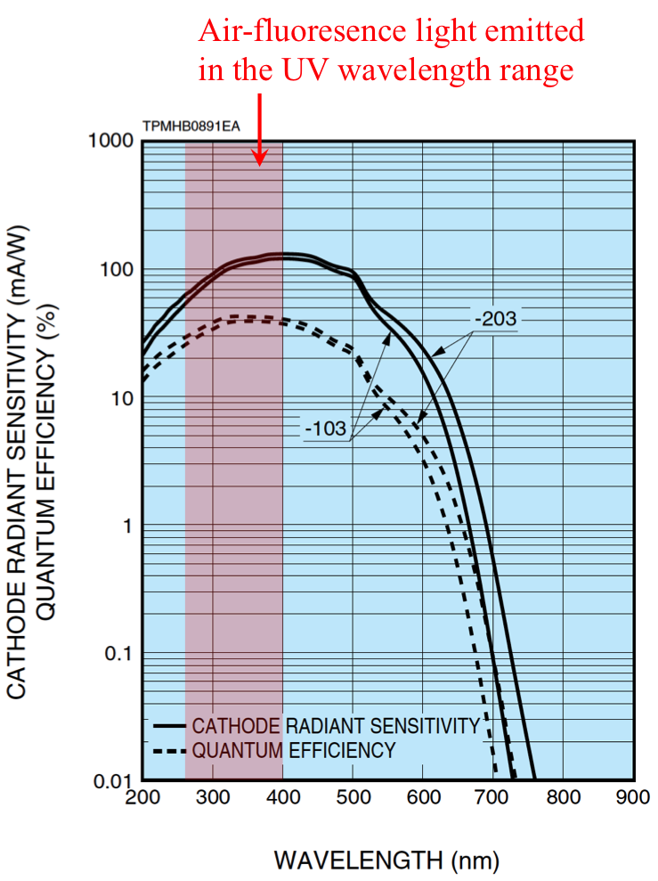
MAPMTs spectral response
Air fluorescence light emitted
in the UV wavelength range
Mini-EUSO main purpose is the measurement and mapping of the UV night-time emissions from the Earth. This is in view of a much larger instrument (K-EUSO and POEMMA) devoted to detection of the fluorescence light emitted by Ultra-High Energy Cosmic Rays (UHECRs) developing a shower in the atmosphere. The spectral response is therefore peaked at the near UV, with a tail in the visible region. That allows Mini-EUSO to be sensitive also to meteors burning in the atmosphere and atmospheric phenomena like lightning and transient luminous events (TLEs).
WAVELENGTH (nm)
Left: quantum efficiencies (dotted line) of Mini-EUSO MAPMTs. Right: Optical transmission of BG3 filter at 1 mm thickness. The total spectral response is the convolution of the two.

Slide 5
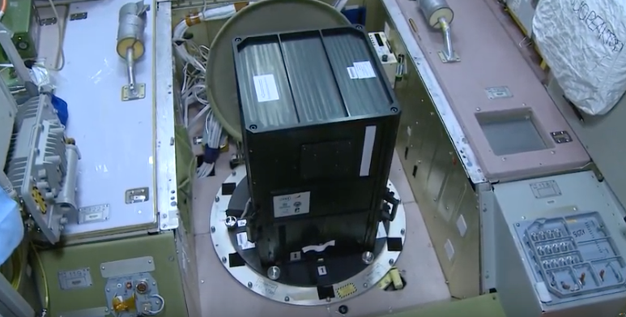
Mini-EUSO temporal and spatial resolution
Mini-EUSO is capable of imaging with a spatial resolution of ~7 km on ground (one pixel angular resolution ~0.9°). The resolution at 100 km altitude (where elves occur) is therefore ~5 km.
As previously mentioned, Mini-EUSO collects data on three different timescales. The temporal unit on each timescale is called GTU (Gate Time Unit). We will therefore talk about D1 GTU (2.5 𝝁s each), D2 GTU (320 𝝁s each) and D3 GTU (40.96 ms each).
Mini-EUSO installed on-board the ISS in the Zvezda module, on the UV-transparent window. Image taken from www.youtube.com/watch?v=QincAp4V-SM

Slide 6
Mini-EUSO, a few trigger details
Mini-EUSO collects data on three different timescales at the same time: a 2.5 𝝁s (D1), a 320 𝝁s (D2) and a 40.96 ms timescale (D3). While data on D3 is saved continuously, D1 and D2 data are taken only if the trigger logic is satisfied.
D1 and D2 trigger logics are optimized for the detection of of UHECRs rather than the detection of atmospheric events. D1 and D2 trigger logics are independent and both require a persistent signal on a single pixel. For details see A. Belov et al.: 'The integration and testing of the Mini-EUSO multi-level trigger system', Advances in Space Research 62 (2018) 2966–2976.
When a trigger is issued 128 consecutive frames are stored in the mass memory, 64 before and 64 after the event. Mini-EUSO can save up to 4 different events in D1 timescale (4x128x2.5 𝝁s) and the same number in D2 (4x128x320 𝝁s) timescale every 5.24 s. Both the number of frames and the number of events may be increased in the near future.
So far, elves have been always detected in D1. An event is triggered when a pixel has a signal 16 σ above the background. In the nominal background conditions of 1cts/pxl/2.5 𝝁s that correspond to 54 counts in the same pixel over 8 consecutive GTUs. With a higher background of 2 cts/pxl/2.5 𝝁s, 100 counts in 8 consecutive GTUs are necessary.

Slide 7
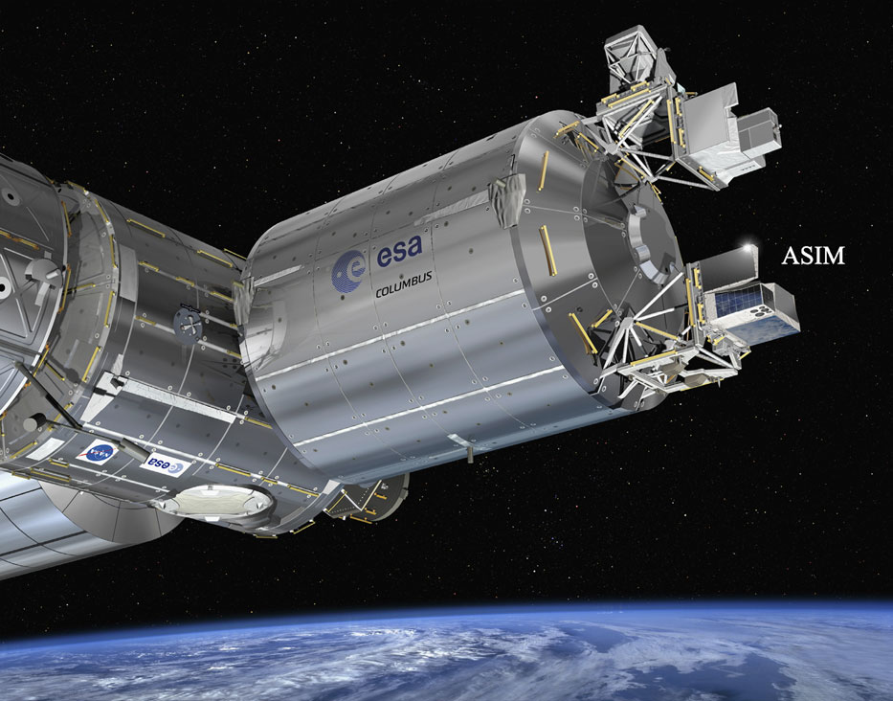
ASIM
The Atmosphere-Space Interactions Monitor (ASIM) is an Earth observation facility deployed as an external payload platform of ESA’s Columbus Laboratory of the ISS.
The primary scientific objectives of the ASIM mission are to study thunderstorm electrical activity such as lightning, Transient Luminous Emissions (TLEs) and Terrestrial Gamma-ray Flashes (TGFs) by observing the associated emissions in the UV, near-infrared, x- and gamma-ray spectral bands. In this comparative study, we are especially interested in the UV detection, which is an indication of emission from elves.
The Modular Multispectral Imaging Array (MMIA), together with the Modular X- and Gamma- ray Sensor (MXGS), are the two main instruments forming ASIM
The MMIA includes two cameras imaging in 337 nm and 777.4 nm, at up to 12 frames per second, and three high-speed photometers at 180–230 nm, 337 nm and 777.4 nm, sampling at rates up to 100 kHz.

Slide 8
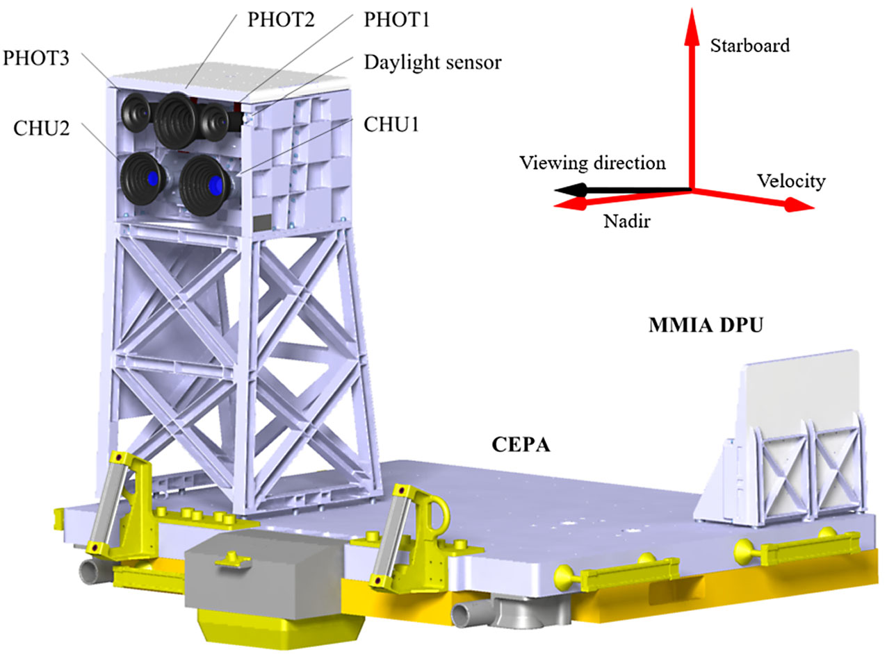
MMIA
The MMIA has two cameras and three
photometers co-aligned and tipped upwards by 5°.
The instruments are operated only during nighttime.
In the table, some characteristics of the detectors componing the MMIA module.
MMIA is capable of self-triggering on lightning and TLEs, basic informations about the triggered data are publicly available on the website asdc.space.dtu.dk/mmia_observation/
For more information: link.springer.com/content/pdf/10.1007/s11214-019-0593-y.pdf

Slide 9
Mini-EUSO data: overview
Launch
08/2019
Session 1
07/10/2019
Session 4
06/11/2019
Today
Mini-EUSO started operating on the 7th October 2019 and is currently acquiring data. Up to now the detector has been switched on 14 times for ~ 11 hours per night. Only a limited amount of data (10%) is telemetered to the mission control centre, the rest has been delivered by the astronauts and will soon be available.
The first 4 sessions were performed in a safe mode called “cathode 2”, were the MAPMTs have reduced gain and reduced collection efficiency. The quality of the data collected during these session is therefore reduced.
The total amount of data available is ~7 hours.
Mini-EUSO has so far detected hundreds of lightning strokes and 5 elves. Elves are produced as horizontally expanding diffuse emission rings of a few hundreds km diameter at about 90 km altitude, when the electromagnetic pulse of a triggering lightning stroke hits the lower ionosphere.
Mini- EUSO
Cathode 2
Cathode 3
elve
two elves
elve
elve
ASIM
Detected
OFF
Under study
For the first elve (the only one in cathode 2 mode) the simultaneous detection by ASIM detector was confirmed.
Two elves took place during a night in which ASIM was not taking data, for the other two events the simultaneous detection by Mini-EUSO and ASIM is still under study.
All the elves show a size-increasing ring-shaped signal in the 2.5 𝝁s time scale (D1). The signal is moving at an apparent superluminal speed and often shows a double-ring shape. In the 40.96 ms time scale (D3) the signal appears as a minor but detectable increase in the luminosity over a huge portion of the PDM, lasting between 1-4 GTUs.
The center of the elve is always outside the FOV. When a lightning or a TLE is directly inside the detector FOV, the system goes in protection mode and switches a part of the PDM to cathode 2 or off.
In the next slides 3 of the 5 elves detected by Mini-EUSO are shown.

Slide 10
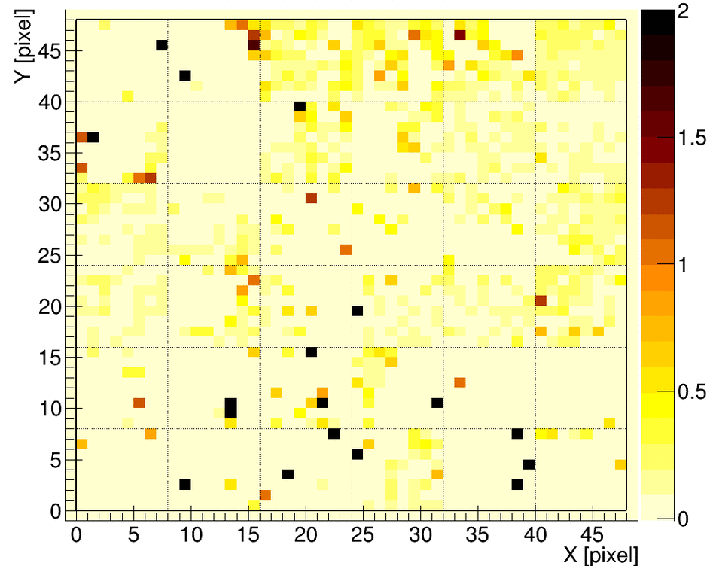
Mini-EUSO: elve (1 of 3)
PRELIMINARY
Mini-EUSO detected the first double ring-shaped signal expanding in the FOV while still in cathode 2 mode.
One TLE was detected by ASIM on the same night and roughly at the same time (07/11/2019 - 05:58:13).
After the synchronization process of the elve event all the lightning detected by ASIM have a counterpart in Mini-EUSO data.
In the upcoming slides a few example are shown.
Each frame in the animation is 20 𝝁s long, obtained by the accumulation of 8 D1 GTUs (2.5 𝝁s each), to obtain smoother images. A flat field is used. The pixel size at 100 km altitude is ~5 km.

Slide 11
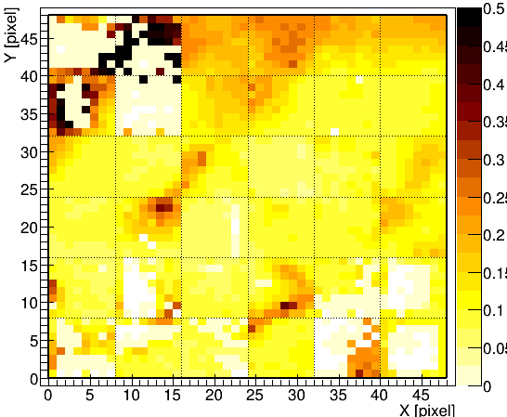
ObservationID: 17928 - Time 05:58:13.893942 - UV event
PRELIMINARY
Mini-EUSO
(GTU 16486-16489)
ASIM
(GTU 16486)
ObservationID: 17928
D3 GTU
Mini-EUSO D3 (40.96 ms) lightcurve.
The blue arrows indicate the position of the elve detected by Mini-EUSO. ASIM data are synchronized assuming the elve took place in the GTU indicated by the red arrow.
Data taken in cathode 2 mode, the efficiency is reduced by a factor of ~100.
In the animation, how the elve appears in D3 data

Slide 12
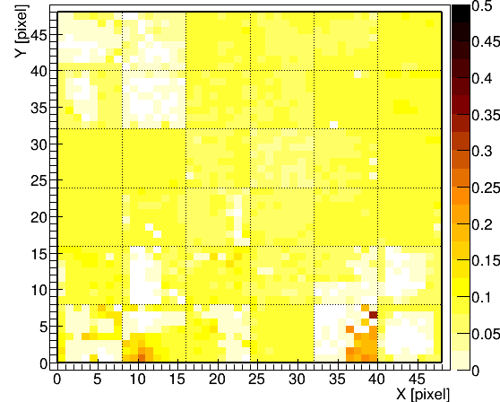
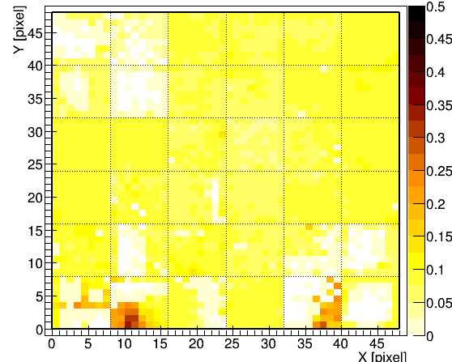
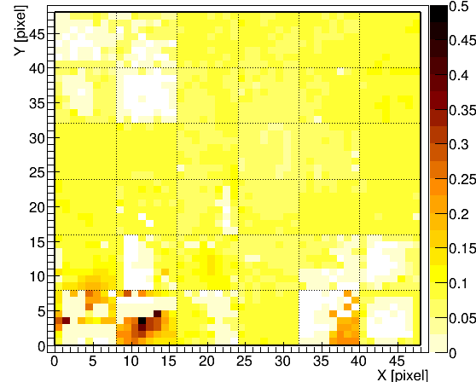
Time 06:00:28 - 06:00:34 - Lightning and UV event
PRELIMINARY
ASIM
(GTU 19763)
ObservationID: 17963
ASIM
(GTU 19779)
ObservationID: 19733
ASIM
(GTU 19804)
ObservationID: 17934
ASIM
(GTU 19914)
ObservationID:17936
Mini-EUSO D3 (40.96 ms) lightcurve.
The blue arrows indicate the position of lightning in Mini-EUSO data, the red ones the position of the ASIM triggered events after the synchronization of the elve event.
Data taken in cathode 2 mode, the efficiency is reduced by a factor of ~100.
Mini-EUSO
(GTU 19765-19783)
Mini-EUSO
(GTU 19806)
Mini-EUSO
(GTU 19914-19920)

Slide 13
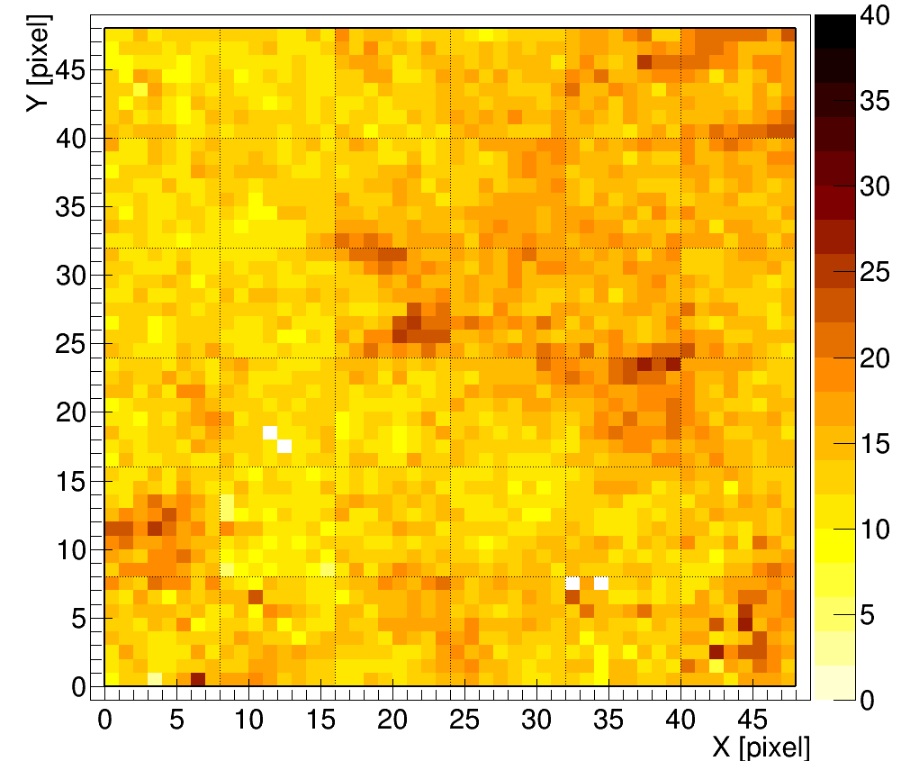
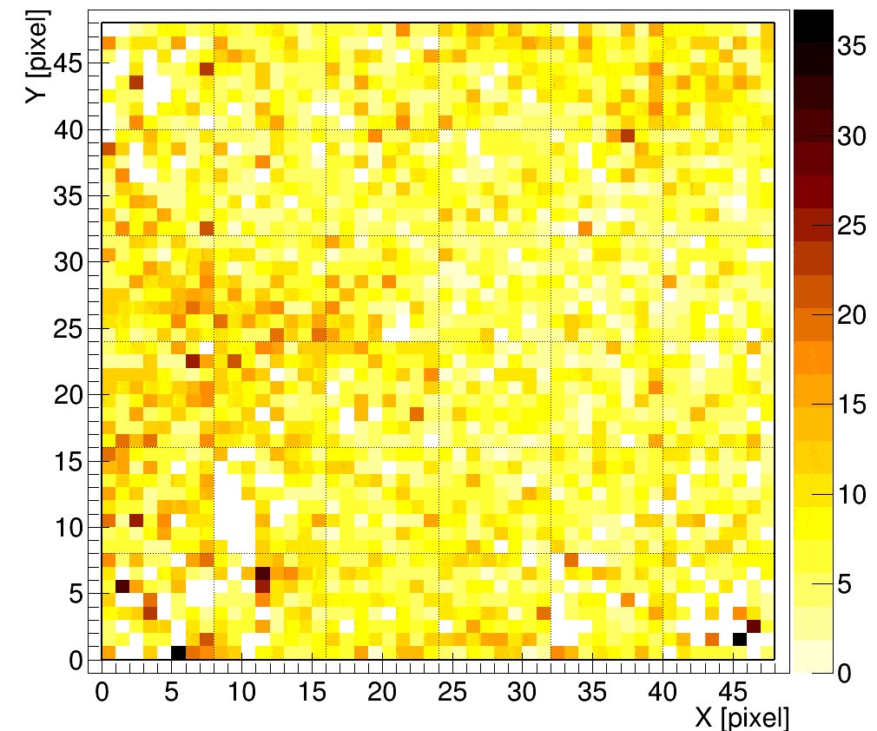
Mini-EUSO: elve (2 and 3 of 3)
PRELIMINARY
PRELIMINARY
Two example of elve detected in nominal working conditions. Both of the events last for ~200 𝝁s.
A flat field is used. The pixel size at 100 km altitude is ~5 km.
Left: each frame is 20 𝝁s long, obtained by the accumulation of 8 D1 GTUs (2.5 𝝁s each). The top-right EC switches to cathode 2 mode when a very intense light source is present in that portion of the field of view.
Right: each frame is 2.5 𝝁s long (a D1 GTU)

Slide 14
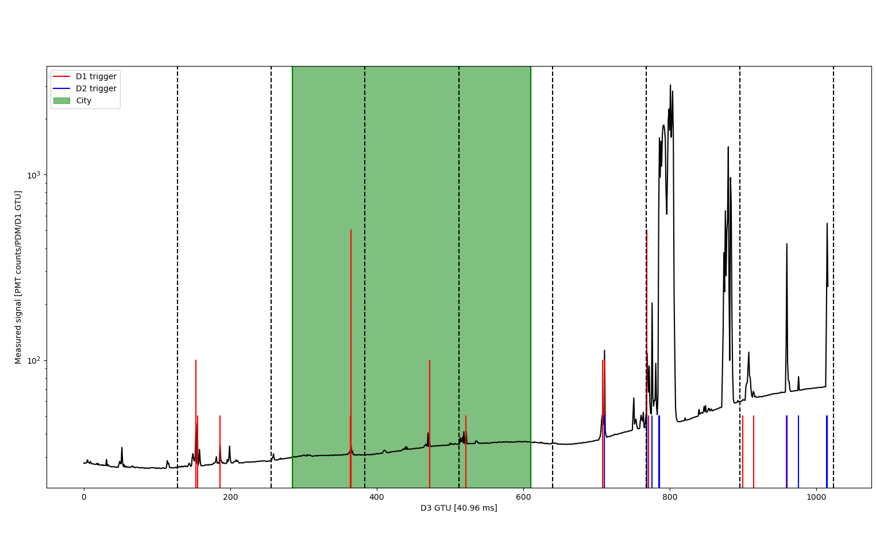
Mini-EUSO: lightning
First session: 40 seconds of lightning
In the very first session Mini-EUSO took data for 40 seconds during which recorded many lightning, both inside and outside the FOV.
The session was in cathode 2 mode, with only one EC active (1/9 of the entire PDM).
Those events were synchronized with ASIM data.
After the synchronization 19 ASIM events (out of 23 detected while Mini-EUSO was on) presented a counterpart in Mini-EUSO data.

Slide 15
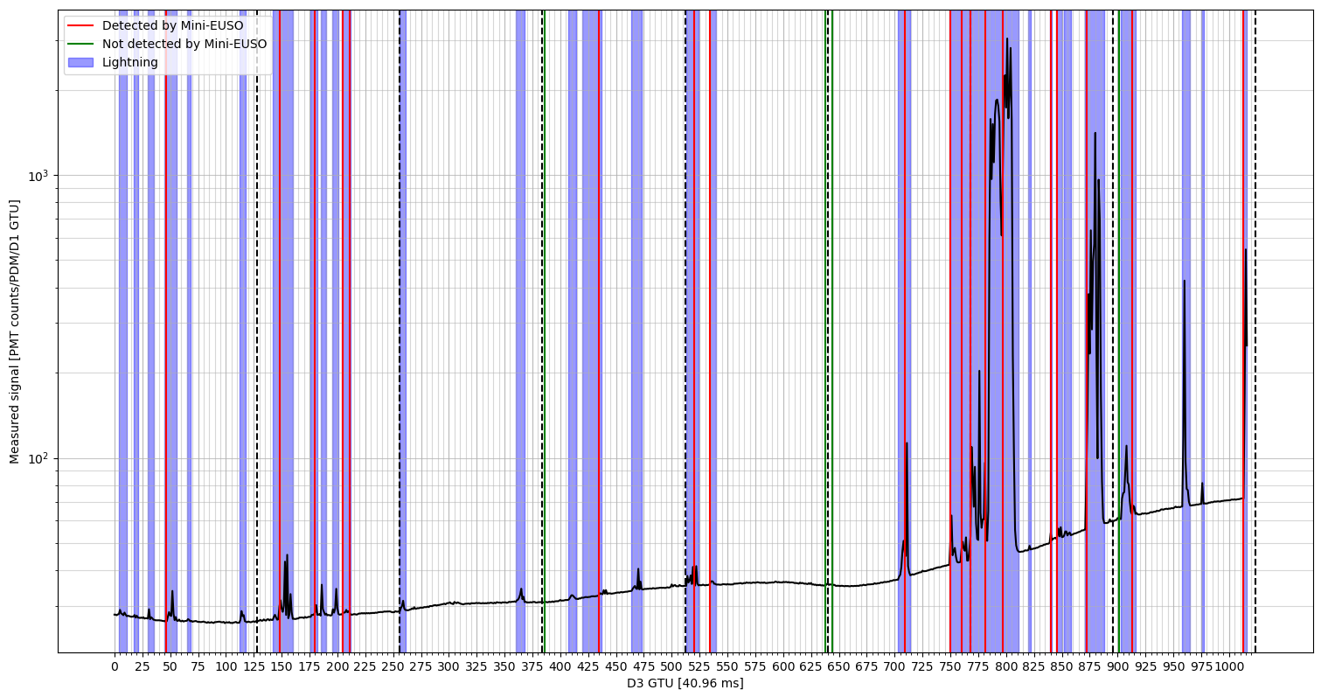
D3 lightcurve with ASIM triggered event - complete lightcurve
Lightcurve (log scale) of the first Mini-EUSO session:
blue → lightning in Mini-EUSO data
red → ASIM trigger happening when a lightning is present in Mini-EUSO data
green → ASIM trigger when there are no lightning in Mini-EUSO data
The lightcurves shown here and in the next slides represent raw data, without flat field

Slide 16
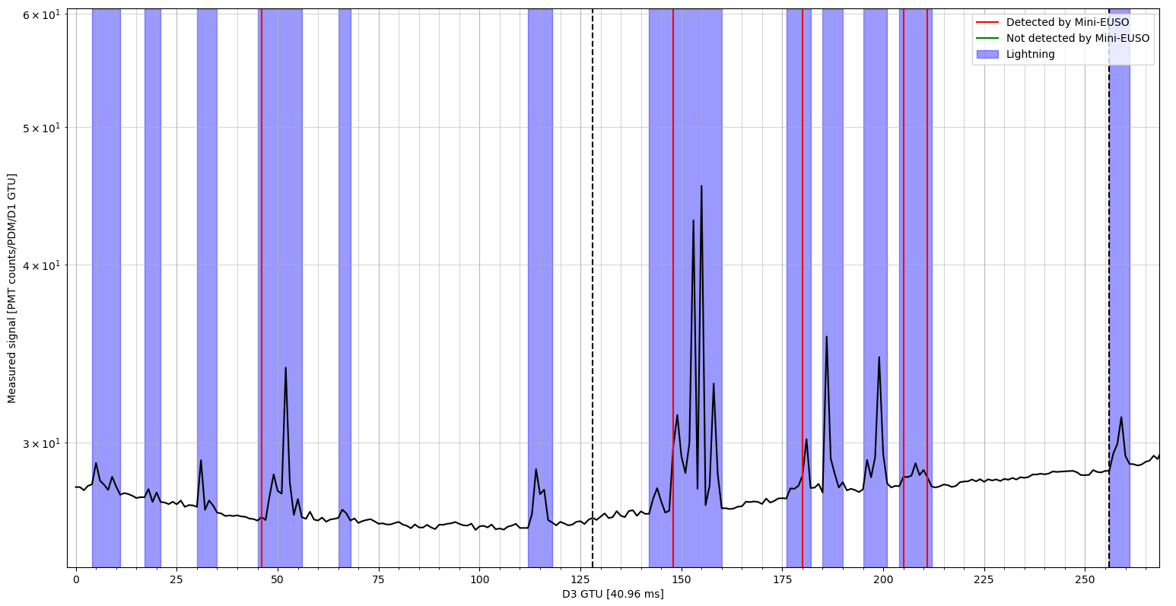
D3 lightcurve with ASIM triggered event - part 1 of 4

Slide 17
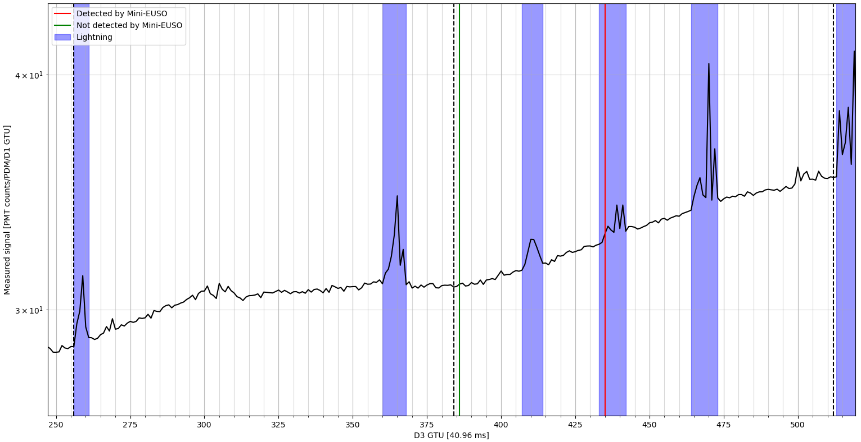
D3 lightcurve with ASIM triggered event - part 2 of 4

Slide 18
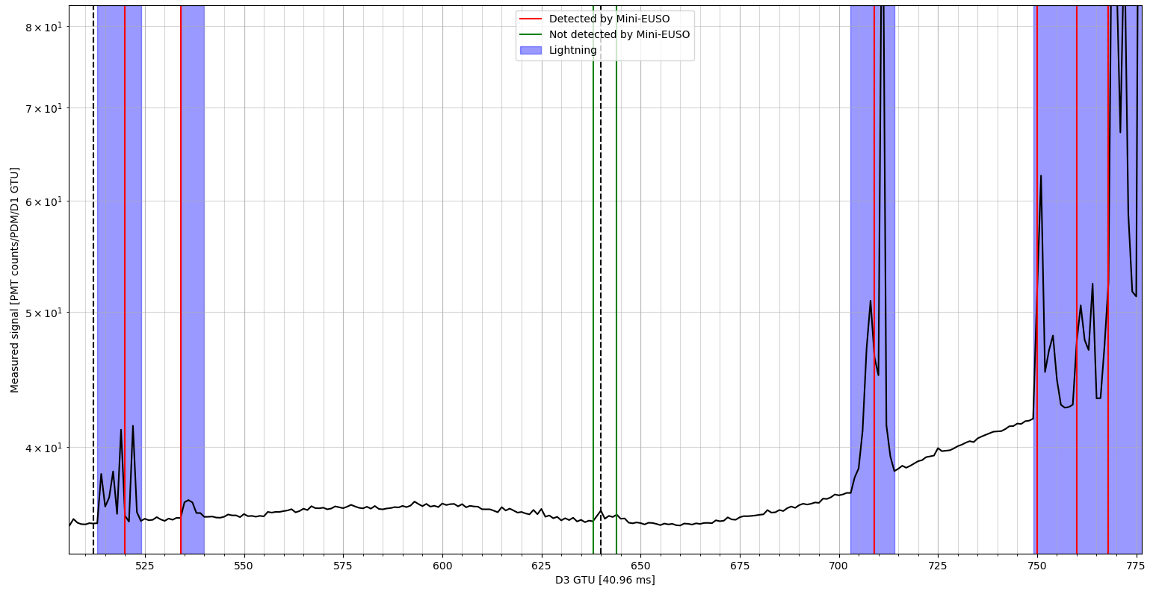
D3 lightcurve with ASIM triggered event - part 3 of 4

Slide 19
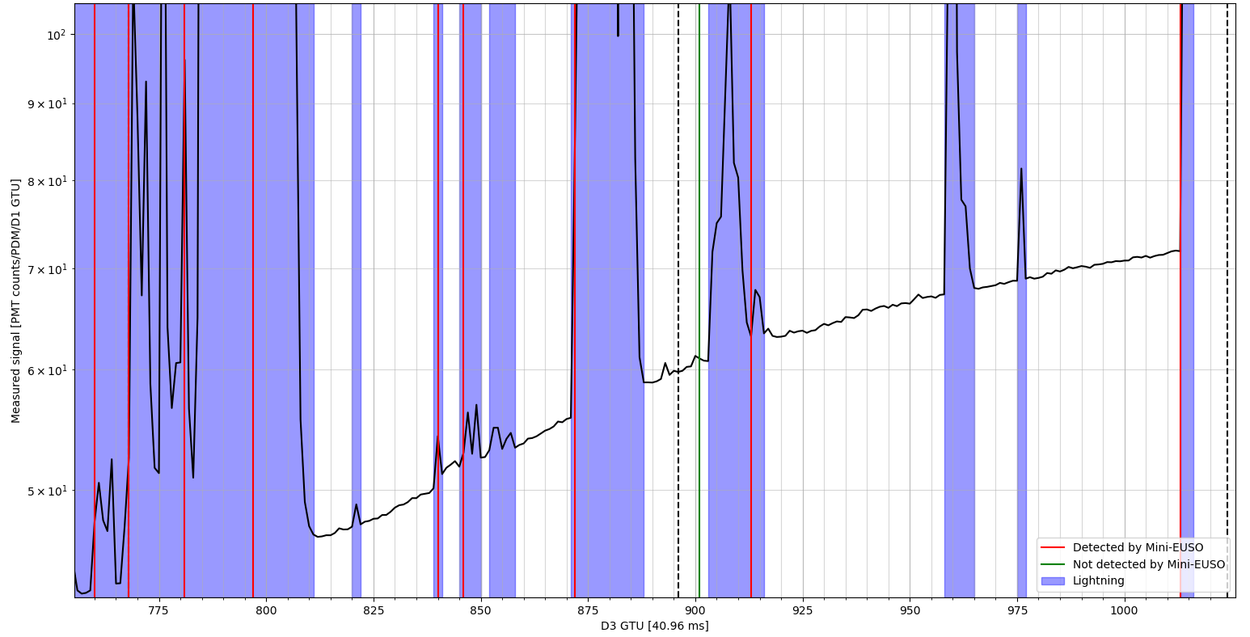
D3 lightcurve with ASIM triggered event - part 4 of 4

Slide 20
Conclusion
Mini-EUSO is a new instrument currently flying onboard the ISS, capable of imaging electromagnetic events such as lightning end elve with different time resolutions (2.5 𝝁s, 320 𝝁s and 40.96 ms) and a few km spatial resolution.
Up to now, Mini-EUSO has detected 5 elves and hundreds lightning in the ~10% of data downlinked from the ISS. Those number should increase by an order of magnitude when the whole dataset will be available.
The possibility to detect the same event both with the fast imaging camera of Mini-EUSO and the instrumentation of ASIM could improve the understanding of phenomena like TLEs.

