Slide 1
Assessment of the 2019 Chamoson debris-flow event (Swiss Alps)
Marc-Henri Derron , Valérie Baumann , Tiggi Choanji , Francois Noël , Ludovic Baron
Simon Hiscox Baux , Aurelien Ballu , Emmanuel Nduwayezu , Michel Jaboyedoff
Risk Analysis Group, Institute of Earth Sciences,
University of Lausanne, Switzerland
www.letemps.ch/suisse

Slide 2
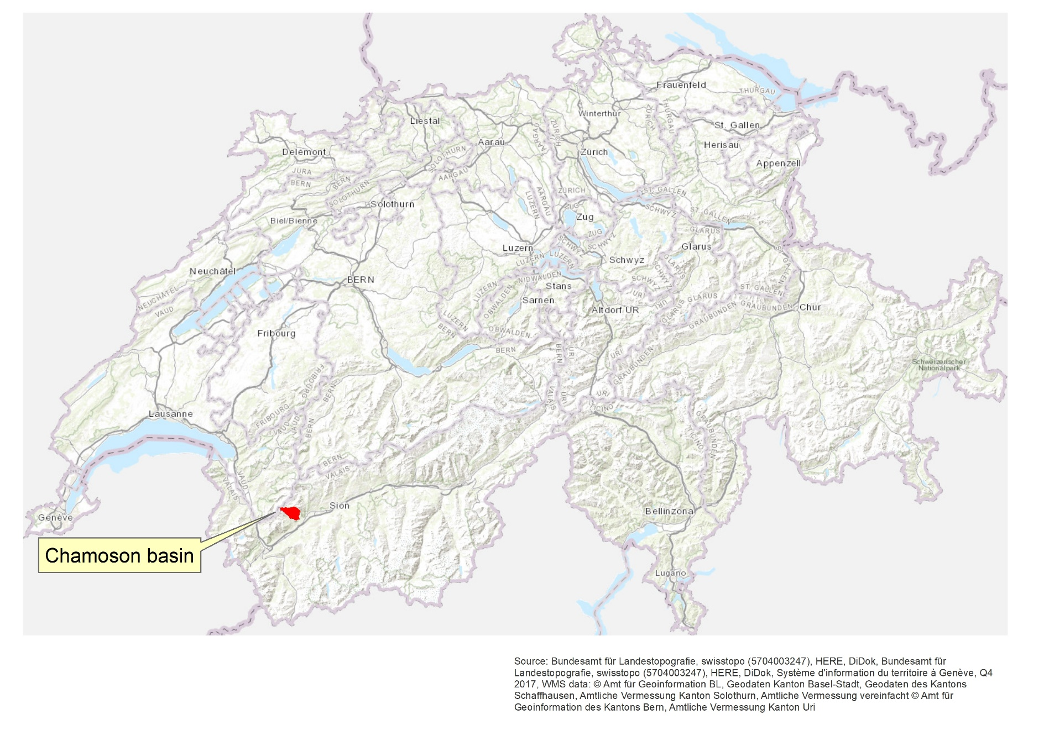
Study area location

Slide 3
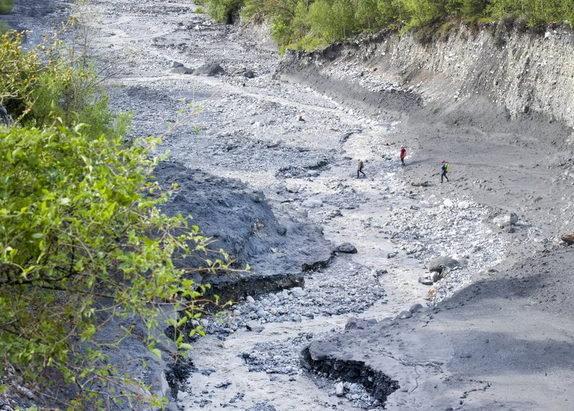
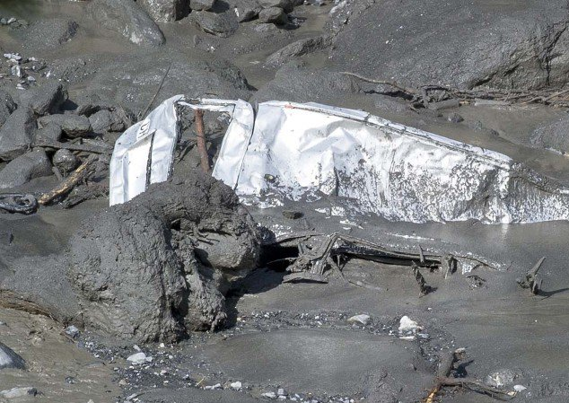
The 11 August 2019 debris flow
Losentsé in the lower basin area
The debris flow event was triggered by a strong storm, between 5 and 6 PM, in the Chamoson basin located in the Swiss Alps.
Around 7 PM, 2 cars were taken by the debris flow, one with 2 people inside.
The debris flow caused two deaths and several damages to the village of Chamoson.
Car carried out by the debris flow
www.lenouvelliste.ch

Slide 4
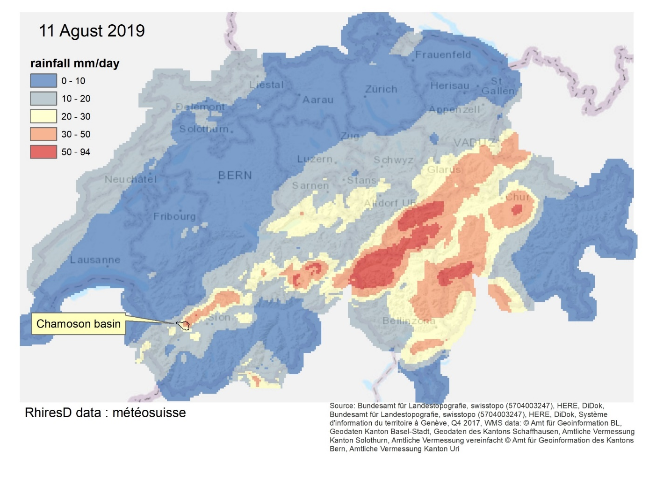
Rainfall 11 August 2019
The RhiresD image is based on daily precipitation totals measured at the high-resolution rain-gauge network of MeteoSwiss.
According to the radar images (not shown here) the rain fell on the Chamoson area between 5 and 6 PM (It rained during 10-15 minutes, but with a high intensity)

Slide 5
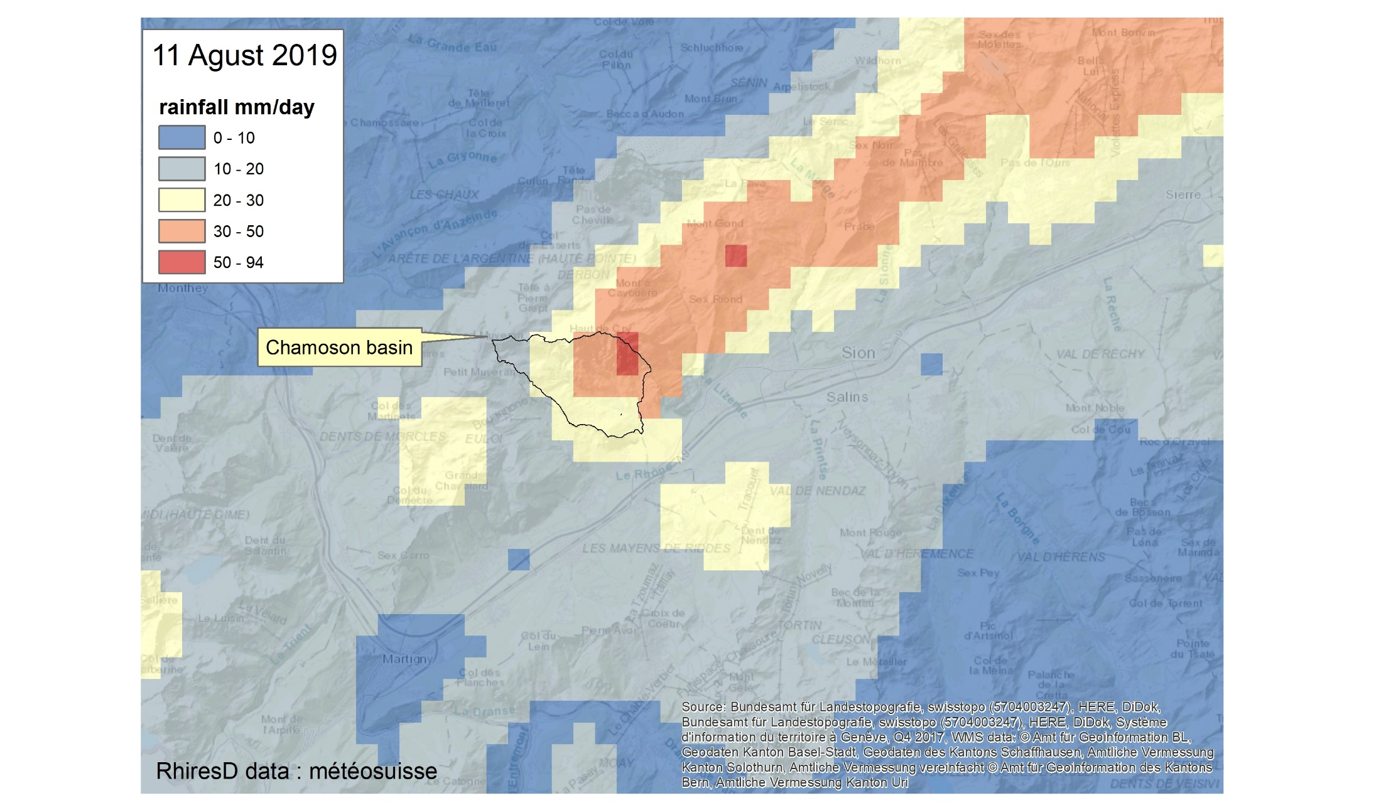
Rainfall 11 August 2019

Slide 6
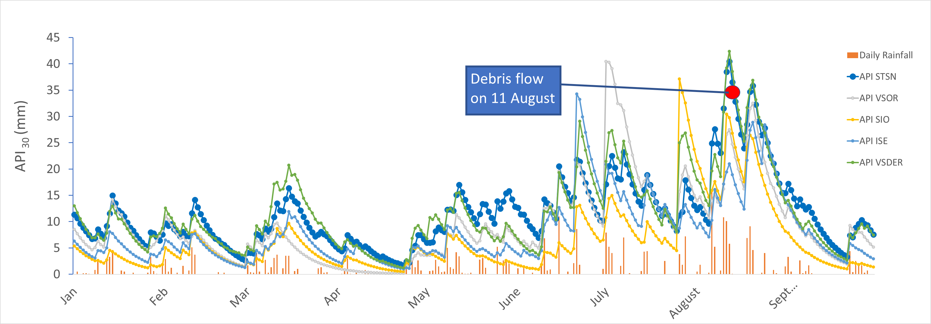
Antecedent Precipitation Index
Antecendent Precipitation Index (30 days) for the Chamoson area (data taken from five nearest stations to the river)
VISE = Iserables, VSOR = Sorniot, VTSN= TsanFleuron, SIO = Sion, VSDER = Deborance

Slide 7
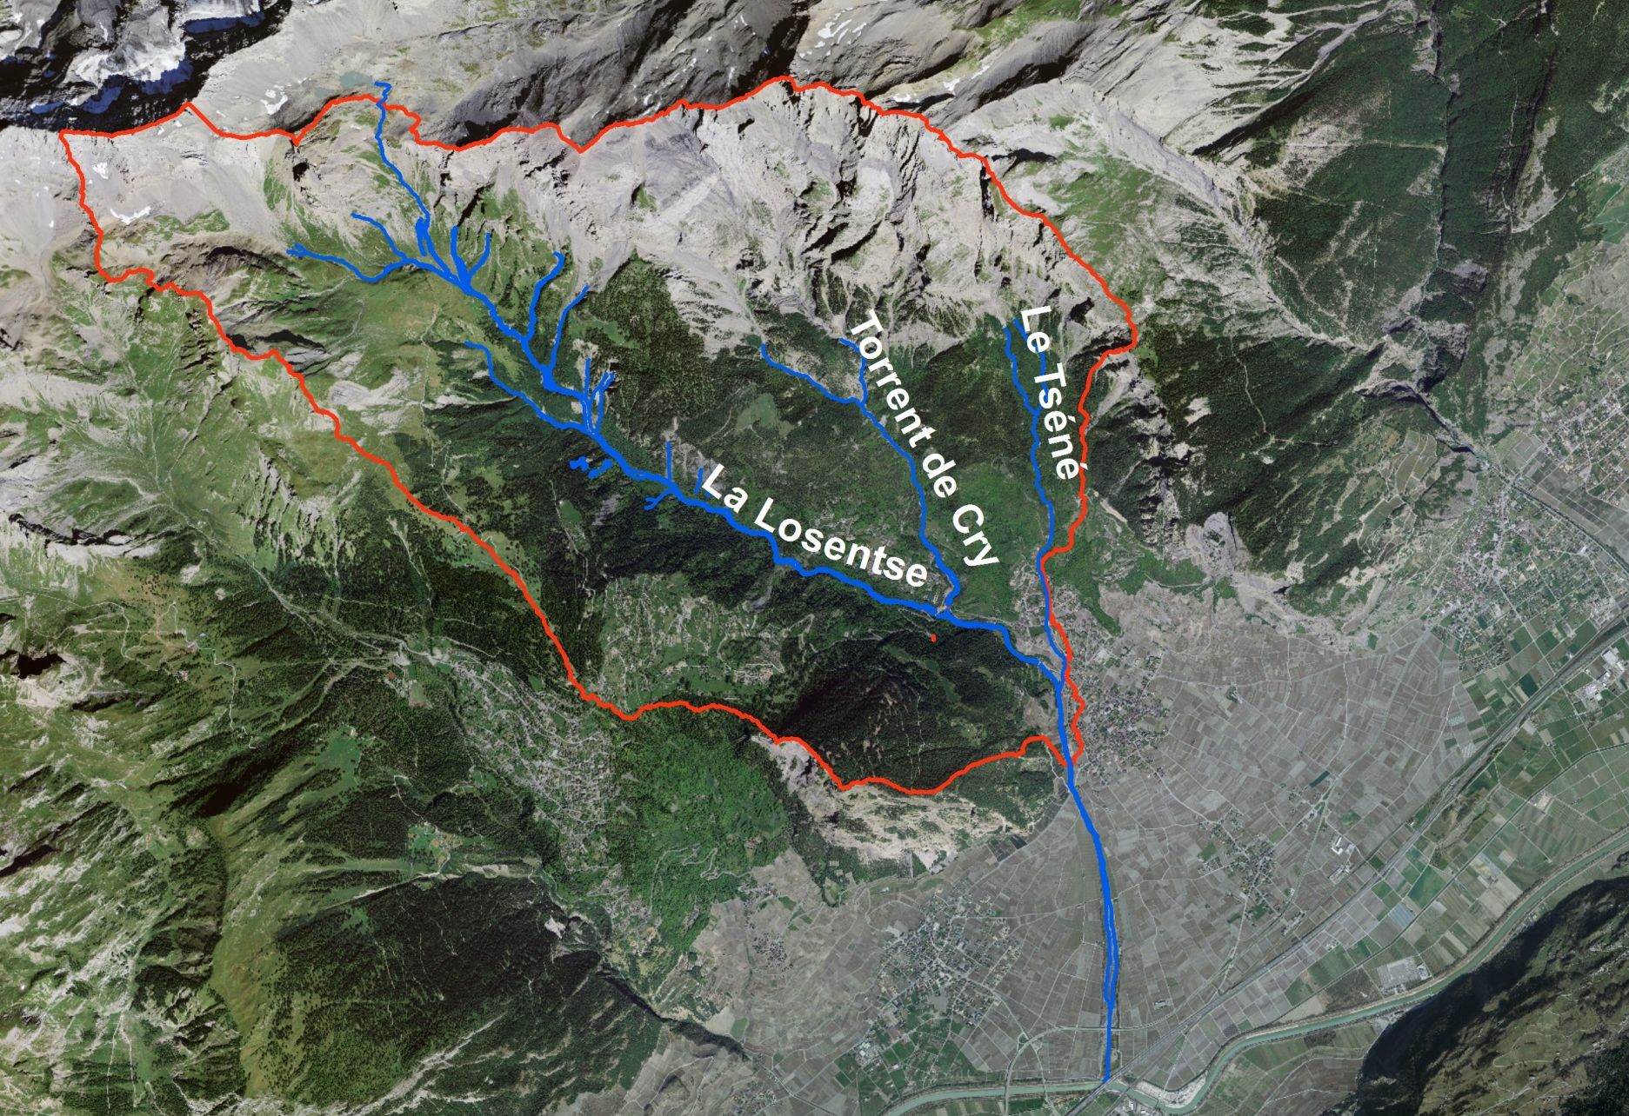
Chamoson basin
Basin area: 21km²
Max. elevation: 3000m
Elevation at fan apex: 600m
Losentsé channel lenght: 9 km

Slide 8
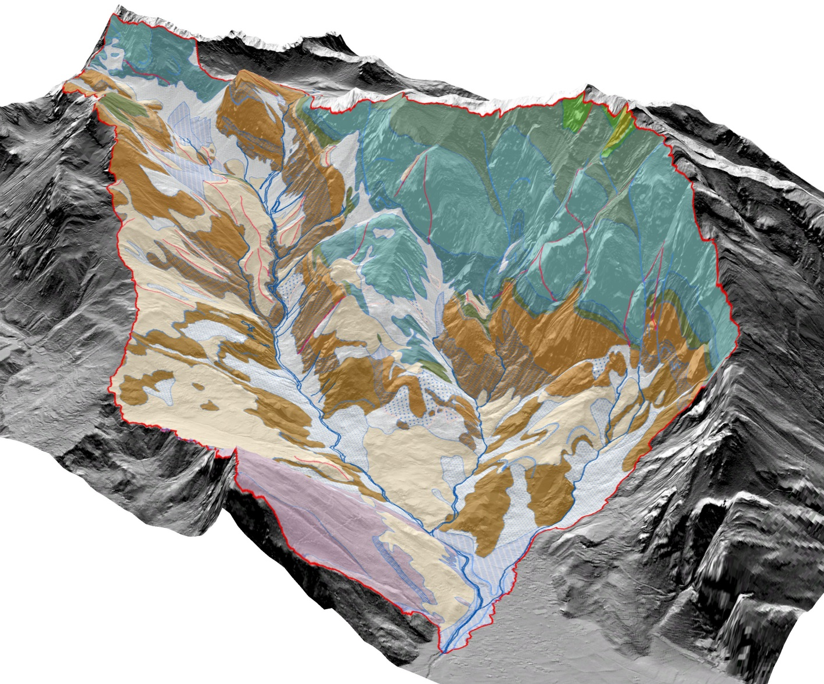
Chamoson basin geology
Alluvial deposits
Colluvial deposits
Landslides
Debris cônes
Rockfall deposits
Glacial deposits
Bedrock
Limestones
Limestones
Shales
Grey limestones
Marl
Dark shales
Limestones and shales
Limestones
Limestones
Shales and limestones
Clayely shales
Dark shales
Shales and limestones
Limestones and marl

Slide 9
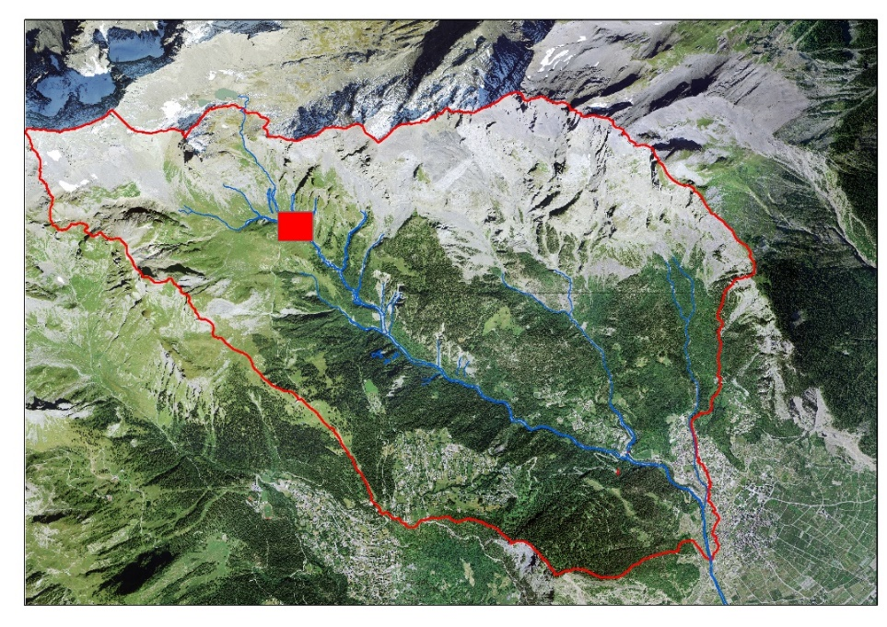
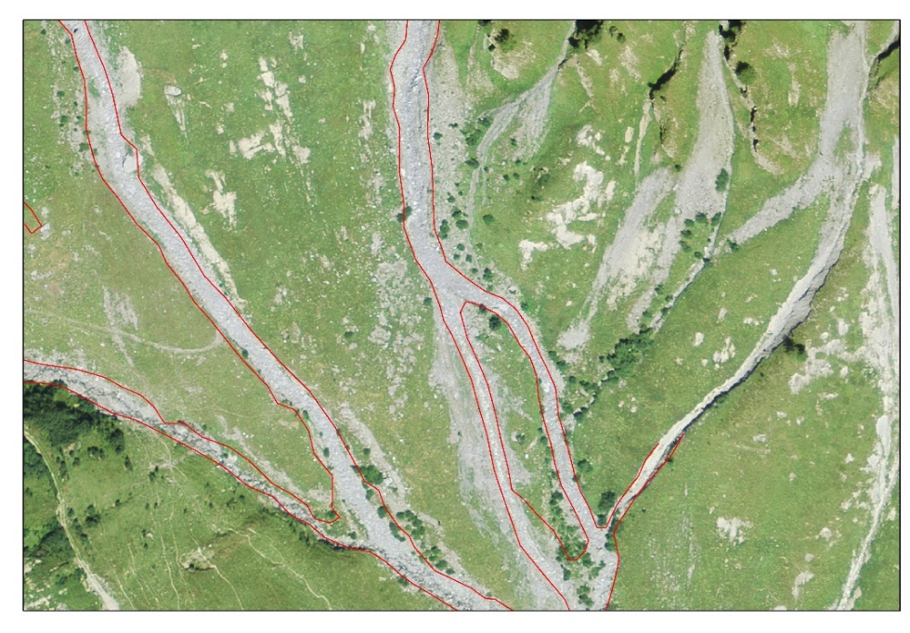
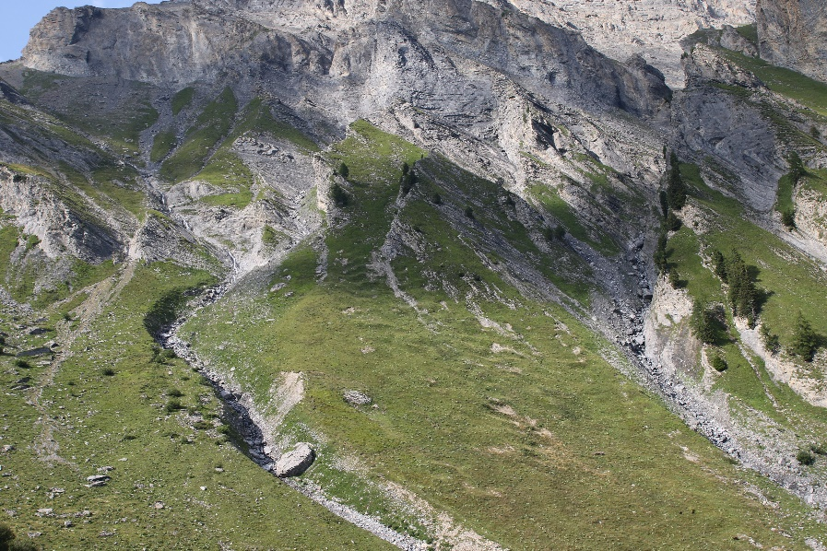
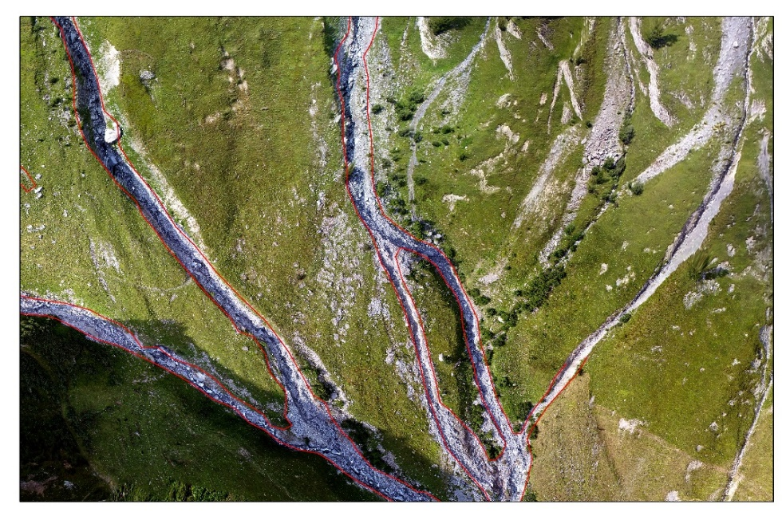
Upper catchment (post event and pre event images)
2013
2019
Steep tributary channels on debris cones

Slide 10
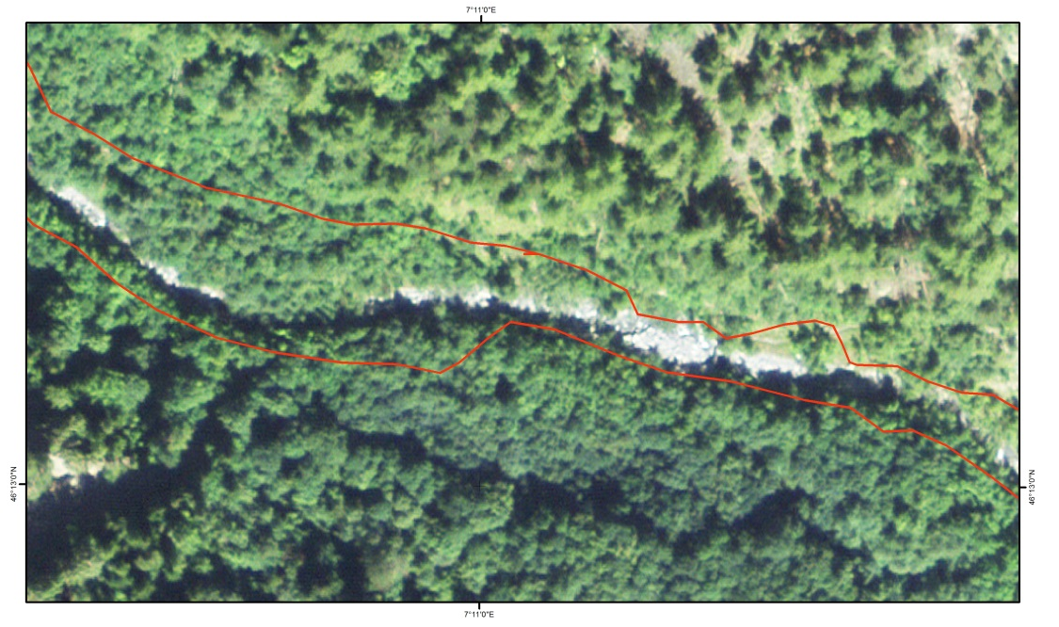
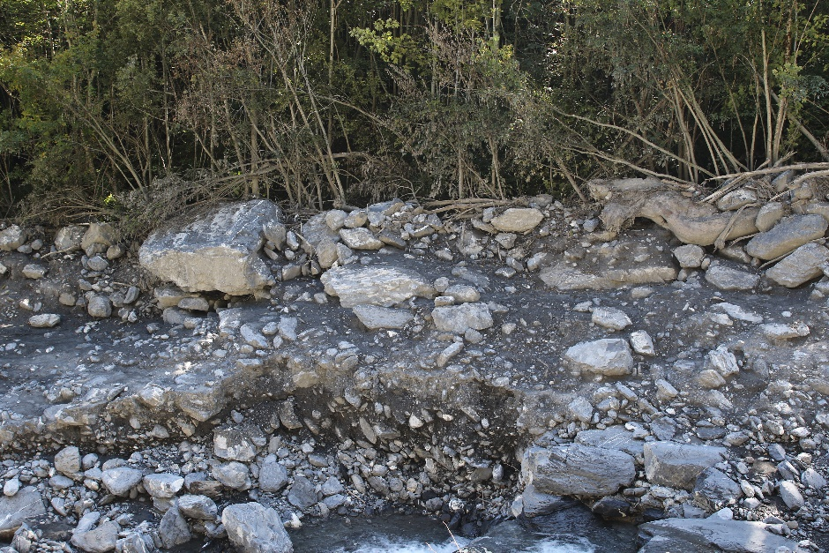
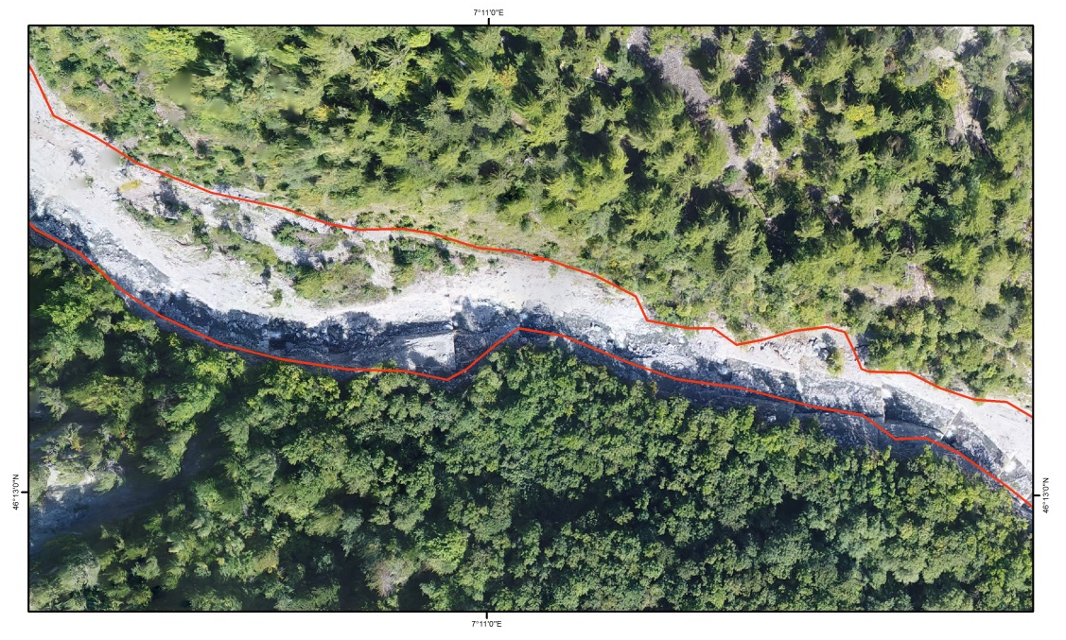
Inundated area (post event and pre event images)
2013
1
2019
Debris flow levee
1
Erosion and deposition

Slide 11
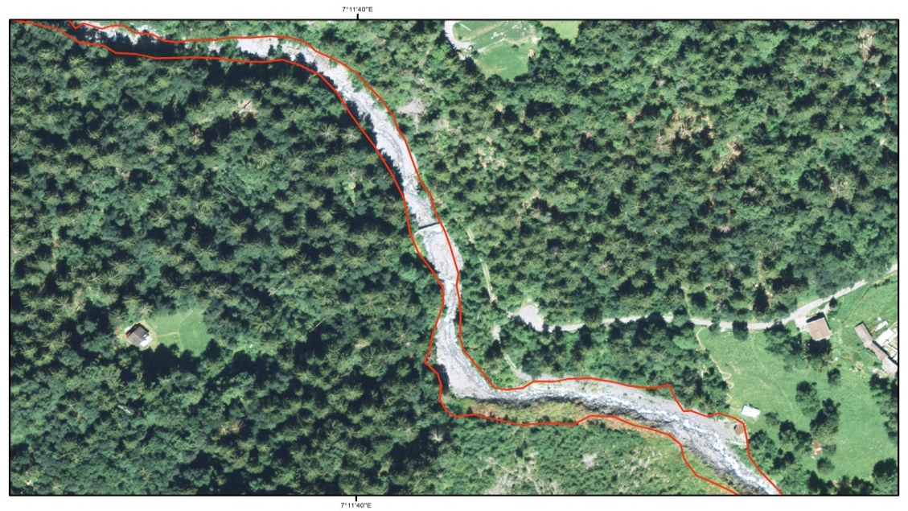
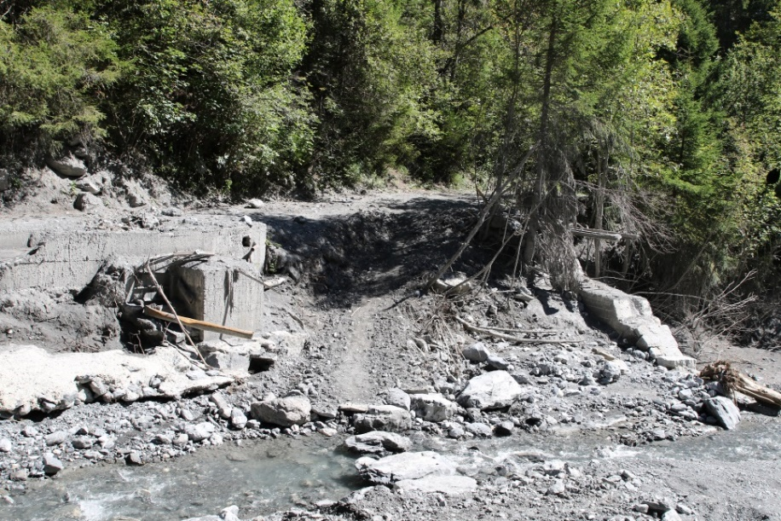
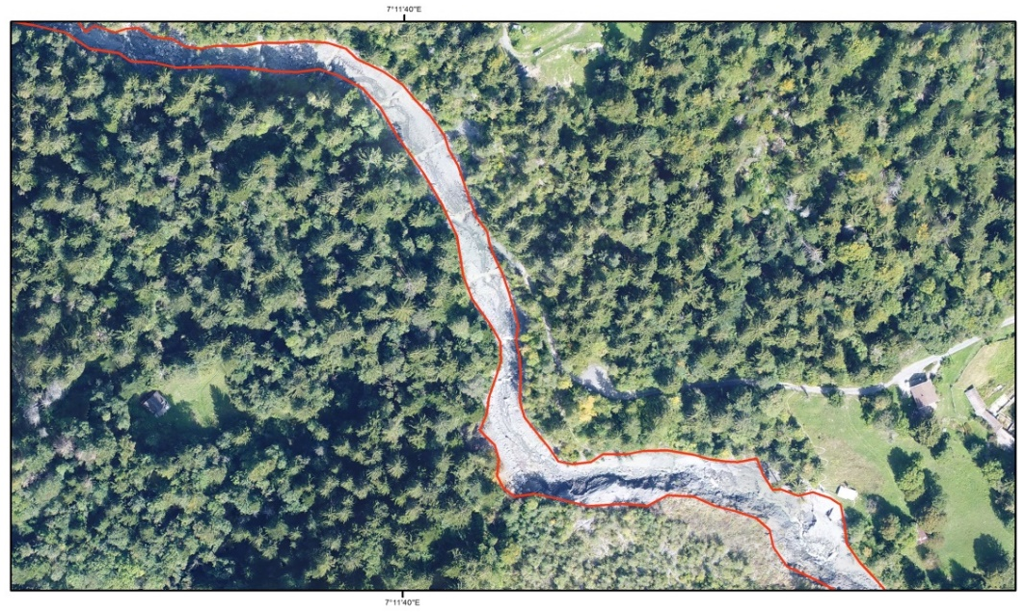
Inundated area (post event and pre event images)
2013
Vérine wood bridge
2019
Mud marks
Vérine wood
bridge missing
6m

Slide 12
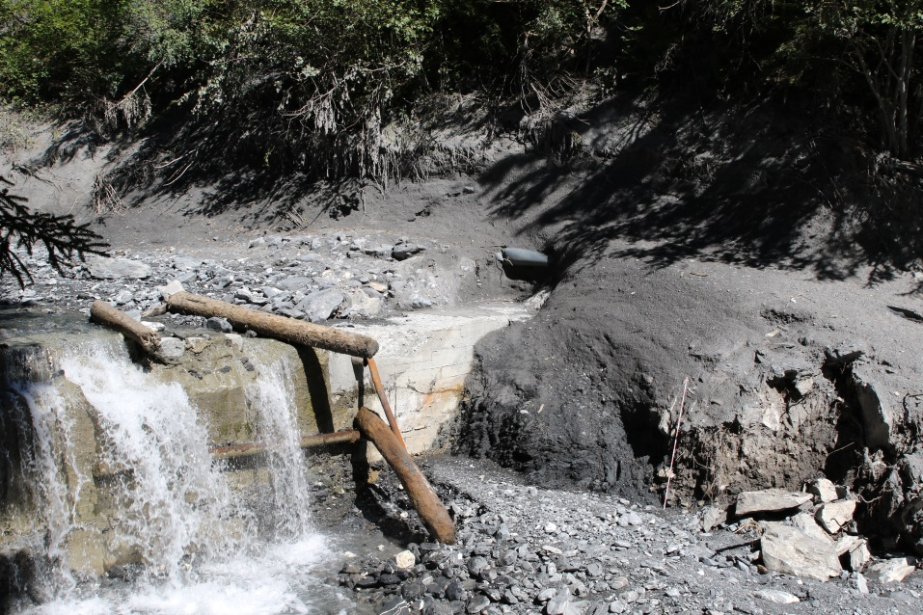
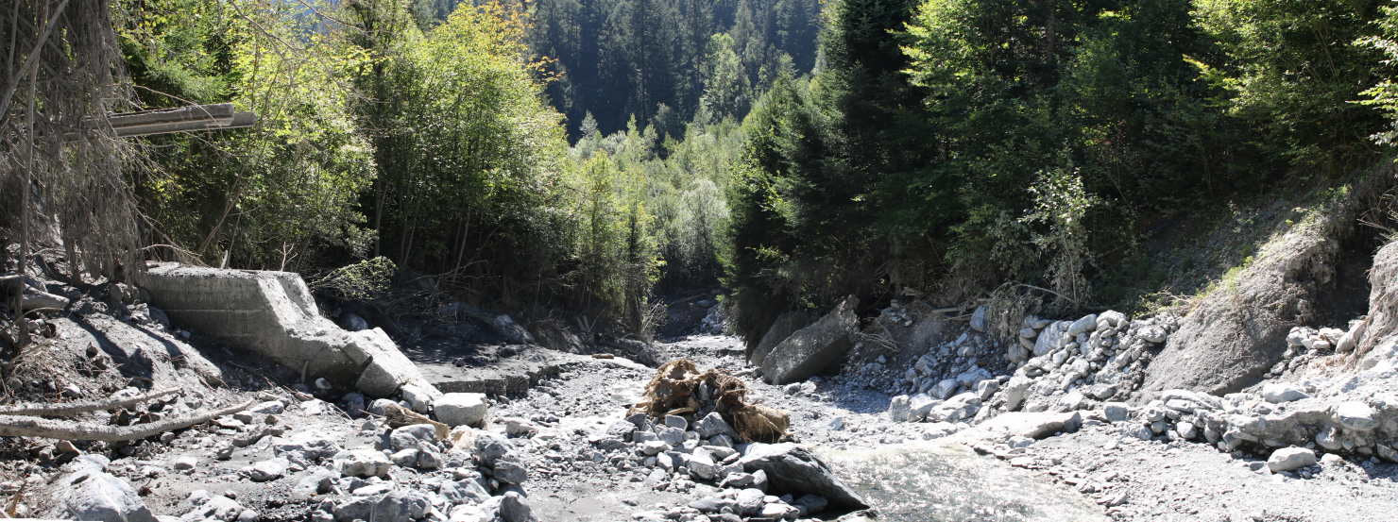
Vérines bridge destroyed along the Losentsé river
Vérine wood bridge before the 2019 event
20m
Inundated
channel cross
sectional area: 111m²
6m
17,2m

Slide 13
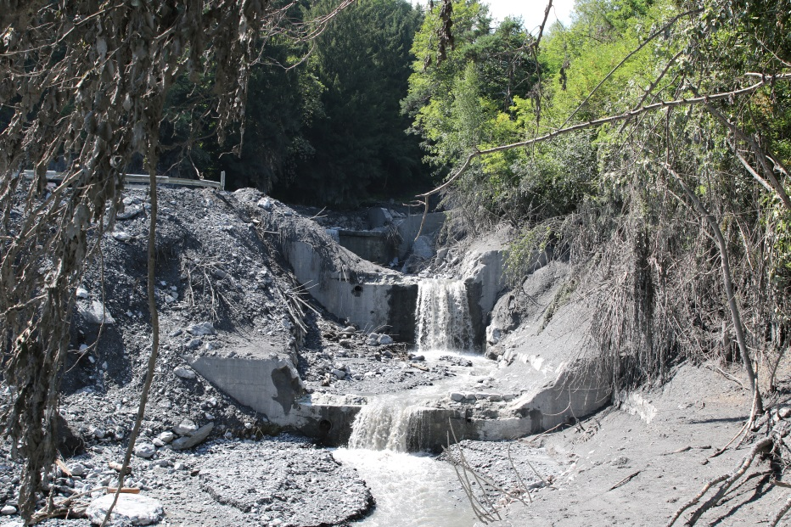
Inundated area (post-event and pre-event images)
2013
2019
The debris flow eroded part of the road
Passed on the road

Slide 14
Inundated channel cross section of the Losentsé river
2019
33m
6m
33 m
Aproximate inundated cross
sectional area = 117 m²
Flow velocity estimated using video = 10 m/s
Peak discharge = 1170 m³/s
117 m²
6m
6m

Slide 15
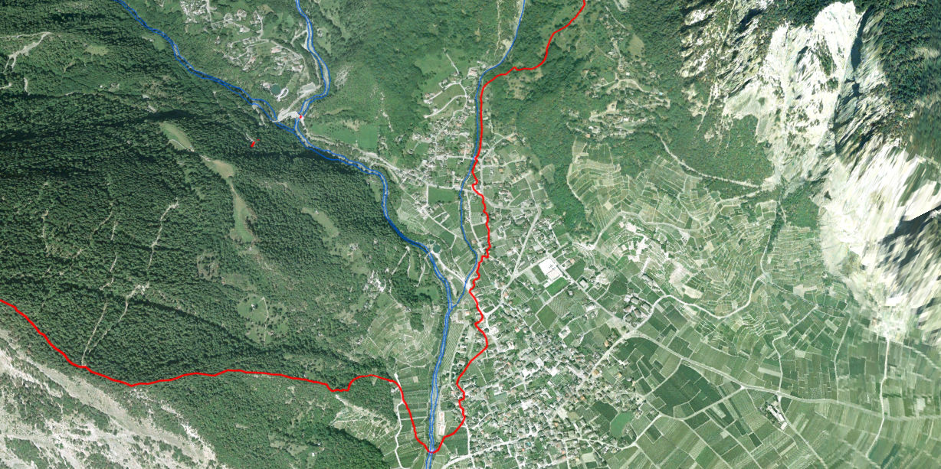
Points where the debris flow overflowed the river
Here, near the water tank,
the debris flow took out 2 cars
on his way

Slide 16
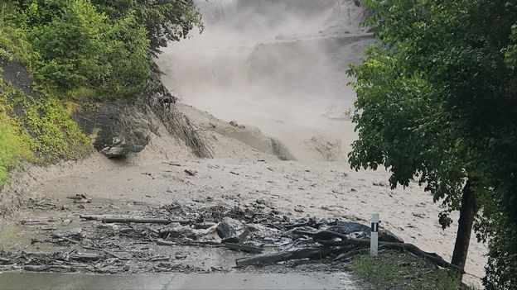
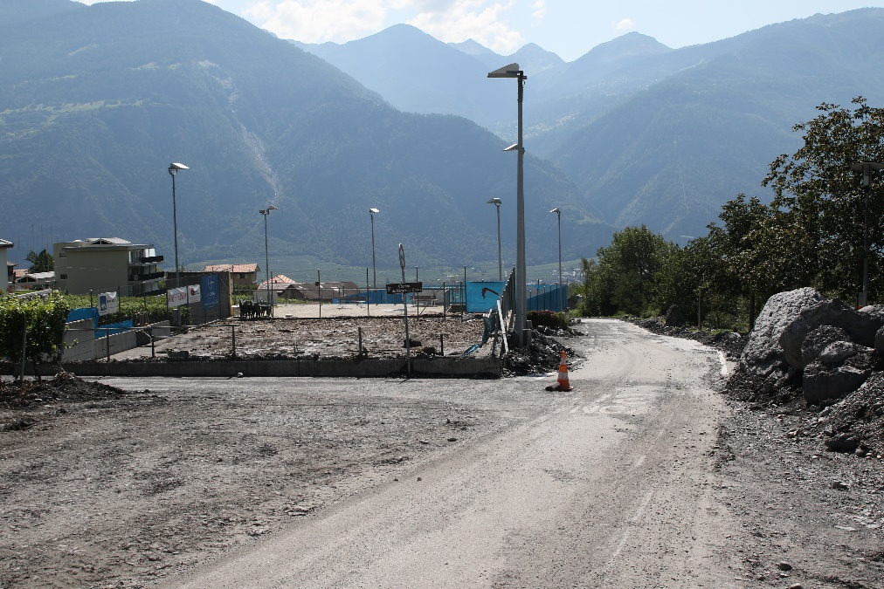
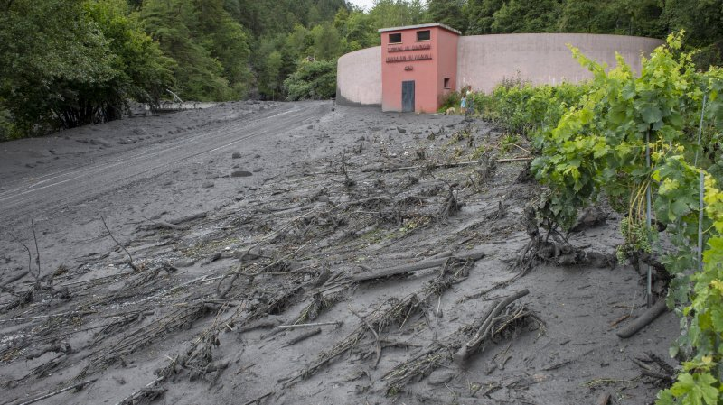
Points where the debris flow overflowed the channel
Foto: Marc Deshusses – Vosinfos RTS
Foto: LeNouvelliste.ch

Slide 17
Conclusions
The pictures acquired in the Losentsé catchment 2 weeks after the debris flow event with a drone, a
few field observations and rainfall data allow us to draw preliminary conclusions. However, detailed studies
in both catchments (the Losentsé and the Le Cry catchments) and on the Chamoson alluvial cone must be
done to complete the 2019 debris flow hazard assessment.
The debris flow event was triggered by a short and heavy rainfall between 5 and 6PM.
The debris flow initiation mechanism was an in-channel mobilization
In the upper catchment (between 2200 and 1800 m) water and debris moved along the tributary
channels to the main channel. New bouldery debris flow deposits and flattened trees has been observed
along the main channel.
Between 1150 and 900 m in the main channel (Losentsé river) the debris flow may have entrained a lot
of materiel, we observed significant lateral erosion and vertical erosion in the channel. Deposition of debris
flow levee with big boulders and debris flow deposits were also observed.
The peak discharge of 1170 m³/s calculated near the cone apex corresponds to 4 in the size classification
for debris flows (Jacob et al., 2005).
The debris flow overflowed the river banks in 3 points reaching the road.
5

