Slide 1
Based on: J. Phys.: Condens. Matter 32 145401
sudipkm1990@gmail.com

Slide 2
Motivation:
Geological:
Competent mineral phases in geonomy for housing significant amount of radionuclides
Lack of experimental or computational studies providing insight into the zircon- to reidite-type phase transition of U_{x}Th_{1-x}O₄ solid solutions
Nuclear Scientific:
Front-end application as economically viable ores of U and Th e.g. coffinite and thorite
Back-end utility as matrix material for nuclear waste immobilization
To provide a method for calculating the distortions of highly irregular
U/ThO₈ polyhedra

Slide 3
Key questions to address:
Variation of hydrostatic pressure of transition with normalized U and/or Th content
Change in mechanical properties of both phases with normalized U and/or Th content
How do the local polyhedral structures and their distortions control the phase transition
i.e. to investigate the correlation between phase transition pressure and distortions of
U/ThO₈ polyhedra.
Methodology: Ab-initio simulations in the framework of Density Functional Theory (DFT)
as implemented in Quantum ESPRESSO suite.

Slide 4
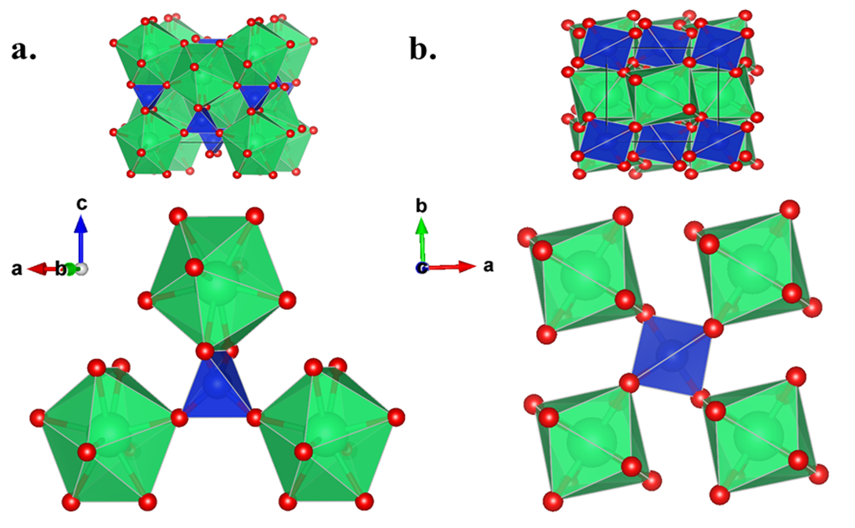
Structural dissimilarities :
Zircon-type
Reidite-type
U/ThO₈ polyhedra or
snub-disphenoids
Edge sharing and corner sharing
Only corner sharing

Slide 5
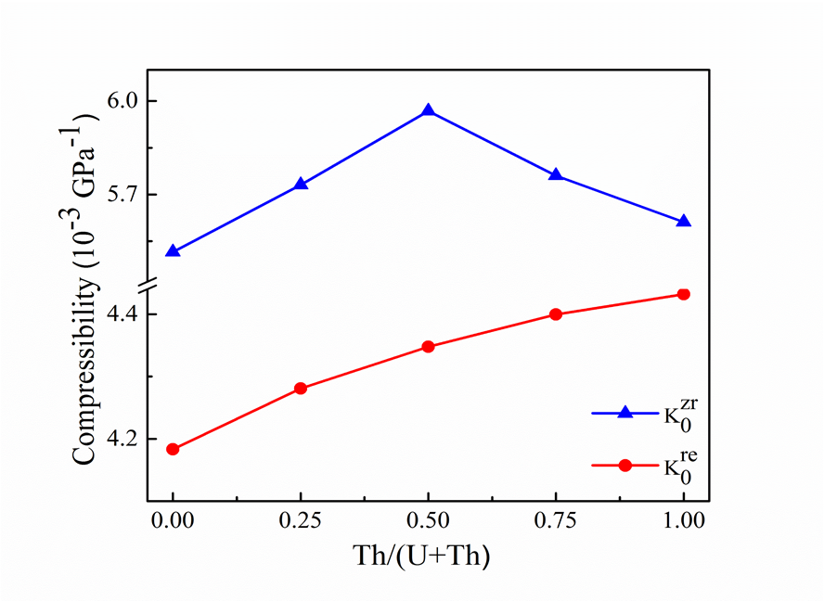
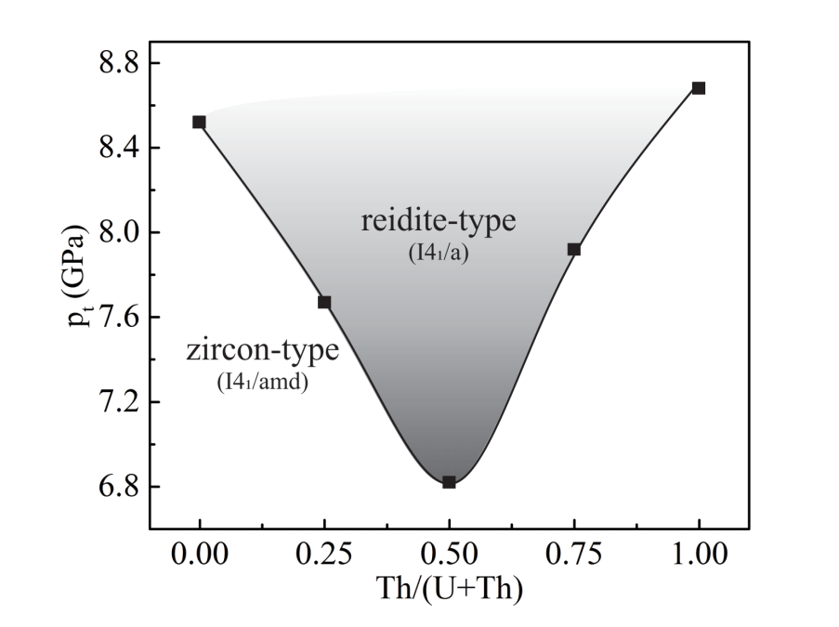
Variation of transition pressures and compressibility of both zircon- and reidite-type phases
with normalized Th content:
Note the concurrence of the minimum transition pressure and minimum compressibility in zircon-type phases at Th/(U+Th) = 0.50

Slide 6
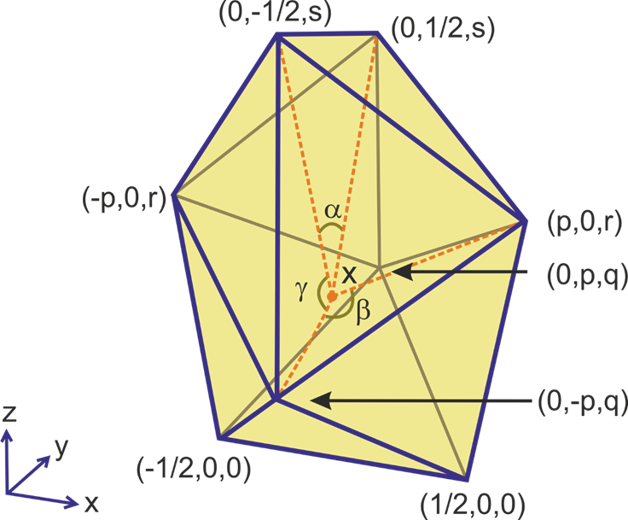
Theoretical considerations for polyhedral distortion:
A
Distortion parameters for :
Bond length
$δ_{U}= {\left(l_{U}−L\right)}^{2} \&$
$δ_{Th}= {\left(l_{Th}−L\right)}^{2}$
Bond angle
Multiplicity
B
$$σ_{α}^{2}= \sum_{i=1}^{2}{ }{\left(α_{i}−65.061\right)}^{2}$$
2
$$σ_{β}^{2}= \frac{1}{3}\sum_{j=1}^{4}{ }{\left(β_{j}−95.297\right)}^{2}$$
4
p ≈ 0.64458, q ≈ 0.57837,
r ≈ 0.98949 & s ≈ 1.56786.
$$σ_{γ}^{2}= \frac{1}{11}\sum_{k=1}^{12}{ }{\left(γ_{k}−75.158\right)}^{2}$$
12
L = XA / XB ≈ 1.374302
$α=65.061°$ $, β=95.297°$ & $γ$ = $75.158°$
$$σ^{2}= σ_{α}^{2}+ σ_{β}^{ 2}+ σ_{γ}^{2}$$

Slide 7
Bond angle and bond length distortions in a. UO₈ and b. ThO₈ polyhedra
Minimum difference in angular distortions between zircon- and reidite- type phases simultaneously in UO₈ and ThO₈ polyhedra at Th/(U+Th) = 0.50

Slide 8
Pressure dependent variation of δ for both UO₈ and ThO₈ in zircon-type phases. x= Th/(U+Th).
Coffinite; x = 0
Thorite; x = 1

Slide 9
Take-home messages:
The distortion analysis identifies two kinds of geometrically distinct vertices of the triangular dodecahedra, occupied by O-atoms, which explains the occurrence of two types of U/Th-O bonds (U/Th-O₄ and U/Th-O₅) with contrasting lengths.
In ideal triangular dodecahedra the bond length ratio (e.g. U-O₄/U-O₅ and Th-O₄/Th-O₅) is observed to demonstrate a unique value (~1.374302), irrespective of the triangular dodecahedral volume.
The concurrence of minima of transition pressure and the difference in σ² indicates that the polyhedral distortion plays a critical role in dictating the zircon- to reidite-type transition.
Since our approach to quantify the polyhedral distortion is theorized without any reference to any external parameter, it can be extended to investigate the distortions of any AO₈ type cationic triangular dodecahedra in other mineral phases.

Slide 10
THANK YOU !
STAY HOME ! STAY SAFE!
If you have any further queries feel free to reach me @:
sudipkm1990@gmail.com
Please visit our lab page @: http://jugeodynamics.org/

