Slide 1
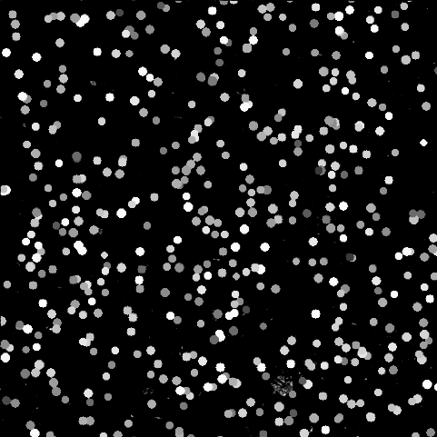
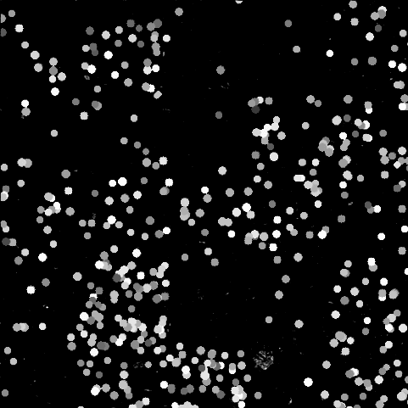
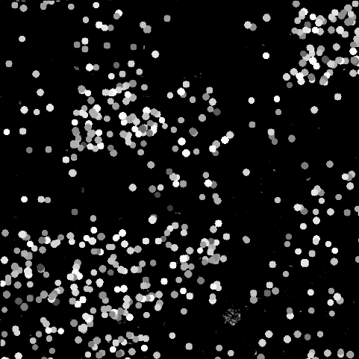
Image-velocimetry techniques under particle aggregation for streamflow monitoring: a numerical approach
Alonso Pizarro ª, Silvano Fortunato Dal Sasso ª, and Salvatore Manfreda ^{b}
ª Department of European and Mediterranean Cultures (DICEM), University of Basilicata, Matera, Italy.
E-mail: alonso.pizarro@unibas.it; silvano.dalsasso@unibas.it
^{b} Department of Civil, Architectural and Environmental Engineering, University of Naples Federico II, Napoli, Italy.
Email: salvatore.manfreda@unina.it
Notes:
To play the animation of moving tracers, select the Slide Show tab on the ribbon

Slide 2
Motivation
Monitoring extreme flood events is still a challenge!
Field campaigns are in general expensive and time-consuming.
Non-contact approaches are a valuable and timing alternative.
Image-velocimetry techniques can be used to this goal.
Figure. 1. Examples of moving and aggregated structures on the water surface: A) Natural seeding during a flood event at the Tiber river, Italy (Tauro et al., 2017); B) and C) Artificial seeding at low/intermediate flow conditions at Brenta river in Italy (Tauro et al., 2017) and Murg river in Switzerland (Detert et al., 2017), respectively.
Even though image-velocimetry techniques are widely used, their accuracy under field conditions is still an issue of research.
So, how to proceed to optimise results?
Numerical approach

Slide 3
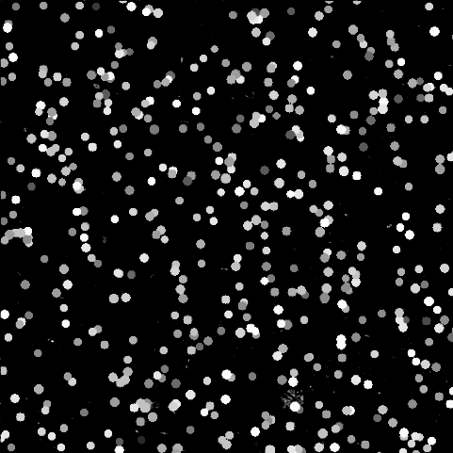
Research Goal
This work aims to quantify the accuracy of surface flow velocity estimates under different seeding densities and aggregation levels.
To achieve this, the following objectives were proposed:
Generation of numerical simulations of synthetically aggregated tracers to produce 33,600 synthetic images of known seeding characteristics;
Using these synthetic images, a functional relationship between seeding densities, aggregations levels, and image velocimetry errors was derived under controlled conditions.
Figure. 2. Numerical simulations of synthetically generated particles that present different aggregation levels
Notes:
To play the animation of moving tracers, select the Slide Show tab on the ribbon

Slide 4

Methodology
Synthetic tracers were randomly distributed in space with a unidirectional and constant velocity (15 px/frame).
They consist of uniform circular shapes with diameter Dxp ≈ 10 px and uniform white colour.
Both diameters and colours were altered with white noise in order to consider more realistic configurations.
Their spatial distribution was controlled by a Generalised Poisson Distribution (GPD) with a theoretical seeding density $λ$ and level of aggregation $υ$.
The quality of the results was determined by the magnitude of the errors that were computed as
$$ε=100×\frac{\left(u_{c}−u_{R} \right)}{u_{R}},$$
where $u_{C}$ is the computed velocity and $u_{R}$ is the theoretical imposed velocity.

Slide 5
Results
The processing times, considering the 33,600 synthetic generated images, for PTV was almost four times higher than PIV under the circumstances considered in this study. The same hardware was used for both image-velocimetry analyses, leading to a fair comparison between them.
For all the cases, PTV and PIV techniques systematically underestimated the theoretical velocity independently of the seeding density and aggregation level under consideration.
A general trend was observed by increasing the seeding density and decreasing the level of aggregation, in which results were improved.
Based on numerical findings, seeding densities lower than 1.0E-03 produced larger errors and in consequence, flows should be extra-seeded in field campaigns for optimal implementation of image velocimetry methods.

Slide 6
Results
Based on numerical results:
Figure 3 shows the envelope error curves for a range of seeding densities and level of aggregation ν.
The yellow and green colours are associated with PTV and PIV error results. Dashed and solid lines are associated with ν = 0.5 and ν = 200, respectively.
Error results of both techniques were influenced by ν, with a higher aggregation level tending to deteriorate the accuracy of image-velocimetry results, producing higher errors and associated variability across the range of seeding densities.
In most of the cases, PTV outperformed PIV under the synthetic conditions analysed in this study. It is noteworthy that the obtained results refer to a single synthetic experiment that, although realistic, is not representative of any field condition. Therefore, further investigations with a larger set of idealised and field circumstances should be carried out to generalise the obtained results.
Figure. 3. Errors as a function of seeding density and aggregation levels.

Slide 7
Thank you for your interest in our research!
Contact the authors for more information.
A manuscript was recently submitted to HESS, applying numerical and field considerations. Soon will be available in HESSD.
The numerical dataset can be downloaded from: https://doi.org/10.5281/zenodo.3761859

Slide 8
Related Literature
Dal Sasso S. F., Pizarro A., Manfreda S. Metrics for the quantification of seeding characteristics to enhance image-velocimetry performances in rivers. Submitted to Remote Sensing (MDPI), 2020.
Pizarro A., Dal Sasso S. F., Perks M., Manfreda S. Spatial distribution of tracers for optical-sensing stream surface flow monitoring. Submitted to Hydrology and Earth System Sciences (HESS), 2020.
Manfreda S., Dal Sasso S. F., Pizarro A., Tauro F. Chapter 10: New Insights Offered by UAS for River Monitoring. In Applications of Small Unmanned Aircraft Systems. Applications of Small Unmanned Aircraft Systems: Best Practices and Case Studies, 2019.
Dal Sasso, S. F., Pizarro, A., Samela, C., Mita, L. and Manfreda, S. Exploring the optimal experimental setup for surface flow velocity measurements using PTV. Environ. Monit. Assess., 190(8), 2018.

Slide 9
Image-velocimetry techniques under particle aggregation for streamflow monitoring: a numerical approach
Alonso Pizarro ª, Silvano Fortunato Dal Sasso ª, and Salvatore Manfreda ^{b}
ª Department of European and Mediterranean Cultures (DICEM), University of Basilicata, Matera, Italy.
E-mail: alonso.pizarro@unibas.it; silvano.dalsasso@unibas.it
^{b} Department of Civil, Architectural and Environmental Engineering, University of Naples Federico II, Napoli, Italy.
Email: salvatore.manfreda@unina.it
Notes:
To play the animation of moving tracers, select the Slide Show tab on the ribbon

