Slide 1
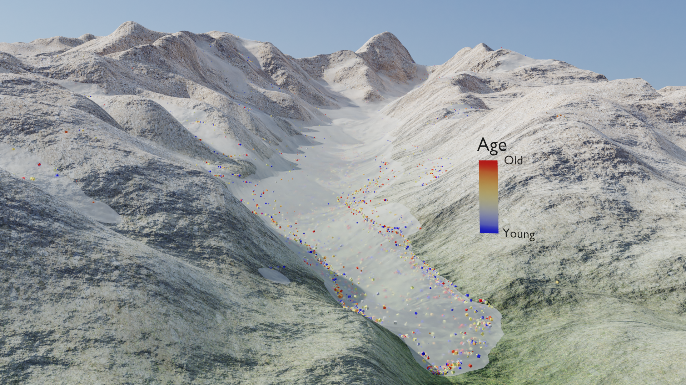
Modelling the effects of the ice sediment transport and sediments sources on the detrital thermochronological age distributions from glacial settings
Maxime bernard¹, Philippe Steer¹, Kerry Gallagher¹, David L. Egholm²
Motivation:
The impact of glaciers on the relief dynamics remains debated. Worldwide glacial erosion rates span four orders of magnitude from 10⁻¹ to 10⁻³ mm.yr⁻¹, depending on the climatic and tectonic setting but also on the method used to infer rates of erosion (Koppes and Montgomery, 2009).
Low-temperature thermochronology is a common tool to investigate exhumation rates over millions of years. While it is classically used to date bedrock exhumation, applying this method to detrital sediments enables to infer the pattern of modern erosion and gives an integrative estimate of past glacier erosion.
Detrital thermochronological data are generally interpreted in terms of probability age distributions. However the shape of these distributions is impacted by numerous processes such as erosion and sediments transport (A1).
Here, we use a numerical model of ice erosion and sediment transport to investigate how these surface processes impact detrital age probability distributions.
¹Univ Rennes, CNRS, Géosciences Rennes, UMR 6118, 35000 Rennes, France.
²Department of Geoscience, Aarhus University, Aarhus, Denmark.

Slide 2
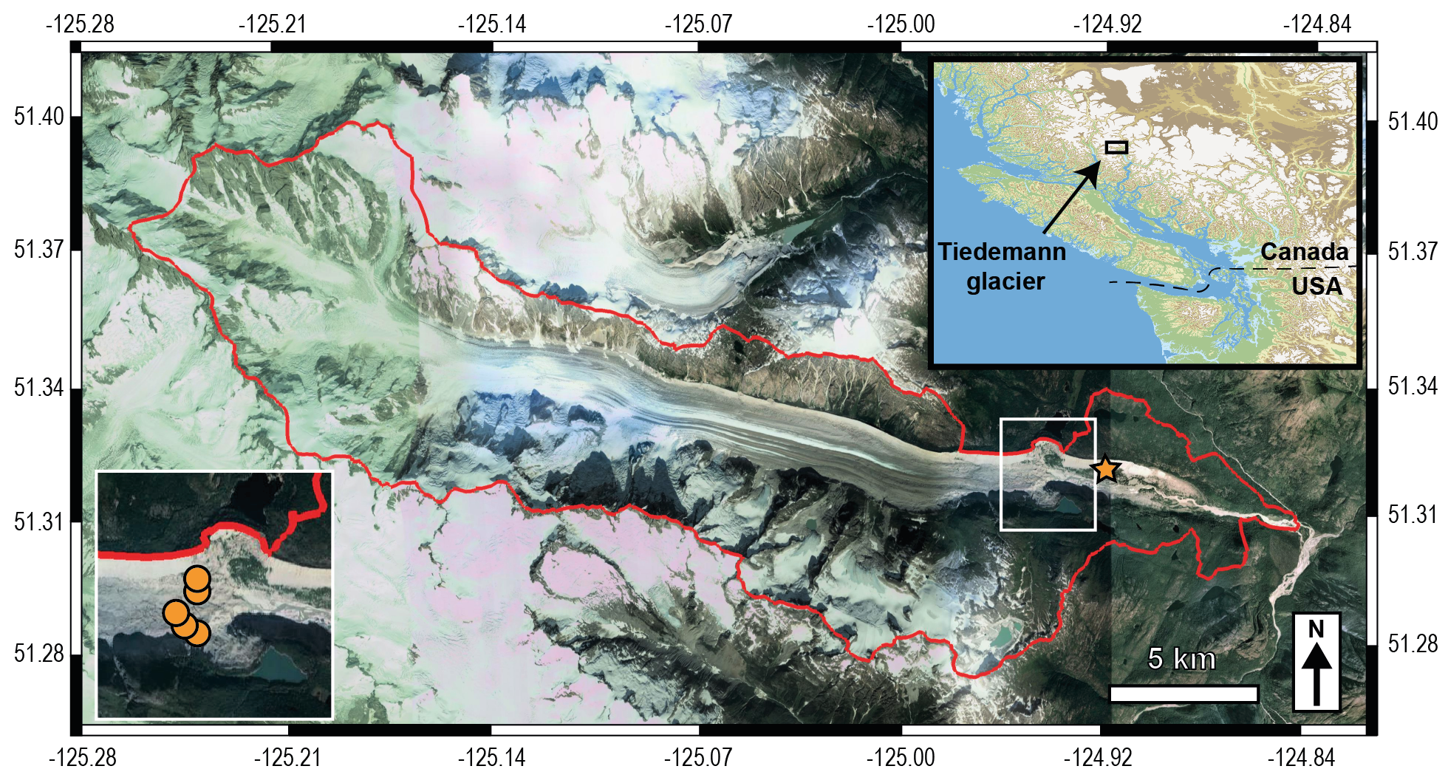
Introduction
Model kinematic
We model the Tiedeman glacier to explore the effect of erosion and sediment transport. It has simple morphological characteristics (straight form, low glacial valley connectivity), and thermochronological data are available (cf. left side).
We use a new version of iSOSIA (Egholm et al., 2011) that enables sediment tracking.
This presentation refers to a study submitted in esurf journal, and currently in review.
For example, Ehlers et al. (2015) and Enkelmann and Ehlers (2015) investigated detrital probability age distributions from the Fission track AFT) and (U-Th)/He on apatite (AHe) systems, through the Tiedemann glacier catchment. They sampled the ice-cored terminal moraine and the pro-glacial river.
From the model, less than half of the initial sediment particles produced reach the frontal moraine, after 8.5 kyrs of sediment transport. A large part is stored upstream in a lateral moraine, and at mid-elevation due to small tributary glaciers that show small sliding velocities (A2).
Figure 1. The Tiedemann glacier location, with the location of detrital ice-cored sample from Enkelmann and Ehlers (2015) and Ehlers et al. (2015).

Slide 3
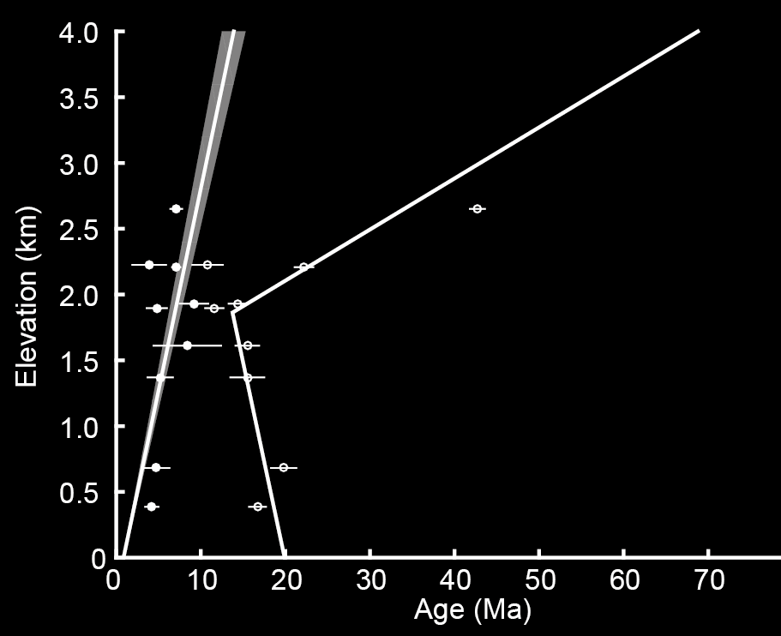
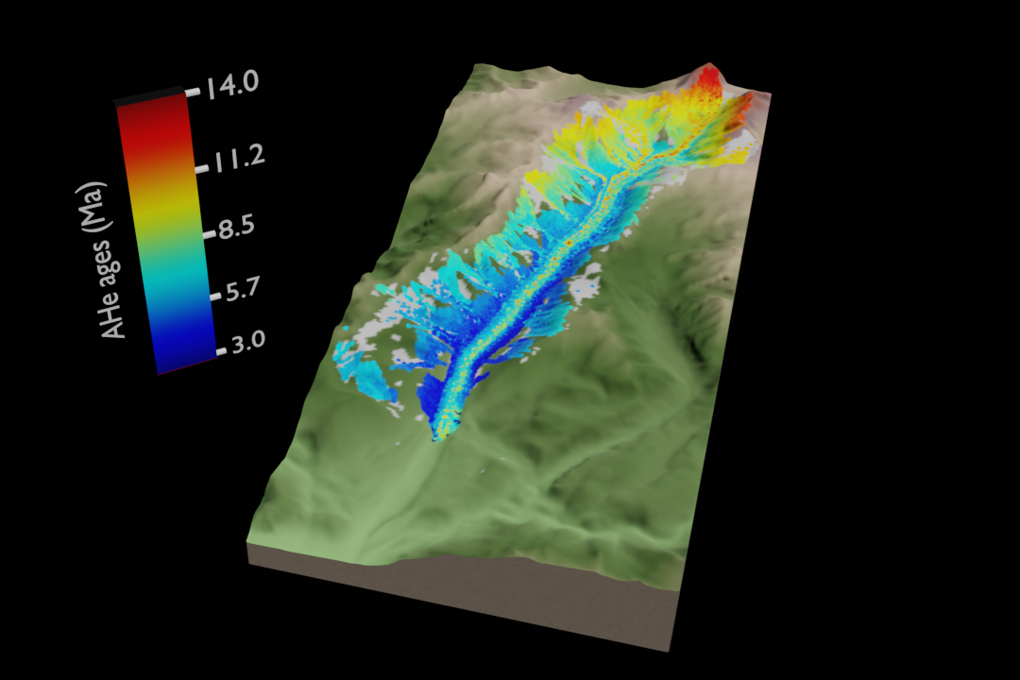
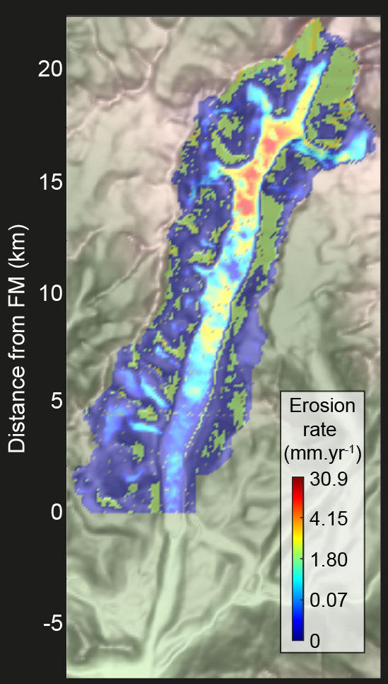
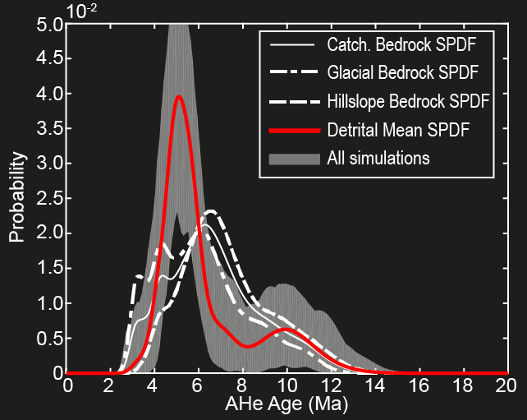
Method
iSOSIA
External routine
FD: further details
4. Set thermochronological scenario (FD)
3. Create sediment trackers
(particles, FD)
AHe
AFT
2. Set erosion and sediment
transport scenario (FD)
From Enkelmann and Ehlers (2015)
Random sampling
5. Sample sediment particles (FD)
Frontal moraine
Non-uniform erosion
x105 particles
The Tiedemann glacier (British Columbia)
1. Set glacial scenario
Results: Role of the ice transport
Results: Role of sediments sources
Results: Role of sampling strategy

Slide 4
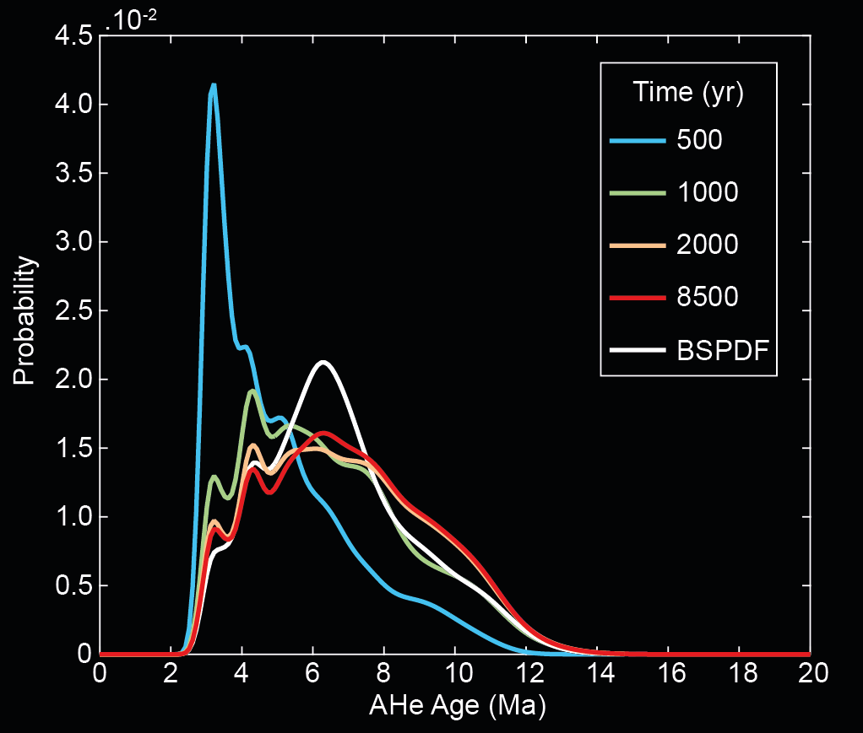
Results: Role of the ice transport
Model setting:
Spatially uniform pulse production of particles (see animation)
AHe ages (Method)
Sampling across the frontal moraine
Model results:
Because of the variable distances from sediment sources to the glacier front, we observe a transient evolution of the detrital SPDF
The steady-state detrital SPDF (red curve) shows lower magnitude of the age peak $\sim$7 Ma compared to the bedrock SPDF (white curve)
Figure 2. Transient evolution of the mean detrital SPDF sampled across the frontal moraine (see animation). BSPDF: Bedrock SPDF.
The storage of a large amount of sediments in a lateral moraine and within small tributary glaciers, due to the pattern of the ice flow (A2), leads to discrepancies between the detrital and bedrock SPDFs.

Slide 5
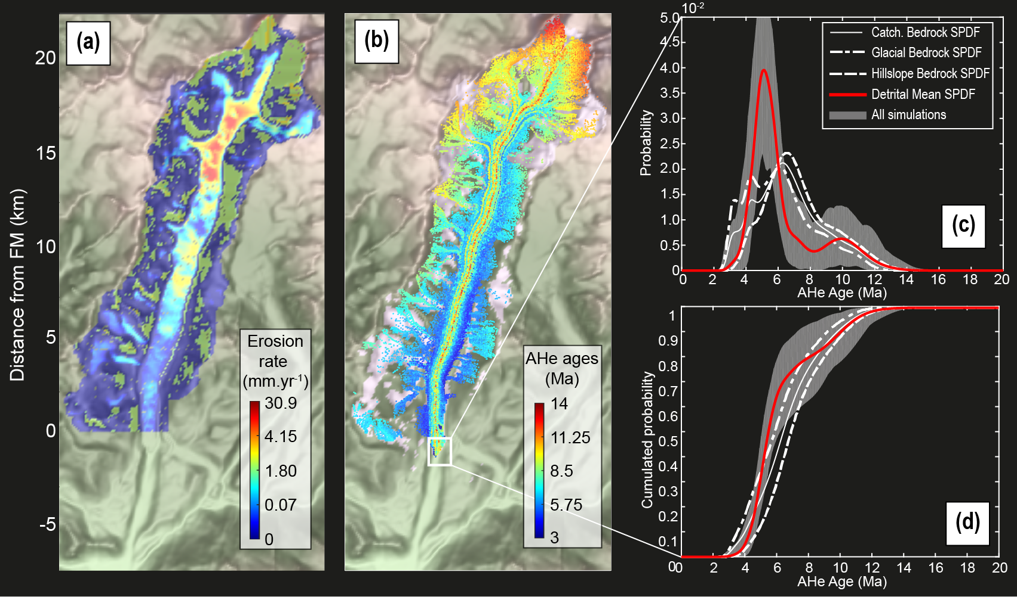
Results: Role of sediments sources
Figure 3. Non-uniform erosion model experiment, with the (a) erosion rate, (b) the spatial detrital AHe age distribution, (c) the AHe age probability distributions and (d) their cumulative for the frontal moraine. The grey shaded area represents the range of the inferred detrital SPDFs from the sampling process. The black square in (b) shows the frontal moraine (FM) location.
Model setting:
Non-uniform erosion (A4)
AHe ages (Method)
Sampling across the frontal moraine
Estimation of sediment sources bedrock age distribution (hillslopes vs glaciers)
Model results:
$\sim$5 Ma age peaks = glacial source (Fig 2c)
$\sim$10 Ma age peak = hillslopes source (Fig 2c)
Estimating the spatial distribution of the sediment sources can help in discriminating between both in the detrital SPDF.
Further details

Slide 6
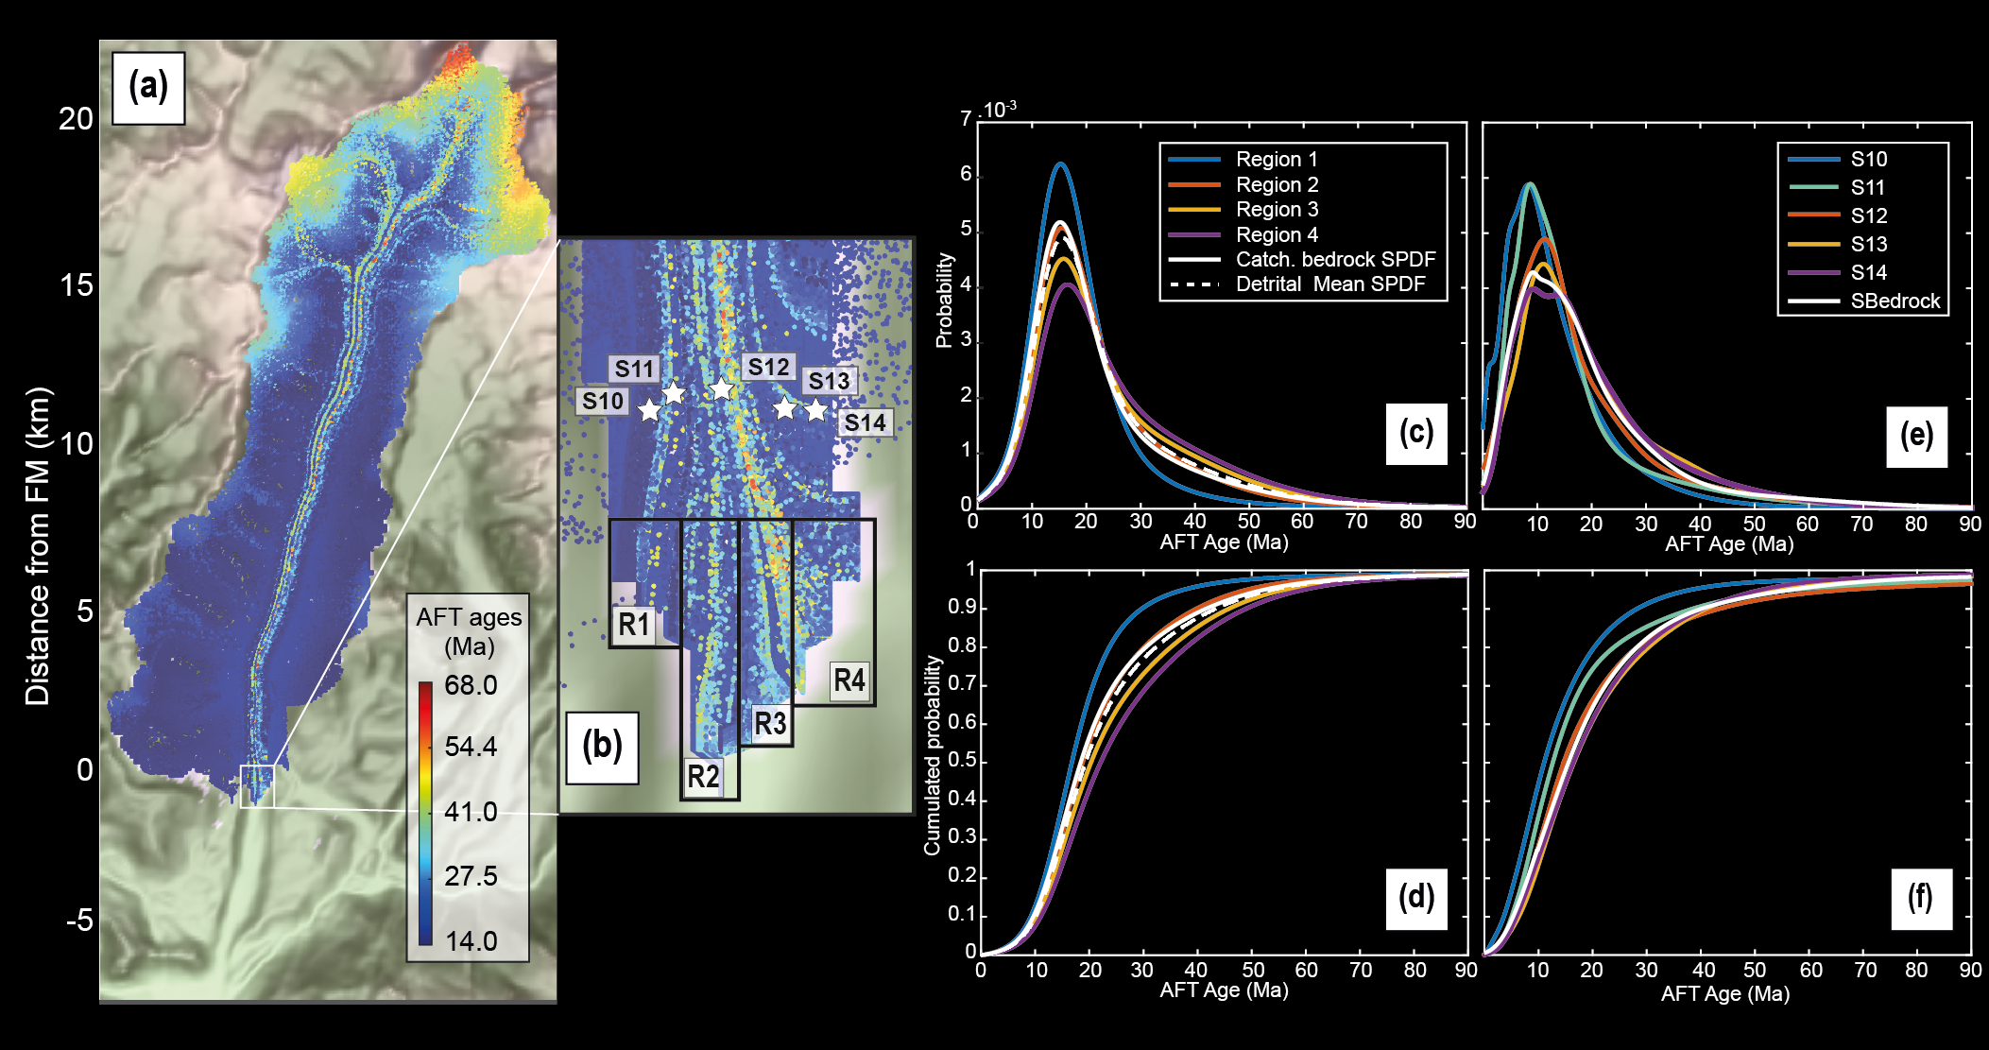
Results: Role of sampling strategy
Model setting:
Uniform erosion
AFT ages (Method)
Local sampling across the frontal moraine (four regions)
Comparison with real data from Enkelmann and Ehlers (2015) (Fig. 3b)
Model results:
Detrital age distributions (SPDF and CSPDF) show older ages from left to right of the frontal moraine (Fig 3. c-d)
Comparison with real data (Fig 3. e-f) show the same tendency
Detrital SPDFs from local sampling are different from the bedrock SPDF (A10)
This study
Enkelmann and Ehlers (2015)
Figure 4. (a) Detrital AFT age distribution of the four regions seen in (b, black rectangles). The density plots and their cumulative distributions are shown in (c) and (d). The dashed white line is the mean detrital SPDF for the frontal moraine (FM). In (e) and (f) are the ice-cored detrital SPDF built with data from Enkelmann et al. (2015).
Further details

Slide 7
Discussions and conclusion
Our numerical approach has the potential to give insights on the effect of sediments transport on the shape of detrital SPDFs.
Results show that:
The ice has the potential to store sediments in small tributary glaciers, and to heterogeneously distribute sediments across the catchment (animation). This leads to discrepancies between detrital and bedrock SPDFs at the glacier front which can lack age components from relevant elevations.
Estimated the distributions of sediments sources with elevation may help to evaluate their contribution to the age peaks components in a detrital SPDF (cf. Role of sediments sources).
Sampling local sites within a frontal moraine may reflect local source upstream. In contrast, sampling through the frontal moraine integrates more age components and thus likely reflect the distribution of erosion upstream (cf. Role of sampling strategy).
Our model has simple assumptions (A11). Future studies should integrate more transport processes, and/or consider particles as active trackers. As such, the modelling approach may be complexified according to the question asked.
This modelling approach has been published for reviewing, and is accessible online:
https://www.earth-surf-dynam-discuss.net/esurf-2020-7/, for further results and details.

Slide 8
References
Brandon, M. T.: Probability density plot for fission-track grain-age samples. Radiation Measurements, 26(5), 663-676, 1996.
Egholm, D. L., Knudsen, M. F., Clark, C. D., and Lesemann, J. E.: Modeling the flow of glaciers in steep terrains: The integrated second‐order shallow ice approximation (iSOSIA). Journal of Geophysical Research: Earth Surface, 116(F2), 2011.
Ehlers, T. A., Szameitat, A., Enkelmann, E., Yanites, B. J., and Woodsworth, G. J.: Identifying spatial variations in glacial catchment erosion with detrital thermochronology. Journal of Geophysical Research: Earth Surface, 120(6), 1023-1039, 2015.
Enkelmann, E., and Ehlers, T. A.: Evaluation of detrital thermochronology for quantification of glacial catchment denudation and sediment mixing. Chemical Geology, 411, 299-309, 2015.
Farley, K. A., and Stockli, D. F: (U-Th)/He dating of phosphates: Apatite, monazite, and xenotime. Reviews in mineralogy and geochemistry, 48(1), 559-577, 2002.
Koppes, M. N., and Montgomery, D. R.: The relative efficacy of fluvial and glacial erosion over modern to orogenic timescales. Nature Geoscience, 2(9), 644, 2009.

Slide 9
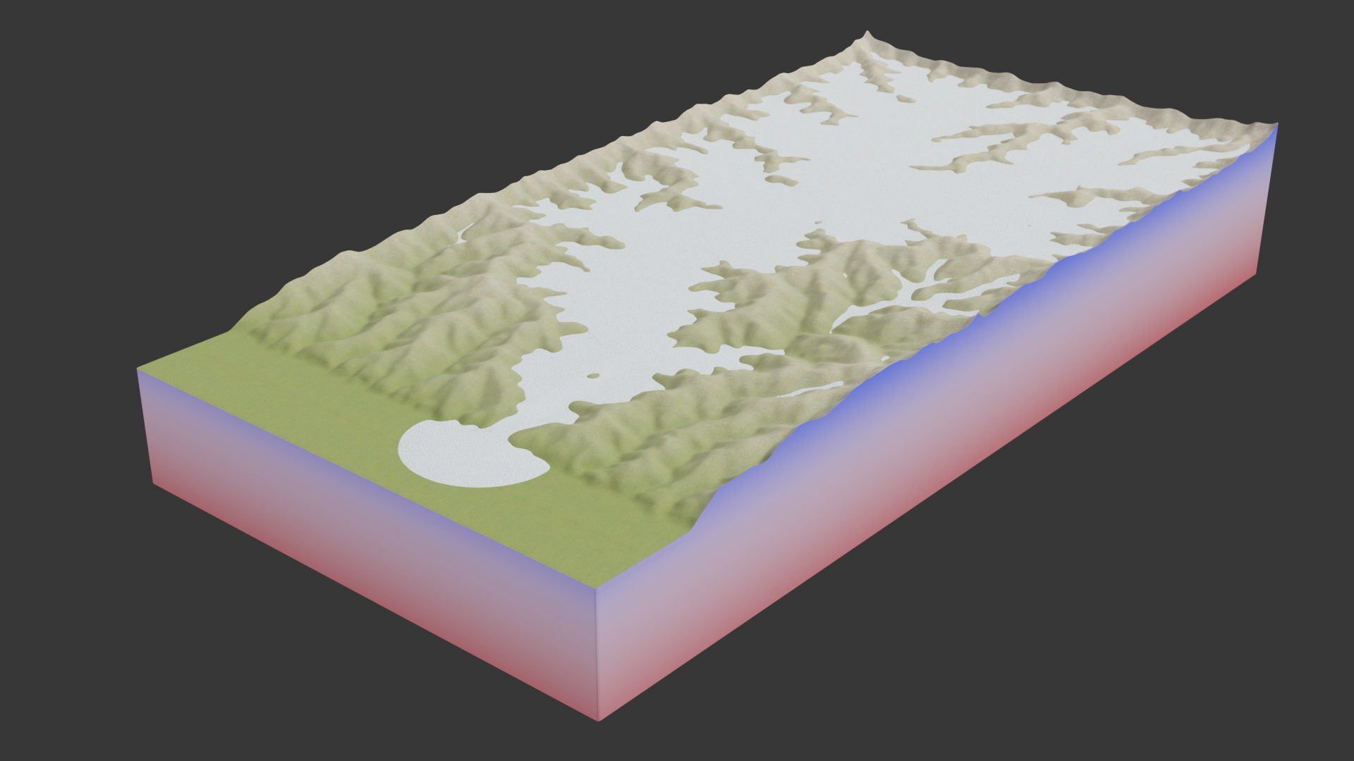
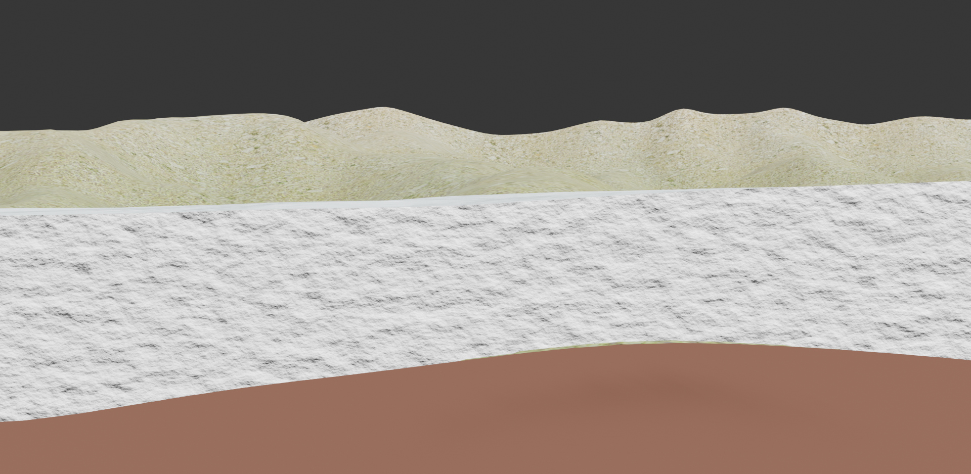
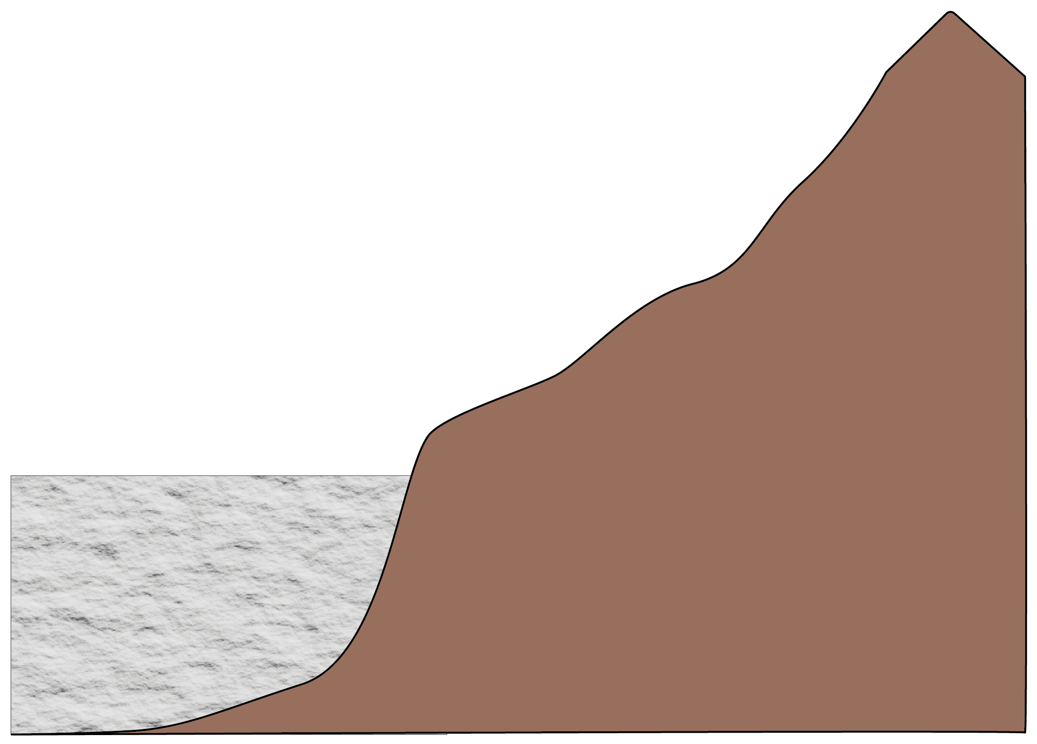
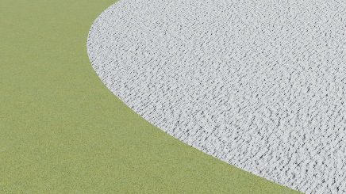
A1. Sampling for low-temperature thermochronology
Back to Motivation
2
1
Exhumation rate
Elevation
3
Ice transport
4
Age
2.
v
3.
1
In-situ
2
1.
3
4
Sediment sources elevation?
4.
Temperature°
x
Access to all eroded areas
Glacier bed
out of access
Elevation of samples
Mineral
v
But the shape of SPDF is influenced by :
- Exhumation history (ages)
- Erosion (sediment availability)
- Transport processes (spatial distribution of deposits)
Detrital
How does the ice erodes its substratum?
Synoptic probability distribution function (SPDF)
Probability
Erosion pattern
How do ice flow and sediment sources impact the shape of the SPDFs ?
Age

Slide 10
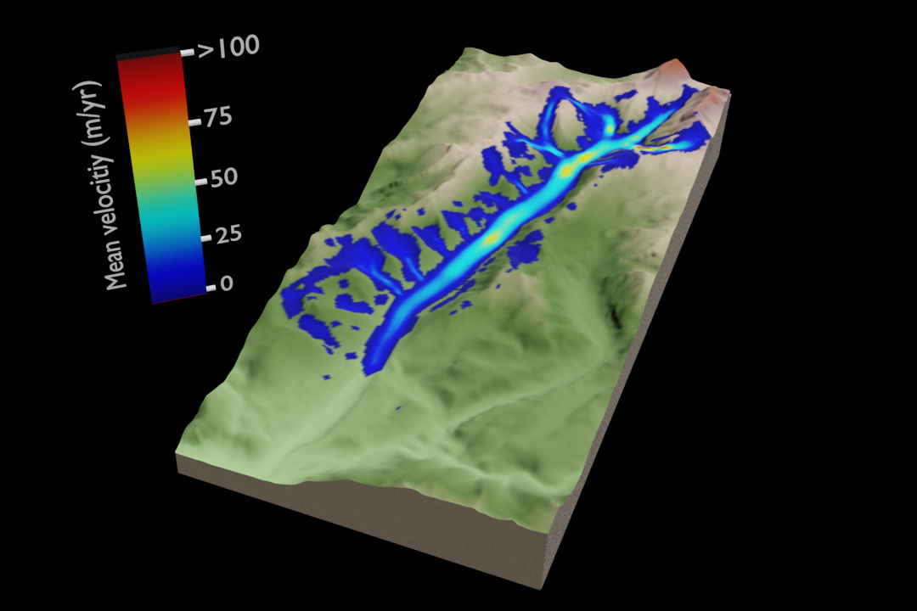
A)
Back to Model kinematic
B)
Back to Role of the ice transport
A2. A) Distribution of particles with elevation after 8.5 kyr of simulation. B) Mean ice velocity across the synthetic Tiedemann glacier.
The results of this graph comes from the model presented in the animation. The proportion of particles in the frontal moraine does not significantly changes after 2 kyr of simulation, so that the result of the graph above are maintained.

Slide 11
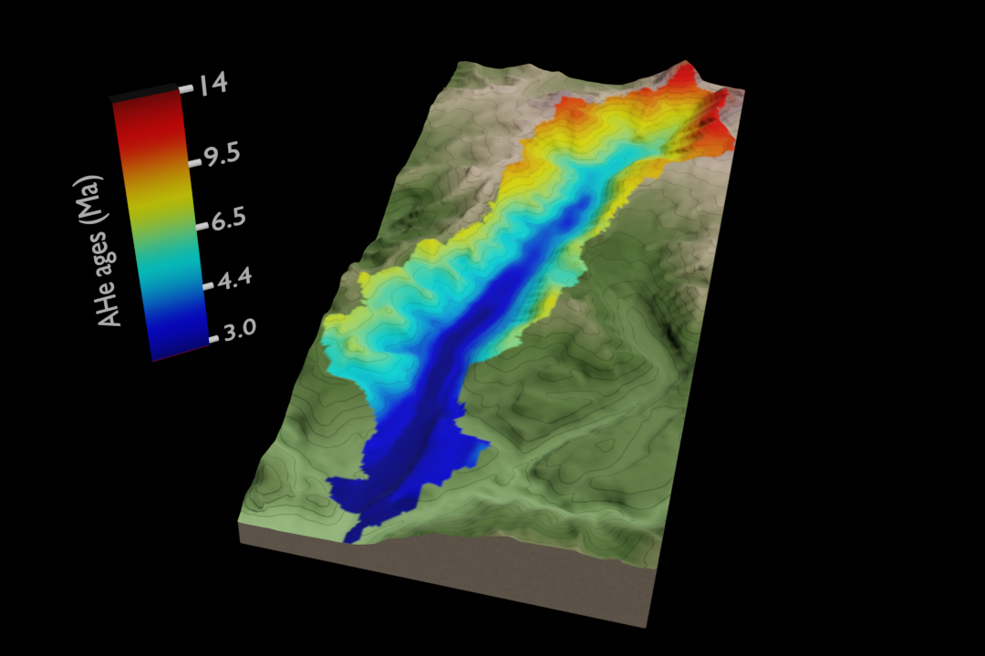
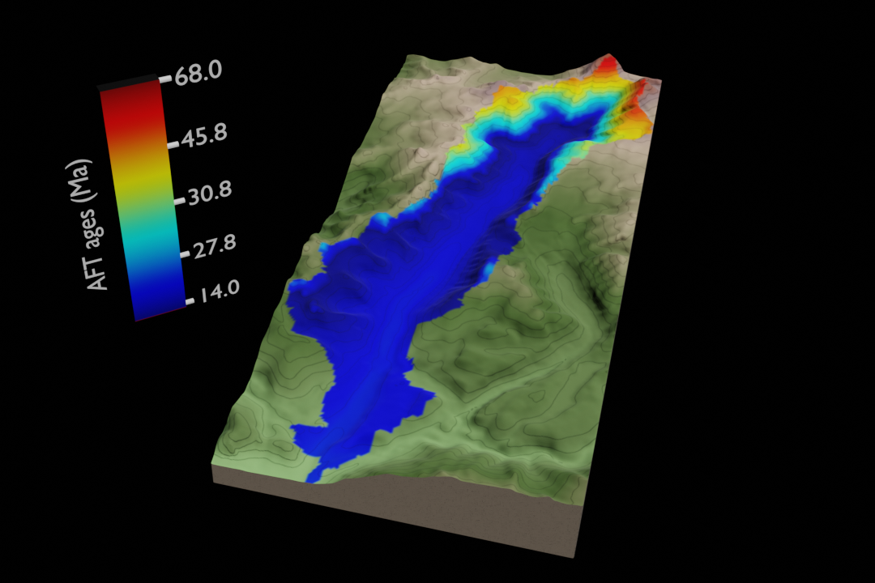
A3. Bedrock age distributions
Back to Method
A)
B)
Figure. Bedrock ages distribution for (A) the (U-Th)/He on apatite system, and (B) for the Fission tracks on apatite system, resulting from the age-elevation profiles.

Slide 12
A4. Methods
Back to Method
$$M= \left\{\begin{aligned}−m_{acc}T_{air}, if T_{air} ≤0 \\ −m_{abl}T_{air }, if T_{air} >0\end{aligned}, \right.$$
$$T_{air}= T_{sl}+dT_{air}.h$$
T_{air} : air temperature (°C)
m_{acc}: Accumulation gradient (0.08 m.yr⁻¹ °C⁻¹)
m_{abl}: Ablation gradient (0.25 m.yr⁻¹ °C⁻¹)
T_{sl}: Sea level temperature (9°C)
h: Elevation (m)
u_{b}: Glacier sliding speed (m.yr⁻¹)
C_{s}: sliding constant (1.29.10⁻² Pa.s^{1/3})
$τ_{b}$: Basal shear stress (Pa)
n: Ice creep constant (3.0)
S: cavity length (m)
L: Mean subcell bed step length (4 m)
k_{q}: Quarrying coefficient (1.97.10⁻⁴ s Pa⁻³)
N: Effective pressure (Model outcome)
$∇b_{s}$: Bed slope in direction of sliding
$b_{s0}$: Threshold bed slope (0.55)
u_{p}: glaciated particle speed (m.yr⁻¹)
z_{p}: burial depth of particle (dimensionless)
$\overline{u}$: Average ice creep speed (m.yr⁻¹)
K_{eh}: Hillslope erosion coefficient (3.95.10⁻⁵ m².yr⁻¹)
S_{c}: Critical slope (1.4)
K_{h}: Hillslope diffusivity (5 m².yr⁻¹)
Mass balance
Glacier sliding law
$$u_{b}=C_{s}.\frac{τ_{b}^{n}}{(1−\frac{S}{L})}$$
Quarring: $E_{q}={k_{q}N}^{3}u_{b}{\left(∇b_{s}+b_{s0}\right)}^{2}$
Glaciated areas
Sediment transport: $u_{p}\left(z_{p}\right)=\frac{5}{4}\left[1−{z_{p}}^{4}\right]\overline{u}+ u_{b}$
Diffusion: $E_{h}= −\frac{k_{eh}.∇b}{1−{\left(\frac{\left|∇b\right|}{S_{c}}\right)}^{2}}$
Hillslopes areas
Sediment transport: $q_{h}= − \frac{K_{h}.∇b}{1−{\left(\frac{\left|∇b\right|}{S_{c}}\right)}^{2}}$
Back to Role of sediments sources

Slide 13
A5. How sediment trackers are formed?
Back to Method
Sediments accumulates in cells due to local erosion until Hs = 0.1 m, where sediment tracker (particle) is formed and transported by the transport process considered, until its deposit site. Here, we focus on sampling the frontal moraine.

Slide 14
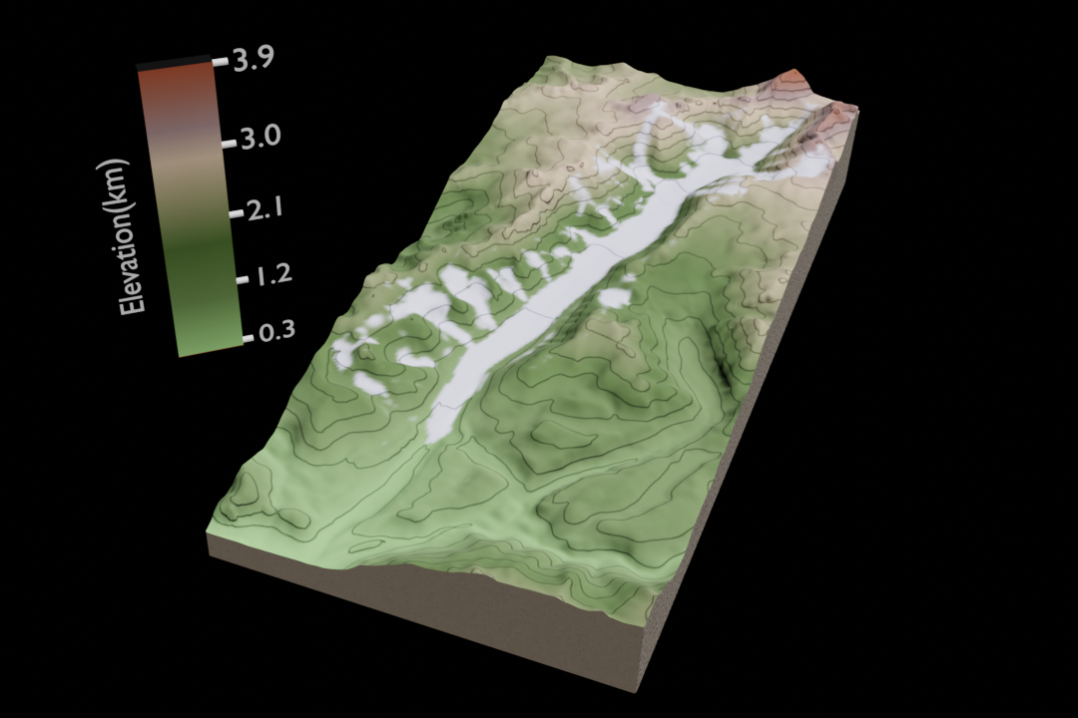
A6. Sampling detrital probability age distributions
Random sampling
Build SPDF
x105 particles
Probability
x10 000 times
Frontal moraine
Age
Store SPDF
Back to Method
Compute mean detrital SPDF

Slide 15
A7. The bedrock and detrital probability age distributions
The synoptic probability age distribution functions (SPDFs) are built by using a gaussian distribution of the error on the age, as follow:
$$S{PDF}_{k}=\frac{1}{N_{p}} \frac{1}{ασ_{t_{k}}\sqrt{2π}}\exp\left[−\frac{1}{2}{\left(\frac{t−t_{k}}{ασ_{t_{k}}}\right)}^{2}\right]$$
N_{p} : number of sampled sediment particle
t : age range
t_{k} : particle age
$σ_{t_{k}}$ : error on particle age
α = 0.6 (Brandon, 1996)
Next we build the cumulatives by simply adding each gaussian contributions:
$$CSPDF = \sum_{j=0}^{N_{p}}{ {SPDF}_{j}}$$
We define a relative constant error of 10% for the AHe ages which is similar to the reproducibility in aliquots of single grain ages (Farley and Stocki, 2002). The relative uncertainty on the AFT ages are defined to be variable and >30%, as in Enkelman and Ehlers (2015).
Back to sampling process

Slide 16
A8. Results: Role of sediment sources
We consider here, a model generating sediment particles according to erosion laws considered. Mean catchment erosion rate is 1 mm.yr⁻¹. Deviations from this mean value occurs and erosion rates reach ~31 mm.yr⁻¹ high in the catchment (Fig. a). We consider (U-Th)/He on apatite ages (slide 6), with a relative constant uncertainty of 10%. Particles are sampled within the frontal moraine after 2 kyrs of transport. Comparison of the mean detrital SPDF (Fig. c) with the bedrock SPDFs of the particles sources (hillslopes vs glaciers), shows that the age peak observed $\sim$5 Ma is likely due to the glacial source, as the glacial bedrock SPDF is above the hillslope bedrock one for this age range. However, the second age peak observed $\sim$10 Ma likely reflects the hillslopes sources, as the inverse occurs for the bedrock SPDFs of the particles sources. We confirm these relations by looking at the spatial distribution of erosion rates (Fig. a), where the highest are below the main glacier $\sim$15 km from the frontal moraine, with low bedrock AHe ages. The hillslopes sources of the older age peak ($\sim$10 Ma) is coherent with the location of hillslope erosion in the highest part of the catchment where bedrock AHe ages are older. Estimating the spatial distribution of the sediment sources can help in discriminating between both in the detrital SPDF.
Back to Role of sediments sources

Slide 17
A9. Results: Role of sampling strategy
We aim here, to look at the effect of sampling by varying strategy across the frontal moraine (FM). We focus on synthetic AFT ages, with relative uncertainties >30% similar to Enkelmann and Ehlers (2015). The results (Fig. c-d) show a gradient of age peak components in the detrital SPDFs that tends to be older from left to right of the frontal moraine regions. We compare our results with the detrital SPDFs from Enkelmann and Ehlers (2015) who sampled across the ice-cored terminal moraine of the real Tiedemann glacier (stars in b). Overall, we observe the same tendency in age components gradient from left (sample s10) to right (sample s14), supporting our modelling approach to explore the effect of ice flow and sediments sources in the shape of detrital SPDFs.
To further support the differences in detrital SPDFs across the frontal moraine, we performed statistical tests. The results support the conclusion that each detrital distribution is different from the catchment bedrock SPDF, although some conclusions from the two statistical tests may be contradictory. However, sampling across the entire frontal moraine leads to better estimates on the catchment erosion pattern (dashed curve, Fig. c).
This study
Enkelmann and Ehlers (2015)
Back to Role of sampling strategy

Slide 18
A10. Statistical tests results from Kuiper and Kolmogorov-Smirnov (KS) tests, with associated p-value for the detrital CSPDFs of the four regions across the frontal moraine. Each detrital CSPDF is tested against the catchment bedrock CSPDF. Frontal Moraine correspond to the mean detrital CSPDF of the entire moraine. Highlighted in colour are contradictions between the two statistical tests about the similarity between the corresponding detrital CSPDF and the catchment bedrock CSPDF. 1: the two distributions are different, 0: the two distributions are statistically identical. The two statistical tests, show that the mean detrital CSPDF of the entire moraine, best estimate the erosion pattern.
 | AHe |  | AFT
 | Kuiper test/p-value | KS-test/p-value | Kuiper test/p-value | KS-test/p-value
Region 1 | 1 / 5,186.10⁻⁵ | 1 / 0,019 | 1 / 3,848.10⁻⁵ | 1 / 5,730.10⁻¹³
Region 2 | 0 / 0,996 | 1 / 0,047 | 0 / 0,999 | 0 / 0,235
Region 3 | 0 / 0,158 | 0 / 0,985 | 1 / 0,049 | 0 / 0,214
Region 4 | 1 / 1,044.10⁻⁴ | 0 / 0,778 | 1 / 5,071.10⁻⁷ | 1 / 0,001
Frontal Moraine | 0 / 0,647 | 0 / 0,985 | 0 / 0,968 | 0 / 0,987
Back to Role of sampling strategy

Slide 19
A11. Model assumptions and limits
Sediment transport
We only consider sediment transport by hillslope diffusion or ice flow. We neglect the transport by meltwater.
Particles do not interact with each other and with the ice (passive markers).
Horizontal velocity of particles within the ice depends on 4th order of the burial depth
Sampling process
We do not consider comminution of particles during transport and sample regardless the size of sediment.
Back to Conclusion

