Slide 1
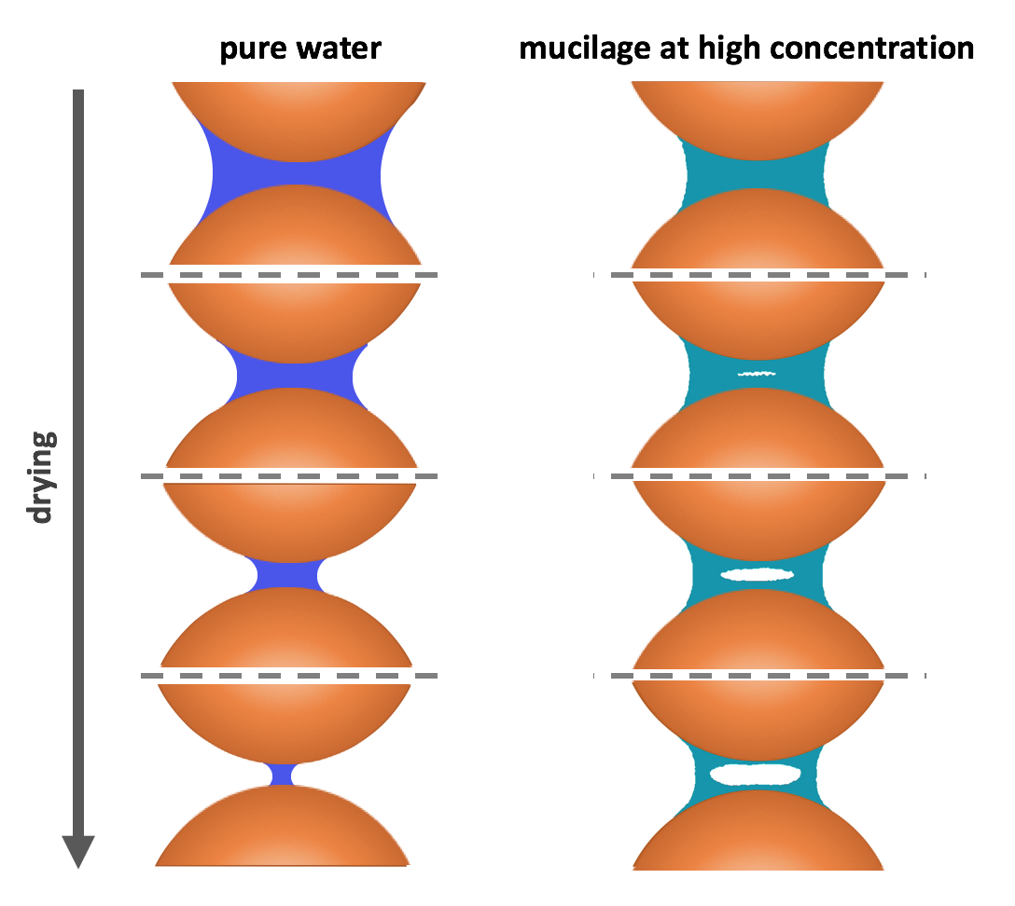
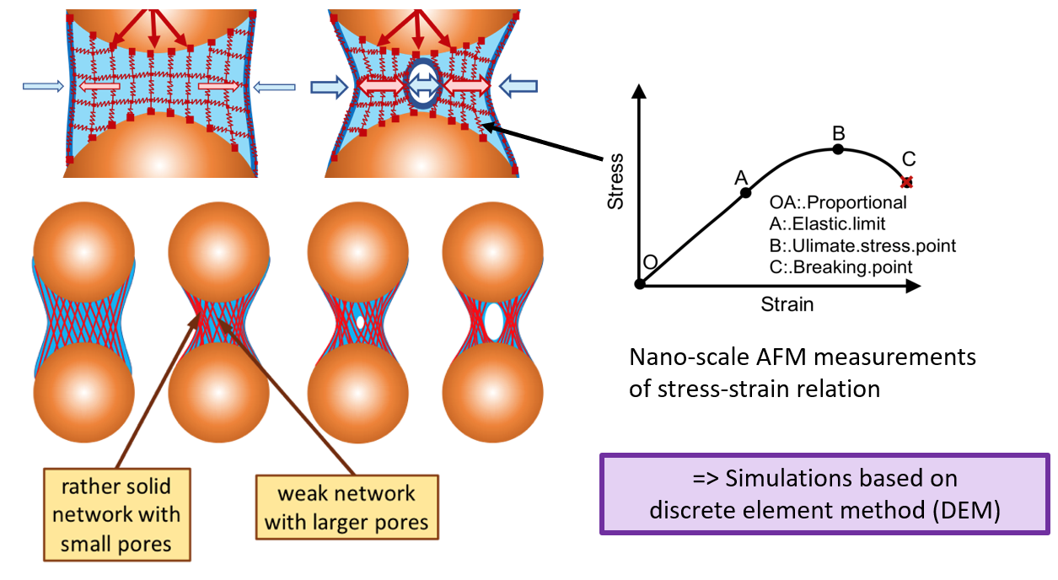
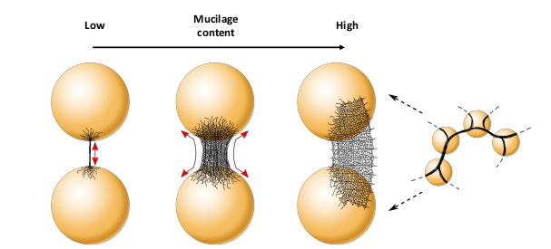
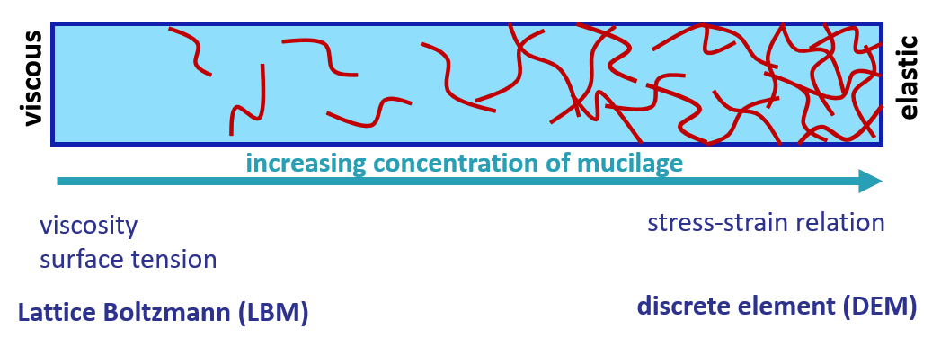
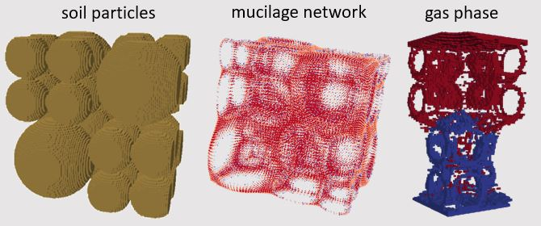
Pore scale simulations of how mucilage alters connectivity of liquid and gas phase in the rhizosphere
Omid Esmaeelipoor Jahromi¹, Jonas Bentz¹, Adrian Haupenthal¹, Ravi Patel², Eva Kröner ¹
¹ Universität Koblenz-Landau, Institute for Environmental Sciences, Geophysics, Landau, Germany
² Laboratory for Waste Management (LES), Paul Scherrer Institute, Villigen, Switzerland
Introduction
Compared to bulk soil, rhizosphere has different properties because of the existence of root mucilage which affects the physical, chemical and also microbial processes. Hydraulic phenomena like limiting water flow at certain dry soil conditions, modulating extreme water contents by slow response to water potential changes; and also influencing solute transport and gas diffusion by varying the connectivity of liquid and gas phases are all classified under the set of the physical processes which are affected by mucilage in the rhizosphere. Here a pore-scale model for more accurate simulation and study of distribution of phases, during physical processes in the rhizosphere will be presented.
Material and Methods
Mucilage is composed out of polymers which form a network and build a hydrogel, something between a solid and a liquid.
At low concentrations, Mucilage is more like a liquid while at higher concentration, when it is almost dry, it becomes a solid and then, usual numerical methods of CFD such as Lattice Boltzmann Method (LBM), won’t be helpful anymore.
Here, a simple simulation using Discrete Element Method (DEM) is presented to observe the distribution of mucilage in the pore space.
Results
Figure 3: Pure water (normal liquid) and mucilage (hydrogel) behavior during drying.
Figure 4: Drying of the mucilage due to its polymeric network.
Figure $1^{1}$: During drying, mucilage forms thin filaments , wide spread bridges and interconnected surfaces at low, mean and high concentrations, respectively.
Figure 2: Dominant mechanisms and corresponding numerical methods are employed for the simulations.
Conclusion & Outlook
The proposed model is still preliminary and will get more accurate and closer to real systems by:
Coupling two separate models based on viscous and elastic behaviours together.
Considering multiphase systems in the pore-scale by adding capillary forces and contact angles.
And finally, a solute transport model can be employed and more reliable results will be obtained.
Figure 5: 3D distribution of mucilage and gas phase in the pore space, during the drainage process.
References
[1] Carminati A et al. 2017. Liquid Bridges at the root-soil interface. Plant and Soil

