Slide 1
An up-to-date assessment of temperature extremes over the MENA region from observational and CIMP5
data
Athanasios Ntoumos¹ , Panos Hadjinicolaou¹ ,George Zittis¹ and Jos Lelieveld^{1,2}
1 Climate and Atmosphere Research Center (CARE-C), The Cyprus Institute – 20 Konstantinou Kavafi Street, Nicosia, 2121, Cyprus
2 Max Planck Institute for Chemistry (MPIC) – Hahn-Meitner-Weg 1, 55128 Mainz, Germany

Slide 2
Purpose of the analysis - Expected outcomes
Derive indices statistics (climatological average,trends) and maps for the MENA region using CMIP5, reanalysis and observational datasets
Spatial and temporal comparison of CMIP5 model indices with indices from reanalyses and observational datasets
Reveal the best performing global model realizations for the temperature extremes
Explore possible role in biases of model resolution and climate sensitivity

Slide 3
CMIP5 models table
Models | longitude(°) | latitude(°) | ECS | TCR
CCSM4 | 1.25 | 0.94 | 2.9 | 1.8
CSIRO_Mk3.6.0 | 1.87 | 1.87 | 4.1 | 1.8
HadGEM2-ES | 1.87 | 1.25 | 4.6 | 2.5
IPSL_CM5A-MR | 2.5 | 1.26 | 4.1 | 2
IPSL-CM5A-LR | 3.75 | 1.89 | 4.1 | 2
MIROC5 | 1.4 | 1.4 | 2.7 | 1.5
MPI-ESM-LR | 1.87 | 1.87 | 3.6 | 2
MRI-CGCM3 | 1.12 | 1.12 | 2.6 | 1.6
CNRM-CM5 | 1.4 | 1.4 | 3.3 | 2.1
GFDL-ESM2M | 2.5 | 2 | 2.4 | 1.3
CanESM2 | 2.81 | 2.79 | 3.7 | 2.4
GFDL-CM3 | 2.5 | 2 | 4 | 2
GFDL-ESM2G | 2.5 | 2 | 2.4 | 1.1
HadGEM2-AO | 1.87 | 1.25 | 4.6 | 2.4
MIROC-ESM | 2.81 | 2.79 | 4.7 | 2.2
MIROC-ESM-CHEM | 2.81 | 2.79 | 4.55 | 2.2
BCC-CSM1.1 | 2.81 | 2.79 | 2.8 | 1.7
BNU-ESM | 2.81 | 2.79 | 4.1 | 2.6
Set of 18 CMIP5 global models used in the present analysis with their respective resolution, the values Equilibrium Climate Sensitivity (ECS) and Transient Climate Response (TCR)

Slide 4
List of Temperature Expert Team On Climate Detection Indices (ETCCDI)
Label | Index name | Description | Units
TN10p | Cold nights | TN <TN_{in}10 | %
ΤΧ10p | Cold days | TX <TX_{in}10 | %
TN90p | Warm nights | TN >TN_{in}90 | %
TX90p | Warm days | TX >TX_{in}90 | %
WSDI | Warm spell duration | At least 6 consecutive days with TX >TX_{in}90 | days
CSDI | Cold spell duration | At least 6 consecutive days with TN <TN_{in}10 | days
TXx | Max TX | Absolute maximum daily temperature | º C
TXn | Min TX | Absolute minimum daily maximum temperature | º C
TNx | Max TN | Absolute maximum daily minimum temperature | º C
TNn | Min TN | Absolute minimum daily temperature | º C
FD | Frost days | days with TN<0 º C | days
ID | Ice days | days with TX<0 º C | days

Slide 5
Reanalyses and Observational datasets
Dataset | Resolution(°)
ERA-Interim | 0.75 x 0.75
MERRA2 | 0.6 x 0.5
Berkeley | 1 x 1
Reanalyses and observational datasets used in the present analysis with their respective resolution. For the purposes of the analysis all datasets were regridded in common grid of resolution 1.87° x 1.87°

Slide 6
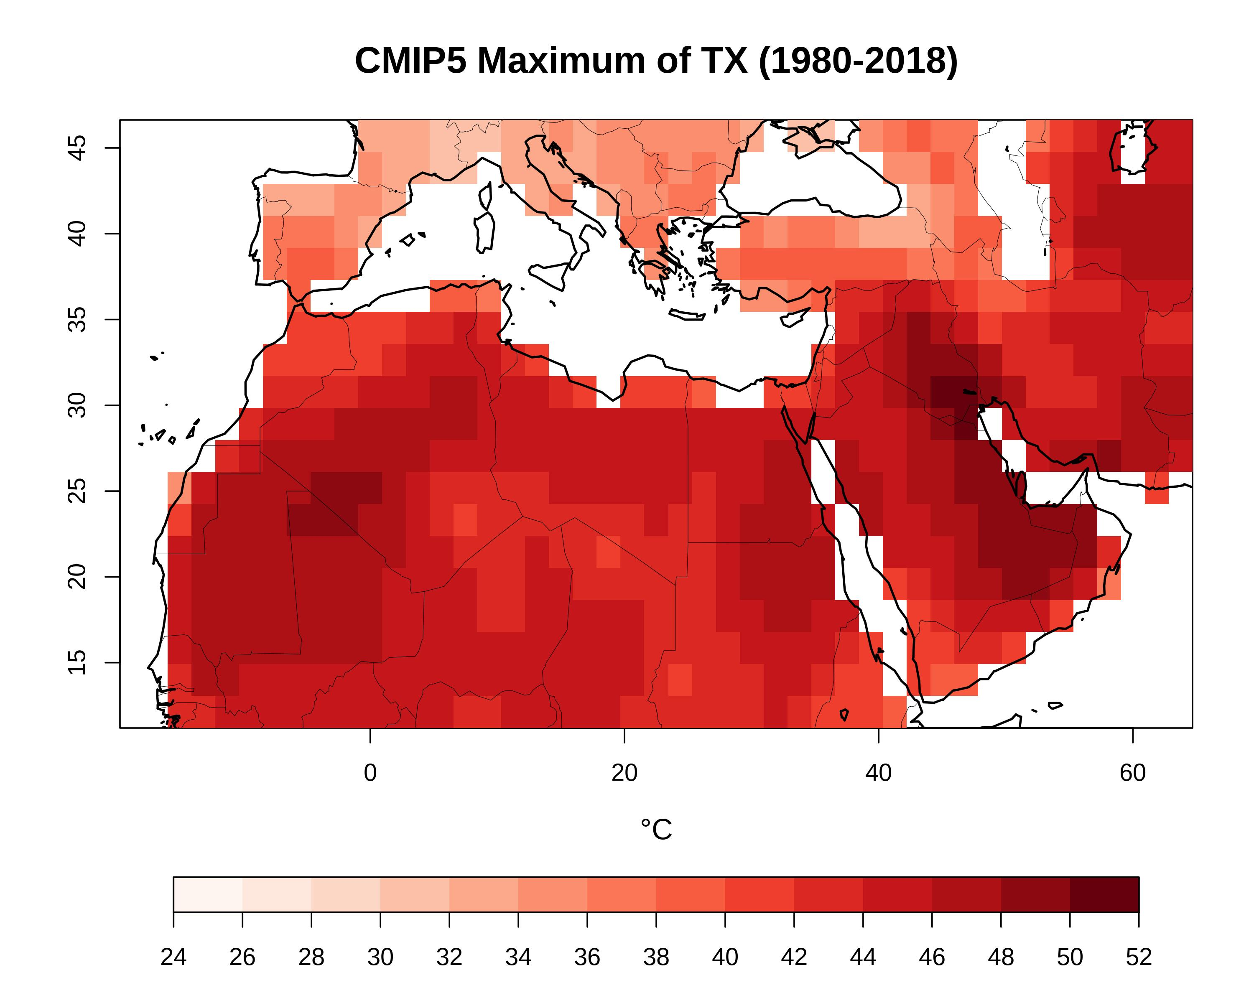
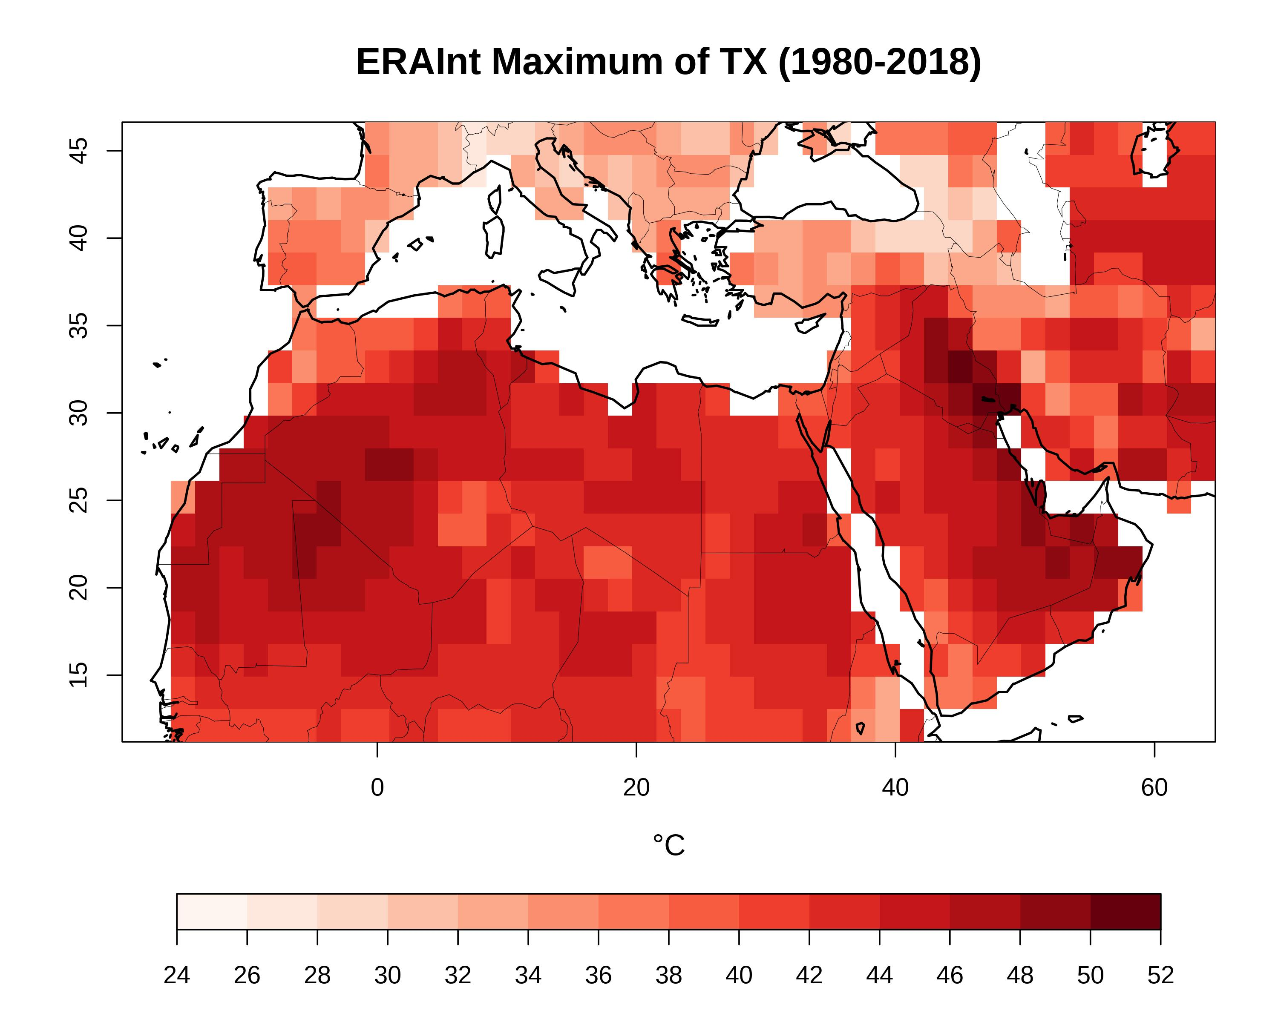
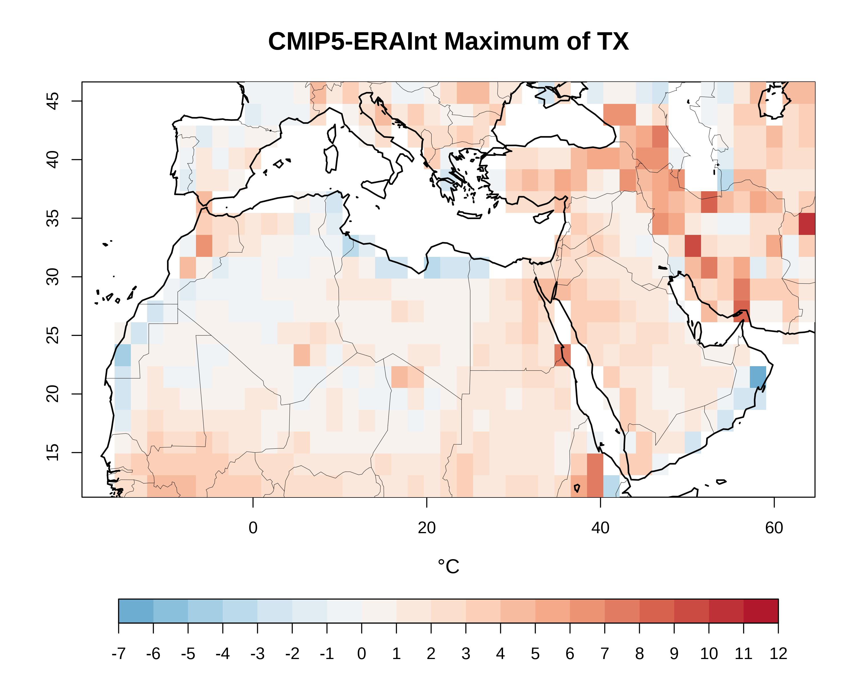
Climatology maps comparison – TXx index
a
b
Figures a,b : 1980-2018 mean of the annual maximum of TX (Txx) for CMIP5 multimodel ensemble mean and ERA-Interim reanalyses for the MENA region
Figure c :difference between CMIP5 multimodel ensemble and ERA-Interim
c
CMIP5 models capture quite well the basic climatological features
Models overestimate the temperature at high terrain regions coarse spatial resolution

Slide 7
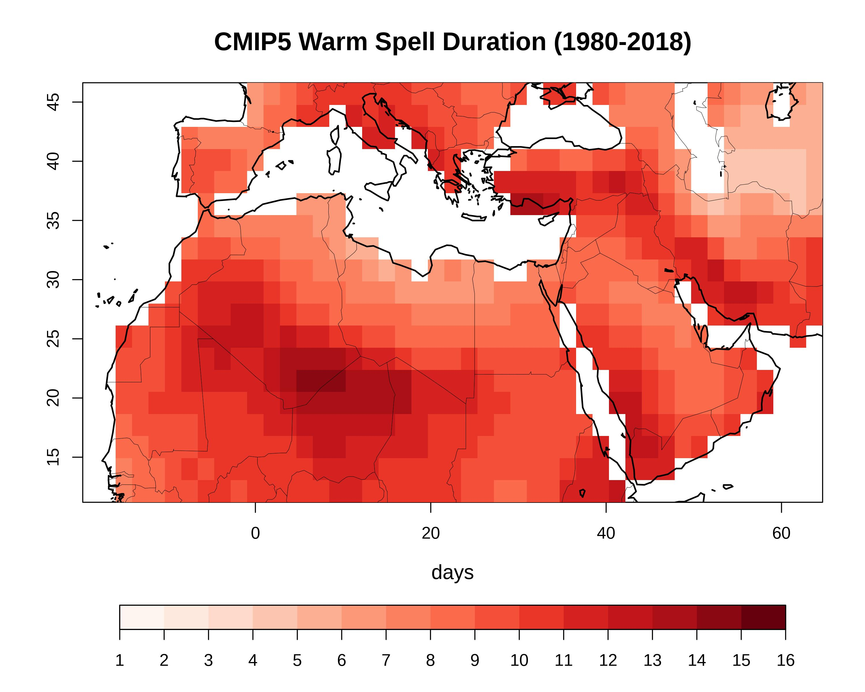
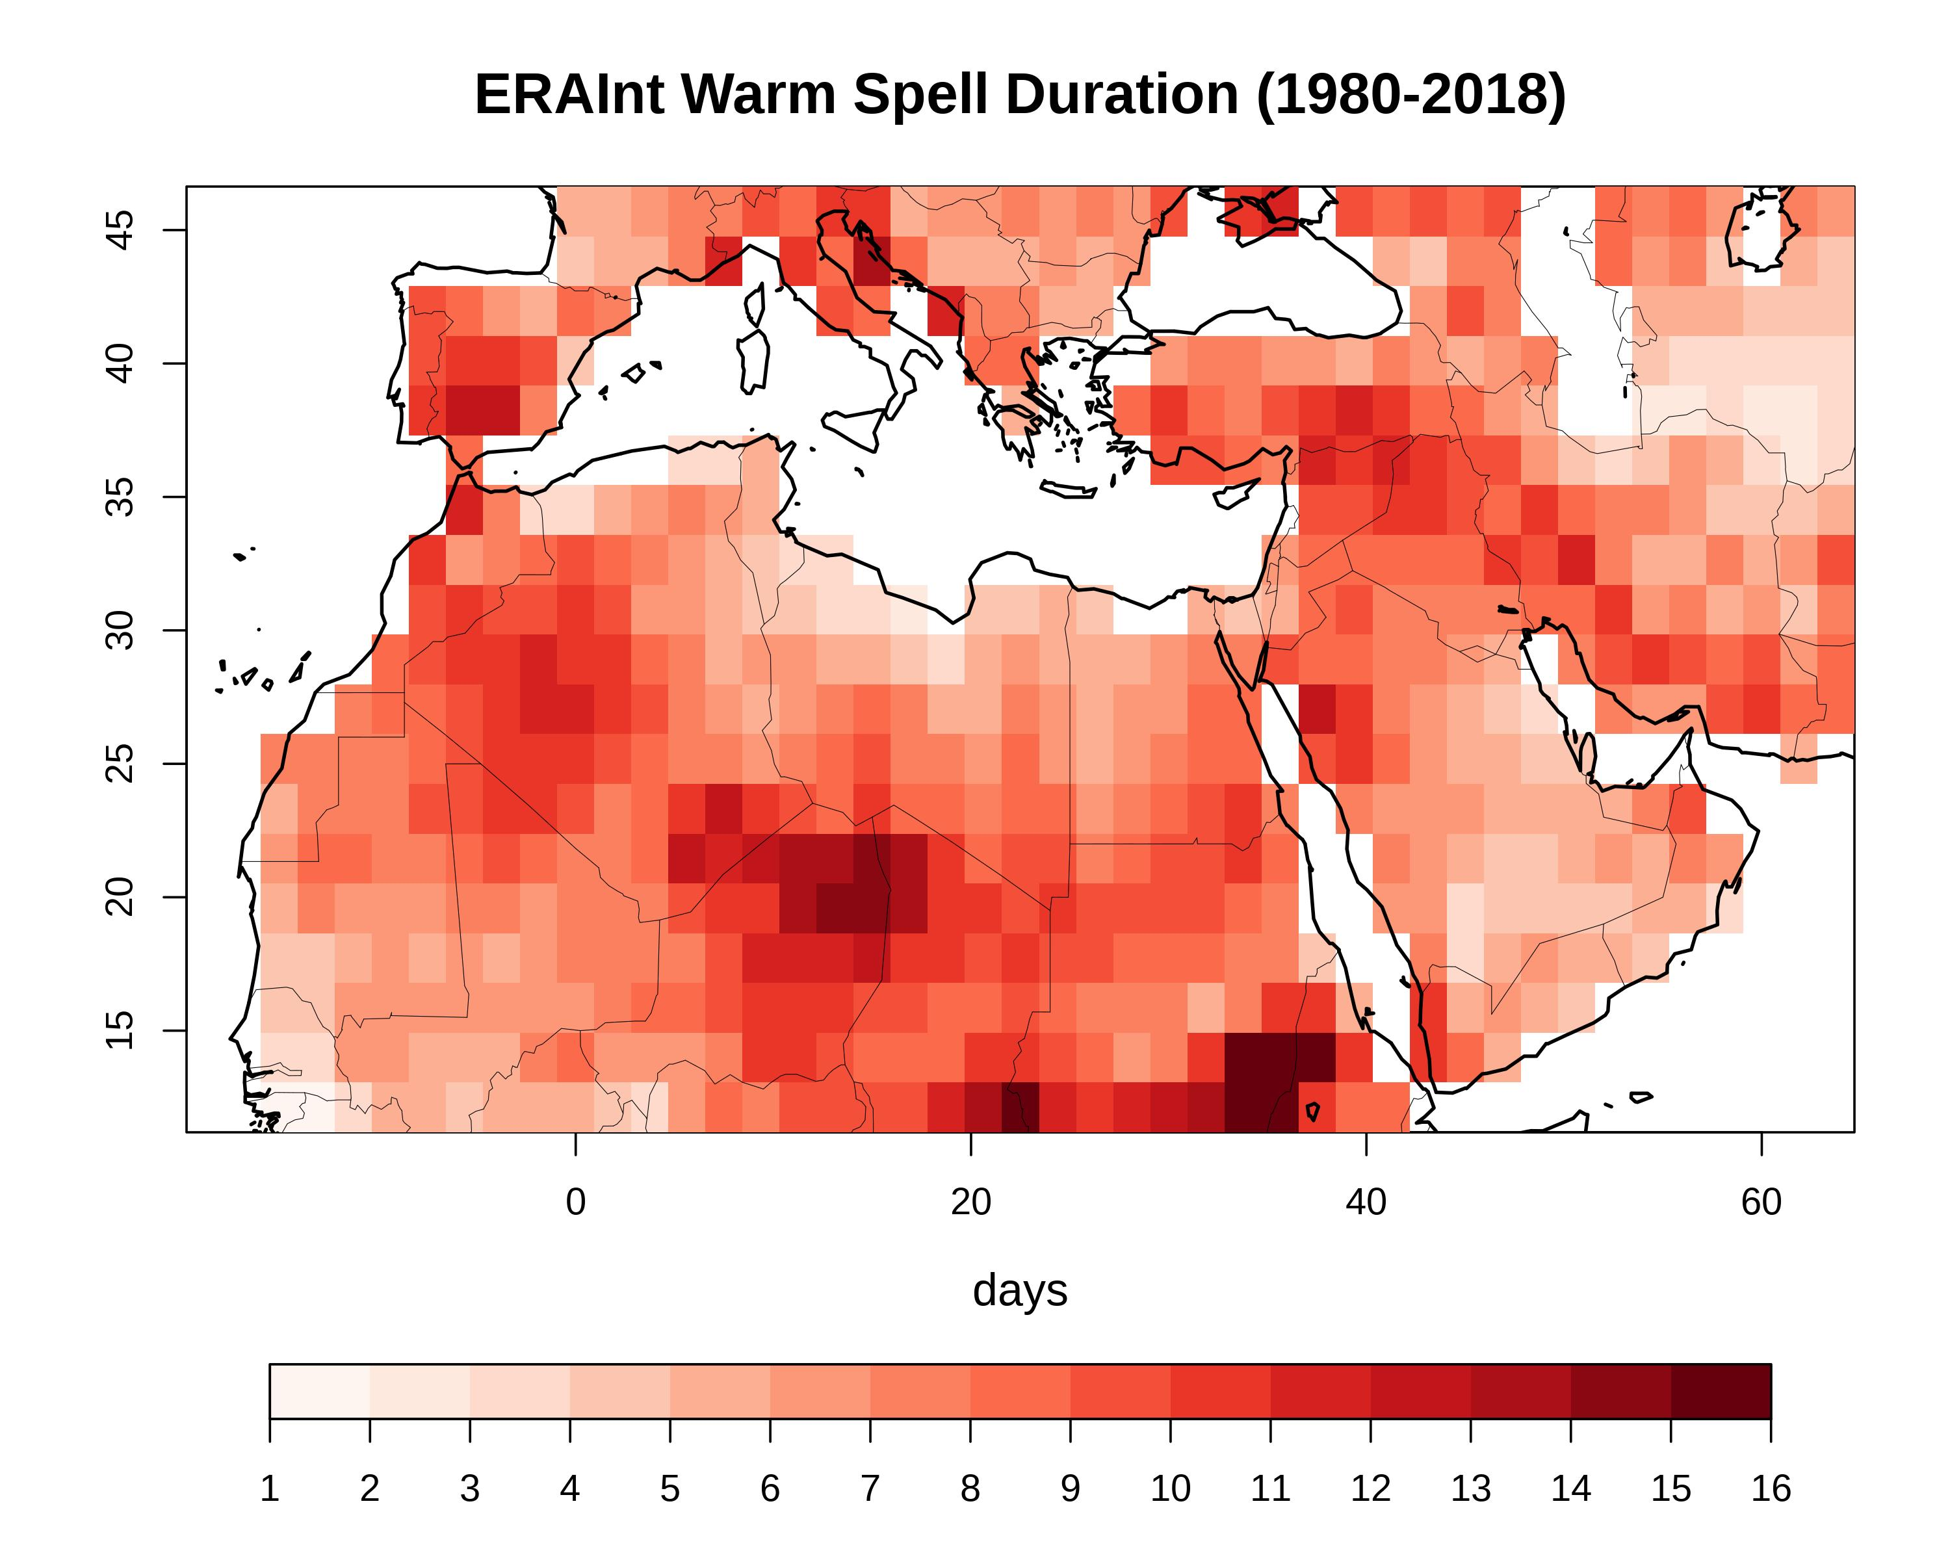
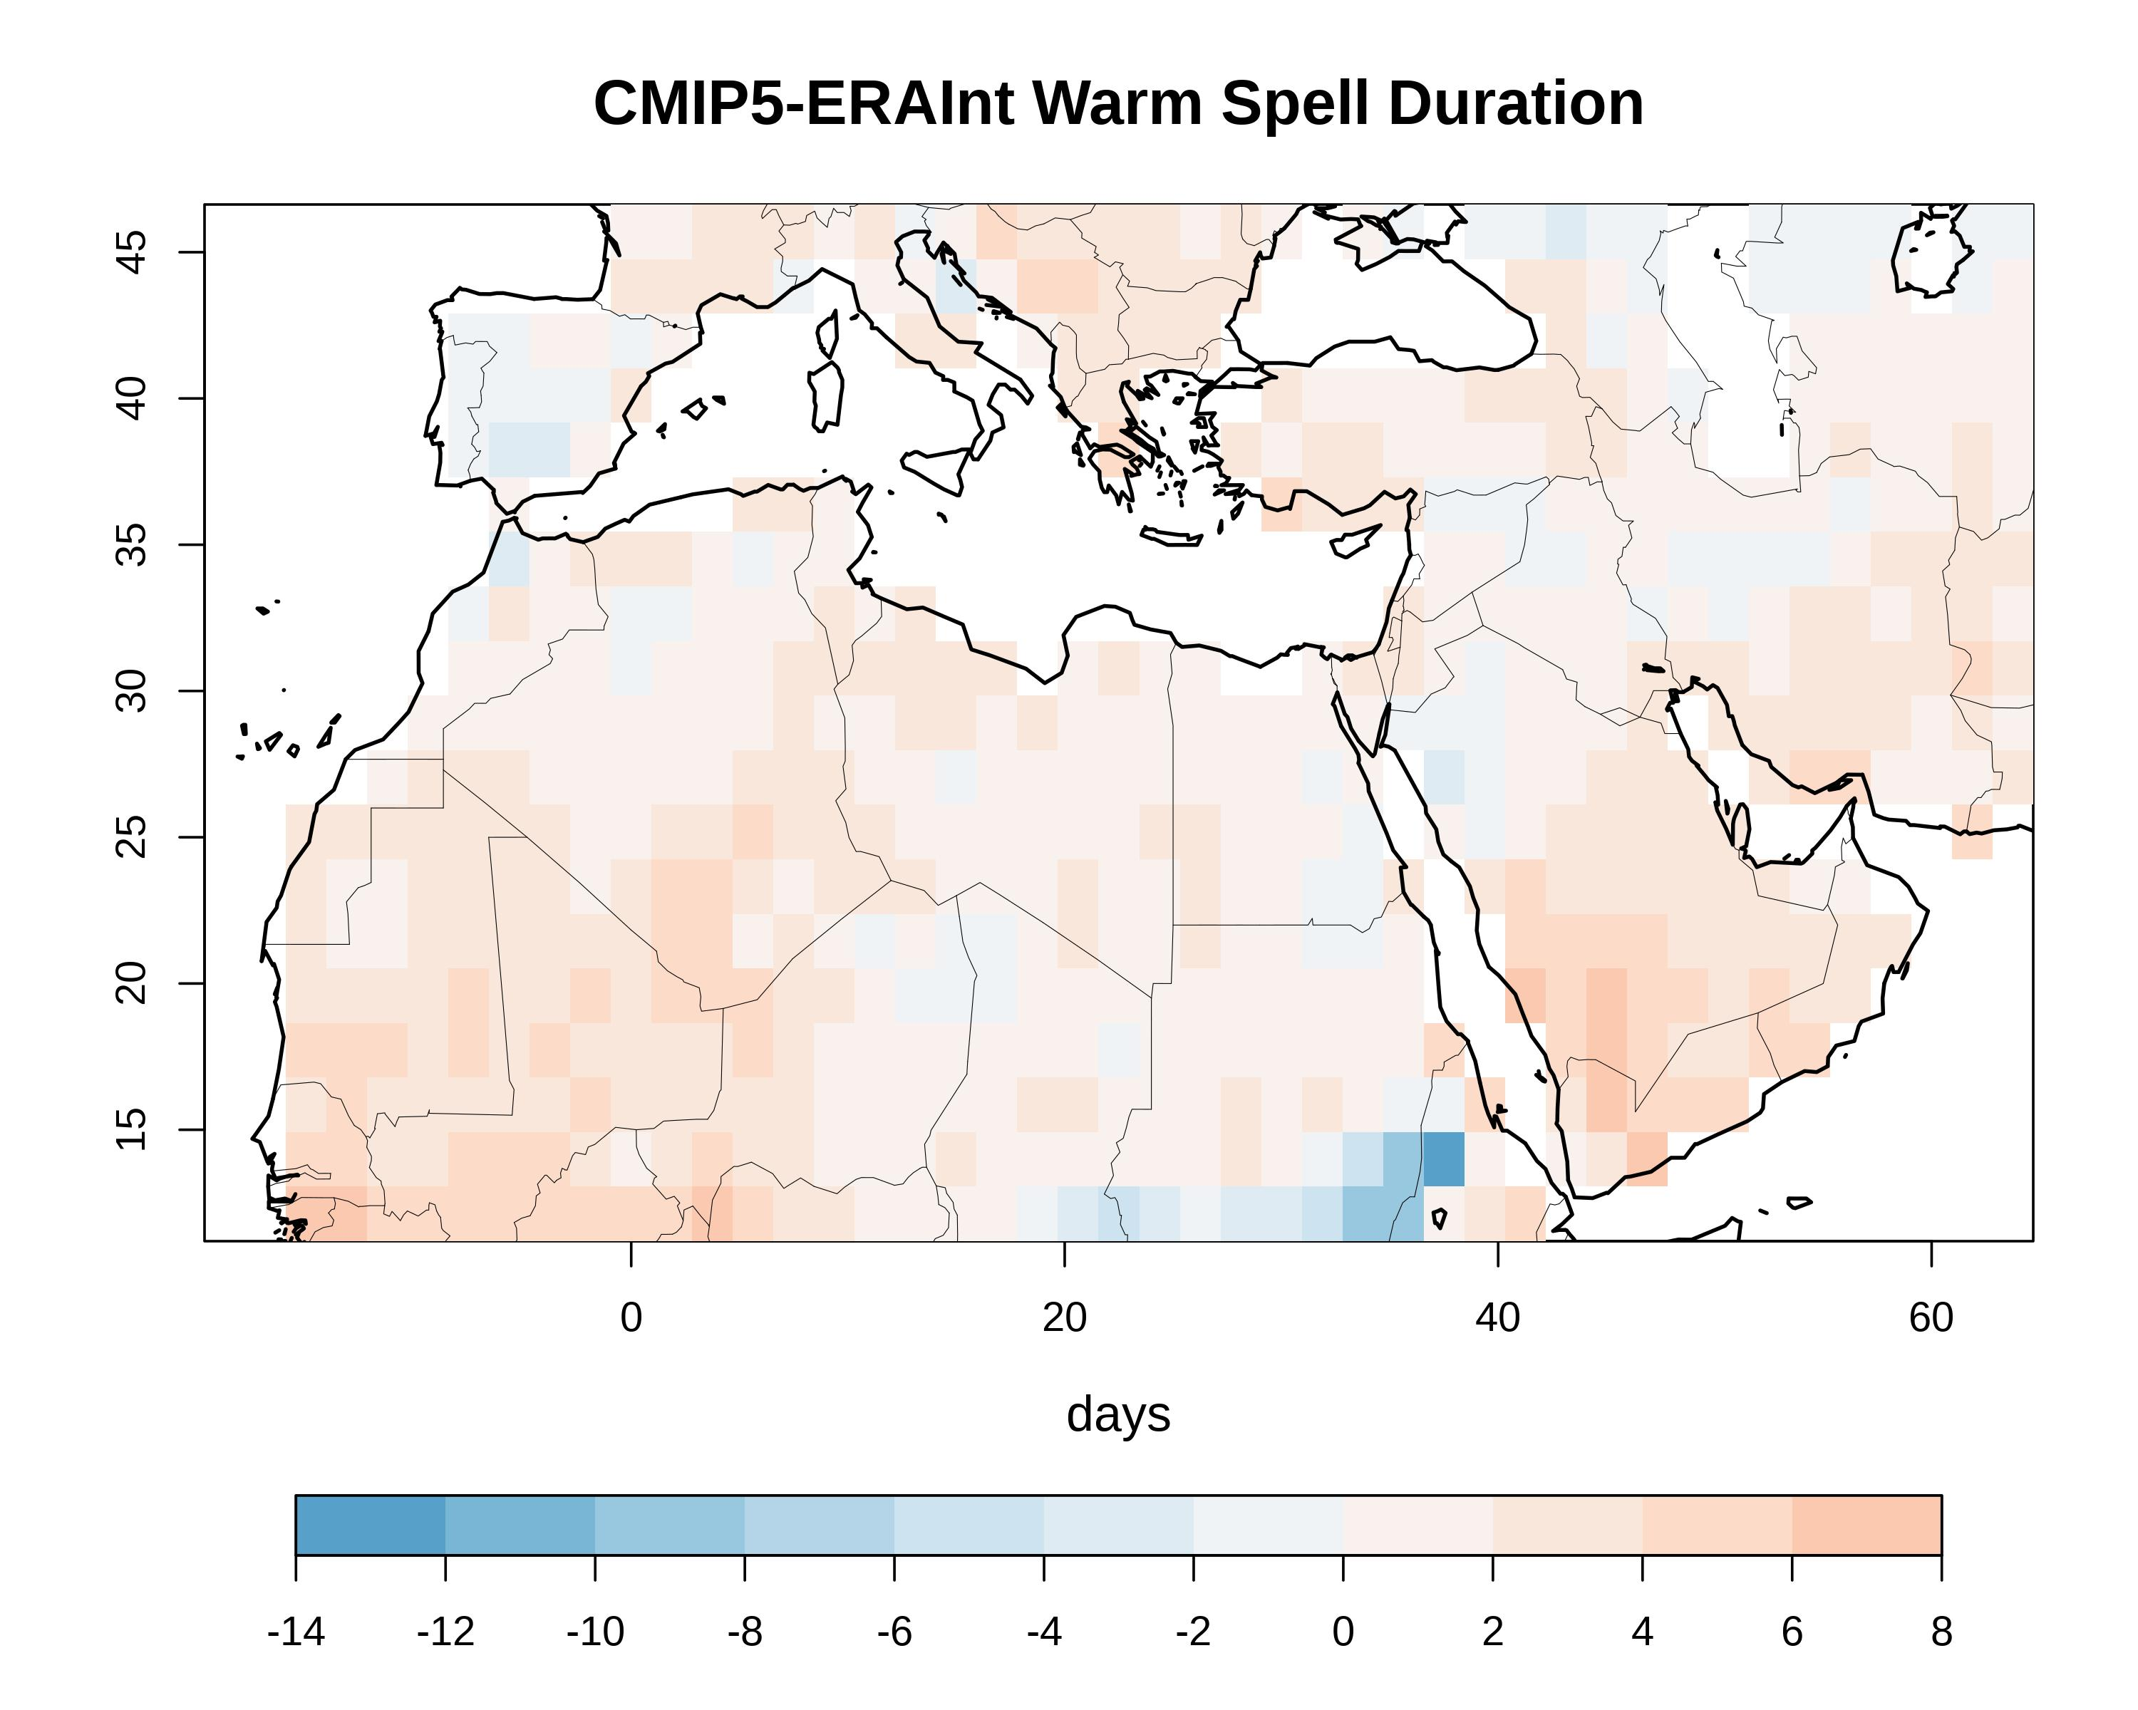
Climatology maps comparison – WSDI index
Figures similar to the previous slide for the the Warm Spell Duration (WSDI) index
CMIP5 models are able to identify the regions with the highest value of WSDI
Overestimate the index in most locations of the MENA

Slide 8
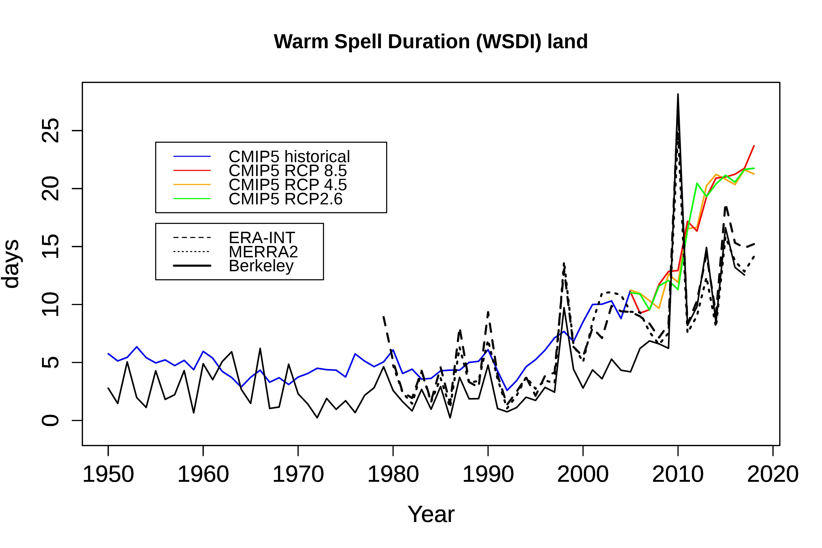
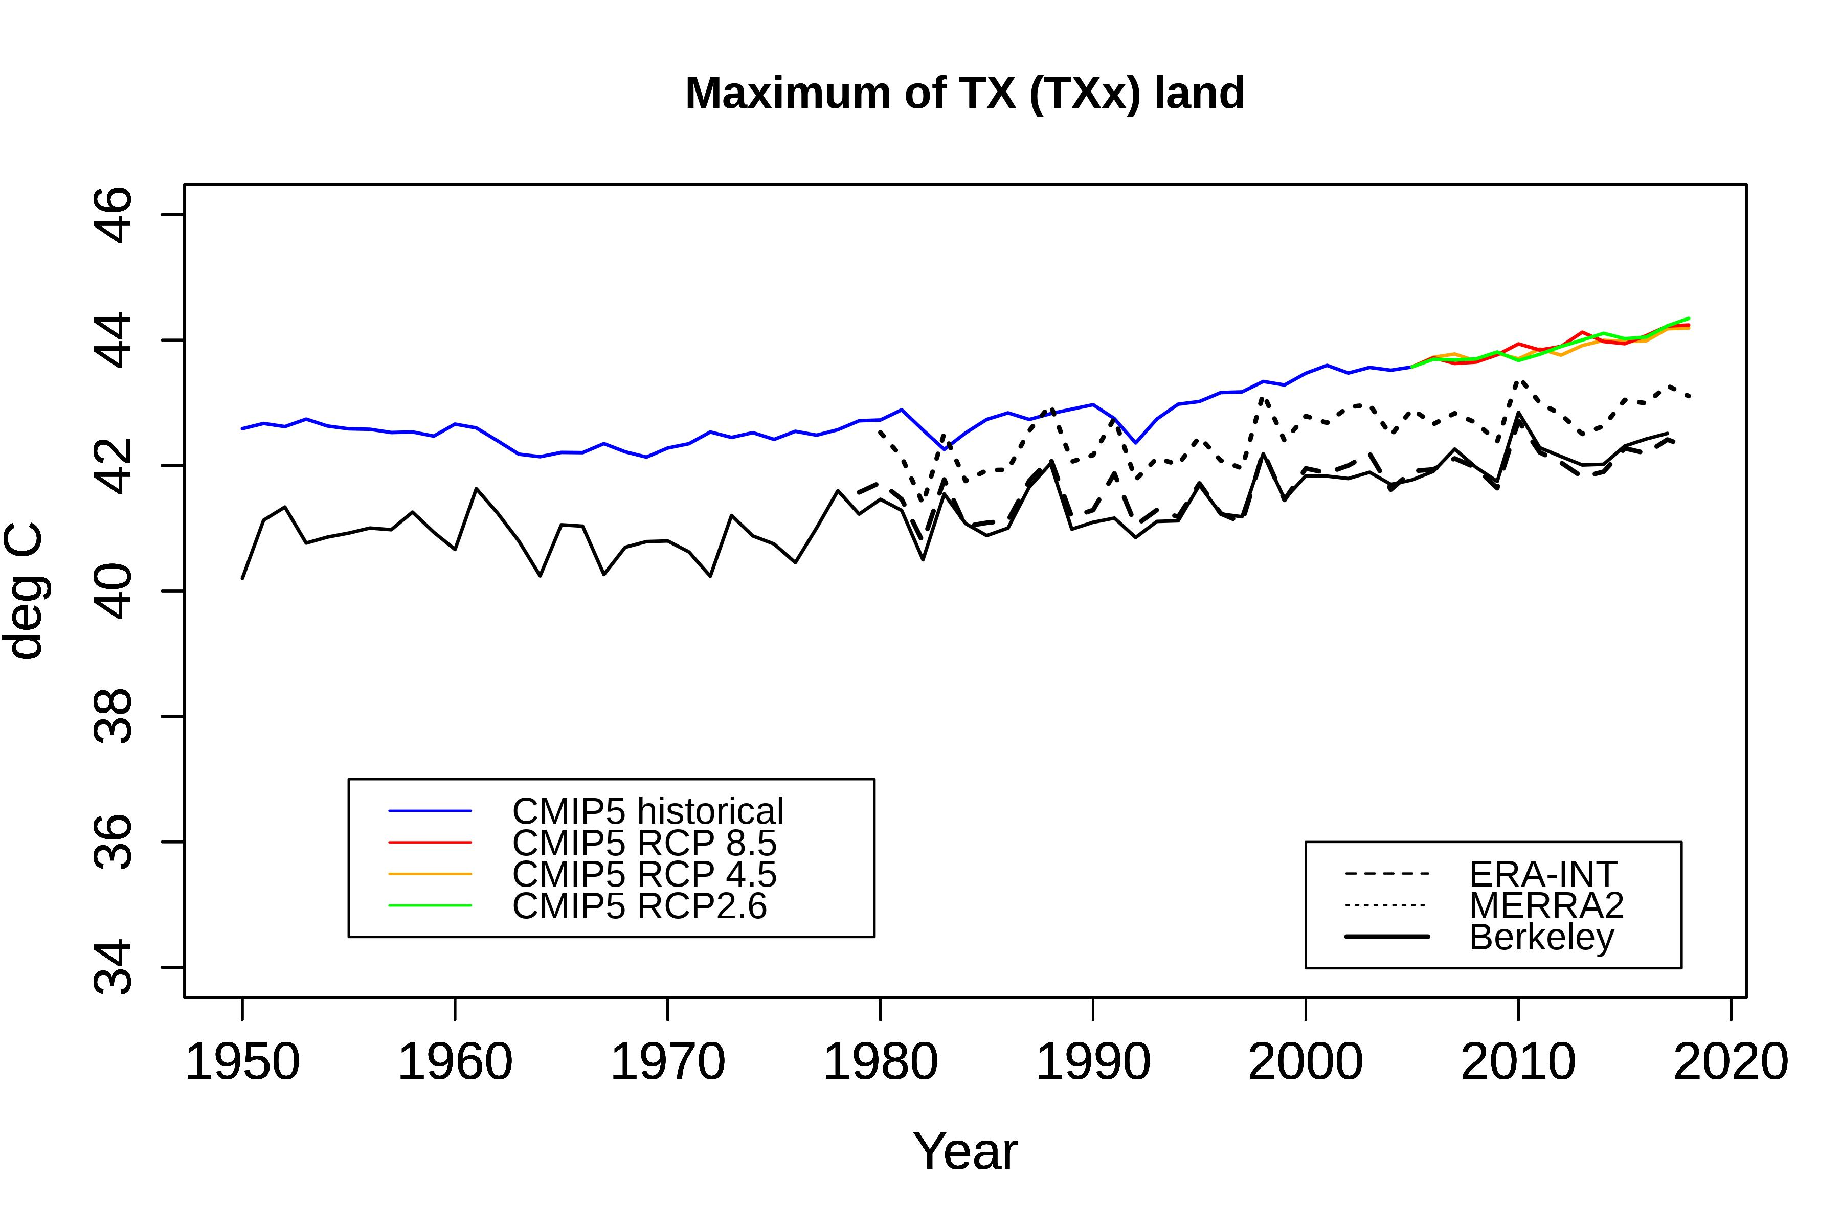
WSDI – TXx MENA Region Temporal Evolution
MENA region time series of WSDI and TXx indices over land grid boxes from 1950 to 2018 of the ensemble mean of historical runs until 2005 (blue) and three scenario runs (RCP2.6 - green, RCP4.5 -yellow, RCP8.5 - red) for 18 CMIP5 models. Also shown are the reanalysis ERA-Interim (dashed) from 1979 to 2018, MERRA2 (fine dashed) from 1980 to 2018 and Berkeley observational data (solid) from 1950 to 2017.
Overall agreement CMIP5 - reanalyses/observations regarding the warming trend
No difference between the RCP scenarios (2006-2018)
WSDI: CMIP5 historical runs (1950-2005) capture well the inter-annual variability scenario runs (2006-2018) tend to overestimate the index
TXx: CMIP5 overestimation of the index by 1-2 ºC

Slide 9
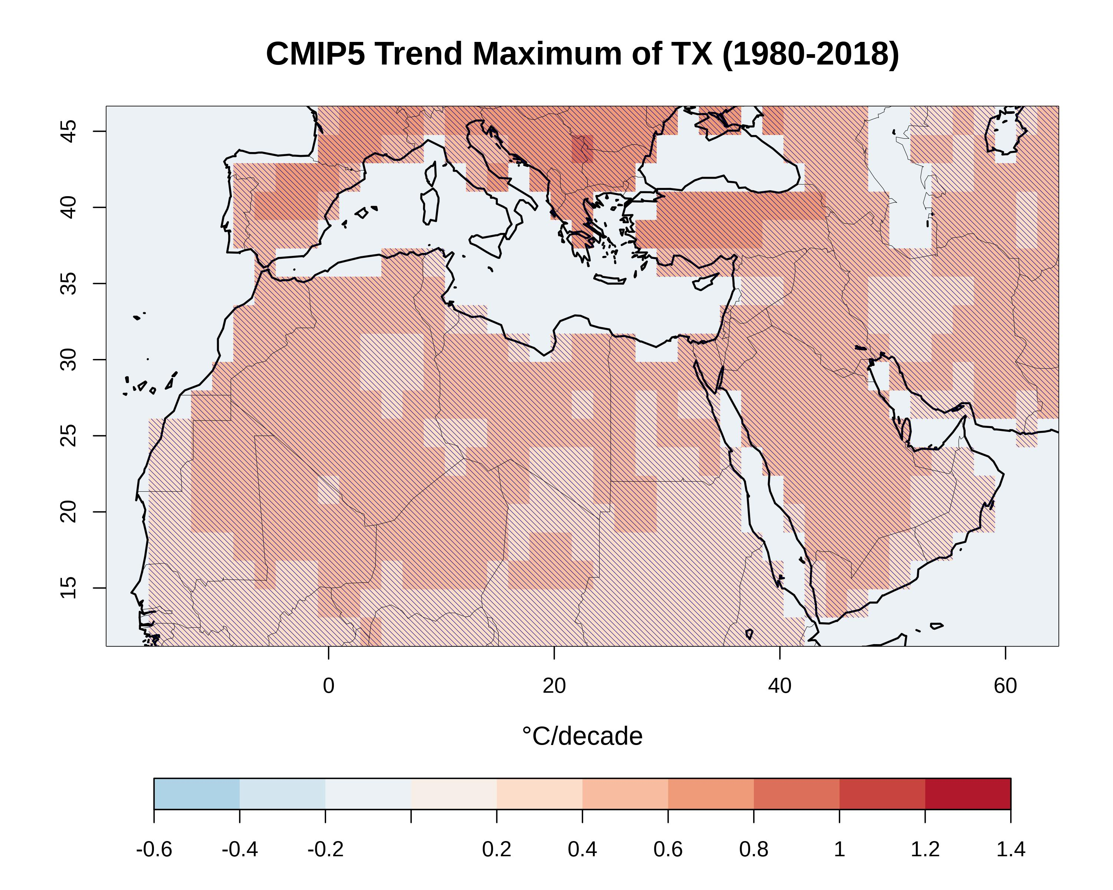
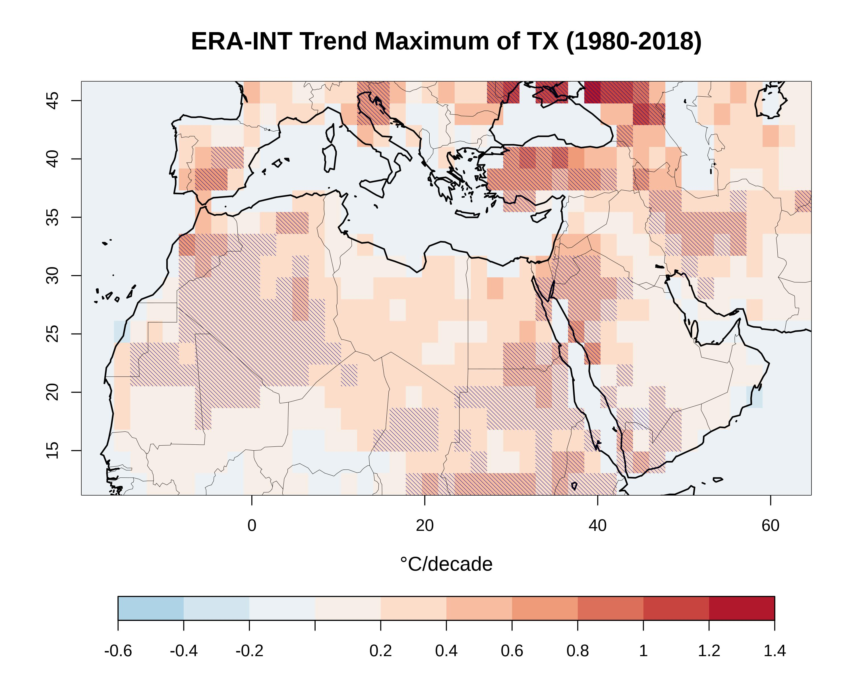
Decadal Trends – TXx Index
The above figures show the the average MENA region decadal trends of the TXx index for CMIP5 multimodel ensemble mean and ERA-Interim reanalyses. The statistical significance of the trends are also illustrated with the parallel lines.
CMIP5 models and ERA-Interim show similar range of warming trend
More intense warming trend for CMIP5 models
ERA-Interim warming trend more spatial variable

Slide 10
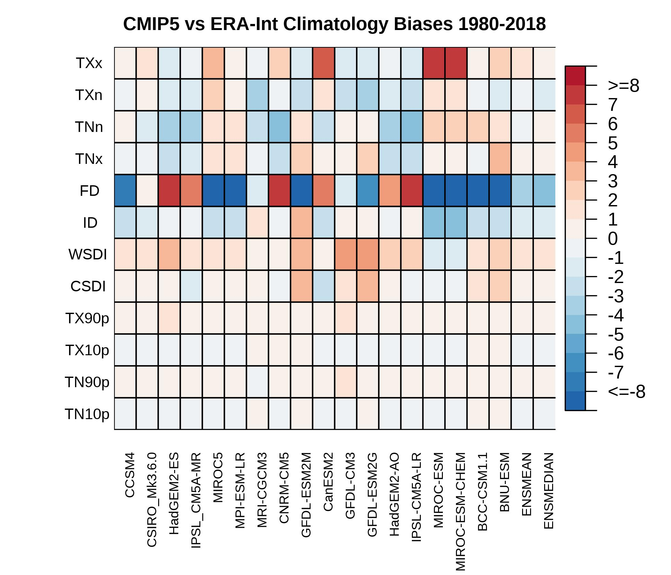
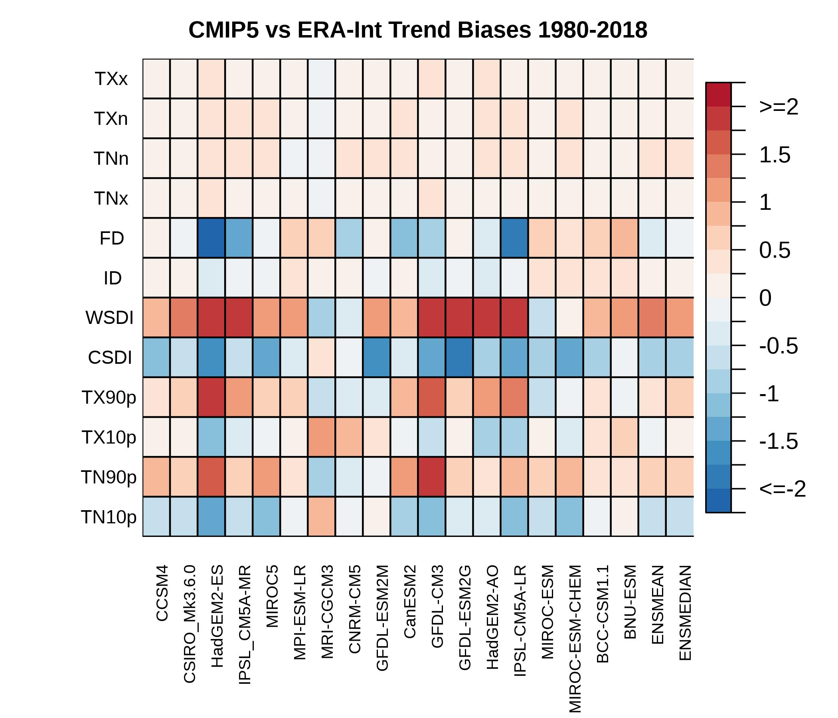
Quantification of Models Biases
The “portrait” diagrams of averaged biases in the 1980–2018 climatology (left) and the 1980-2018 average decadal trend (right) of temperature indices simulated by the CMIP5 models with respect to ERA-Interim reanalyses. The relative magnitude of spatially averaged bias for each index (rows) and for each model (columns) is displayed. The biases are spatially averaged over MENA region land grid points.
Ensemble mean and ensemble median outperform individual models
Insignificant biases for percentile indices (TX90p, TX10p, TN90p, TN10p) in climatology diagram as expected by their definition (base period 1980-2010)
On average, most indices are well represented by the models especially by MRI-CGCM3, CCSM4 and CSIRO_Mk3.6.0
Larger biases are observed for FD index (climatology) and WSDI/CSDI indices (trends)

Slide 11
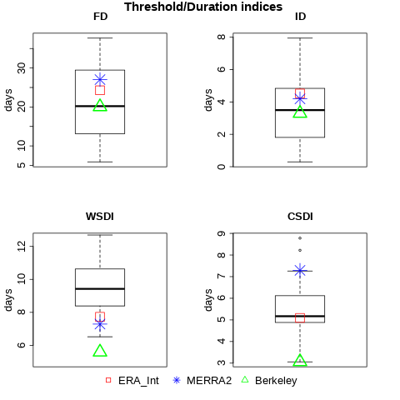
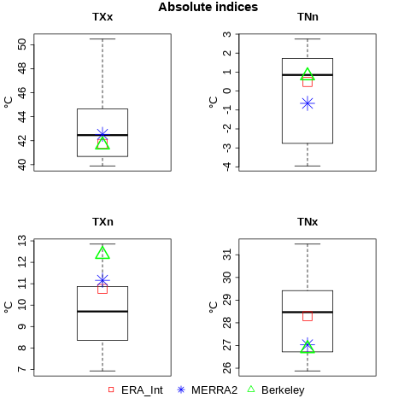
Box and whisker plots
Box-and-whisker plots for temperature indices climatology calculated from 18 CMIP5 models for MENA region over the time period (1980-2018). The boxes indicate the interquartile model spread (range between the 25th and 75th quantiles), the black/grey solid marks within the boxes show the multimodel median and the whiskers indicate the total intermodel range. The reanalyses and observations are indicated in different shapes for ERA-Interim (red), MERRA2 (blue) and Berkeley (green). Displayed are the absolute (top left), threshold/duration (top right) and percentile (bottom) indices.
Reanalyses – observational data in agreement with the model spread in most cases
Most models seem to overestimate Warm Spell Duration (WSDI) and underestimate the annual minimum of TX (TXn)

