Slide 1
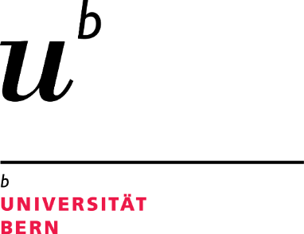
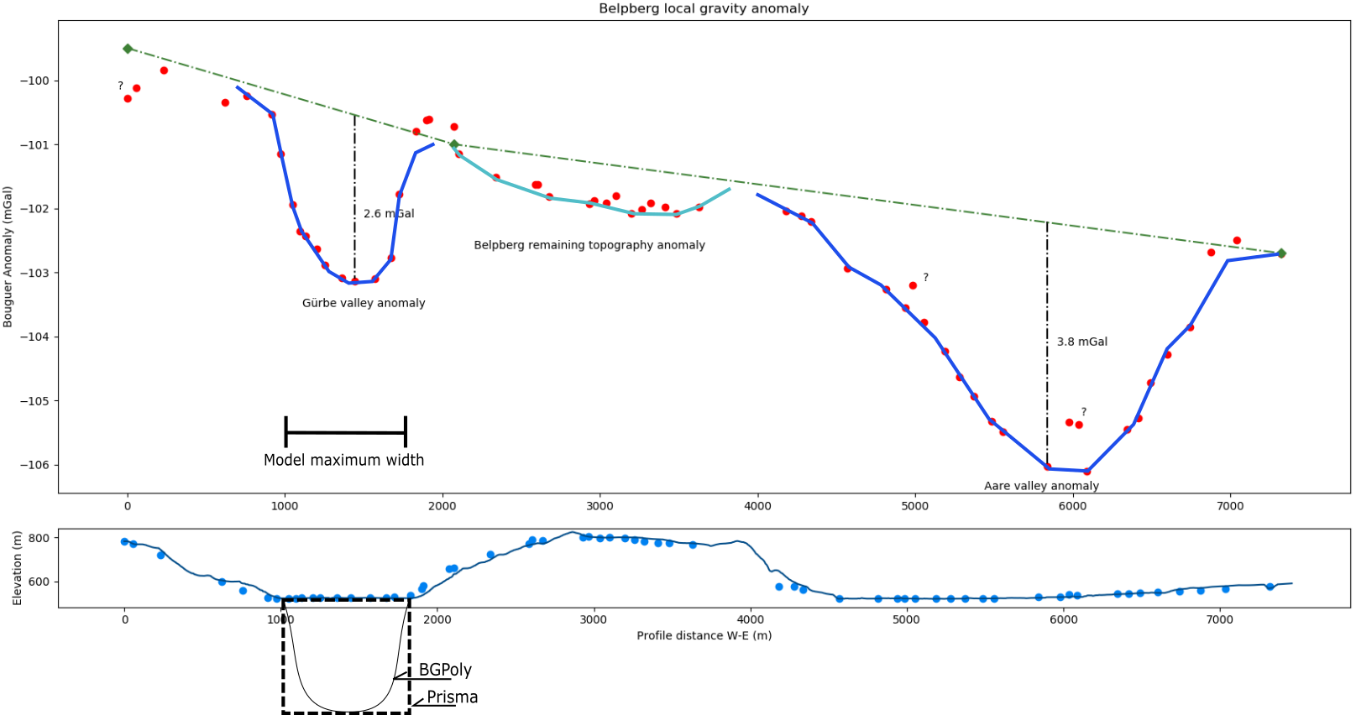
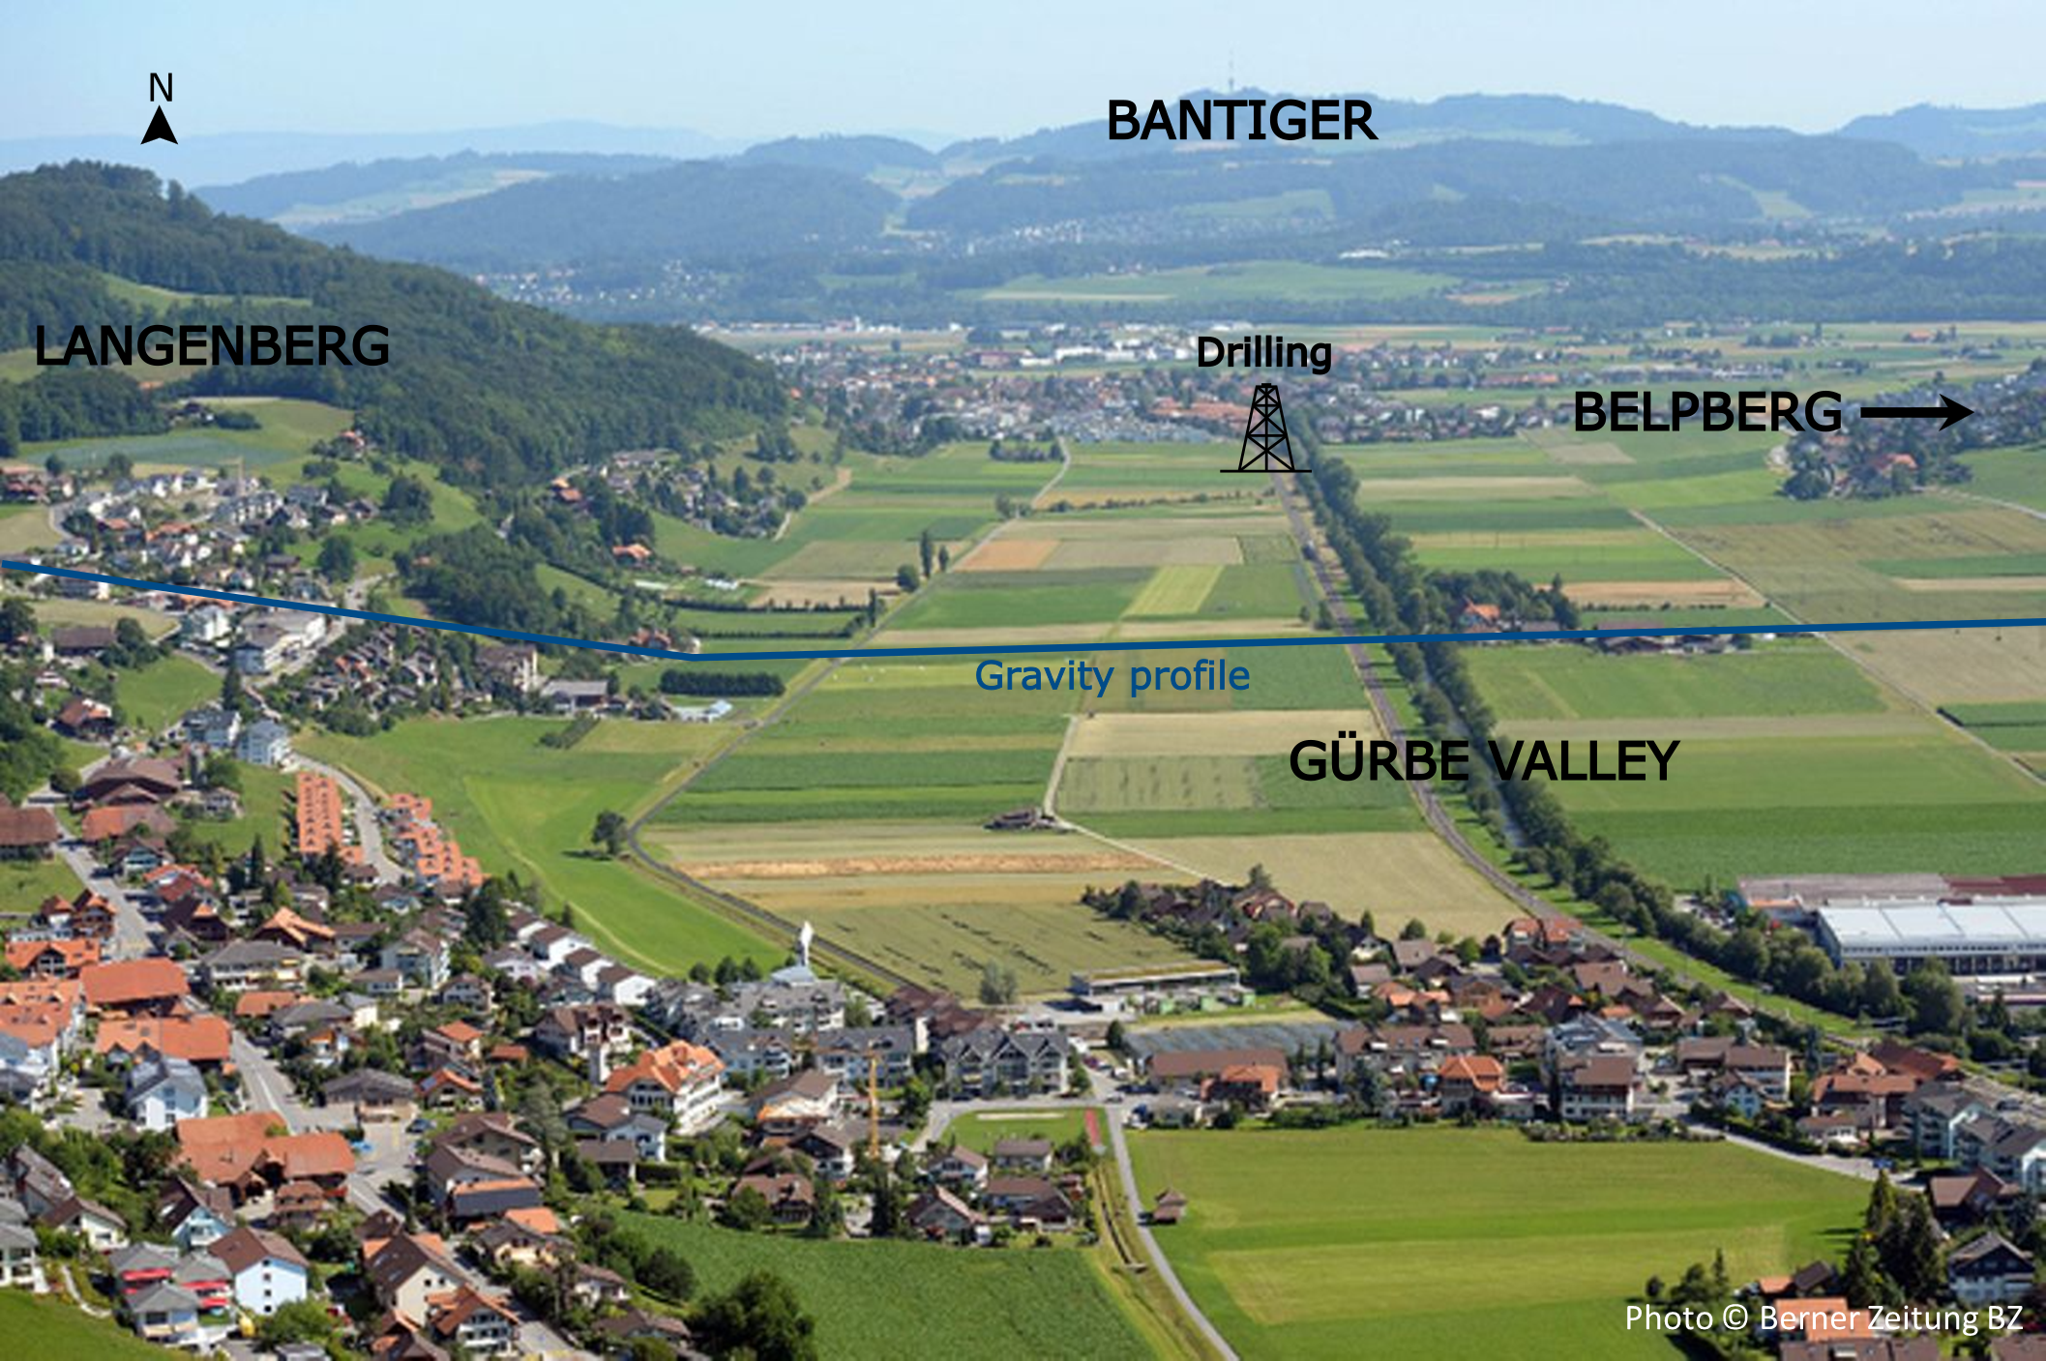
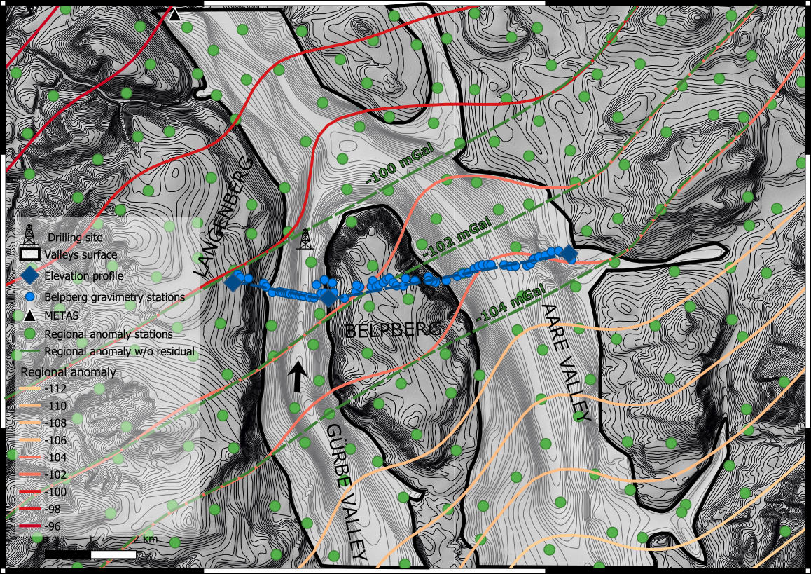
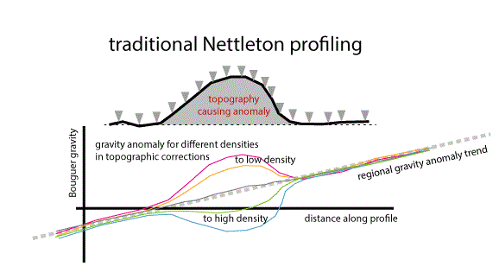
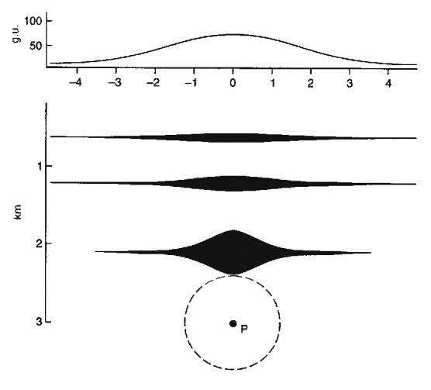
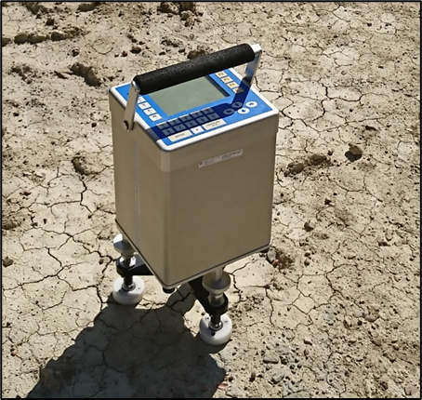
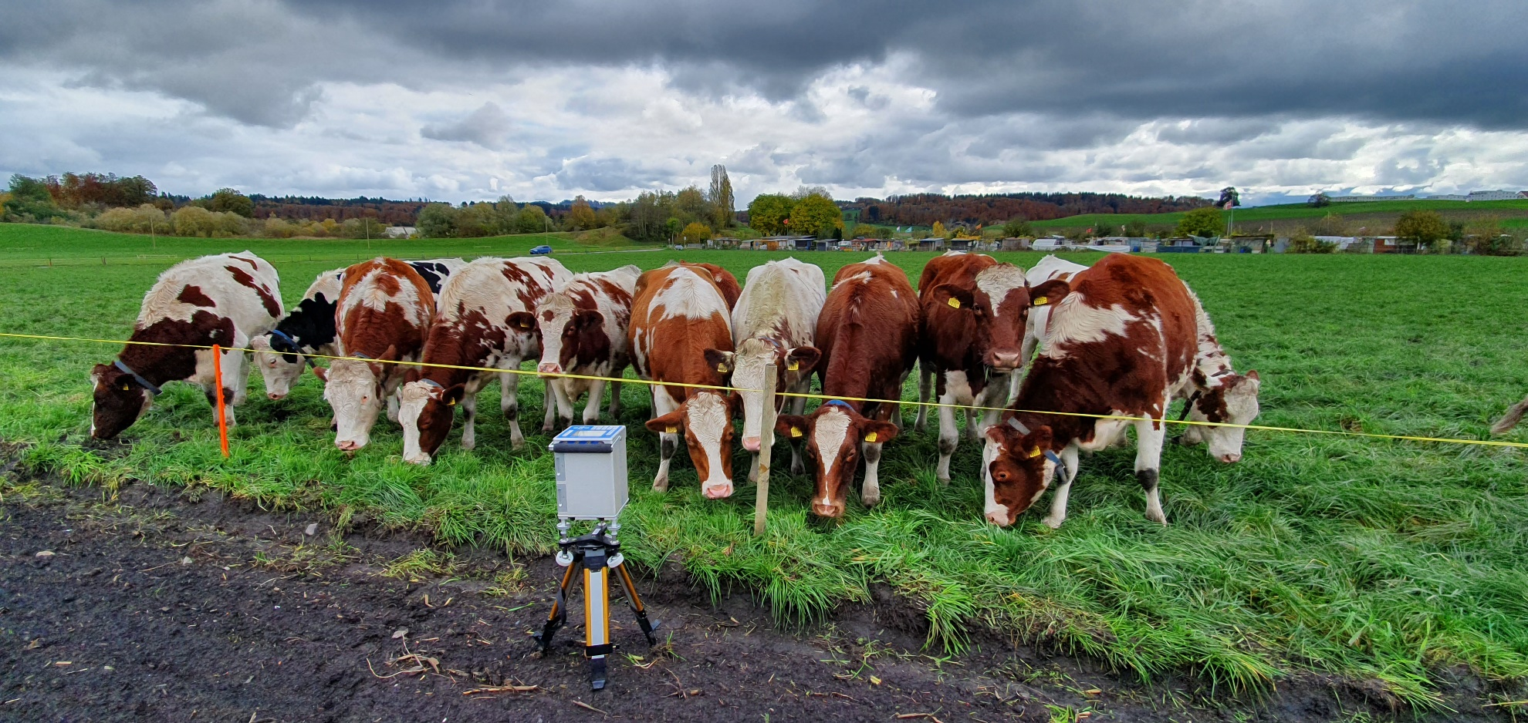
Overdeepenings modelled with gravimetry-based data
Dimitri Bandou*, Patrick Schläfli*, Michael Schwenk*, Guilhem A. Douillet*, Edi Kissling** & Fritz Schlunegger*
*Institut für Geologie, Universität Bern, Balzerstrasse 1+3, CH-3012 Bern (dimitri.bandou@geo.unibe.ch)
**Institut für Geophysik, ETH Zürich, Sonnegstrasse 5, CH-8092 Zürich
Introduction
The main formation mechanism of overdeepenings, whether it is a mostly a glacial or fluvio-glacial process, or even if these structures are relict features of e.g. riverbeds of yet unknown age, is still matter of debate (Cook and Swift, 2012). In order to answer the question, “how are overdeepenings formed?”, we plan to fill the lack of information on the morphology of overdeepened valleys by using gravimetric data in 3D forward modelling. It will allow us to reconstruct the flank geometries and depth of the overdeepenings, leading to a better understanding of their origin. Here, we present how we acquire density data and how we create our 3D forward model. This allow us to explore the general effect of overdeepenings on the Bouguer anomaly and to show how to estimate the density of the bedrock where the overdeepenings were formed. Last, we present how this data set constrains our 3D models.
Results : Belpberg local Bouguer anomaly
(A)
(B)
Figure 3 – (A) Standard Bouguer anomalies (red dots) calculated for the newly measured profile stations (blue dots in figure 2), for a density of 2.67 g/cm3. The green dashed line represents the regional Bouguer gravity field without the local (residual) anomalies as documented by the green dashed lines in figure 2. The dark blue lines illustrate the local residual gravity effects related to the Gürbe and Aare overdeepenings. The vertical black dashed lines mark the valleys maximum residual anomalies. The light blue line shows the Belpberg residual anomaly. The question marks were placed to mark gravity stations with obvious outliers. In these locations among others, the gravity will be remeasured for verification.
Bouguer gravity anomalies are the expression of a mass deficit (for negative anomalies) or mass excess (for positive anomalies) relative to a layer wise homogenous mass distribution. We clearly observe the mass deficits represented by the sedimentary infills of the two tunnel valleys relative to the bedrock. Furthermore, the lightly negative gravity anomaly between the two valleys corresponding in profile distance with the Belpberg refers to the fact, that the local bedrock lithology (Upper Marine Molasse) has a bulk average density that is significantly smaller than the standard value of 2.67 that is used for Bouguer anomaly calculation. Subsequently, this anomaly will be used to determine the correct density for the bedrock UMM by so-called “Nettleton modelling” (see below).
For a symmetrical shaped tunnel valley, the residual Bouguer gravity anomaly would yield a symmetrical shape as is nearly the case for the Gürbe valley. The Aare valley gravity anomaly, however, shows a strong asymmetry between the western and the eastern flanks and this suggests a similar asymmetry in the shape of the bedrock.
Figure 3 – (B) The dark blue line represents the surface elevation of the Gürbe valley, Aare valley and the Belpberg, that we followed to conduct the gravity survey (figures 1 and 2). The light blue dots are the gravity stations location. The offset between stations’ positions and the elevation is caused by 2D surface topography interpolation effect along the profile.
The information from this data can be further exploited through modelling in order to determine the density and to reconstruct the geometry of the overdeepenings in 3D. We developed a new code called Gravi3D, which build on prisms (black dash cube) and polygons (black line).
Figure 1 – Photograph of the formerly glaciated Gürbe valley. (Photo © Berner Zeitung BZ). The Gürbe valley is bordered on its lateral flanks by bedrock ridges made up of Upper Marine Molasse (UMM) sandstones. A drilling in the middle of the valley disclosed that the valley infill comprises of Quaternary sediments, 80 m of lacustrine clay with a till interbed these deposits are underlined by additional 30 m of fluvial gravels. The bedrock as not been reached (Geotest, 1995).
Building the 3D models
Figure 4 - (A) As gravity provides information about the total mass of a structure, knowing the density would allow us to determine the geometry of the target body. As the bedrock underlying the valleys is of the same composition as all the neighbouring hills, including the Belpberg, we employ the Nettleton profiling to model the density of the bedrock.
Figure 4 - (B) We developed a 3D forward model to determine the shape of the overdeepenings, because the gravity effect provides non unique solutions as illustrated in figure 4 – (B).
This is accomplished in two steps: - First, the extent of the model space is estimated by using prisms (figure 3 (B)) through the Prisma routine. -Second, a first geometry constrain is taken from the bedrock topography model (figure 2) for constructing polygons, using in the BGPoly routine.
The bedrock model of the target area is then improved by trial and error, until a best fit between the modelled and the measured residual anomaly is found.
(A)
(B)
Distance
Body 1
Depth
Body 2
Body 3
Density is determined using the Nettleton method. As gravity and topography are independent of each other.
Body 4
Gravity interpretation is non unique (Skeels, 1947) – All these bodies of different geometry and densities can produce the same gravity effect. Hence knowing the density is mandatory to interpret gravity data and model the geometry. http://www.ukm.my/rahim/gravity%20lecture(MSc).htm
Figure 2– Map of the bedrock topography in the Bern area. The subsurface topography has been modelled from drilling data by Reber and Schlunegger (2016). The pale grey area encircled by a solid black line corresponds to the current valley surface. The contour lines show the elevation of the bedrock (equidistance 10 meters). The black arrow represents the view direction of the photo on figure 1. The blue dots denote the new gravity stations taken by this survey and the blue line marks the orientation of the 2D profile shown in Figure 3. The green dots mark the gravity stations used for the calculation and interpolation of the Bouguer map of Switzerland (1:100’000, Olivier et al. 2010) represented by the pink to red isolines. The three green dashed lines represent the regional Bouguer gravity field without the Aare and Gürbe valleys residual anomalies.
The Bouguer map of Switzerland (1:100’000) clearly shows the gravity effects related to the sedimentary fills of the overdeepened valleys. This is illustrated by the local isoline distortion visible over the Aare valley and in the southern Gürbe valley. The regional map, however, has a to large station spacing to precisely assess the local gravity effects of the two valleys as exemplified, f.e., by missing the effect of the sediments in northern Gürbe valley. For this reason we measured additional points (see blue dots stations) along a profile crossing both valleys and the Belpberg between them.
<- Measurement perturbation on the field
References Nagy, D., 1966 : The gravitational attraction of a right rectangular prism. Geophysics, Vol 31, No. 2, 362-371 Olivier, R., Dumont, B. and Klingelé, E. 2010 : L’Atlas gravimetrique de la Suisse 1:100000 Preusser, F., Reitner, J.M. and Schlüchter, C., 2010: Distribution, geometry, age and origin of overdeepened valleys and basins in the Alps and their foreland. Swiss Journal of Geoscience, 103, 407-426 Reber, R. & Schlunegger, F. 2016 : Unravelling the moisture sources of the Alpine glaciers using tunnel valleys as constraints, Terra Nova, Vol 28, No. 3, 202-211 Talwani, M. & Ewing, M., 1960 : Rapid computation of gravitational attraction of three-dimensional bodies of arbitrary shape. GEOPHYSICS 25, 203–225 Geotest A.G., 1995 : Grundlagen für Schutz und Bewirtschaftung der Grundwasser der Kantons Bern. Hydrogeologie Gürbetal und Stockental.

Slide 2
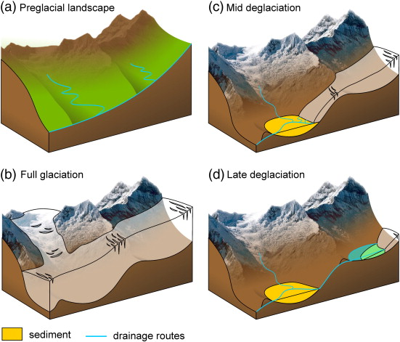
Additional figures
Overdeepening formation (Cook & Swift, 2012)

Slide 3
Gürbe valley drill log (Geotest, 1995)
Additional figures

