Slide 1
Mapping and comparing wildfire progressions using freely available, multi-source satellite data
Morgan A. Crowley¹
Jeffrey A. Cardille¹
Joanne C. White²
Michael A. Wulder²
¹ McGill University
² Canadian Forest Service (Pacific Forestry Centre)
@morganahcrowley
European Geosciences Union- May 6, 2020
morgan.crowley@mail.mcgill.ca

Slide 2
Research Objective and Presentation Outline
To map and analyze fire progressions using a multi­-source approach in Google Earth Engine.
Today’s Presentation:
Background
Satellite earth observations and fire progressions
Methods
Bayesian Updating of Land Cover (BULC) Algorithm
Google Earth Engine
Applications
Prototype
2017 and 2018 fire seasons in British Columbia, Canada
Comparison with MODIS fire progressions
Future research opportunities
@morganahcrowley

Slide 3
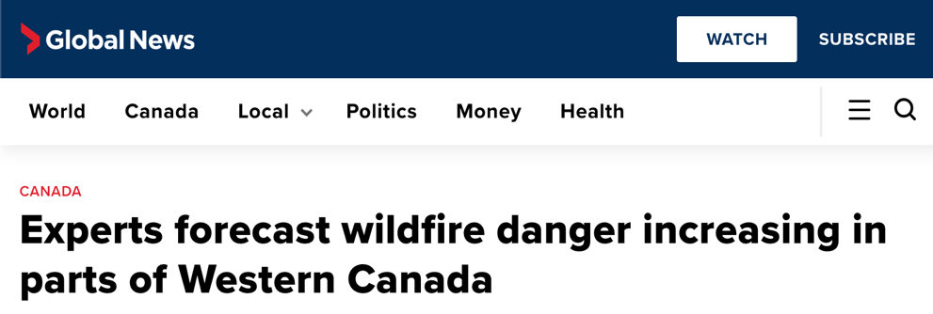
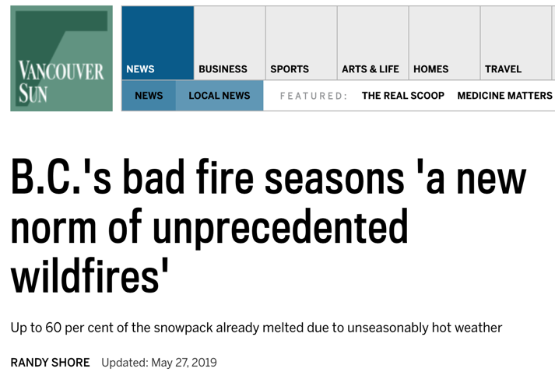
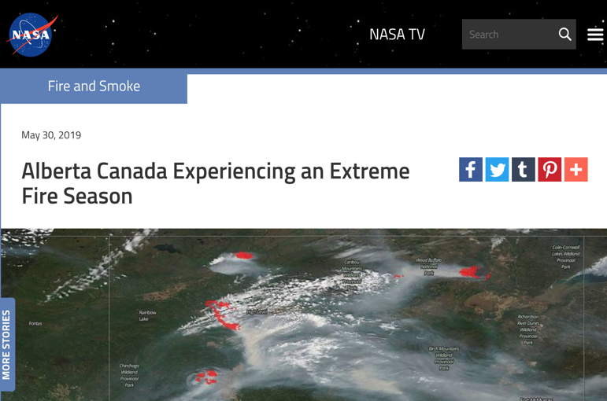
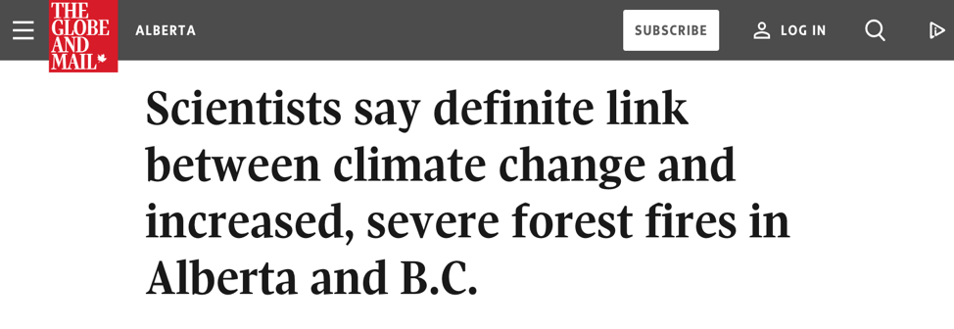
Canada has been facing extreme fire seasons
2

Slide 4
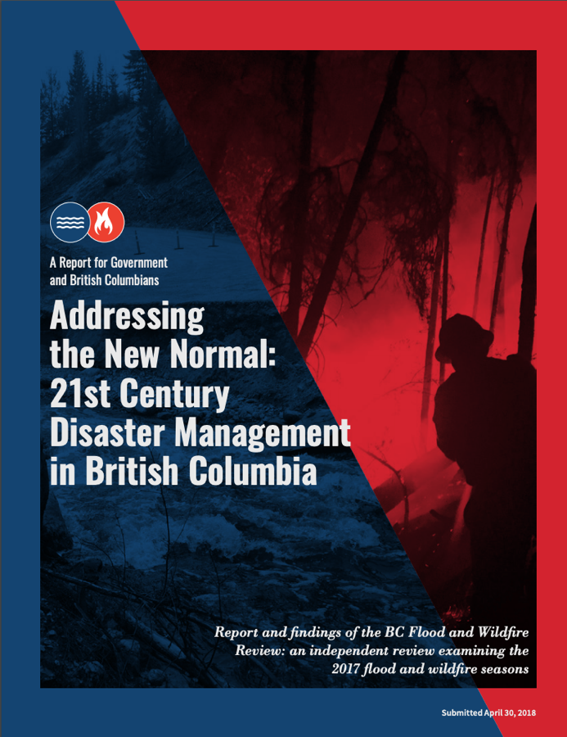
Calls to advance wildfire monitoring in Canada
Recommendation 74.
As part of overall emergency management, … undertake hazard risk mapping... in communities vulnerable to crisis situations.
Recommendation 90.
Increase use of technology… during response by incorporating... real-time mapping... to assess and assist with planning in all phases of emergency management.

Slide 5
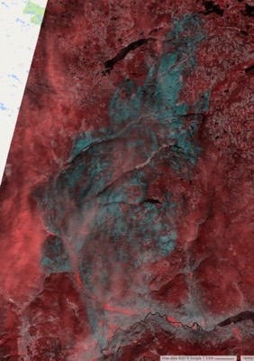
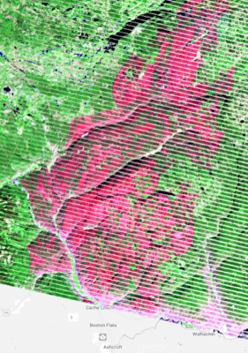
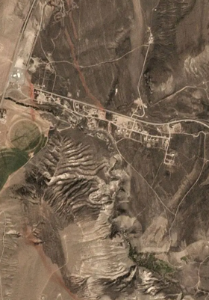
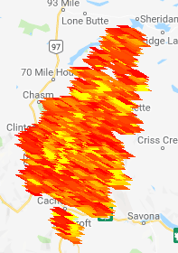
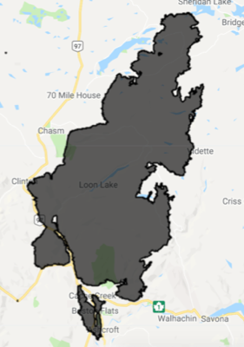
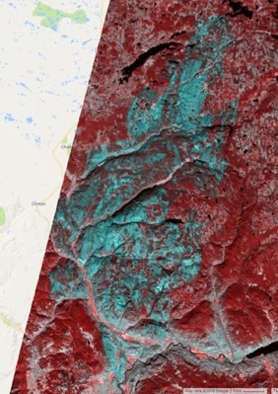
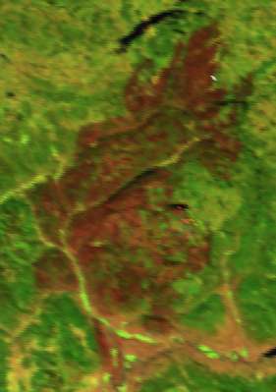
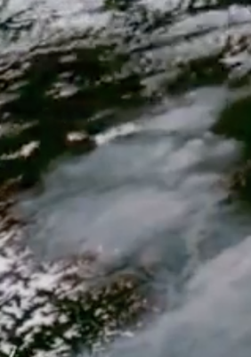
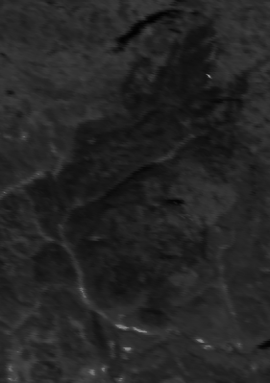
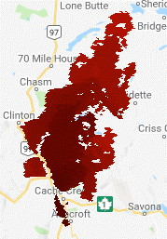
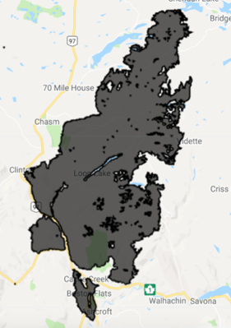
Many satellites collect active fire observations in Canada
Landsat 8
Landsat 7
Planet
VIIRS
Fire Perimeters
Sentinel 2
MODIS
GOES-16, -17
WildFireSat
MCD64A1
Burn Composites
@morganahcrowley

Slide 6
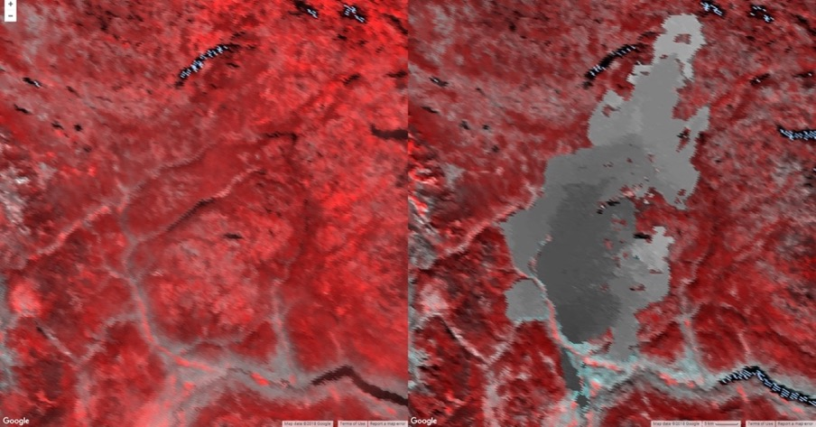
MODIS provides daily global observations
MODIS
MCD64A1
Pros:
Global Algorithm
Daily
Cons:
Coarse Spatial Resolution (500m)
4+ months to produce
July 5, 2017
September 16, 2017
Sentinel 2
July 4, 2017
October 1, 2017
Giglio, L., Justice, C., Boschetti, L., Roy, D. 2015. MCD64A1 MODIS/Terra+Aqua Burned Area Monthly L3 Global 500m SIN Grid V006
[Data set]. NASA EOSDIS Land Processes DAAC. doi: 10.5067/MODIS/MCD64A1.006

Slide 7
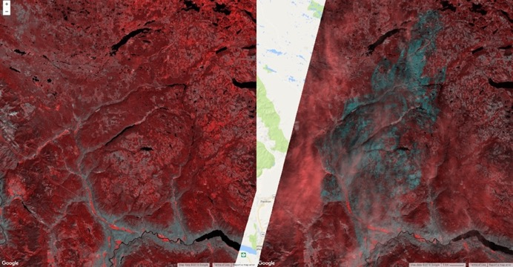
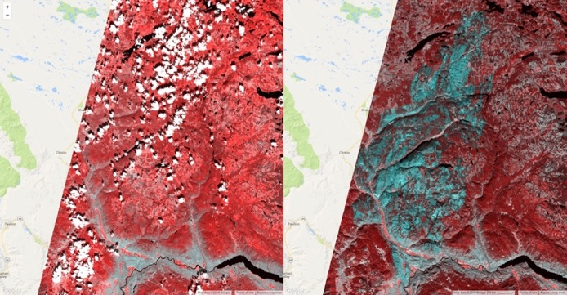
LC8 and S2 are useful for before-and-after approach
Landsat-8
Pros:
Easy processing
Field evidence
Fire severity estimates
Fine spatial scale
Cons:
Impacted by clouds, haze
July 5, 2017
September 16, 2017
Sentinel-2
July 2, 2017
October 5, 2017
Frazier et al. 2018, RSE 205: 32-45; Hall et al. 2008, Int. J. Wildland Fire 17(4): 476-489; Key & Benson 2006; San-Miguel et al. 2017,
Forest Ecol. Manag. 399: 155-165; Soverel et al. 2010, RSE 114(9):1896-1909; Soveral et al. 2011, Int. J. Wildland Fire 20(4):518-531.

Slide 8
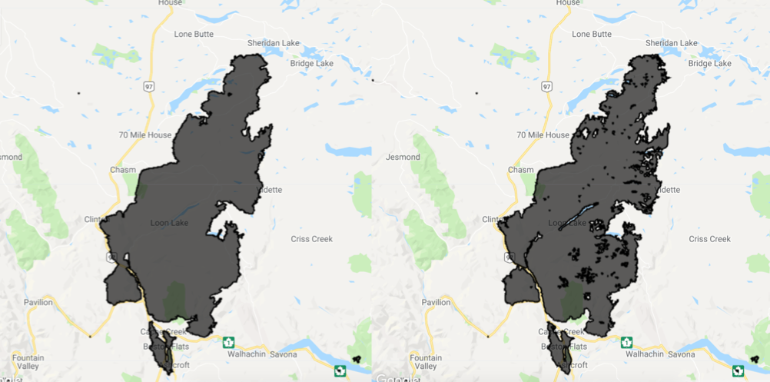
Canadian databases provide reliable fire extents
Provincial fire agency perimeters
National Burned Area Composite
Pros:
Best available algorithm for each fire
Useful for carbon modelling
Cons:
Doesn’t store “when” and “where” of fire progression
January 25, 2018
September 30, 2018
Natural Resources Canada, 2018. Canadian National Fire Database - National Burned Area Composite [Data set].
http://cwfis.cfs.nrcan.gc.ca/ha/nfdb

Slide 9
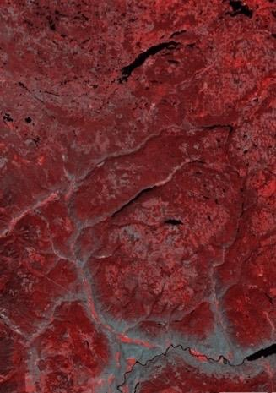
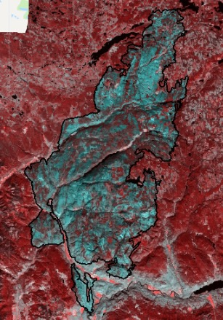
Before-and-after relies on two images for area estimates

Slide 10
Observations are available throughout fire season

Slide 11
Other satellites collect active fire images, as well

Slide 12
Observations from multiple satellites fill in time series

Slide 13
Until we have images of the entire actively burning period

Slide 14
From data stack, we calculate fire’s growth progression

Slide 15
What happens at a fine spatial scale as a fire burns?
We answer this by…
Combining sensors to improve spatial and temporal resolution
Time-series analysis of fire progressions
Increasing processing speeds and capacity using Google Earth Engine
@morganahcrowley
Notes:
What you’ll see here in this gif is the growth of the elephant hill fire that can be visualized using imagery from the multiple sources we just discussed.

Slide 16
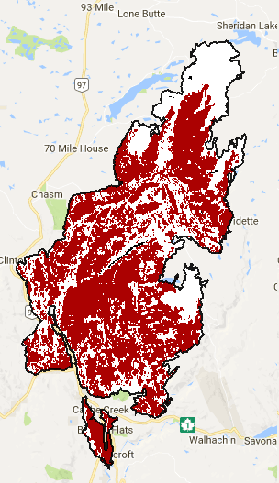
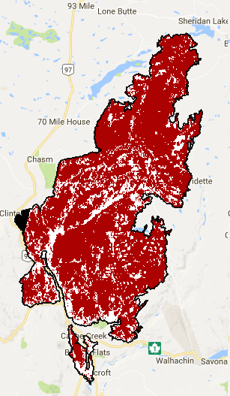
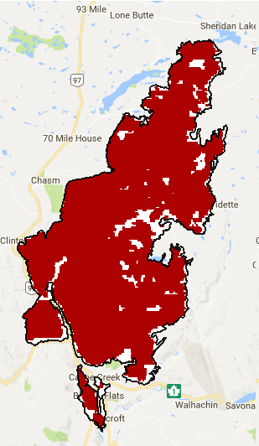
We can’t just stack classifications directly...
Landsat 8
Sentinel 2
MODIS
August 22, 2017
September 15, 2017
September 16, 2017
@morganahcrowley
Notes:
You might ask why we don’t just stack the imagery together in date order. That is because each classification is noisy, and when ordered in a time series, raw, they disagree with eachother which could really impact our further analyses.

Slide 17
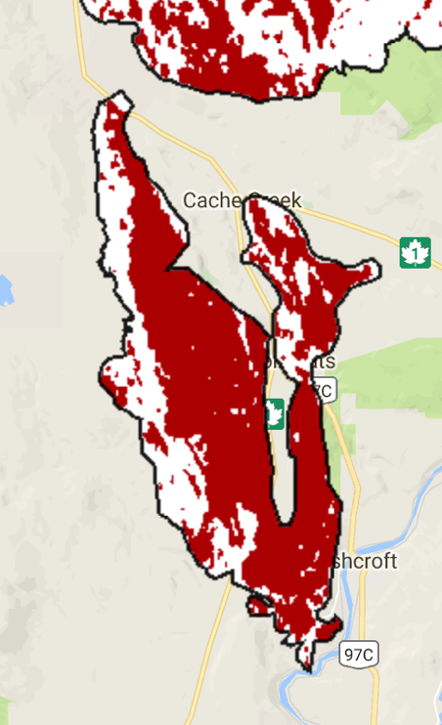
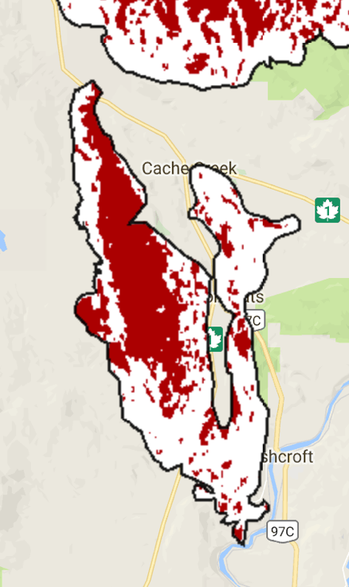
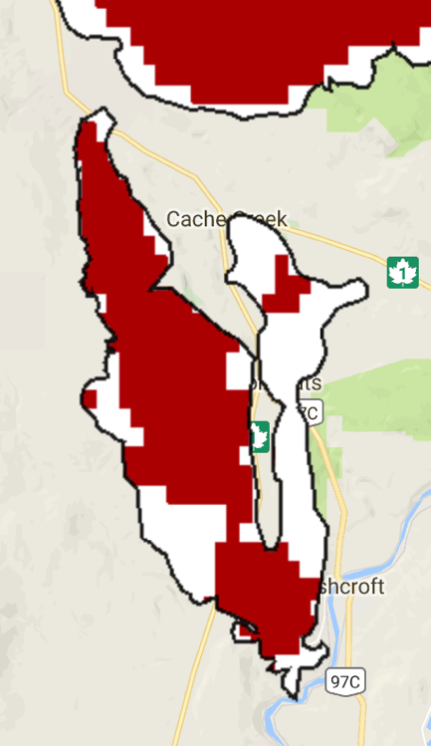
...because individual classifications are noisy
Landsat 8
Sentinel 2
MODIS
August 22, 2017
September 15, 2017
September 16, 2017
@morganahcrowley
Notes:
And if we zoom in further, we can really see that they won’t necessarily correspond in each pixel when stacked temporally.

Slide 18
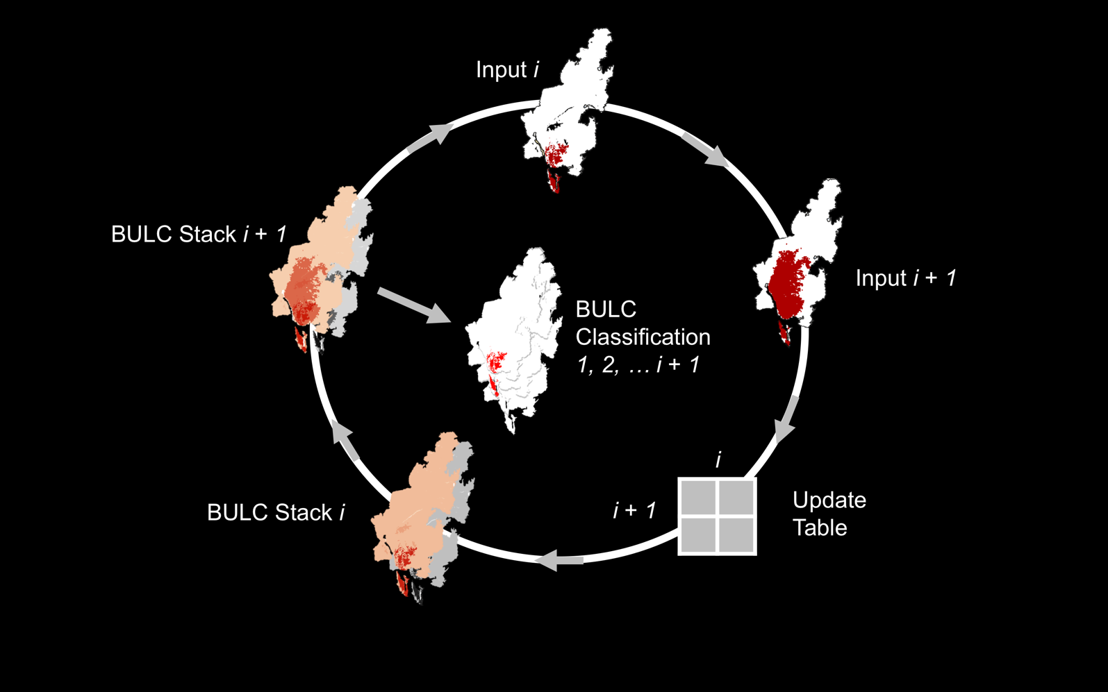
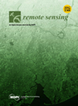
BULC is our lab’s Bayesian synthesis algorithm
1.
4.
3.
2.
Cardille & Fortin 2016, RSE 186: 234-249; Lee et al. 2018, Remote Sensing 10(9): 1455; Crowley et al. 2019a, Remote Sens. Lett. 10:3, 302-311; Crowley et al. 2019b, RSE 232: 111295; Deines et al. 2019, RSE 233: 111400
Notes:
First, to be able to map continuous fire progressions, we need an algorithm that can synthesize imagery together from multiple sources.
Our lab has a way to synthesize these classifications, using the Bayesian Updating of Land-Cover algorithm. Essentially, we take each classification and compare it with the previous one for a given area shown in step 1 and 2, to evaluate its probabilities of burned-area within each pixel shown in step 3. From these probabilities, we can create a synthesized, evidence-based time series dataset shown in step 4.

Slide 19
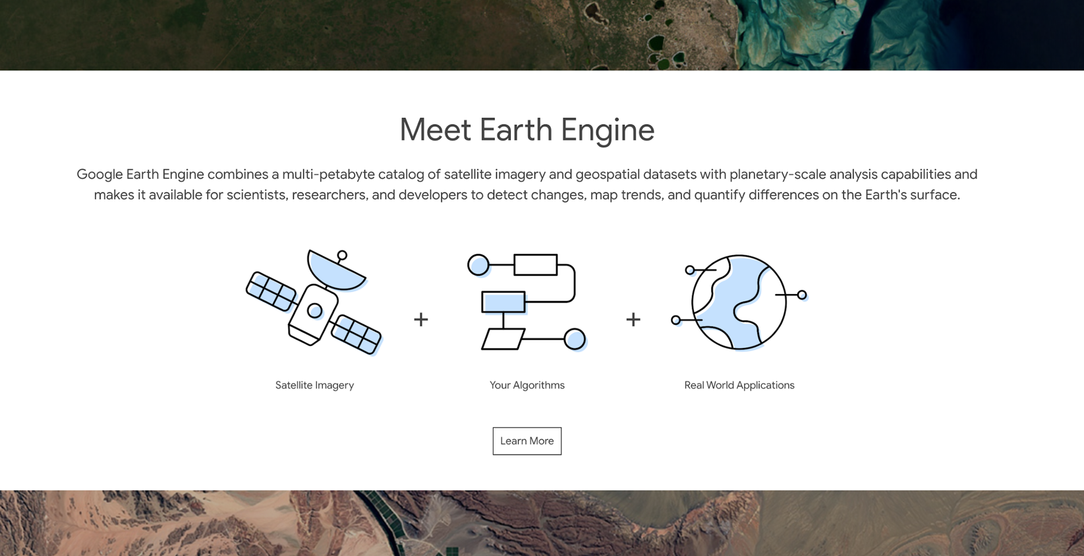
Google Earth Engine platform stores and processes images
@morganahcrowley

Slide 20
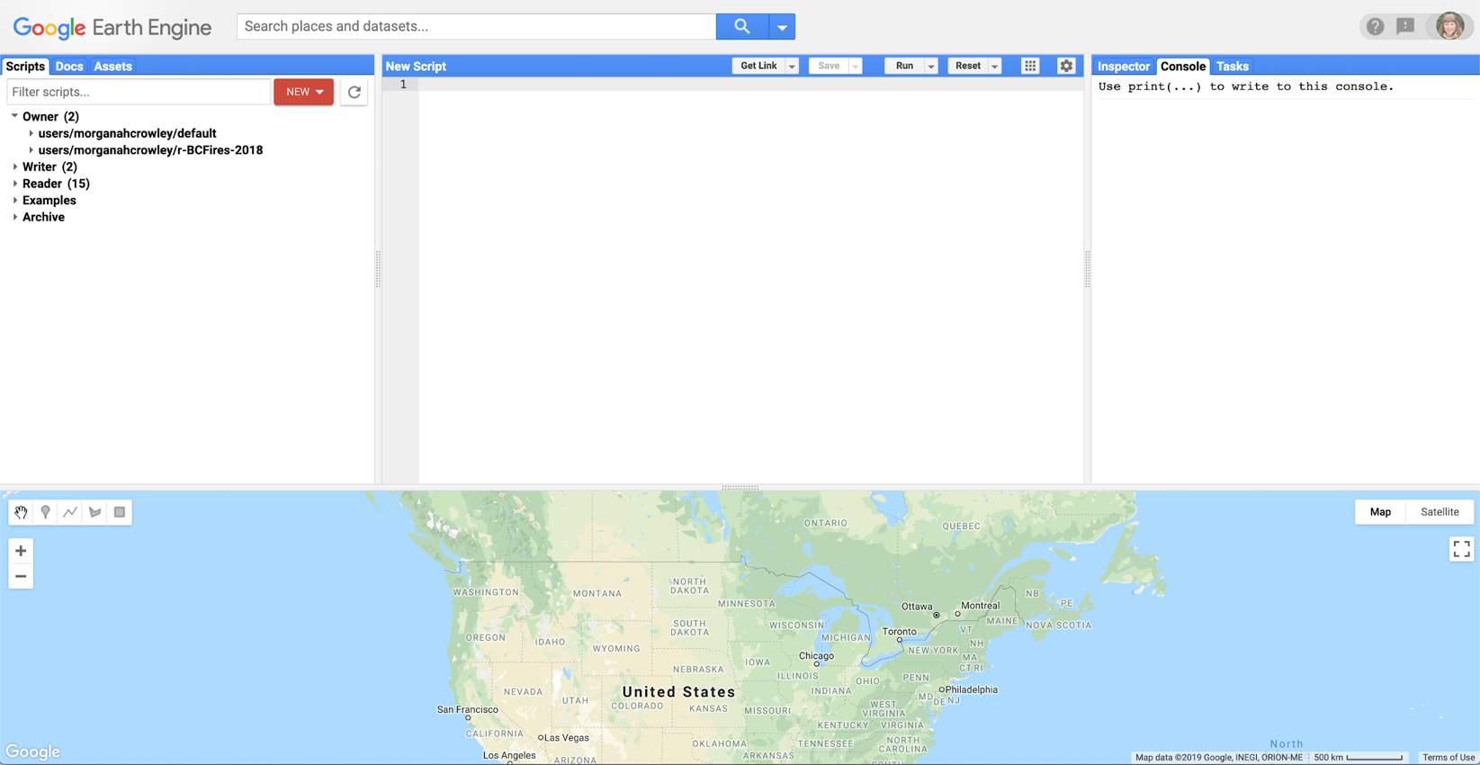
The code editor enables replicable large-scale analyses
@morganahcrowley

Slide 21
First, we create the provisional fire classifications
Stage 1
Satellite
Images
Fire
Perimeters
BAP
Composite
Provisional Classification Creation
Provisional Classification Creation
Provisional Burned Areas
@morganahcrowley

Slide 22
Second, we synthesize these classifications using BULC
Stage 1
Stage 2
Satellite
Images
Provisional Burned Areas
Fire
Perimeters
BAP
Composite
BULC Algorithm
Provisional Classification Creation
Provisional Classification Creation
BULC Probabilities
BULC Classifications
Provisional Burned Areas
@morganahcrowley

Slide 23
Third, we compare our findings with NBAC dataset
Stage 1
Stage 2
Stage 3
Satellite
Images
Provisional Burned Areas
BULC Classifications
Fire
Perimeters
NBAC
Polygons
BAP
Composite
BULC Algorithm
Dataset Validation
Provisional Classification Creation
Dataset Validation
Provisional Classification Creation
BULC Probabilities
BULC Classifications
BULC Fire Progressions
Provisional Burned Areas
@morganahcrowley

Slide 24
Fourth, we analyze progressions per fire and per season
Stage 1
Stage 2
Stage 3
Stage 4
Satellite
Images
Provisional Burned Areas
BULC Classifications
BULC Fire Progressions
Fire
Perimeters
NBAC
Polygons
BAP
Composite
BULC Algorithm
Fire Attribute Analysis
Dataset Validation
Provisional Classification Creation
Dataset Validation
Provisional Classification Creation
BULC Probabilities
Progression Insights
BULC Classifications
BULC Fire Progressions
Provisional Burned Areas
@morganahcrowley

Slide 25
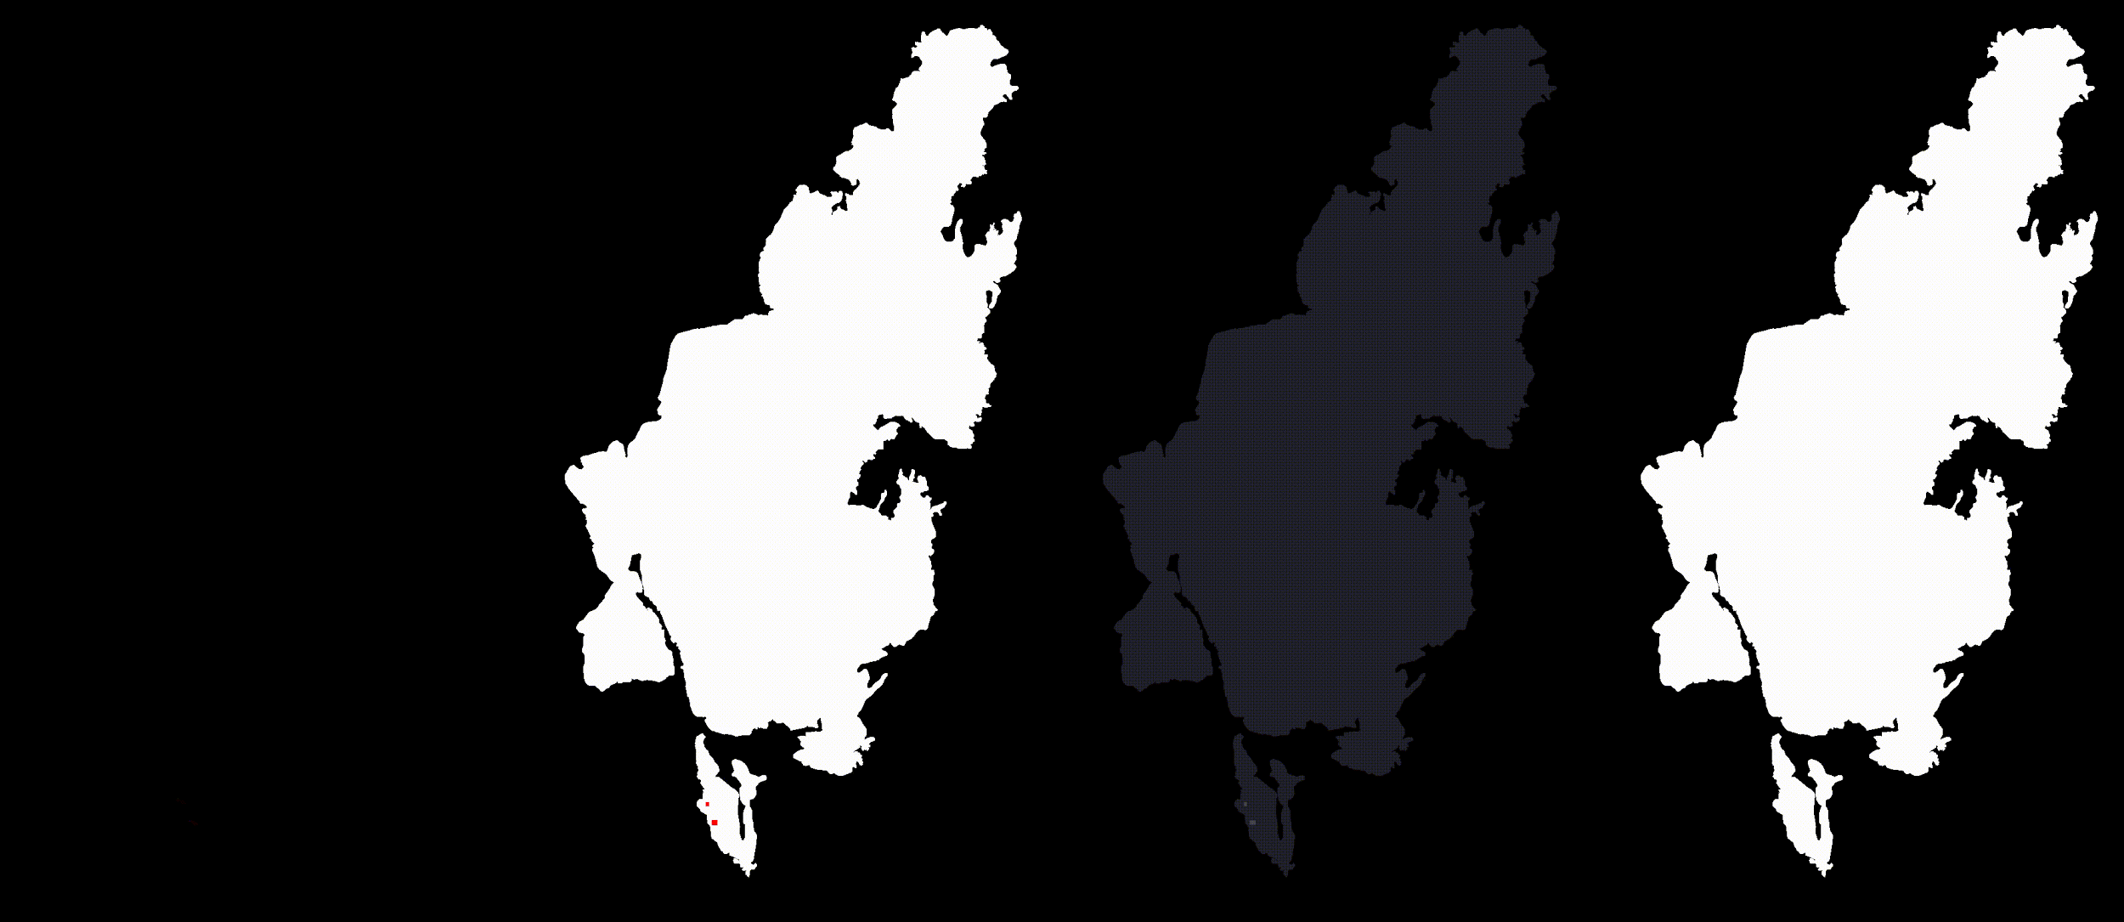
The time series prototype captures the fire’s growth.
1. Raw
2. Provisional
Classification
3. Confidence
4. BULC
Landsat-8
Sentinel-2
MCD64A1
July
2017
Oct.
2017
Crowley, Cardille, White & Wulder (2019) Multi-sensor, multi-scale, Bayesian data synthesis for mapping within-year
wildfire progression, Remote Sensing Letters, 10:3, 302-311, DOI: 10.1080/2150704X.2018.1536300
Notes:
What you see here is our prototype for the Elephant Hill fire’s burn progression, with the raw data in panel 1, the provisional classifications in 2, BULC confidences in 3, and final classifications in 4. Below, you can see the cumulative burned area in hectares, with the number of observations corresponding with this top gif.
We created this prototype relying on 23 provisional classifications images synthesized using BULC to inform the resulting classification.

Slide 26
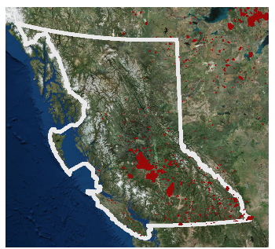
Methods were scaled up to entire 2017 fire season
Hectares
Observations
Cumulative burn progression area
All 2017 Fires in BC, Canada
Dataset features:
Fires | Coverage (km²) | Sensors | Images | Temporal Res. | Ecozones
1 | 1,000 | 3 | 23 | weekly | 1
89 | 15,000 | 4 | 1500+ | sub-weekly | 7
Crowley, Cardille, White & Wulder (2019b) Generating intra-year metrics of wildfire progression using multiple open-access satellite data streams, Remote Sensing of Environment, 232, 111295, https://doi.org/10.1016/j.rse.2019.111295

Slide 27
Burned-area metrics highlight large fire patterns
1. Burned-areas
Plateau Fire
Hanceville-Riske Creek
Elephant Hill
White River
All Other Fires
hectares
Crowley, Cardille, White & Wulder (2019b) Generating intra-year metrics of wildfire progression using multiple open-access satellite data streams, Remote Sensing of Environment, 232, 111295, https://doi.org/10.1016/j.rse.2019.111295

Slide 28
Second, counts show when most fire ignitions occurred
1. Burned-areas
Plateau Fire
Hanceville-Riske Creek
Elephant Hill
White River
All Other Fires
hectares
2. # of active fires
count
Crowley, Cardille, White & Wulder (2019b) Generating intra-year metrics of wildfire progression using multiple open-access satellite data streams, Remote Sensing of Environment, 232, 111295, https://doi.org/10.1016/j.rse.2019.111295

Slide 29
Third, we can identify slow or fast growing fires
1. Burned-areas
Plateau Fire
Hanceville-Riske Creek
Elephant Hill
White River
All Other Fires
hectares
2. # of active fires
count
3. Prop. total burned
prop. total burned per fire
Crowley, Cardille, White & Wulder (2019b) Generating intra-year metrics of wildfire progression using multiple open-access satellite data streams, Remote Sensing of Environment, 232, 111295, https://doi.org/10.1016/j.rse.2019.111295

Slide 30
Fourth, spikes due to lightning and wind storms
1. Burned-areas
Plateau Fire
Hanceville-Riske Creek
Elephant Hill
White River
All Other Fires
hectares
2. # of active fires
count
3. Prop. total burned
prop. total burned per fire
4. Fire spread rates
ha per day
Crowley, Cardille, White & Wulder (2019b) Generating intra-year metrics of wildfire progression using multiple open-access satellite data streams, Remote Sensing of Environment, 232, 111295, https://doi.org/10.1016/j.rse.2019.111295

Slide 31
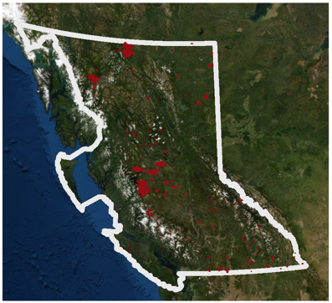
We are applying methods to examine 2018 fire season
Hectares
Observations
Preliminary cumulative burn progression (overestimation)
All 2018 Fires in BC, Canada
Dataset features:
Fires | Coverage (km²) | Sensors | Images | Temporal Res. | Ecozones
1 | 1,000 | 3 | 23 | weekly | 1
89 | 15,000 | 4 | 1500+ | sub-weekly | 7
220 | 25,000 | 4 | 2400+ | sub-weekly | 6
@morganahcrowley
Notes:
We applied the same mapping protocol to reconstruct the 2018 fire season and compared aggregated fire season progressions for 2017 and the preliminary 2018 dataset. The 2018 fire season started later and burned larger than the 2017 fire season. Further refinement is necessary to finalize the estimated 2018 BULC-Fire progression.

Slide 32
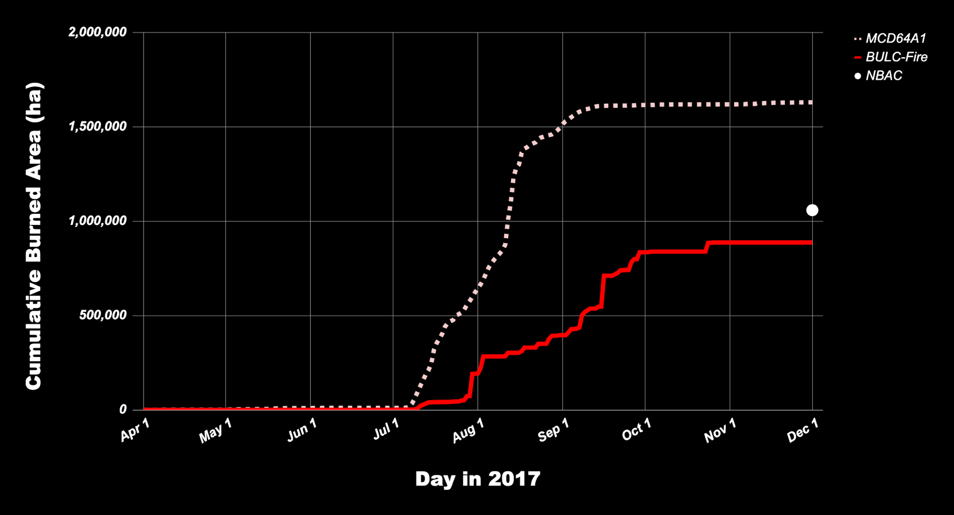
BULC-Fire vs MODIS progressions for 2017 BC fire season
@morganahcrowley
Notes:
We charted the 2017 BULC-Fire progression against the MODIS fire progression to compare their agreement over time. Coarse resolution sensors provide observations, but can overestimate burned area measurements, it’s important to use fine-scale observations when we’re able. Despite the different spatial resolution for BULC-Fire (20m) and MODIS (500m), they frequently agreed about the timing of the fire season's growths in burned area.

Slide 33
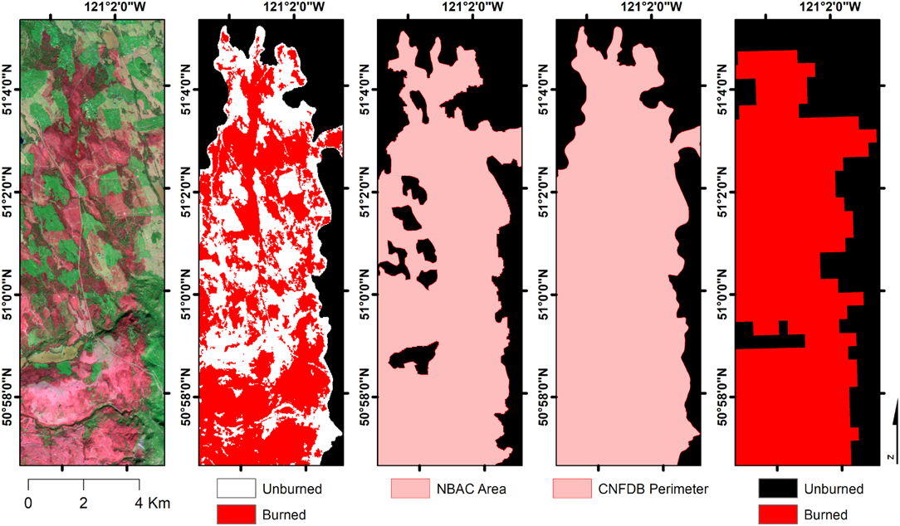
Spatial resolution impacts burned-area estimations
Dataset | All BC fires (ha) | NBAC (ha) | Relative difference
BULC-Fire 2017 | 890,988 | 1,057,998 | −15.79 %
MODIS 2017 | 1,629,343 | 1,057,998 | 54.00 %
1.
2.
3.
4.
5.
Crowley, Cardille, White & Wulder (2019b) Generating intra-year metrics of wildfire progression using multiple open-access satellite data streams, Remote Sensing of Environment, 232, 111295, https://doi.org/10.1016/j.rse.2019.111295
Notes:
We compared a raw Sentinel-2 image of the Elephant Hill fire [1], the final BULC-Fire classification [2], the NBAC dataset [3], CNFDB perimeter [4], and the MODIS burned area estimation [5]. Our BULC-Fire dataset agreed with the unburned islands in the Sentinel-2 raw image, which were undetected by the other datasets. Difference in definition? (stand-replacing fires), slightly different target.

Slide 34
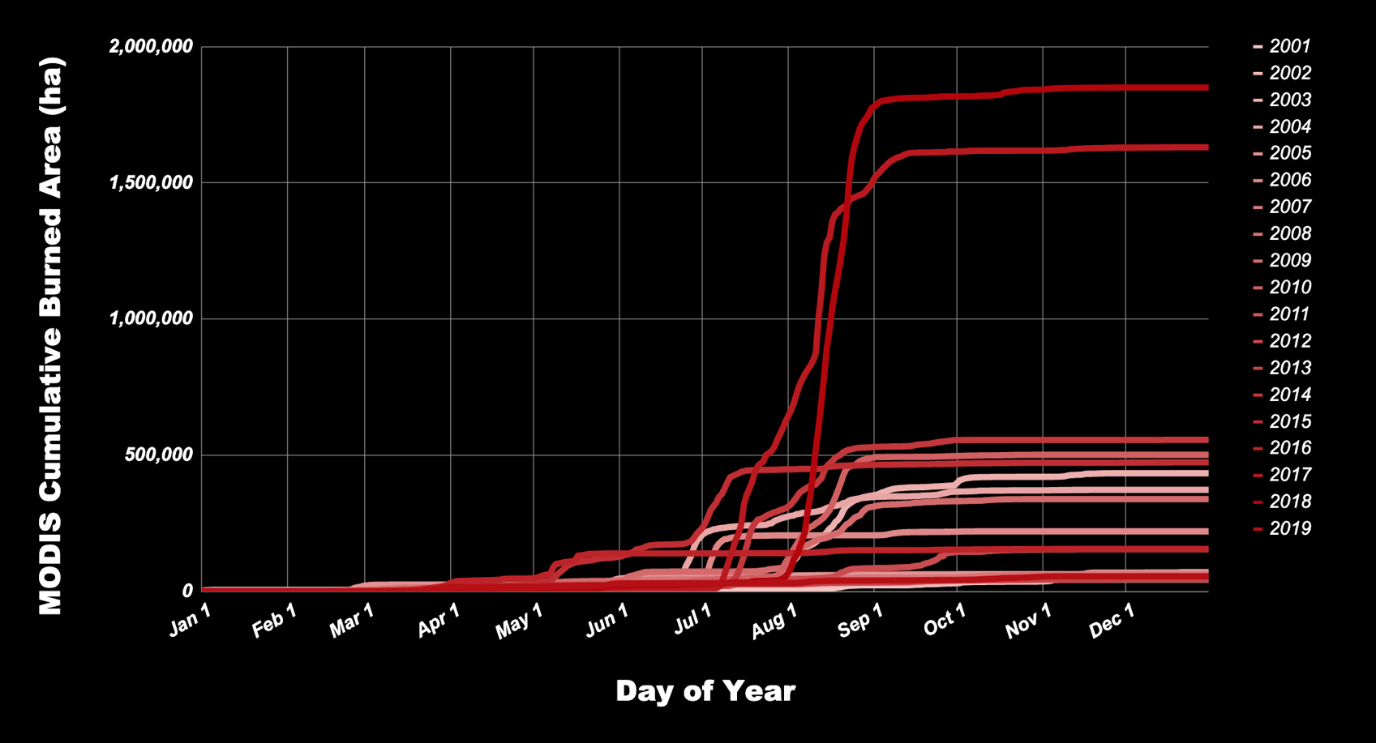
But, MODIS (MCD64A1) provides long-term observations
2018
2017
2019
@morganahcrowley
Notes:
We compared historic fire season progressions using MODIS burned areas (MCDA64A1) from 2001 to 2019. The 2017 and 2018 fire seasons were very different from other BC fire seasons in the study period. 2017 and 2018 burned more cumulative area despite starting later in the summer.

Slide 35
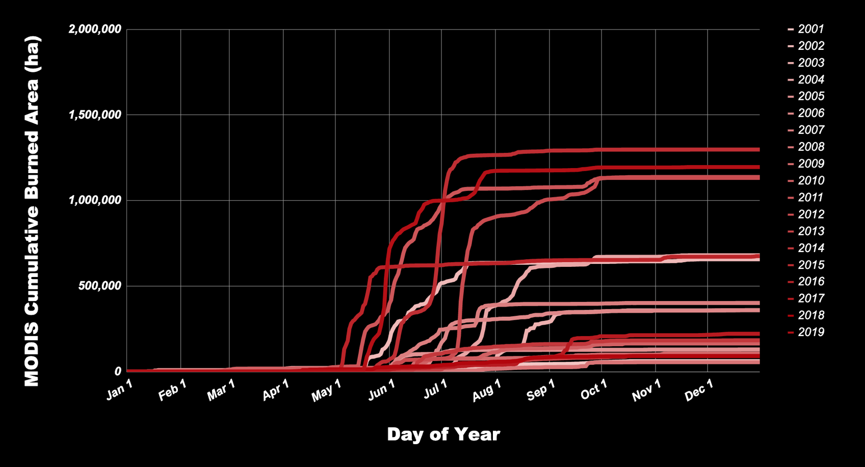
Long-term fire season progressions for Alberta
2015
2019
2011
2012
2016
@morganahcrowley
Notes:
Alberta's fire seasons generally tend to start earlier than those in BC but did not grow as large as BC's 2017 and 2018 fire seasons.

Slide 36
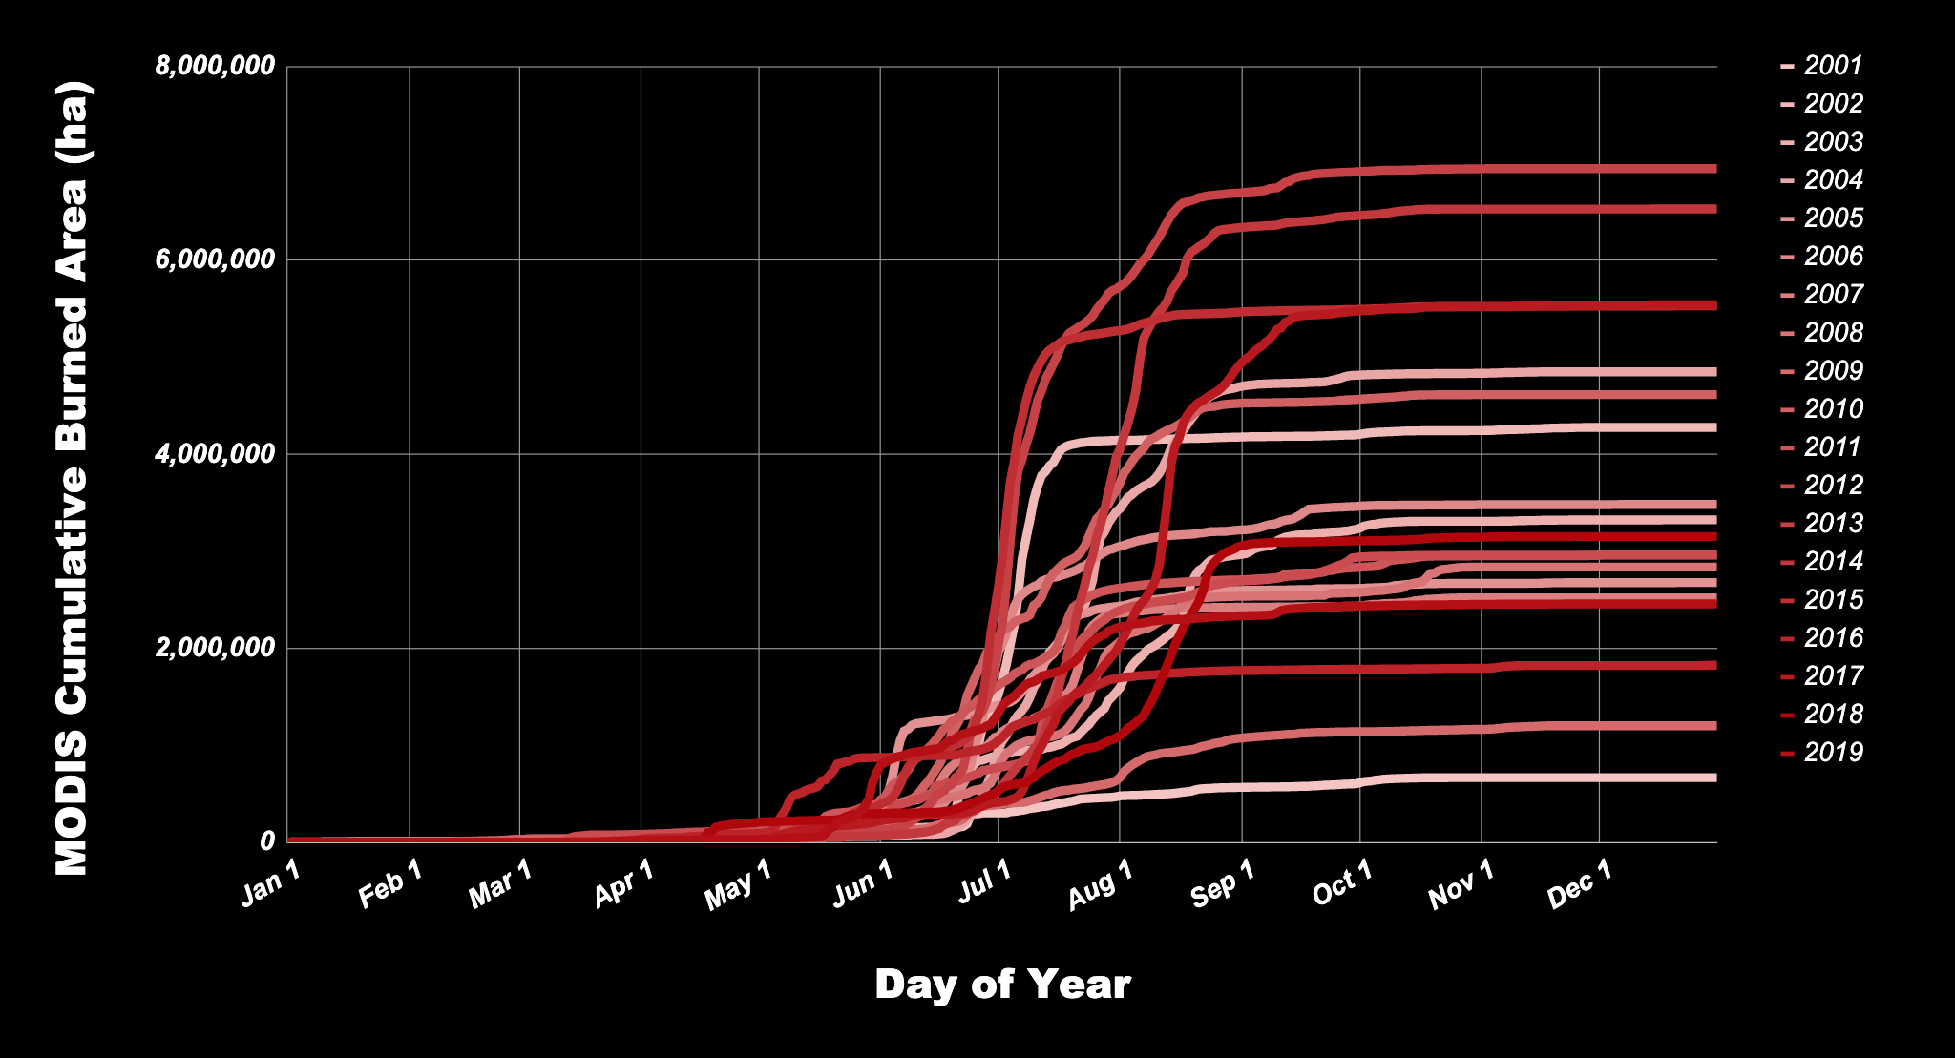
Long-term fire season progressions for Canada
2013
2014
2015
2017
2019
@morganahcrowley
Notes:
At the national scale, fire seasons varied over the last ~20 years. 2013 and 2014 were the largest in burned hectares due to extreme fire seasons in Quebec, Manitoba and the Northwest Territories.
MODIS burned area estimates are large because of the sensors' coarse spatial resolution. However, the fine temporal resolution that MODIS provides is particularly useful for evaluating the timing of fire seasons.

Slide 37
Opportunities for next stages of this research
Increase data sources:
fine temporal scale satellite data (e.g., WildFireSat, GOES-16, -17)
fine spatial scale satellite data (e.g., Planet microsatellites)
SAR to fill gaps in clear observations (e.g., Sentinel-1, RCM)
Alternative analysis options:
use ranked severity estimates (e.g., low, medium, high)
map historical fire progressions
map fires in near-real time
expand study region (e.g., all of Canada, global boreal region)
use to examine drivers and/or cross-validate risk models
@morganahcrowley

Slide 38
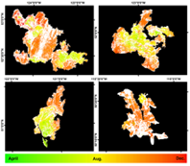
Research Highlights
Rapid and replicable methods
for multi-source fire
progression mapping.
Fire progression metrics can
be analyzed to understand fires
and fire seasons.
Opportunities for analyzing drivers and
cross-validating
fire-risk models.
@morganahcrowley
Notes:
TO summarize the dissertation, I….

Slide 39
Mapping and comparing wildfire progressions using freely available, multi-source satellite data
Thank you!
Many thanks to my supervisor, collaborators, and research/ travel funding sources:
Prof. Jeffrey A. Cardille
Dr. Joanne C. White
Dr. Michael A. Wulder
Twitter: @morganahcrowley
Email: morgan.crowley@mail.mcgill.ca

