Slide 1
High volumes of mineral dissolution by localized fluid pulses in UHPM metasediments of Lago di Cignana, Western Alps
Optional audio per slide.
Hover over and click play to start.
H.W. van Schrojenstein Lantman¹, D. Wallis², M. Scambelluri³, M. Alvaro¹
hugo.vanschrojenste01@universitadipavia.it
mineralogylab.com
@hugolantman
1. Department of Earth and Environmental Sciences, University of Pavia
2. Department of Earth Sciences, Utrecht University
3. Department of Earth, Environment and Life Sciences DISTAV, University of Genoa
Notes:
Thank you for checking out my presentation. First, I would like to thank my coauthors for the help with this research, and the ERC for funding this project.
Fluids are essential for many processes in and around subduction zones, and one particular process I’m interested in is how rocks are affected by external fluids passing through, so essentially, fluid-rock interaction along fluid pathways. What I’m going to show you here is a petrological and microstructural study of an extreme case of fluid-rock interaction in deeply subducted metasediments, with emphasis on dissolution.

Slide 2
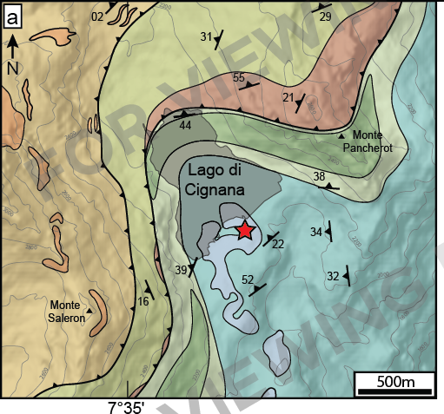
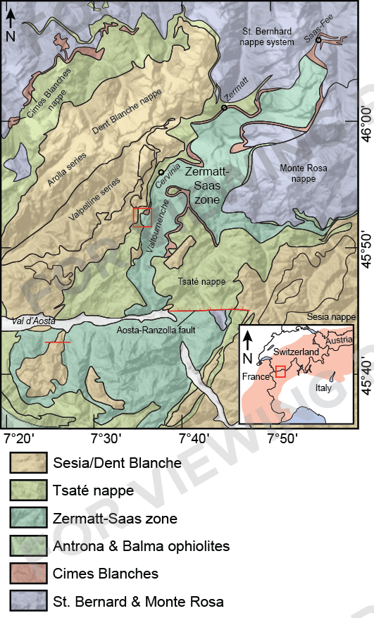
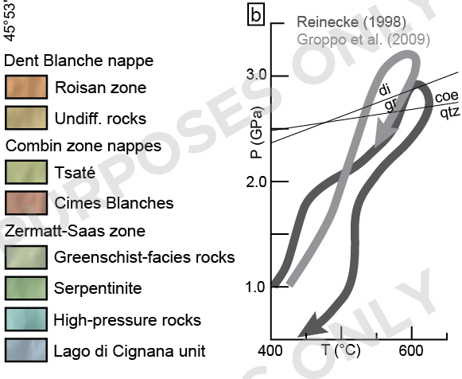
Lago di Cignana
Lago di Cignana Unit (LCU): UHPM ophiolitic lens in Zermatt-Saas zone in Western Alps.
LCU is famous for bearing coesite and microdiamonds (Reinecke, 1998; Frezzotti et al., 2011).
Metamorphic peak: 590—630 ℃, 2.7—3.2 Gpa (Reinecke, 1998; Groppo et al., 2009)
Mix of eclogite and various metasediments, often Mn-rich
Has experienced influx of external fluids (Halama et al., 2020) and has recorded evidence of dissolution of carbonate (Frezzotti et al., 2011) and solute-rich fluids (Hawkins et al., 2009)
From Van Schrojenstein Lantman et al. (in prep.), modified after Kirst et al., (2017)
Notes:
The Lago di Cignana Unit (LCU) is a slice of UHPM-metamorphic ophiolitic material in the Zermatt-Saas zone in the Western Alps. LCU is famous for bearing coesite and microdiamonds (Reinecke, 1998; Frezzotti et al., 2011), and has been studied extensively for being one of few ophiolitic terranes that underwent UHPM.
UHPM conditions were reached during Alpine subduction of Piemonte-Ligurian oceanic crust, locally established peak conditions of 590—630 ℃, 2.7—3.2 Gpa (Reinecke, 1998; Groppo et al., 2009)
LCU consists of eclogites and various metasediments, most abundantly quartzites and calcschists.
LCU has previously been the subject of fluid-related studies. For example, two studies on fluid inclusions in garnet found evidence for dissolution of carbonate and perhaps much more, somewhere “upstream” between the fluid source and its capture in garnet. Another study suggests an external fluid to be derived from partially dehydrated serpentinites – which are rather abundant nearby LCU. So now the question is: what exactly is the full extent of fluid-rock interaction along a fluid pathway that accommodates the migration of large amounts of externally-derived fluids?

Slide 3
Outcrop
Inner garnetite
Outer garnetite
grt
grt+qtz
Garnetite
Quartzite host rock
Qtz+grt+phg+
amph+bt+ep
Notes:
This is a close-up of the studied outcrop. The garnetite-bearing quartzite shown here is one of the main lithologies for LCU. While many lithologies of LCU contain garnetite lenses, the one studied here has a particularly well preserved relationship between host rock and garnetite. The quartzite consists of mostly quartz, containing occasional garnet and epidote with a foliation defined by phengite and amphibole-phengite-biotite-quartz aggregates.
Zooming in on the garnetite, we can see that it is heterogeneous in garnet content. Some darker areas with the appearance of a single crystal consist of almost entirely garnet, and are from hereon called inner garnetite. Other zones lighter in colour as the result of a higher quartz content will be referred to as outer garnetite.

Slide 4
Approach
Majority of minerals are retrograde in nature: study garnet and its inclusions
Construct a metamorphic and metasomatic history for the host rock, outer garnetite and inner garnetite through time
Taken into account will be:
Garnet composition and size
Mineral assemblages of inclusions in garnet, and inferred changes to the rock matrix assemblage
Microstructures in garnet that indicate fluid-rock interaction
Garnet composition and inclusion assemblages combined can be used for relative timing, assuming coeval reactions throughout the outcrop
A compilation of results and interpretations is next;
for detailed observations and measurements, see slides after references
Notes:
The host rock in particular is challenging to work with, as it has undergone a significant retrograde overprint, including the breakdown of coesite to quartz and the breakdown of an unidentified mineral leading to the formation of the amphibole-phengite-biotite-quartz aggregates. As a result, this focus studies on garnet as it has the potential to record conditions and events throughout metamorphism.
Based on garnet from the host rock, outer garnetite and inner garnetite, a record of metamorphism and metasomatism will be constructed so we can assess the extent of fluid-rock interaction, and the relative timing of processes between the different rock types. In order to do this, garnet size and composition will be studied, as well as mineral assemblages recorded as inclusions in garnet and any changes to the rock matrix that they infer. Any microstructures in garnet that record fluid-mediated mechanisms will also be taken into account.
Relative timing between rock types will be achieved by comparing trends in garnet composition and inclusion assemblages, assuming these were coeval across the outcrop.

Slide 5
Garnet zoning and structures
Strong similarities in garnet composition and inclusion assemblages between host rock and garnetite.
Key observation is the disappearance of carbonates after the first fluid-related microstructure in garnet zoning (GBM, pressure solution, dissolution-growth cycle boundaries).
Schematic garnet zoning and microstructure overview
qtz+mgs+
dol+ap+rt
qtz+mgs+
dol+ap
coe+ky+
phg+clz+zrc
qtz
qtz+mgs+
dol+ap+rt
qtz+mgs+
dol+ap
qtz+mgs+
dol+ap+rt
From Van Schrojenstein Lantman et al. (in prep.)
The differences in microstructures and growth style tell a story of metasomatism that varies from host rock to outer garnetite to inner garnetite.
Notes:
Despite different garnet sizes, a strong similarity exists in garnet compositional zoning between the host rock, outer garnetite and inner garnetite. Two different zoning trends have been observed as summarized in the right-side figure, both depleting in Mn and enriching in Fe, although the metamorphic trend includes Mg-richer compositions, which is not the case in the trend of late recrystallization and alteration. The metamorphic zoning trend has been colour-coded so it can be compared to the left-side figure. The composition field for UHP conditions was determined by the location of coesite inclusions.
Not only the garnet composition is strongly similar between host rock and garnetite, also the inclusion assemblages match to some degree. Particularly in the core, we find an assemblage of quartz, magnesite, dolomite, apatite and sub-micron rutile. In outer garnetite and host rock, this inclusion assemblage extends beyond the rt-rich core, without the sub-micron rt of course. The UHPM assemblage that includes coesite, kyanite, phengite and clinozoisite is only found in the host rock. Note that no carbonate is present in any garnet beyond the first fluid-rock interaction evidence recorded in garnet, be it GBM, pressure solution or the cycles of dissolution and growth inferred for the host rock. As additional argument for the dissolution phases in host rock garnet, there are abundant zircon inclusions within the UHPM garnet, and Zr release from garnet dissolution is a potential driver for the growth of metamorphic zircon. The final garnet growth stage, marked in dark blue, contains occasional quartz inclusions, suggesting that it is a retrograde phase.

Slide 6
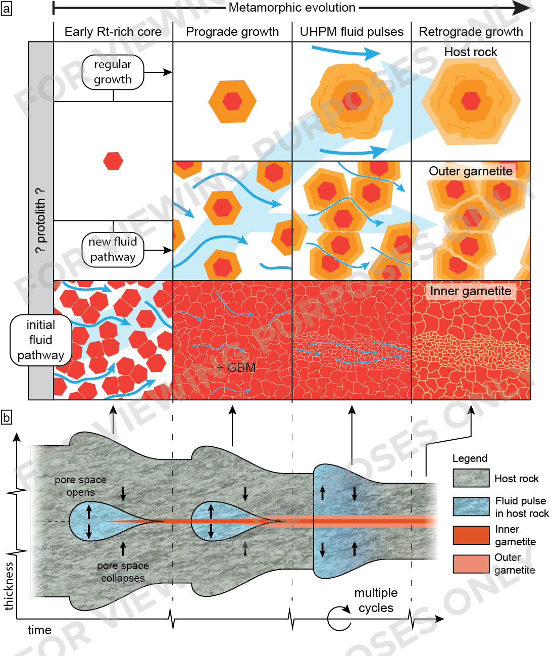
Fluid-rock interaction record
Metasomatic record created using garnet composition for relative timing
Qtz + dol + mgs (+ ??) mass removal
Garnet enriched into “stylolite”
Fluid pathway active in different zones through time
After ceasing to be main fluid pathway, garnetite still fluid-rich (e.g., GBM, pressure solution)
Entire quartzite host to fluid pulses during UHPM conditions
From Van Schrojenstein Lantman et al. (in prep.)
Notes:
Based on the idea that the metamorphic zoning trend is linked throughout the host rock – garnetite system, it can be used to create a timeline where microstructures indicating fluid-rock interaction can be compared. After the initial rt-rich garnet growth, garnets in the inner garnetite already came into contact, so the minerals that were included in garnet during growth were already removed from the system by dissolution by then suggesting strong fluid-rock interaction. After garnet-garnet contact was established, GBM took place. As this recrystallization altered the composition of garnet, a fluid with different composition is necessary, so this is evidence of a continued fluid presence, although not undersaturated. Fluid infiltration during and after UHPM is limite to localized pathways with reduced grain size, and the late wetting fluid that sealed the grain boundaries. The first evidence for fluid-rock interaction in the outer garnetite also comes from the timing of garnet-garnet contact and subsequent pressure solution, alongside the disappearance of carbonates from the matrix. This took place later than the matrix removal in the inner garnetite, indicated by the preservation of garnet after the ri-rich core but before pressure solution at garnet-garnet contacts. In the host rock, the fluid pulses cause cycles of dissolution and growth during UHPM. The final stage of fluids in the system related to garnet is the final euhedral growth tha sealed grain boundaries and fractures, and grew a euhedral rim over all garnet crystals.
Combining all this results in a timeline of fluid-rock interaction for the entire system. The fluid pathway uncovered here was localized at first in what is now the inner garnetite, then in what is now the outer garnetite and eventually the entire quartzite. After fluid activity turned a piece of quartzite into garnetite by removing interstitial material, thereby concentrating garnet into what is essentially a stylolite, fluid still remained present, but no longer with as high an affect, perhaps due to limited flux or higher saturation.

Slide 7
Conclusions
Extensive fluid-rock interaction recorded in garnet through microstructures, compositional zoning and inclusions
Evidence mass removal and compaction by dissolution
Garnet relatively enriched by removal of interstitial material
Progressive migration and widening of pathway for fluid pulses
Implications: If it takes an extreme case to notice this dissolution, how much goes unnoticed elsewhere? What is the total impact of fluid-rock interacting along pathways on a large scale?
Mail: hwlantman@gmail.com
Web: mineralogylab.com
Twitter: @hugolantman
Notes:
To conclude, garnet in this quartzite and garnetite from LCU has recorded evidence for extensive fluid-rock intearction through microstructures, compositional zoning and inclusions. By combining relative timing from the combination of inclusion assemblages, garnet-garnet contacts and garnet composition, a metasomatic history was created for this system. This metasomatism includes dissolution of significant amounts of interstitial minerals, at least quartz and carbonates but potentially more. As a result, garnet was relatively enriched into garnetite, after which garnet also started to dissolve. The fluid pathway uncovered here started as fairly localized, possibly the result of slightly varying initial bulk compositions or inherited weaknesses in the rock, but over time migrated and widened. During UHPM, the entire quartzite acted as pathway for up to five fluid pulses.
The system here may be fairly unique, as not a large part of the slab will act as large fluid pathway, however it is an example of the strong effect that fluid-rock interaction can have, and how extreme an example we need to recognize this impact in the first place. Is it possible that lesser amouts of dissolution or other fluid-rock interaction have an unseen impact on rocks in the slab? And if it’s only localized along these fluid pathways, what is the total effect of fluids in between their source and the mantle wedge?

Slide 8
References
Frezzotti, M.L., Selverstone, J., Sharp, Z.D., Compagnoni, R., 2011. Carbonate dissolution during subduction revealed by diamond-bearing rocks from the Alps. Nature Geoscience. DOI: 10.1038/NGEO1246
Groppo, C., Beltrando, M., Compagnoni, R., 2009. The P-T path of the ultra-high pressure Lago di Cignana and adjoining high-pressure meta-ophiolitic units: insights into the evolution of the subducting Tethyan slab. J. metamorphic Geol. 27, 207-231
Halama, R., Konrad-Schmolke, M., De Hoog, J.C.M., 2020. Boron isotope record of peak metamorphic ultrahigh-pressure and retrograde fluid-rock interaction in white mica (Lago di Cignana, Western Alps). Contributions to Mineralogy and Petrology. 175, 20 https://doi.org/10.1007/s00410-020-1661-8
Hawkins, A.T., Selverstone, J., King, P.L., Frezzotti, M.L., 2009. HP/UHP fluids preserved in Mn-rich garnets from Lago di Cignana, Italy. Geological Society of America Abstracts with Programs. 41(7), 238
Kirst, F., Leiss, B., 2017. Kinematics of syn- and post-exhumational shear zones at Lago di Cignana (Western Alps, Italy): constraints on the exhumation of Zermatt-Saas (ultra)high-pressure rocks and deformation along the Combin Fault and Dent Blanche Basal Thrust. Int J Earth Sci (Geol Rundsch). 106, 215-236 DOI 10.1007/s00531-016-1316-1
Reinecke, T., 1998. Prograde high- to ultahigh-pressure metamorphism and exhumation of oceanic sediments at Lago di Cignana, Zermatt-Saas Zone, western Alps. Lithos. 42, 147-189

Slide 9
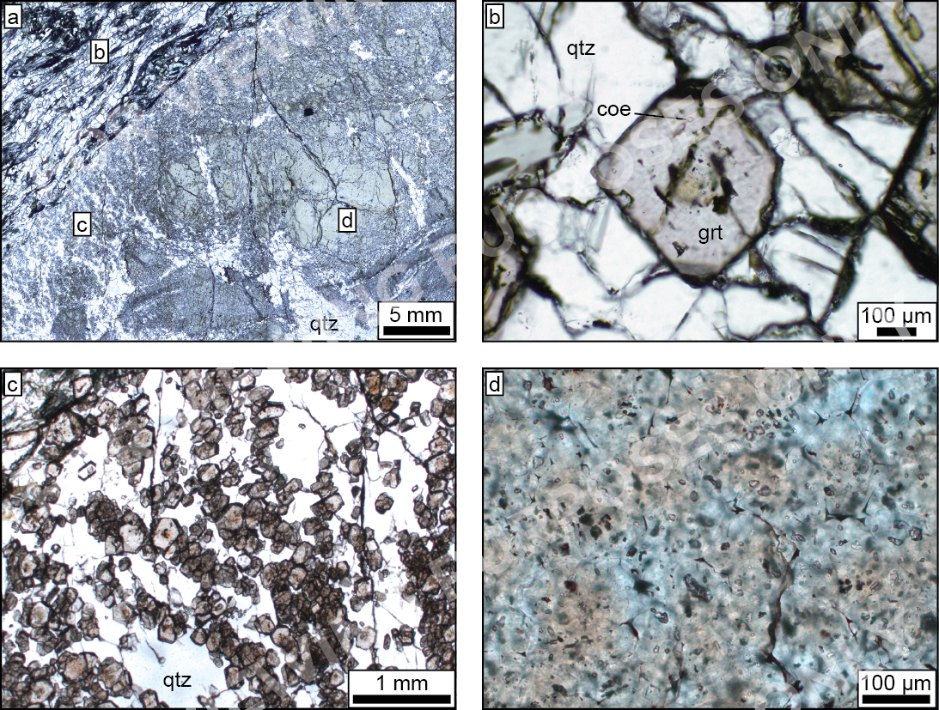
Thin section
Overview (a): host rock quartzite in the top left. The garnetite exhibits a fairly complex structure.
Host rock (b): close-up of a garnet representative for the host rock. Coesite inclusions are found in a wide mantle surrounding a quartz-bearing inclusion-rich core.
Outer garnetite (c): garnets are aligned in chains separated by quartz. Some garnets are slightly flattened at garnet-garnet contacts.
Inner garnetite (d): garnets “welded” together, giving the appearance of a single crystal. Abundant inclusions throughout the garnet.
In all garnet: orange haze in core of garnet is from sub-micron rutile inclusions
From Van Schrojenstein Lantman et al. (in prep.)
Notes:
This slide provides an overview of what the garnets in the host rock and garnetite look like in thin section. Figure a is an overview of a thin section with host rock in the upper left corner, and the garnet in figure b is representative of garnets from this host rock. Coesite is located in the wide, clear rim that surrounds a quartz bearing, inclusion rich core. Figure c displays garnets in the outer garnetite, which are commonly aligned in chains. At the garnet-garnet contacts, the grains are flattened. The inner garnetite, seen in figure d, initially appears as one mass of garnet, but consists of many small crystals “welded” together. The garnets are rich in inclusions.
In all garnet types, an orange haze marks the core. This haze is the result of many sub-micron rutile inclusions.

Slide 10
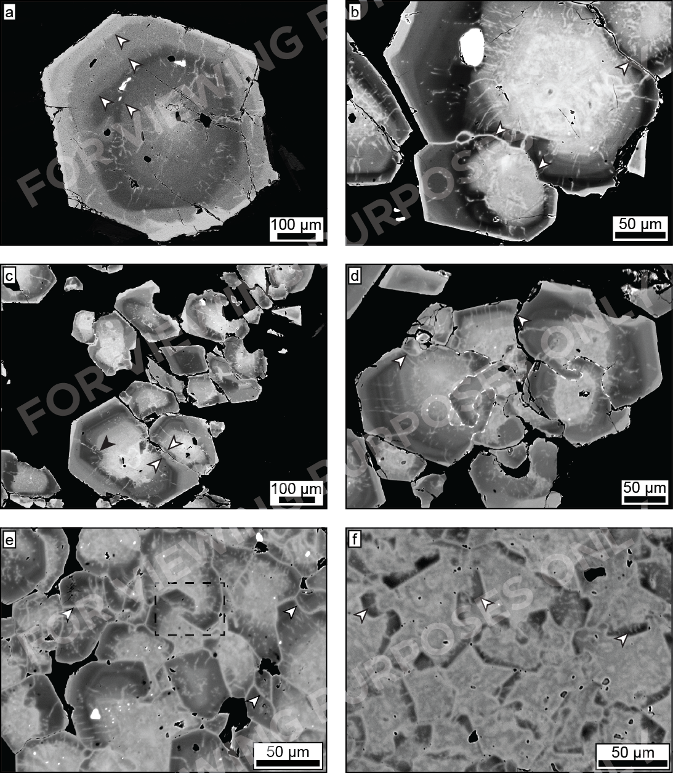
Garnet microstructures
Host rock (a): contrasts between garnet compositions are irregular; interpreted as cycles of dissolution and growth. Pervasive resealed radial fractures from a late-stage event.
Outer garnetite (b—e): less irregular composition contrasts than in host rock, also resealed fracturing. Zoning often truncated at garnet-garnet contacts, suggesting pressure solution. Arrows of (c) indicate garnet growth over truncation. Local grain-boundary migration (GBM) causing interlocking garnet (d—e).
Inner garnetite (f): Small, chaotically zoned grains; dark lobes of GBM-recrystallized garnet (Arrows in (f)).
Late stage garnet (bright) forming euhedral rim (a—c) and sealing garnet-garnet contacts (b,d—f) – requires wetting fluid.
From Van Schrojenstein Lantman et al. (in prep.)
Notes:
In this slide I’ll give an overview of microstructures found in garnet. Host rock garnets like the one in figure a, exhibit two structures of interest; firstly, compositional zoning is interrupted several times by an irregular boundary that indicates a composition contrast, see the arrows. These are interpreted as the result of a phase of dissolution followed by continued growth. Up to five of these boundaries are present within a single garnet. Secondly, there are resealed radial fractures throughout the garnets.
These two microstructures are also present in the outer garnetite, see figures b to e, although there is generally only one composition contrast present. In this zone, garnets are often in contact, and it is at these contacts where zoning is often truncated. As the truncated zoning at garnet-garnet contacts is not congruent, pressure solution is implied. Examples of this truncated zoning are visible in b-d, and in c we also see that new garnet grew over the truncated zoning, as indicated by the arrows. In figures d and e, interlocking structures have been highlighted. While a minor degree in interlocking can be caused by pressure solution, the cases shown here are extreme in comparison, yet representative for interlocking structures found in the garnetite. That is why this is interpreted as the result of grain boundary migration.
Figure f is a representative part of inner garnetite. There is no clear zoning pattern, it is very irregular, but similar to the core of garnet from other zones. Dark garnet is also often interlocking, and is the result of grain boundary migration recrystallization.
Late stage garnet as most clearly visible in figures a to c has formed euhedral rims with bright BSE signals, but also sealed grain boundaries like visible in b and d to f, and radial fractures like in a to e. A wetting fluid was necessary for this distribution of garnet precipitation.

Slide 11
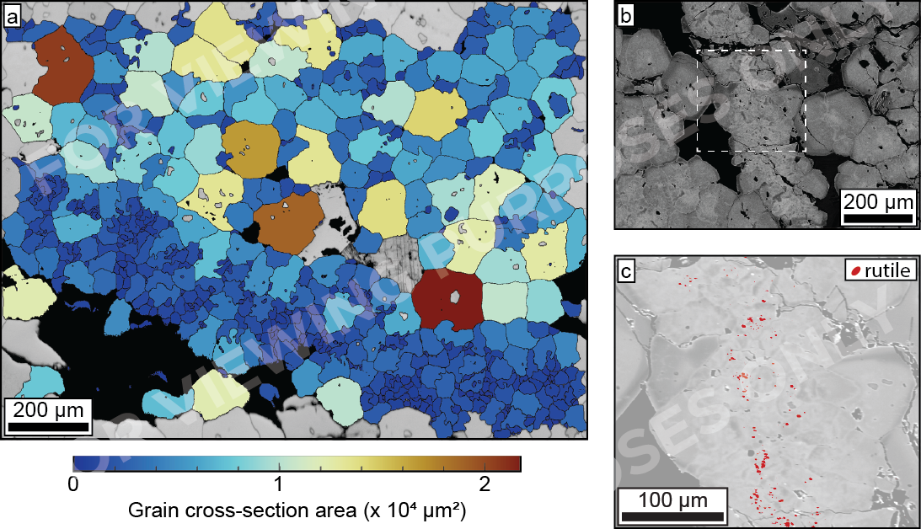
Garnet microstructures
All coloured grains are garnet.
From Van Schrojenstein Lantman et al. (in prep.)
Inner garnetite (a): zone of reduced grain size cross-cuts inner garnetite. (c): a similar zone of reduced grain size. Ti mapping uncovers a strong enrichment of rutile. There is also an enrichment in zircon.
Grain size reduction is interpreted as the result of dissolution by localized fluid influx.
Notes:
The inner garnetite is cross-cut by an anastomosing network of zones with a smaller grain size than the surrounding inner garnetite. These zones have an increase in grain morphology complexity. Additionally, a strong enrichment in rutile and zircon is observed in these zones, as figure c indicates, where strong Ti signals from an EPMA element map have been highlighted over a BSE image.
The reduced grain size is interpreted as the result of dissolution of the garnet, as result of localized fluid influx. Rutile and zircon enrichment can be the result of the freeing of sub-micron inclusions from garnet and liberation of Zr resulting in zircon growth, or perhaps Ti and Zr were mobilized by this fluid.

Slide 12
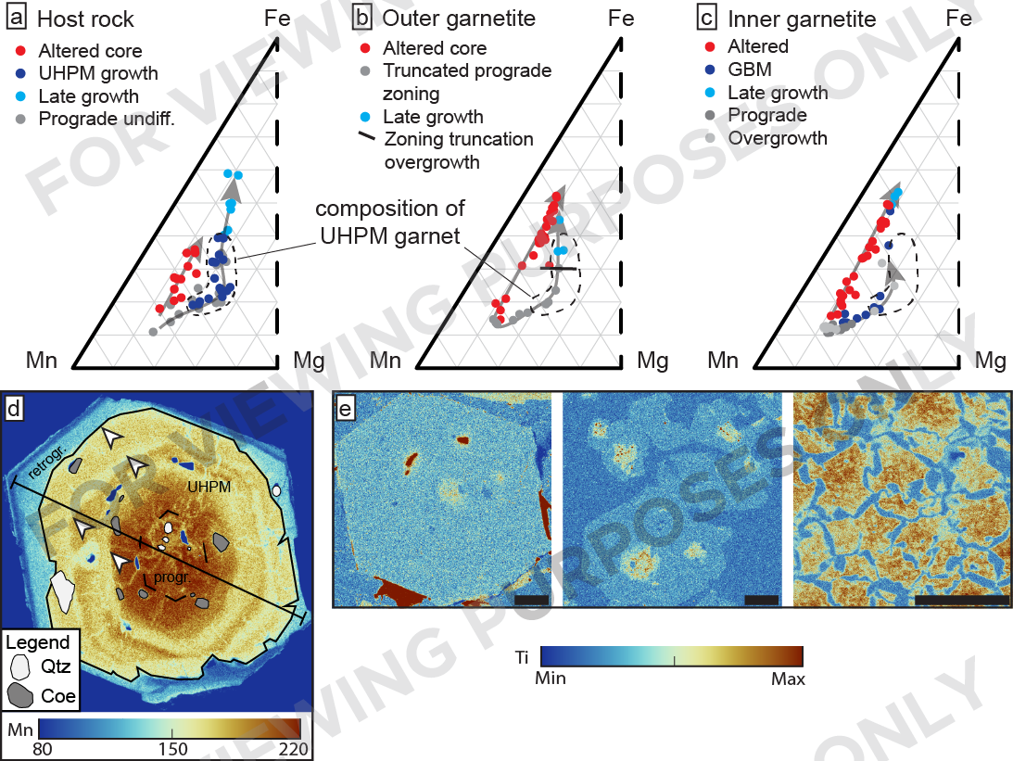
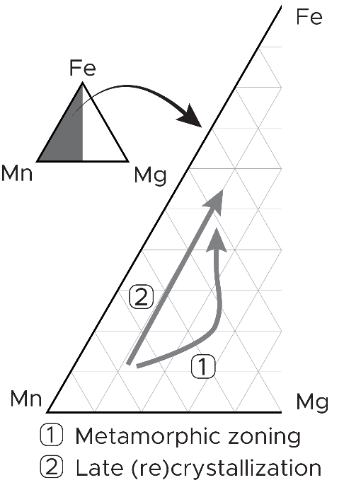
Garnet zoning
Strong similarity in garnet composition.
Metamorphic trend with higher Mg
Alteration/recrystallization trend
Both trends enrich in Fe at the cost of Mn, but metamorphic trend includes higher Mg compositions.
(d): Irregularities in Mn zoning in the UHPM part of a host rock Garnet.
Coe & qtz marked.
(e): Ti maps of garnets from the host rock, outer garnetite and inner garnetite respectively. Ti is from sub-micron rutile inclusions. This rt-rich core is the same size in all garnet types.
Scale bar represents 100 μm
From Van Schrojenstein Lantman et al. (in prep.)
Notes:
Representative garnet compositions are plotted in figures a to c, where colours are used when possible to indicate further information on garnet growth. Using a combination of garnet compositions and the location of coesite inclusions as shown in figure d, the composition of UHPM garnet has been marked in the composition plots. Two trends are clear from these plots, the first one is the metamorphic trend which depletes in Mn and enriches in Fe, with a Mg-richer excursion. There is also a trend related to late stage recrystallization or alteration, which depletes Mn and enriches Fe without additional Mg. The only garnet growth that took place at and just before UHPM in the inner garnetite is minor overgrowth on the outside margin of the garnetite as well as GBM-recrystallization internally. In the outer garnetite, only little growth took place at UHPM in comparison to the host rock, and it is also within the UHPM zone where we find the composition of garnet overgrowing zoning truncation related to pressure solution.
Figure e shows three Ti element maps of garnets from the host rock, outer garnetite and inner garnetite. The Ti signal comes from sub-micron rutile inclusions, all limited to the garnet core. The approximate size of these rt-rich zones is roughly the same in all rock types. The main difference is that there is relatively less later garnet growth in the garnetite, so the rt-rich core is a relatively larger component in the garnet.

