Slide 1
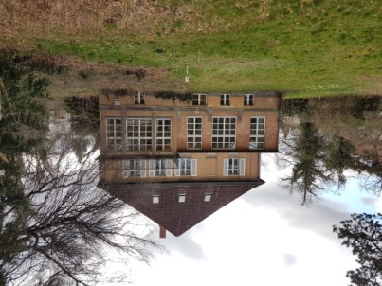
DFG RTG2032 Urban Water Interfaces
Using stable isotopes to quantify ecohydrological flux dynamics at the soil-plant-atmosphere continuum in urban green spaces
Lena-Marie Kuhlemann^{1,2}, Dörthe Tetzlaff^{1,2}, Birgit Kleinschmit^{4,} Stenka Vulova⁴ and Chris Soulsby^{3,4}
Leibniz-Institute of Freshwater Ecology and Inland Fisheries (IGB)
Humboldt-Universität Berlin
University of Aberdeen
Technische Universität Berlin
©S. Vulova
Research question:
“How do different kinds of typical urban green spaces affect ecohydrological partitioning?”
© Authors. All rights reserved.

Slide 2
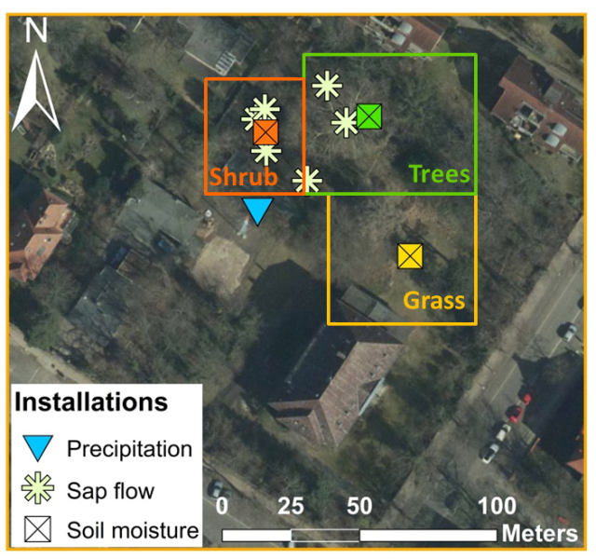
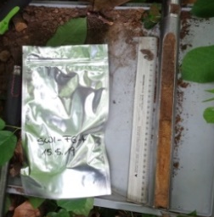
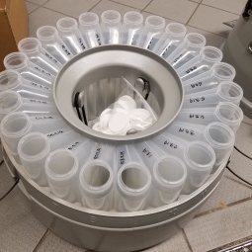
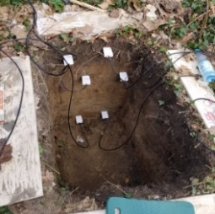
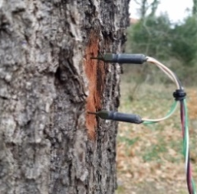
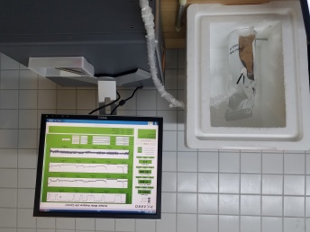
Field work at the Steglitz Urban Ecohydrological Observatory
Measurement | System | Time period | Resolution | Locations
Permanent installations
Soil moisture | CS650 (Campbell Scientific) | Since March 2019 | hourly | 3 (grassland, shrub, trees)
Sap flow | FLGS-TDP XM1000 (Dynamax) | Since March 2019 | hourly | 6
Water isotope sampling
Precipitation | ISCO autosampler | Since February 2019 | daily |  | 1
Soil water | Soil auger, Direct Equilibrium method | April-November 2019 | monthly |  | 3 under each vegetation unit
Surface- & groundwater | Grab sampling | October 2018-July 2019 | seasonally |  | 37 &10
© Authors. All rights reserved.

Slide 3
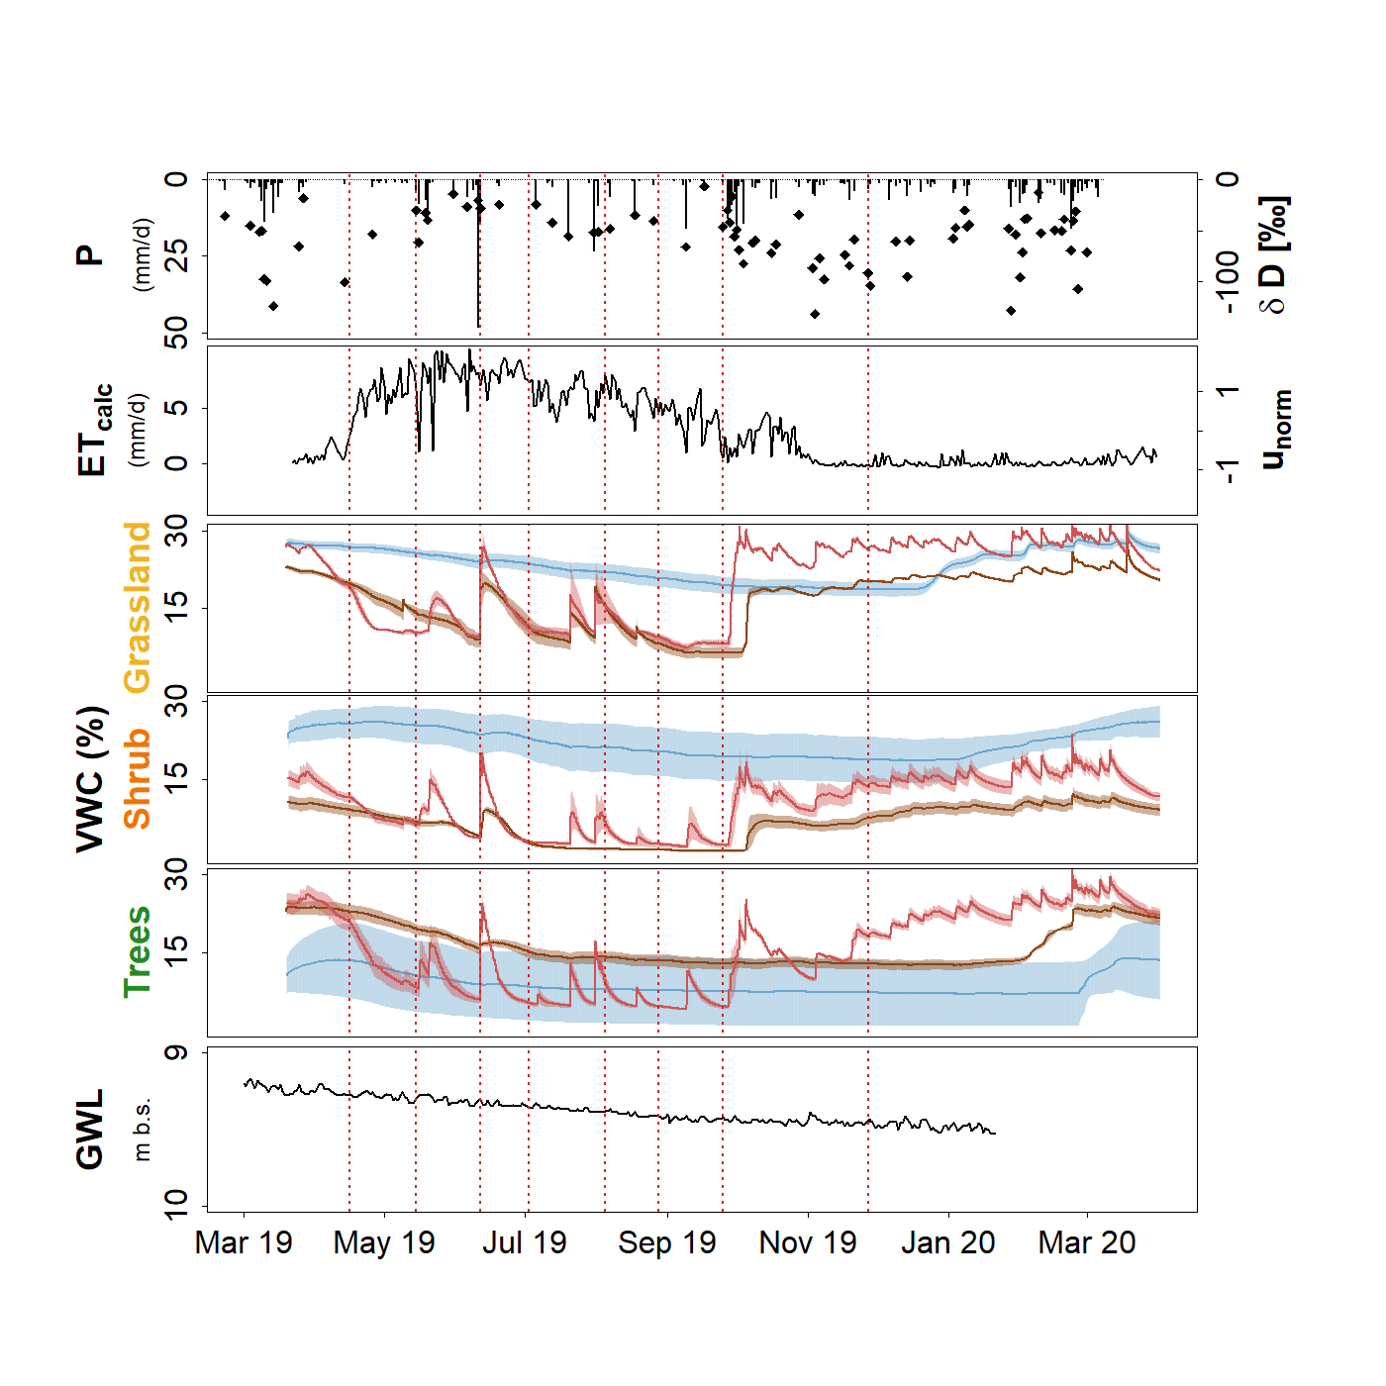
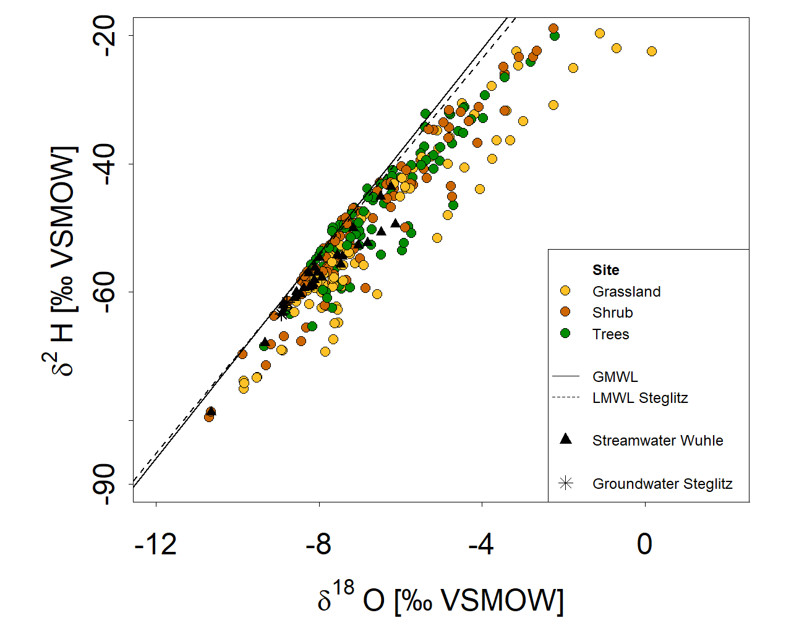
Results: monitoring seasonal dynamics of urban water cycling
P-isotopes with seasonal variations (most enriched in summer, especially after heavy convective precipitation events)
Transpiration high over the growing season
Soil moisture declines over the summer, exception: response to heavy P-events in the upper soil
Soil water isotopes deviate from the LMWL (→ fractionation), especially at the grassland site
Figure 2: Dual isotope plot showing the isotopic composition of soil water sampled between 0 and 90 cm depth over the growing period of 2019 under three typical, urban vegetation types: grassland, shrub and trees.
-1 1
Figure 1: Precipitation amount (DWD, 2020) and isotopes, mean daily normalized sap flux velocity and mean daily soil moisture at 15 cm (red), 40 cm (brown) and 100 cm (blue) depth at the different sampling sites.
© Authors. All rights reserved.

Slide 4
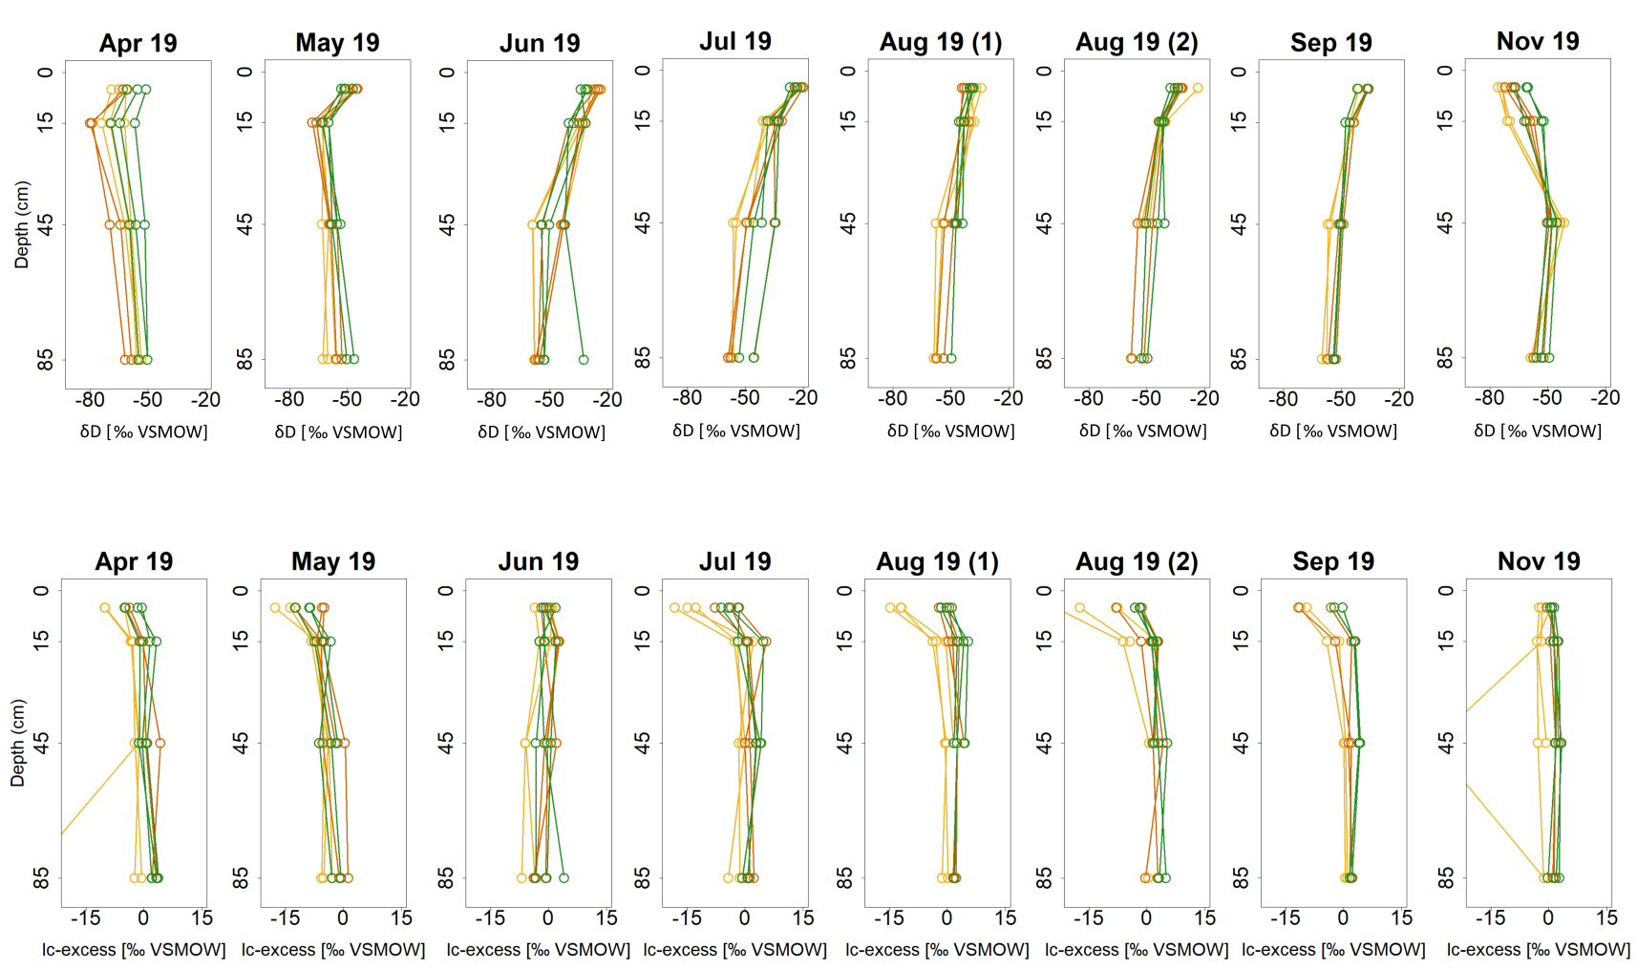
Results: monitoring seasonal dynamics of urban water cycling
Spring 2019:
Isotopic composition rather constant with depth
Negative lc-excess only in the upper soil
More depleted values in 10-20 cm depth
Summer 2019:
Samples in the upper soil more enriched and with negative lc-excess
Values become gradually more depleted with increasing depth
Autumn 2019:
upper soil more depleted than deeper layers (→ more depleted P-inputs)
wet dry wet dry wet dry wet wet
Figure 3: Depth-profiles showing the variations of δD and lc-ecxess at the grassland (yellow), shrub (orange) and tree (green) sites at different depths over the growing period of 2019 with variable wetness conditions.
© Authors. All rights reserved.

Slide 5
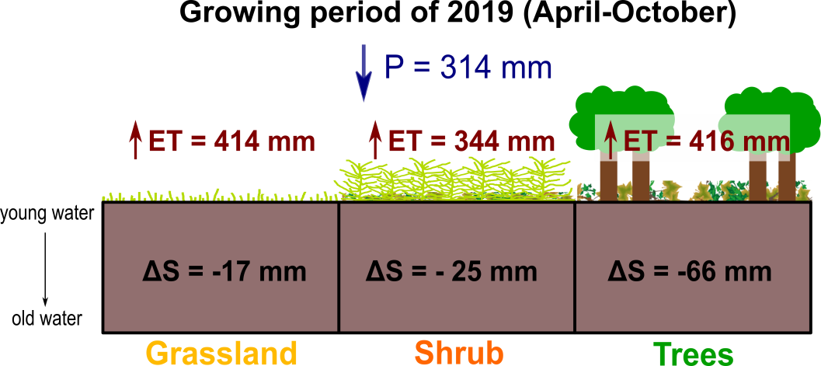
Conclusions and Outlook
The persisting, exceptionally warm and dry conditions impact urban water cycling during the growing period of 2019:
ET is high and exceeds P, especially at the grassland and tree sites
Soil water storage declines over the summer, especially at the tree site
Combining climatic and hydrometric measurements with stable isotopes shows:
At the grassland site, evaporation primarily happens in the upper soil
(→ direct exposure to sunlight)
At the tree site, water transpired by trees contributes to the losses in soil water storage
Figure 4: Water balance at the Steglitz Urban Ecohydrological Observatory based on a mass balance approach (ET = P - ΔS).
Despite the complexity of urban water fluxes, applying stable isotopes as environmental tracers provides valuable insights into water partitioning at the soil-water-atmosphere interface under different kinds of urban green space; which will be crucial for adapting urban water management strategies to future climate changes
See further: Gillefalk, M., Tetzlaff, D., Hinkelmann, R., Kuhlemann, L.-M., Smith, A., Meier, F., Soulsby, C.: „Quantifying the effects of urban vegetation on water partitioning in complex cityscapes – The potential of isotope-based ecohydrological models”. HS10.1, ID: EGU2020-413, Display: D417.
© Authors. All rights reserved.

