Slide 1





Airborne Experiment for Soil Moisture Retrieval using GNSS Reflectometry
Authors
Hamza Issa^{1,2}, Georges Stienne¹, Serge Reboul¹, Maximilian Semmling³, Mohammad Raad⁴, Ghaleb Faour² and Jens Wickert³
¹ Laboratoire d’Informatique, Signal et Image de la Côte d’Opale (LISIC)
² National Council of Scientific Research - Lebanon (CNRS-L)
³ German Research Centre for Geosciences (GFZ)
⁴ Lebanese International University (LIU)

Slide 2
Outline
Motivation for Soil Moisture Remote Sensing with GNSS-R
GNSS-Reflectometry
General Overview
System Implementation
Conclusion

Slide 3
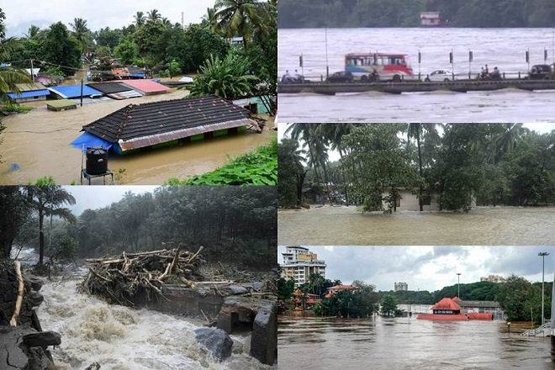
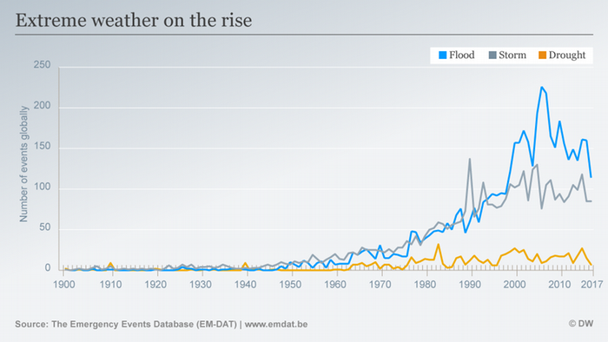
Motivation for Soil Moisture Remote Sensing with GNSS-R
Introduction
GNSS-Reflectometry technique is used for remote sensing in land applications.
This dissertation uses GNSS-R techniques for soil moisture estimation with 1 ms $C/N_{0}$ observations.

Slide 4
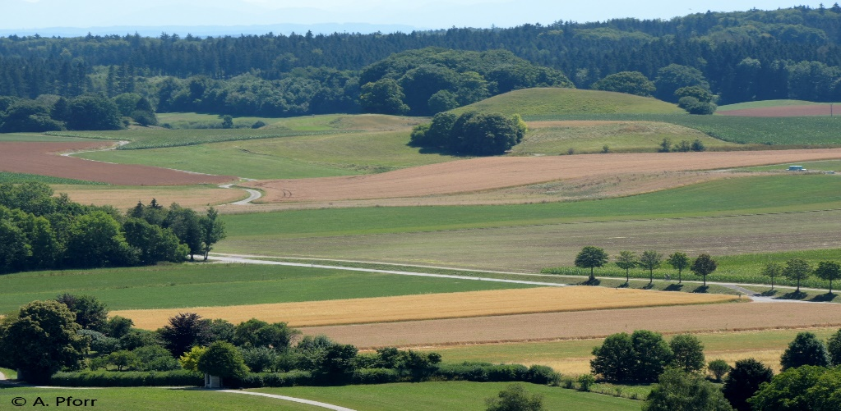
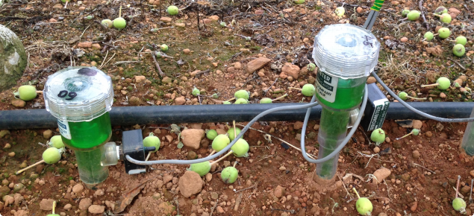
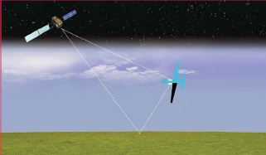
Motivation for Soil Moisture Remote Sensing with GNSS-R
Introduction
Hard and Impractical
GNSS-R Advantages
Scan large surface areas
Quickly reach the areas to monitor.
24 hours detection.
Precisely locate and date the data
Reduced development cost.

Slide 5
Outline
Motivation for Soil Moisture Remote Sensing with GNSS-R
GNSS-Reflectometry
    GNSS-R Concept
    GNSS-R Geometry
General Overview
System Implementation
Conclusion

Slide 6
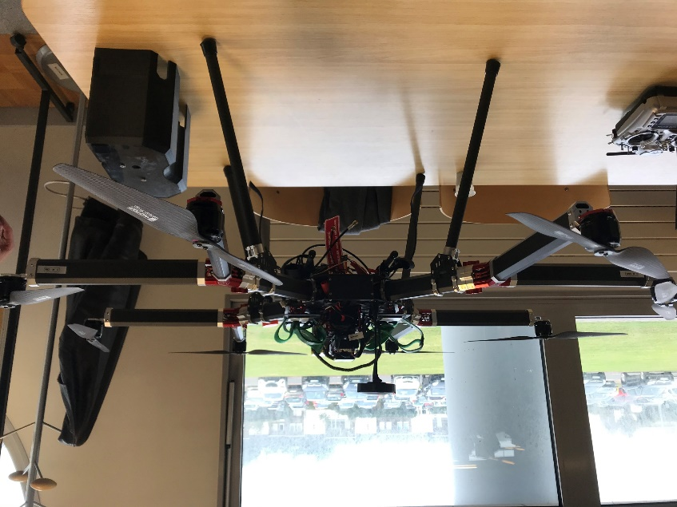
GNSS-R Concept
GNSS-Reflectometry
Bi-static radar technique
Uses L-band GNSS signals.
Characterize the Earth’s surface.

Slide 7
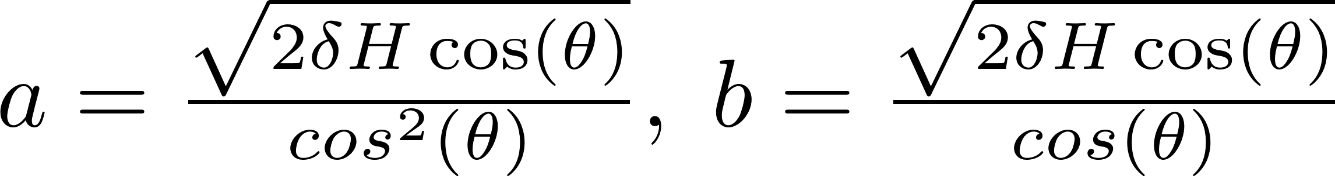
GNSS-R Geometry
GNSS-Reflectometry
Main Concern
Surface Type | Active Region
Flat (Smooth) | First Fresnel zone
Rough | Glistening zone

Slide 8
Outline
Motivation for Soil Moisture Remote Sensing with GNSS-R
GNSS-Reflectometry
General Overview
System Implementation
Conclusion

Slide 9
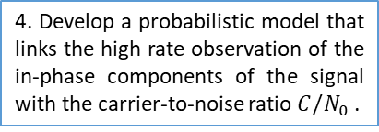
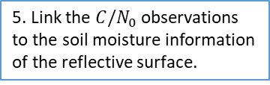
General Overview
3. Develop GNSS signal processing techniques for airborne reflectometry and assess it on real data.
1. Develop a Geographic Information System to predict the number and the position of the satellites’ footprints over the experimental zones .
4. Develop a probabilistic model that links the high rate observation of the in-phase components of the signal with the carrier-to-noise ratio $C/N_{0}$ .
2. Develop a system to detect the number and the position of the satellites’ footprints along the real receiver trajectory .
5. Link the $C/N_{0}$ observations to the soil moisture information of the reflective surface.
6. Link the soil moisture content to each reflective surface

Slide 10
Outline
Motivation for Soil Moisture Remote Sensing with GNSS-R
GNSS-Reflectometry
General Overview
System Implementation
  Detection of the Satellites’ Footprints
    Calculation of the Satellites’ Footprints
    Real Flight Experimentation
  Carrier-to-Noise Ratio: Rate of Observation
Conclusion

Slide 11
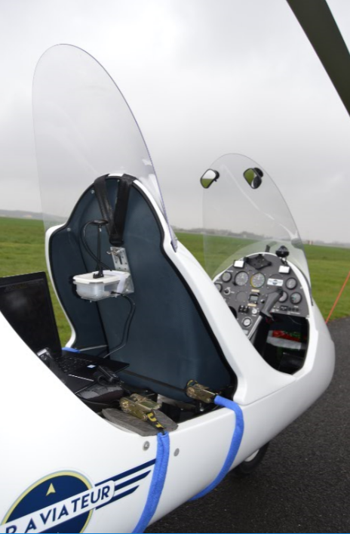
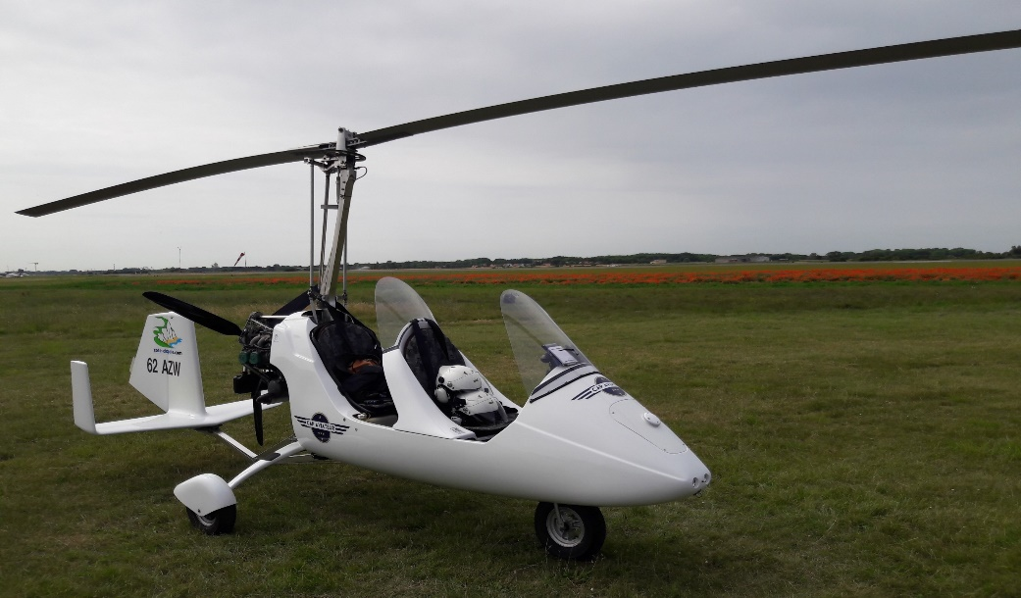
Detection of the Satellites’ Footprints
System Implementation
Detect the reflective surfaces (footprints) from which each analyzed signal has reflected.
Link the reflected signals to the satellites' footprints.
Drone Sensor (records gyrocopter’s attitude)
Signal Digitization
Dual Polarization Antenna
Real Flight Experimentation

Slide 12
Calculation of the Satellites’ Footprints
System Implementation
Detection of the Satellites’ Footprints

Slide 13
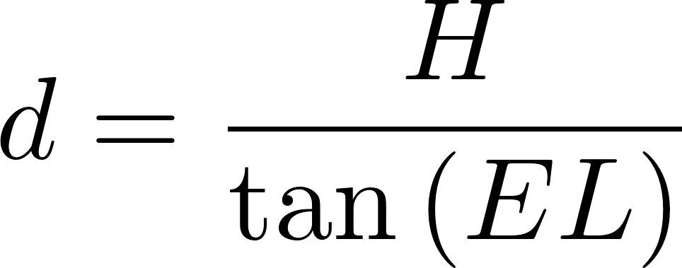
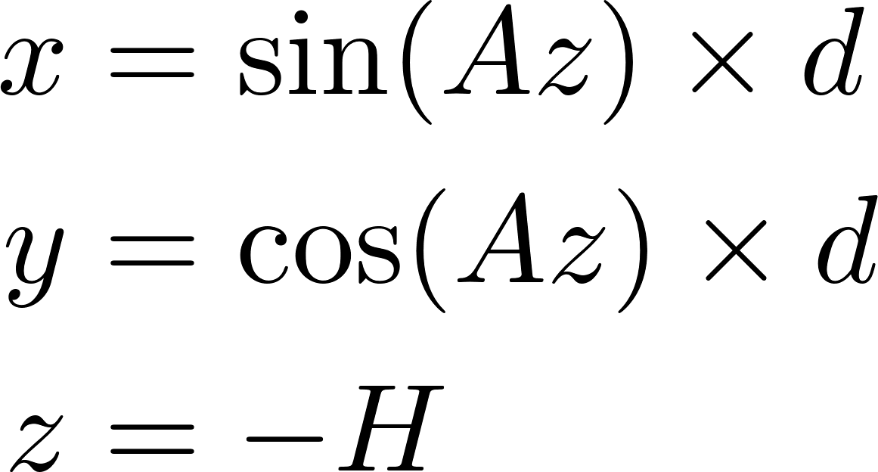
Coordinates of the specular point S
System Implementation
Calculation of the Satellites’ Footprints
Calculation of d | Calculation of S (x,y,z)

Slide 14
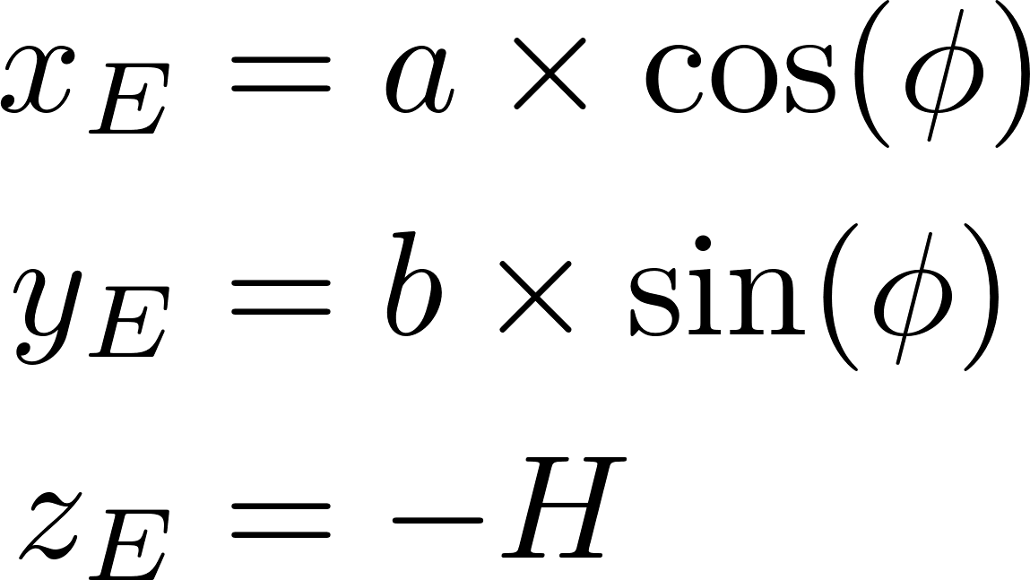
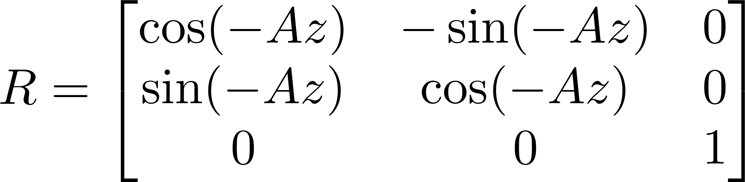
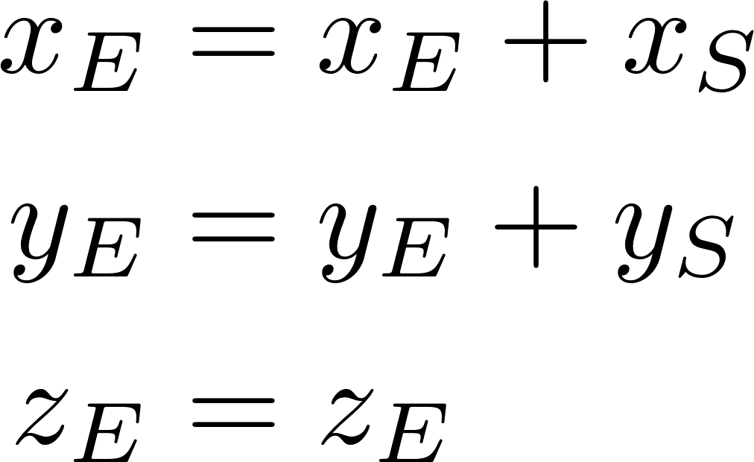
Coordinates of the First Fresnel Ellipse
System Implementation
Calculation of the Satellites’ Footprints
Ellipses’ Coordinates | Rotation with angle= -Az | Translation
Transform back to geodetic coordinates for representation on Google Earth.

Slide 15
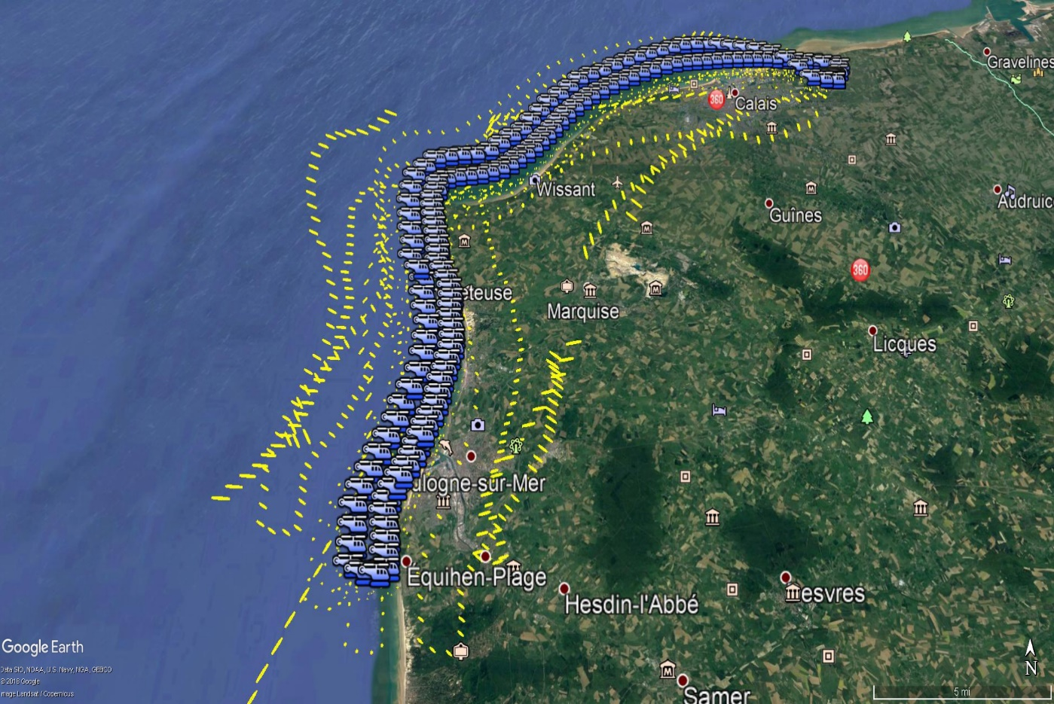
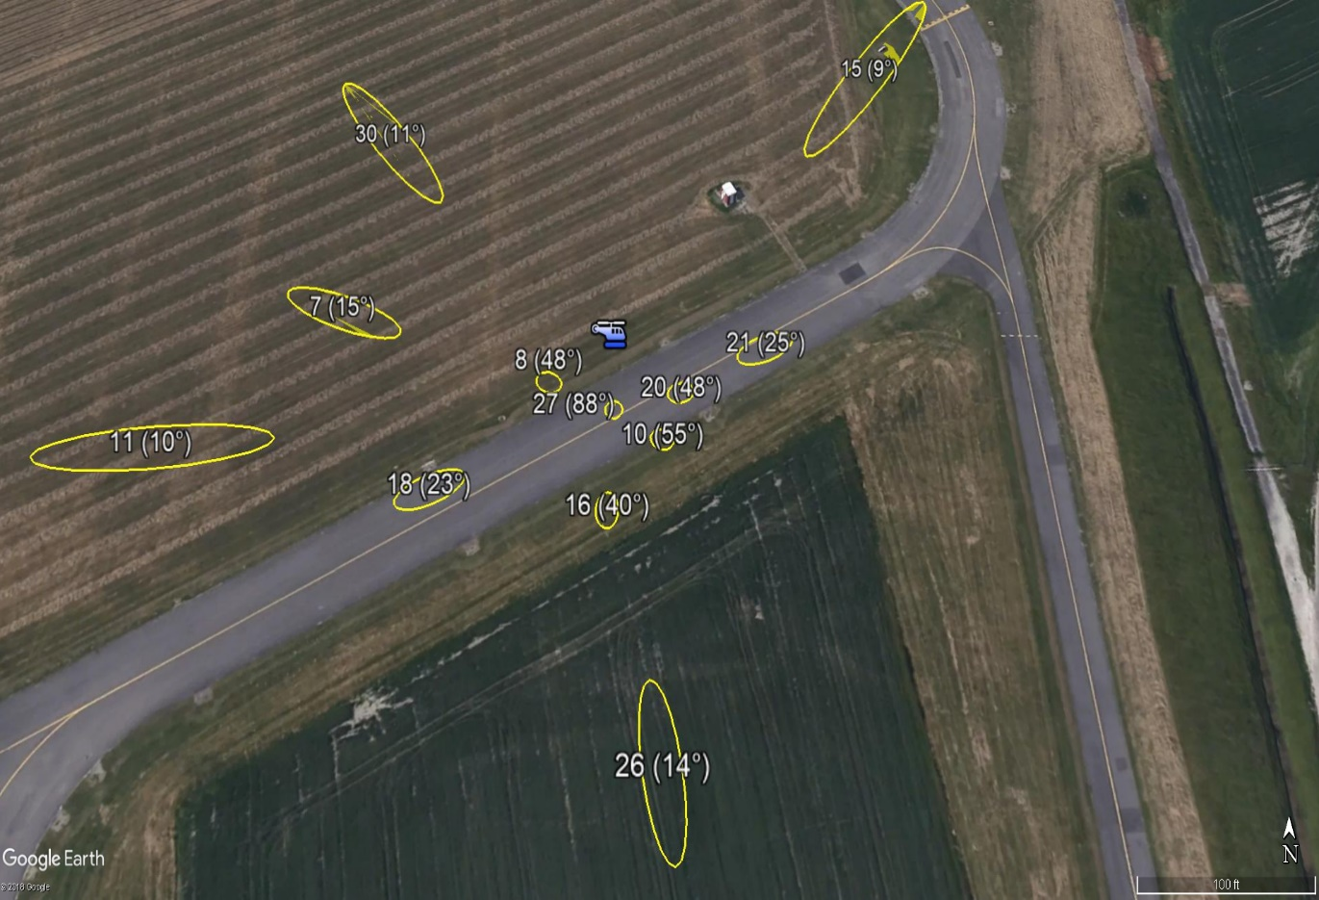
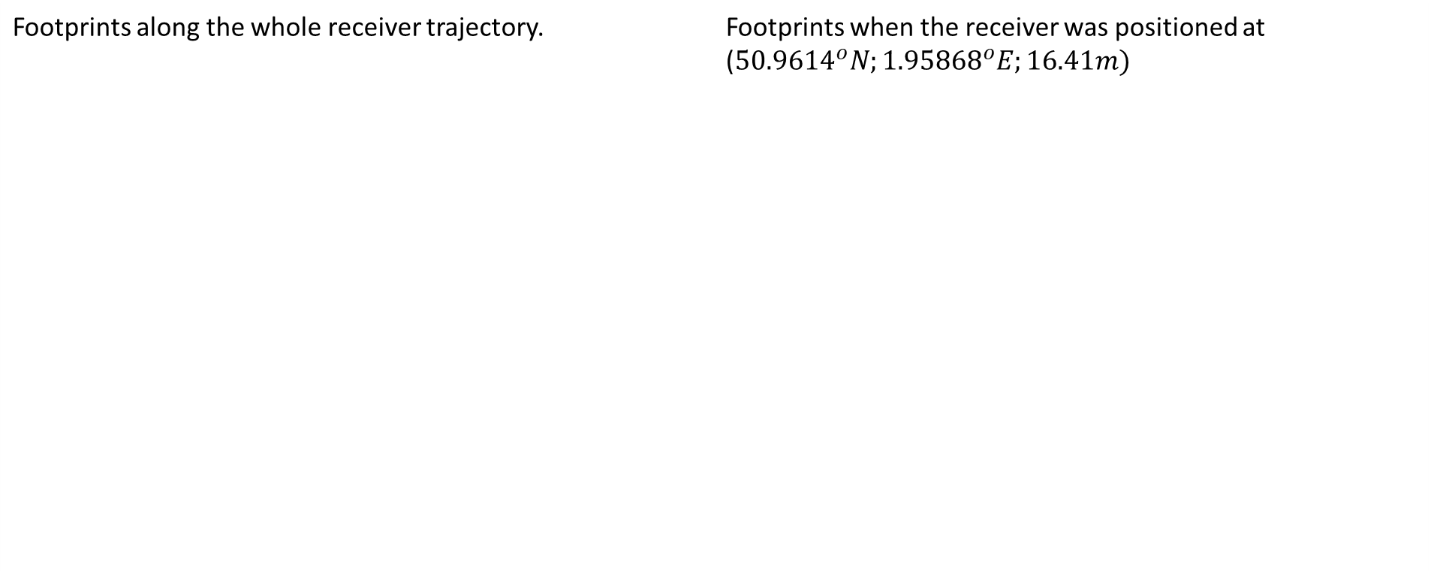
Real Flight Experimentation
System Implementation
Detection of the Satellites’ Footprints
Footprints along the whole receiver trajectory. | Footprints when the receiver was positioned at (${50.9614}^{o}N;{1.95868}^{o}E;16.41m)$

Slide 16
Carrier-to-Noise Ratio: Rate of Observation
System Implementation
GNSS-R uses SNR observations to derive the properties of the reflective surface.
The amplitude of the GNSS signals can’t be directly observed.
For 1 bit quantization, the in-phase component provides a direct observation of the SNR.
High rate SNR observations is needed to cope with the rapid change in the locations of the satellites’ footprints.

Slide 17
Carrier-to-Noise Ratio: Rate of Observation
System Implementation
Gyrocopter’s parameters during the flight:
Average speed of displacement of the satellites’ footprints during the flight:
Average speed = 26.31 m/sec = 2.63 cm/ms | Average height = 718 m.
High speed of displacement per second
The reflective surfaces’ characteristics might change during 1 second
Satellite PRN | Average Speed (m/sec) | Average Speed (cm/ms)
1 | 26.42 | 2.64
8 | 26.22 | 2.62
18 | 26.4 | 2.64
32 | 26.13 | 2.61
Very low speed of displacement per ms
Footprints move approximately 2.63 cm per ms
Footprints’ localization is in cm accuracy at ms rate
1 ms rate of $C/N_{0}$ observations is applied. (G. Stienne, J. Kucwaj, M. Semmling and S. Reboul, "GNSS signals inversion for amplitude estimation: a concept for high-rate reflectometry," 2018 International Conference on Electromagnetics in Advanced Applications (ICEAA), Cartagena des Indias, 2018, pp. 368-371.)

Slide 18
Outline
Motivation for Soil Moisture Remote Sensing with GNSS-R
GNSS-Reflectometry
General Overview
System Implementation
Conclusion

Slide 19
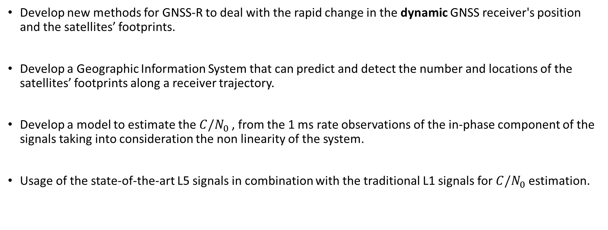
Research Novelty
Conclusion
Develop new methods for GNSS-R to deal with the rapid change in the dynamic GNSS receiver's position and the satellites’ footprints.
Develop a Geographic Information System that can predict and detect the number and locations of the satellites’ footprints along a receiver trajectory.
Develop a model to estimate the $C/N_{0}$, from the 1 ms rate observations of the in-phase component of the signals taking into consideration the non linearity of the system.
Usage of the state-of-the-art L5 signals in combination with the traditional L1 signals for $C/N_{0}$ estimation.

Slide 20
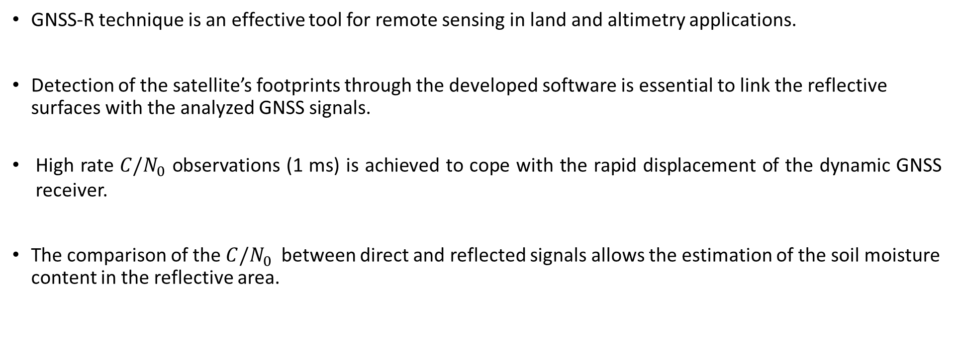
Conclusion
GNSS-R technique is an effective tool for remote sensing in land and altimetry applications.
Detection of the satellite’s footprints through the developed software is essential to link the reflective surfaces with the analyzed GNSS signals.
High rate $C/N_{0}$ observations (1 ms) is achieved to cope with the rapid displacement of the dynamic GNSS receiver.
The comparison of the $C/N_{0}$ between direct and reflected signals allows the estimation of the soil moisture content in the reflective area.

Slide 21

Special Thanks
A special thanks goes to the MARCO Project which provided this research with the drone, essential to the global implementation of this research.

Slide 22
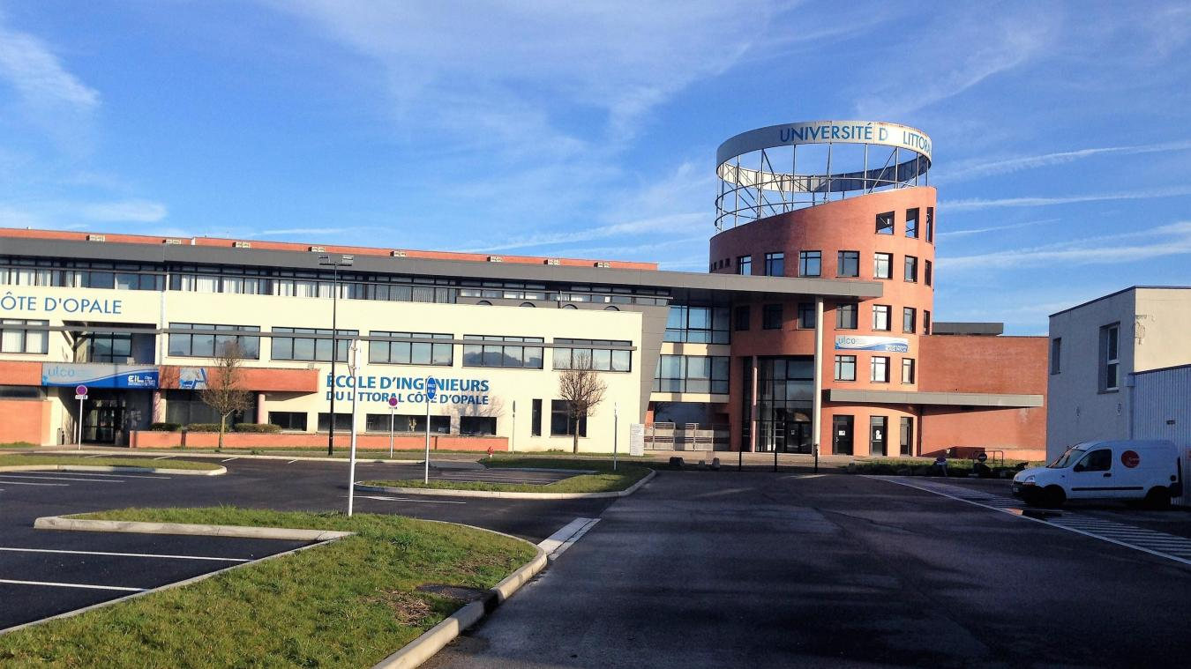

THANK YOU
FOR YOUR ATTENTION

Slide 23

Questions?

