Slide 1
2020-1604
Experimental study of the duct-effects of the tidal current turbines in multi-row-staggered layout
Yaling Chen¹, Binliang Lin², Jinxi Guo²
¹College of Earth and Environmental Sciences, Lanzhou University, Lanzhou 730000, China
²State Key Laboratory of Hydro-science and Engineering, Tsinghua University, Beijing 100084, China
chenyaling@lzu.edu.cn

Slide 2
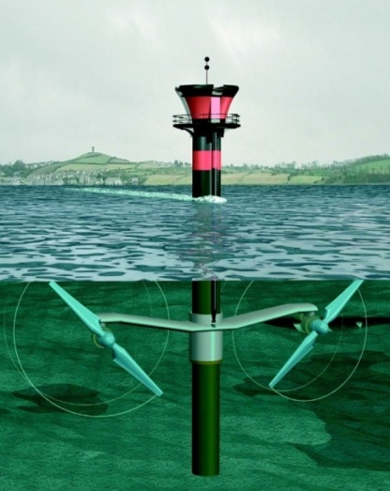
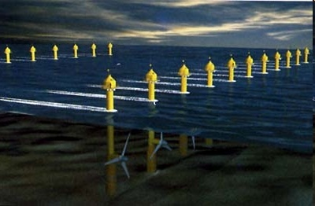
1. Back ground
?
1MW
100MW
Power from turbine farm does not scale linearly!!
Inflow
Ambient
flow
Ambient
flow
Wake flow
Wake hydrodynamics?
Wake interaction?
Array performance?

Slide 3
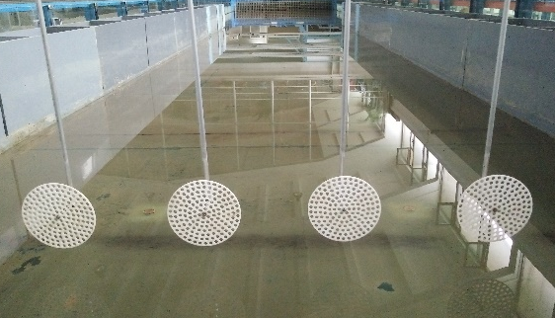
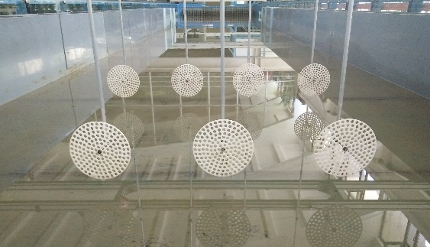
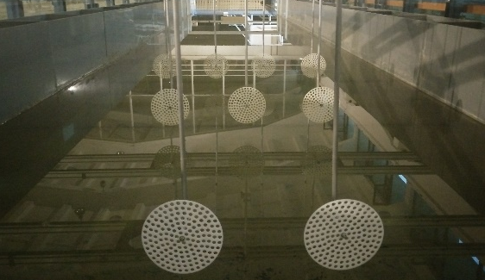
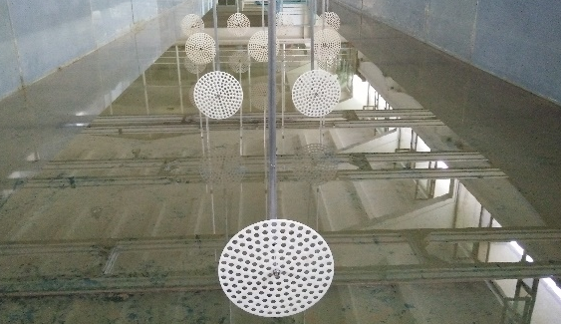
2. Physical experiment
Diameter (m) | Porosity | Blockage ratio (%)
0.15 | 0.39 | 4
(a)
(b)
(c)
(d)

Slide 4
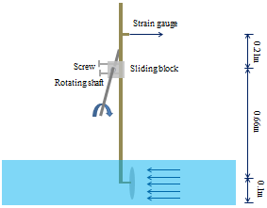
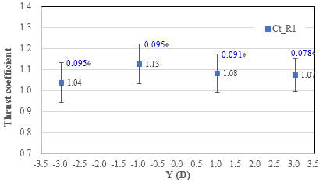
3. Velocity & Thrust measurement
Velocity & Turbulence
Thrust measurement
Velocity
Thrust coefficient
0.26
0.26
0.26
0.26
Turbulence intensity
Standard deviation
8.1
7.9
7.9
8.1
Single row array
High velocity flow in the region Y = (-0.45 m, 0.45 m)
Vertical velocity difference over disc area up to 0.04 m/s
Turbulence intensity in high velocity region is low

Slide 5
4. Duct-effects
Wake velocity
Wake Turbulence
1D
1D
2D
2D
3D
3D
4D
4D
6D
6D
8D
8D
10D
10D

Slide 6
4. Duct-effects
Two rows array
Thrust coefficient
Velocity
0.24
0.24
0.24
Turbulence intensity
15.5
16.0
15.7
Three rows array
Thrust coefficient
Velocity
0.20
0.20
Turbulence intensity
14.1
13.7

Slide 7
4. Duct-effects
Four rows array
Thrust coefficient
Velocity
0.19
Turbulence intensity
12.9
Summary
The longitudinal spacing between rows should be less than 6D when the duct-effect is enhanced to obtain the accelerated velocity.
In staggered array, the duct-effect between discs is weakened while the wake superposition is enhanced beyond two rows.
The shear-induced turbulence is enhanced by the duct-effect while reduced by wake superposition.

