Slide 1
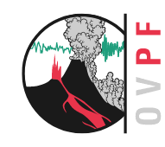
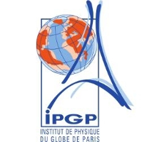
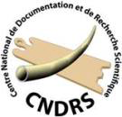
Geochemistry of noble gases and radiogenic isotopes of ultramafic mantle xenoliths from La Grille volcano (Grand Comore Island, Indian Ocean)
Claudio Ventura Bordenca*(1), Antonio Caracausi*(2) , Andrea Di Muro (3), Guillaume Boudoire (2), Massimo Coltorti (4), Barbara Faccini (4), Marco Liuzzo (2,4), Andrea L. Rizzo (2,4), and Raphaël Pik (5) and Alessandro Aiuppa (1)
(1) Università di Palermo, Dipartimento di Scienze della Terra e del Mare (DiSTeM), Palermo, Italy
(2) Istituto Nazionale di Geofisica e Vulcanologia (INGV), Palermo, Palermo, Italy,
(3) Observatoire Volcanologique du Piton de la Fournaise (OVPF)-La Réunion, Institut de Physique du Globe de Paris (IPGP)-Paris, France
(4) Università degli Studi di Ferrara, Dipartimento di Fisica e Scienza della Terra, Ferrara, Italy,
(5) Centre de Recherche Petrographique et Geochimie, Nancy, France
*corresponding authors:
antonio.caracausi@.ingv.it
claudio.venturabordenca@unipa.it

Slide 2
1. Introduction
The western Indian Ocean has recently received significant interest in the scientific literature as far as concern late Cenozoic to present Comorean magmatism which have provided petrological and geochemical constraints to be placed on the genesis and magmatic evolution of the Comorean archipelago and Le Reunion volcanism (Class et al. 2005 and references therein; Vlastelic and Pietruszka 2016). In fact, here are located the two most active volcanoes in the southwest Indian Ocean: Piton de la Fournaise at La Réunion Island and Karthala on Grande Comore in the Comorian archipelago. Karthala is a magnificent volcano and, although its eruptions are less frequent than those of Piton de la Fournaise, it poses a serious threat to the population living close to its shores and around its flanks, as demonstrated by recent eruptions. Karthala, the youngest of the Comorian volcanoes, rises from the floor of the Mozambique Channel. Grande Comore rises as a volcanic doublet comprising the coalescing shields of La Grille and Karthala. There are, however, no historic eruptions from La Grille, whereas Karthala has erupted at least twenty times since records began in 1857 and three of them occurred since 2000 producing damages to the villages at Gran Comore and led to the evacuation of people.

Slide 3
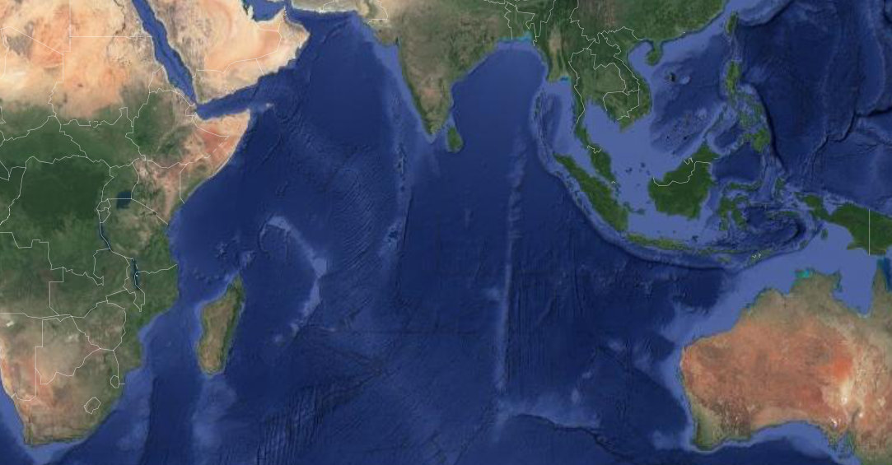
1. Introduction
INDIAN OCEAN
East African
Rift System
Comoros
Madagascar
Mozambique Channel
Mid-ocean ridge
La Reunion

Slide 4
1. Introduction
The Comoros Archipelago is an age-progressive volcanic chain located in the northern part of the Mozambique Channel in the Western Indian Ocean between Madagascar and East Africa. It is composed of four islands: from west to east these are Grand Comore, Moheli, Anjouan and Mayotte followed by two, poorly known submarine volcanic banks (Geiser and Leven; Daniel et al. 1972). Geochronological data indicate that magmatic activity in Comoros archipelago was diachronous. It supposedly started in Mayotte around 11 Ma ago, then in Mohéli and Anjouan 3.9 and 5 Ma ago, respectively, and finally in Grande Comore approximately 0.13 Ma ago (Emerick and Duncan 1982; Nougier et al. 1986; Debeuf 2004). No geochronological and geochemical data are currently available for the submarine sector of each volcanic island where oldest rocks may occur. This magmatism is coeval with other volcanic provinces around the Mozambique Channel, namely the East African Rift System and the central-northern Madagascar, whose magmatic periods are dated back since Upper Oligocene.

Slide 5
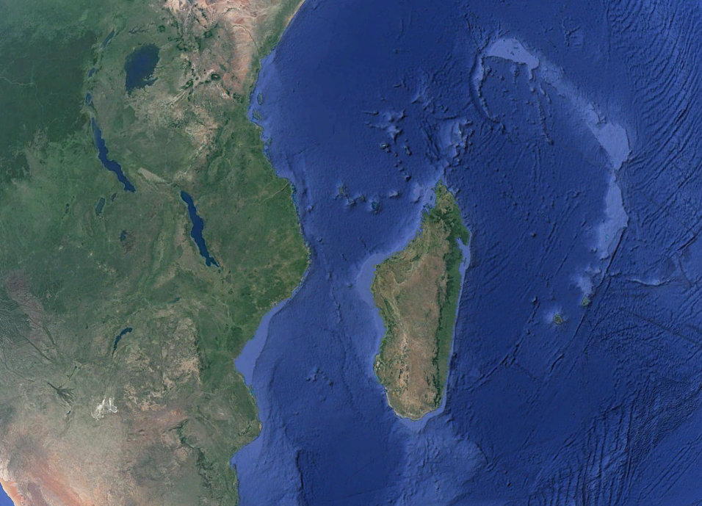
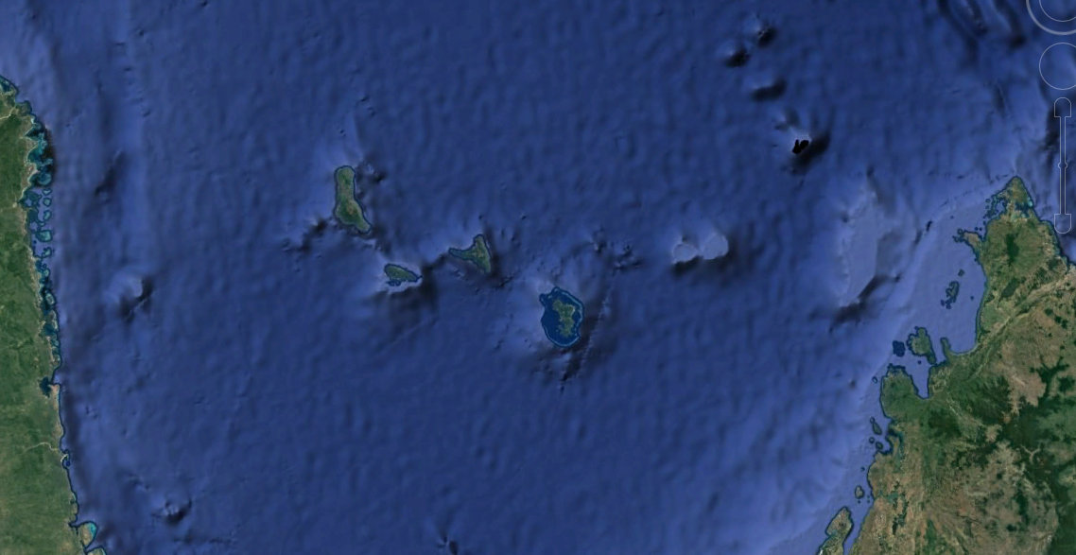
1. Introduction
Western Indian Ocean
Comoros
Archipelago
Tanzania
East African Rift System
Mozambique
Madagascar
Mozambique
Channel
Grand Comore
La Reunion
Anjouan
Mayotte
Moheli
Madagascar
Mozambique Channel

Slide 6
2. The study area: Grand Comore Island
Grand Comore Island consists of two shield volcanoes, La Grille (1087m) located in the north and Karthala (2361m) in the south. La Grille volcano is characterized by eroded and weathered lava flows associated with a series of monogenic cinder cones mainly located in the summit area and aligned along structural fissures (Bachelery and Coudray 1990), while Karthala is the second most active volcano of the Indian Ocean (after Piton de la Fournaise at the Reunion Island) with last volcanic activity recorded in January 2007 (web source: https://volcano.si.edu; Global Volcanism Program, Smithsonian Institution). Alkali basalts including oceanites (olivine-rich basalts) and ankaramites (pyroxene-rich basalts) are the most common lithotypes at Karthala volcano, while La Grille products are markedly more silica-undersaturated than those of Karthala, ranging from basanites to nephelinites. Contrary to those of Karthala, lavas from La Grille often enclose xenolithic mantle nodules of ultramafic rocks resulting from phreatomagmatic maar-like eruptions (Bachelery and Coudray 1993).
Ultramafic mantle-derived xenoliths were collected on the north-eastern coast of Grand Comore during 2017-2018 field campaigns with the aim of characterizing and constraining the mantle source beneath La Grille volcano. Olivine, clinopyroxene and orthopyroxene (hereafter Ol, Cpx and Opx) crystals of 1-mm size-fraction were handpicked from crushed ultramafic xenoliths with binocular microscope for noble gas (He, Ne, and Ar) and radiogenic isotopes (Sr, Nd) measurements.

Slide 7
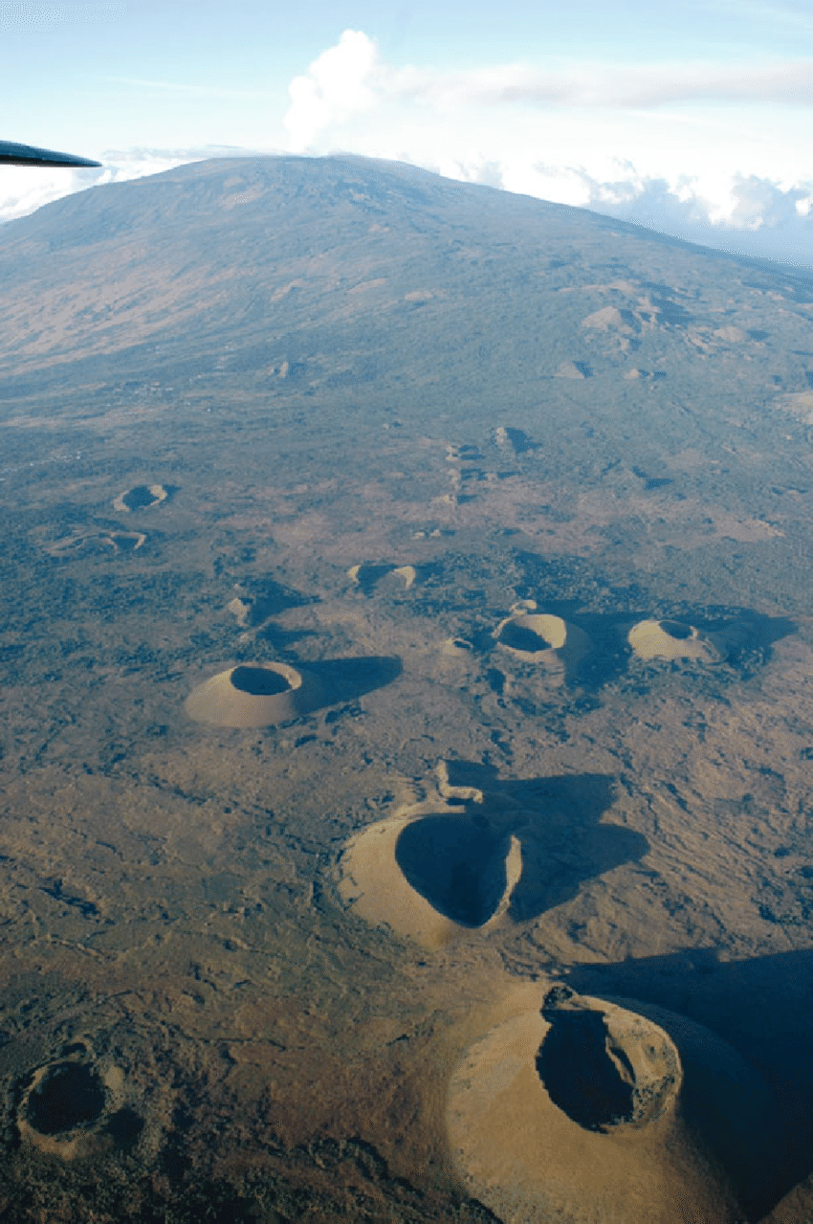
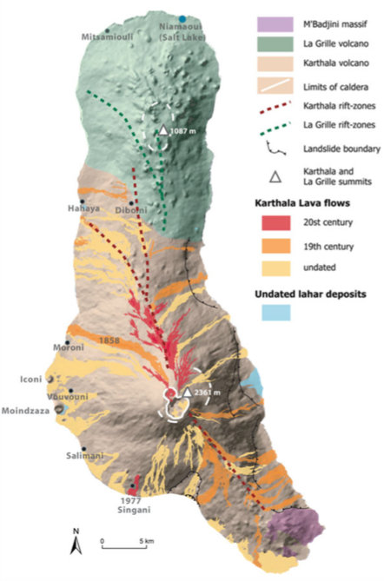
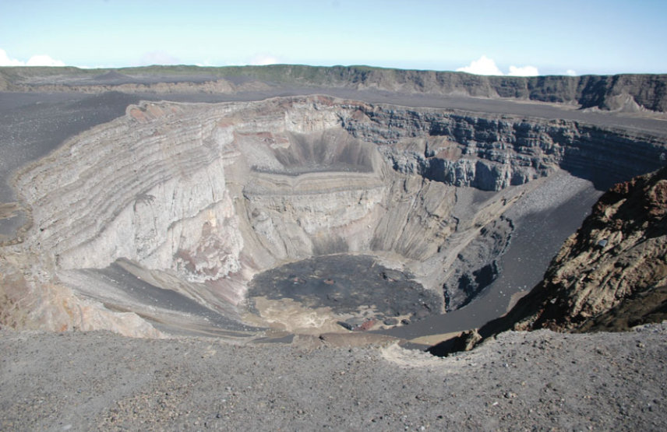
2. The study area: La Grille volcano
Monogenic cones
at the summit of
La Grille volcano
Photo: J. Morin
Karthala’s pit crater
Photo: J. Morin
Bachelery & Coudray 1993

Slide 8
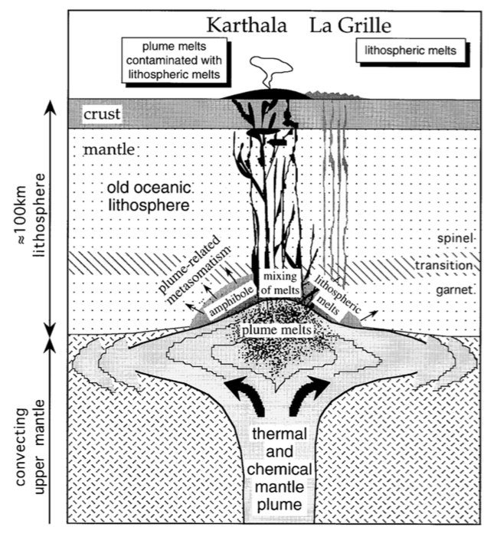
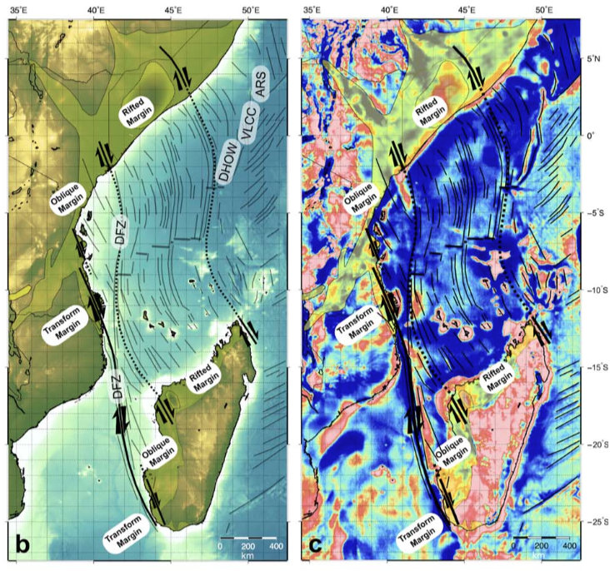
3. The Comorean Archipelago: A long debated origin
1. Lithospheric migration above a stationary plume-related hot-spot track (Emerick & Duncan 1982; Class et al. 1996, 1998)
2. Passive response of lithospheric tearing due to activation of transform zones (Nougier et al. 1986; Courtillot et al. 2003; Phethean et al. 2016)
The process of plume-lithospheric interaction beneath Grande Comore. The upwelling plume impinges on the lithospheric plate. Plume-derived volatile-rich melts form amphibole-bearing assemblage in the lower part of the lithospheric mantle, which results in a lower solidus temperature. Karthala lavas reflect mixing between plume melts and high-degree melts of the metasomatized lithospheric mantle. On its fringes, the conductive heating by the plume raises the temperature above the solidus, causing low-degree melting producing the alkali magmas of La Grille. NOT IN SCALE.
(b) Basin configuration with strike-slip tectonics along the edge of the Tanzania Coastal Basin considered as an obliquely rifted margin. The Davie Fracture Zone is a major ocean-ocean fracture zone. DFZ, Davie Fracture Zone; DHOW, Dhow Fracture Zone; VLCC, Very Large Crude Carrier Fracture Zone; ARS, Auxiliary Rescue and Salvage Fracture. (c) Free-air gravity is the measured anomaly after a free-air correction applied to correct for the elevation at which a measurement is made

Slide 9
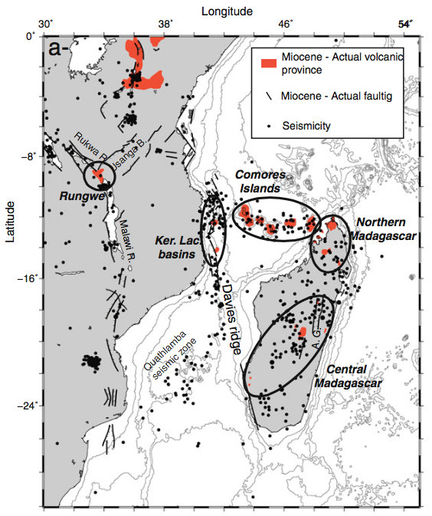
4. Why the Comoros Archipelago?
The Comoros Archipelago is located in one of the most seismically and volcanically-active area of the Indian Ocean
Mayotte
Michon 2016. Distribution of seismicity, volcanism and normal faults active from the Miocene to the actual.

Slide 10
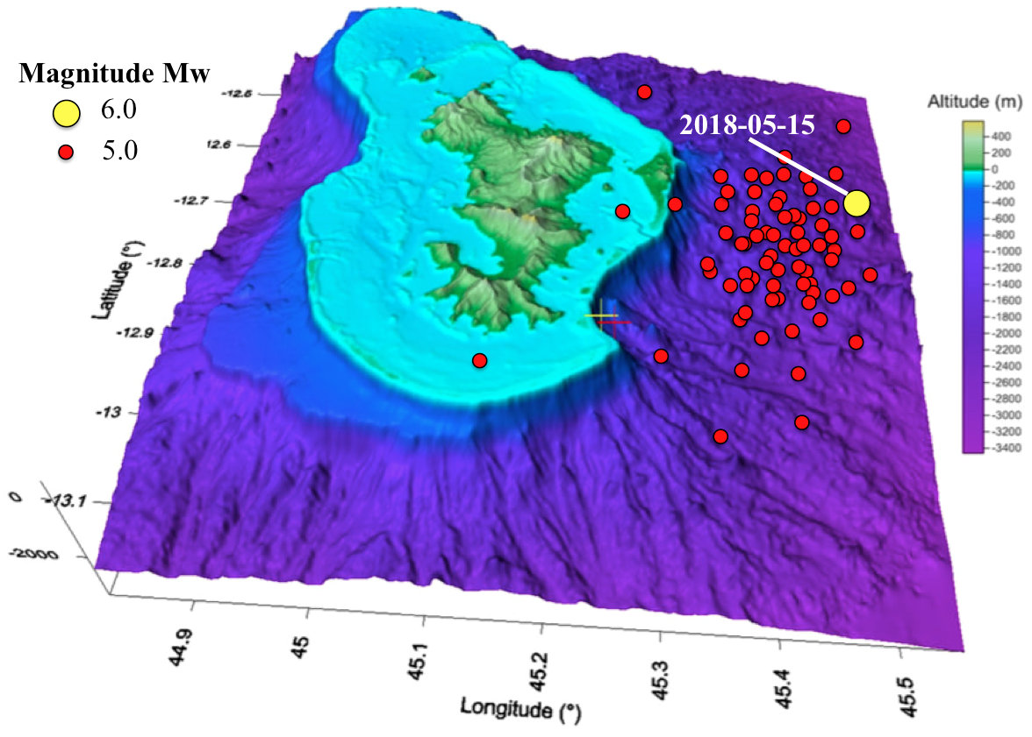
4. Why the Comoros Archipelago?
A magmatic intrusion in the oceanic crust? (Cesca et al. 2019 EGU)
Roger 2019. Digital Elevation Model (DEM) of Mayotte Island with bathymetric/topographic data and seismic swarms (red dots) before 15th May 2018 (yellow dot).

Slide 11
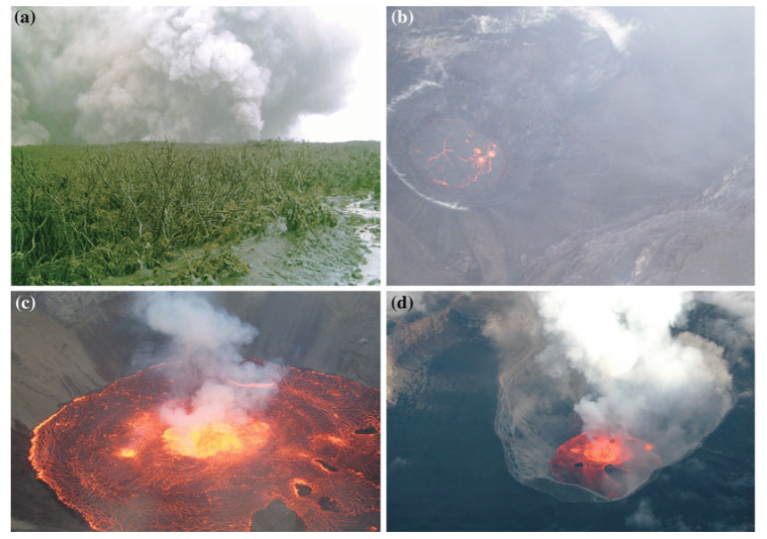
4. Why Grand Comore Island?
A natural laboratory
Bachelery et al. 2016. Recent Karthala’s volcanic eruptions. (a) Explosive activity (Photo: D. Hoffschir); (b, c) Lava lakes on April 2005 (Photo: H. Soule and C. Roche); (d) Lava lake on May 2006 )Photo J. Morin).

Slide 12
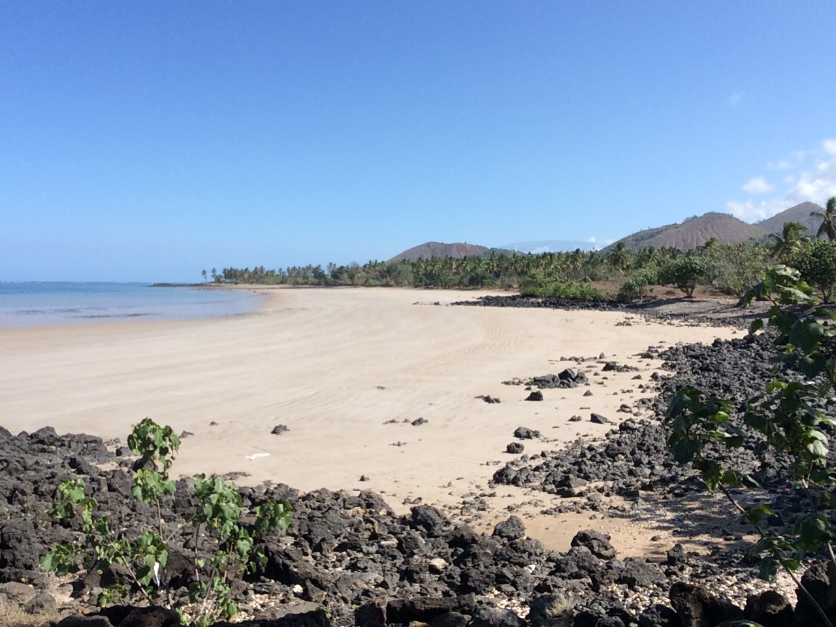
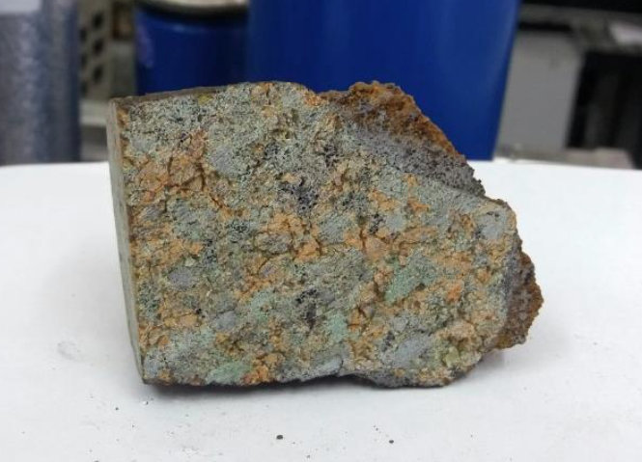
5. Field campaigns: Rock samplings
Ndroude xenolith
Noble gases in FI
Radiogenic Isotopes
Ndroude beach
5 cm

Slide 13
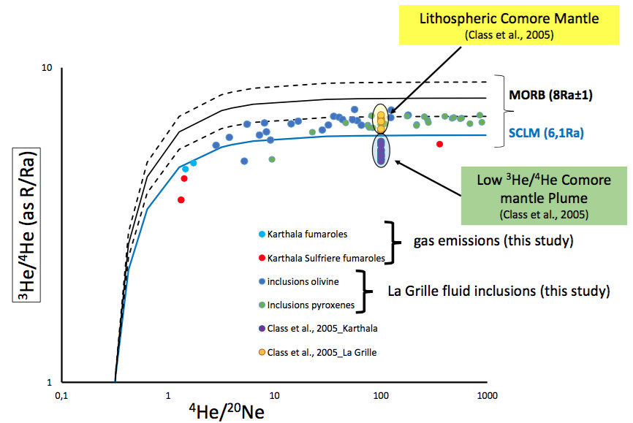
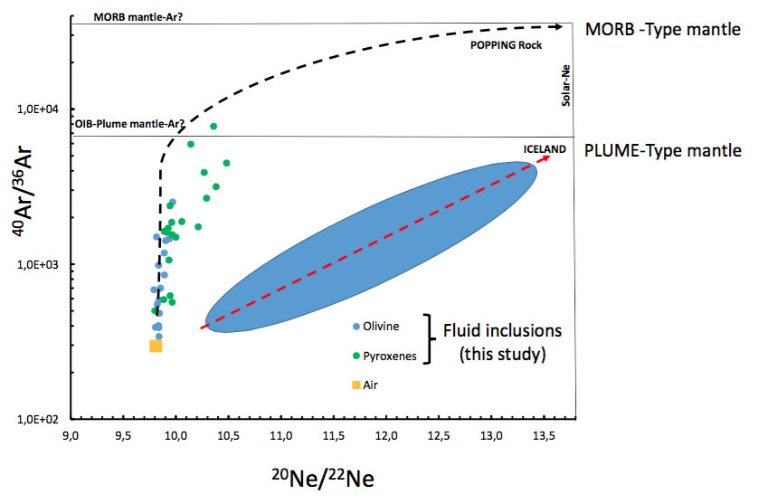
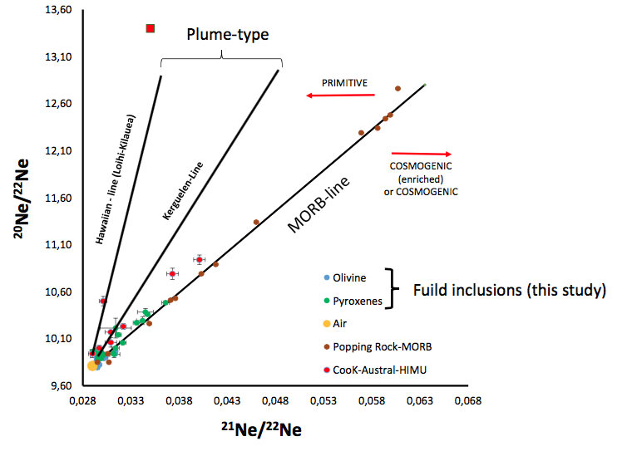
6. Results: Noble gases in FI from La Grille xenoliths
Solar
La Grille
xenoliths
He-Ne-Ar isotope systematics of fluid inclusions in ultramafic mantle xenoliths from La Grille volcano indicate a MORB-type reservoir.

Slide 14
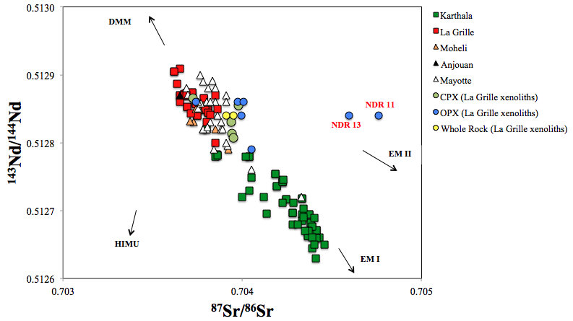
6. Results: Sr-Nd isotopes in La Grille xenoliths
(Class et al. 1998)
(Class and Goldstein 1997; Class et al. 1998)
GEOROCK Database
http://georoc.mpch-mainz.gwdg.de/georoc/
This study
Sr-Nd isotope compositions of Opx-Cpx show higher variability than bulk lavas.
Mixing between DMM and EM1 sources
Two opx show the most extreme Sr signature pointing to EM2.

Slide 15
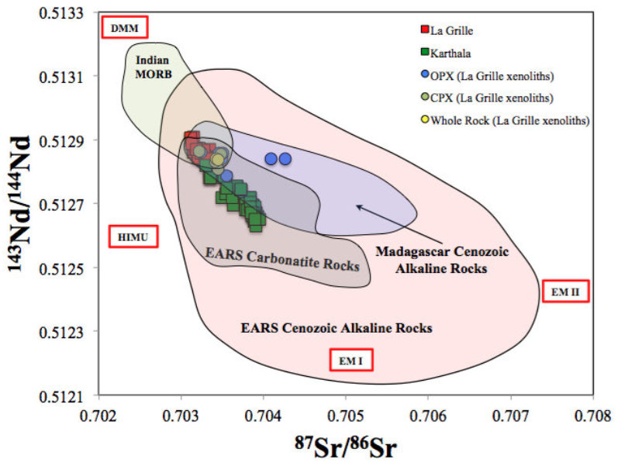
6. Results: Radiogenic isotopes in La Grille xenoliths
EARS= East African Rift System
Data of Indian MORB, Madagascar and EARS rocks from GEOROC Database

Slide 16
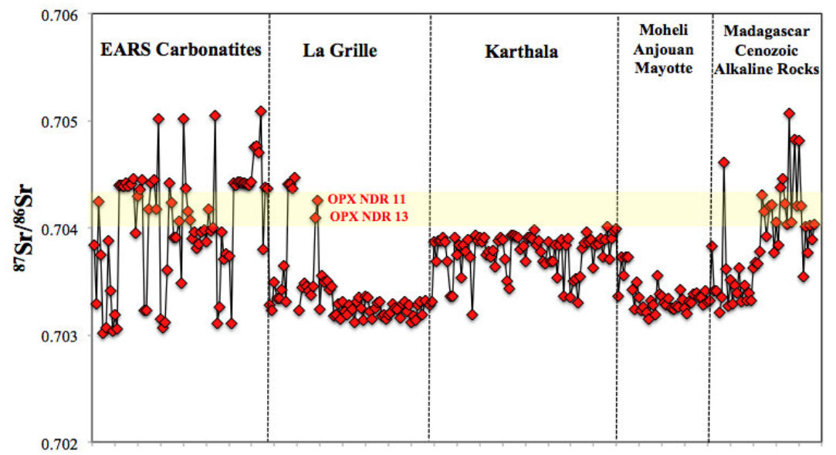
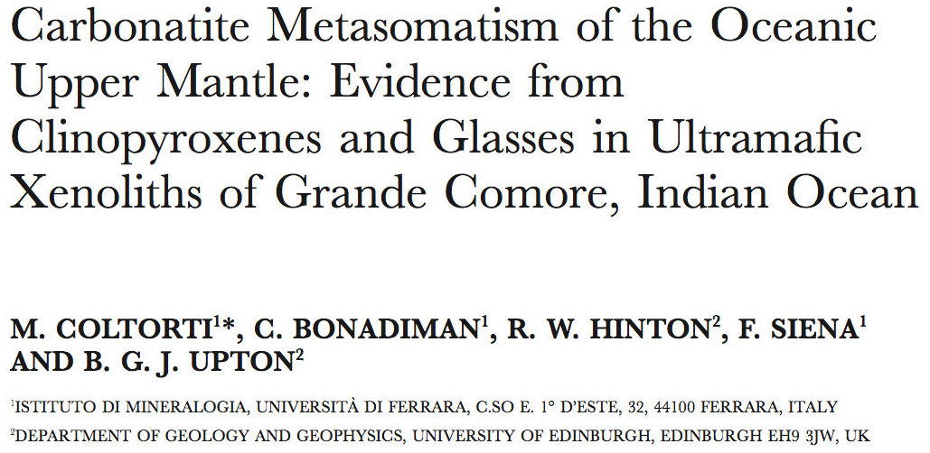
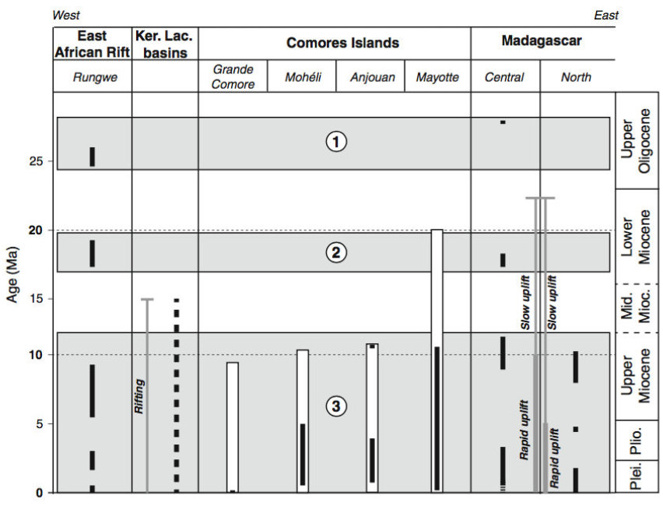
Coltorti et al. 1999
Michon 2016

Slide 17
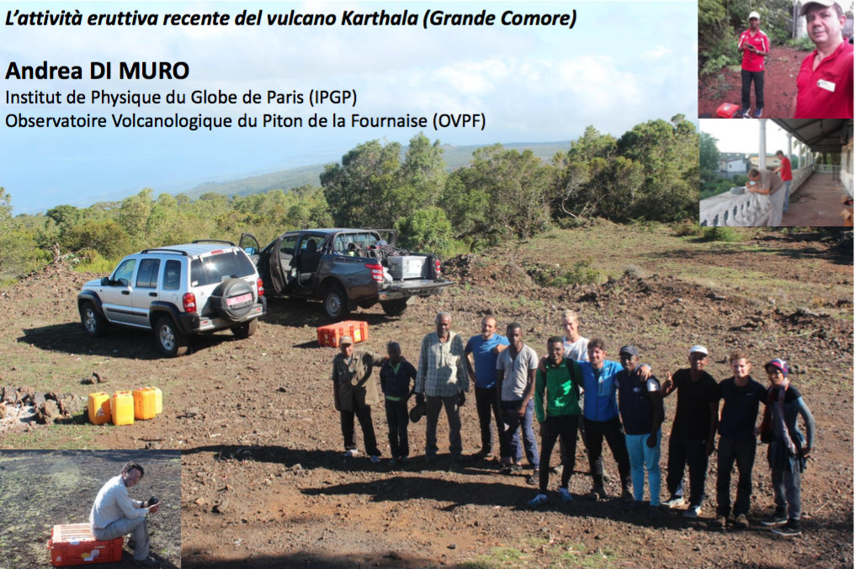
7. Conclusions
Noble gas isotopes (He-Ne-Ar) in La Grille xenoliths MORB-type source
Radiogenic isotopes (Sr-Nd) in La Grille xenoliths mixing between Depleted Morb Mantle and Enriched Mantle 1 reservoirs
Two Opx Enriched Mantle 2 and affinities with coeval magmatism from East African Rift System and central-northern Madagascar
Geochemical dataset of Gran Comore future monitoring of an active, dangerous and very poorly-explored volcanic system.
Thanks to all the Comoros crew

Slide 18
Bibliography
Bachelery P. and Coudray J. (1990) – La Grande Comore et son volcan actif: Le Karthala, Journal of Nature 2, pp. 32-48
Bachelery P. and Coudray (1993) - Carte geologique des Comores: Carte volcano-tectonique de la Grande Comore (Ngazidja), Laboratoire de Cartographie et d’informations geographiques, Cultures Annuelles, St. Denis de la Reunion.
Bachelery P., Morin J., Villeneuve N., Soule H., Nassor H., and Radadi Ali A. (2016) – Structure and Eruptive History of Karthala Volcano - In: Bachelery, P., Lénat, J. F., Di Muro, A. and Michon, L. (Eds.), Active Volcanoes of the Southwest Indian Ocean: Piton de la Fournaise and Karthala, Springer-Verlag, pp. 345-366.
Cesca S., Letort J., Razafindrakoto H. N. T., Heimann S., Rivalta E., Passarelli L., Isken M., Petersen G., Cotton F., and Dahm T. (2019) – Very long period signals and seismic swarm activity offshore Mayotte, Comoro Island – Geophysical Research Abstracts, vol. 21, EGU General Assembly 2019.
Class C., Goldstein S. L. and Kurtz M. D. (1996) - Significance of lower mantle entrainment or plume–lithosphere interaction in oceanic islands basalts: helium isotope evidence from Grande Comore - Goldschmidt Conference, Journal of Conference Abstracts 1, 112.
Class C. and Goldstein S. L. (1997) – Plume-lithosphere interactions in the ocean basins: constrains from the source mineralogy, Earth Planet Sci Lett 150, pp. 245-160.
Class C., Goldstein S. L., Altherr R. and Bachelery P (1998) – The process of plume-lithosphere interaction in the ocean basins: the case of Grand Comore - Journal of Petrology 39, pp. 881-903.
Coltorti M., Bonadiman C., Hinton R. W., Siena F. and Upton B. (1999) – Carbonatite metasomatism of the oceanic upper mantle: evidence from clinopyroxenes and glasses in ultramafic xenoliths of Grande Comore, Indian Ocean, Journal of Petrology 40, pp. 133-165

Slide 19
Bibliography
Courtillot V, Davaille A, Besse J, Stock J (2003) - Three distinct types of hotspots in the Earth’s mantle - Earth Planet Sci Lett 205:295–308
Daniel J., Dupont J. and Jouannic Ch. (1972) – Relations Madagascar-Archipel des Comores (Nord-Est du Canal du Mozambique). Sur la nature volcanique du Banc de Leven. C R Acad Sci Paris 274, pp. 1874-1877
Debeuf D. (2004) - Etude de l’évolution volcano-structurale et magmatique de Mayotte (Archipel des Comores, Océan Indien), PhD Thesis, La Réunion Univ., p277”
Emerick, C. M. & Duncan, R. A. (1982) - Age progressive volcanism in the Comore Archipelago, Western Indian Ocean, and implications for Somali plate tectonics - Earth Planet Sci Lett 60:415–428.
Michon L. (2016) - The volcanism of the Comoros archipelago integrated at a regional scale - In: Bachelery, P., Lénat, J. F., Di Muro, A. and Michon, L. (Eds.), Active Volcanoes of the Southwest Indian Ocean: Piton de la Fournaise and Karthala, Springer-Verlag, pp. 333-344
Nougier, J., Cantagrel, J. M. & Karchie J. P. (1986) - The Comores archipelago in the western Indian Ocean: volcanology, geo- chronology and geodynamic setting - Journal of African Earth Sciences 5, 135–145.
Phethean J., Kalnins L. M., van Hunen J., Biffi P. G., Davies R. J., and McCaffrey J. W. (2016) – Madagascar’s escape from Afica: A high-resolution plate reconstruction for the Western Somali Basin and implications for supercontinent dispersal. Gcubed,17, pp. 5036-5055
Roger J. (2019) – Potential tsunami hazard related to the seismic activity east of Mayotte Island, Comoros Archipelago – Journal of Tsunami Society International, vol. 38, n. 3, pp. 118-131
Vlastelic I. and Pietruszka A. J. (2016) – A review of the recent geochemical evolution of Piton de la Fournaise volcano (1927-2010) - In: Bachelery, P., Lénat, J. F., Di Muro, A. and Michon, L. (Eds.), Active Volcanoes of the Southwest Indian Ocean: Piton de la Fournaise and Karthala, Springer-Verlag, pp. 185-201

