Slide 1
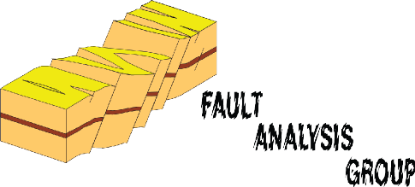


EGU2020-16378
Changes in the location of the nucleation point of slip events on ancient normal faults
Efstratios Delogkos^{1,2}, Conrad Childs^{1,2}, Tom Manzocchi^{1,2}, and John Walsh^{1,2}
¹Fault Analysis Group, UCD School of Earth Sciences, University College Dublin, Belﬁeld, Dublin 4, Ireland
²iCRAG (Irish Centre for Research in Applied Geosciences), UCD School of Earth Sciences, University College Dublin, Belﬁeld, Dublin 4, Ireland
We would like to thank the Public Power Corporation (ΔEH/ΛKΠA) for permission to work in the mines. This publication has emanated from research supported in part by a research grant from Science Foundation Ireland (SFI) under Grant Number 13/RC/2092 and is co-funded under the European Regional Development Fund.
Reference: Childs, C., Delogkos, E., Manzocchi, T. and Walsh, J.J., 2020. A geological record of changing propagation directions of fault slip events during the growth of a normal fault system. Tectonophysics, 774, p.228296, https://doi.org/10.1016/j.tecto.2019.228296

Slide 2

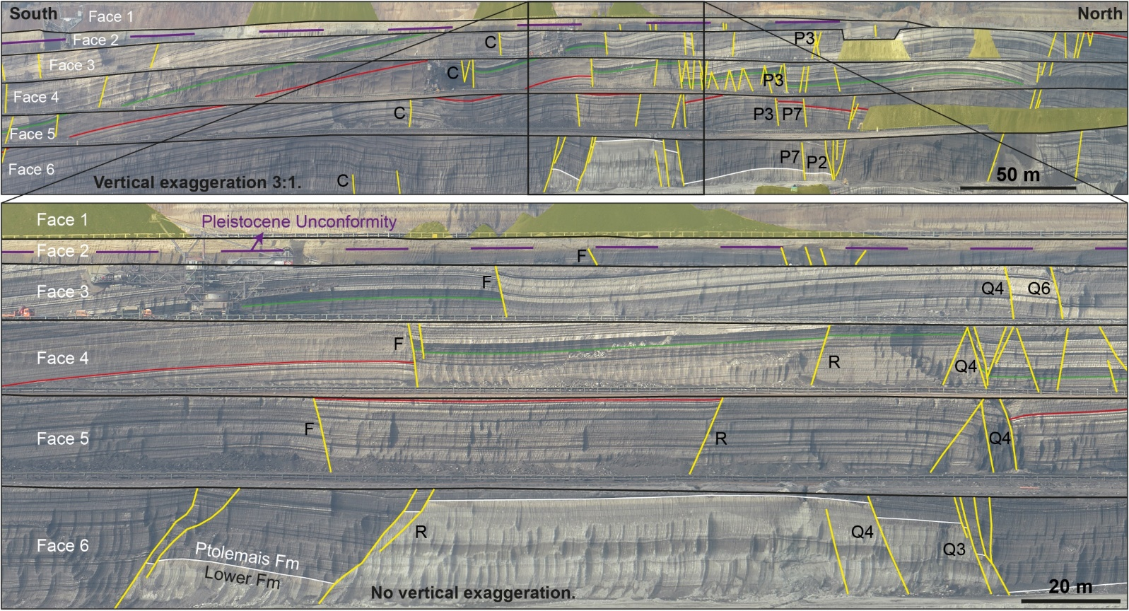
Study area – Ptolemais Basin, NW Greece (1)
Quaternary normal faults are excavated during mining of Pliocene lignite.
Geological map of the southern part of Ptolemais Basin showing the major faults and more detailed fault interpretations within the Mavropigi, Kardia and Notio opencast lignite mines.
Vertically exaggerated (x3) panoramic view and true scale zoom-in of the active, opencast, Kardia lignite mine as mapped in October 2013. Fault are exposed on 6 ~ 20 m high benches.
Delogkos et al., 2017a

Slide 3
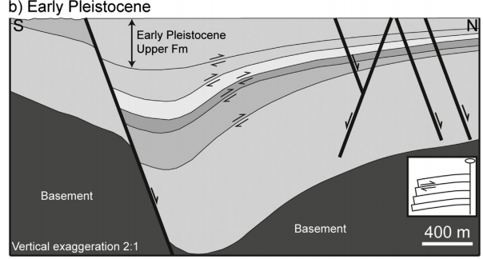
Study area – Ptolemais Basin, NW Greece (2)
Faulting was accompanied by bed-parallel slip related to movement on the basin-bounding fault.
Fault map of the Kardia Mine. Dashed lines show the mining faces as mapped in October 2013 Typical stratigraphic log from Kardia Mine (Steenbrink et al., 1999).
Faulting in Kardia Mine is accompanied by top to the north bed-parallel slip accommodating deformation in the hanging wall of the basin-bounding fault (Delogkos et al., 2018)

Slide 4
Determination of fault slip propagation direction
Fault movement
Bed-parallel slip
Synchronous faulting and bed-parallel slip provides a means of determining the propagation direction of a fault slip event.
Sketch cross-sections illustrating the development of the three fault geometries that indicate the propagation directions of fault slip events. A left dipping normal fault with a throw of Ti (a) is offset by top to the right bed-parallel slip shown red (b). In the following slip increment the continuity of the fault is re-established by upward (c), downward (d), or by both upward and downward propagation (e) to form a fault-bound lens. Arrowheads indicate the propagation direction of the slip event in the plane of the cross-section.
Fault movement
Fault geometry indicates whether the first fault slip event after bed-parallel slip propagated upwards, downwards or both.
Childs et al, in press
Upward propagation
Downward propagation

Slide 5
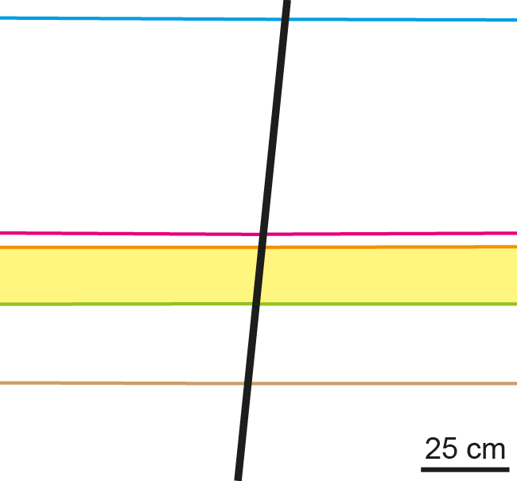
Outcrop examples (1)
The thickness of the section that is repeated or missing across the bed-parallel slip surface is equal to the throw at the time of bed-parallel slip (Ti).
Upward propagation
To see the animation use slide show view.
(a) Outcrop photograph of a normal fault that downthrows to the left with a Tf of 21 cm. (b) Stages in the development of the fault geometry in (a). The area shaded yellow is cut-out by a top to the north bed-parallel slip surface (half arrows). The thickness missing section is equal to Ti and is indicated by the double-headed arrows in (a). Full arrow in (b) indicates the propagation direction of the first slip event following bed-parallel slip offset of the fault.
Ti - Throw at the time of bed-parallel slip
Tf - Final throw on the fault
Delogkos et al., 2017b

Slide 6
Outcrop examples (2)
The thickness of the section that is repeated or missing across the bed-parallel slip surface is equal to the throw at the time of bed-parallel slip (Ti).
Downward propagation
Both
(a) A normal fault down throwing to the right with a Tf of 31.5 m. The top to the right bed-parallel slip surface (dashed line) offset the fault at a throw of 24 m and the fault subsequently propagated downwards. (b) Annotated outcrop photograph and successive restorations of a normal fault zone that downthrows to the right with Tf of 8 m. The repeated section, from which a Ti of 2.3 m is measured, lies between the narrow and bold red lines within the fault zone. In the restored cross-sections the elevation of the footwall sequence is kept constant. In each figure full arrows indicate the propagation direction of the first slip event(s) following bed-parallel slip offset of the fault.
Ti - Throw at the time of bed-parallel slip
Tf - Final throw on the fault

Slide 7
Results (1)
Fault slip events propagated upwards when the faults had low throws (Ti) but as the faults continued to grow, slip events developed more mixed propagation directions.
Data collected for Fault R projected onto a vertical plane parallel to mean fault strike. The mapped fault surface is contoured for throw. Vertical lines are locations of mine faces exposed over a 6-year period and arrowheads indicate the direction of slip propagation. The intersections of the fault surface with one horizon on the upthrown and downthrown side of the fault are shown in white.
Histogram of the fault throws when they were offset by bed-parallel slip. The histogram is coloured according the whether a continuous fault was re-established by upward propagation of the lower segment, downward propagation of the upper segment or both. Cartoons of the fault geometries associated with each are shown in the inset.

Slide 8
Results (2)
The transition from upward propagation to mixed propagation directions occurred earlier on small faults.
Graph of the final throw against the instantaneous throw (throw at the time of bed-parallel slip). The colour of the data points indicates the propagation direction of the slip propagation following bed-parallel slip and its size indicates the magnitude of the offset across the bed-parallel slip-surface. (b) Same as (a) but in logarithmic scale. Tie-lines connect data points that represent multiple bed-parallel slip offsets of the same fault at the same outcrop as the fault increased in throw (from bottom to top). The filled circles connected by a thicker line represent four faulting/bed-parallel slip cycles recognised in one mine face and described by Delogkos et al. (2017b).

Slide 9
Slip propagation direction through time
The location of the point of nucleation of slip events varied over the fault surfaces as they grew.
Free
surface
Late slip event
Late tip-line
Early tip-line
Mining
level
Early slip event
An outcrop (solid circle) within the mined section on a small fault will show early mixed slip propagation directions because slip initiation points (stars) can be located below, along strike or above throughout growth of the fault. An outcrop on a large fault will show early upward slip propagation because the majority of the fault surface and therefore the points of slip initiation lie below the mined section with later along strike and downward propagation.
The stars represent the initiation points for slip events that then propagate outwards. White stars occurred when the tip-lines were at the dashed lines and black stars when the tip-lines were at the solid lines

Slide 10
Conclusions
Mutually cross-cutting normal faults and bed-parallel slip-surfaces provide the first robust geological means for determining the propagation direction of slip events during the growth of normal faults.
The slip events on fault surfaces in Kardia Mine propagated upwards at low throws but as the faults continued to grow, slip events developed more mixed propagation directions.
The location of the point of nucleation of slip events varied over the fault surfaces as they grew.
This approach could be applied to other, and perhaps more commonly occurring structures, such as conjugate fault intersections.

Slide 12
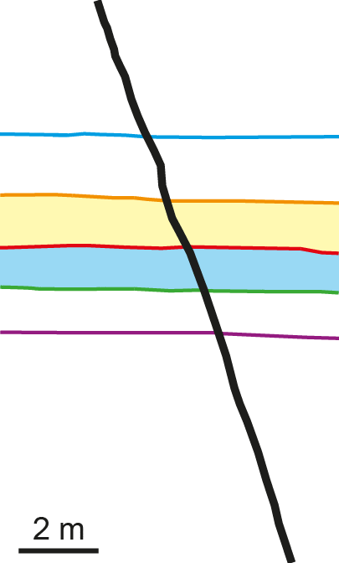
Extra Animation of Outcrop Example (1)
To see the animation use slide show view.
Delogkos et al., 2017b

Slide 13
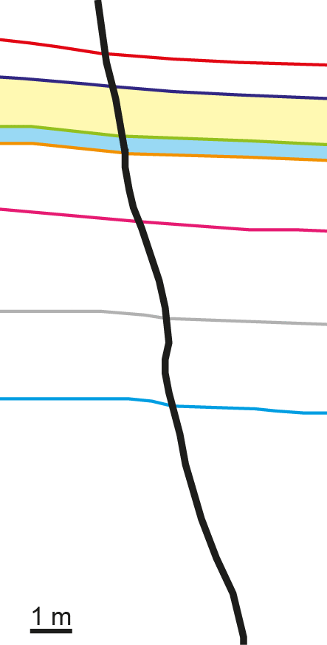
Extra Animation of Outcrop Example (2)
To see the animation use slide show view.
Delogkos et al., 2017b

Slide 14
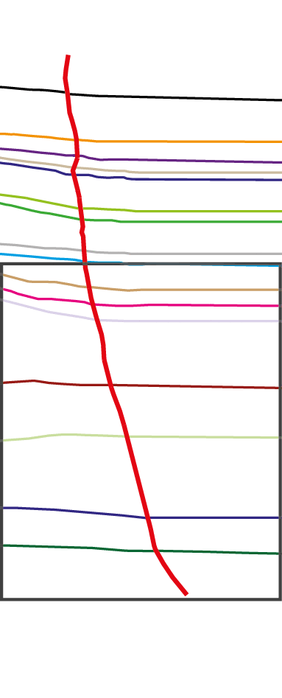
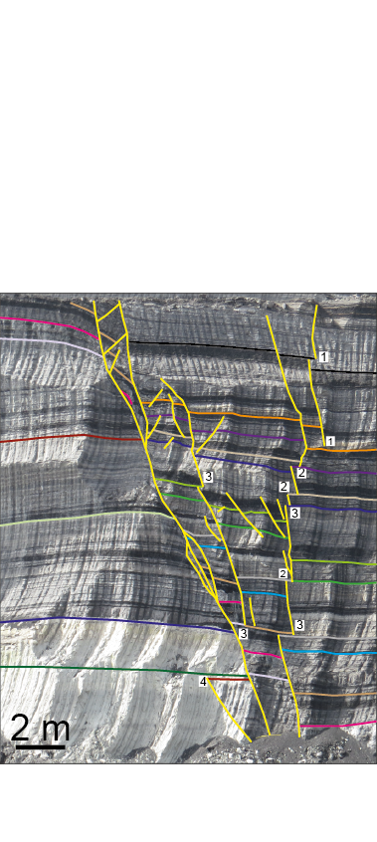
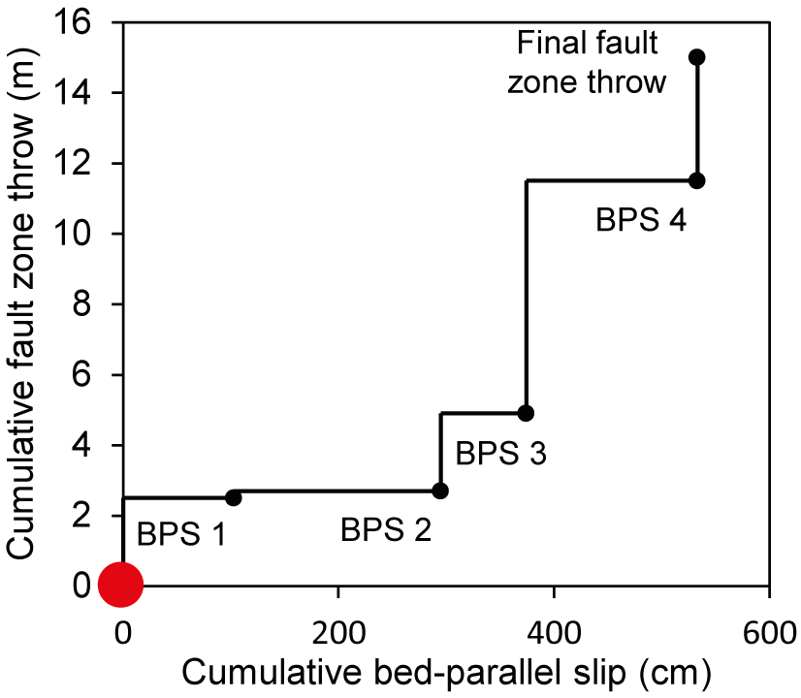
Extra Animation of Outcrop Example (3)
To see the animation use slide show view.
Delogkos et al., 2017b

