Slide 1
EGU 2020 SM6.5
NordVulk
© Thorbjarnardóttir et al. 2020. All rights reserved.
The Great Geysir and tectonic interactions in South Iceland
Bergthóra S. Thorbjarnardóttir¹, Ingi Th. Bjarnason^{1,2*}, Revathy M. Parameswaran¹
¹Institute of Earth Sciences, University of Iceland, Reykjavik, Iceland
²NordicVolcanologicalCenter(Nordvulk),Institute of Earth Sciences,University of Iceland, Iceland
*Email: ingib@hi.is
Notes:
1

Slide 2
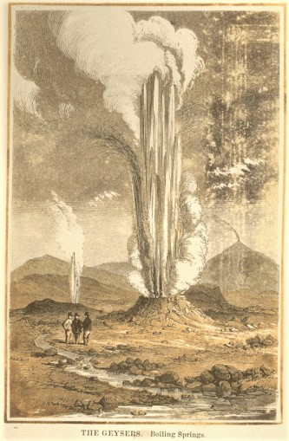
Geysers are rare phenomena of erupting hot springs. They are named after the Great Geysir in South Iceland. Its fame goes back to the middle ages. When active, it erupts up to heights of 70-80 meters. Comparatively, its currently active neighbor, the Strokkur geyser, has an eruption height of 15-20 meters. The Great Geysir has been largely dormant for a century. The last active period, lasting several decades, followed a sequence of large earthquakes in the year 1896, ~50 km to the south and southwest of the Geysir area. Induced hydrological activity of geothermal areas has been observed several times following large earthquakes in Iceland.
A similar sequence of large earthquakes in South Iceland occurred in the year 2000. It induced significant earthquake activity in the Geysir area, but did not ‘wake up’ the Great Geysir significantly.
We touch upon why there was not an increase in activity in the Great Geysir following the 2000 events, but the main objective of our analysis is to document the tectonics of the extended Geysir area.

Slide 3
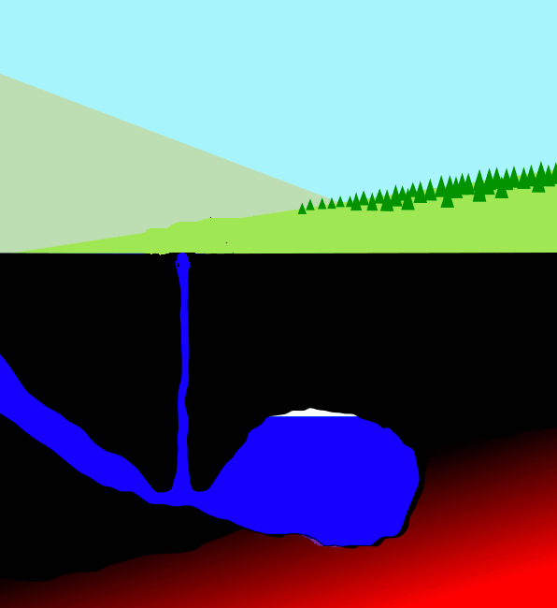
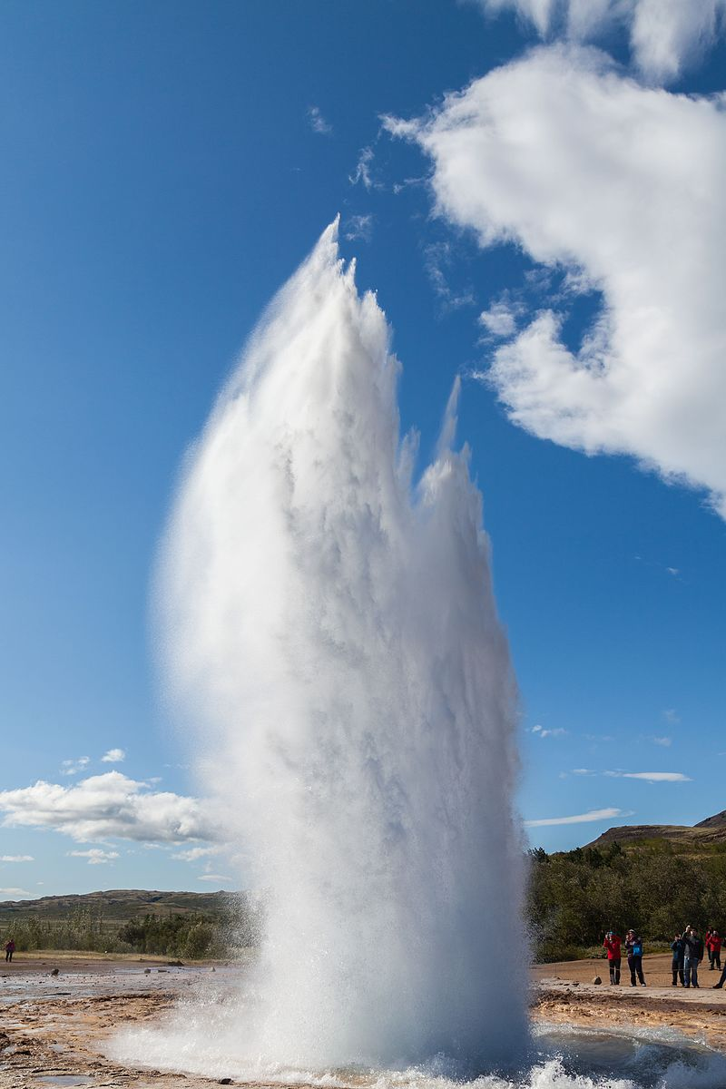
Strokkur quarter height of Great Geysir
Delso, 2014

Slide 4
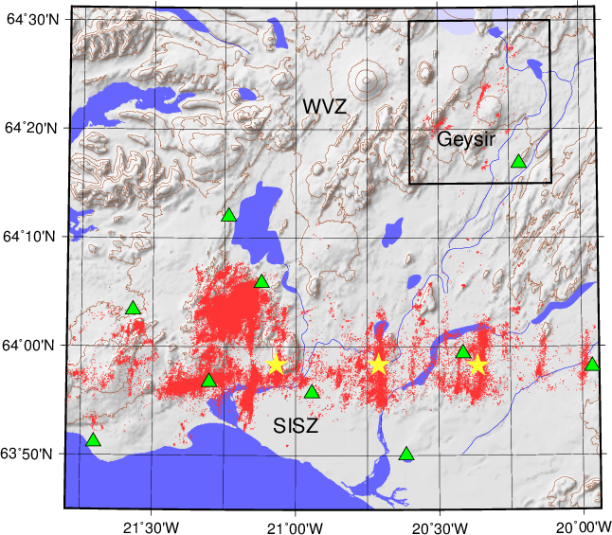
Relative relocations 1991-2016
Double-difference (DD)
Original phase data and focal mechanisms from The
Iceland Meteorological Office.
Tringles: Seismic stations
Stars: Large earthquakes in years 2000 and 2008.
WVZ: Western Volcanic Zone
SISZ: South Iceland Seismic Zone.

Slide 5
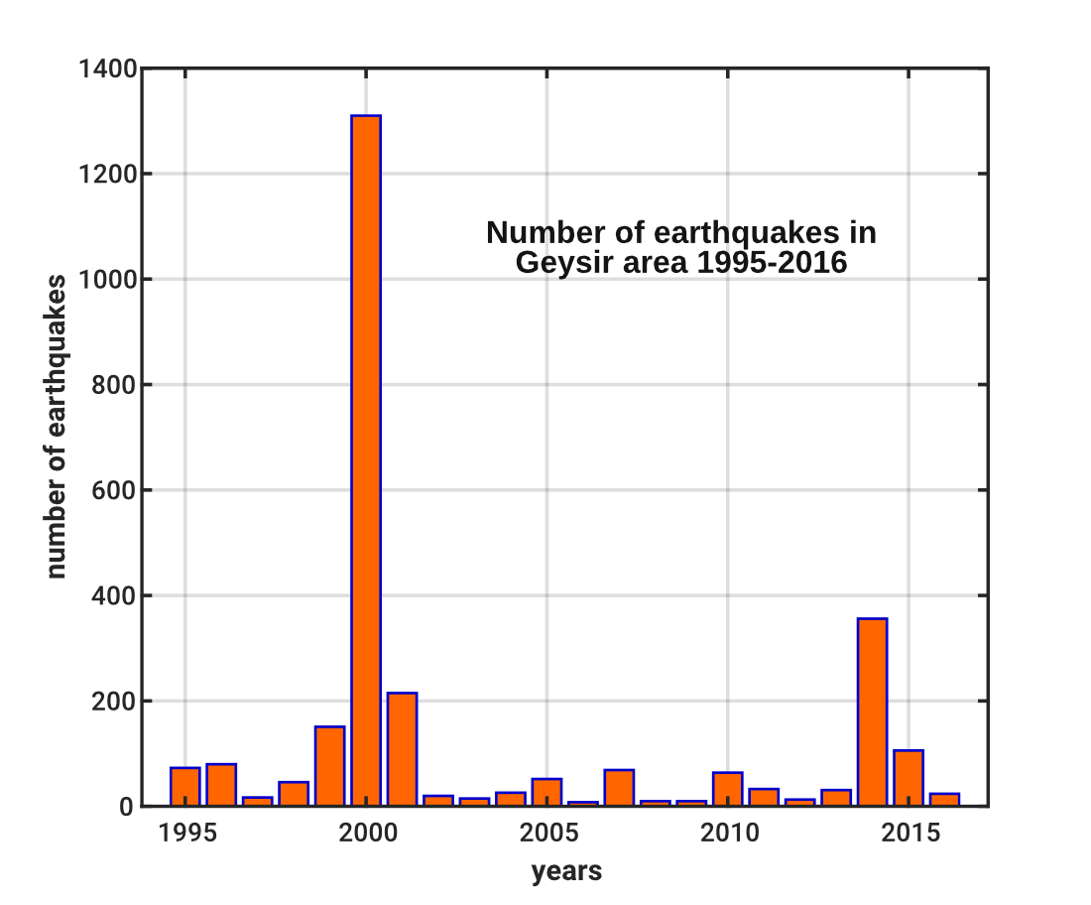
Seismicity clearly induced in the Geysir area
by the 2000 South Iceland events
Notes:
5

Slide 6
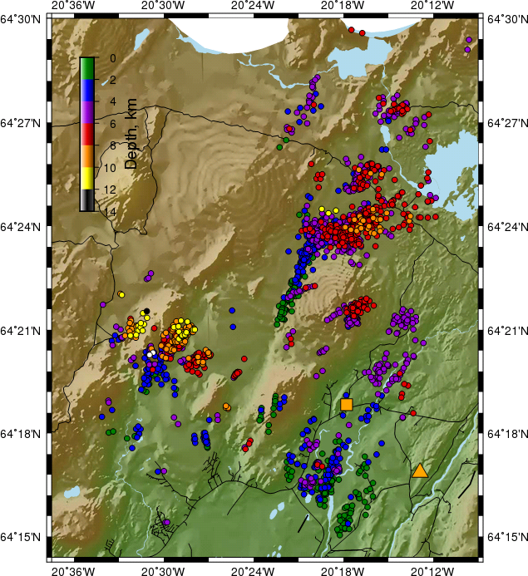
Relative relocations 1995-2016
Sandvatn
Predominant NNE-NE and ~ENE seismic lineations.
Color depth scale shown.
Deep seismicity (>8 km) at the edge of volcanic zone
(left in figure).
ENE trending rather broad seismicity WSW of Sandvatn
(Sand Lake) is intriguing. Probably been active for
~half a century.
Seismicity (active faulting) in the vicinity of Geysir.
Geysir
Seismometer

Slide 7
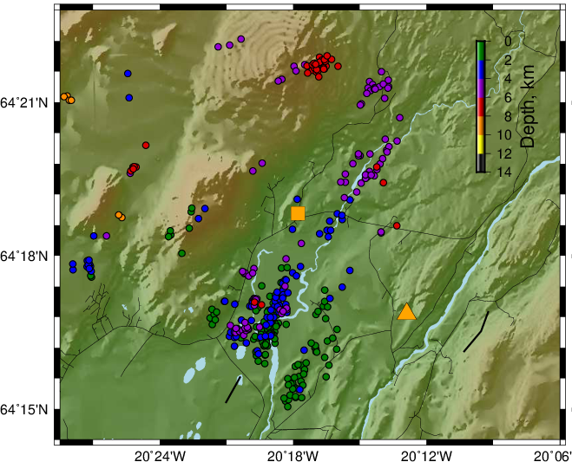
NNE predominant seismic lineations.
Riverpath with exact trend and position of seismic lineation. Suggesting river flow along surface fracture of a vertical fault.
Minor activity in immediate vicinity of
Geysir. 2000 events not strong enough to awake the Great Geysir?
Geysir
Seismometer

Slide 8
NNE extension (red arrow) of a seismic lineament south of Geysir may indicate a geothermal feeder for Geysir at rather shallow depth.
Several ENE topographic lineaments may suggest more complicated Riedel shear structures in the area.
Geysir
Seismometer

Slide 9
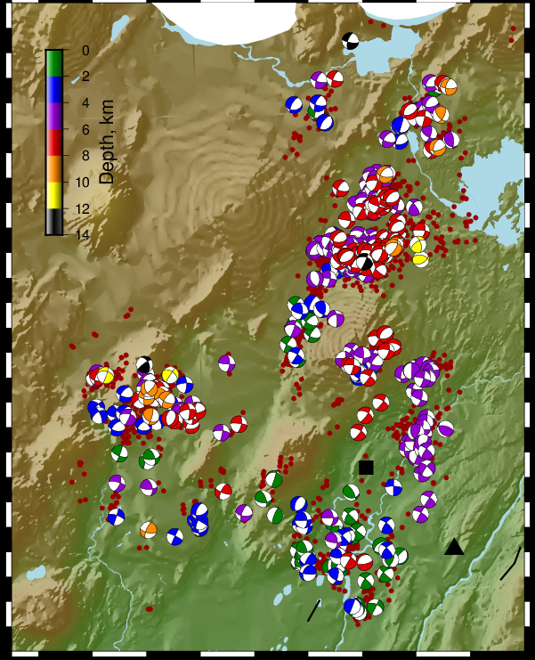
Subset of better constrained focal mechanisms.
Strike-slip, Normal, Reverse, all types.
Notes:
9

Slide 10
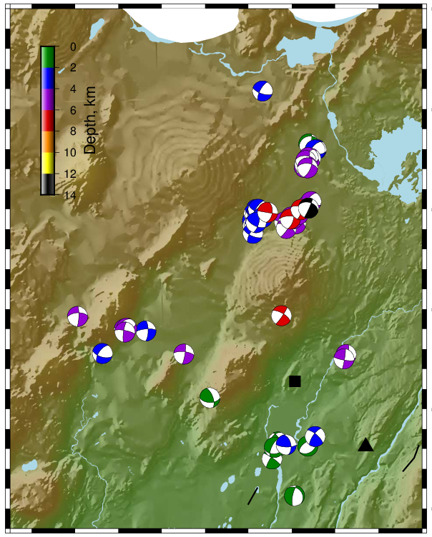
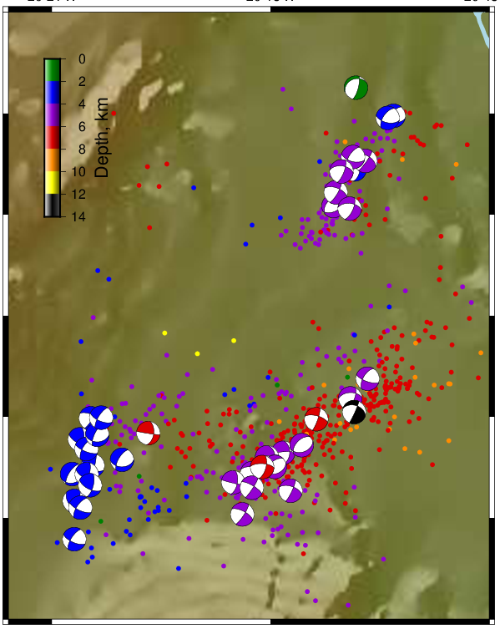
magnitudes≥2.0
Sandvatn area
magnitudes≥2.0
Sandvatn

Slide 11
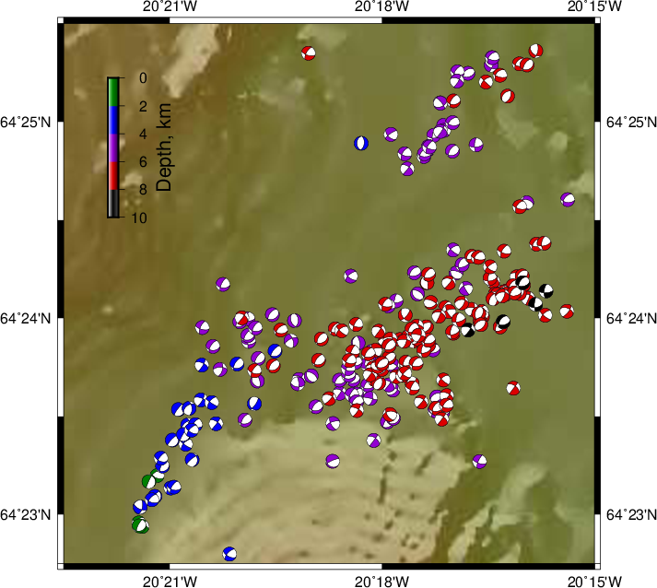
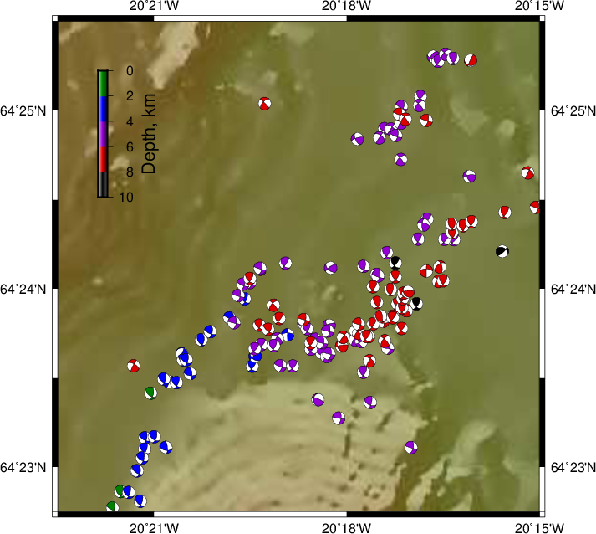
Sandvatn area
Focal mechanisms relocated with DD
Normal
Reverse
Notes:
11

Slide 12
Results
The Geysir region was seismically triggered by the large earthquakes in South Iceland in year 2000
~50 km south and southwest of Geysir. No comparable activity has been recorded in a 30 years
period since installment of a sensitive national network.
2. Faults that likely feed the geothermal area at Geysir were not activated by
the 2000 events, and neither was The Great Geysir to any significant extent.
The triggering mechanism of the Geysir area is unclear. E.g. a ~30 km wide area between the
Geysir region and the source zone of the 2000 events is mostly aseismic.
Majority of seismic lineaments trend NNE-NE. Other populations trend ENE, the most significant
the Sandvatn swams. Wide range of hypocenter depths (2-12 km) that are relatively well constrained.
Some of the deepest at the edge of the Western Volcanic Zone, where the crust is expected to
be hotter.

Slide 13
4. For the larger events in the area (2.0 ≤ml<4.0) most common focal mechanisms are
oblique normal, then strike-slip, and oblique reverse mechanisms are not
uncommon. Normal events are common for smaller (<2.0) earthquakes.
5. Nodal planes that better fit the NNE-NE seismic lineaments tend to have right-lateral shear
component. Even the Sandvatn ENE trending tensional swarms have right-lateral shear
component, with nodal planes rather dipping ~SSE.
6. The extended Geysir region is in transtensional stress state.

Slide 14
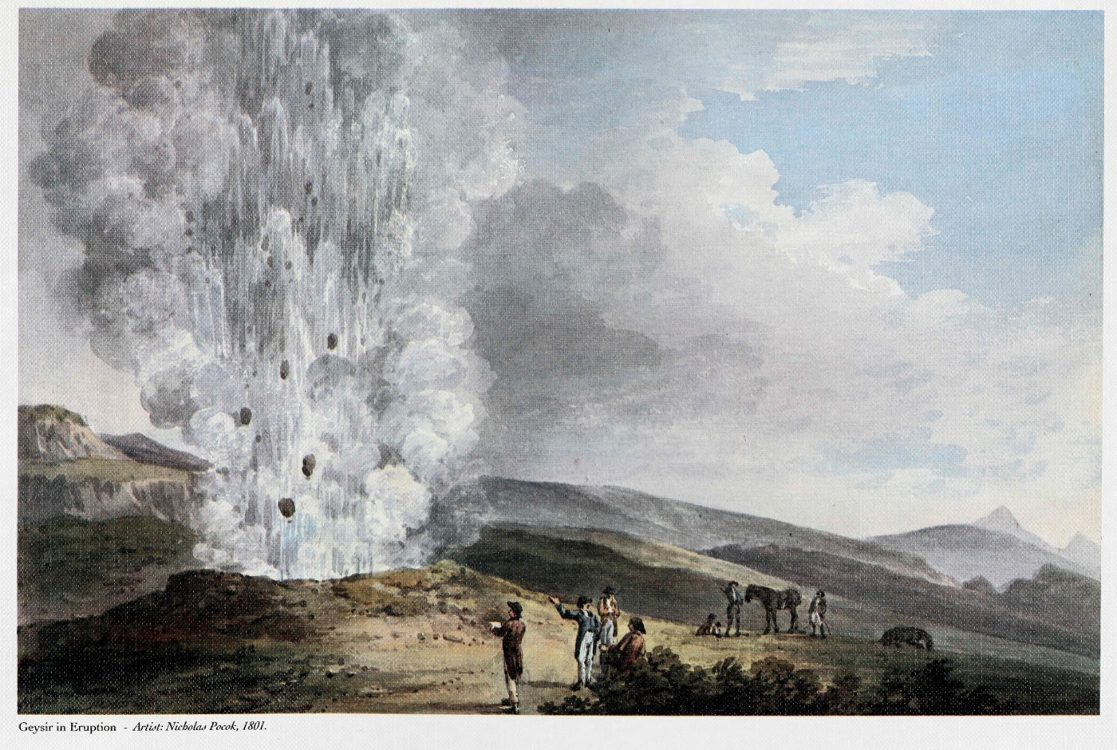
The Great Geysir will wake up
Geysir in Eruption – Nicholas Pocok, 1801.

