Slide 1

Properties and effects of supercritical fluids
Huaiwei Ni
University of Science and Technology of China

Slide 2
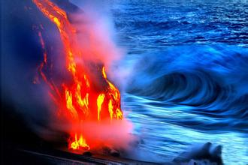
Silicate melt vs. Aqueous fluid
At low P,
However, as P-T increase
Contrasting composition and properties
very limited miscibility

Slide 3
Enhanced mineral solubility in water
SiO2-H2O
Dolejs & Manning (2010) Geofluids
Hunt & Manning (2012) GCA

Slide 4
Enhanced water solubility in silicate melt
Keppler (2013) Phys chem Deep Earth

Slide 5
Closure of miscibility gap and
formation of supercritical fluid
Albite-H2O
Basalt-H2O
Synchrotron X-ray radiography
Hydrothermal DAC
Shen and Keppler (1997) Nature
Mibe et al. (2011) PNAS

Slide 6
So what ?

Slide 7
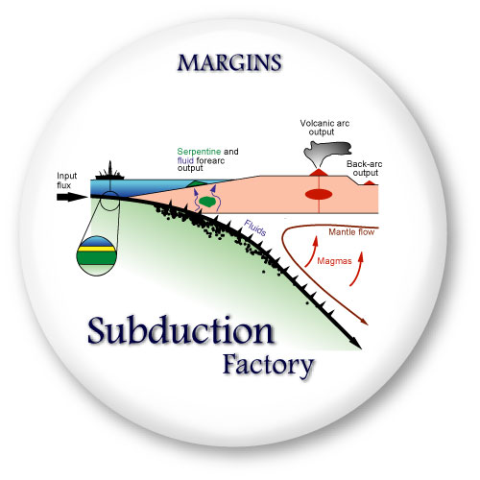
Chemical cycling at subduction zones
Signal from the subducted slab
Bebout (2014) Treatise Geochem

Slide 8
The agent for the grand mass transfer
Aqueous fluid (dilute)?
Silicate melt (thick)?
Supercritical fluid (intermediate)?
Kawamoto (2012) PNAS

Slide 9
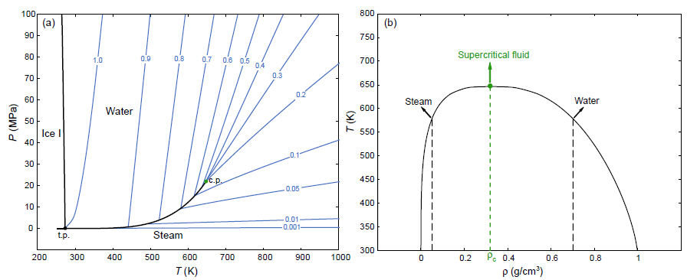
Supercritical fluid in unary systems
V
Supercritical H2O
L
V
L
Supercritical: P > P_{c} & T > T_{c}

Slide 10
Binary systems:
NaAlSi₃O₈ – H₂O

Slide 11
Preferred definition of Supercritical fluids
For silicate-H₂O systems:
Fluids with intermediate composition
(both H₂O and silicate fall in the range of 30-70 wt%)
Therefore, they are endowed with special (“super”) properties…

Slide 12
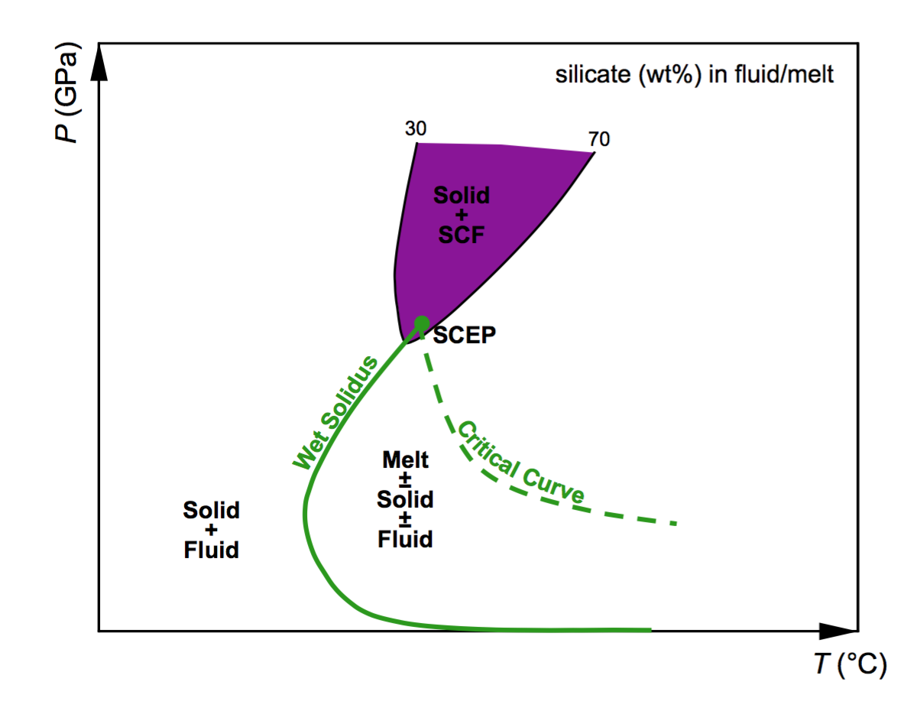
Formation conditions of supercritical fluids
Hinge on SCEP
The end point of both the critical curve and the wet solidus curve

Slide 13
Critical curves
Mafic
Felsic
Ni et al. (2017) Earth-Sci Rev

Slide 14
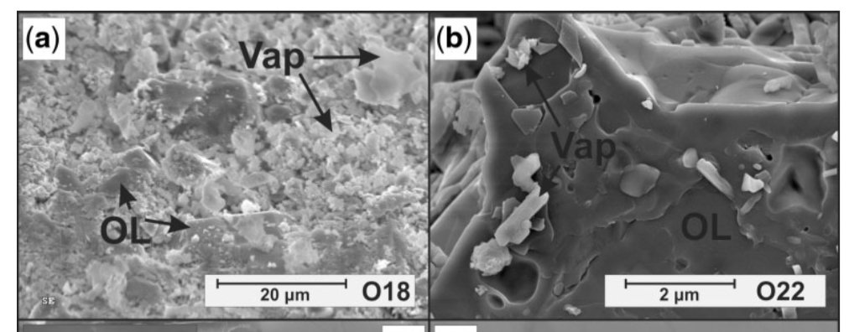
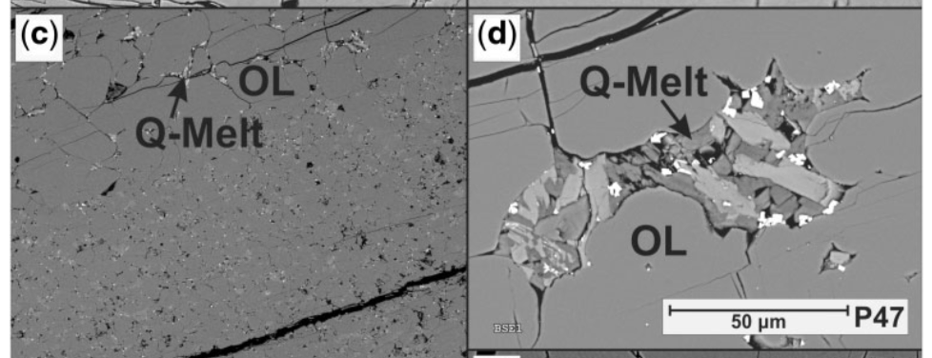
Wet solidus: melting exp + texture analysis
Fluid (before melting)
Porous texture
Planes of fluid inclusions
Pargasite/phlogopite
Quench melt
Interstitial patches of acicular or path-shaped crystals of amphibole, mica and glass
Not easy to distinguish at high P
Green et al. (2014) JP

Slide 15
Wet solidus: melting exp + chemical analysis
(ETH approach)
Diamond trap
Frozen-stage LA-ICP-MS

Slide 16
Termination of the wet solidus
Basalt-H2O
SCEP: 5.5 GPa, 1050ºC
Kessel et al. (2005) EPSL

Slide 17
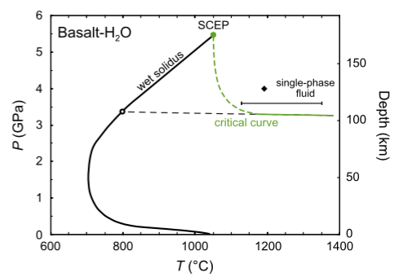
Inconsistencies between exp results
SCEP of basalt-H₂O system:
5.5 GPa, 1050ºC (quench) vs.
3.4 GPa, 770ºC (in situ)
Peridotite-H₂O
Grove et al. (2006) AREPS

Slide 18
>100 km or
>160 km?
Mibe et al. (2011) PNAS

Slide 19
Why supercritical fluids?
Fluid/Solid
Fluid-like viscosity
Melt-like element-carrying capability
Audetat & Keppler (2004) Nature
Kessel et al. (2005) Nature

Slide 20
Structure of supercritical fluids
Q⁰
Q¹
Q²
Q¹
Q²
Q¹
Intermediate degree of polymerization

Slide 21
Multi-phase inclusions
Ferrando et al. (2005) CG
Zhang et al. (2008) GCA

Slide 22
Misconception I
Supercritical fluid with “super” properties forms when the P-T condition is above the critical curve or above the SCEP.
Correct view:
Super-SCEP condition will not necessarily produce SCF
The special properties of SCF arise fundamentally from their intermediate composition (and structure), not because any magic P-T threshold has been crossed
SCF should not be defined without specifying chemical composition
Hermann et al. (2013) Elements

Slide 23
Misconception II
During subduction (P-T increase):
S S+F S+F+M S+SCF
Correct view:
S+F S+M
S+F S+SCF S+M
S+M
S+F
S+F
Silicate
Silicate

Slide 24
Multicomponent rock-H₂O systems
S S+F S+F+M S+M
Mibe et al. (2011) PNAS
S+F S+SCF S+M

Slide 25
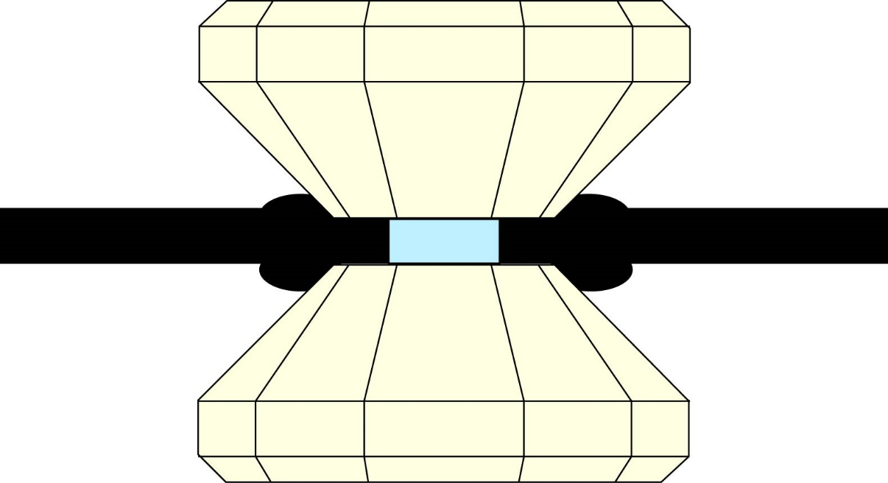
Search for well-preserved SF inclusions?
FTIR or Raman
SCF
Inclusion?
Bulk H₂O > 30 wt%?
Organic
solvent
Homogenization in HDAC

Slide 26
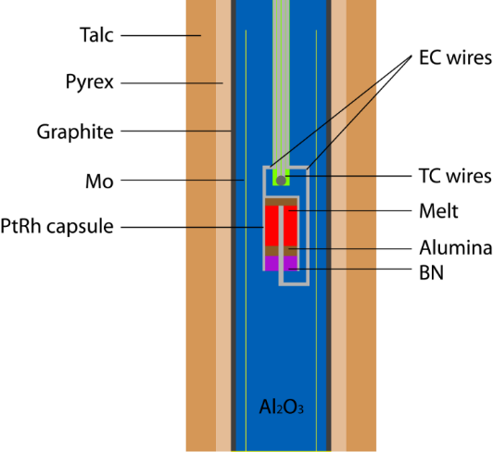
Melting indicated by electrical conductivity jump?
S+F S+M±F
Ni et al. (2011) CMP

Slide 27
Electrical conductivity of SF
Pommier (2014) EPS
Ni et al. (2014) RSI
Electrical profile of the Cascades
EC measurement in HDAC
SCF
Melt
Fluid
Silicate
H2O

Slide 28
Molecular dynamics simulations
Complex compositions
Complicated interatomic interactions
Mookherjee et al. (2008) Nature
MgSiO3 melt with 10 wt% H2O

Slide 29
Conclusion
Supercritical fluids have great potential to play an essential role in mediating chemical transport at deep subduction zones (>100 km).
Things that remain to be done:
Identify robust geological records of SF (multi-phase inclusions?)
Resolve formation P-T conditions of SF
Determine physicochemical properties of SF

