Slide 1


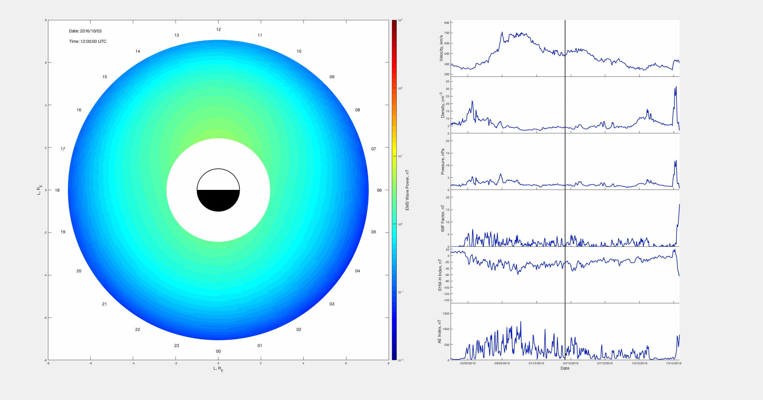
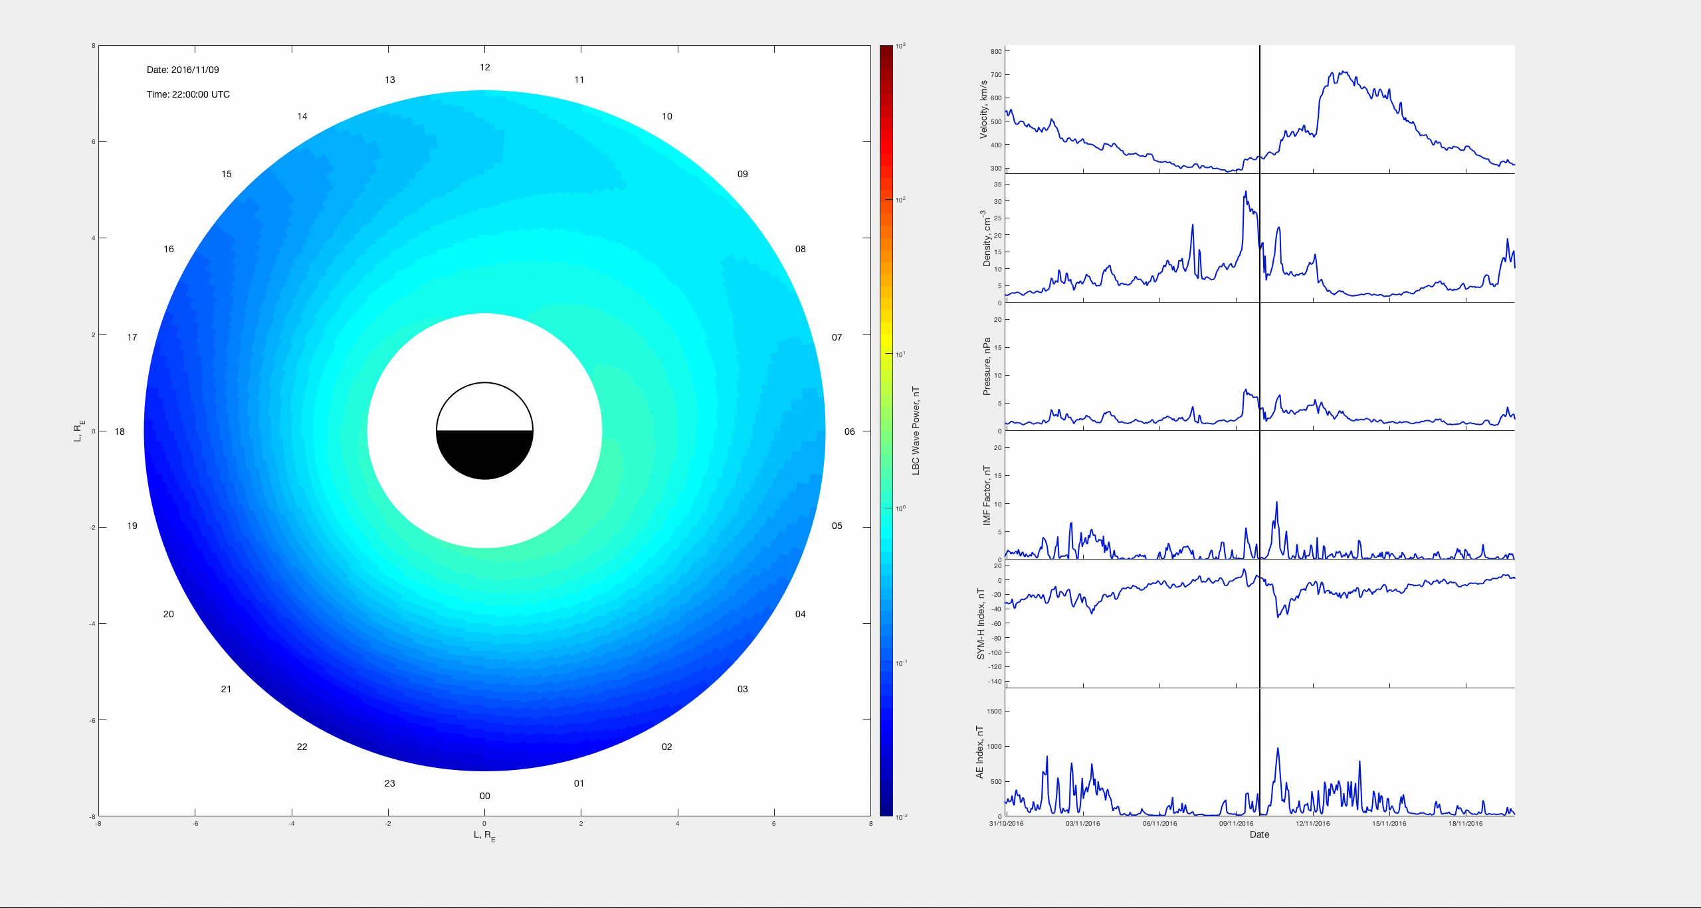
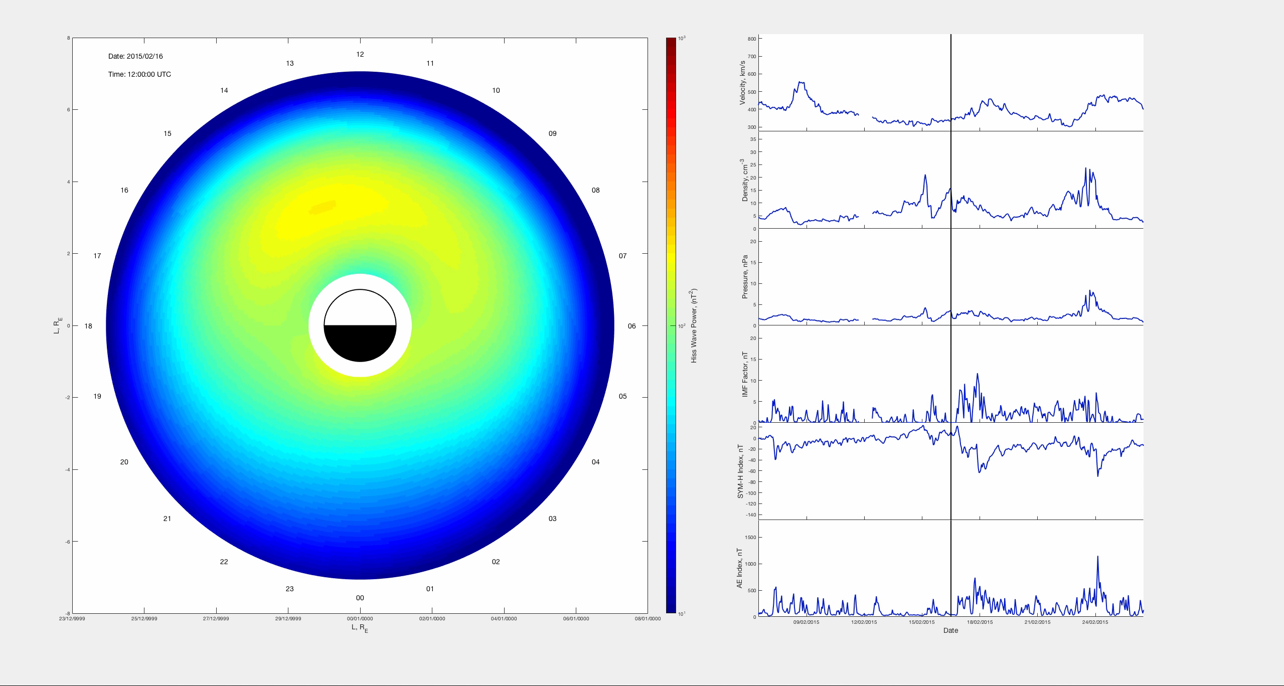
System identification models for waves in the inner magnetosphere
R. J. Boynton¹, H. Aryan^{1,2}, S. N. Walker¹, M. A. Balikhin¹
¹University of Sheffield, ²UCLA
Introduction
Wave Models
Conclusions
Emissions in the inner magnetosphere play key roles in the dynamics of energetic electron fluxes that make up the radiation belts. First principle numerical models that were developed to study the evolution of high energy electron fluxes are mainly based on quasilinear diffusion. Application of such numerical codes requires statistical models for the distribution of key magnetospheric modes to estimate diffusion coefficients. These statistical wave models are often static models of the waves parameterised by location and geomagnetic indices (e.g. AE or Kp). This study presents a new dynamic spatiotemporal model for the equatorial magnetosonic, Lower Band Chorus and Hiss waves. The waves, measured by the VAP, are modelled using the time lags of the solar wind and geomagnetic indices as inputs as well as the location at which the measurement is made. The resulting models performance is assessed on a separate dataset of VAP data.
The figures below shows the comparison between the measured wave amplitude as observed by the track of the VAP (blue) and the estimate by the model (orange) at the VAP position.
The videos below show the wave intensity mapped out to the whole inner magnetosphere by using all locations as spatial inputs for each time. From this we will be able to see how the wave intensities evolve in space and time.
The NARMAX System identification technique has been used to model the Spatiotemporal evolution of the wave intensity in the inner magnetosphere.
Equatorial magnetosonic waves had the lowest model performance when compared to the measurements made by VAP. This is followed by Lower Band Chorus then Hiss.
The model performance could potentially be improved by incorporating wave data from other missions into the training of the models, such as Cluster and THEMIS.
VAP have good coverage up to L=6. Lower band chorus waves often appear at higher L shells than this so using data from other missions is needed to model the whole spatial range.
VAP have the best coverage of Hiss waves and this has also resulted in the model with the highest performance metrics.
Equatorial Magnetosonic
Prediction efficiency = 34.0 %
Correlation Coefficient = 56.9 %
1 January 2016 – 31 December 2017
NARMAX
To model a complex system, we can start from first principles to develop a mathematical model of the system. However, this is difficult since may not yet have a complete understanding of all the processes involved.
An alternative approach is the systems identification/machine learning approach:
The Nonlinear AutoRegressive Moving Average eXogenous inputs is one of the most advanced system identification methodologies.
Lower Band Chorus
Prediction efficiency = 42.1 %
Correlation Coefficient = 61.5 %
1 January 2016 – 31 December 2017
Involves three stages
Structure selection:
Coefficient estimation
Model validation
Data
The NARMAX algorithm requires both input and output training data for the algorithm to deduce a model.
Inputs Data: Time lags of the Velocity V, Density n, pressure p, and a southward IMF factor B_{f}, SYM-H, AE index, and spatial location at the time of the measurement (L, sin(MLT), cos(MLT), and cos(MLAT)). The solar wind data were from the Advanced Composition Explorer (ACE) spacecraft positioned at the L1 Lagrange and supplied by the OMNI website for training the model.
Output Data: The output for each of the models are the wave data taken from the VAP.
This results in the NARMAX model of the form:
Hiss
Prediction efficiency = 66.3 %
Correlation Coefficient = 70.7 %
1 January 2016 – 31 December 2017
  Contact: Richard Boynton (r.boynton@sheffield.ac.uk)

