Slide 1


Mapping the Friction Coefficient of Asphalt Roads Using Airborne Imaging Spectroscopy
Nimrod Carmon and Eyal Ben-Dor*
Porter School of Environmental and Erath Science
Faculty of Exact Science
Tel Aviv University, Tel Aviv, Israel
*Correspondence: bendor@post.tau.ac.il

Slide 2
Outline
Friction coefficient and asphalt roads – Tradition Measurements
Spectral ground measurements: Proof of concept for optical HSR sensors
Optical HSR Airborne measurements: Road mapping
Spectral ground measurements: Proof of concept for thermal hsr sensors
Thermal HSR Airborne measurements: Road mapping
Future Ideas

Slide 3


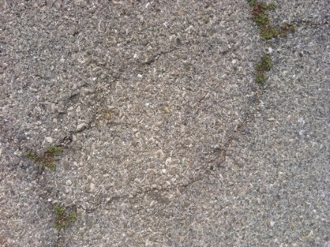
Asphalt Composition
“composite material composed of mineral aggregate adhered with a binder”
Micro and Macro textures which creates high friction with the rubber tire
The binder material, usually Bitumen, binds the aggregates together
Aging effects may degrade the binder, exposing the minerals and reducing the asphalt’s firmness and reducing friction with tires

Slide 4
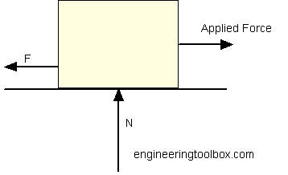
Friction Coefficient of Roads
Dynamic\Kinetic Friction Coefficient
F_{f} = μ N
where
F_{f} = frictional force (N, lb)
μ = static (μ_{s}) or kinetic (μ_{k}) frictional coefficient
N = normal force (N, lb)

Slide 5
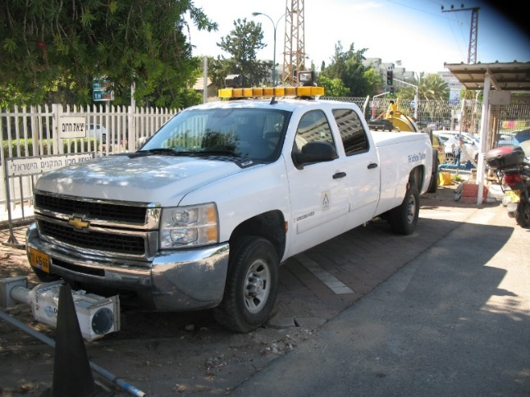
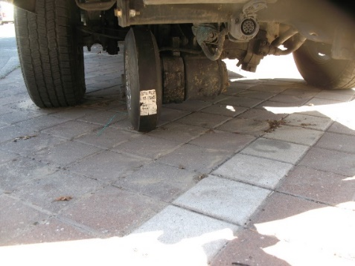
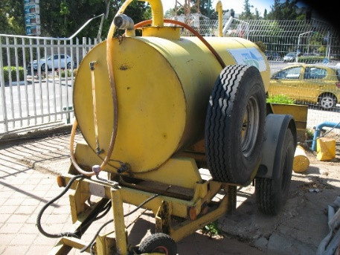
Dynamic Friction Mapping Today
The 5th wheel concept
Mechanical system
Many disadvantages

Slide 6
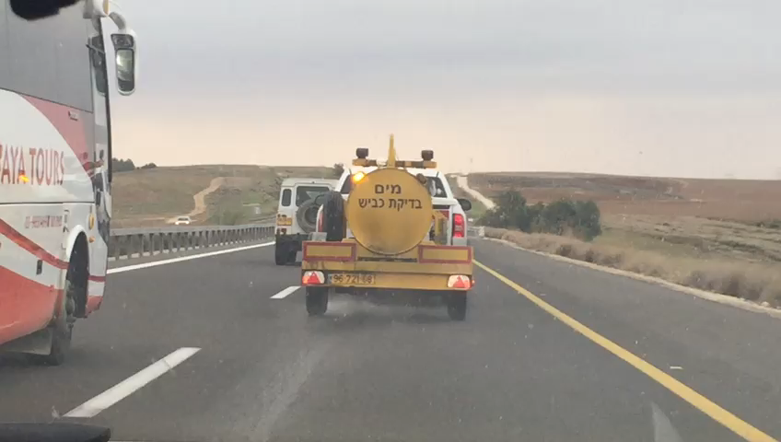

Slide 7
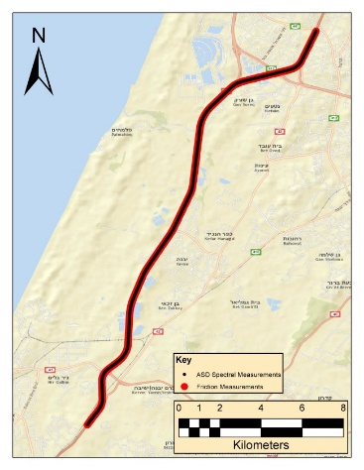
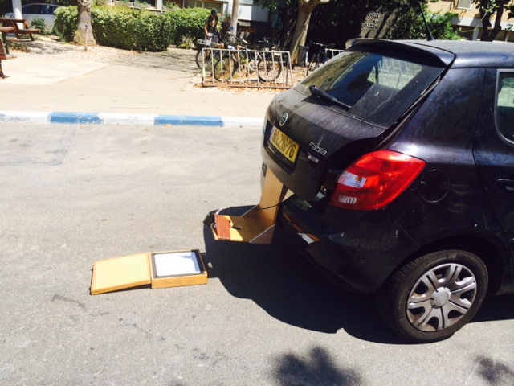
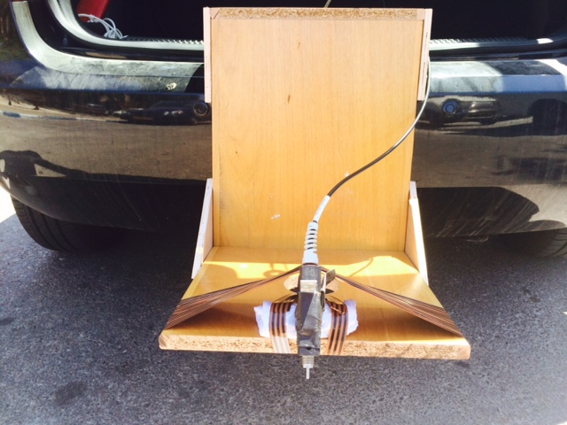
VIS-NIR-SWIR region Ground
Spectrometer acquisition
  Sensor: ASD
  Research Area: 5km segment of Road 4
  Flight height: 40 cm
  Spectral sensitivity: VIS-NIR-SWIR
  Spectral resolution: 2150 bands

Slide 8
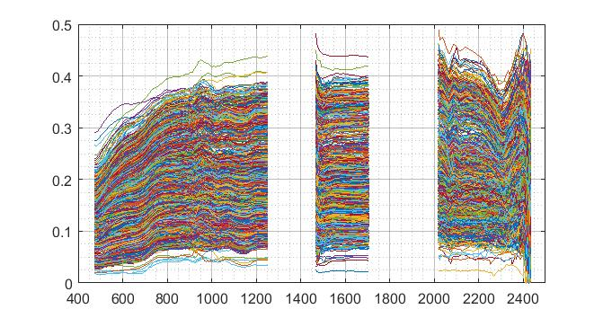
Reflectance
Wavelength (nm)

Slide 9
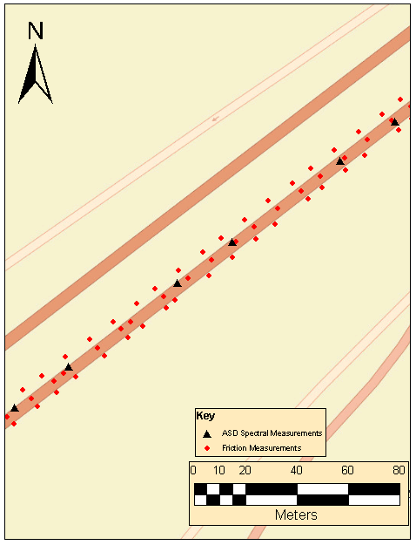
Data Processing
Processing Steps:
Pairing
Merging
Modeling
~10m
~30m

Slide 10

Machine Learning
Spectral Information Chemical Attribute
We need a BIG dataset of samples for creating a VALID correlation model
Then, we can predict the chemistry from the spectral data
$$Y=aX+b$$
pH
COx
Salt
Clay
Minerals

Slide 11
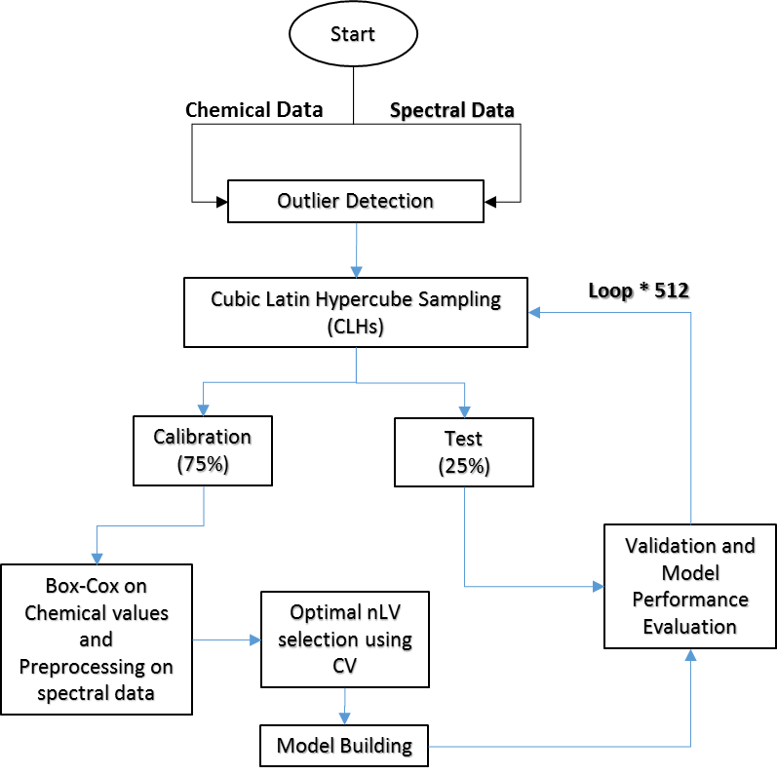
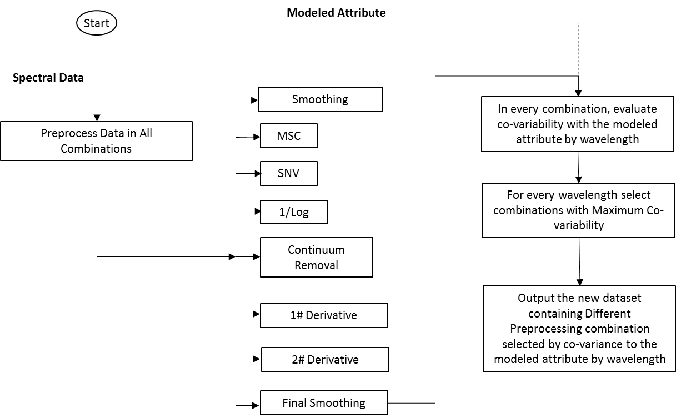
Machine Learning Analysis
PARACUDA II

Slide 12
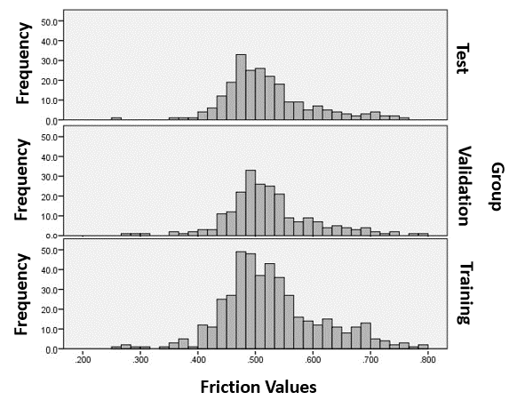
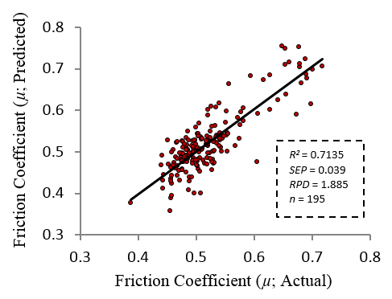
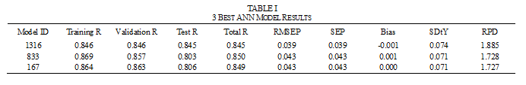
Modeling

Slide 13
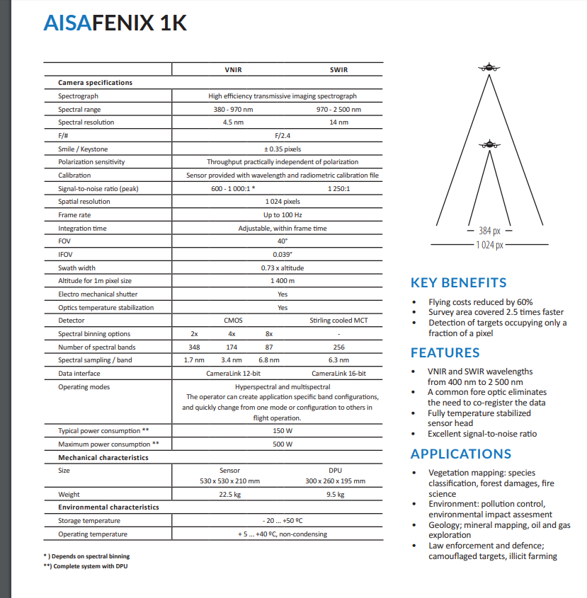
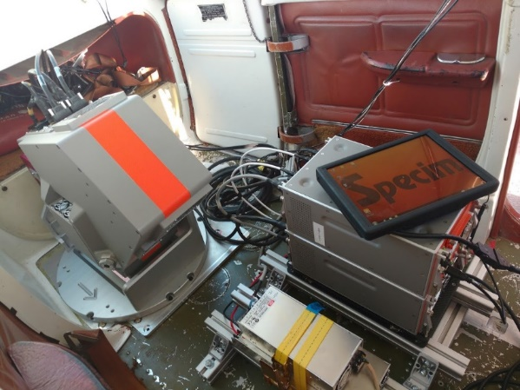
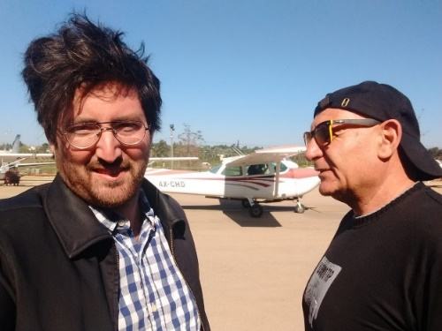
Airborne –VNIR-SWIR
380-2500nm
4.5-14nm
Aerial acquisition campaign

Slide 14
Working Scheme
Data Acquisition over a selected high way “latron”
Acquisition with the FENIX1K sensor
Friction Coefficient by the “Israel ways”
Geo rectification – FENIX 1K
Atmosphere Correction
Data Mining Full spectrum (PLS + field Model)

Slide 15
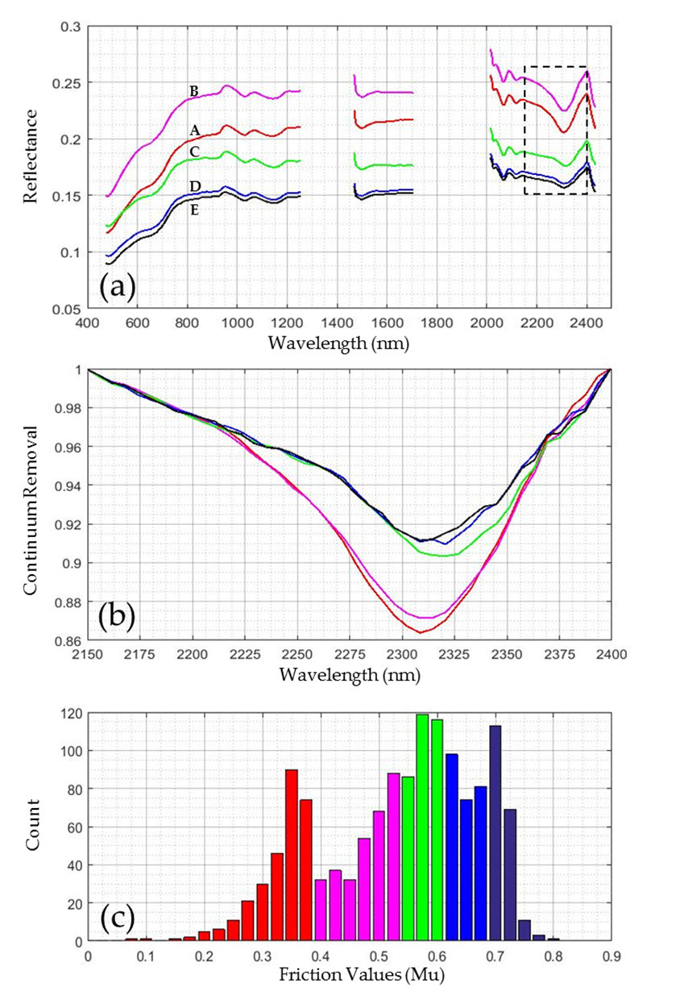

Slide 16
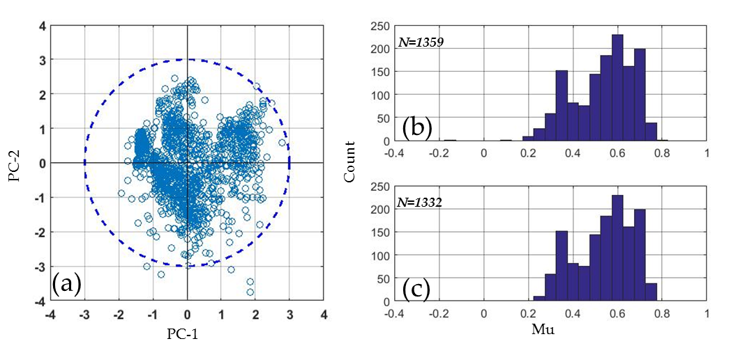
Calibration (b) validation ( c )

Slide 17
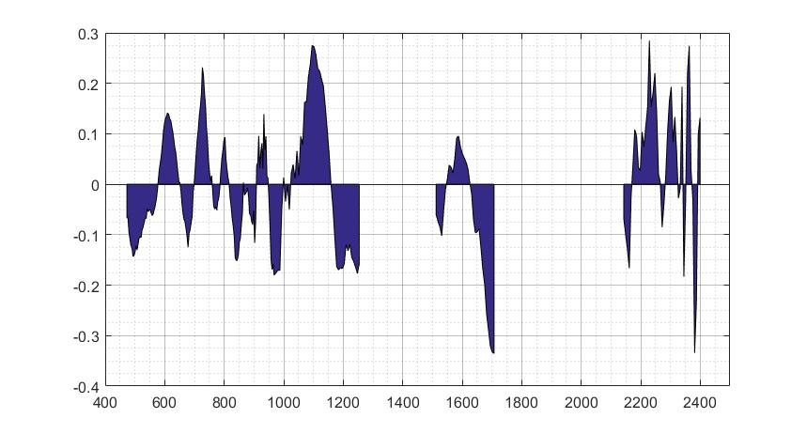
VNIR
SWIR-1
SWIR-2
B Coefficient
Wavelength (nm)

Slide 18
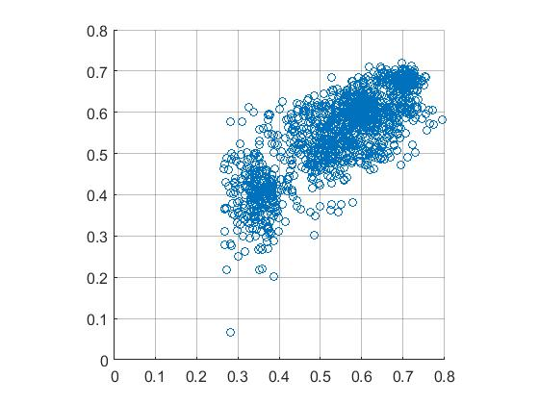
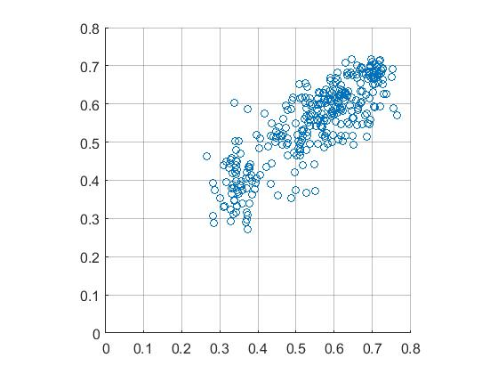
R² = 0.6316
RMSEP = 0.0776
RPD = 1.6462
N= 1332
P<0.0001
R² = 0.702
RMSEP = 0.0696
RPD = 1.8325
N= 333
P<0.0001
Predicted (Mu)
Predicted (Mu)
Measured (Mu)
Measured (Mu)
(a)
(b)

Slide 19
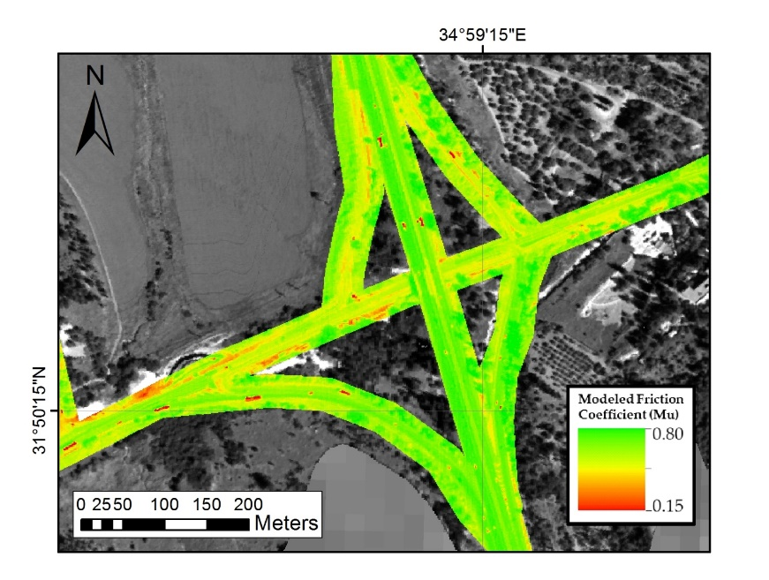
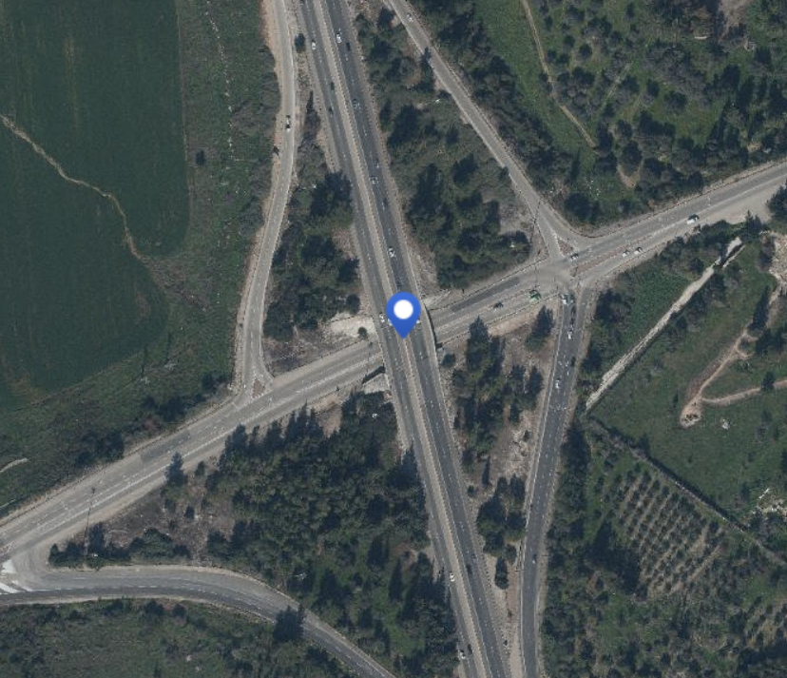

Slide 20
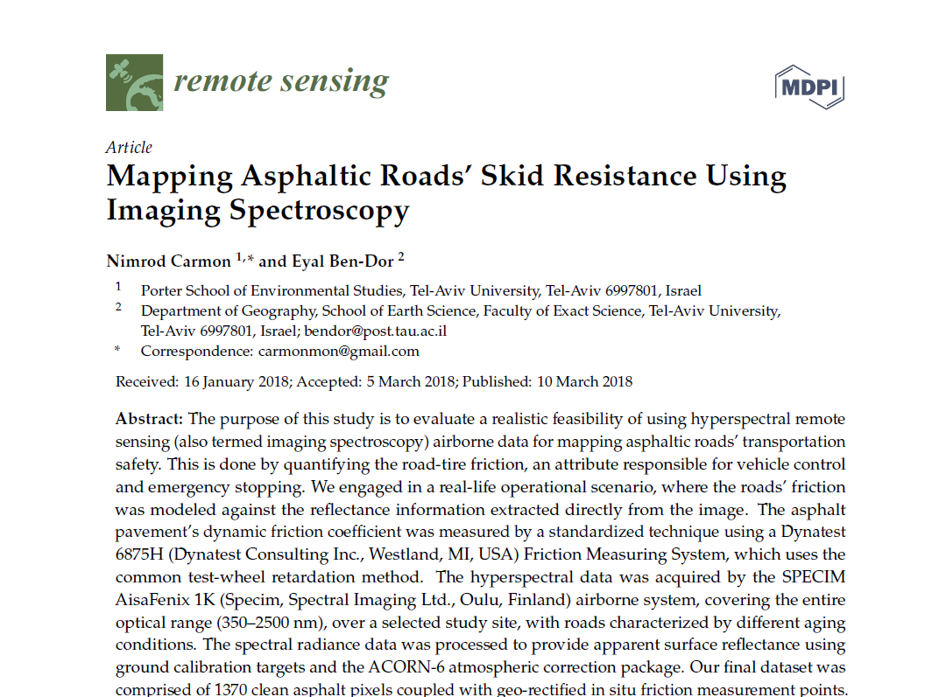
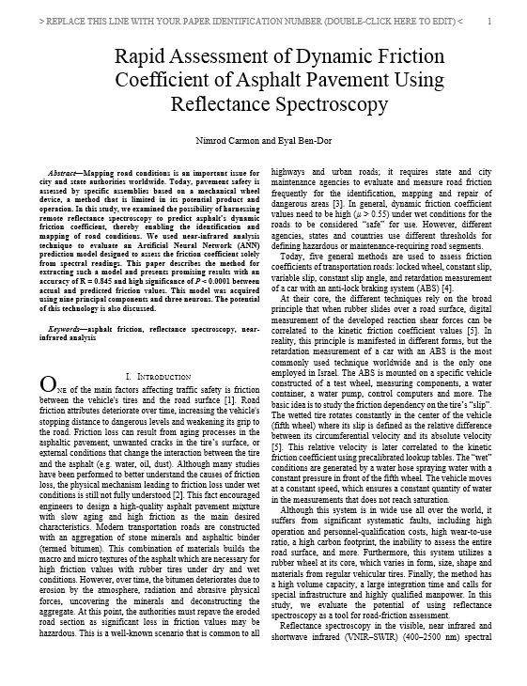
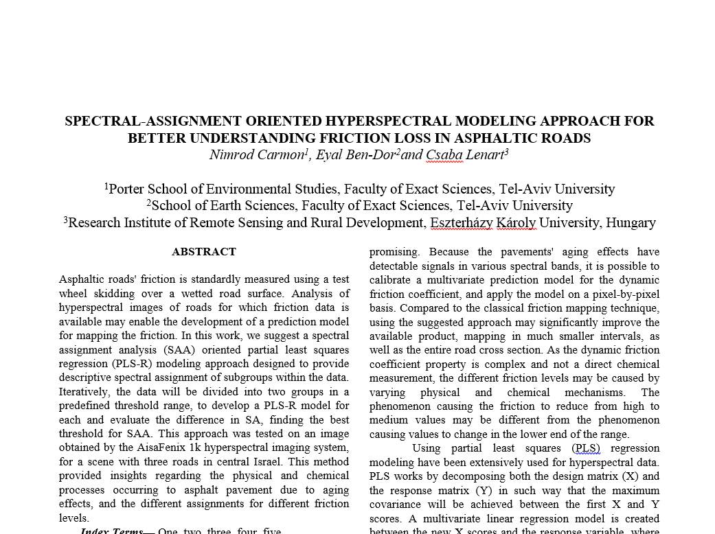

Slide 21
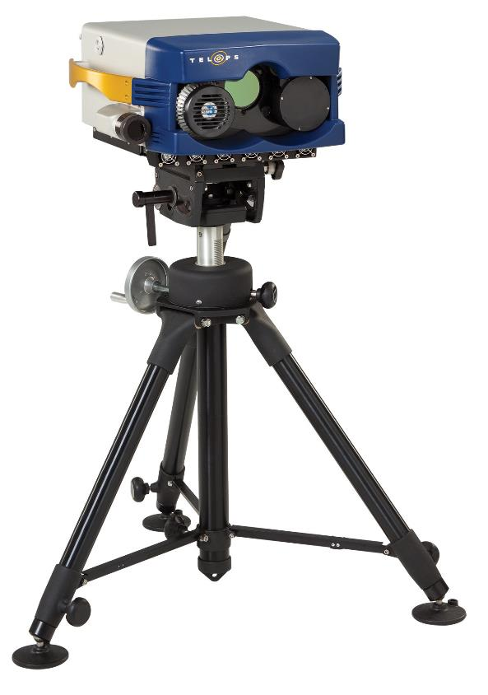
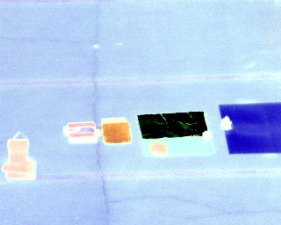
TIR region Ground

Slide 22
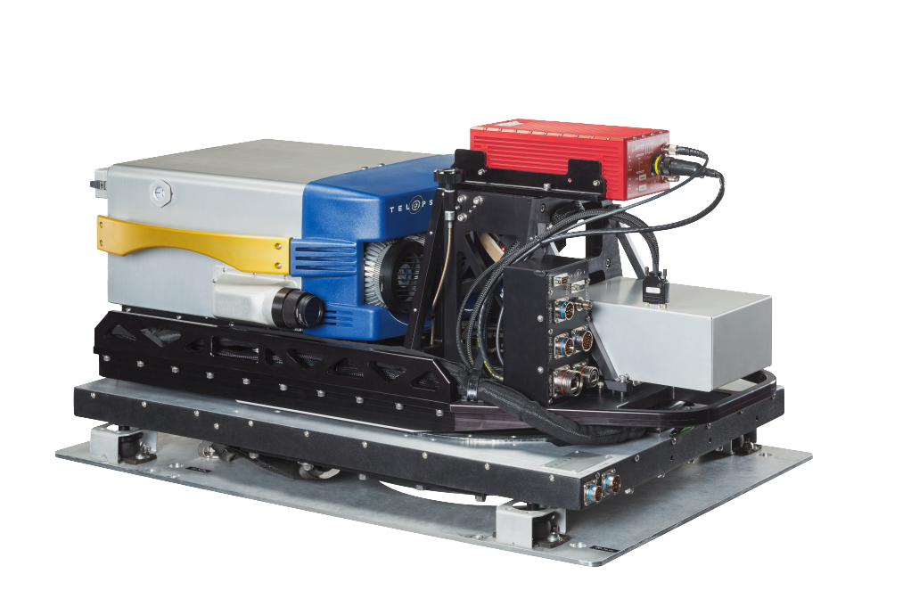
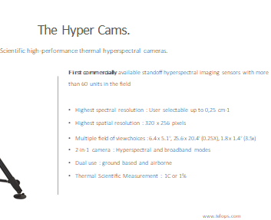
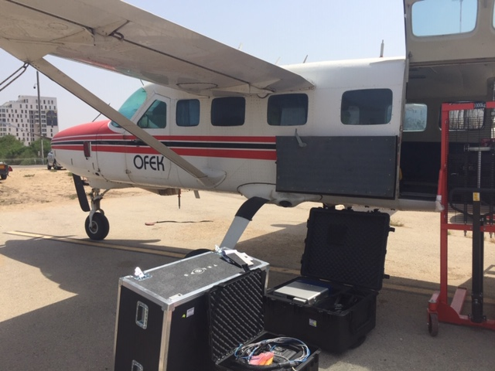
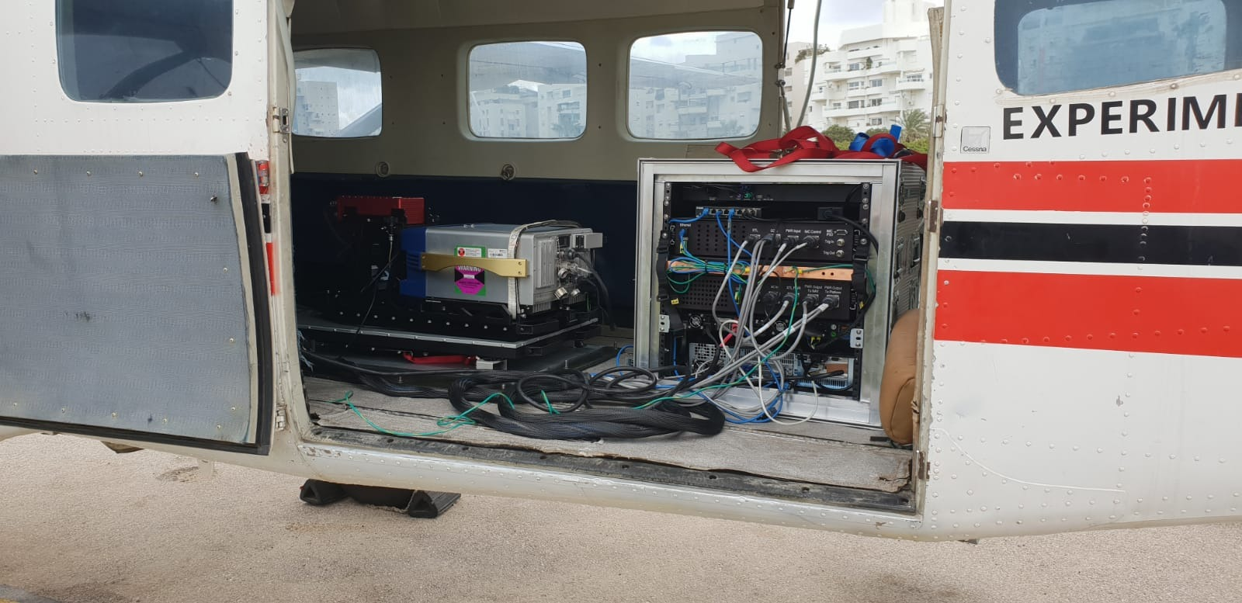
Airborne –LWIR
7.6-11.7 μm
4cm-1; 70 bands
Aerial acquisition campaign
www.telops.com
www.telops.com

Slide 23
Airborne Operation
Collect airborne data of roads (RAD)
Obtain DFC data (Vehicle)
Correct spectral cubes for atmospheric attenuation and TES (FLASH IR)
Develop geometric tools for developing a dataset (TAU tool box)
Analyze dataset with data mining methods

Slide 24
Geometric Correction
Radiance
TELOPS
FLASH IR
TAU tool box
Atmosphere Correction
Emissivity Separation
Plank Fit

Slide 25
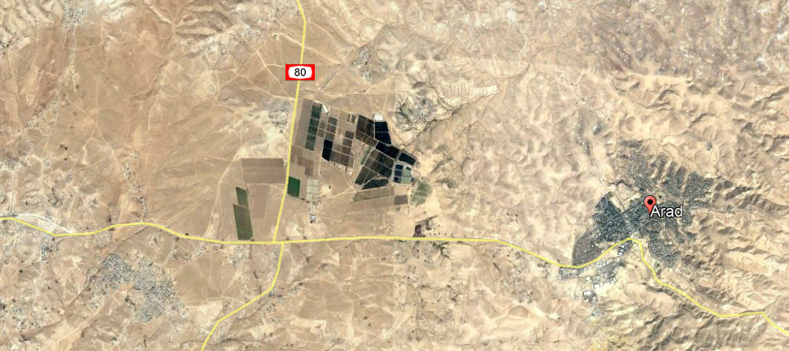
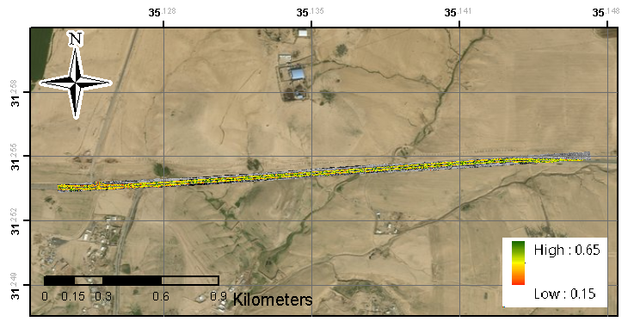

Slide 26
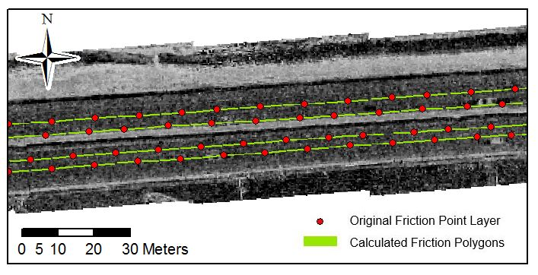

Slide 27
a
Min | Max | Mean | Std | n
0.22 | 0.634 | 0.45 | 0.073 | 1055

Slide 28
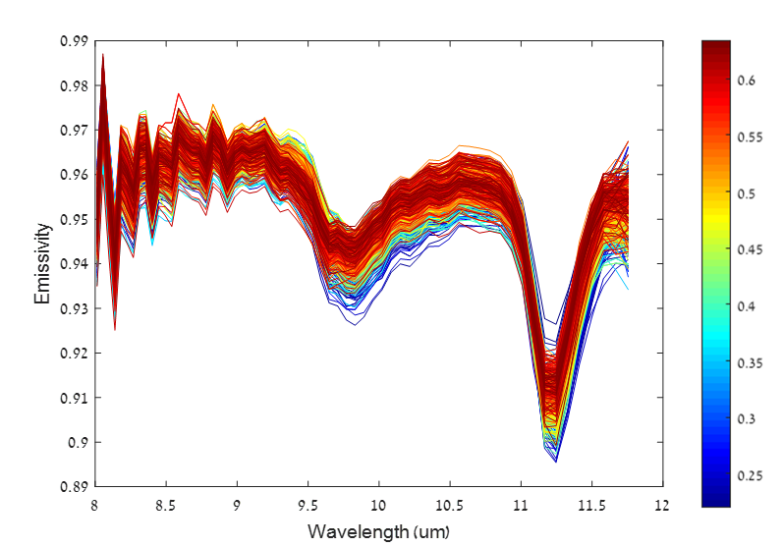
EMISIVITY AND FRICITION COEF

Slide 29
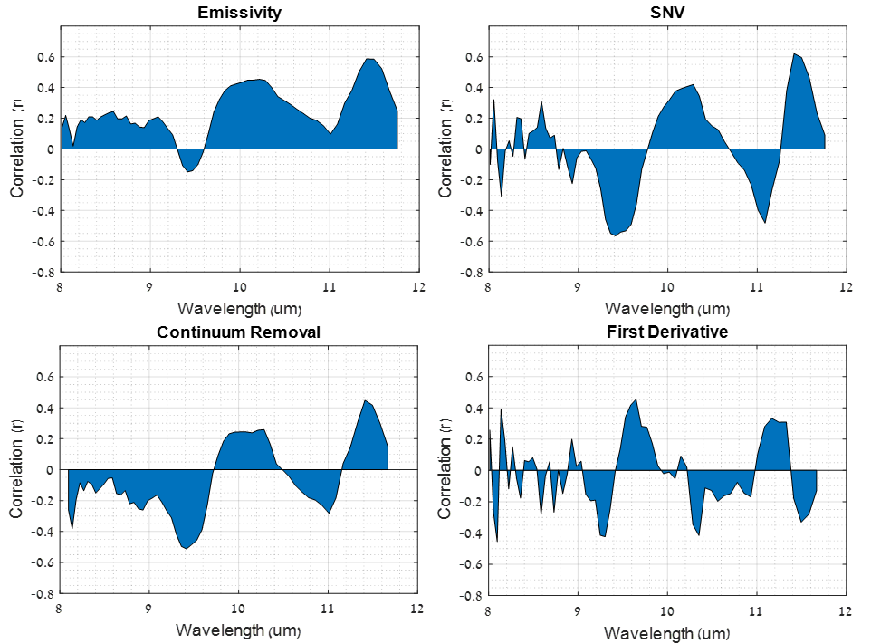

Slide 30
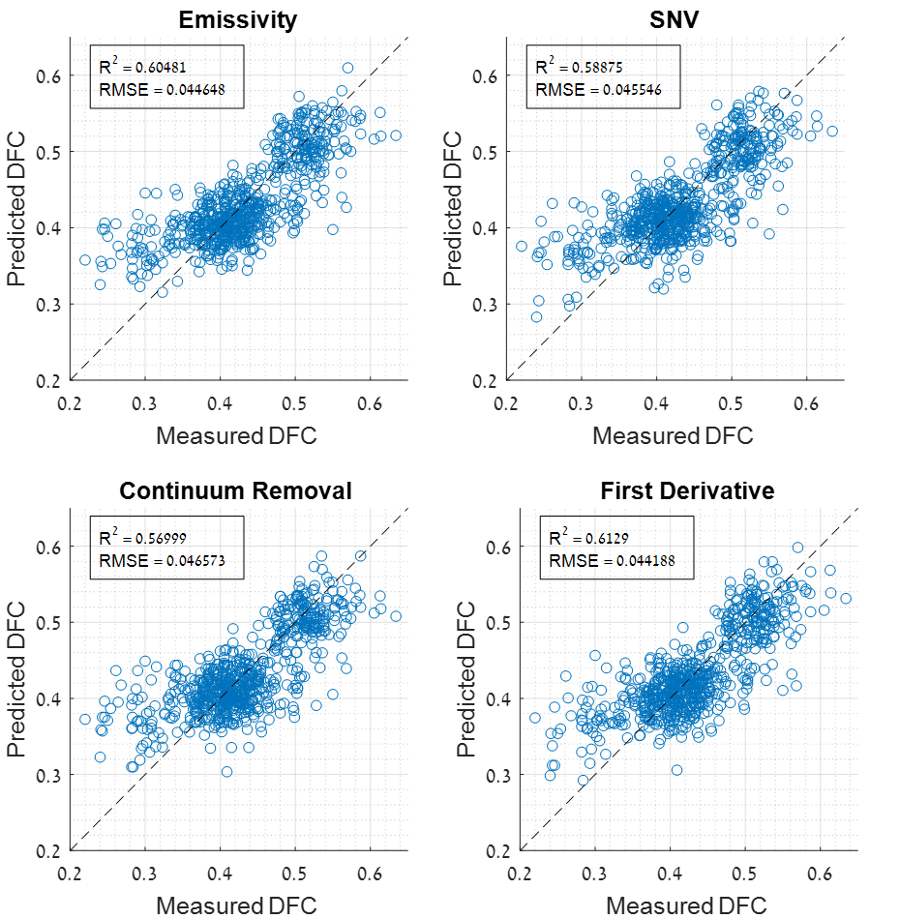

Slide 31
All Bands
88

Slide 32
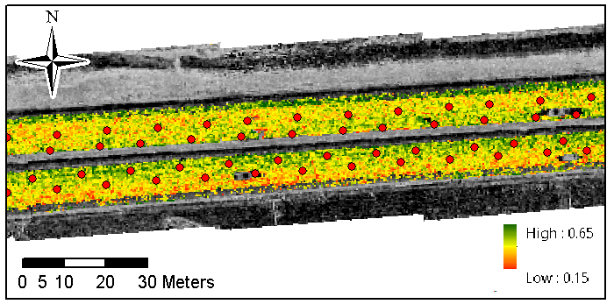

Slide 33
11.5
10.3
11.1
9.4

Slide 34

4 Selected Bands
9.4, 10.3, 11.1 11.5

Slide 35
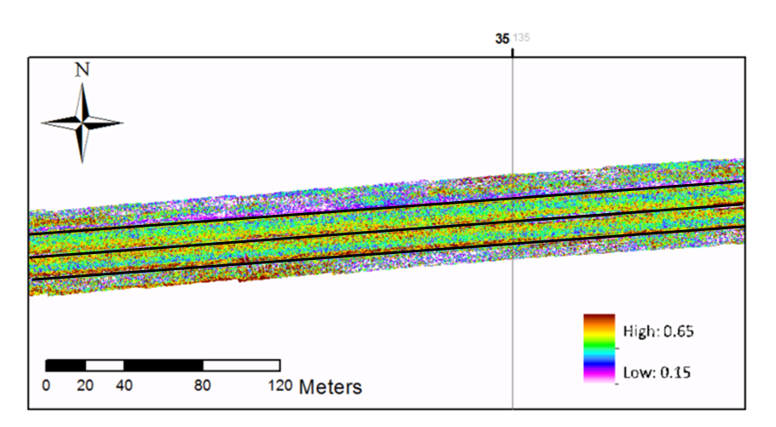
Road Asphalt
Road Margin

Slide 36

The Vision
HSR-TIR sensor
Forward Looking TIR sensor

Slide 37
Conclusions
Airborne Hyperspectral Remote Sensing is capable to map the friction coefficient (FC) in asphaltic roads in both optical and thermal spectral regions
The VIS-NIR-SWIR is limited to day acquisition
The TIR is available is open for day and night acquisition
The FC can be extracted using only 4 channels only from the LWIR region .
Future vision: adopting the technology for safty driving and autonomous cars

Slide 38
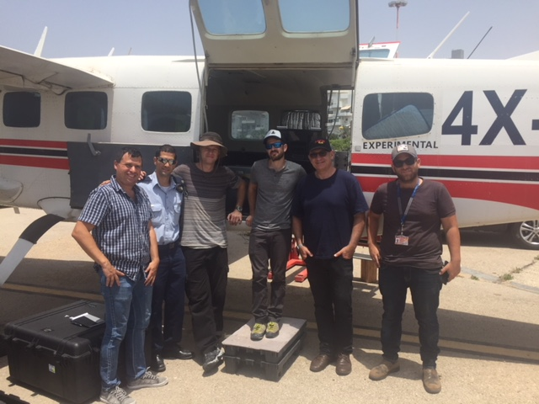

Thank you for your attention!

