Slide 1
A multi-spacecraft analysis of energy transfer associated with near-Earth magnetic reconnection
S. Fadanelli, B. Lavraud, F. Califano and MMS team
Abstract
We present an analysis of energy transfers in a reconnecting near-Earth plasma, obtained by interpreting MMS data within the framework of multi-fluid plasma theory. In our analysis, energy transfers are calculated and examined locally. This way, correlations between different mechanisms of energy exchange can be retrieved in all spatial and temporal detail provided by the high-frequency, multi-point sampling capacity of the four MMS satellites. In particular, compressional effects are separated from effective sources in the energy density evolution equations, allowing to distinguish whether some effective energy transfer is occurring locally. A large database of MMS encounters with reconnecting current sheets is exploited in order to assess the statistical validity of all results presented.

Slide 2
A multi-spacecraft analysis of energy transfer associated with near-Earth magnetic reconnection
S. Fadanelli, B. Lavraud, F. Califano and MMS team
Idea: determine patterns of energy transfers near reconnections
Abstract
We present an analysis of energy transfers in a reconnecting near-Earth plasma, obtained by interpreting MMS data within the framework of multi-fluid plasma theory. In our analysis, energy transfers are calculated and examined locally. This way, correlations between different mechanisms of energy exchange can be retrieved in all spatial and temporal detail provided by the high-frequency, multi-point sampling capacity of the four MMS satellites. In particular, compressional effects are separated from effective sources in the energy density evolution equations, allowing to distinguish whether some effective energy transfer is occurring locally. A large database of MMS encounters with reconnecting current sheets is exploited in order to assess the statistical validity of all results presented.

Slide 3
A bit of theory
$K_{s}$ := $m_{s}nu_{s}^{2}/2$
kinetic energy density:
internal energy density:
$U_{s}∶={Tr[P}_{s}]/2$
Evolution equations for energy densities:
change along trajectory
compressions
pressure work
electric work
$$d_{t}K_{s} := \left[∂_{t}+u_{s}∙∇\right]K_{s}= −K_{s} ∇∙u_{s}− u_{s}∙∇∙P_{s}+q_{s}n_{s} u_{s}∙E$$
$$d_{t}U_{s} := \left[∂_{t}+u_{s}∙∇\right]U_{s}= −U_{s} ∇∙u_{s}− P_{s} :∇u_{s}−∇∙Q_{s}/2$$
flow work
heat exchange

Slide 4
A bit of theory
$K_{s}$ := $m_{s}nu_{s}^{2}/2$
kinetic energy density:
internal energy density:
$U_{s}∶={Tr[P}_{s}]/2$
Evolution equations for energy densities:
change along trajectory
compressions
pressure work
electric work
$$d_{t}K_{s} := \left[∂_{t}+u_{s}∙∇\right]K_{s}= −K_{s} ∇∙u_{s}− u_{s}∙∇∙P_{s}+q_{s}n_{s} u_{s}∙E$$
$$d_{t}U_{s} := \left[∂_{t}+u_{s}∙∇\right]U_{s}= −U_{s} ∇∙u_{s}− P_{s} :∇u_{s}−∇∙Q_{s}/2$$
flow work
heat exchange
energy transfers
Idea: determine patterns of energy transfers near reconnections
first in simulations – then with MMS

Slide 5
In simulations: first identify a reconnection site in turbulence
2D - kinetic ions and fluid , isothermal electrons
no information on $d_{t}U_{e}$

Slide 6
In simulations: evaluate relations between energy transfers

Slide 7
In simulations: evaluate relations between energy transfers

Slide 8
In simulations: evaluate relations between energy transfers

Slide 9
In simulations: evaluate relations between energy transfers

Slide 10
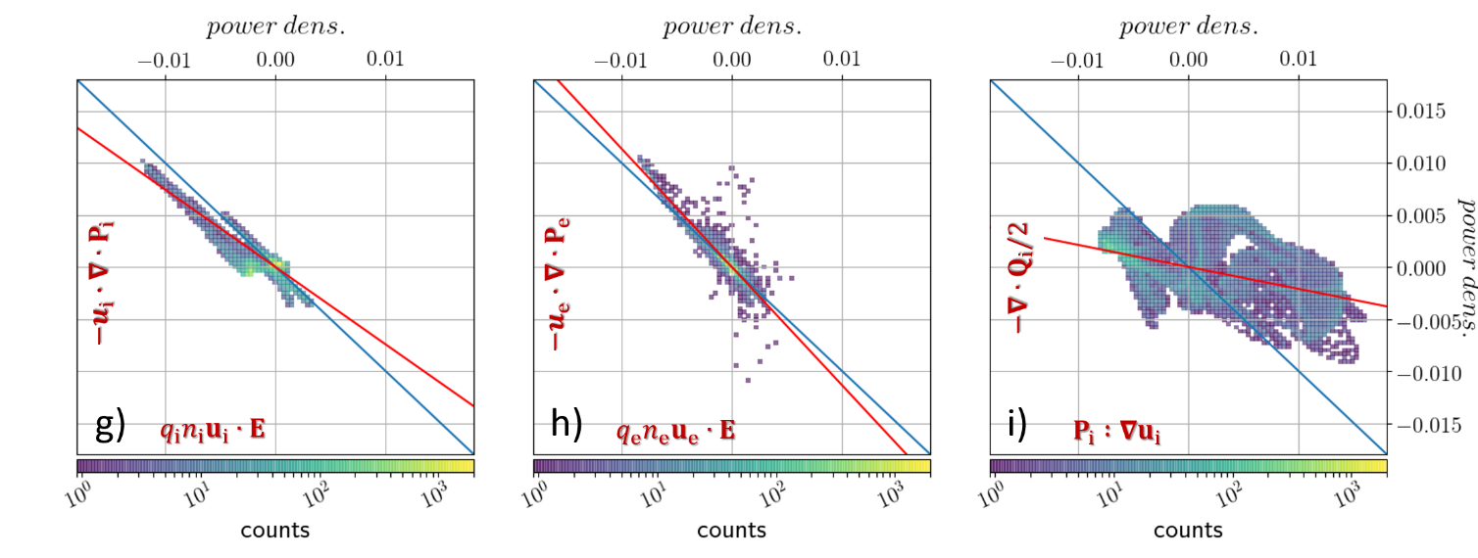
In simulations: evaluate relations between energy transfers

Slide 11
In simulations: evaluate relations between energy transfers

Slide 12
In simulations: evaluate relations between energy transfers

Slide 13
In simulations: evaluate relations between energy transfers
approximate force balance
“noisy” polytropic
which are coherent with long-known studies in the field (Birn and Hesse 2010, Fruehauff 2017)

Slide 14
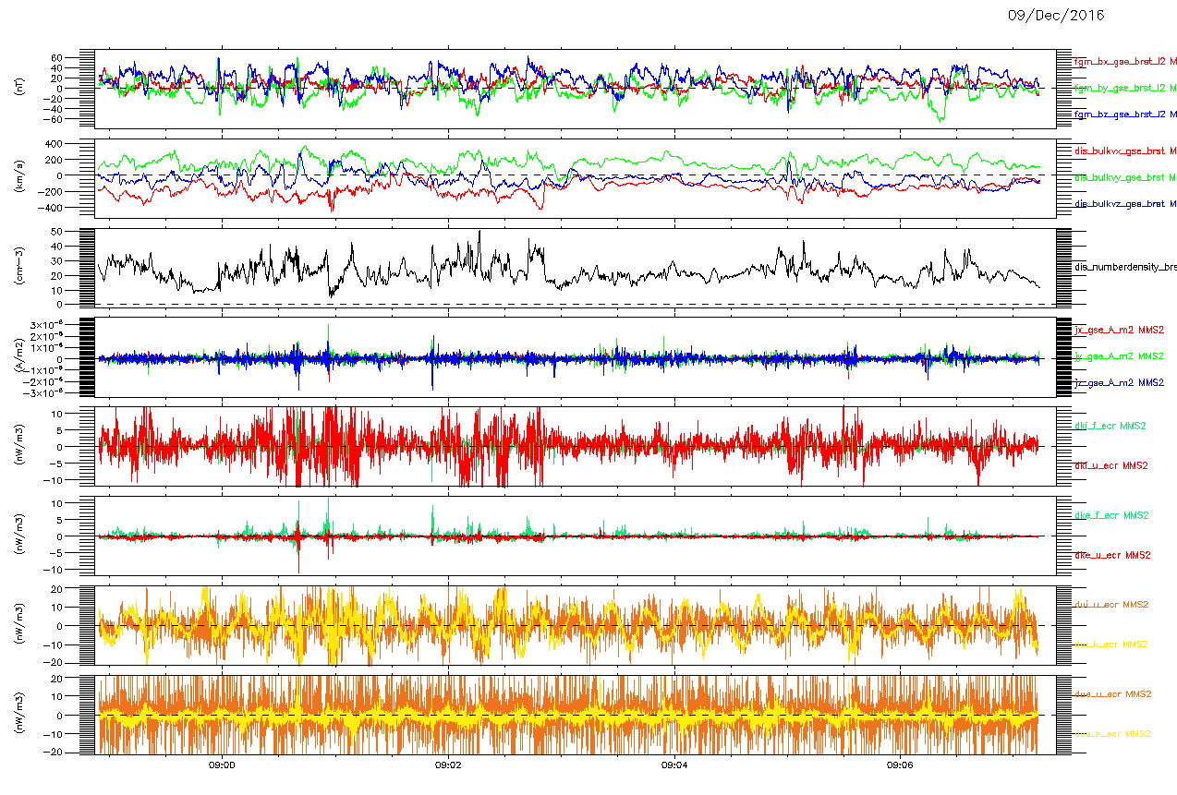
With MMS: identify a data interval with turbulent reconnection
N.B. in this data interval, T. Phan found electron-only MR (see Phan et al. 2018) and J. Stawarz studied turbulence properties (Stawarz 2019)

Slide 15
With MMS: evaluate relations between energy transfers
$$d_{t}K_{i}$$
$$d_{t}K_{e}$$
$$d_{t}U_{i}$$
$$d_{t}U_{e}$$
periodic signal, possibly from instrumental effect
In general, no evident correlation appears in the time-series.
However, let’s re-create the same correlation plots as in the simulation …

Slide 16
With MMS: evaluate relations between energy transfers
approximate force balance seems gone …
… and so does also the “messy” polytropic
here electrodynamic work prevails over the thermodynamic one
here thermodynamic work prevails over the electrodynamic one
here heat flux prevails over the thermodynamic work term
no clear predominance, nor trend
$$d_{t}K_{i}$$
$$d_{t}K_{e}$$
$$d_{t}U_{i}$$
$$d_{t}U_{e}$$
N.B. remember the possible instrumental effect

Slide 17
So – what has happened?

Slide 18
So – what has happened?
That’s not clear yet. More intervals (turbulence, and only reconnection) have been examined, but the patterns seem not conclusive for the moment. Possible explanations include:

Slide 19
So – what has happened?
That’s not clear yet. More intervals (turbulence, and only reconnection) have been examined, but the patterns seem not conclusive for the moment. Possible explanations include:
- instrumental effects (MMS not accurate enough – note that we need gradients of $u_{s} P_{s} Q_{s}$ here …) - not the “best” data intervals (in spite of all those tried) - issues in data treatment (in spite of trying different interpolations and time-averaging windows) - not the “right” simulation for comparison (isothermal electrons, or two-dimensional assumption)

Slide 20
So – what has happened?
That’s not clear yet. More intervals (turbulence, and only reconnection) have been examined, but the patterns seem not conclusive for the moment. Possible explanations include:
- instrumental effects (MMS not accurate enough – note that we need gradients of $u_{s} P_{s} Q_{s}$ here …) - not the “best” data intervals (in spite of all those tried) - issues in data treatment (in spite of trying different interpolations and time-averaging windows) - not the “right” simulation for comparison (isothermal electrons, or two-dimensional assumption)
… so, research is ongoing – as usual …
Thanks for your time, sorry for the partial status of this research and welcome to any comment/suggestion!

Slide 21
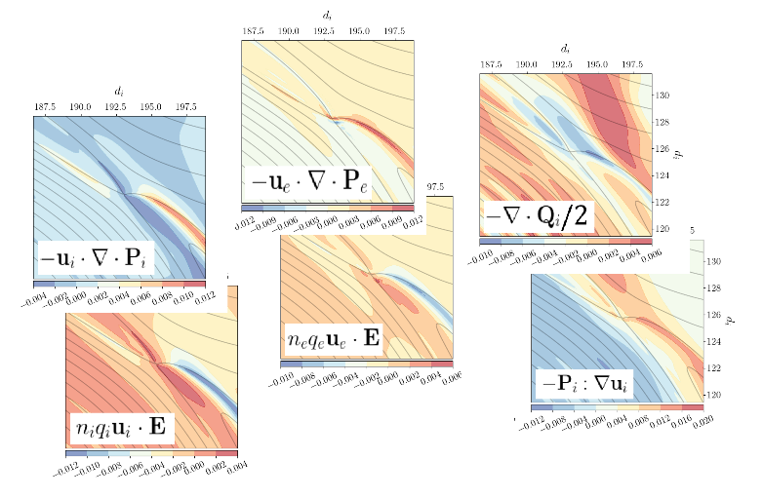
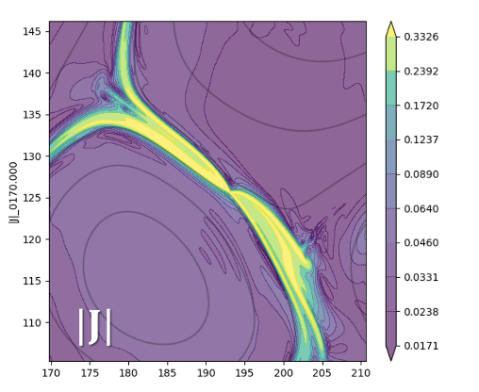
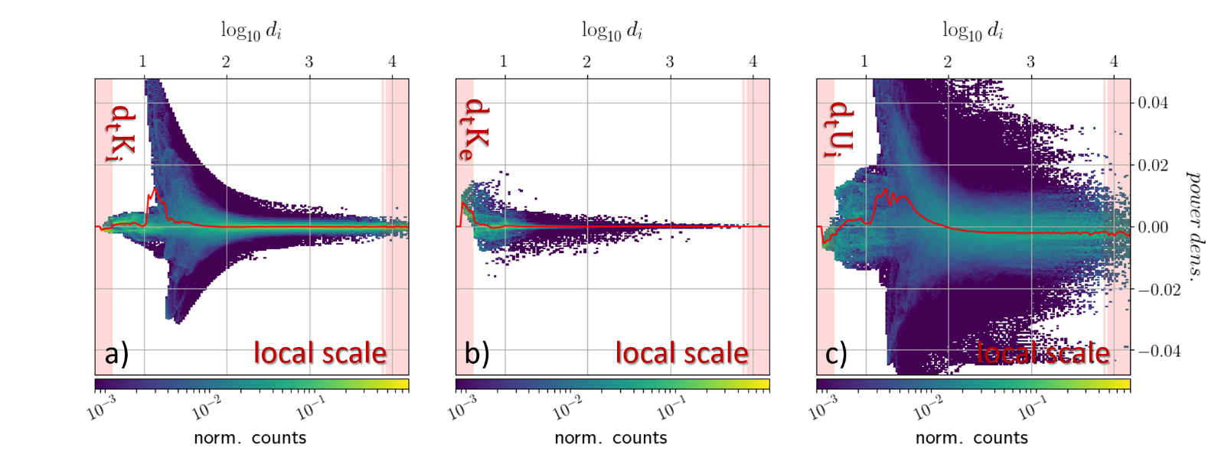
Energy conversions associated with magnetic reconnection
S. Fadanelli, B. Lavraud, F. Califano, G. Cozzani, F. Finelli, M. Sisti
- soon to be resubmitted -
(just here for advertisement)
• we examine spatial patterns of energy densities and energy conversion rates close to a reconnection site inside a hybrid, Eulerian simulation of plasma turbulence
• kinetic energy is approximately conserved due to force balance, and internal energy evolution can be well described within a polytropic framework
• smaller system scales are shown to be correlated with larger values of the overall energy conversion rates

