Slide 1

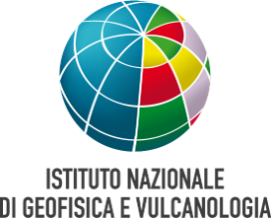
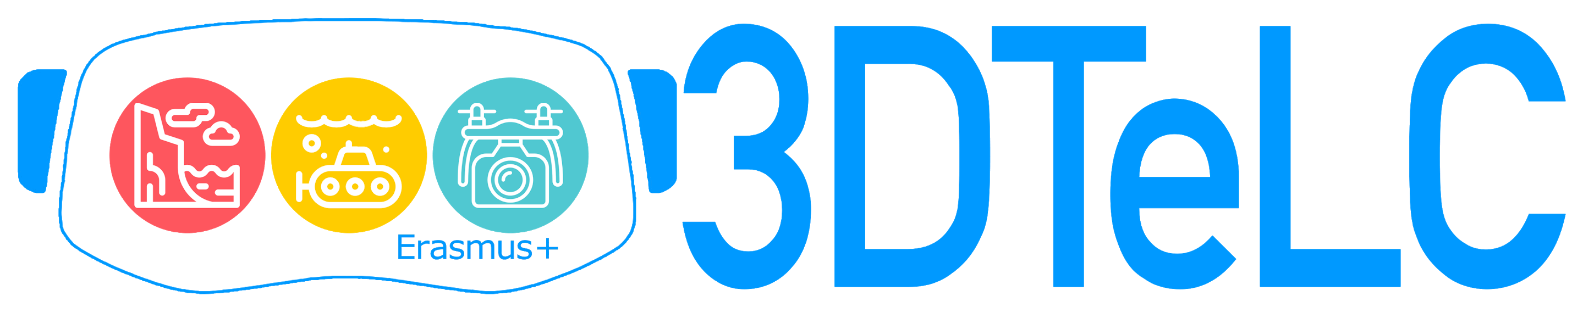

Augmented reality for volcanic and seismic risk communication
Danilo Reitano and Susanna Falsaperla
Istituto Nazionale di Geofisica e Vulcanologia, sezione di Catania, Osservatorio Etneo, Italy
EGU2020-16813

Slide 2
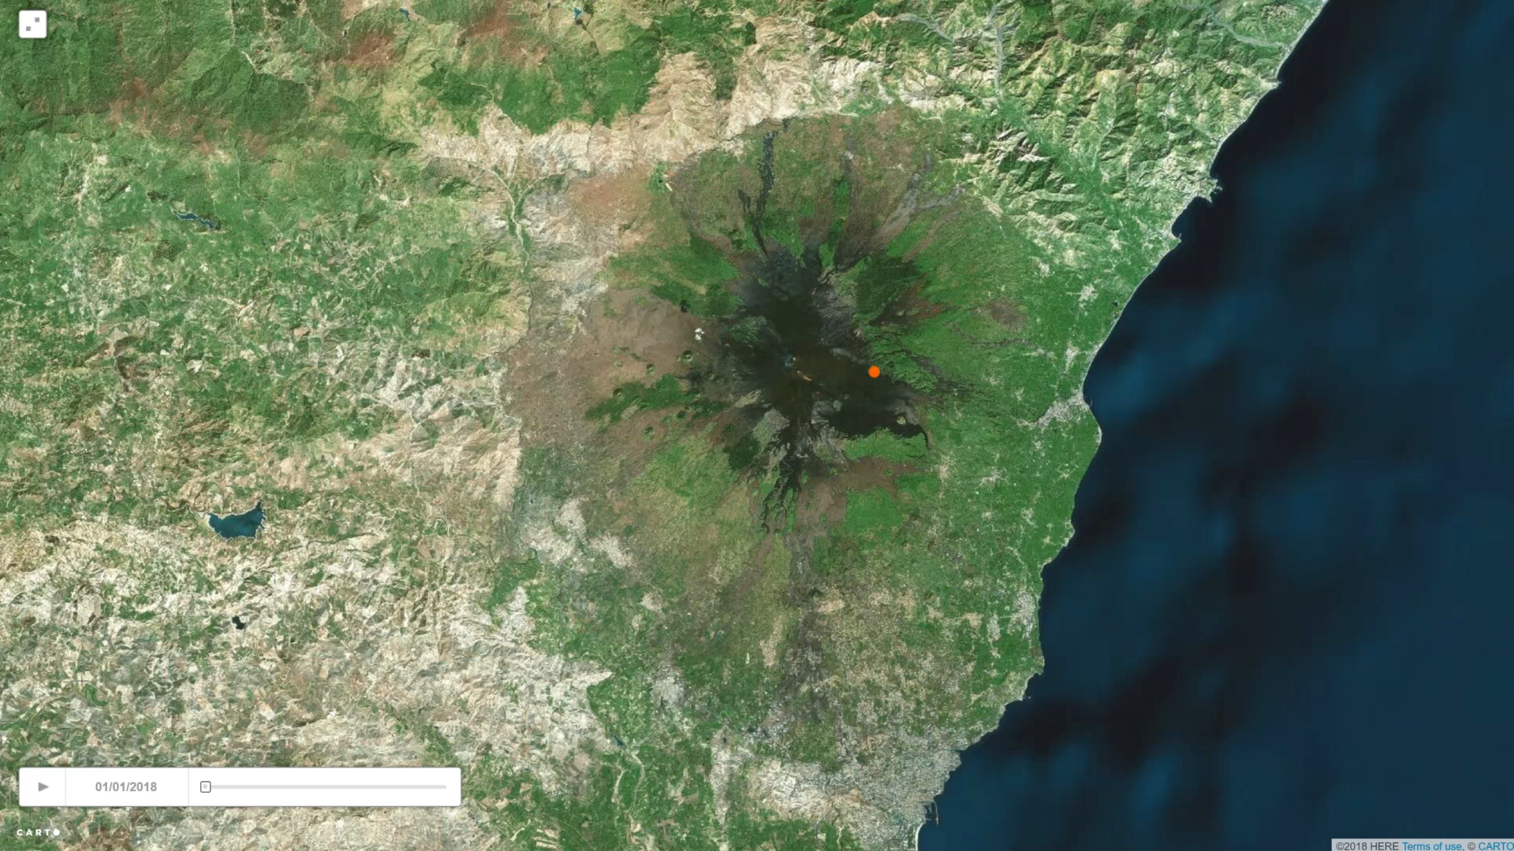
Mt. Etna: not only eruptions!
Italy
Etna
Etna is located in southern Italy. It is a persistently active strato-volcano with basaltic lava effusions. Earthquakes are mainly shallow (< 5 km), with magnitude rarely exceding ML 5. Despite the magnitude, the surficial foci can yield structural and non-structural damage.
EGU2020-16813
Click on the image to see the epicentral distribution of earthquakes occurred from January to November 2018

Slide 3
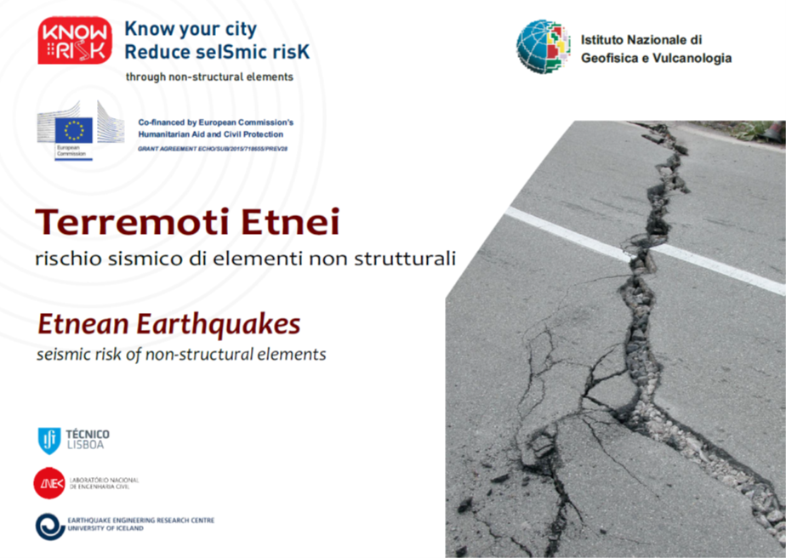
The social and economic impact of earthquakes and eruptions affects a quite large population which lives along the flanks of the volcano, even though at distance of tens of chilometers from the active craters.
This requires the adoptions of effective measures of education and communication to increase the resiliency of the population and reduce seismic and volcanic risk.
Photo credits: Marco Neri
(From Azzaro et al., 2016)
EGU2020-16813

Slide 4
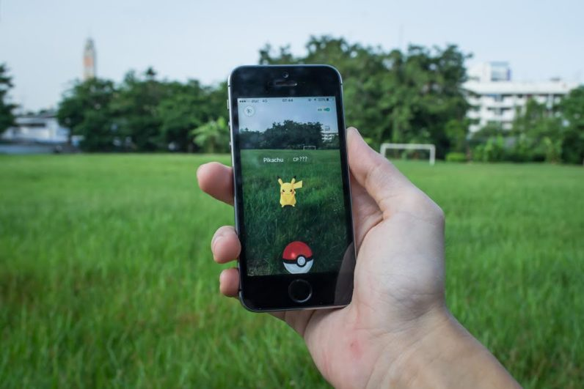
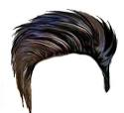

Augmented Reality (AR) and Virtual Reality (VR) are well known by Native Digital and can be used by lower-level and university students to promote their understanding of natural risks.
Reality
Augmented Reality
Virtual Reality
3DTeLC is a three-year trans-European project funded by the Erasmus+. The main goal of this project is to help young students to become highly-skilled professionals in the field of environment and geosciences, gaining knowledge in image and 3D-spatial analysis, data management and informatics, and strengthening their mathematical and numerical skills in Earth observation and data analysis.
EGU2020-16813

Slide 5
New Tools for Earth Science: Teaching, Learning and Citizen Science promotion
Augmented Reality (AR): We promoted the development of a tool that can be easily used by common people, in particular young people, who have the smartest approach with new technologies. At this aim, we designed “the Talking poster” technique.
Virtual Reality (VR): 3DTeLC project promotes 3D-Virtual Tours that can be used to help students discover, study and deepen their knowledge: starting from data acquired by drone surveys, students can “surf” real landscapes even if these are distant or inaccessible. Consequently, they can explore and study geological elements as many times as they want.
EGU2020-16813

Slide 6
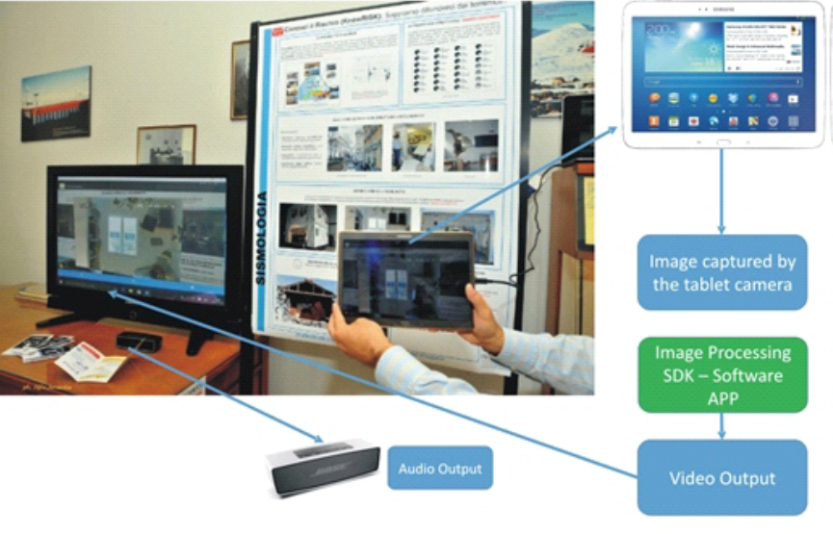
The “Talking poster” based on our AR scheme
This tool has been developed for tablet/smartphones within the Wikitude™ framework. The APP is able to recognize images, users’ position and produces outputs such as videos, images, sounds, web info, etc. The prototype is easy to use, auto explicative, and providers are able to reconfigure and adapt it to new targets with little effort.
In the PICO presentation the audience would have had the opportunity to see an example of AR tools.
(From Reitano et al., 2019)
EGU2020-16813

Slide 7
Acknowledgments
We acknowledge the 3DTeLC, which is a three-year trans-European project funded by the Erasmus+ Key Action 2 programme: “Cooperation for Innovation and Exchange of Good Practices, a European scheme that fosters higher education partnerships” (https://www.erasmusplus.org.uk/key-action-2). Project reference: 2017-1-UK01-KA203-036719.
We are also grateful to Riccardo Merenda for his support in the development of our AR applications.
References
Azzaro R., D’Amico S., Tuvè T. & Cascone M. (2016), Terremoti Etnei, rischio sismico di elementi non-strutturali [Etnean earthquakes, seismic risk of non-structural elements]. Progetto UE Know-Risk (echo/sub/2015/718655/prev28), 35 pp., Catania (versioni italiano e inglese).
Reitano, D., S. Falsaperla, G. Musacchio, R. Merenda (2019), Awareness on Seismic Risk: How can Augmented Reality help? In: Proceedings of the International Conference on Earthquake Engineering and Structural Dynamics, Geotechnical, Geological and Earthquake Engineering 47, R. Rupakhety et al. (eds.), Springer International Publishing AG, part of Springer Nature, Chapter 36, 485-492, https://doi.org/10.1007/978-3-319-78187-7_36.
EGU2020-16813

