Slide 1
Multi-scale numerical modelling of debris flow: coupling 2D and 3D simulation strategies
A. Pasqua*, A. Leonardi, M. Pirulli
*andrea.pasqua@polito.it

Slide 2
Flow chart of the research
Motivations
Very fast phenomena;
Cause of economic and human loss.
Issues
Velocity and pressure approximated to the mean (RASH3D);
Coupling
Modelling
tools
RASH3D (shallow-water method);
Hybird (3D method);
Fewer data to process;
impossible evacuation;
Enhancement of time calculation;
Reliable results;
Fewer results to interpret.
Less expensive than full scale experiment;
Computational power almost satisfying.
Large computational time necessary for big area simulated (Hybird).

Slide 3
Question: why do we need to understand and model debris flow phenomena? Answer: see next slide

Slide 4
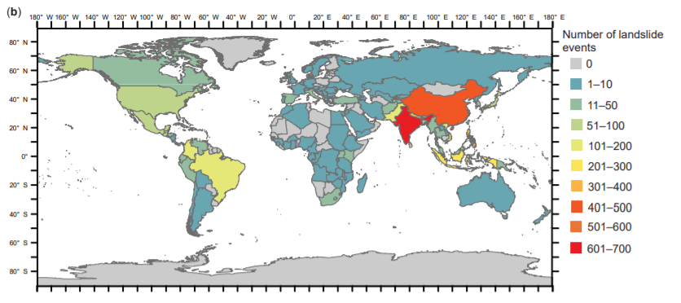
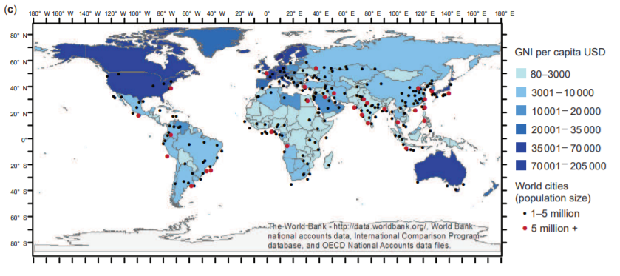
Motivations
(a)
(b)
(c)
The location of non-seismically triggered fatal landslide events from 2004 to 2016. Individual landslide events shown by a black dot. *
(b) Number of non-seismically triggered fatal landslide events from 2004 to 2016 by country. *
(c) The gross national income per capita (USD) by country (World Bank, 2018a), and the location of major urban centres globally (ESRI, 2018).*
* All the images in this slides are from: Froude & Petley (2018) Natural Hazards and Earth System Sciences, 18(8), 2161–2181.

Slide 5
Question: what kind of approach are suitable for this phenomena? Answer: see next slide

Slide 6
Modelling tools
RASH3D (shallow-water model)
Hybird (3D model)
de Saint-Venant equations;
Finite volume method (FVM);
Lattice-Boltzmann equations
Mesoscopic method;
Collision and streaming processes;

Slide 7
Question: what are the limits and the issues of these approaches? Answer: see next slide

Slide 8
Limits and issues
RASH3D (shallow-water model)
Hybird (3D model)
Pros:
Fast analysis;
Reliable results;
Adaptable to topography.
Cons:
Mean results;
The run out must be greater than the flow’s height
Mitigation structure are difficult to design using this approach
Pros:
Able to simulate complex geometry;
Results represented point by point;
Easy to pair with other models (DEM)
Cons:
Large analysis require a large time to run
Allows to design mitigation structures
Results may be complex to interpret

Slide 9
Question: How can we improve the analysis? How can we have even more suitable results (in relation to informatics and graphic devices) Answer: Coupling

Slide 10
Coupling
Idea:
Hypothesis:
Dam break problem;
Run out longer than 1km;
RASH3D + Hybird approach.
Conclusions:
Time calculation minimized;
No loss of information (velocity and height of the flow, forces);
Design of mitigation structure is possible
Combining the pros of each modelling tool.
Fewer data to process
Fewer results to interpret
Enhancement of time calculation

Slide 11
Coupling
Imagine from Ming-liang Chen et al (2019), Contribution of Excessive Supply of Solid Material to a Runoff-Generated Debris Flow during Its Routing Along a Gully and Its Impact on the Downstream Village with Blockage Effects, MDPI
RASH3D
The image shows the main idea. In order to save computational time is useful to use an integrated model where it is not necessary to collect a large amount of information. Otherwise, if the flow is close to strategic points, it is necessary to have more information (velocity, forces, etc..) to design correctly the defence structures.
Hybird

Slide 12
Focus on Lattice-Boltzmann method
Lattice-Boltzmann method considers a set of particles in a volume of control. The space must be discretised
The main parameter is the function f(x,t,c), which indicates the position (x,y,z) of a particle at the time t and what velocity that particle has (c).
collision: particles collide between them (simulation of the fluid’s viscosity)
Streaming: particles’ movement in the volume of control;
Main stages of calculation: streaming and collision
Continues in the next slide

Slide 13
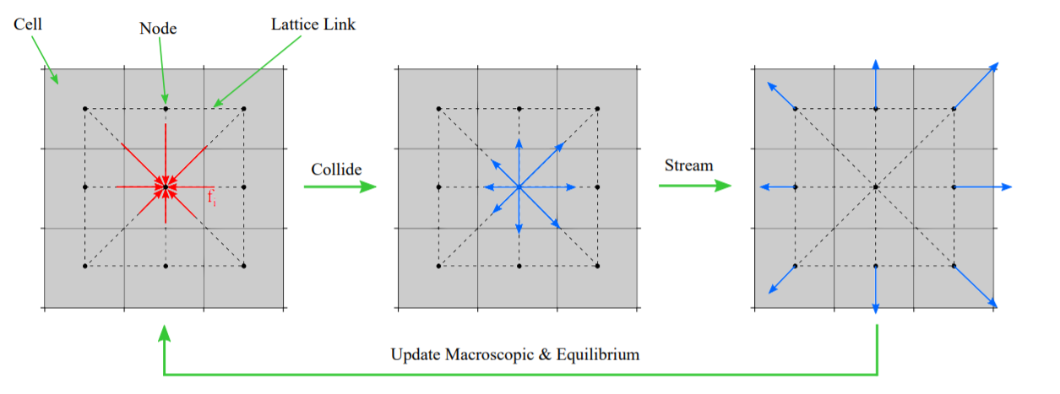
Focus on Lattice-Boltzmann method
$$ρ(x,t)=\sum_{i}{f_{i}}$$
𝜌(𝒙,𝑡)=∑1_𝑖▒𝑓_𝑖
$$u(x,t)=\frac{\sum_{i}{f_{i}}c_{i}}{ρ}$$
𝑢(𝒙,𝑡)=(∑1_𝑖▒𝑓_𝑖 𝑐_𝑖)/𝜌
Reconstruction of macroscopic variables (density ρ and velocity u):
Streaming step:
Each particle moves into the domain due to its own velocity c
Collision step:
macroscopic variables are modified by the collision between the particles
Free-surface is obtain through volume of fluid method (VOF)
* Imagine from Adrian R. et al., A real-time modelling and simulation platform for virtual engineering design and analysis (2018), 6th European Conference on Computational Mechanics (ECCM 6) 11–15 June 2018, Glasgow, UK

Slide 14
Preliminary study (LBM D3Q19)
Newtonian fluid
Results of NSE in permanent and uniform motion
Bagnold fluid
Results of NSE in permanent and uniform motion
Idea: comparison between the analytical solution of Navier-Stokes equations (NSE) and the numerical results

Slide 15
Preliminary study (LBM D3Q19)
Laminar flow (Poiseuille)
Procedure for a Newtonian fluid to obtain analytical solutions:
NSE
Solutions in uniform and permanent motion (velocity and pressure)
Flow rate and height’s flow
Numerical model LBM D3Q19 must verify:
Froude number calculation
Flow rate
Height
Fr
If Fr>1 supercritical flow; if Fr<1 subcritical flow

Slide 16
Preliminary study (LBM D3Q19)
Laminar flow (Poiseuille)
Procedure for a Bagnold fluid to obtain analytical solutions:
Velocity and pressure in Bagnold fluid
Flow rate calculation
flow’s height calculation
Numerical model LBM D3Q19 must verify:
Froude number calculation
Flow rate
Height
Fr
If Fr>1 supercritical flow; if Fr<1 subcritical flow

Slide 17
Preliminary study (LBM D3Q19)
In this presentation are studied two different problems which are particularly interesting for fluid dynamics. Both of them are studied using the coupled method (constant velocity inlet)
Channel
Preliminary results (Newtonian and Bagnold)
Dam-break
Preliminary results (Newtonian and Bagnold)
Problems

Slide 18
Channel

Slide 19
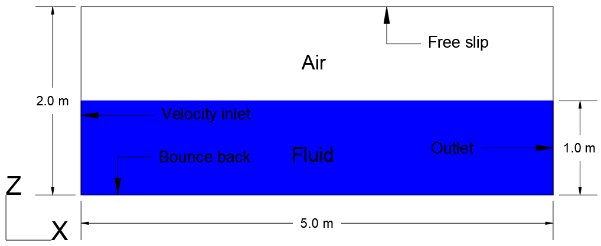
Preliminary results (Newtonian fluid)
Constant inlet velocity
Newtonian rheology;
BCs: Zou-He velocity inlet & outlet;
fluid characteristics specified (see table);
Parabolic Inlet profile
Lc [m] | 5.00 | Velocity inlet [m/s] | 0.50
Hc [m] | 2.00 | Velocity outlet [m/s] | 0.50
Fluid Min X [m] | 0.00 | Force X [m/s²] | 3.35
Fluid Max X [m] | 5.00 | Force Z [m/s²] | -9.21
Fluid Min Z [m] | 0.00 | ρ [kg/m³] | 1500.00
Fluid Max Z [m] | 1.00 | µ [Pas] | 60.00
Slope:
Θ = 20°

Slide 20
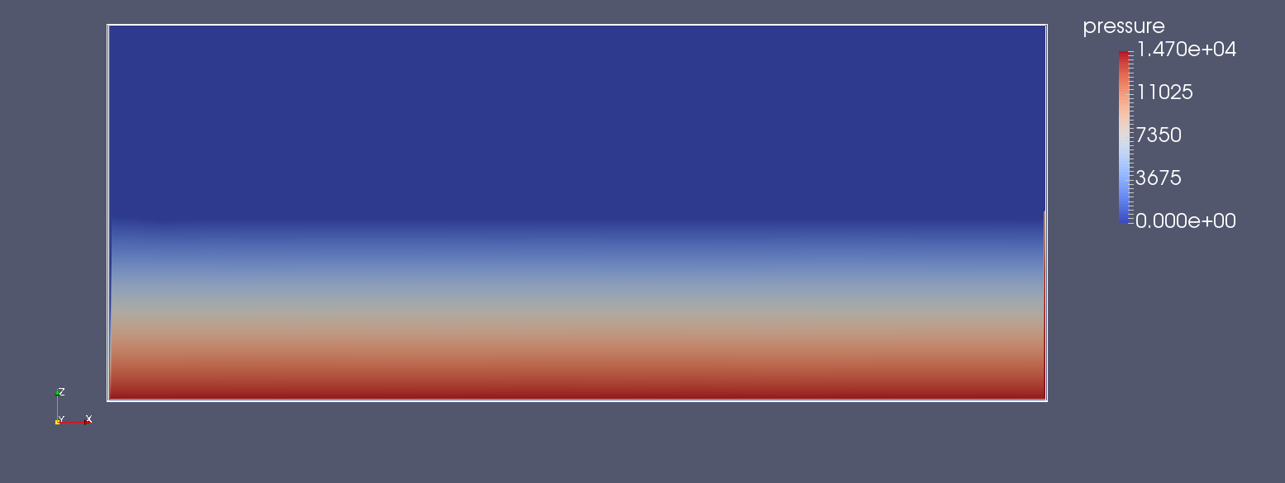
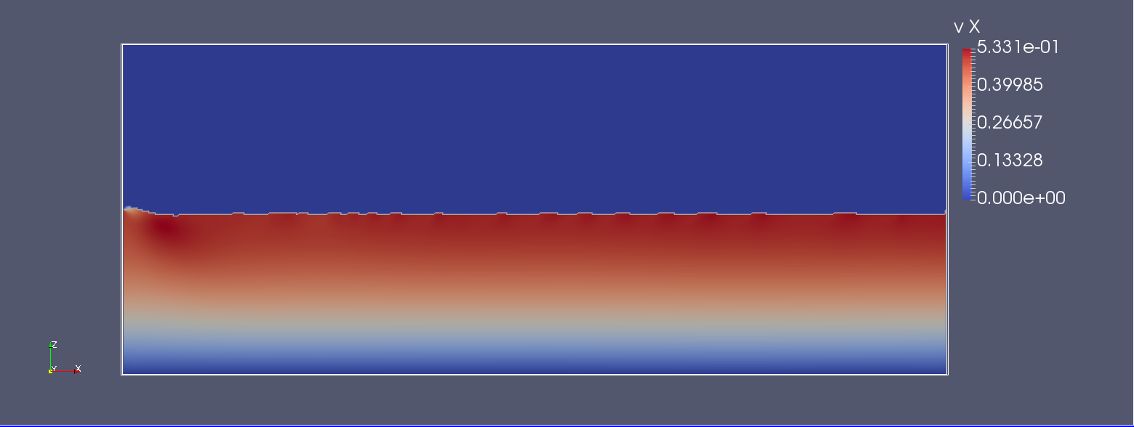
Preliminary results (Newtonian fluid)
Analytic solutions |  | Numeric solutions
uMax [m/s] | 0.50 | uMax [m/s] | 0.53
uMean [m/s] | 0.33 | uMean [m/s] | 0.35
Fr [-] | 0.1 | Fr [-] | 0.1
Re [-] | 8.3 | Re [-] | 8.8
discrepancies
uMax [m/s] | 0.03
uMean [m/s] | 0.02
Fr [-] | 0.0
Re [-] | 0.5
Numerical results
Pressure
Velocity

Slide 21
Preliminary results (Newtonian fluid)
Variable flow (height changes during the simulation)
Depending on the course of the free surface, the velocity and pressure values ​​adapt satisfactorily to the new configuration.
the system may be approximate to a Poiseuille flow.

Slide 22
Preliminary results (Newtonian fluid)
In the next slide you will able to observe how the free surface and velocity evolve during the simulation;
The mass is represented on the left
The velocity is represented on the right

Slide 23
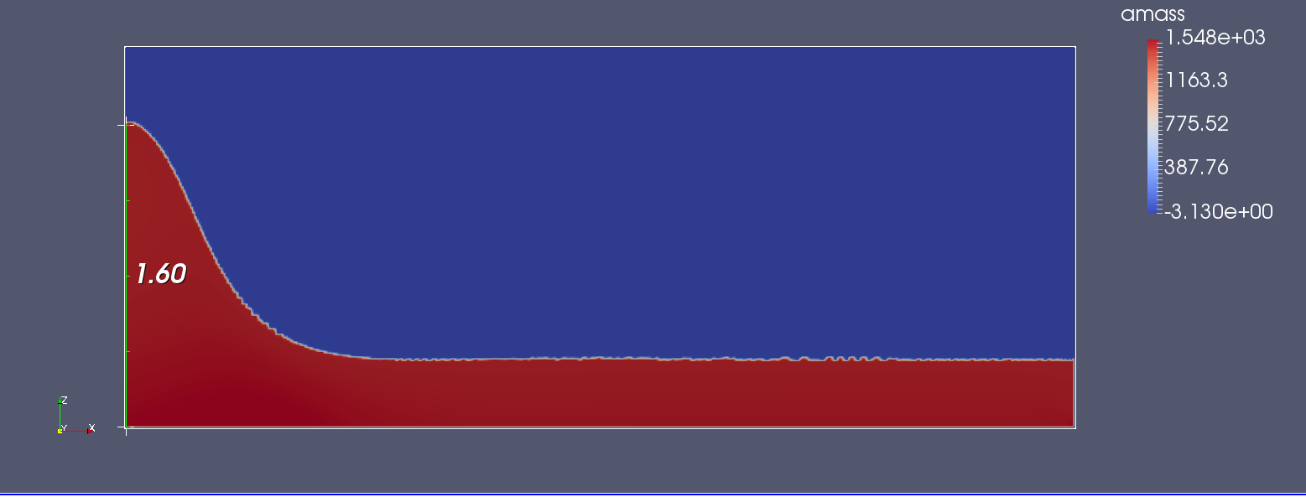
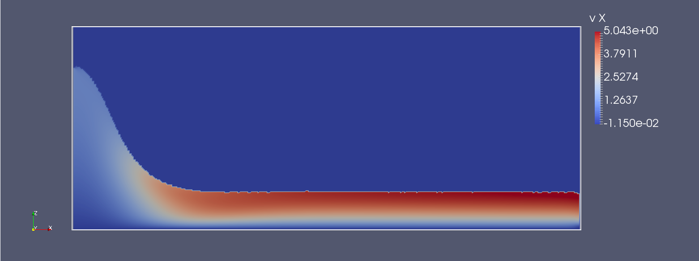
Preliminary results (Newtonian fluid)
Mass
Velocity
Time=0s
Time=60s

Slide 24
Dam break

Slide 25
Preliminary results (Newtonian fluid)
Problem
Characteristics of the fluid:
flow’s height (h) in inlet 0.50 m
Dynamic viscosity 60.00 Pas
Density 1500.00 kg/m³
Problems analysed:
Increasing of flow rate,
Newtonian fluid
Dam break
Constant slope (20°)

Slide 26
Preliminary results (Newtonian fluid)
Comparison of analytical with numerical solutions for a Newtonian fluid (increase in flow rate and constant slope)
hInlet=0.5m
μ=60Pas
ρ=1500kg/m³
Fx=3.35m/s²
q [m²/s]
u mean [m/s], h [m] Fr [-]

Slide 27
Preliminary results (Newtonian fluid)
Problem
Characteristics of the fluid:
flow’s height (h) in inlet 0.50 m
Dynamic viscosity 60.00 Pas
Density 1500.00 kg/m³
Constant flow rate
Problems analysed:
Increasing in slope
Newtonian fluid
Dam break
Constant flow rate

Slide 28
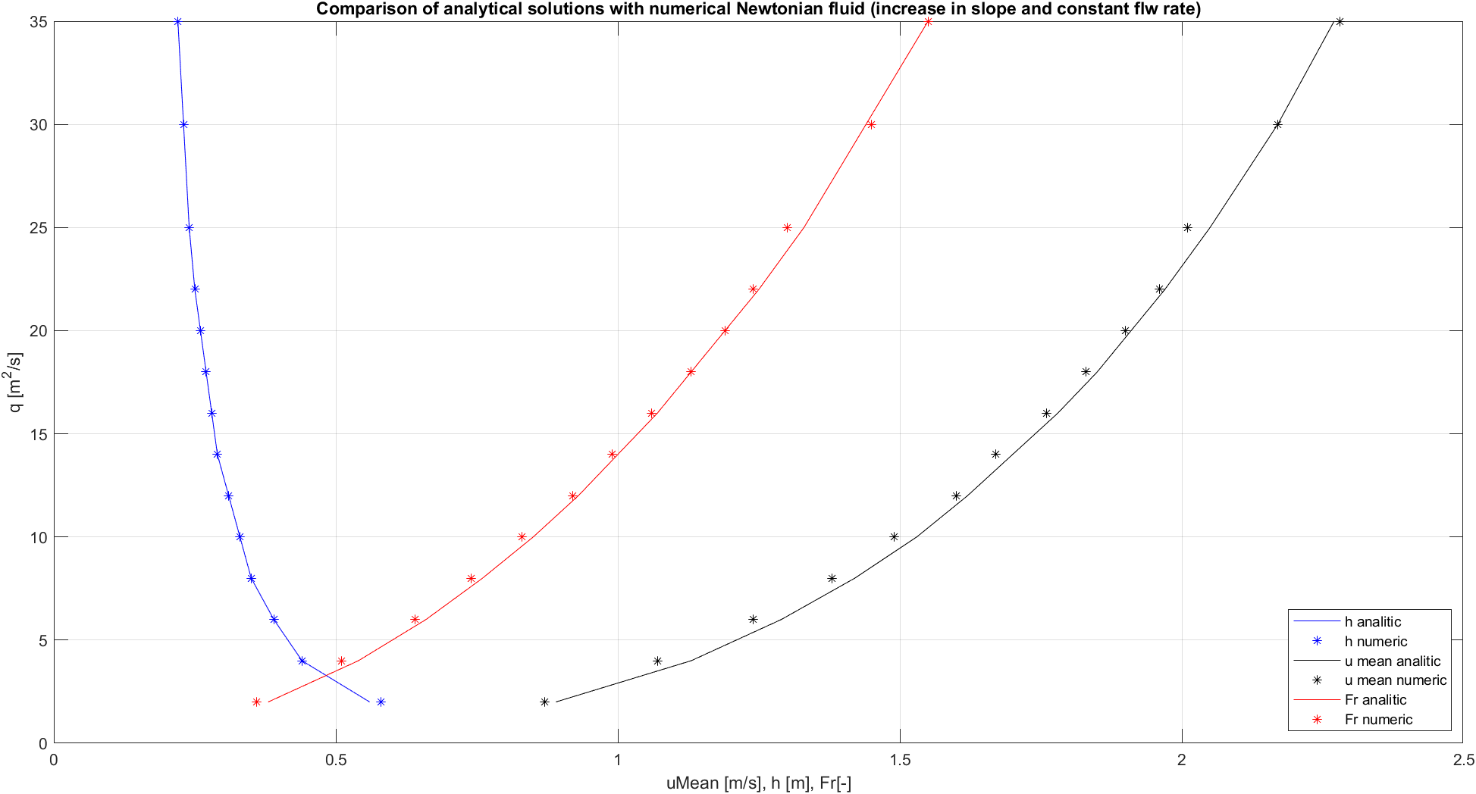
Preliminary results (Newtonian fluid)
Comparison of analytical with numerical solutions for a Newtonian fluid (increase in slope and constant flow rate)
hInlet=0.5m
uMeanInlet=1.0m/s
qInlet=0.5m²/s
μ=60Pas
ρ=1500kg/m³
slope [°]
u mean [m/s], h [m] Fr [-]

Slide 29
Preliminary results (Bagnold fluid)
Problem
Characteristics of the fluid:
flow’s height (h) in inlet 0.50 m
Dynamic viscosity 60.00 Pas
Density 1500.00 kg/m³
Problems analysed:
Increasing in flow rate,
Bagnold fluid
Dam break
Constant slope (20°)

Slide 30
Preliminary results (Bagnold fluid)
Comparison of analytical with numerical solutions for a Bagnold fluid (increase in flow rate and constant slope)
hInlet=0.5m
d=0.02m
ρ=1500kg/m³
Fx=3.35m/s²
ϑ=20°
q [m²/s]
u mean [m/s], h [m] Fr [-]

Slide 31
Preliminary results (Bagnold fluid)
Problem
Characteristics of the fluid:
flow’s height (h) in inlet 0.50 m
Dynamic viscosity 60.00 Pas
Density 1500.00 kg/m³
Problems analysed:
Constant flow rate,
Bagnold fluid
Dam break
Increasing in slope

Slide 32
Preliminary results (Bagnold fluid)
Comparison of analytical with numerical solutions for a Bagnold fluid (increase in slope and constant flow rate)
hInlet=0.5m
uMeanInlet=1.0m/s
qInlet=0.5m²/s
d=0.02m
ρ=1500kg/m³
Teta [°]
u mean [m/s], h [m] Fr [-]

Slide 33
Conclusions
Coupling shallow-water models to 3D models is a valid and achievable;
The present job shows how analytical solutions are comparable to numeric results. This suggests that in more complex scenarios coupled numerical models are a reliable tool to simulate debris flow phenomena;
Moreover the coupled method allows saving computational time without losing important information.

Slide 34
Contacts
Andrea Pasqua
Ph.D. Student,
Dept. of Structural, Building
and Geotechnical Engineering
Politecnico di Torino
Corso Duca degli Abruzzi 24,
10124 Torino (Italy)
Mail andrea.pasqua@polito.it
Tel. +390110904914

