Slide 1
Why Water Bodies(Wetlands) of Iran Have Been Dried up?
Davood Moshir Panahi^{1,2*}
Saeid Aminjafari¹
Bagher Zahabiyon²
1- Department of Physical Geography and Bolin Centre for Climate Research, Stockholm University, SE- 10691, Stockholm, Sweden.
2-Department of Civil Engineering, Iran University of Science and Technology, Tehran, 13114-16846, Iran.
✉e-mail: Davood.moshir@gmail.com

Slide 2

Aims of this study :
Detecting and Separating the portion the climatic and non-climatic drivers on drying up of wetlands by using budyko space diagram and formulation.

Slide 3
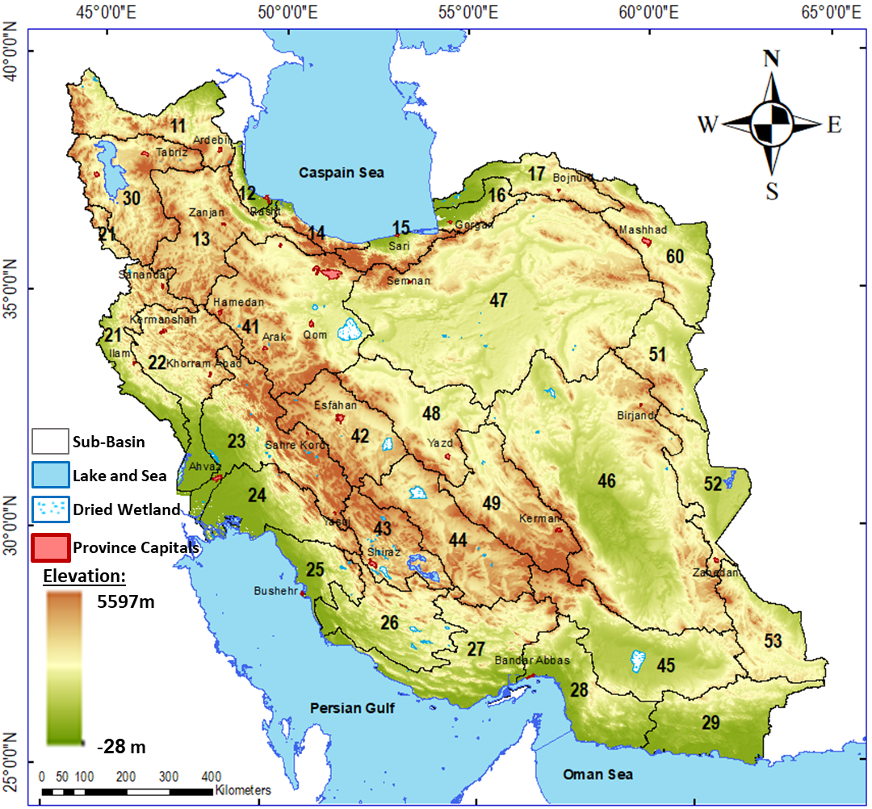
The study Area and Case study :
Gorgan Bay
Urmia lake
Gavkhouni wetland
HorAlzim Wetland
Maharlou Lake
Parishan Lake
Fig1 :The study Area

Slide 4
Methodology :
1- Comparing the time series of Runoff and Area of wetland time series by using their time series and 5 years moving average.
2- Develop the Formulation based on Budyko space diagram to detect the change driver portion ( climate or non-climate) and their portion.

Slide 5
Data and Methodology:
Hydro climatic data :
Hydro climatic Variables comes from Moshir Panahi etal.,2020
Wetland Area
the Global Surface Water Dataset (GSWD) (Pekel et al. 2016) is used to estimate the time series of surface water extent of the lakes
Moshir Panahi, D., Kalantari, Z., Ghajarnia, N. et al. Variability and change in the hydro-climate and water resources of Iran over a recent 30-year period. Sci Rep 10, 7450 (2020). https://doi.org/10.1038/s41598-020-64089-y
Pekel, Jean-François, Andrew Cottam, Noel Gorelick, and Alan S Belward. 2016. “High-Resolution Mapping of Global Surface Water and Its Long-Term Changes.” Nature 540 (7633): 418.

Slide 6
Fig2 :Time Series of Wetland Area (Ha) and Upper Basin Runoff(mm/yr), (A) Gavkhoni wetland, (B)Gorgan Bay, (C) HorAlzim Wetland, (D)Parishan Lake, (E) Urmia Lake , and (F) Maharlou Lake
(A)
(B)
Wetland Area (Ha)
Runoff(mm/yr)
(C)
(D)
(E)
(F)

Slide 7
Fig3 :5 Years Moving Average of Wetland Area (Ha) and Upper Basin Runoff(mm/yr), (A) Gavkhoni wetland, (B)Gorgan Bay, (C) HorAlzim Wetland, (D)Parishan Lake, (E) Urmia Lake , and (F) Maharlou Lake
(A)
(B)
5 Years Moving Average Wetland Area (Ha)
5 Years Moving Average Runoff(mm/yr)
(C)
(D)
(E)
(F)

Slide 8
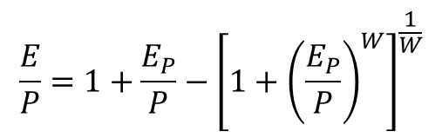
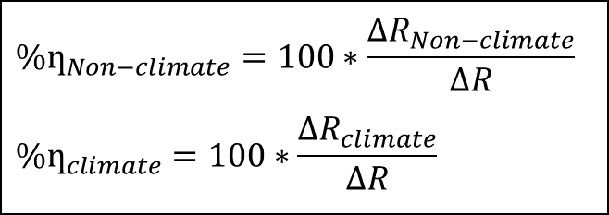
Separating the impacts of climate and Non-Climate on runoff change:
Formulation:
∆R=∆R_{clim}+∆R_{non-climate} Eq(1)
∆R_{clim}= ∆P - ∆ET_{climate}
Eq(2)
Use the Budyko space to find the ET-climate changes.
From data
$${\%ƞ}_{Non−climate}=100∗\frac{{∆R}_{Non−climate}}{∆R}$$
$${\%ƞ}_{climate}=100∗\frac{{∆R}_{climate}}{∆R}$$
Eq(3)
Eq(4)
to this aim Fu function was used.
$$\frac{E}{P}=1+\frac{E_{P}}{P}−{\left[1+{\left(\frac{E_{P}}{P}\right)}^{W}\right]}^{\frac{1}{W}}$$
Fu:
W is an empirical parameter that has not been ascribed a specific physical meaning, but is generally conceptualized as an integrated catchment property that reflects characteristics such as land cover, soil properties, topography and seasonality (Zhang et al., 2004).
Fig 4 : Schematically representation of the parameters of change used along the manuscript describing movement of a basin from Point A to Point B in Budyko space

Slide 9
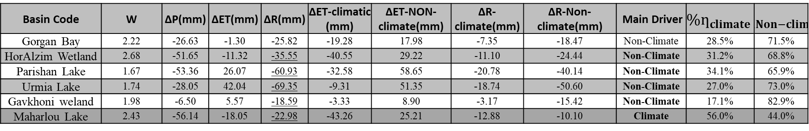
Result :
Table 1 : Distinguishing the main Drivers on Runoff Change ( Climate or Non-Climate)
Basin Code | W | ∆P(mm) | ∆ET(mm) | ∆R(mm) | ∆ET-climatic (mm) | ∆ET-NON-climate(mm) | ∆R-climate(mm) | ∆R-Non-climate(mm) | Main Driver | $${\%ƞ}_{climate}$$ | $${\%ƞ}_{Non−climate}$$
Gorgan Bay | 2.22 | -26.63 | -1.30 | -25.82 | -19.28 | 17.98 | -7.35 | -18.47 | Non-Climate | 28.5% | 71.5%
HorAlzim Wetland | 2.68 | -51.65 | -11.32 | -35.55 | -40.55 | 29.22 | -11.10 | -24.44 | Non-Climate | 31.2% | 68.8%
Parishan Lake | 1.67 | -53.36 | 26.07 | -60.93 | -32.58 | 58.65 | -20.78 | -40.14 | Non-Climate | 34.1% | 65.9%
Urmia Lake | 1.74 | -28.05 | 42.04 | -69.35 | -9.31 | 51.35 | -18.74 | -50.60 | Non-Climate | 27.0% | 73.0%
Gavkhoni weland | 1.98 | -6.50 | 5.57 | -18.59 | -3.33 | 8.90 | -3.17 | -15.42 | Non-Climate | 17.1% | 82.9%
Maharlou Lake | 2.43 | -56.14 | -18.05 | -22.98 | -43.26 | 25.21 | -12.88 | -10.10 | Climate | 56.0% | 44.0%
Fig 5 : Portion od Drivers (climatic and non-climatic) charts on Iran Wetlands.

Slide 10
Conclusion :
5 of 6 wetlands and their upper basin(cases of this study) have experienced decrease.
Main driver of changes is Non-climatic variables.

Slide 11
THANK YOU FOR YOUR ATTENTION.

