Slide 1
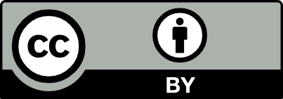
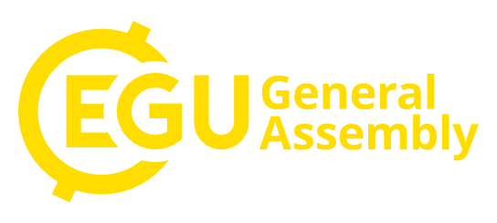
Influence of gravity wave drag parametrisations on the stratospheric circulation of seasonal ICON-NWP experiments
Raphael Köhler, D. Handorf, R. Jaiser, K. Dethloff, G. Zängl, D. Majewski & M. Rex
4th May 2020

Slide 2
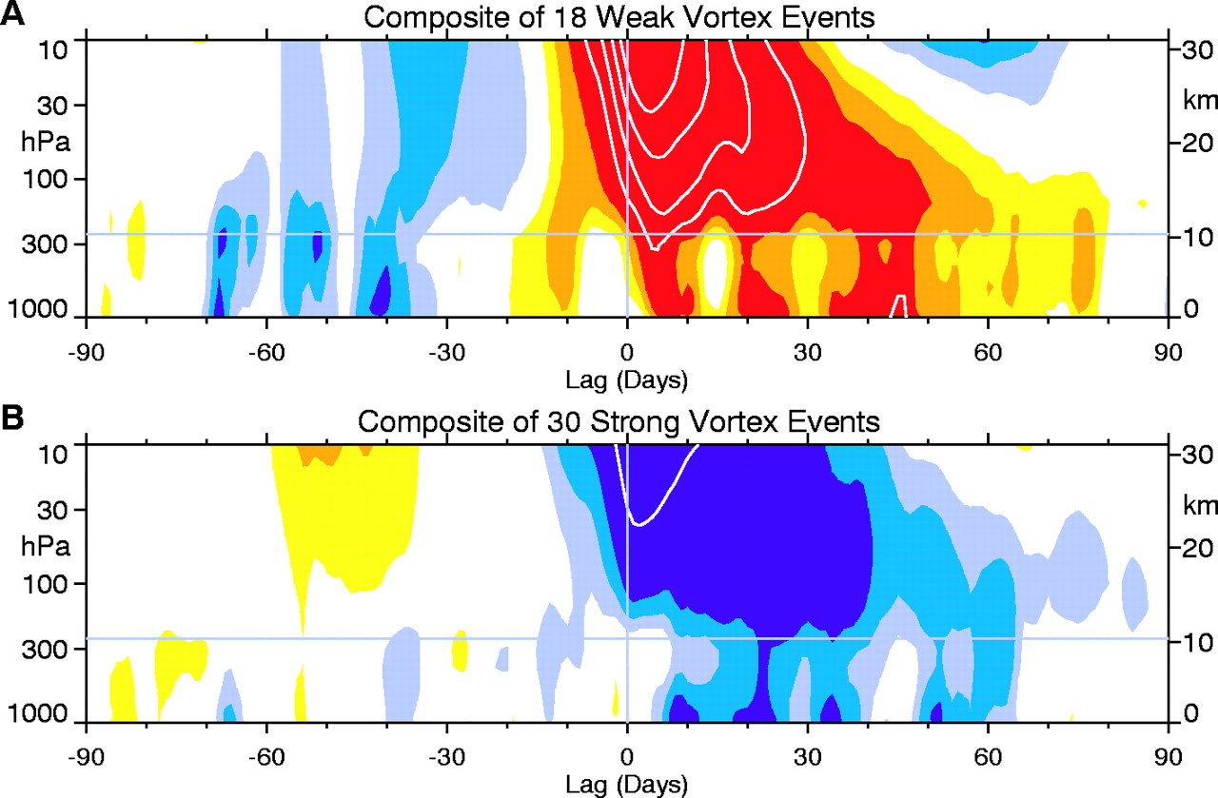
Why the stratosphere?
Composites of time-height development of the northern annular mode for (A) 18 weakvortex events and (B) 30 strong vortex events.
Stratospheric influence
Stratospheric events can influence tropospheric weather patterns up to 80 days after
Seasonal prediction
Accurate simulation of the stratosphere as a potential predictor for the troposphere
Goal of this study
Analyse stratospheric circulation in seasonal ICON-NWP runs Improve strat. circulation by adjusting the gravity wave drag parameteristation
M. P. Baldwin, and T.J. Dunkerton,
Science 2001;294:581-584

Slide 3
ICON-NWP basic setup
ICON-NWP | ICOsahedral Nonhydrostatic model in Numerical Weather Prediction mode
Model version | Icon 2.1.0 (2018)
Seasonal experiments | September - May
Horizontal resolution | R2B5 (~ 79km, T159)
Vertical resolution | 90 model levels up to 75km
Initial / bound. data | ERA-Interim / CMIP6
Simulated years | 1979/80 – 2016/17
Ensemble size | 5 (± 6h & ±12h)
Results are compared to ERA-Interim reanalysis

Slide 4
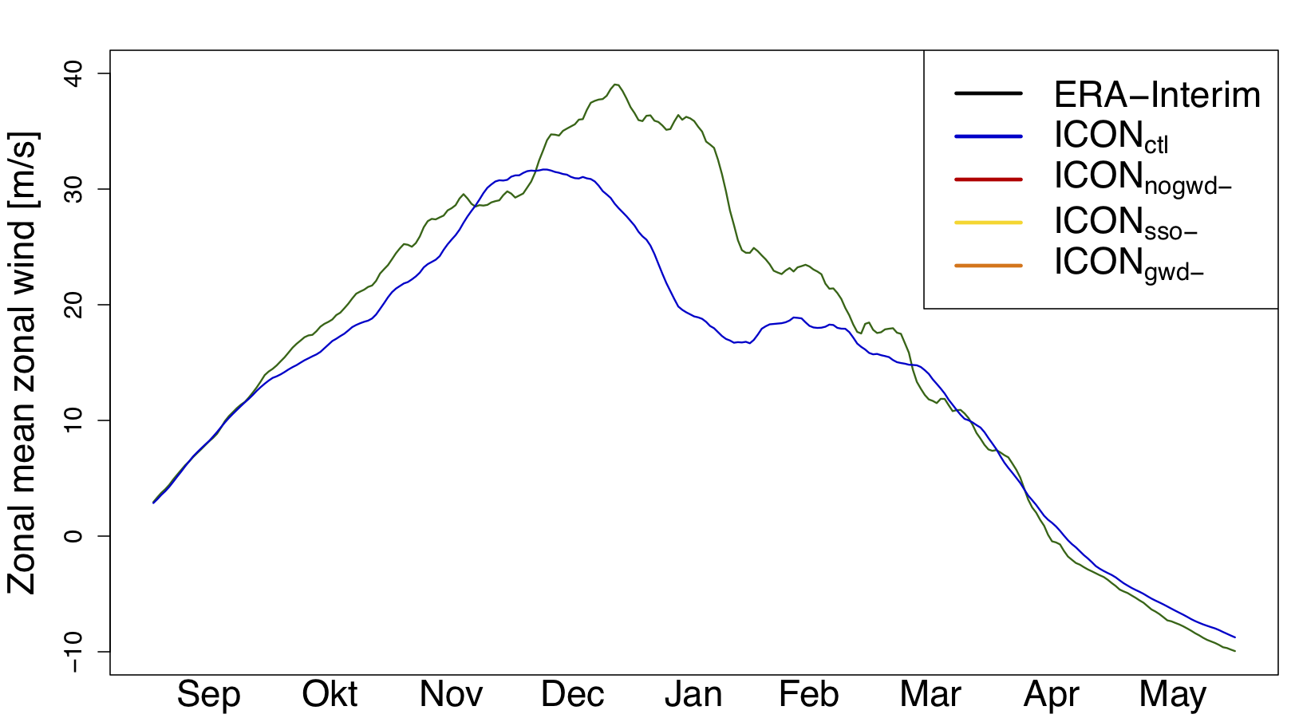
Stratospheric polar vortex
Zonal mean zonal wind @ 60°N
Polar vortex variability and extreme values well represented in ICON
Vortex strength in winter is strongly underestimated by ICON

Slide 5
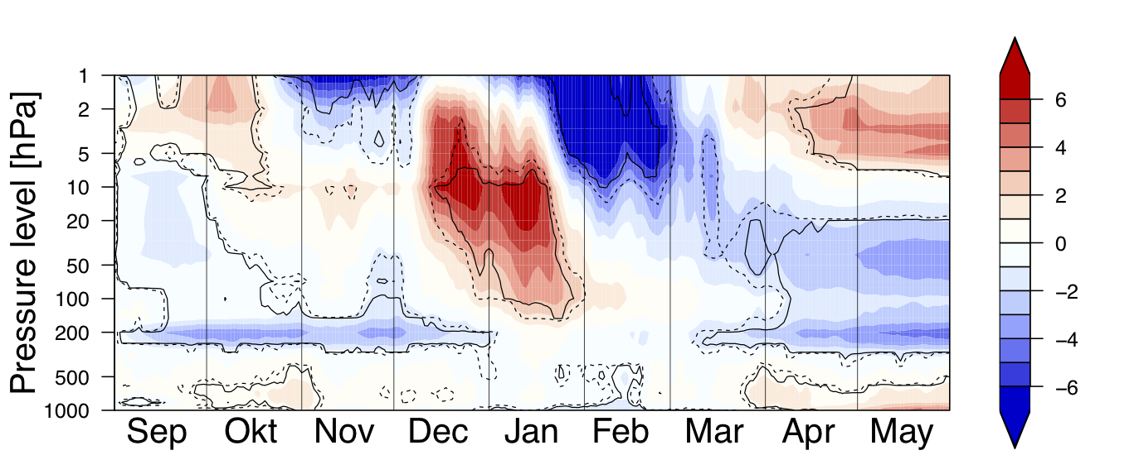
Polar Atmosphere: ICON – ERA-Interim
[K]
Polar cap mean
temperature diff.
ICON: Significant positive temperature and negative wind bias in the stratosphere of the high latitudes in winter
Connected to a
strongly overestimated amount of major stratospheric warmings

Slide 6
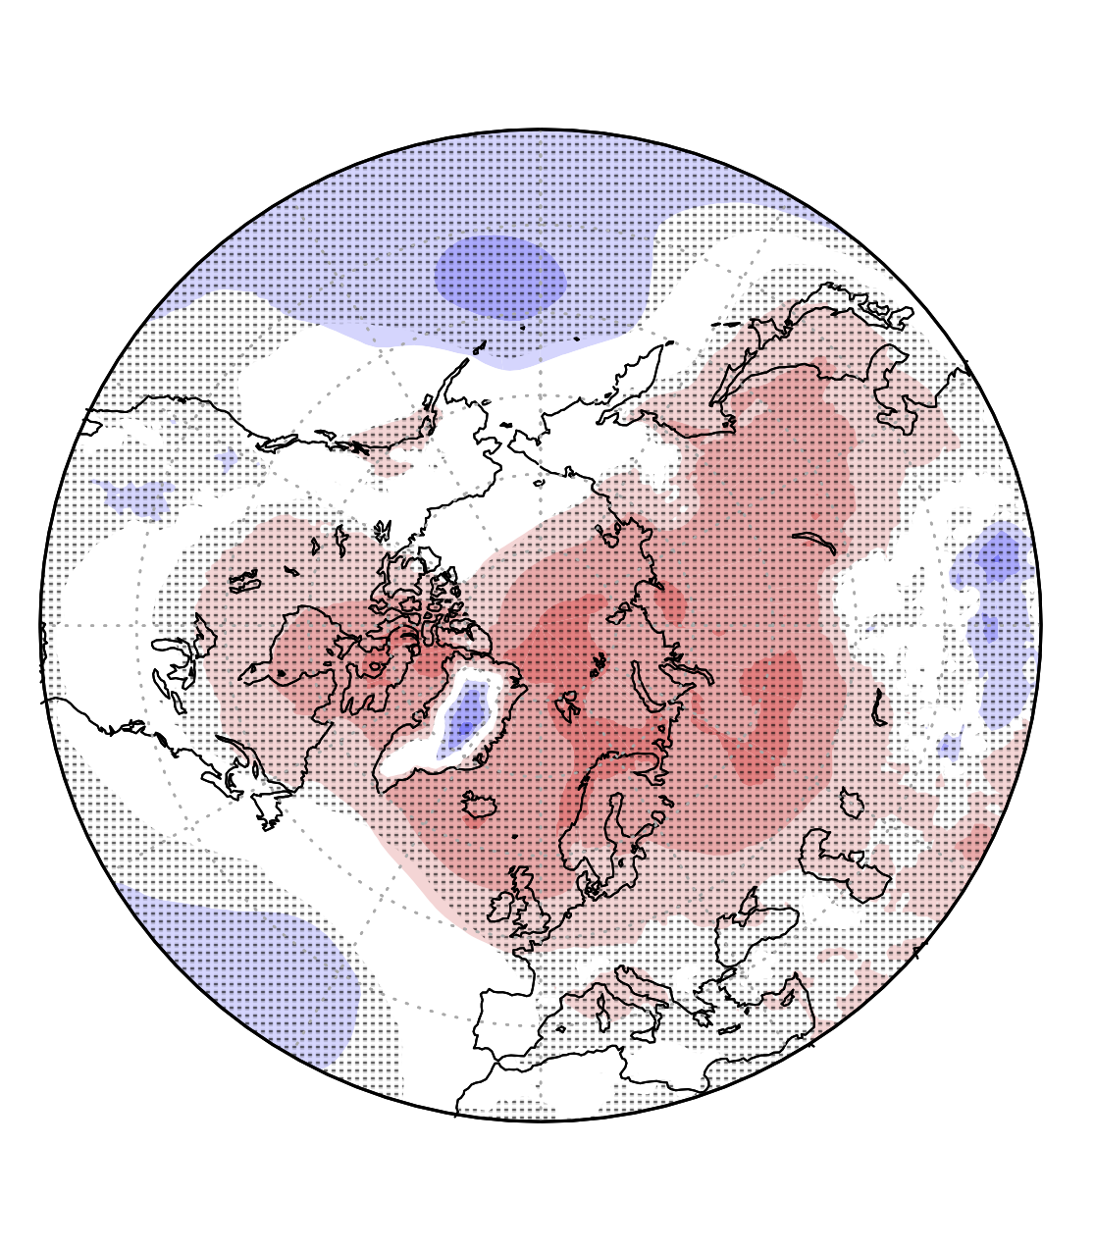
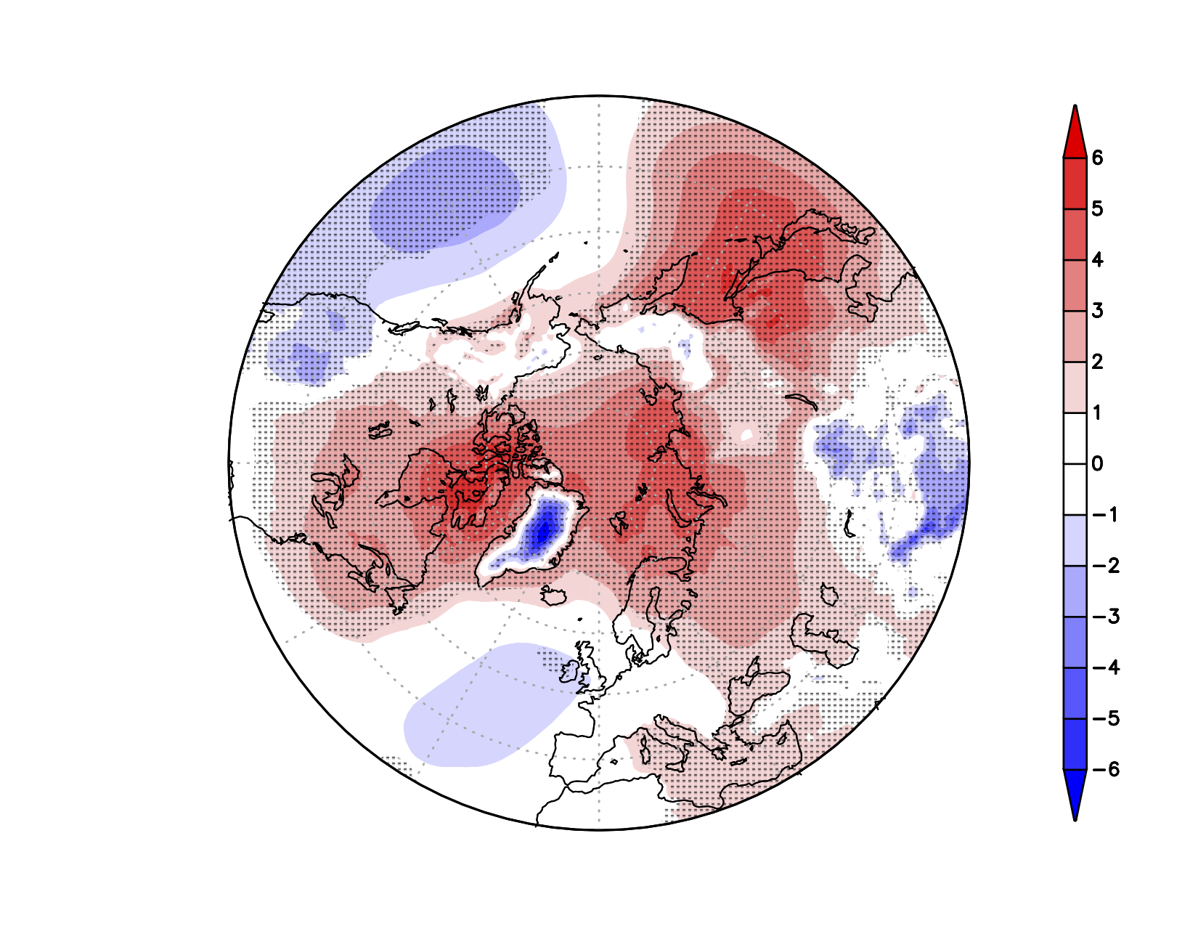
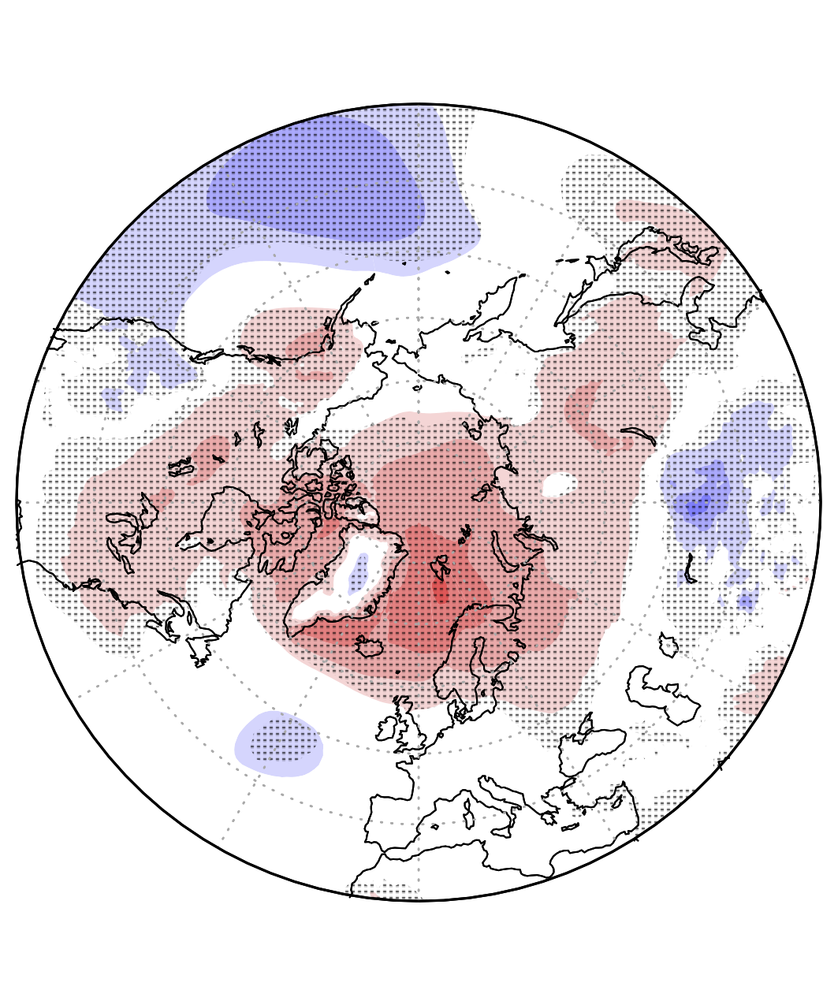
ICON vs. ERA-Interim: MSLP
SON
DJF
MAM
Mean sea level pressure bias
[hPa]
Weak polar vortex connected to a tendency towards the negative phase of the Arctic Oscillation with high pressure bias in high latitudes and low pressure bias in lower latitudes
MSLP bias especially large in winter
Similar results found for ICON-A
(see Crueger et al. 2018)

Slide 7
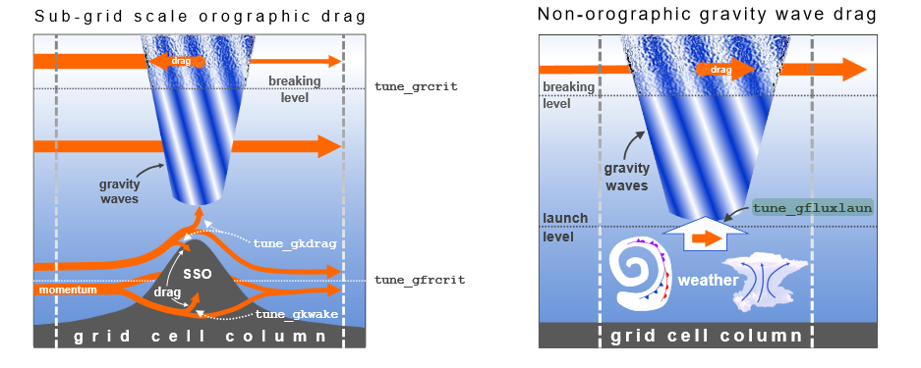
Gravity Wave Drag (GWD) experiments
ICON_{ctl}
Deafault GWD
ICON_{nogwd-}
Reduced non-orographic GWD
F. Prill, D. Reinert, D. Rieger, G. Zängl (2019),
ICON Model Tutorial, April 2019, Working with the ICON Model
Practical Exercises for NWP Mode and ICON-ART
ICON_{sso-}
Reduced orographic GWD
Tuned SSO scheme
Experiment | tune_gfluxlaun | tune_gkwake | tune_gkdrag | tune_gfrcrit
ICON_{ctl} | 2.5mPa | 1.5 | 0.075 | 0.4
ICON_{nogwd-} | 2mPa | 1.5 | 0.075 | 0.4
ICON_{sso-} | 2.5mPa | 1.2 | 0.06 | 0.5
ICON_{gwd-} | 2mPa | 1.2 | 0.06 | 0.5
ICON_{gwd-}
Overall reduced GWD
Combines ICON_{nogwd-} with ICON_{sso-}
2mPa
1.2
0.06
0.5
2mPa
1.2
0.06
0.5

Slide 8
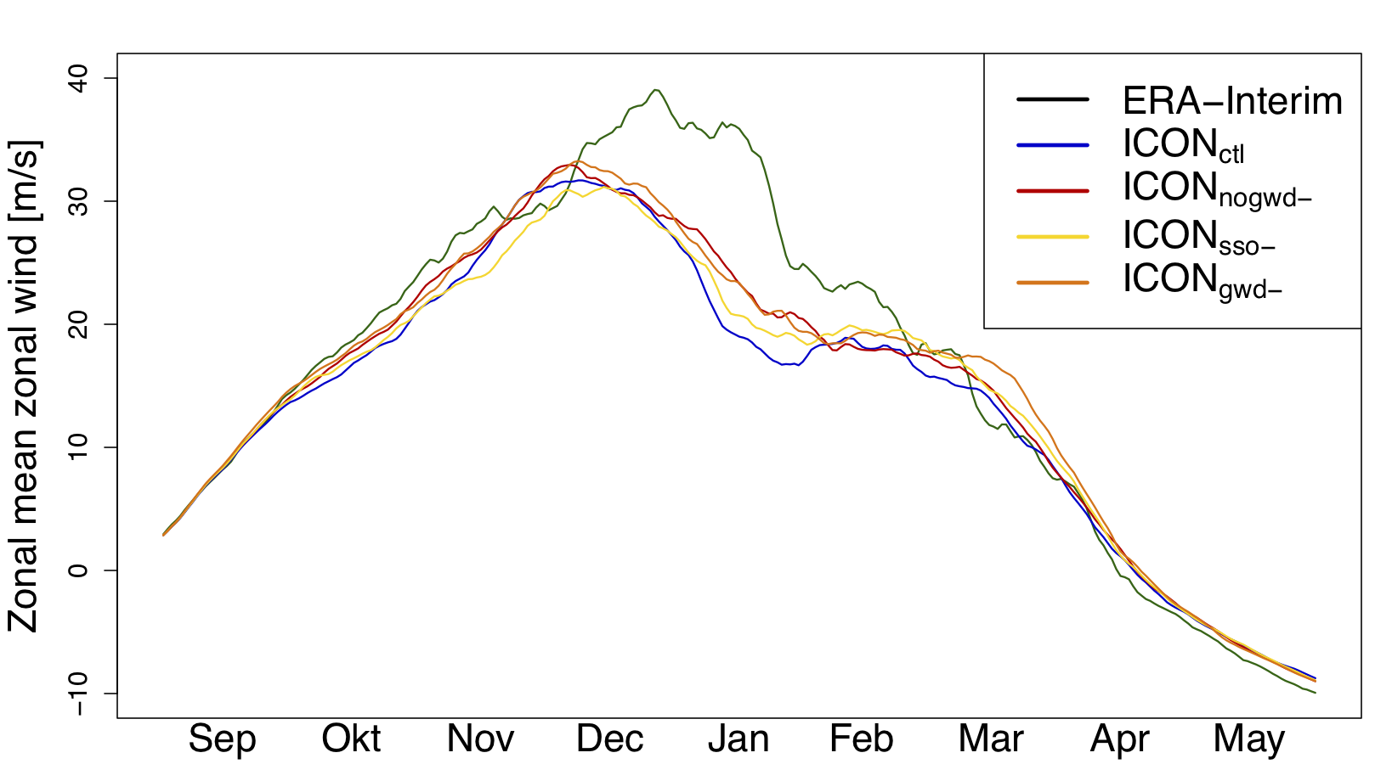
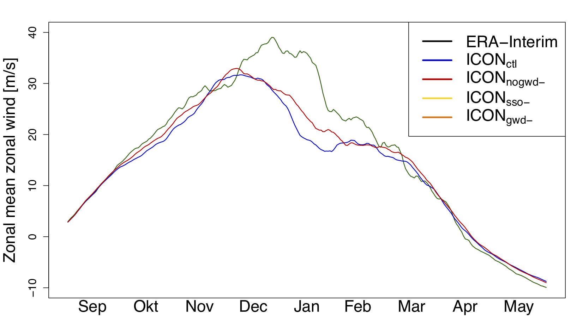
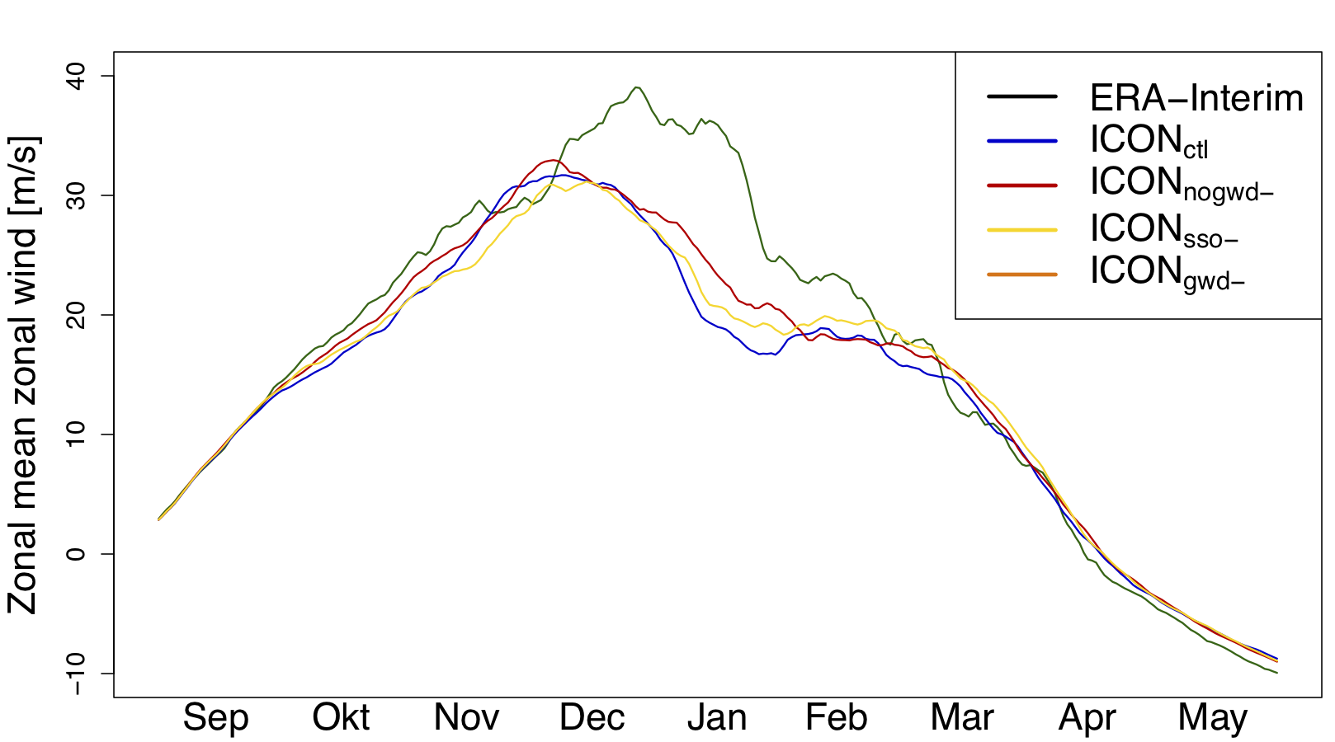
Effect on stratospheric polar vortex
Zonal mean zonal wind @ 60°N
All GWD reductions lead to a strengthening of the stratospheric polar vortex in winter
Effect of non-orographic GWD is stronger

Slide 9
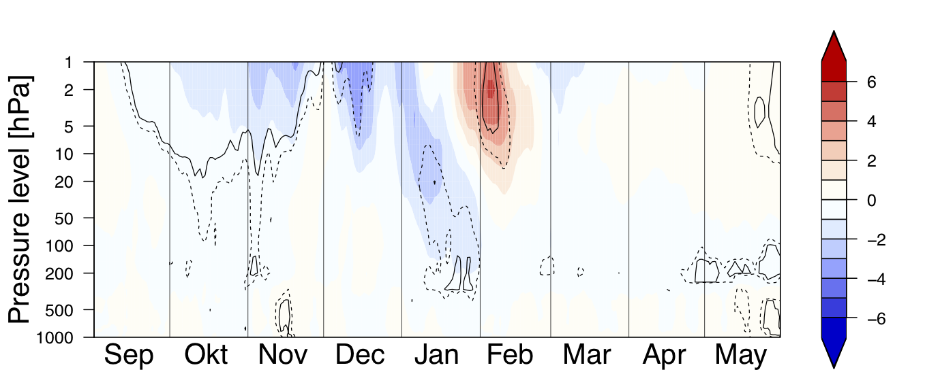
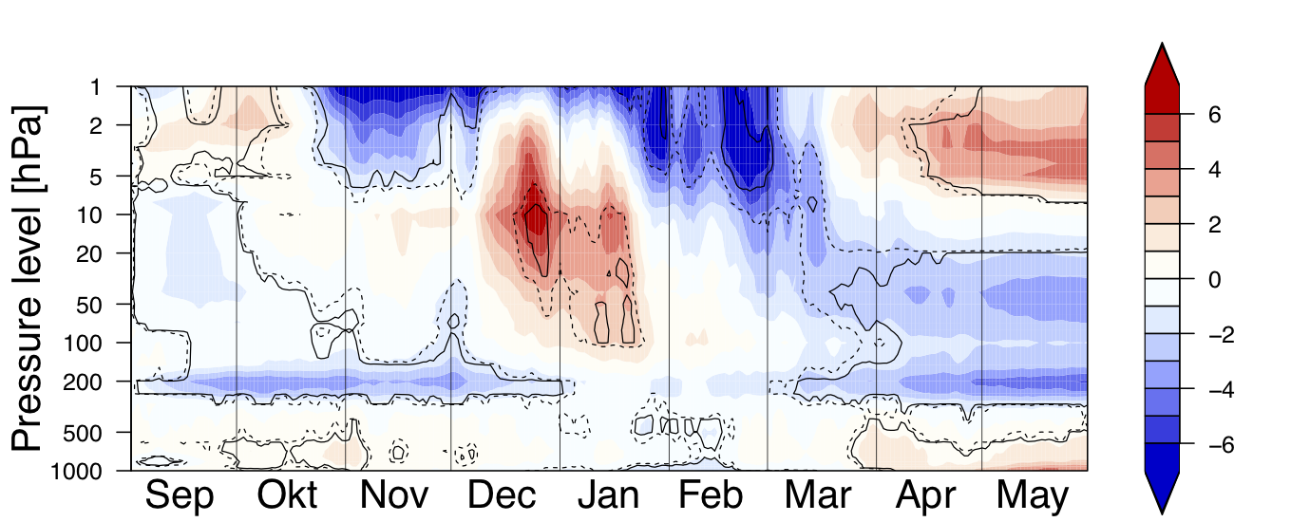
Effect of non-orographic GWD
ICON_{nogwd-}
-
ICON_{ctl}
[K]
Polar cap mean zonal wind diff.
Strong strat. bias reduction, especially in January
ICON_{ctl}
-
ERA-Interim
ICON_{nogwd-}
-
ERA-Interim
[K]

Slide 10
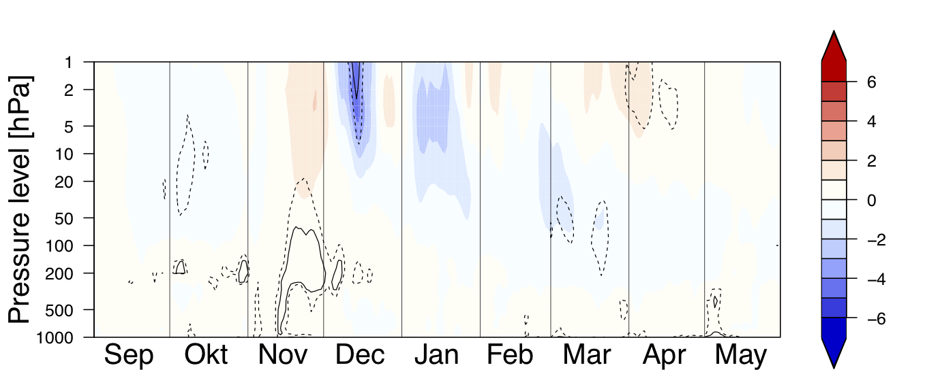
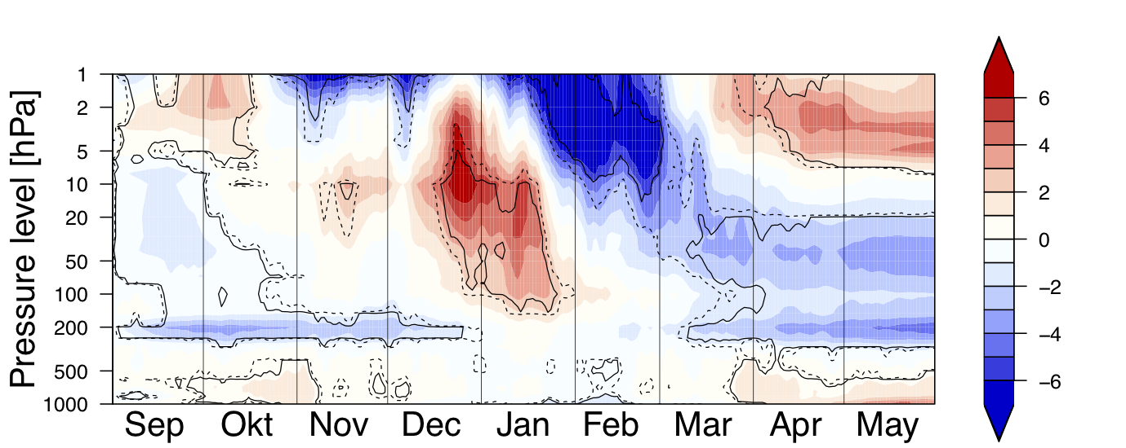
Effect of SSO-scheme
ICON_{SSO}
-
ICON_{ctl}
[K]
Polar cap mean zonal wind diff.
Weak strat. bias reduction
ICON_{ctl}
-
ERA-Interim
ICON_{SSO}
-
ERA-Interim
[K]

Slide 11
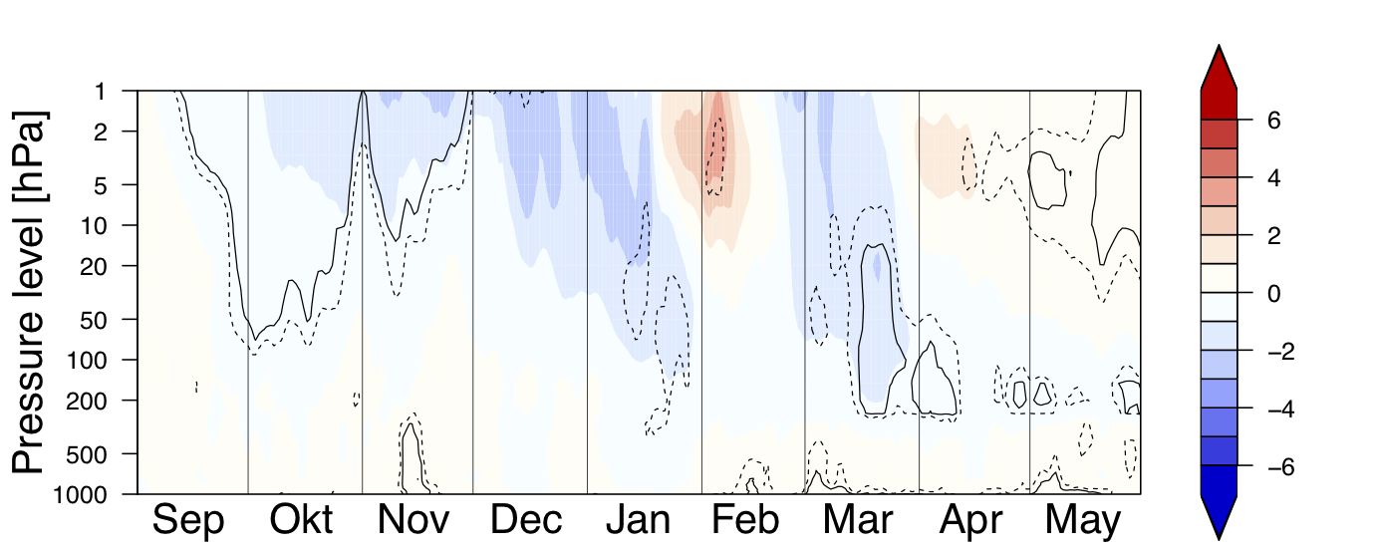
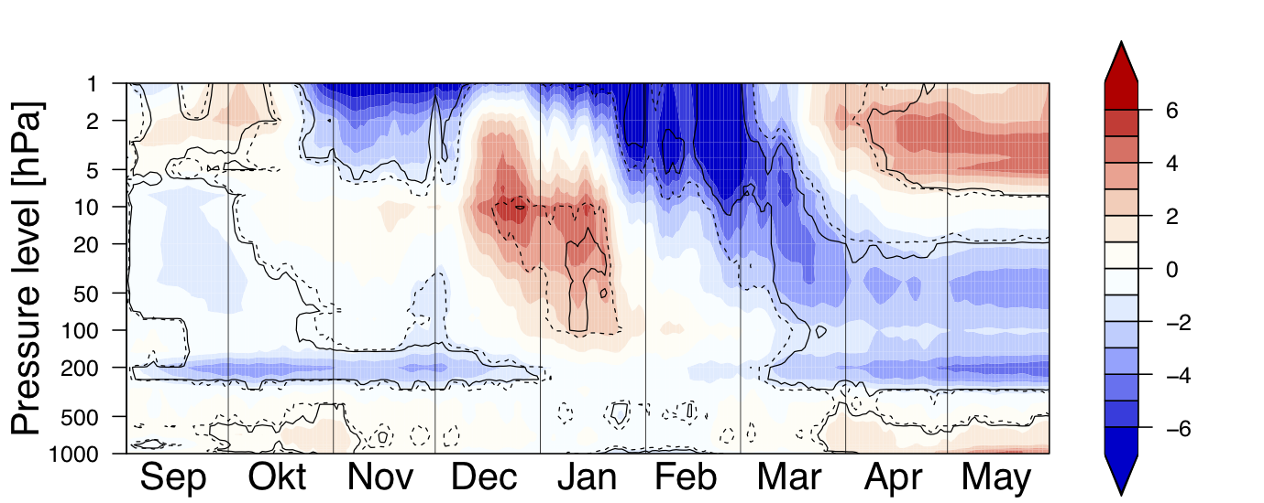
Combined GWD effect (SSO + non-oro.)
ICON_{gwd-}
-
ICON_{ctl}
[K]
Polar cap mean zonal wind diff.
Strong strat. bias reduction, especially in January
ICON_{gwd-}
-
ERA-Interim
ICON_{ctl}
-
ERA-Interim
[K]

Slide 12
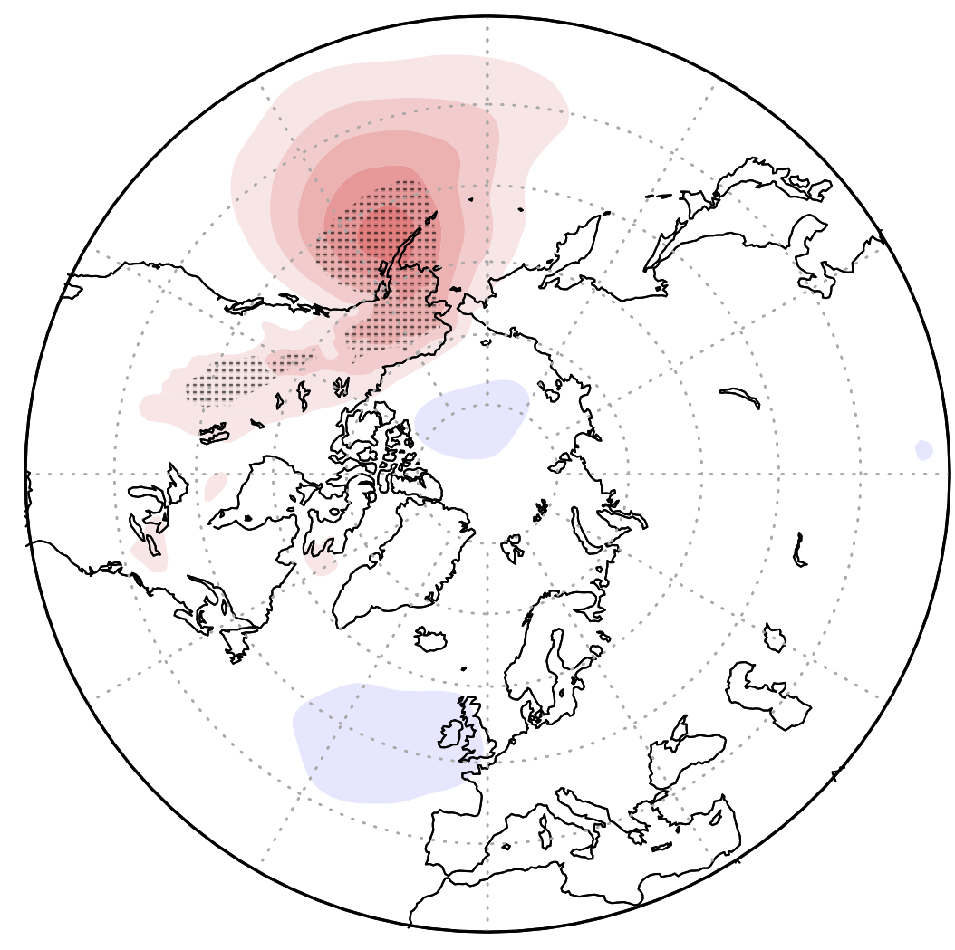
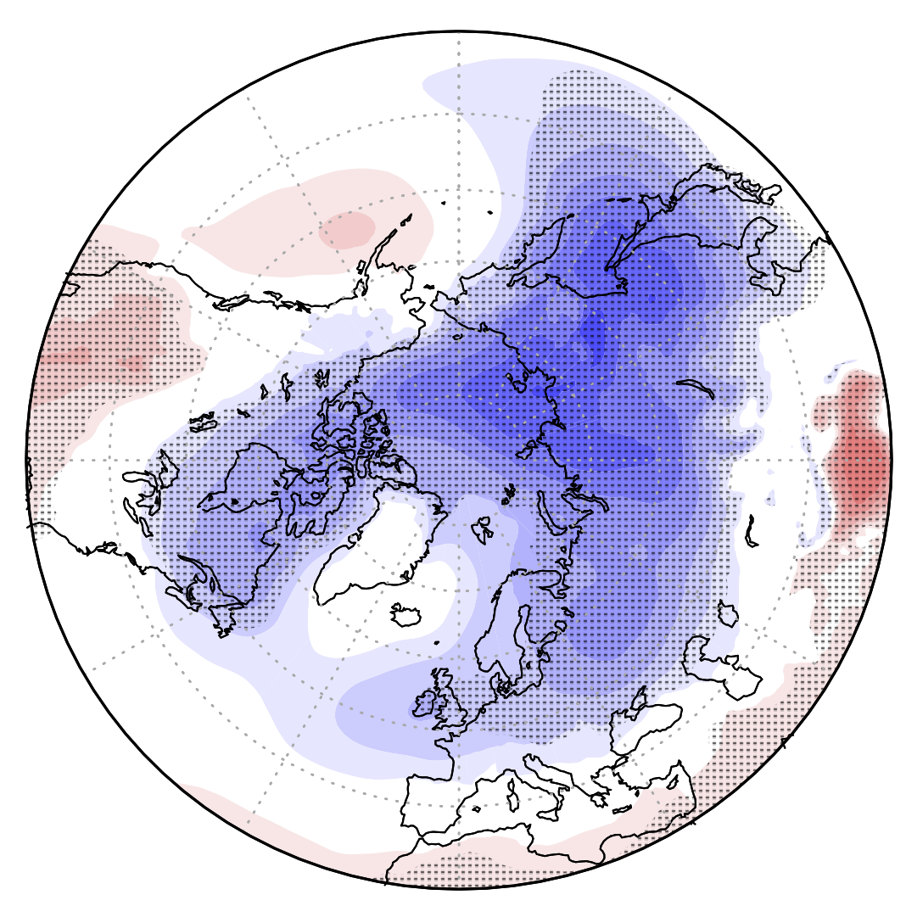
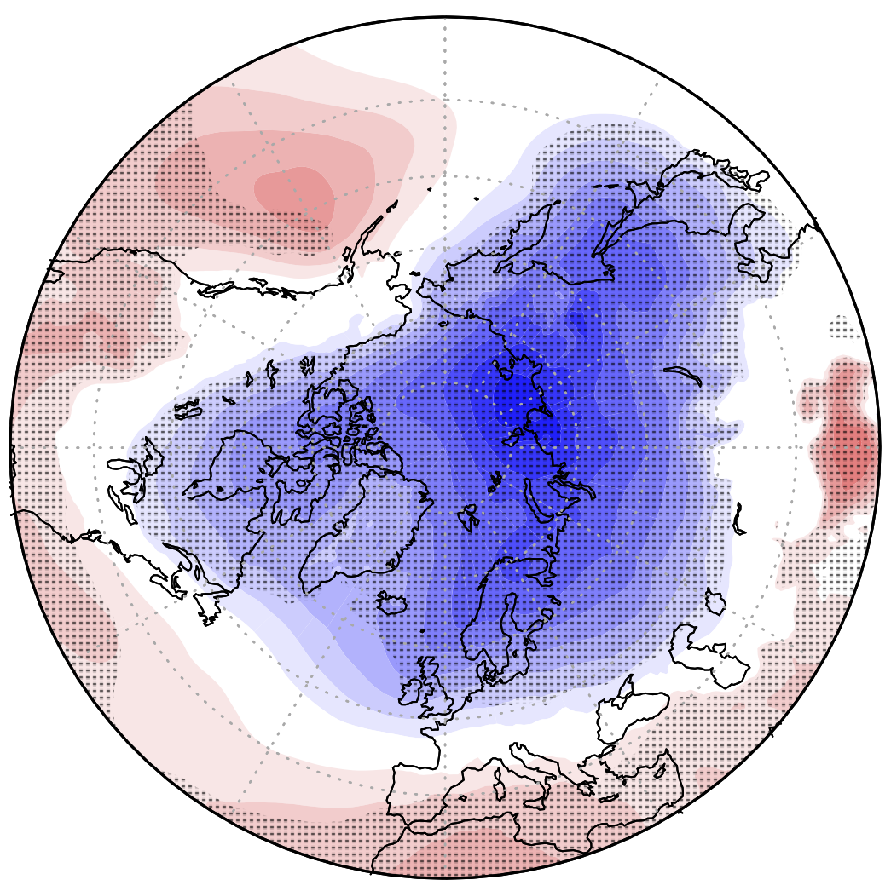
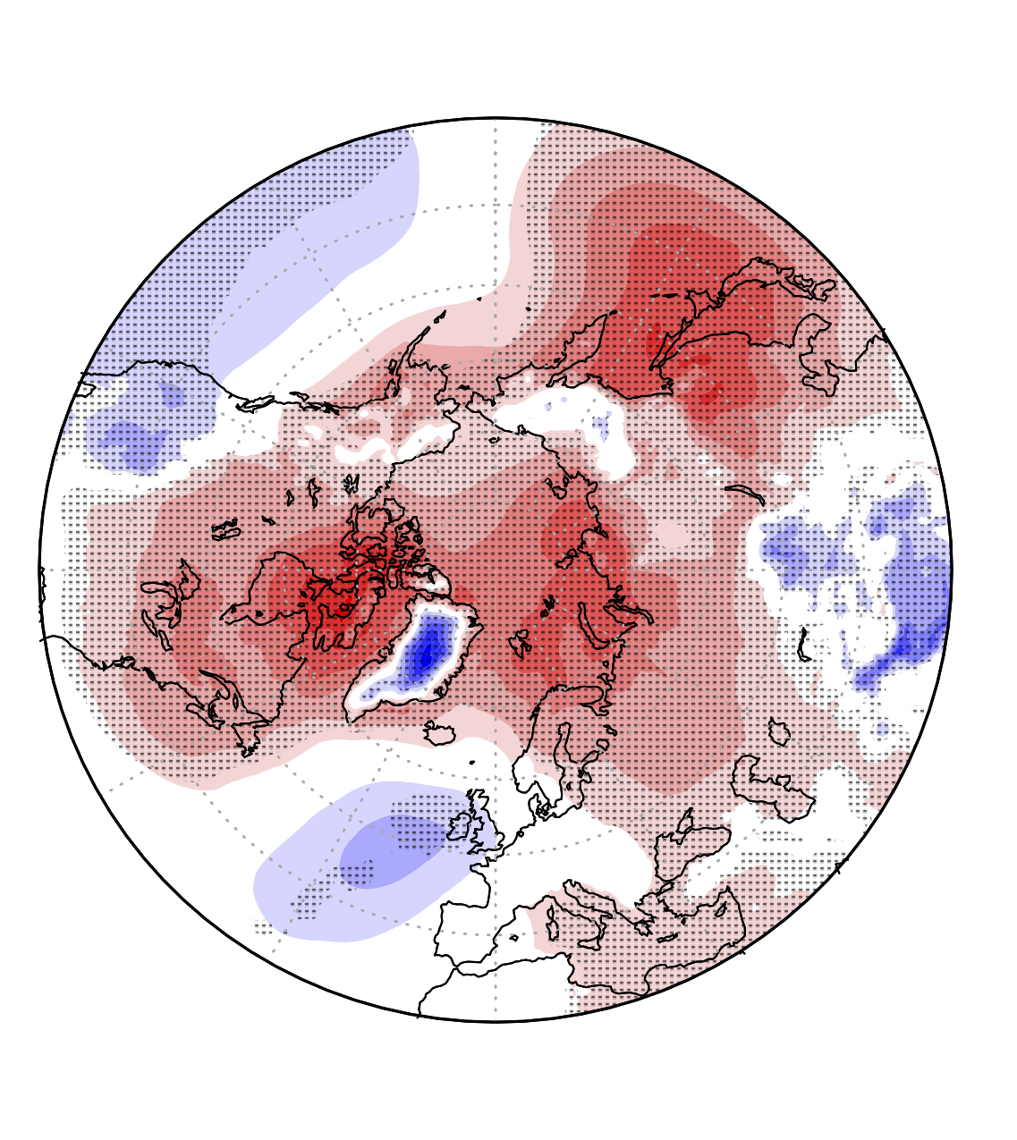
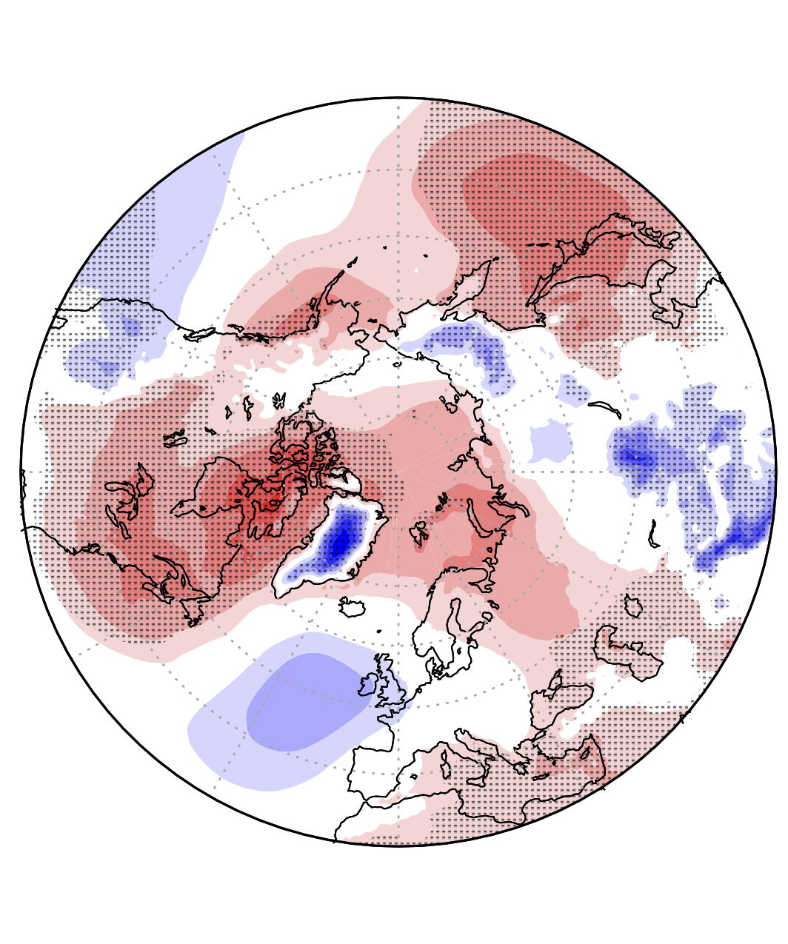
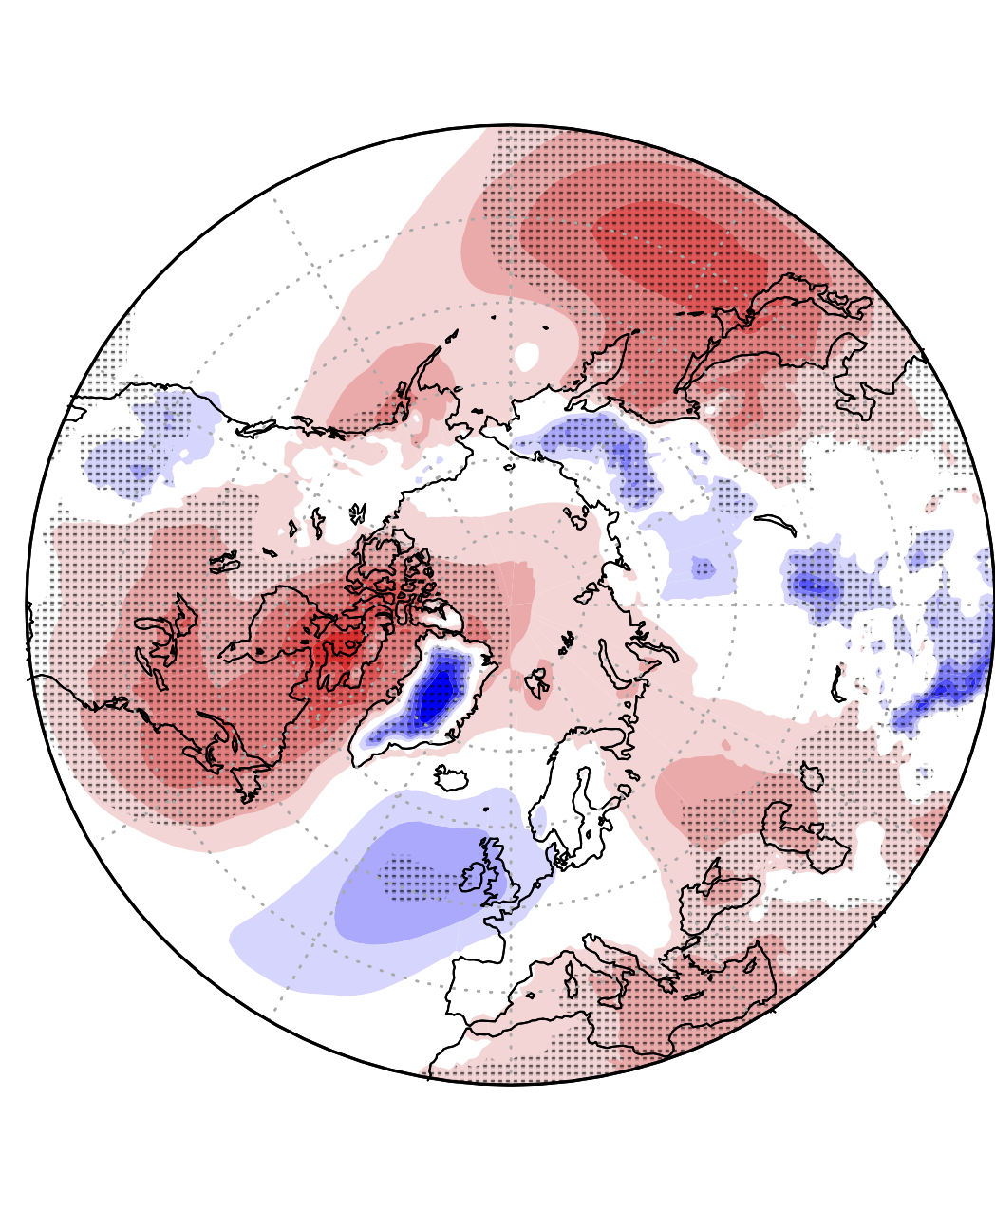
Effect on MSLP bias in winter
ICON_{ctl}
ICON_{nogwd-}
ICON_{SSO}
ICON_{gwd-}
Sensitivity - Control
[hPa]
ICON –ERA-Interim

Slide 13
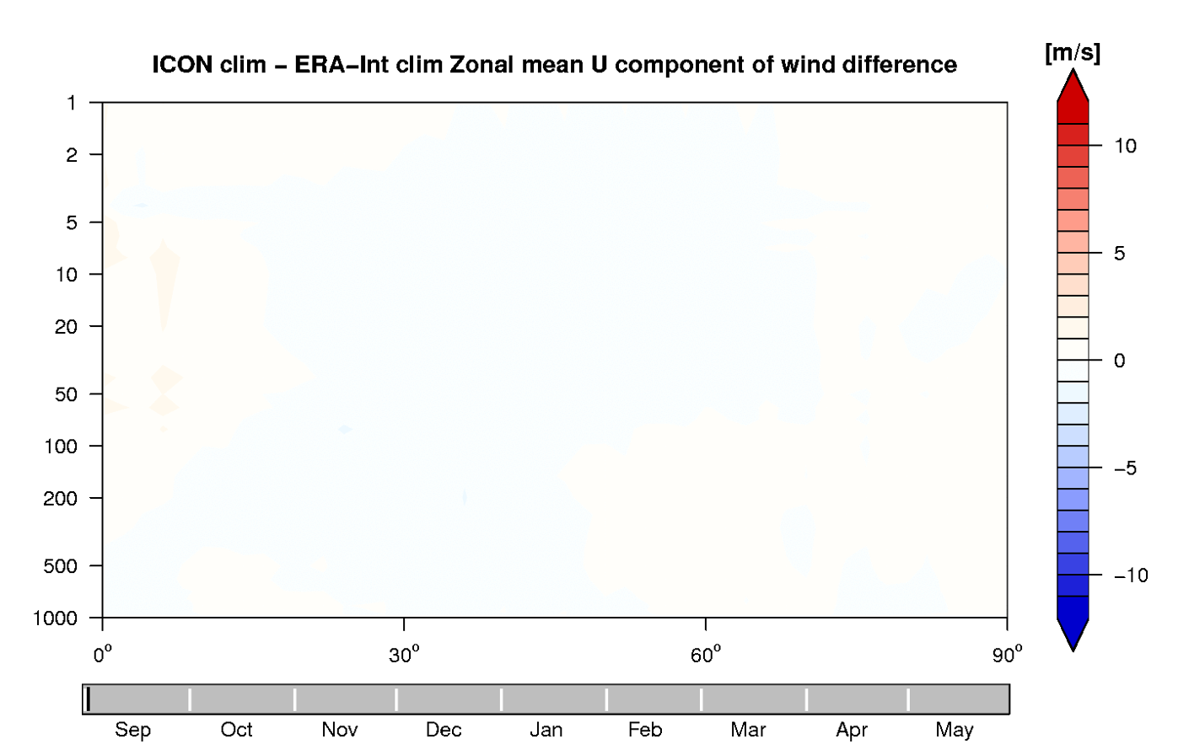
A further source for the weak polar vortex?
ICON_{ctl} – ERA-Interim zonal mean zonal wind

Slide 14
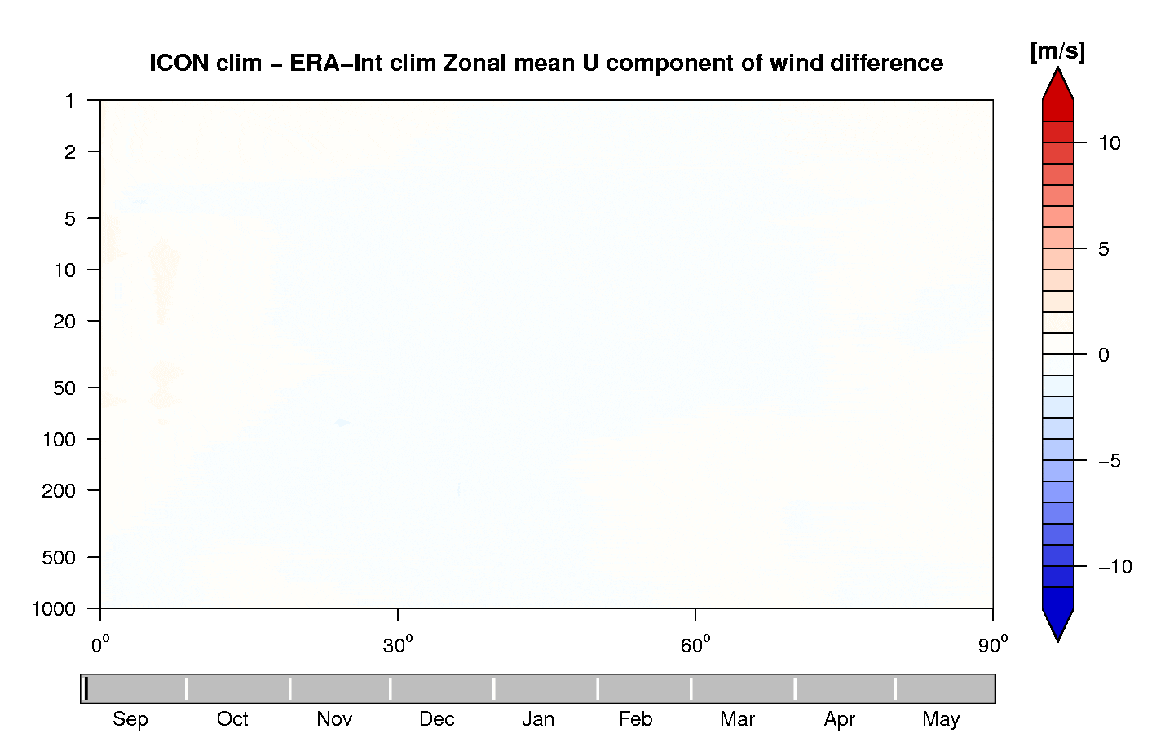
A further source for the weak polar vortex?
ICON_{ctl} – ERA-Interim zonal mean zonal wind
Large negative zonal wind bias in tropical stratosphere in Autumn
Negative bias travels north in Nov. - Dec
Bias reaches the polar vortex & leads to a weakening of it in January
Signal weakens & slowly propagates downward in late winter and spring

Slide 15
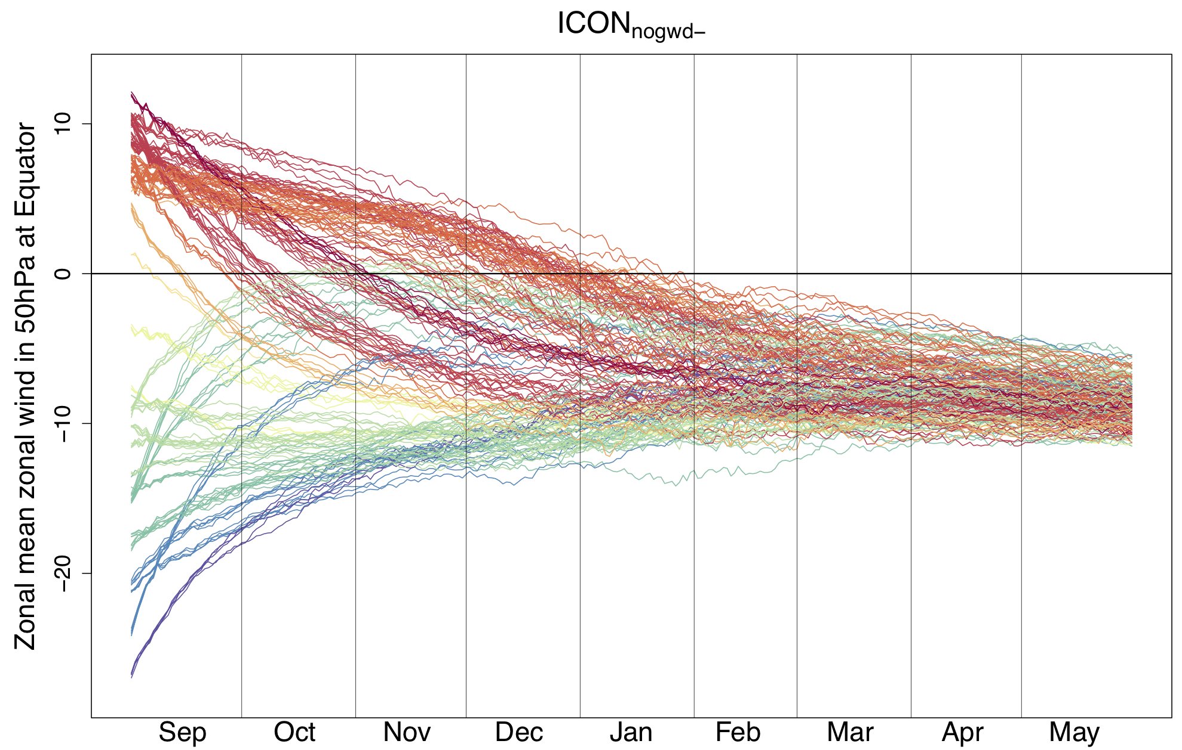
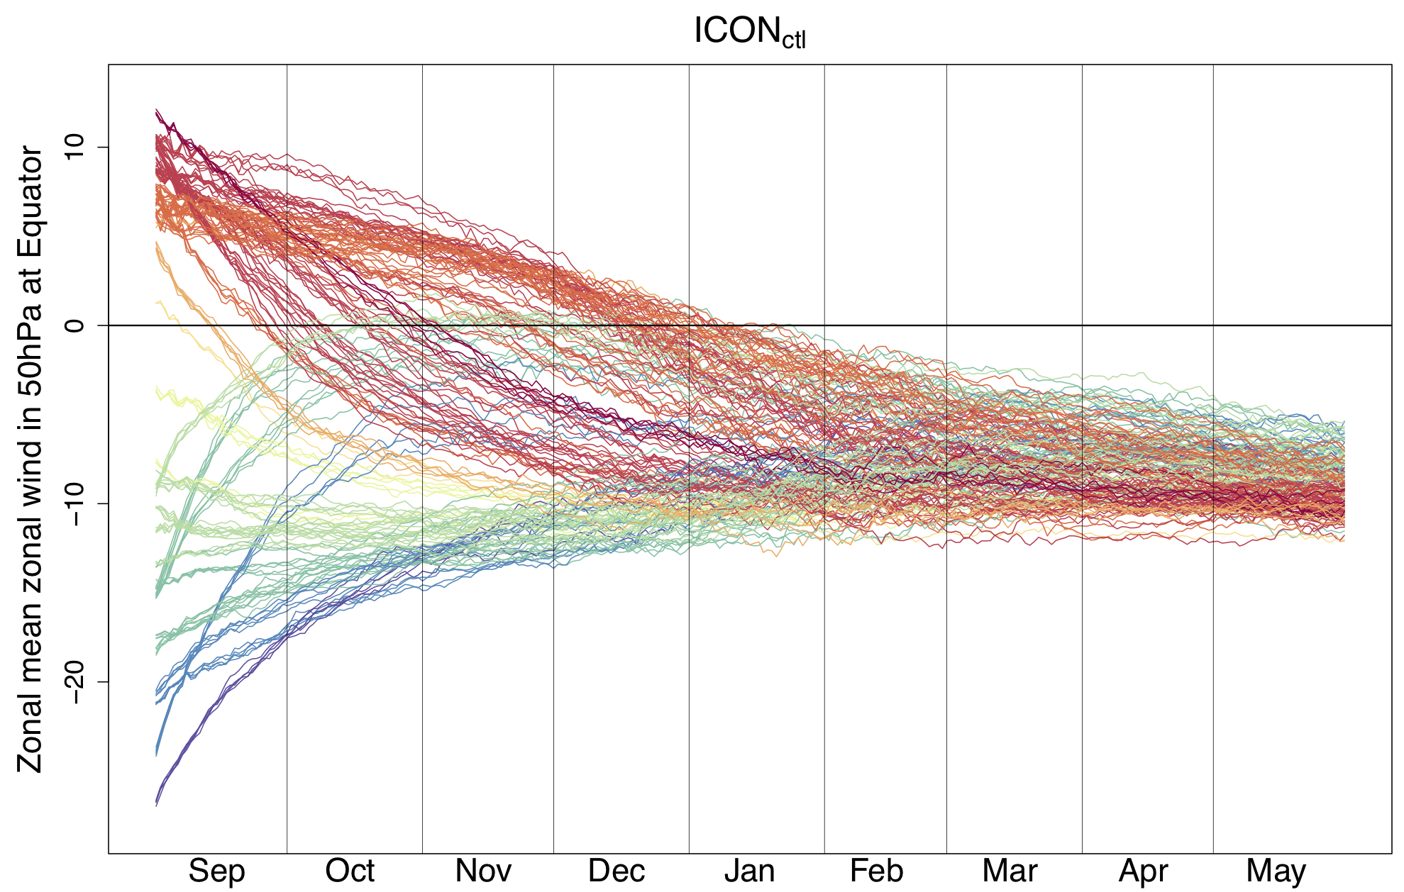
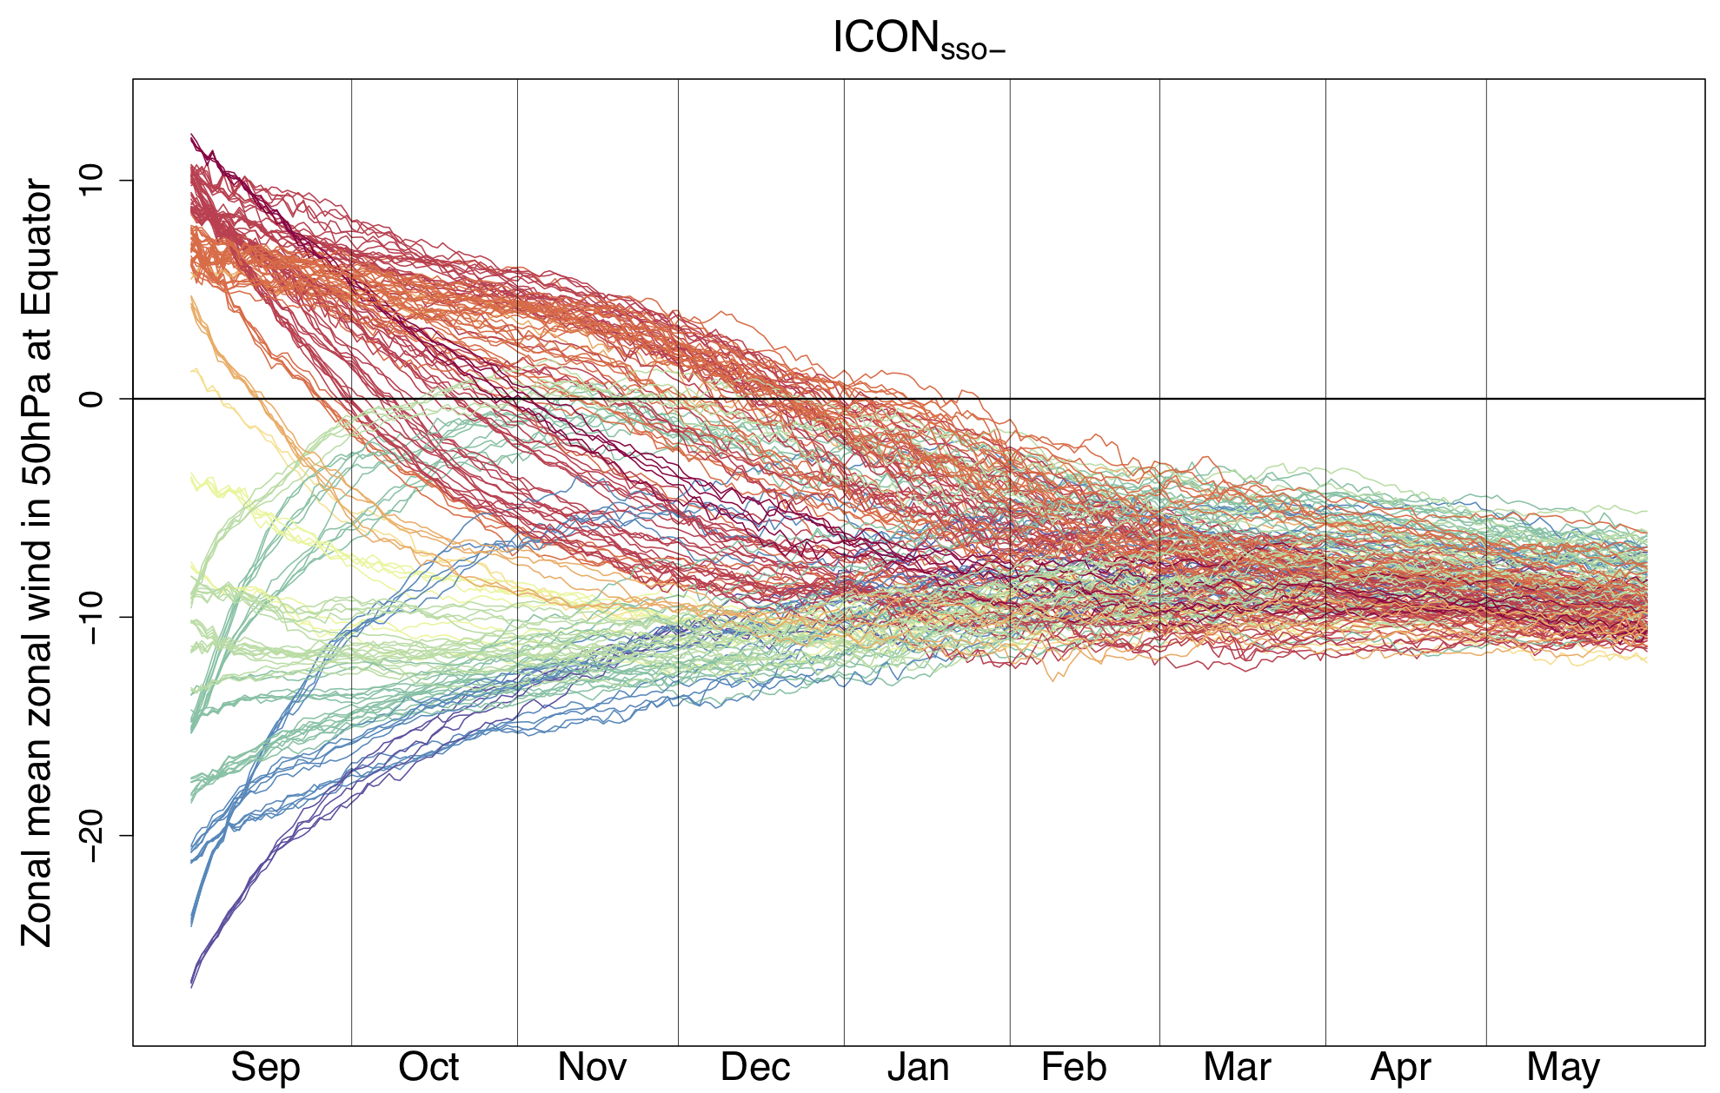
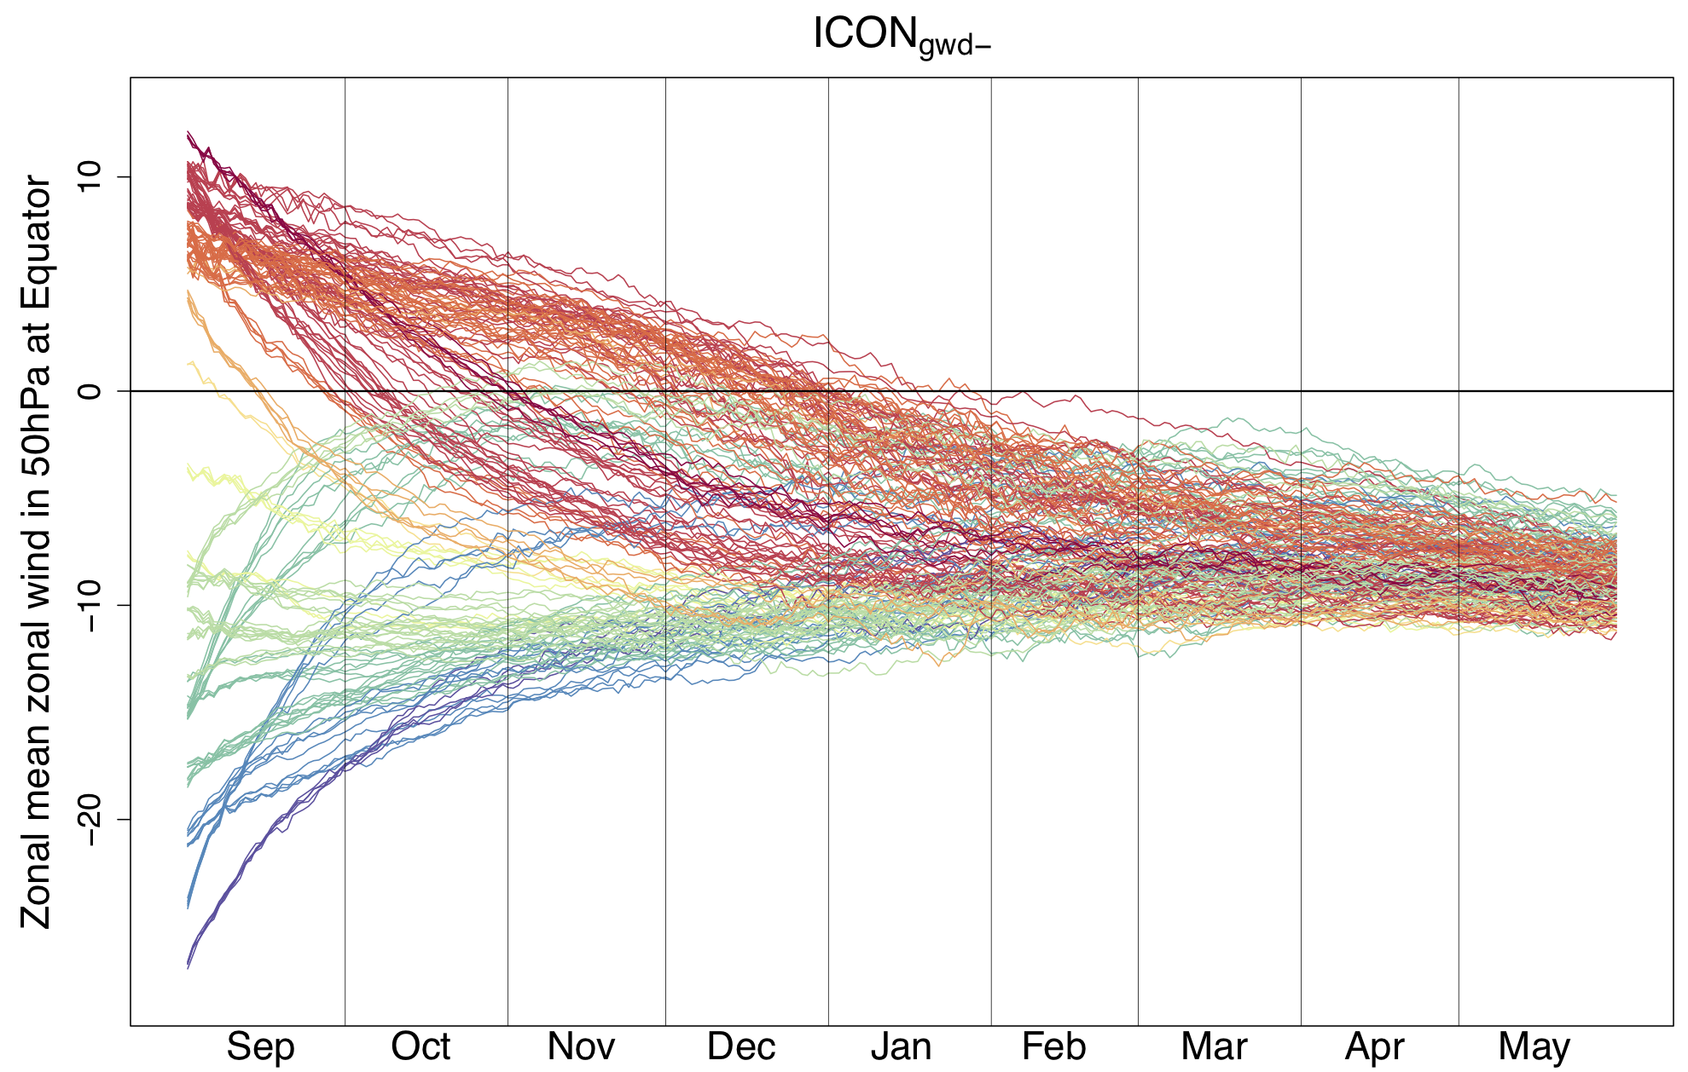
QBO in ICON?
ICON does not simulate the quasi-biennial oscillation (QBO)
No effect of GWD-parameterisation on QBO behavior
Easterlies in tropical Stratosphere could disturb the polar vortex

Slide 16
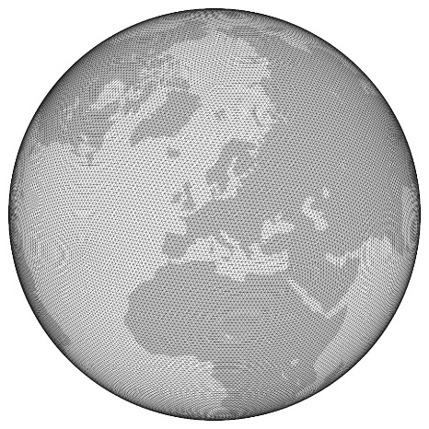
Conclusion
Effect MSLP DJF
Strat.-trop. coupling
Reduced n.-o. GWD
No QBO
ICON_{nogwd-}
No QBO
H
Reduced GWD (NOGWD + SSO)
ICON_{gwd-}
L
No QBO
Reduced SSO
Effect MSLP DJF
Effect MSLP DJF
ICON_{ctl}
No QBO
ICON_{sso}

Slide 17
Please contact me at Raphael.Koehler@awi.de for further information.

