Slide 1
An experiment of determining the geopotential difference using two hydrogen atomic clocks
Kuangchao Wu, Wen-Bin Shen*，Ziyu Shen, Chenghui Cai, Xiao Sun, An Ning，Yifan Wu
Wuhan University
Email: wbshen@sgg.whu.edu.cn
1

Slide 2
Contents
Introduction
Method
Experiments
Data Analysis
Discussion
2

Slide 3
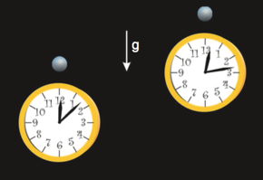
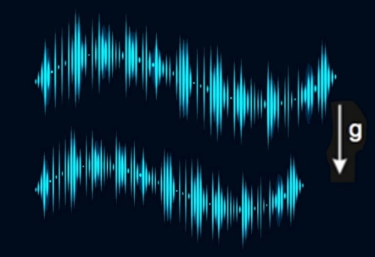
Introduction
Background
(Cited from BaiDu)
(Cited from BaiDu)
(Nathan et al. 2018)
Fig. 1 The principle of clock measurement for geopotential difference determination (Modified from Muller et al. (2018)).
3

Slide 4
Introduction
Theory
Background
ΔHAB
10⁻¹³
10⁻¹⁷
10⁻¹⁸
10⁻¹⁷
10⁻¹⁸
1979
2008
2013
2018
2024
GP-A
（ Satellite ）
ACES
（Satellite）
STE-QUEST
（ Satellite ）
（laboratory）
（laboratory）
4

Slide 5
Contents
Introduction
Method
Experiments
Data Analysis
Discussion
5

Slide 6
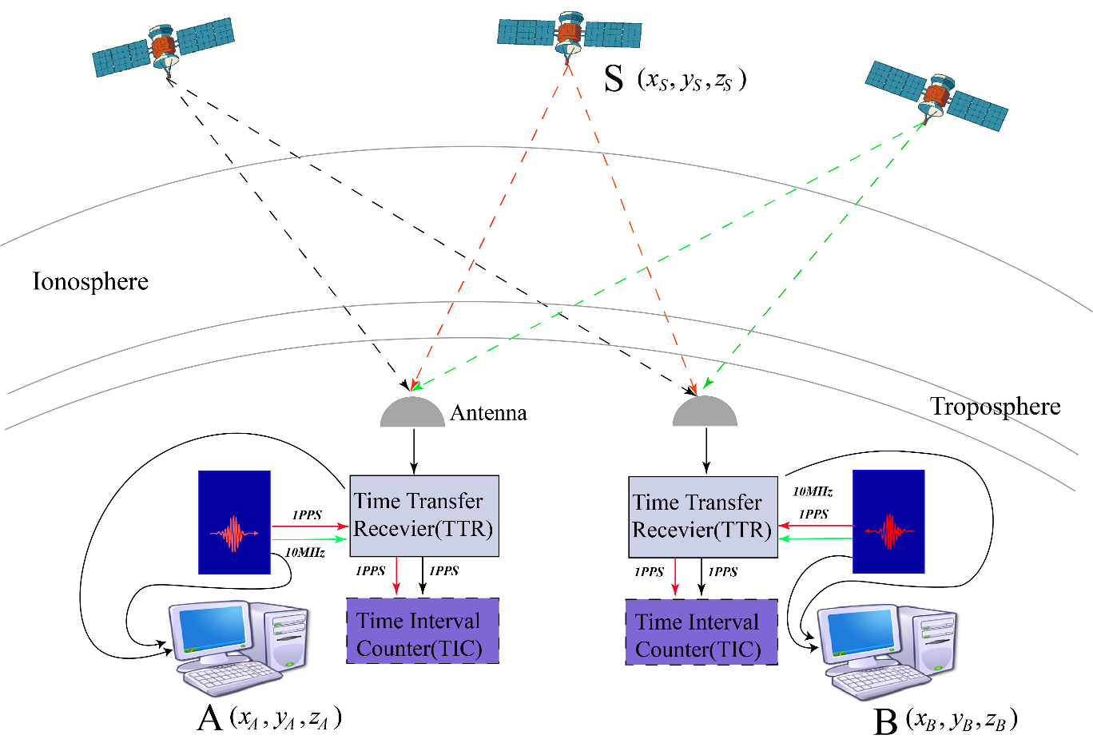
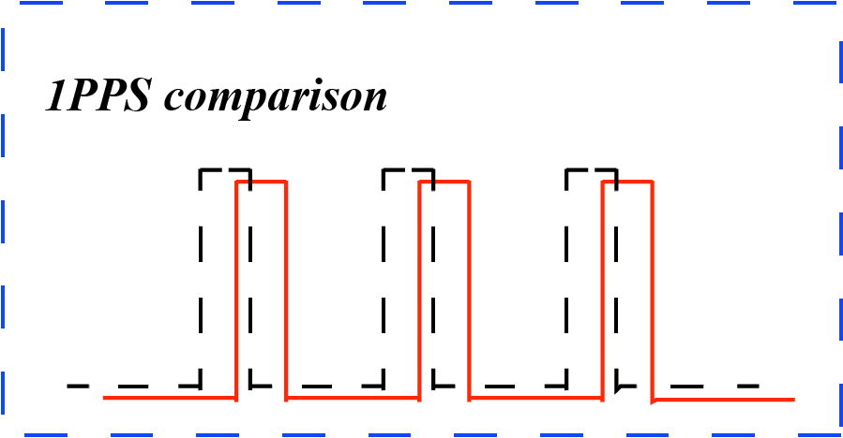
Method
CVSTT principle
Fig. 2 The schematic diagram of the CVSTT technique. The GNSS receiver receive 1PPS (1 pulse per second) signals from atomic clocks and the satellites. Then the 1PPS signals were compared in the TIC (Time Interval Counter).
6

Slide 7
Method
Error sources
Clock error :
Intrinsic properties
Satellite Position error
Ionospheric effect
Tropospheric effect
Sagnac effect
Cable delay
Propagation
error
:
Temperature
Humidity
Electromagnetic field
Noise
Environmental
influence
:
7

Slide 8
Contents
Introduction
Method
Experiments
Data Analysis
Discussion
8

Slide 9
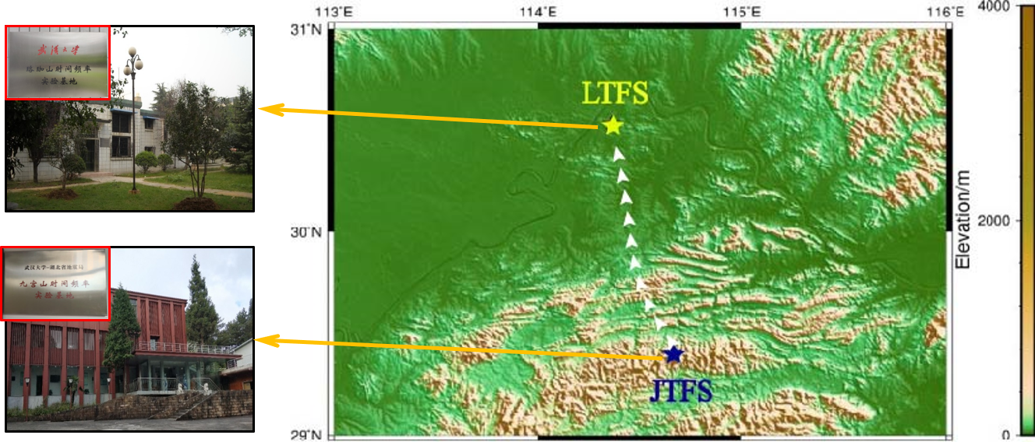
Experiments
Basic information
Fig.3 The distribution of the two stations JTFS and LTFS. In the experiment, the clock was transported from JTFS to LTFS. The two stations are about 240 km away. The orthometric heights of JTFS and LTFS are 1265.15 m and 35.51 m, respectively.
9

Slide 10
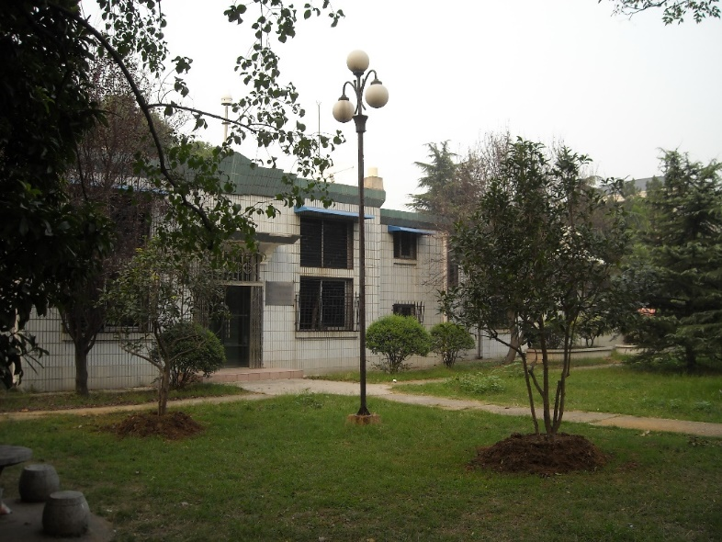
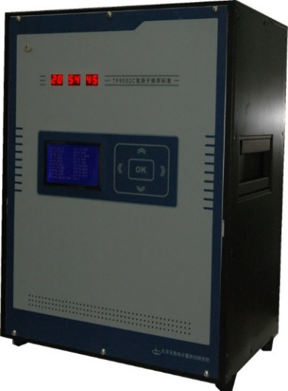
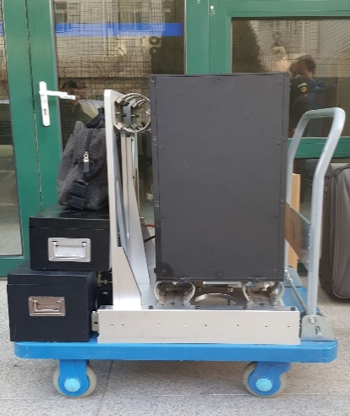
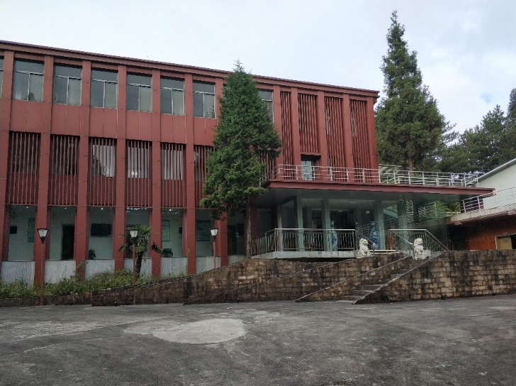
Experiments
Basic information
LTFS
JTFS
10

Slide 11
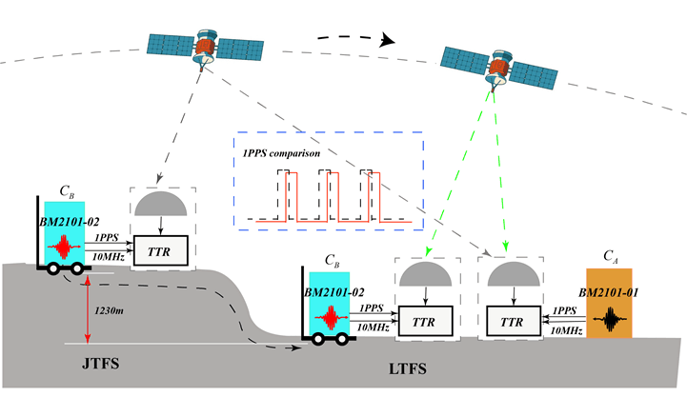
Experiments
Experimental program
Fig. 4 The experiment process in the experiment. The clock C_{B} was transported to LTFS from JGFS after geopotential difference measurement. And the two stations are around 240 km away. The OH difference of clocks' locations of JTFS and LTFS is about 1230 m.
11

Slide 12
Contents
Introduction
Method
Experiments
Data Analysis
Discussion
12

Slide 13
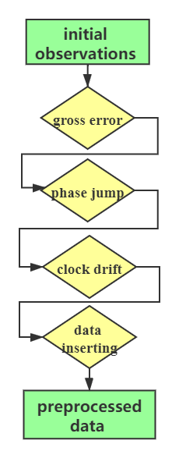
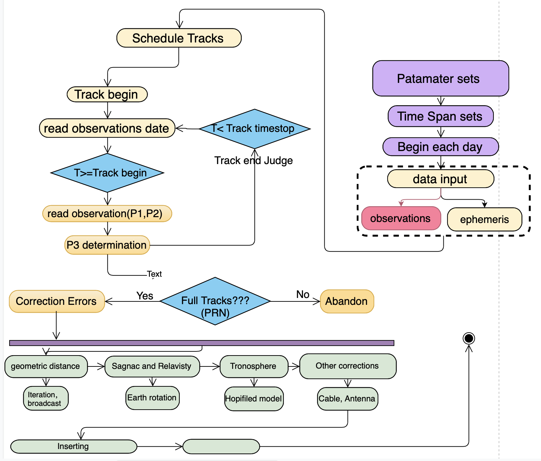
Data Analysis
Data preprocessing
(a)
(b)
Fig. 5 The data preprocessing process.(a)The determination of CGGTTS files; (b) the data preprocessing from initial observations to preprocessed data.
13

Slide 14
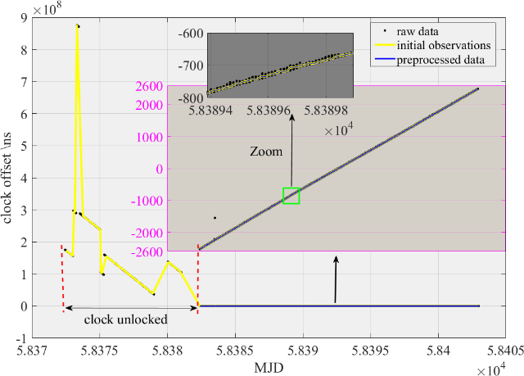
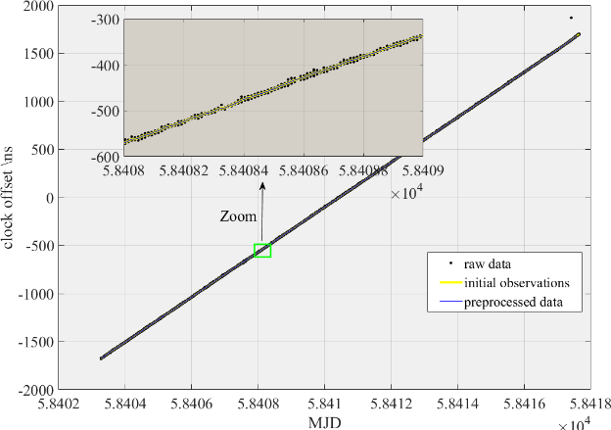
Fig. 3 The data preprocessing of the results of CVSTT technique in the experiments
Data Analysis
Preprocessed data
:
the experiments
(a)
(b)
Fig. 6 The data preprocessing of the results of CVSTT technique. (a) the experiment results of geopotential difference measurement (Sep. 21, 2018 to Oct. 11, 2018), (b) the experiment results of zero-baseline measurement (from Oct. 12, 2018 to Oct. 26, 2018).
14

Slide 15
Data Analysis
EEMD method
EMD steps:
1) Identify all extrema of x(t);
2) Interpolate between minima(resp. maxima), ending up with some ‘envelope’
e_{min}(t)(resp. e_{max}(t));
3) Compute the average m(t)=(e_{min}(t)+e_{max}(t))/2;
4) Extract the detail d(t)=x(t)-m(t);
5) Iterate on the residual m(t)
15

Slide 16
Data Analysis
EEMD method
1) y(t) is determined after adding Gaussian white noise ：
2) Then use the EMD method to implement decomposition:
(9)
3) Add different Gaussian white noise and repeat step 1) and step 2):
4) The c_{j} is determined after averaging:
(10)
5) The x(t) is decomposed into different c_{j} and a residual trend r:
(11)
(12)
16

Slide 17
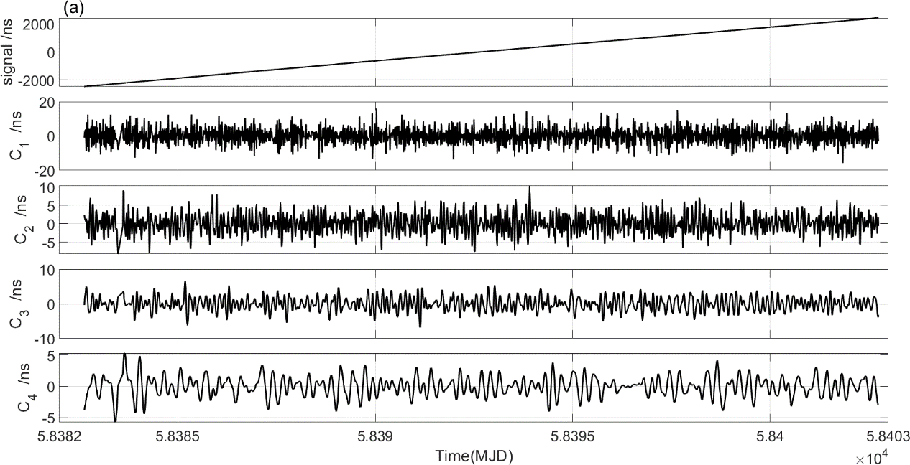
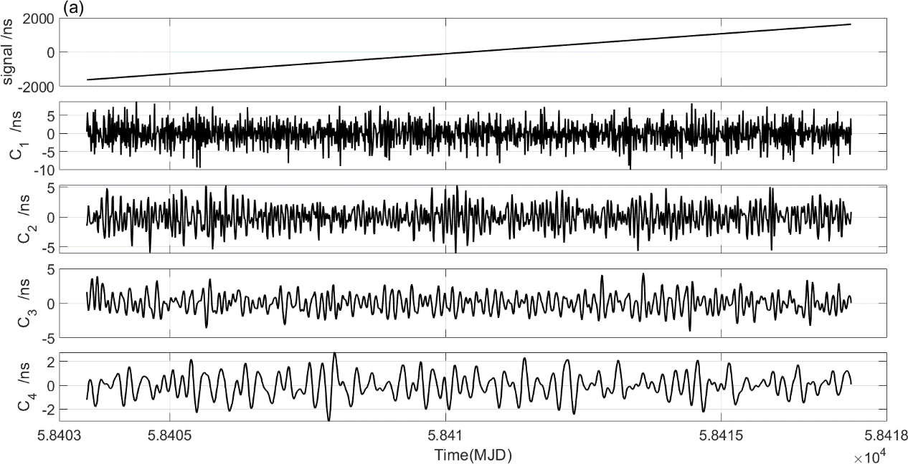
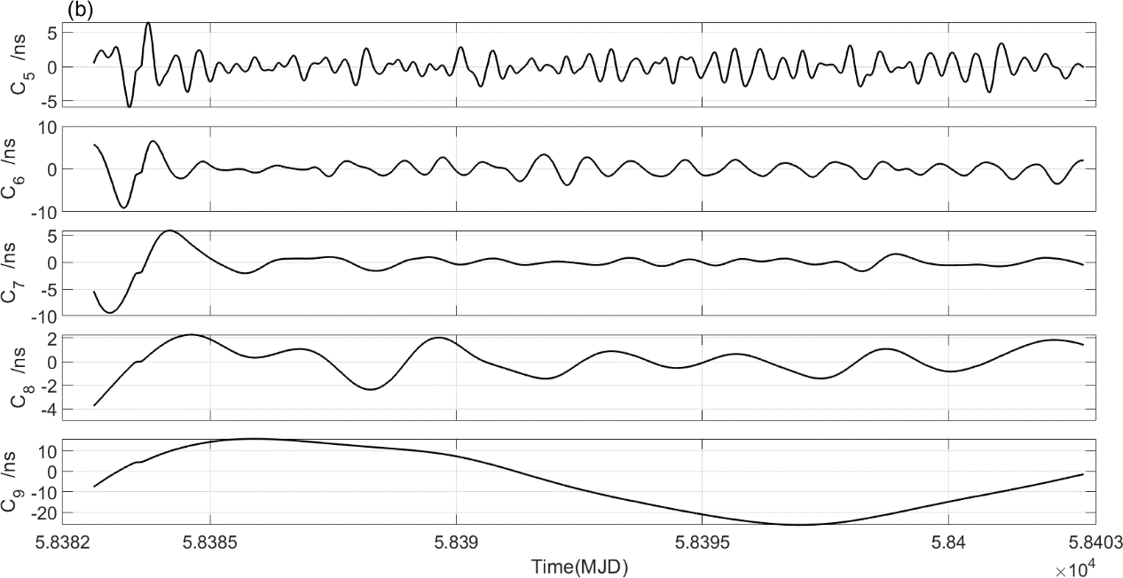
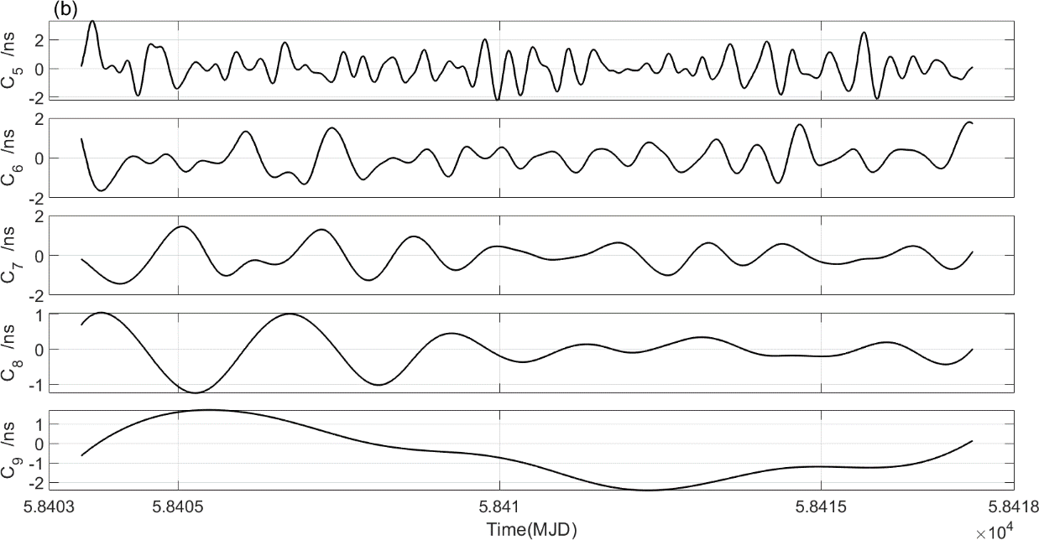
Data Analysis
Fig. 7 The resulting EEMD components in geopotential difference measurement (Sep. 21, 2018 to Oct. 11, 2018) and zero-baseline measurement (from Oct. 12, 2018 to Oct. 26, 2018), respectively.
17

Slide 18
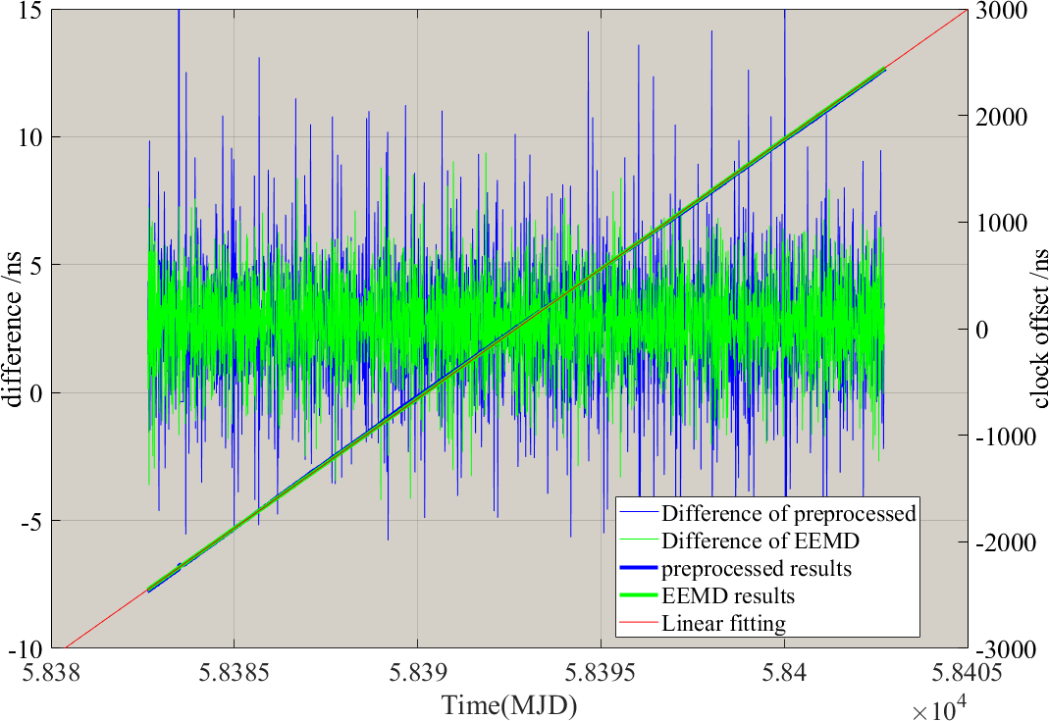
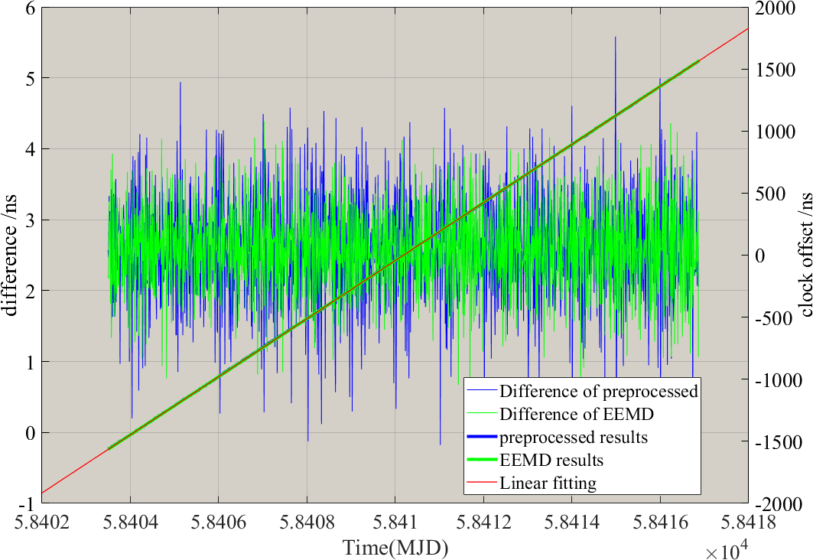
Data Analysis
EEMD results
(a)
(b)
Fig. 8 The CVSTT results before and after EEMD decomposition. The results of geopotential difference measurement (a) and that of zero-baseline measurement (b). It should be noted that the blue curve is the preprocessed data sets, the green curve is the result after EEMD decomposition (denote as EEMD results), and the red curve is a linear fitting of the EEMD results.
18

Slide 19
Data Analysis
Relative clock speed
Fig. 9 The clocks running rates of (C_{B}-C_{A}) in the geopotential difference measurement and that of in zero-baseline measurement (Unit:10⁻¹⁴). The subfigure (a) and (b) is the preprocessed results and EEMD results, respectively. The dotted curve is the instant running rates of (C_{B}-C_{A}) , the measurement results is the average results of around 210,000s nearby. On average, the measured results agree with the interval of uncertainty (shade area) around the expected results of weighted average value, demonstrating the validity of the experiments.
19

Slide 20
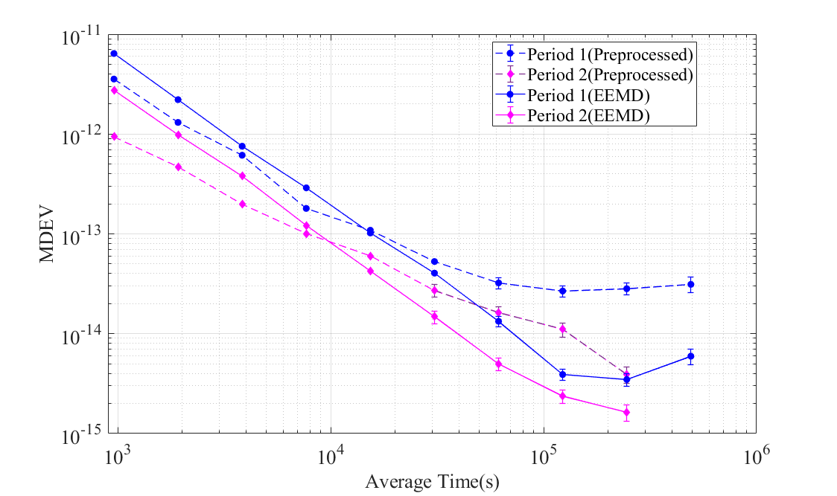
Data Analysis
Experimental results
Fig. 10 The Modified Allan Deviation (MDEV) of the preprocessed results and that of after EEMD decomposition in the experiments. The MDEV of preprocessed results is at the level of 10⁻¹⁴/day, and the EEMD results is at the level of 10⁻¹⁵/day, which indicates that the accuracy of the determined geopotential is limited to tens of meters to hundreds of meters.
$$H_{JTFS}^{}$$
Table. 2 The clock-comparison-determined geopotential difference and OH of clock C_{B} at station JTFS( ). is the difference between and the EGM 2008 results ( ).
MethodMethod
Preprocessed | 9823.40±4979.10 | 1041.28±508.07 | 188.36±508.07
EEMD results | 9347.05±1608.77 | 992.68±164.16 | 236.96±164.16
20

Slide 21
Contents
Introduction
Method
Experiments
Data Analysis
Discussion
21

Slide 22
Discussion
The results of the experiment is consistent with the quality of hydrogen clocks.
The residual errors should be taken into consideration carefully.
With quick development of time and frequency science and technology, the approach proposed in this study for determining the geo-potential difference is prospective.
22

Slide 23
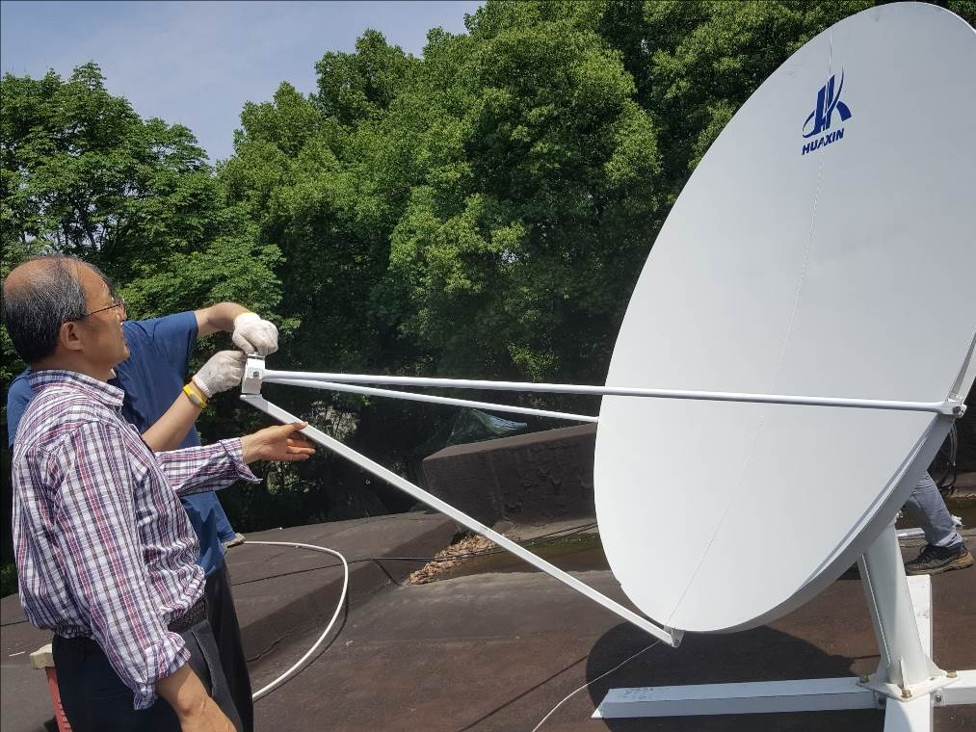
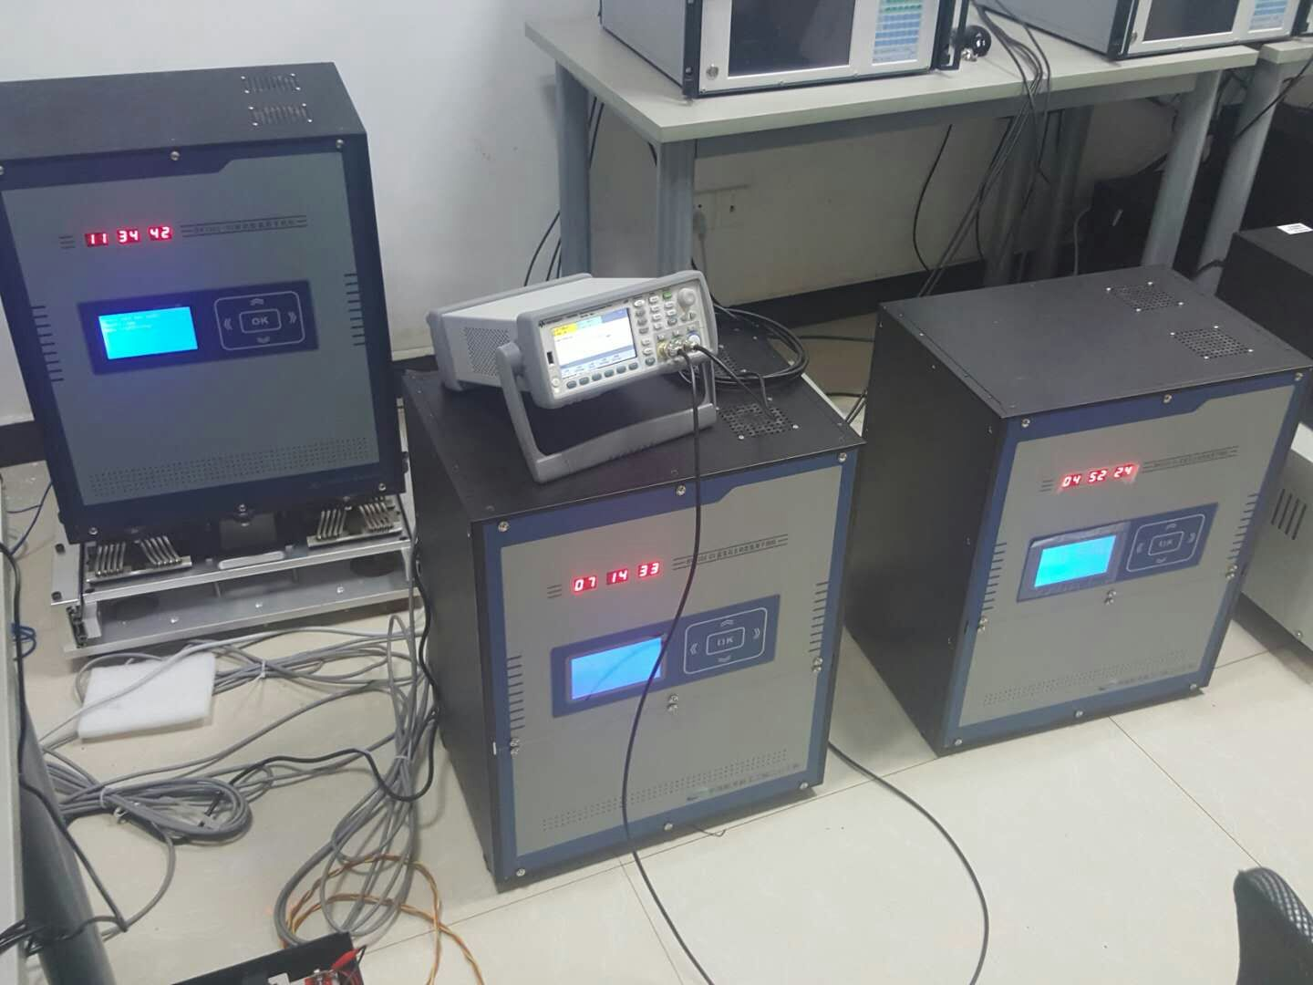
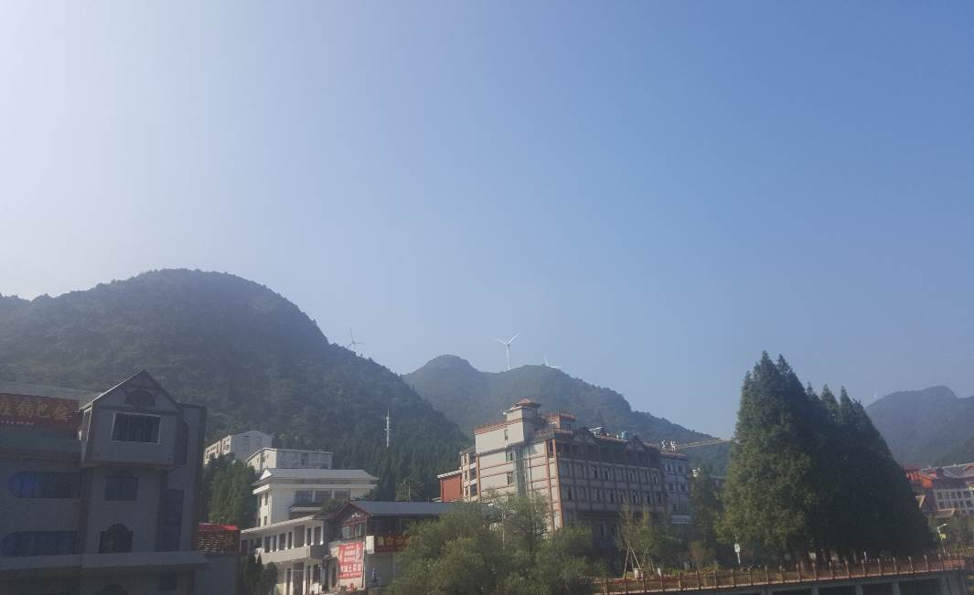
Thanks for your attention！
23

