Slide 1
Determination of aerosol size and microphiysical proprierties based on multi-wavelength raman lidar measurements in the framework of HyMeX-SOP1
Benedetto De Rosa¹ , Paolo Di Girolamo¹ , Donato Summa²
¹ Scuola di Ingegneria, Università degli Studi della Basilicata, Potenza, 85100, Italy
² CNR-IMAA, Istituto di Metodologie Ambientali, Tito Scalo (PZ), Italy
*Email: benedetto.derosa@unibas.it
A limited number of techniques can provide profiles of aerosol size microphysical properties
Reported measurements were carried out in the frame of the First Special Observation Period of the Hydrological Cycle in the Mediterranean Experiment (HyMeX-SOP1), which is a field campaign that took place in the period September–November 2012 in the western Mediterranean area, involving a large ensemble of instruments distributed on a variety of measurement sites
The University of Basilicata Raman Lidar (BASIL) was deployed in Candillargues, in Southern France. The French research aircraft ATR42, equipped with a variety of in situ sensors for turbulence and aerosol/cloud microphysical measurements, performed more than 60 flight hours.

Slide 2
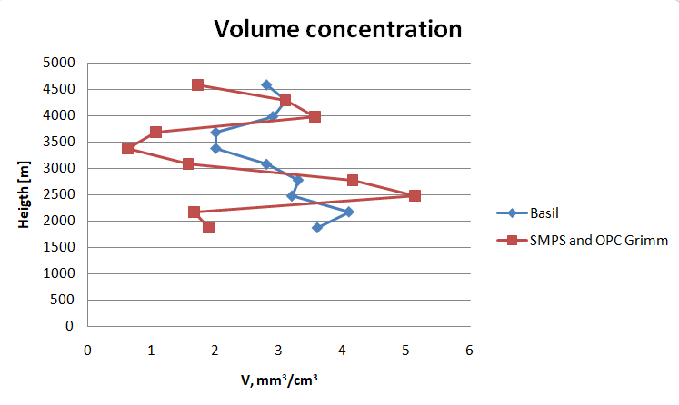
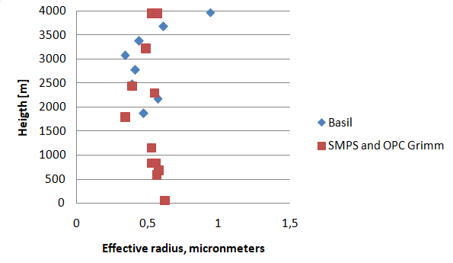
Size and microphysical properties of aerosol particles have been retrieved from MW Raman lidar measurements (3 b+2a) based on the application of a retrieval scheme exploiting Tikonov inversion with regularization.
Size properties obtainmed from the RL (volume concentration, effective radius and size distribution) are found to be in good agreement with simultaneous and almost colocated in-situ measurements performed by airborne sensors.
We focused our attention on the case study on 2 October 2012.
Comparison of the RL and in situ sensors in terms of volume concentration measurements
The figure shows the variability with altitude of the effective radius, with values in the range 0.2-0.6 mm.

Slide 3
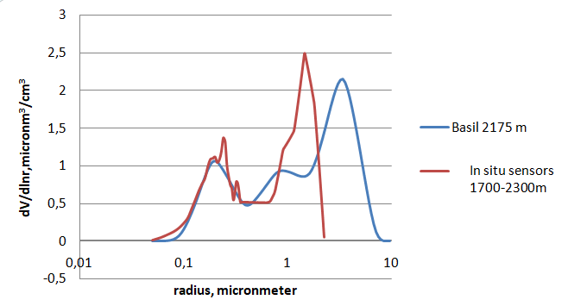
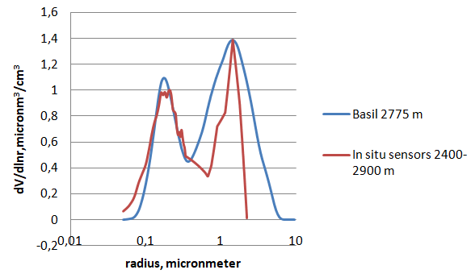
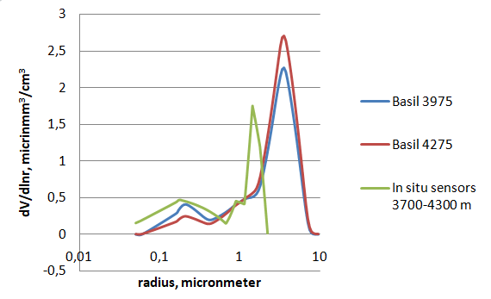
The figures show the comparison in terms of aerosol size distribution at different heigth
The agreement between Raman lidar and in-situ sensors is good. It is to be specified that the in-situ sensors are not sensitivity to particle with diameters in excess of 2 mm.

Slide 4
THANKS FOR THE ATTENTION

