Slide 1
Linking Momentum and Scalar Roughness Lengths of Urban Surfaces at the Macro and Micro Scales
Qi Li¹, Elie Bou-Zeid², Sue Grimmond³, Sergej Zilitinkevich⁴ and Gabriel Katul⁵
May 4th 2020
1: School of Civil and Environmental Engineering, Cornell University, Ithaca, US
2: Department of Civil and Environmental Engineering, Princeton University, Princeton, US
3: Department of Meteorology, University of Reading, Reading, UK
4: Finnish Meteorological Institute, P.O. Box 503, 00101 Helsinki, Finland
5: Nicholas School of the Environment and Earth Sciences, Duke University, Durham, US

Slide 2
Background: Roughness Lengths in Urban Land-Atmosphere Interaction Studies
Bluff-rough surface
MOS (Monin-Obukhov Similarity) remains the cornerstone for representing turbulent exchanges between surfaces and the lower atmosphere, under neutral condition:
H
LE
z_{0m} and z_{0s} are usually related by
Notes:
An urban surface consists of large bluff bodies, which we call a bluff-rough surface.
To capture the turbulent exchanges of momentum, energy and mass, such as the sensible and latent heat fluxes from such complex surfaces, especially in land-atmospheric interaction studies, MOS remains the cornerstone.
The momentum and scalar roughness lengths, and displacement heights encode information of the bluff-rough surfaces
Under neutral condition, we can write down these equations according to MOS.
In the literature, the momentum and scalar roughness lengths are usually related by a log ratio. K or kappa B minus one, where kappa is the von Karman constant, kappa B inverse is a function of the roughness Reynolds number.

Slide 3
Motivation:
Operationally determine z_{0m} and z_{0s} over bluff-rough surfaces by relating them to directly-measurable surface geometrical properties.
Goal:
Approach:
Conduct high resolution Large Eddy Simulations (LES) for various configurations of roughness elements by varying frontal and plan area densities (λ_{f} and/or λ_{p}). LES output to be analyzed using surface renewal theory (SRT).
Notes:
There are two main motivations:

Slide 4
Results: Comparison with Models for z_{0m}
Models in the literature agree with LES results , especially z_{0m}.
Even the two-parameter model by M98.
M98: Model by McDonald et al. (1998)
K13: Model by Kanda et al. (2013)
Notes:
We considered three groups of simulations. VPF stands for variable plan and frontal area densities,

Slide 5
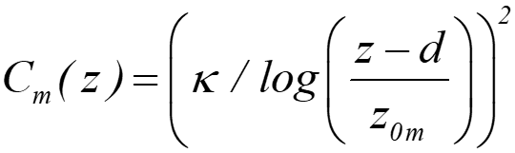
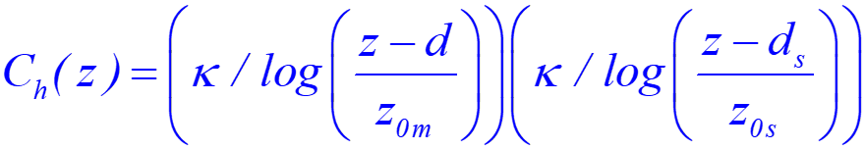
Opposing trend of momentum and scalar transfer coefficients.
Notes:
We can also consider the momentum and scalar transfer coefficients, which are widely used parameters in urban land-atmospheric interaction modeling. It is clearly that they follow opposite trends.
To address our goal, which is to determine the functional dependence of kB-1 on roughness Reynolds number, we next consider the surface renewal theory.
So what is surface renewal theory?

Slide 6
The Surface Renewal Theory (SRT)
(e.g. Danckwerts,1951)
Well-mixed bulk flow
Renew
Air Parcel
Eject
In contact for a duration s
Interfacial sublayer
Surface

Slide 7

Surface Renewal and Scalar Transfer
Well-mixed bulk flow
z
In general, different approaches of SRT depends on how the mean contact duration 1/R is specified.
: mean temperature change within the local interfacial sublayer
Interfacial sublayer
$$θ$$
Surface

Slide 8
The Surface Renewal for Bluff-rough Surfaces: A Qualitative Picture
Well-mixed bulk flow
Air Parcel
Renew
Eject
Interfacial sublayer
Exchange
Bluff-rough Surface

Slide 9
Air Parcel
Renew
Well-mixed bulk flow
Eject
Interfacial
sublayer
Exchange

Slide 10
SRT: Micro-Eddy Model
Conceptual Picture
Scaling Analysis
The collision frequency between eddies and the viscous sublayer dictates the renewal frequency.
Size of micro-eddy ~ Kolmogorov length scale.
Very small eddies in the vicinity of the interface are expected to experience collision events with the viscous sublayer.
Micro-eddy
Macro-eddy

Slide 11
SRT: Macro-Eddy Model
Conceptual Picture
Scaling Analysis
Rate limiting step: the efficiency of coherent eddies in delivering parcels of fresh air to the surface
For canopy flows, the shear length scale L_{s} dictates the penetration depth of vortices
Large canopy-layer air ventilation events control the renewal rate, and the entire building facet area then exchanges scalar with the macro-eddy.
Micro-eddy
Macro-eddy

Slide 12
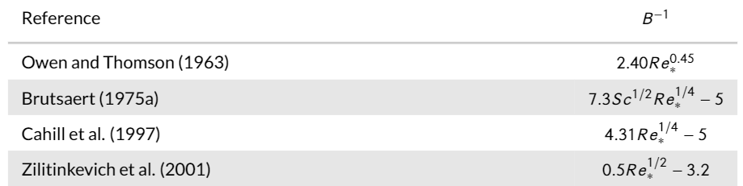
Linking Surface Renewal to log(z_{0m}/z_{0s})
Macro-eddy?
Micro-eddy
Micro-eddy
A different approach, same result as macro-eddy model

Slide 13
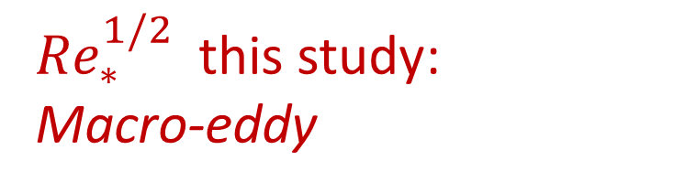
${Re}_{∗}^{1/2}$ this study:
Macro-eddy
B: Brutsaert (1975a) Micro-eddy
K: Kanda et al. (2007) Micro-eddy

Slide 14
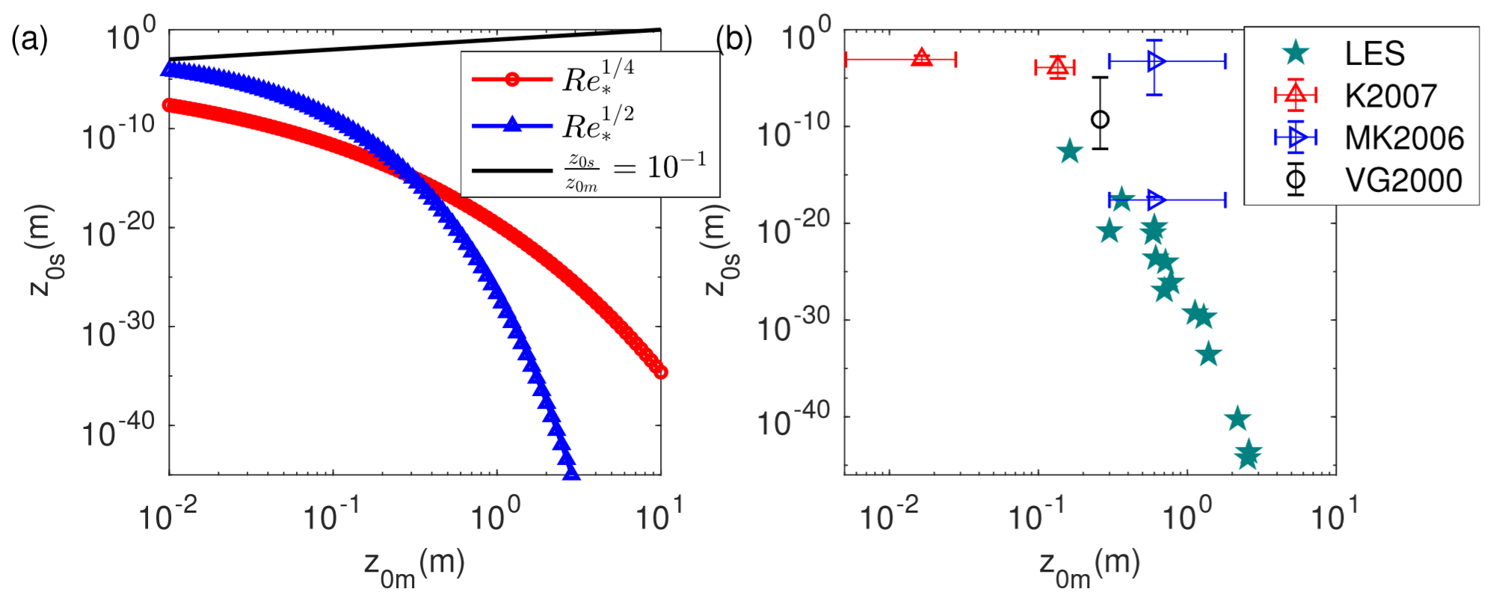
Implications: Inverse relation between z_{0m} and z_{0s}
“Trade-off effects” in the effectiveness of a bluff-rough surface in exchanging momentum and scalars with a fluid
z_{0m}/z_{0s}=Constant
K2007: outdoor urban scale models in Kanda et al. 2007
MK2006: measurements from a suburban site in Tokyo, Japan by Moriwaki and Kanda 2006.
VG2000: measurements from a light industrial site in Vancouver, British Columbia, Canada from Voogt and Grimmond, 2000.

Slide 15
Implications
As obstacle-resolving LES is becoming a promising tool to explore urban atmospheric boundary layers, one should be mindful of how to interpret the bulk transfer properties directly computed from LES, especially for scalars => Implications of the wall-model choice
Making use of the good predictive skills of morphometric models in the literature to determine C_{m} and the Re* dependence of scalar transfer => A ‘two-step’ approach is feasible

Slide 16
Implications
As obstacle-resolving LES are proliferating, bulk transfer properties directly computed from LES are sensitive to the wall-model choice
As morphometric models begin to approximate well C_{m} , the Re* dependence of scalar transfer feasible => A ‘two-step’ approach is recommended

Slide 17
Limitations and Outlook
Limitations
  the number of idealized cases
  simple thermal boundary condition
  neutral stability
Needs:
  to explore a larger morphometric parameter space, with realistic geometry
  more field experiments to test theories (e.g. SRT) and numerical models

Slide 18
Acknowledgement
This work is supported by the start-up fund from Cornell University, NOAA-Princeton Cooperative Institute for Climate Science, Princeton's Andlinger Center for Energy and the Environment, the Academy of Finland grant314798/799(2018-2020) and the U.S. National Science Foundation’s Sustainability Research Network Cooperative Agreement 1444758 and grant 1664091. The simulations were performed on the computing clusters of the National Center for Atmospheric Research through projects P36861020 and UPRI0007. SZ acknowledges support from the Academy of Finland grant314798/799(2018-2020).

Slide 19
Linking Momentum and Scalar Roughness Lengths of Urban Surfaces at the Macro and Micro Scales
Thank you and questions?
Qi Li¹, Elie Bou-Zeid², Sue Grimmond³, Sergej Zilitinkevich⁴ and Gabriel Katul⁵
Jan. 16th 2020
1: School of Civil and Environmental Engineering, Cornell University, Ithaca, US
2: Department of Civil and Environmental Engineering, Princeton University, Princeton, US
3: Department of Meteorology, University of Reading, Reading, UK
4: Finnish Meteorological Institute, P.O. Box 503, 00101 Helsinki, Finland
5: Nicholas School of the Environment and Earth Sciences, Duke University, Durham, US
Contact: ql56@cornell.edu
Submitted to QJRMS

Slide 20
Thank you and questions?

Slide 21
Backup slides

Slide 22
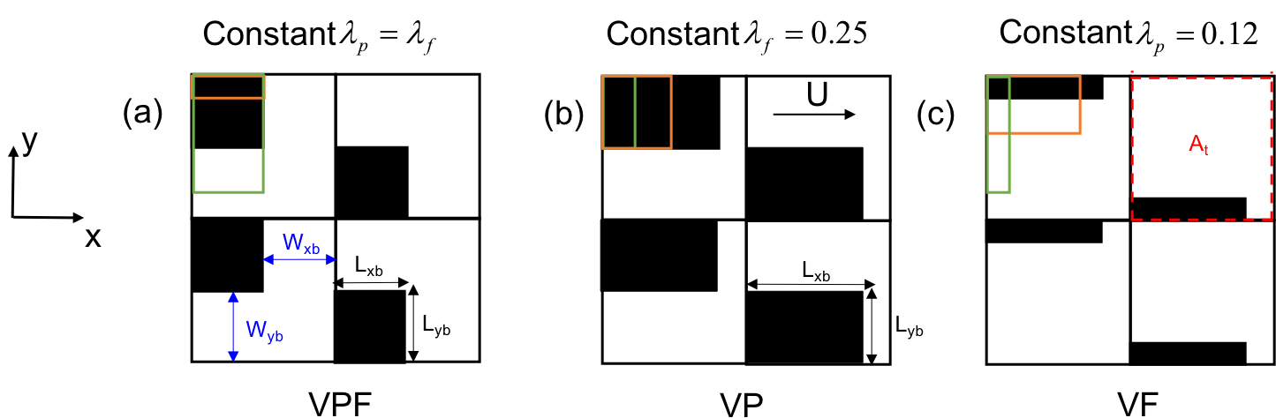
Setup of Numerical Experiments

Slide 23
Method: Wall-modeled Large Eddy Simulation (WM-LES)
Resolves the macro-scale roughness and models the micro-scale roughness
Assuming a smooth facet/wall:

Slide 24
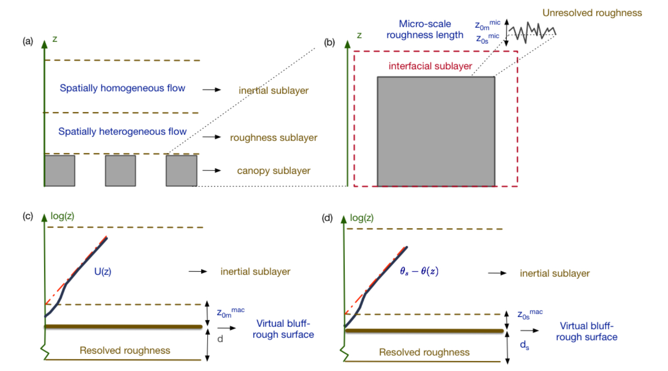
Method: A Conceptual Framework of Macro vs. Micro-scale Roughness
Consider flows above the roughness sublayer
d, d_{s}, z_{0m}^{mac} and z_{0s}^{mac} are manifestations of the aggregate effects of the bluff-rough surfaces on the inertial sublayer aloft.
logarithmic mean velocity and air temperature profiles hold in the inertial sublayer. (i.e. c and d)
Notes:
aremanifestations of the aggregate effects of
110 the bluff-rough surfaces on the inertial sublayer aloft, where the logarithmicmean velocity and air temperature profiles
111 hold

Slide 25
Method: A Conceptual Framework of Macro vs. Micro-scale Roughness
Unresolved micro-scale roughness
Requires parameterization
Over a single building facet (e.g. a wall), a local or micro-scale roughness must be introduced.
  Examples of such micro-scale roughness: e.g. subgrid-scale wind ripples on resolved waves [Sullivan et al., 2017]; small indentations on the surfaces of built structures [Cai, 2012, Li et al., 2016b].
In the context of wall-modeled large-eddy simulations (WM-LES), micro-scale roughness lengths need to be specified.

Slide 26
Determine displacement heights and roughness lengths from LES
A least-square fitting procedure to the log-law is a common approach in previous studies.
Search the parameter space spanned by d and z_{0m} and set z_{0m} <d
Assume constant von Karman constant = 0.4.
Take pre-normalized horizontal velocity (temporally and spatially averaged) from 1.25<z/H<2.25.
Compute the root-mean-square error and select the combination of d and z_{0m} with the lowest root-mean-square error.
Performed sensitivity tests of adopting different procedures, e.g. different range of velocity and whether d =d_{s}

