Slide 1
Insights into a pulsing debris flow
Nagl Georg., Hübl Johannes., Kaitna Roland
University of Natural Resources and Life Sciences, Vienna
Institute of Mountain Risk Engineering
Abstract: The internal deformation behavior of natural debris flows is of interest for model development and model testing for debris-flow hazard mitigation. The pulsing nature of debris flows can increase the runout length by remobilization of deposited material. Up to now, only a view attempts were made to measure internal deformation behavior in natural debris-flow surges due to the low predictability and high destructive power of these flows. In this contribution we present recent advances of measuring in-situ velocity profiles together with flow parameters like flow height, basal normal stress, and pore fluid pressure. For that a fin-shaped monitoring barrier was constructed in the Gadria creek (IT), laterally carrying an array of paired conductivity sensors. We present results from a debris-flow event in 2018 with 12 surges and flow heights up to 2 m. We observe changing velocity profiles during the passage of the surges and identify deposition and remobilization domains in the flow. The flows exhibited significant longitudinal changes of flow properties like flow height and density. Between surges, the lower levels of the flow deposited and were subsequently overridden by the next surge and reactivated. These measurements gain new insights of the dynamics of surges of a real-scale debris flow.

Slide 2
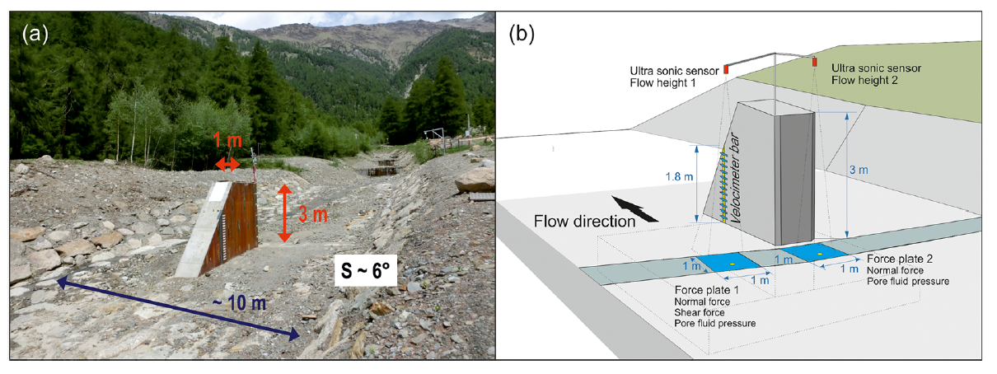
(a) Looking upstream of the channel reach at the monitoring barrier. (b) Illustration of the monitoring barrier showing the locations of the different sensors (Nagl et al. 2020 ).
(a) Velocimeter bar at the downstream end of the monitoring barrier. (b) Example of raw signals of sensor 1 and sensor 2 at the lowest level of the velocimeter bar for the debris-flow event (Nagl et al. 2020 )

Slide 3
Part of the debris flow of 2018
Supporting Informations
https://onlinelibrary.wiley.com/doi/full/10.1002/esp.4844

Slide 4
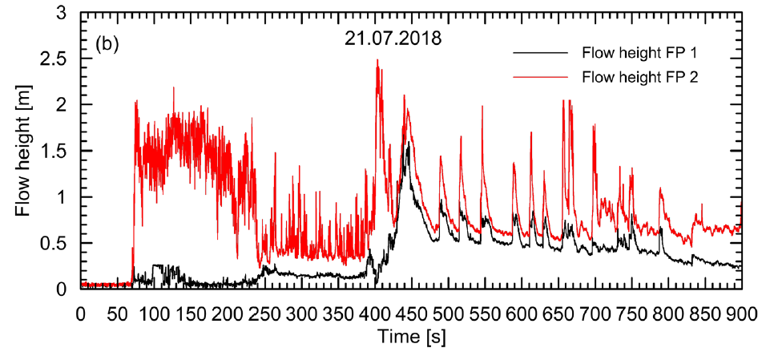
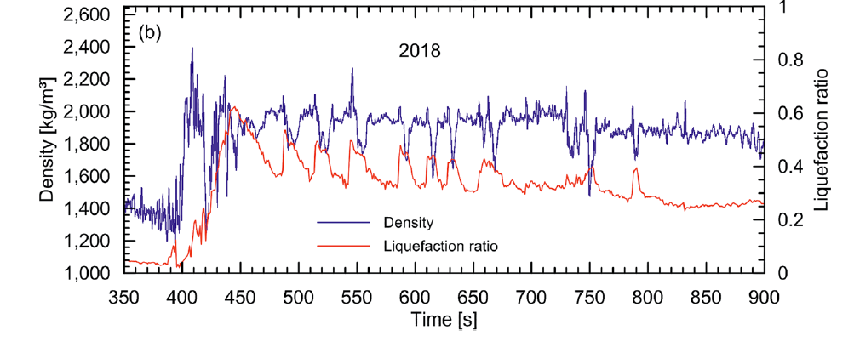
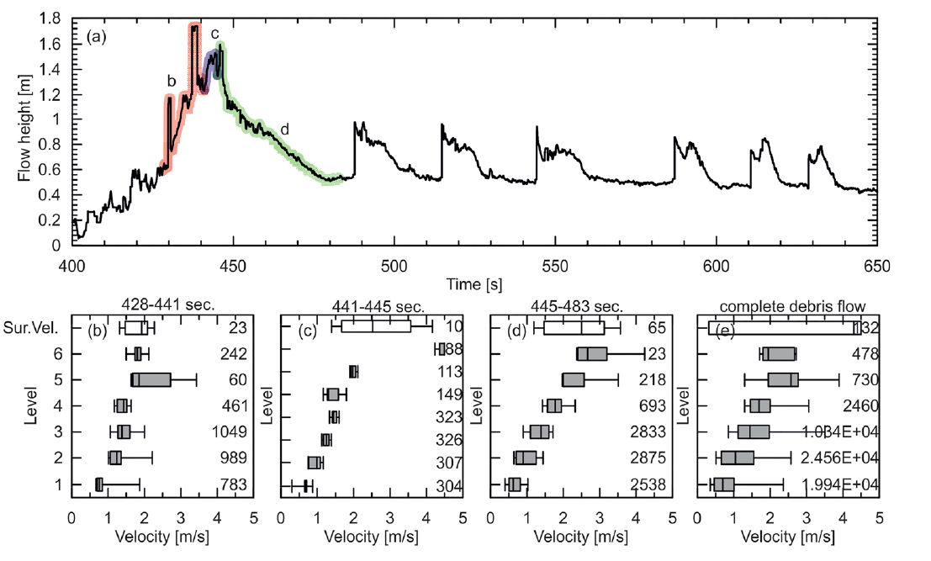
21st July 2018. The black line denotes the flow height at the position of FP 1 and the red line at the position of FP 2. T = 0 is the instant at which the measurements start
Temporal evolution of bulk density and liquefaction ratio for the debris flow 2018.
Velocity profiles derived for the debris-flow event in 2018. (a) Flow height measurement and the position of each velocity profile. (b)–(d)
Velocity profiles with surface velocity. (e) Velocity profiles with surface velocity of the complete debris flow, surface velocity was derived by particle
tracking from video analysis with box plots (box width represents the 10th/90th percentile). The grey boxes represent values derived from the velocity
profiler. The number on the side of the velocities represents the number of values available for the whisker plot.

Slide 5
CONCLUSION:
The 2018 flow was visually more fluid, transformed from a flash flood into a debris flow, and displayed periodic deposition and remobilization. The liquefaction ratio decreased from 0.6 to 0.3 through time as the flow passed over the sensor. A standing wave formed at the barrier and might have affected the measurement of basal stresses. After the peak flow, velocity profiles transformed from concave to convex, indicating the onset of deposition in the lower layers of the flow. Our results demonstrate that natural debris-flow events undergo different flow regimes and do not show a constant velocity profile or basal stress relations along the flow and between events. We think that this is related to variations in grain size distribution and is highly relevant for run-out as well as deposition and remobilization processes. Increasing shear rates with depth point to shear rate-dependent flow resistance in parts of the flow. We do not find evidence that excess fluid pressure is related to shear rate or normal stress fluctuations. The development of more physically based modelling approaches will benefit from the results presented in this study. Additionally, the data may serve as a benchmark for model testing.
References:
Nagl, G., Hübl, J., & Kaitna, R., 2020, Velocity profiles and basal stresses in natural debris flows. Earth Surface Processes and Landforms.

