Slide 1
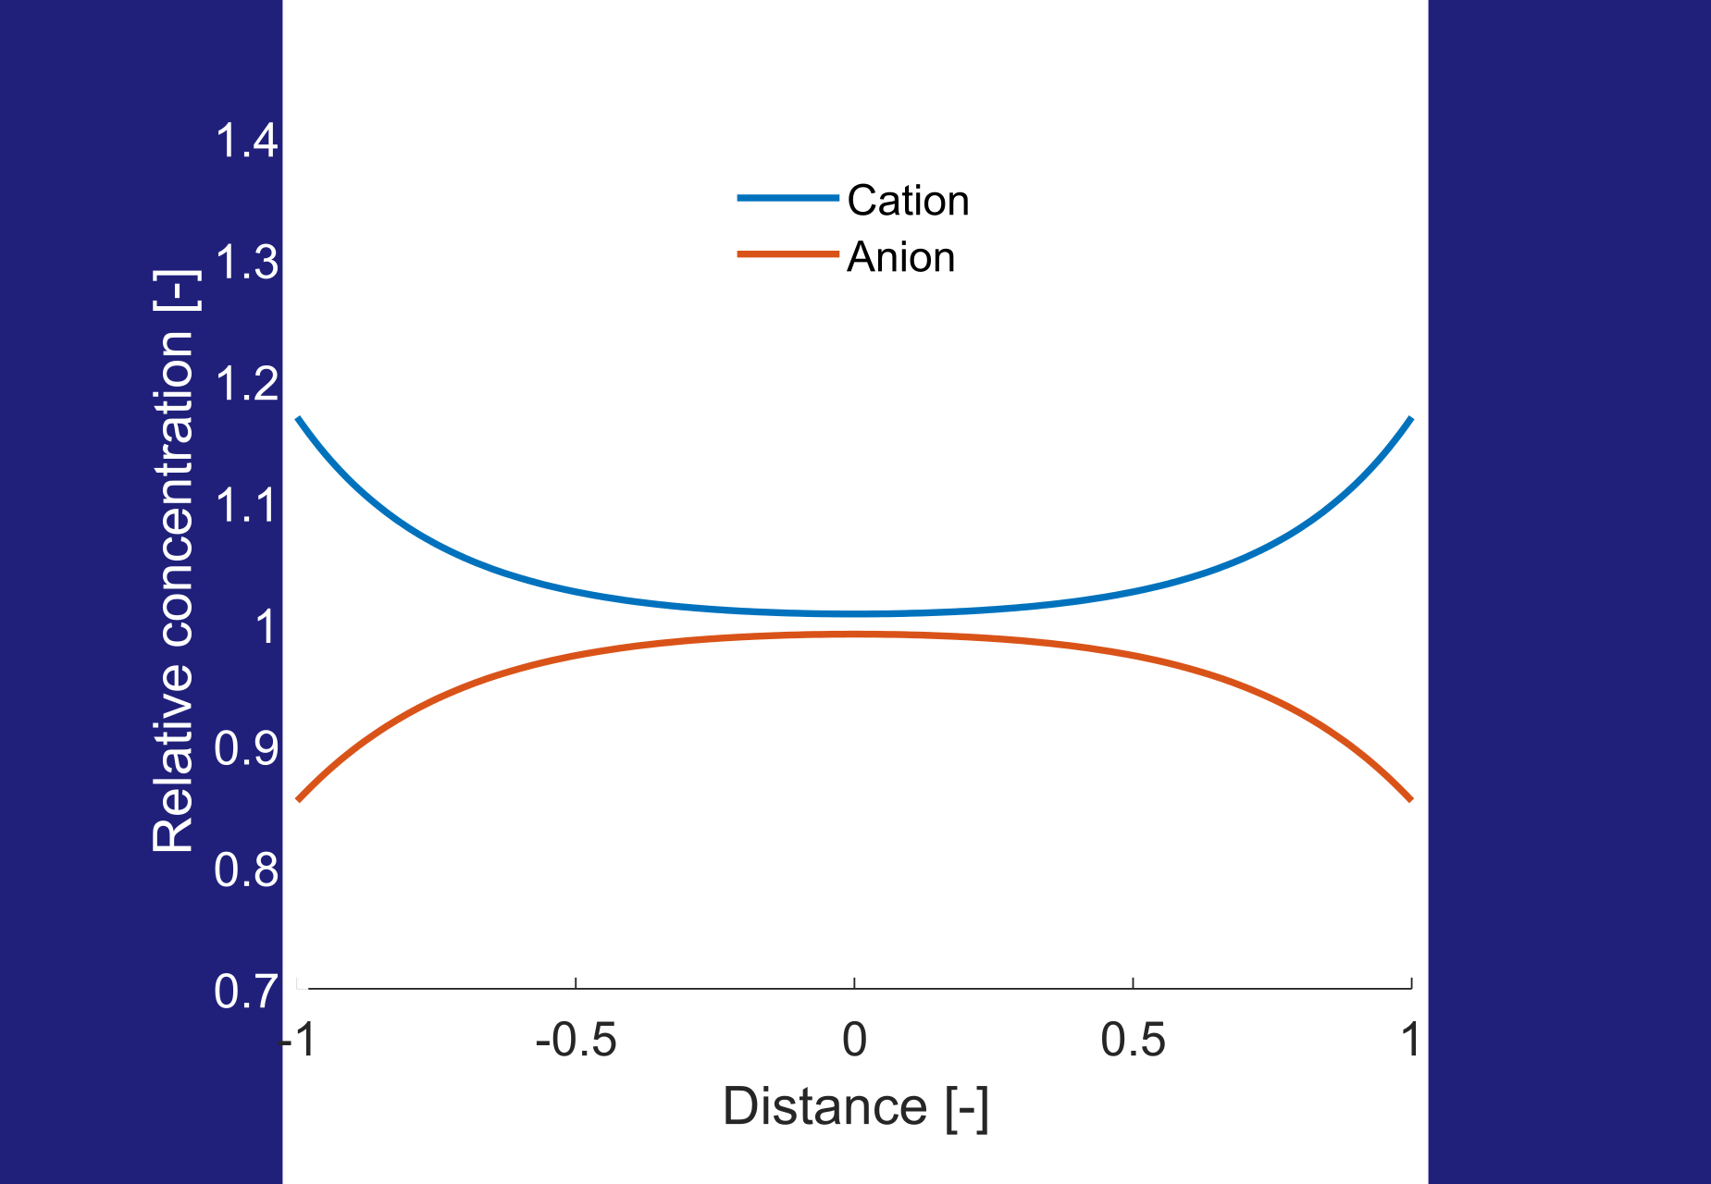
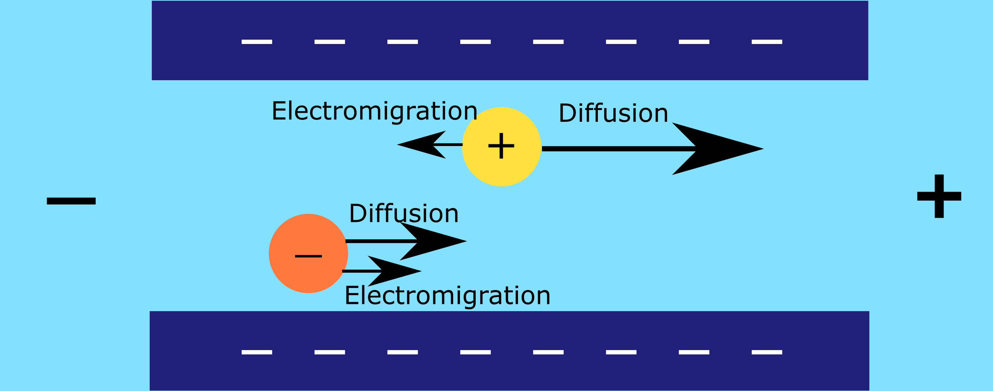
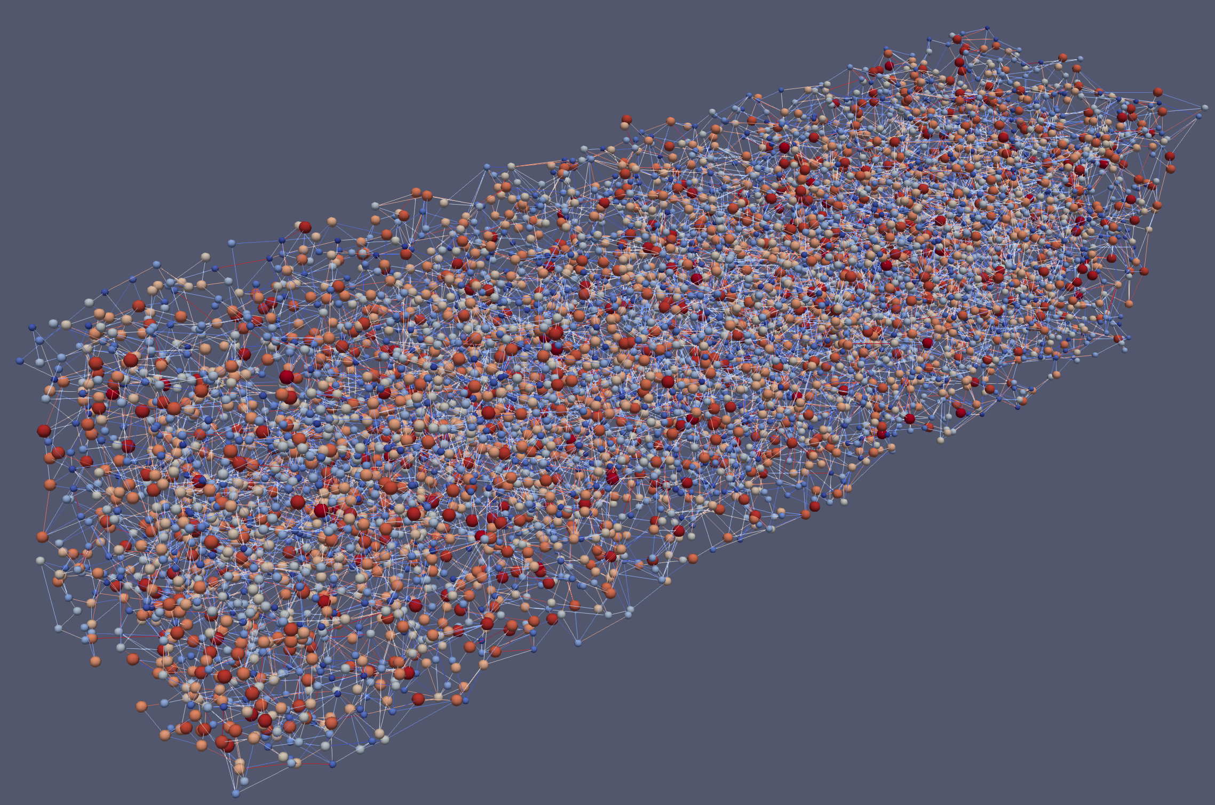
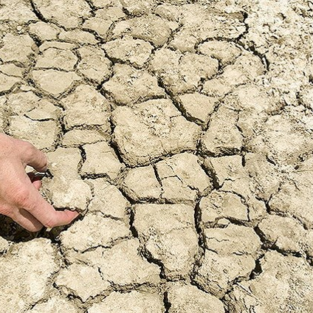
Salt diffusion in clay
Pavan Cornelissenª, A. Leijnseª, V. Joekar-Niasar^{b}, S.E.A.T.M. van der Zeeª
ª Wageningen University, ^{b} University of Manchester

Slide 2
Salt diffusion in clay
Difference with other porous media:
  Clay behaves like a semi-permeable membrane, which restricts salt transport
  Degree of semi-permeability is a function of the salt concentration

Slide 3
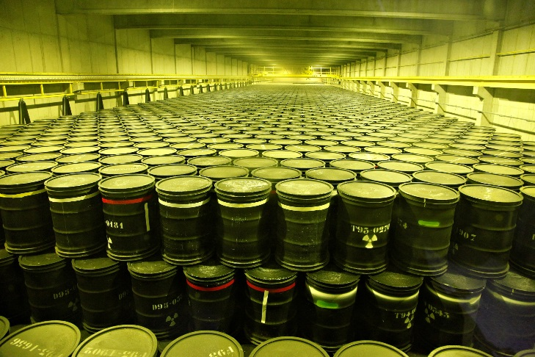
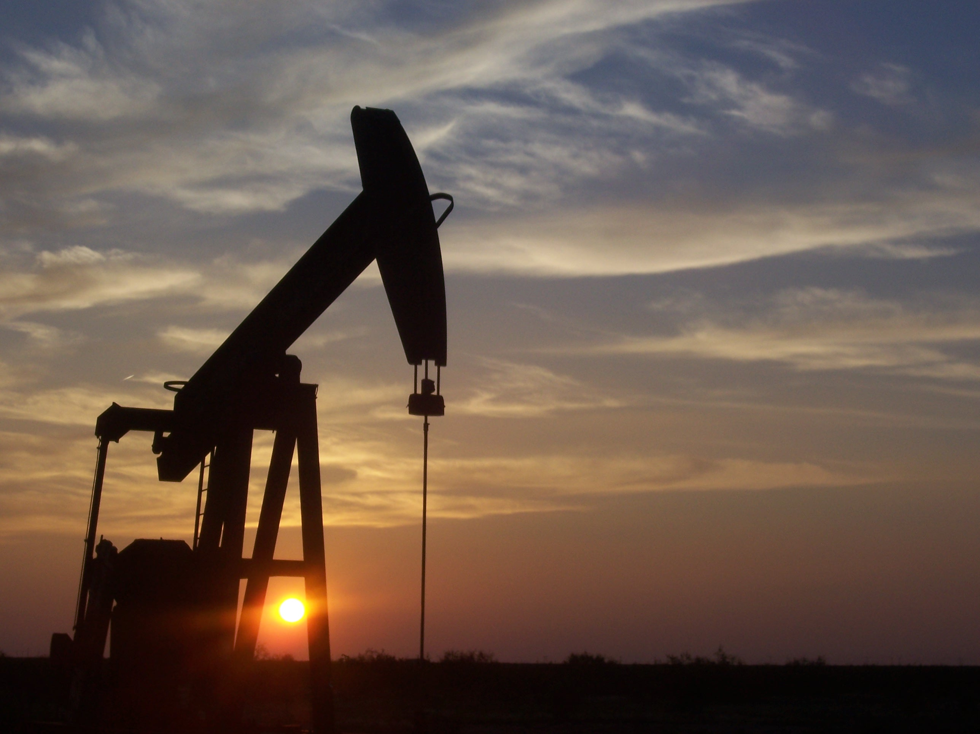
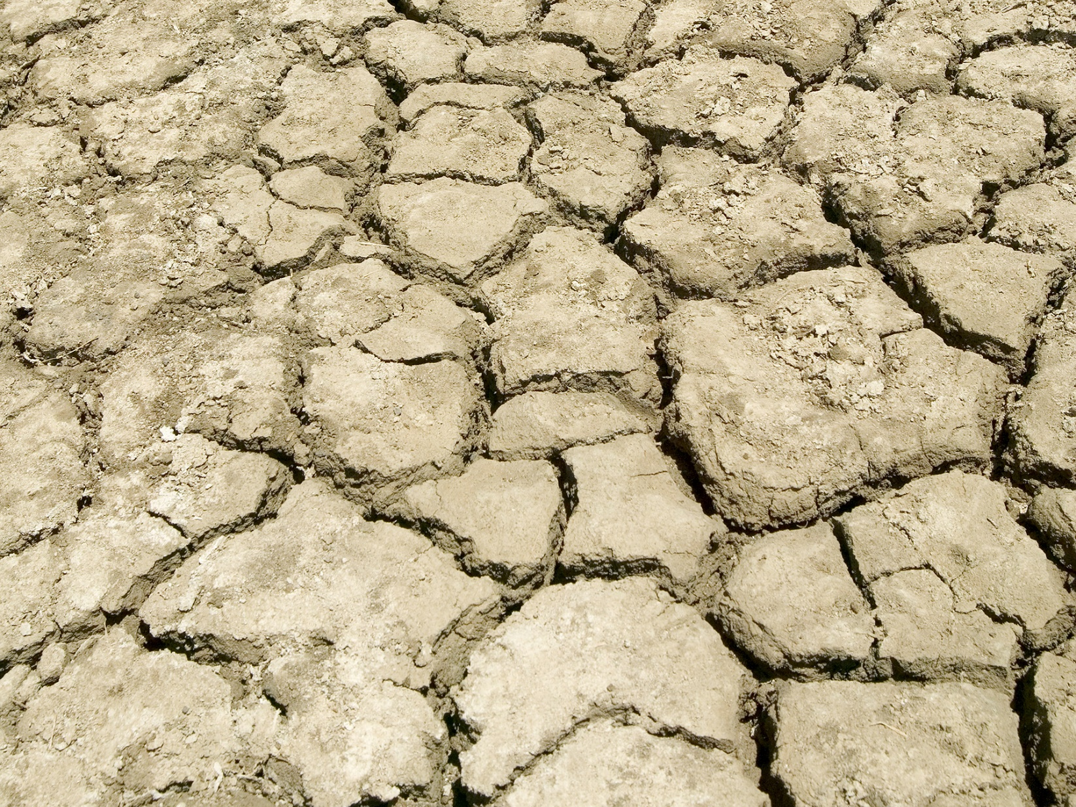
Examples where these processes are relevant
Underground disposal of radioactive waste
Enhanced oil recovery
[1]
Salt management in agriculture
[3]
[2]

Slide 4
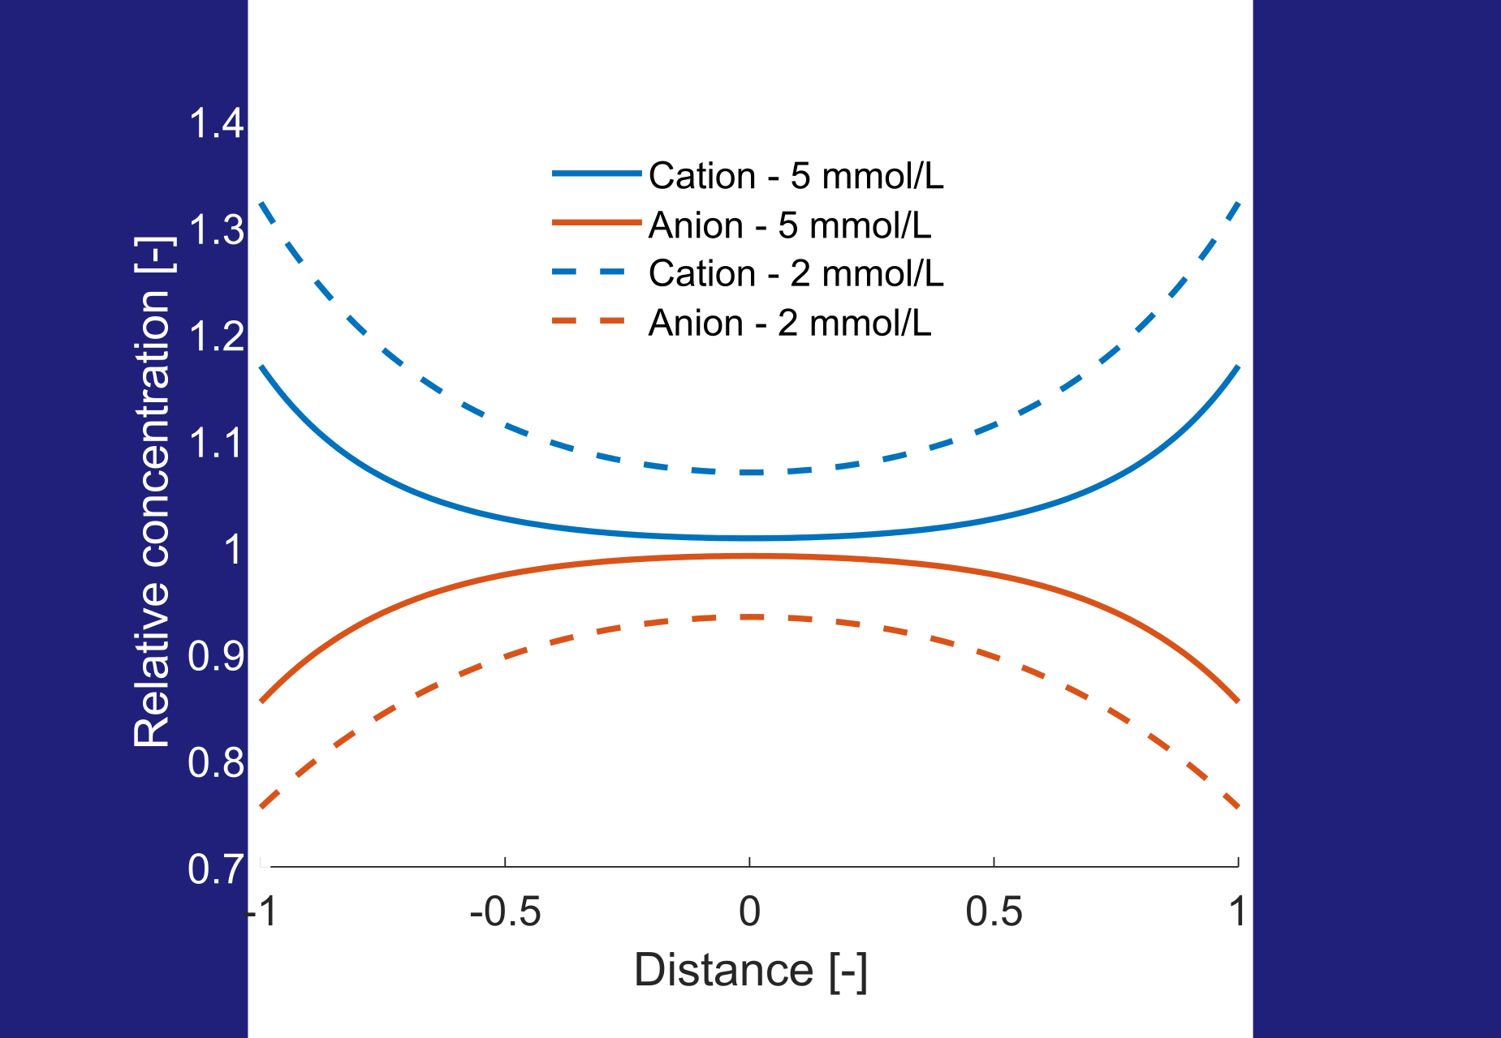
Why are clays semi-permeable?
The negative surface charge of clay minerals attracts cations and repels anions, forming a diffuse double layer
Therefore, cations can travel easier through pores than anions
This effect is enhanced at lower salt concentrations, where the double layer is thicker

Slide 5
Why are clays semi-permeable?
Preferential ion transport leads to rise of electric potential, which reduces cation transport and enhances anion transport
The net result is that salt transport is slowed down compared to uncharged porous media

Slide 6
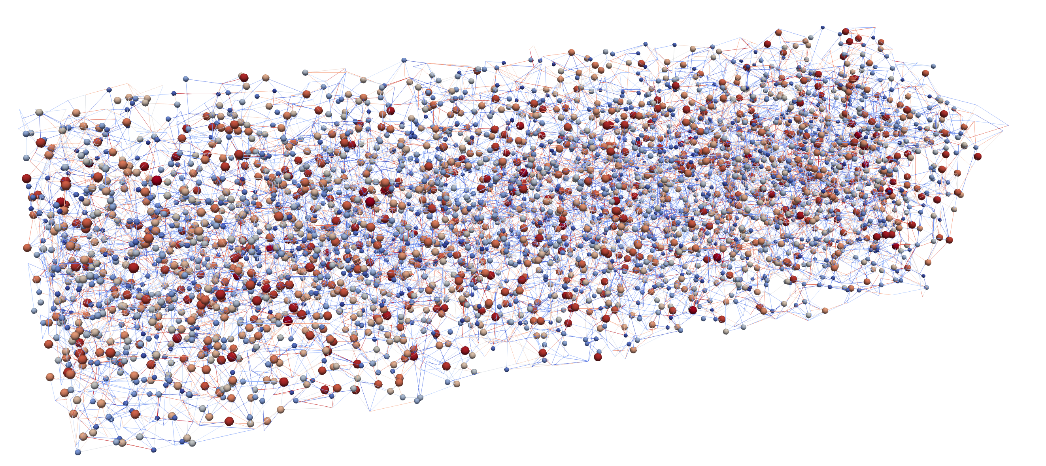
Pore-network modelling
Pore-network models use simplified pore geometry, but realistic statistics such as pore size distribution and pore connectivity
Effective method for upscaling heterogeneous systems

Slide 7
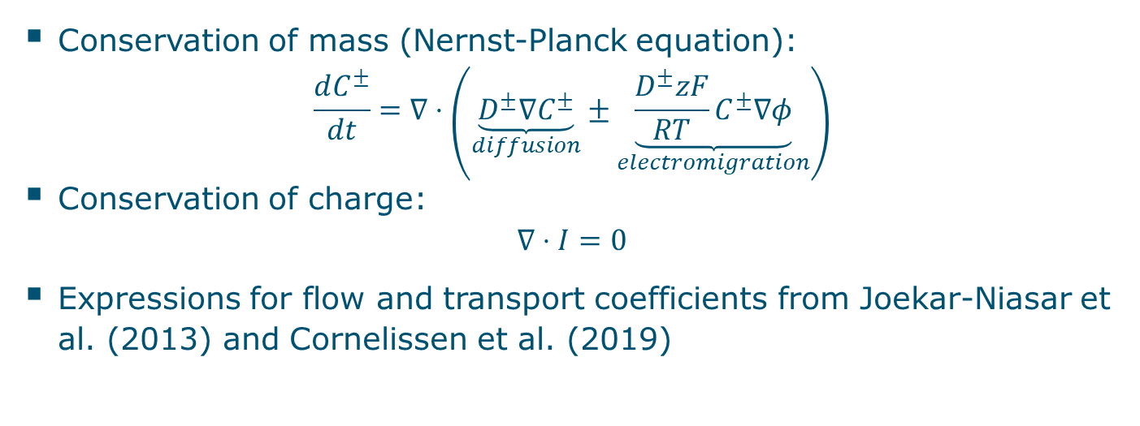
Governing equations
Conservation of mass (Nernst-Planck equation):
$$\frac{dC^{±}}{dt}=∇⋅\left(\underset{diffusion}{\underbrace{D^{±}∇C^{±}}}±\underset{electromigration}{\underbrace{\frac{D^{±}zF}{RT}C^{±}∇φ}}\right)$$
Conservation of charge:
$$∇⋅I=0$$
Expressions for flow and transport coefficients from Joekar-Niasar et al. (2013) and Cornelissen et al. (2019)

Slide 8
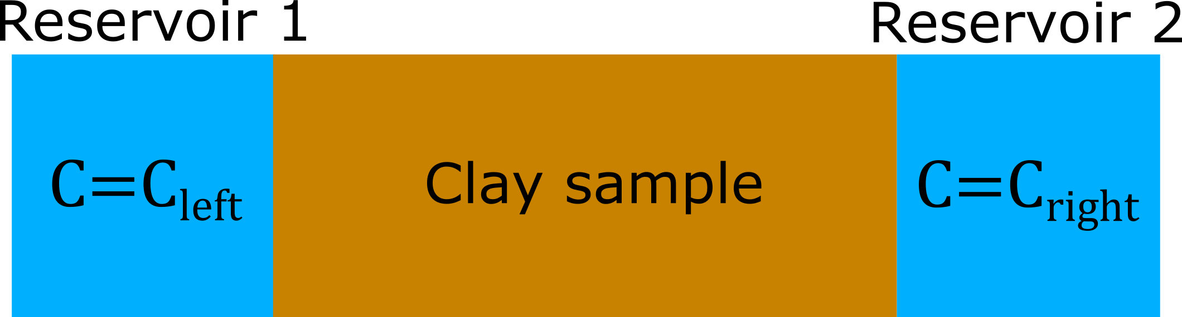
Setup of the numerical experiments
Pore sizes and surface charge density based on montmorillonite
Boundary conditions:
  Left/right boundaries: Dirichlet conditions for salt concentration and electric potential, concentration difference = 0.1 mol/m³
  Top/bottom boundaries: No salt flux and no current

Slide 9
Results: salt concentration profile
The steady state concentration profile is linear
Therefore, the double layer is thicker on the right-hand side of the pore-network than on left-hand side
Diffusion transport direction

Slide 10
Results: electric potential profile
Steady state: cation transport increased near inlet, but reduced near outlet
The electric field is stronger at low salt concentrations, and thus stronger reduction of salt flux
Electromigration transport direction
Electromigration transport direction

Slide 11
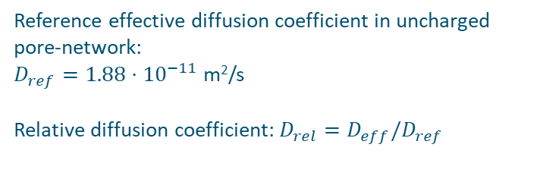
Results: effective diffusion coefficient
Reference effective diffusion coefficient in uncharged pore-network:
$D_{ref}=1.88⋅{10}^{−11}$ m²/s
Relative diffusion coefficient: $D_{rel}=D_{eff}/D_{ref}$
The effective diffusion coefficient is calculated from the salt flux through the pore-network at steady-state
The effective diffusion coefficient is very sensitive to the salinity at low salt concentrations

Slide 12
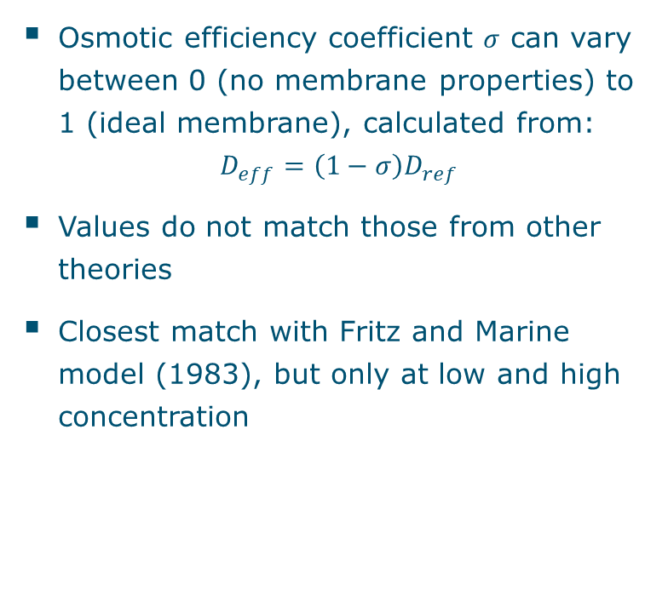
Results: membrane efficiency
Osmotic efficiency coefficient $σ$ can vary between 0 (no membrane properties) to 1 (ideal membrane), calculated from:
$$D_{eff}=\left(1−σ\right)D_{ref}$$
Values do not match those from other theories
Closest match with Fritz and Marine model (1983), but only at low and high concentration

Slide 13
Summary
Salt transport in clay is generally a combination of diffusion and electromigration
The membrane behaviour of clays can significantly reduce the salt flux
The membrane efficiency is strongly dependent on the salt concentration, and the relationship did not match that of other studies

Slide 14
References
Literature
Bolt, G.H., (1982). Soil Chemistry B. Physical-Chemical
Models. Elsevier, Amsterdam.
Bresler, E., (1973). Non-steady transport through
unsaturated soils. Soil Science Society of America
Proceedings 37, 663-669.
Cornelissen, P., Leijnse, A., Joekar-Niasar, V., van der Zee,
S.E.A.T.M., (2019). Pressure development in charged
porous media with heterogeneous pore sizes. Advances in
Water Resources 128, 193-205.
Fritz, S.J., Marine, I.W., (1983). Experimental support for a
predictive osmotic model of clay membranes. Geochimica et
Cosmochimica Acta 47, 1515-1522.
Joekar-Niasar, V., Leijnse, A., Schotting, R., (2013).
Analytical solution of electrohydrodynamic flow and
transport in rectangular channels: inclusion of double layer
effects. Computation Geosciences 17, 497-513.
Nielsen, D.R., Jackson, R.D., Cary, J.W., Evans, D.D., (1972).
Soil water. Amer Society of Agronomy, Wisconsin.
Figures
[1] www.niras.be
[2] Photo by Peggy Greb, USDA Agricultural Research Service.
https://www.ars.usda.gov/oc/images/photos/apr13/d186-2/
[3] Wikimedia Commons
https://commons.wikimedia.org/wiki/File:West_Texas_Pumpjack.JPG

