Slide 1
Changes of groundwater levels and land use with the introduction of canal system in Maheshwar block of Narmada basin (Central India)
Sakshi Shiradhonkar ^{*1} and Tomochika Tokunaga¹
¹Geosphere Environment Systems Laboratory,
Department of Environment Systems, Graduate School of Frontier Sciences,
The University of Tokyo, Japan
EGU 2020 Online Conference, May 04, 2020
*Corresponding author: Sakshi Shiradhonkar E-mail address: sakshi_rs_gis@envsys.k.u-tokyo.ac.jp

Slide 2
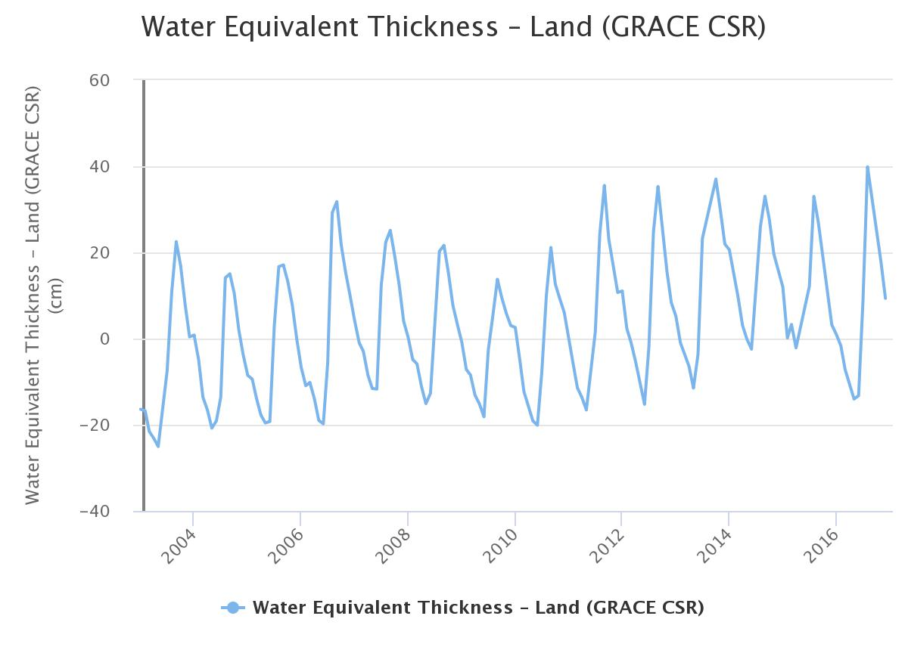
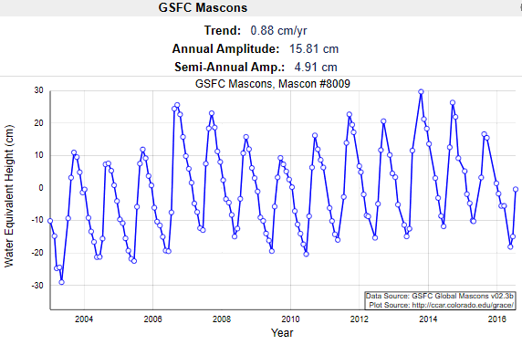
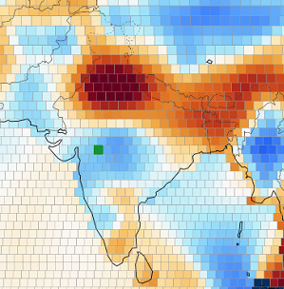
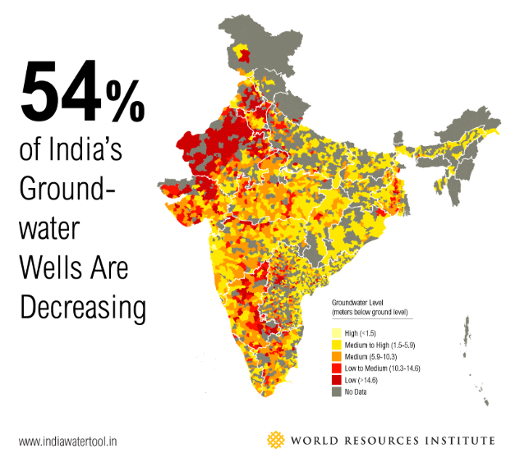
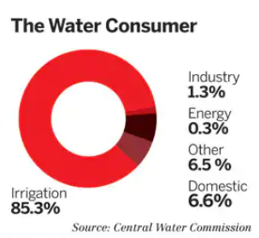
Terrestrial Water Storage (TWS) increase indicated by GRACE satellite and previous studies in central India during 2003-2016.
1. Background
Three possible reasons for TWS increse:
Increase of surface water (SW) storage
Increase in Groundwater (GW) storage
Increase in Soil moisture (SM) storage
Because TWS = SW + GW + SM
0.88cm/year
Begin study focusing on Groundwater because,
httpshttp://ccar.colorado.edu/grace/about.html
Trend analysis by Mascon Visualization Tool showed an increase in TWS by 0.88cm/year.
www.wri.org
Source: Central Water Commission
2
GRACE: Gravity Recovery and Climate Experiment
Source: www.indiawatertool.in
Source: United Nations World Water Development report

Slide 3
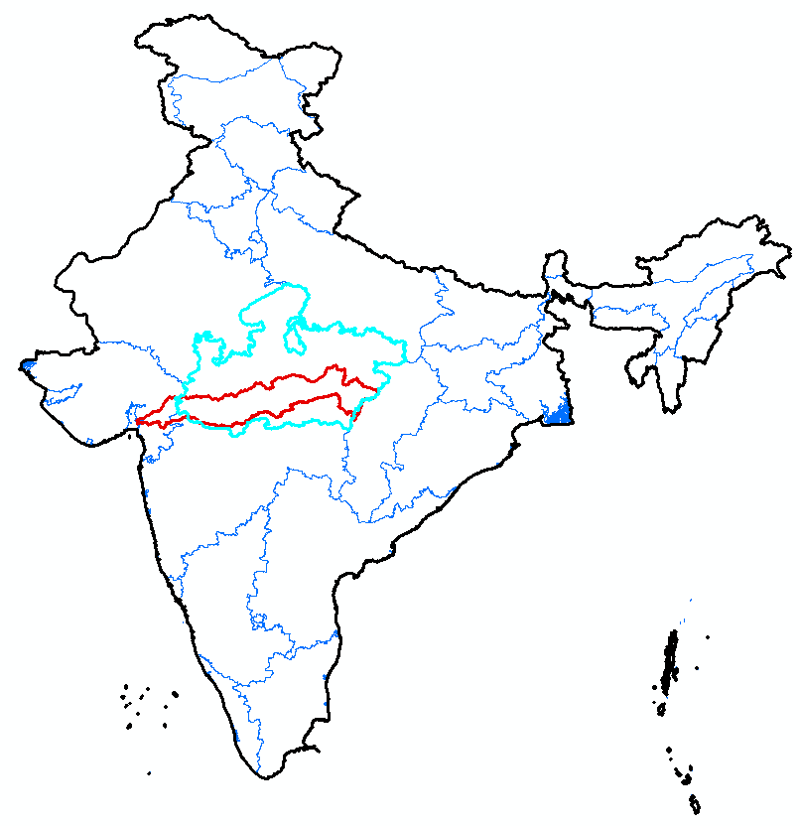
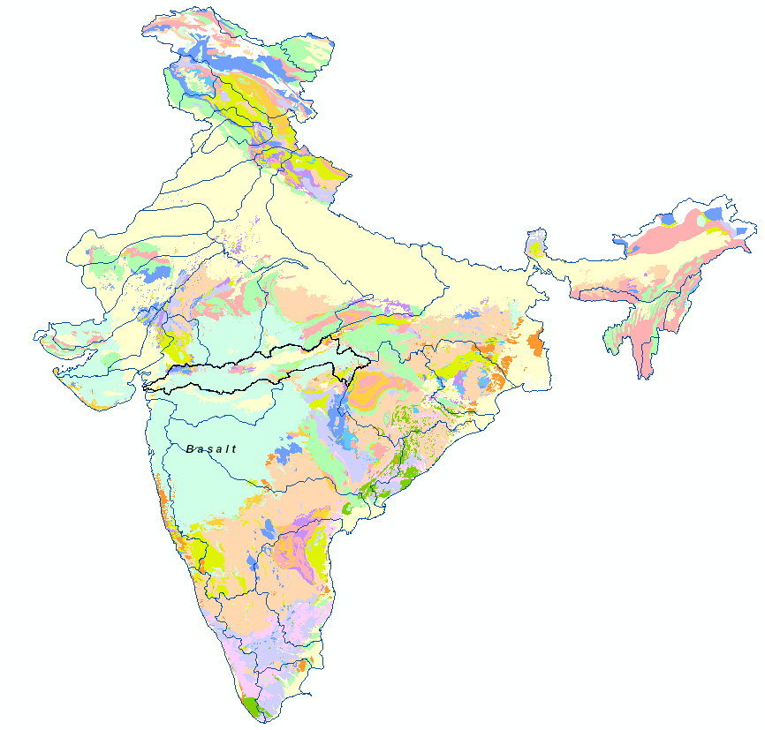
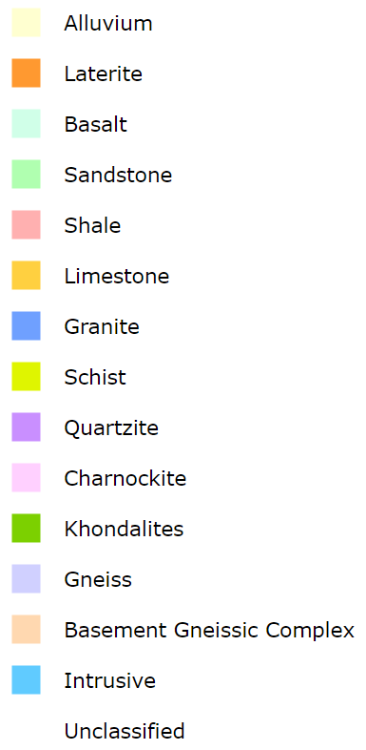
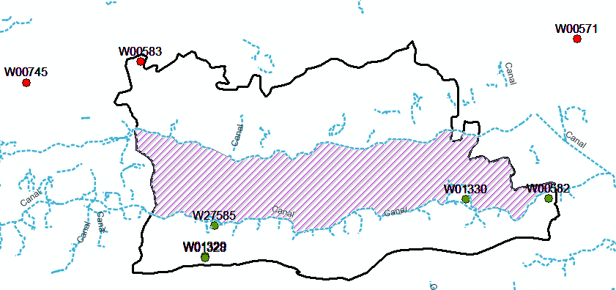
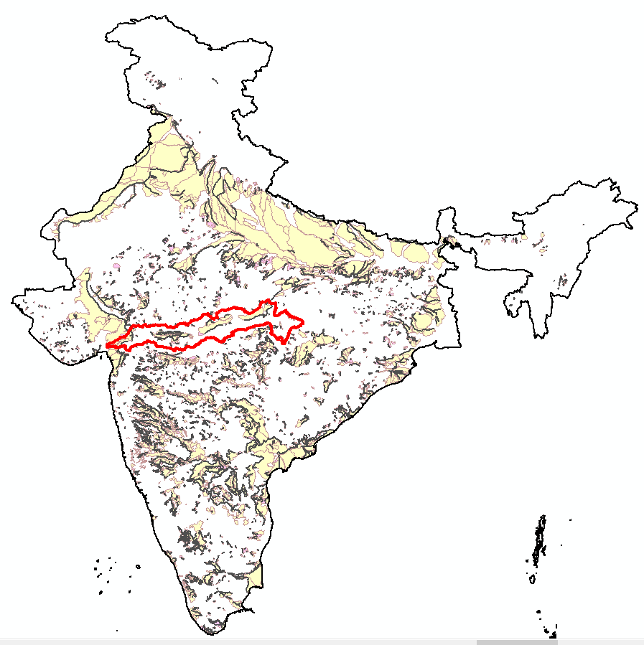
2. Study area: Narmada basin (Central India)
Canal Command Area (CCA) and Non-Canal Command Area (NCA) of the basin
INDIA
N
River length = 1312 km
River direction = West to East
Latest dam = Omkareshwar (2008)
Canal Operation (2010 ~)
Study site = Maheshwar block (simple canal network + single aquifer)
N
Canal Network
INDIA
Aquifer System of Narmada basin
Main CCA
Narmada river
Arabian Sea
Bay of Bengal
Medium CCA
Basin boundary
Arabian Sea
Bay of Bengal
Extension, Renovation & Modernization
Reservoirs
Maheshwar block
Maheshwar block
Zone B
Maheshwar block
Zone A
W01328
3
http://indiawris.gov.in
3

Slide 4
3. Methodology
3. Results
Choose study site -> Maheshwar block in Narmada basin due to single aquifer setting and simple canal layout.
Classification of wells based on location -> Wells in Command area (Zone A and B) and wells outside command area
Deriving statistics like Maximum/minimum depth, average, standard deviation of each well during pre-monsoon (dry) and monsoon (wet) season. This is calculated before (2003-10) and after (2011-16) the canal operation event.
Land use land cover (LULC) change detection by supervised classification method using Landsat series datasets. LULC change was studied between 2003 and 2013.
3.1 Increase in groundwater well level especially during pre-monsoon (dry) season
3.1 Statistics of Groundwater Wells located in the Omkareshwar Canal Command Area
3.2 Land use change: Fallow -> Agriculture
(double/triple cropping pattern)

Slide 5
Result I:
Observations from the well water level statistics
Depth of well water level in
Wells in CCA | Pre-Monsoon |  | Monsoon
 | High | Low | High | Low
Before | 6.06 | 9.63 | 3.63 | 6.05
After | 5.19 | 7.50 | 2.06 | 4.83
Wells in CCA | Avg. Fluctuation amplitude
 | Premonsoon | Monsoon
Before | 3.57 m | 2.41 m
After | 2.31 m | 2.77 m
Wells in Non-CCA | Pre-Monsoon |  | Monsoon
 | High | Low | High | Low
Before | 6.78 | 10.15 | 3.26 | 4.96
After | 6.47 | 10.20 | 3.82 | 4.96
Wells in Non-CCA | Avg. Fluctuation amplitude
 | Premonsoon | Monsoon
Before | 3.36 m | 1.70 m
After | 3.73 m | 1.14 m
Unit : meter below ground level (mbgl)
Before/After= Before/After Canal operation;
CCA = Canal command area; Non-CCA= Non canal commanded Area
high/low = highest/lowest water levels;
Notes:
Please use slide show to view the statistic table.
Statistics derived from the well existing in commanded area (Zone A) indicates the rise in water levels after the canal operation when compared to the water levels before the availability of surface water through canal networks. This change is more prominent in Pre-monsoon.

Slide 6
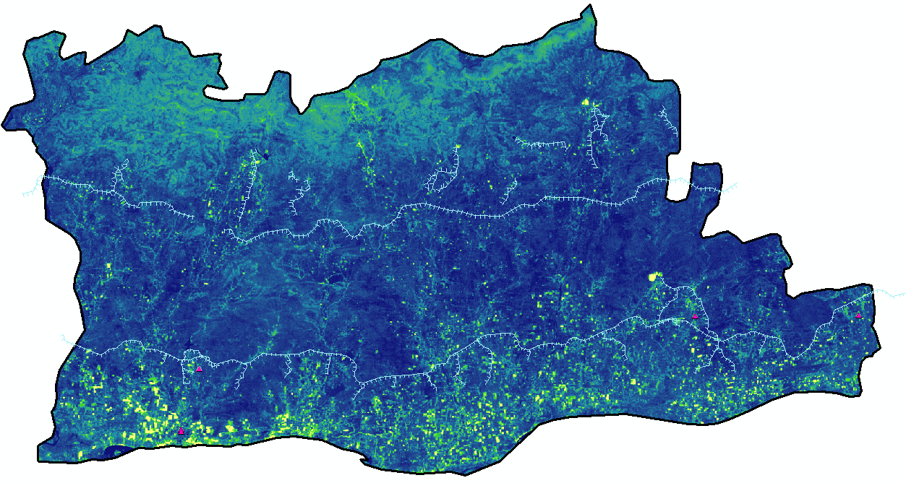
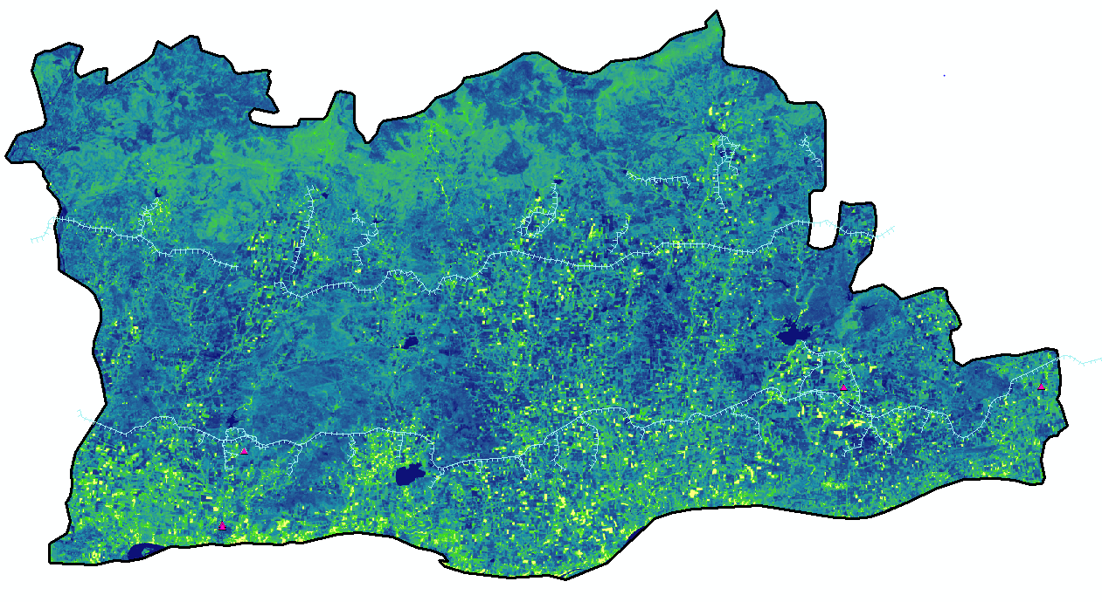
Result II: NDVI map of Maheshwar Block (2003 & 2013)
Legend
Legend
2013
Groundwater well
2003
Groundwater well
Canal
Canal
Boundary
Boundary
NDVI
NDVI
0.36
0.50
-0.48
-0.11
ZoneB
ZoneB
ZoneA
ZoneA
NDVI: Normalized Difference Vegetation Index

Slide 7
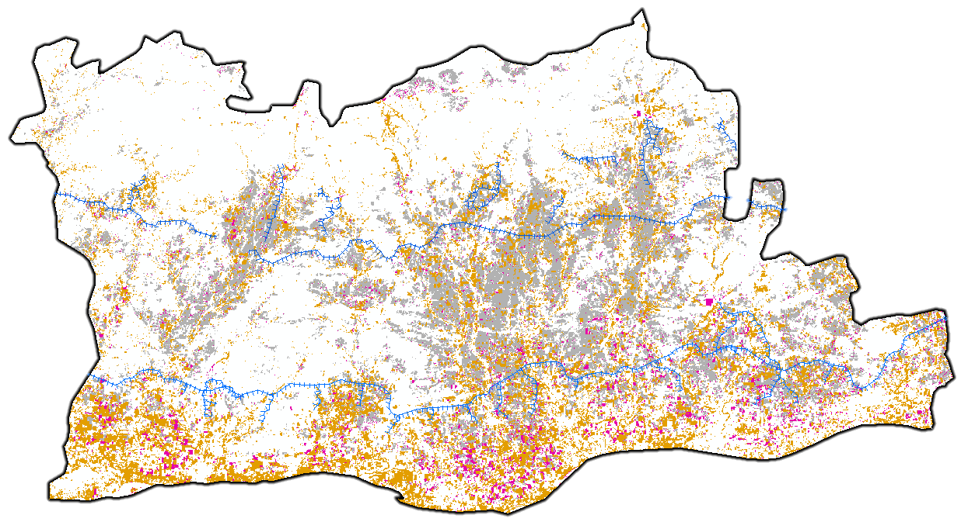
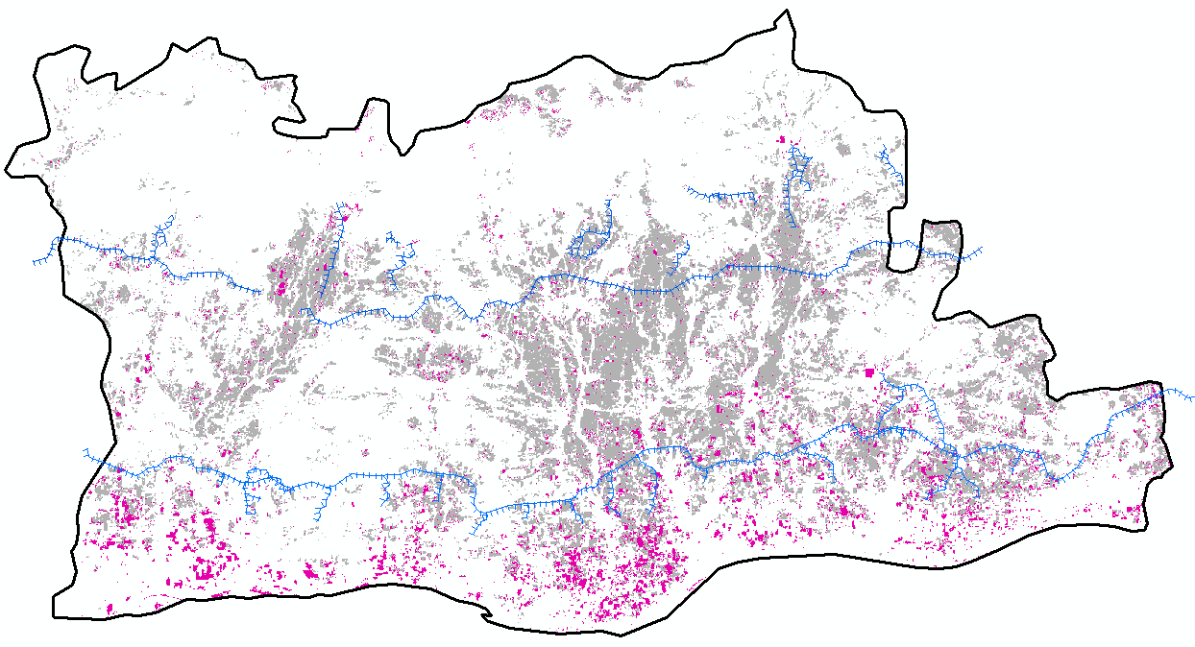
Result II: Extraction of the Agriculture/Fallow land use class
Legend
Agriculture (2003)
Fallow/DC/TC
2013
2003
Agriculture (2013)
Canal
Boundary
ZoneB
ZoneA
Notes:
The Agriculture land use increased in Zone A and Zone B as calculated in the LULC change matrix.
Change in cropping pattern from single to double/triple cropping was observed as well.

Slide 8
4. Conclusions
Study site: GRACE satellite data Narmada basin Maheshwar Block
(single aquifer system and simple layout of canal network)
2. After the canal construction, on an average, about 1 m rise was observed in the well water levels, that is, about 1.26 m in pre-monsoon while 0.35 m in monsoon seasons, respectively.
Land Use Change:
Expansion in Agriculture land use in Zone A and Zone B.
Change in cropping pattern from single to double/triple cropping.
Implication: Availability of water even during pre-monsoon (dry) season through the canals. Thus, less stress on groundwater resources due to availability of surface water resulting in increase of groundwater storage.
4. Based on the observations, available amount of water and the groundwater storage have increased after the canal operation compared with before the operation, and this may at least partly explain the reason why TWS has increased in this area.

Slide 9
THANK YOU
Save water and stay safe !

