Slide 1
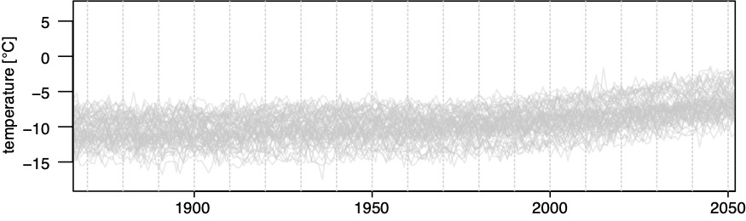





Evaluation of a novel non-parametric approach to identify Time of Emergence (ToE) of climate signals
Eric Pohl^{1,2}, Christophe Grenier², Mathieu Vrac²
¹Alpine Cryosphere and Geomorphology Group, Université de Fribourg, Fribourg, Switzerland
²LSCE/IPSL, CEA-CNRS-UVSQ, Université Paris-Saclay, Gif-sur-Yvette, France
emerging climate change or natural variability?
Notes:
regional study in Eastern Siberia
underlain by mainly continuous permafrost
predicted strong climate change based on climate model simulations (e.g. IPCC reports)
this means a lot of impacts on environment and socio-economic impacts (livelihoods, landscape changes, hydrology)
Limited in situ data tell regionally different stories (variable T and P gradients)
How to find out if climate change is emerging ; and if it is, how far is it emerged ?

Slide 2
Motivation
Climate model projections provide data on the evolution of climate variables
Signal changes over time can be more or less striking
Interpretation of these signal changes is subject to a high degree of subjectivity
When does climate change?
  AND
How much does climate change?
How certain are we that these changes occur?
Notes:
regional study in Eastern Siberia
underlain by mainly continuous permafrost
many uncertainties about what happens when permafrost thaws (killer viruses, climate feedbacks through bioactivity and carbon cycle, ecosystem changes, hydrology and landscape changes, AND livelihoods)
implied socio-economic impacts demand for an estimate of when we have to talk about climate change, a state where we are out of the bounds of natural variability
I.e. a state where we have left a possible return but have to face the upcoming changes and find mitigation strategies to cope with these changes
Approaching the problem with data (luckily temperature and precipitation records and climate simulations are available)

Slide 3
Method
Ensemble of 65 climate model simulations
Time of Emergence (ToE) approach:
test when a signal permanently exceeds its natural variability (target vs reference)
Notes:
first problem is addressed by PDFs
basically independent of the distribution family
provides already an idea about how a distribution is moving away from a reference
second is the data
best is measurements but gaps and is point-wise
second best is reanalysis or interpolated data but has the same temporal restrictions as in situ
third is climate simulations (high uncertainty but future projections)

Slide 4
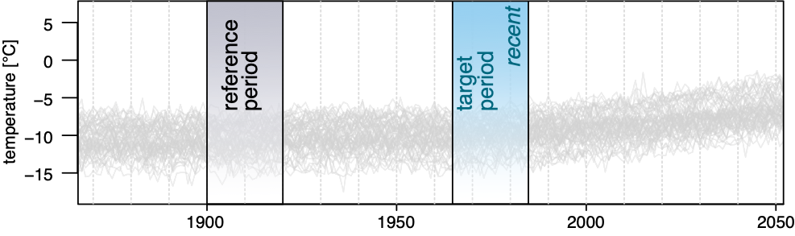
Method
Time of Emergence (ToE) approach:
test when a signal permanently exceeds its natural variability (target vs reference)
Notes:
first problem is addressed by PDFs
basically independent of the distribution family
provides already an idea about how a distribution is moving away from a reference
second is the data
best is measurements but gaps and is point-wise
second best is reanalysis or interpolated data but has the same temporal restrictions as in situ
third is climate simulations (high uncertainty but future projections)

Slide 5
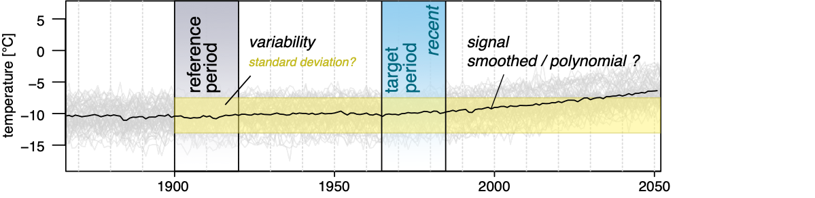
Method
Time of Emergence (ToE) approach:
test when a signal permanently exceeds its natural variability (target vs reference)
How to define natural variability ?
  statistics (e.g. standard deviation)
And what is the signal ?
  smoothed time-series signal, data distributions..
Strongly parameterized !
Notes:
first problem is addressed by PDFs
basically independent of the distribution family
provides already an idea about how a distribution is moving away from a reference
second is the data
best is measurements but gaps and is point-wise
second best is reanalysis or interpolated data but has the same temporal restrictions as in situ
third is climate simulations (high uncertainty but future projections)

Slide 6
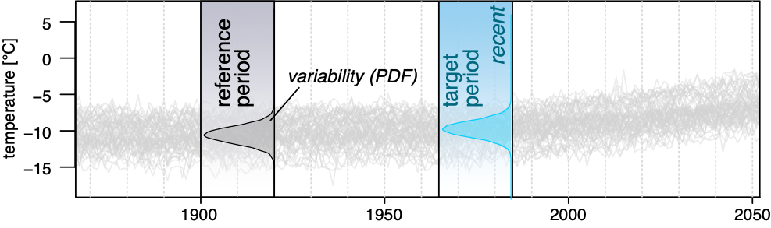
Method
signal (PDF)
Our approach:
Using the sample distributions of target and reference periods directly with a probability density function (PDF)
Notes:
first problem is addressed by PDFs
basically independent of the distribution family
provides already an idea about how a distribution is moving away from a reference
second is the data
best is measurements but gaps and is point-wise
second best is reanalysis or interpolated data but has the same temporal restrictions as in situ
third is climate simulations (high uncertainty but future projections)

Slide 7
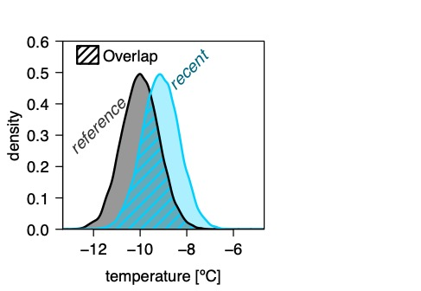
Method
signal (PDF)
… and describing the difference as overlap
Hellinger (1909) - Neue Begründung der Theorie quadratischer Formen von unendlichvielen Veränderlichen.
Notes:
first problem is addressed by PDFs
basically independent of the distribution family
provides already an idea about how a distribution is moving away from a reference
second is the data
best is measurements but gaps and is point-wise
second best is reanalysis or interpolated data but has the same temporal restrictions as in situ
third is climate simulations (high uncertainty but future projections)

Slide 8
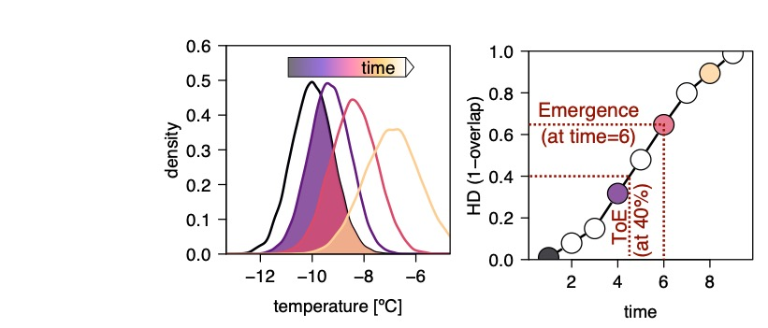
Method
signal (PDF)
… over time
… to derive the time
… and the strength of emergence
Pohl, E., Grenier, C., Vrac, M., and Kageyama, M.: Emerging climate signals in the Lena River catchment: a non-parametric statistical approach, Hydrol. Earth Syst. Sci. Discuss., https://doi.org/10.5194/hess-2019-360, in press, 2019.
Notes:
first problem is addressed by PDFs
basically independent of the distribution family
provides already an idea about how a distribution is moving away from a reference
second is the data
best is measurements but gaps and is point-wise
second best is reanalysis or interpolated data but has the same temporal restrictions as in situ
third is climate simulations (high uncertainty but future projections)

Slide 9
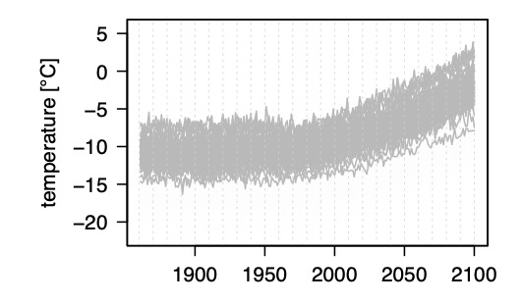
Example
65 climate model simulations
evolution of temperature
And their emergence
emergence of temperature
Notes:
example of how data look like T and P
emergence of ensemble mean is ultra fast
how realistic is that ? the smoothed signal will directly emerge

Slide 10
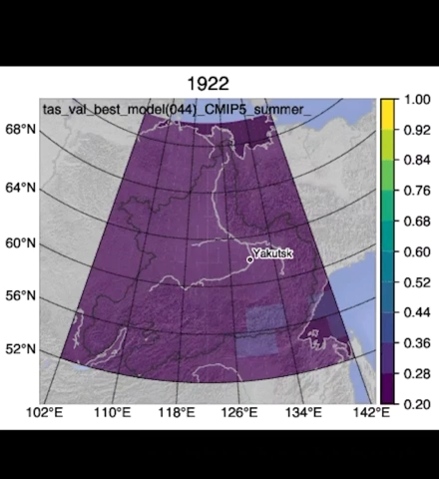
Example
Example Siberia
Pohl, E., Grenier, C., Vrac, M., and Kageyama, M.: Emerging climate signals in the Lena River catchment: a non-parametric statistical approach, Hydrol. Earth Syst. Sci. Discuss., https://doi.org/10.5194/hess-2019-360, in press, 2019.
Notes:
example of how data look like T and P
emergence of ensemble mean is ultra fast
how realistic is that ? the smoothed signal will directly emerge

Slide 11
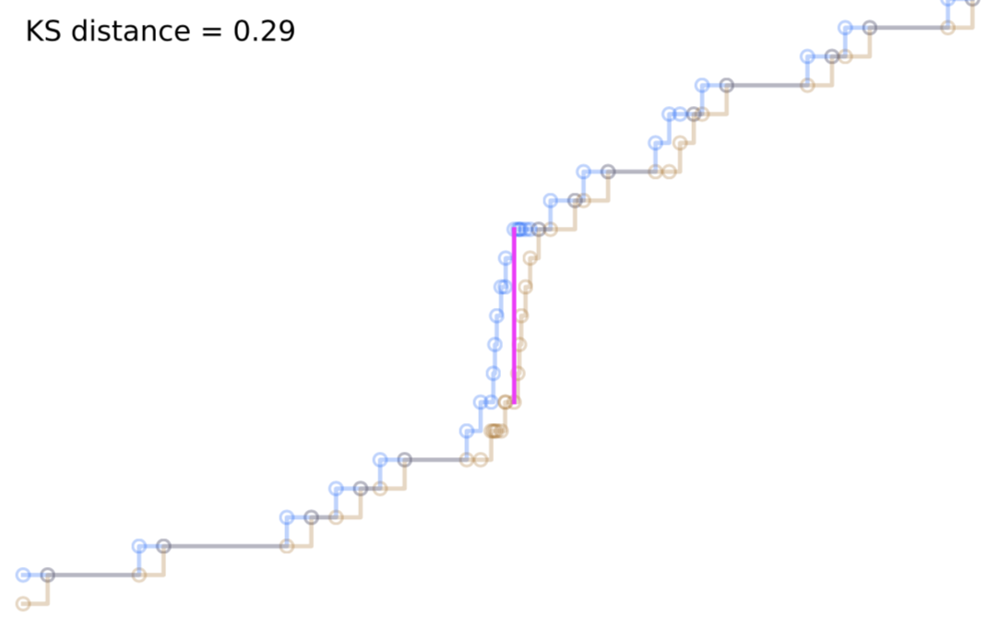
Comparison
Completely objective and non-parametric?
The HD-approach uses a Kernel Density Estimator (KDE) to obtain the distributions
  → Unavoidable introduction of hyperparameter for the KDE (bandwidth & kernel)
Alternatives:
Kolmogorov-Smirnov test is based on a distance metric (KS-metric) and defined significance level
Most similar approach
KS-metric based on comparison of Cumulative Density Functions (no additional parameters needed!)
What is the impact of hyperparameters on the results?
Is the KS-metric without need for hyperparameters a better choice?
Notes:
example of how data look like T and P
emergence of ensemble mean is ultra fast
how realistic is that ? the smoothed signal will directly emerge

Slide 12
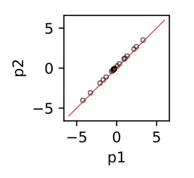
Comparison
Test case with slightly offset values (p2) of a sample (p1)
Notes:
example of how data look like T and P
emergence of ensemble mean is ultra fast
how realistic is that ? the smoothed signal will directly emerge

Slide 13
Comparison
PDF of p2
PDF of p1
Difference
Notes:
example of how data look like T and P
emergence of ensemble mean is ultra fast
how realistic is that ? the smoothed signal will directly emerge

Slide 14
Comparison
Choosing bandwidth only based on number of data points (Scott’s factor):
Relatively low range for expected sample sizes between 10 and 100
Notes:
example of how data look like T and P
emergence of ensemble mean is ultra fast
how realistic is that ? the smoothed signal will directly emerge

Slide 15
Comparison
Expected low PDF offset and thus low HD for various bandwidths (bw)
Notes:
example of how data look like T and P
emergence of ensemble mean is ultra fast
how realistic is that ? the smoothed signal will directly emerge

Slide 16
Comparison
KS-metric is very sensitive to this special case !
Notes:
example of how data look like T and P
emergence of ensemble mean is ultra fast
how realistic is that ? the smoothed signal will directly emerge

Slide 17
Comparison
Test case of signal with defined onset of linear increase
Notes:
example of how data look like T and P
emergence of ensemble mean is ultra fast
how realistic is that ? the smoothed signal will directly emerge

Slide 18
Comparison
Pohl, et al. 2019
Range in distances
Distance
The curves in the lowest panel show the distances of the KS-metric (orange) and the HD (blue). Shading is the inner quartile range (IQR) and dots show 5-95% interval of 5000 generated random time series parameterized as the example above.
Similar representation although slightly higher variability for KS-metric
“Edgy” progression of KS-metric
Notes:
example of how data look like T and P
emergence of ensemble mean is ultra fast
how realistic is that ? the smoothed signal will directly emerge

Slide 19
Comparison
Test case of signal with slowly increasing standard deviation
Notes:
example of how data look like T and P
emergence of ensemble mean is ultra fast
how realistic is that ? the smoothed signal will directly emerge

Slide 20
Comparison
Pohl, et al. 2019
The KS-metric (orange) shows a step-like progression and cannot detect the change until crossing a certain threshold. The HD (blue) detects the change early on.
High sensitivity of HD to even slight changes with as narrow or narrower variability in obtained results
Notes:
example of how data look like T and P
emergence of ensemble mean is ultra fast
how realistic is that ? the smoothed signal will directly emerge

Slide 21
Sensitivity to non-normal distributions
Gamma distributions with different shape parameters (a)
- 1000 randomly generated samples for each (a)
Normal distributed values (e.g. long temporal aggregation; temperature)
vs.
Non-normal distributed values (e.g. short temporal aggregation; precipitation)
The KDE approach uses normal distributions as kernel in our approach:
- Can the HD still accurately identify the overlap in such cases?
Notes:
example of how data look like T and P
emergence of ensemble mean is ultra fast
how realistic is that ? the smoothed signal will directly emerge

Slide 22
Sensitivity to non-normal distributions
Dark colour if difference in (a) is big – i.e. the shapes are very different
Pohl, et al. 2019
Sample size used to generate the PDF
Light colour if difference in (a) is small – i.e. the shapes are very different
True distance based on the actual gamma distributions – not on the KDE-PDF
Notes:
example of how data look like T and P
emergence of ensemble mean is ultra fast
how realistic is that ? the smoothed signal will directly emerge

Slide 23
Sensitivity to non-normal distributions
Pohl, et al. 2019
Even with low sample size robust once a difference of ~30% is reached
Notes:
example of how data look like T and P
emergence of ensemble mean is ultra fast
how realistic is that ? the smoothed signal will directly emerge

Slide 24
Conclusions
The Hellinger Distance approach is robust for all test cases to identify the emergence of climate change signals
Using a KDE to calculate the needed PDFs introduces unavoidable hyperparameters
  → The most important one (bandwidth) seems to have low impact if Scott’s factor is used (only dependent on sample size)
  Higher computational costs compared to KS-metric has huge benefit of providing capability to detect even slightest changes and being more robust
  HD approach is also applicable for non-normal distributed data
Further reading and more details here:
Pohl, E., Grenier, C., Vrac, M., and Kageyama, M.: Emerging climate signals in the Lena River catchment: a non-parametric statistical approach, Hydrol. Earth Syst. Sci. Discuss., https://doi.org/10.5194/hess-2019-360, in press, 2019.
Notes:
example of how data look like T and P
emergence of ensemble mean is ultra fast
how realistic is that ? the smoothed signal will directly emerge

