Slide 1
Geology and geochemical characteristics of coal bearing source rocks in Nariin sukhait deposit, southern Mongolia Presenter: N.Baigalmaa Senior lecturer Department of Geology and Geophysics, School of Arts and Sciences, National University of Mongolia 2020.05.07

Slide 2
Contents
Brief introduction of Mongolian coal bearing basins
Geology of the Nariin Sukhait deposit
Geochemistry of sedimentary rocks from the Nariin Sukhat deposit
Trace elements and SEM-CL imaging study on quarts of sedimentary rocks from the Nariin Sukhat deposit
Conclusions

Slide 3
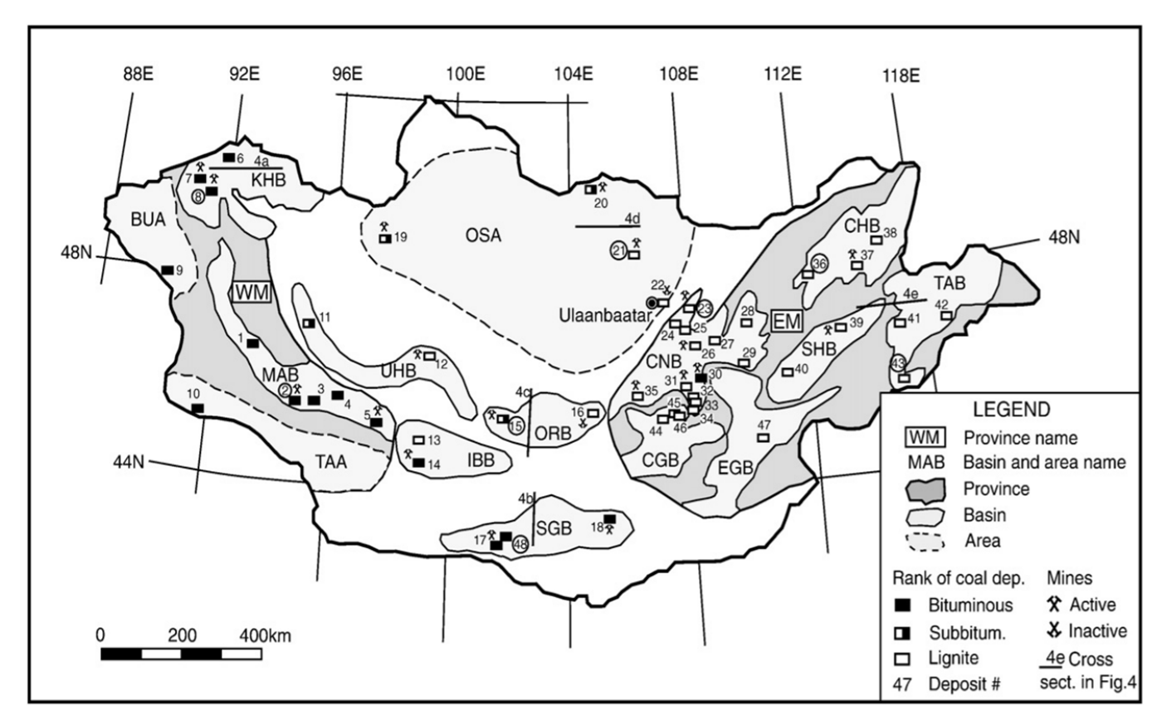
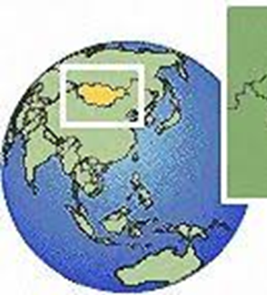
A location map of Mongolian coal-bearing provinces, basins and Nariin Sukhait deposit
17-Nariin sukhait
modified after Bat-Erdene, 1989

Slide 4
Coal quality of South Gobi, Southern Khangai, Ikh Bogd, and Ongi river basins and Orkhon–Selenge area
B. O. Erdenetsogt et al 2009

Slide 6
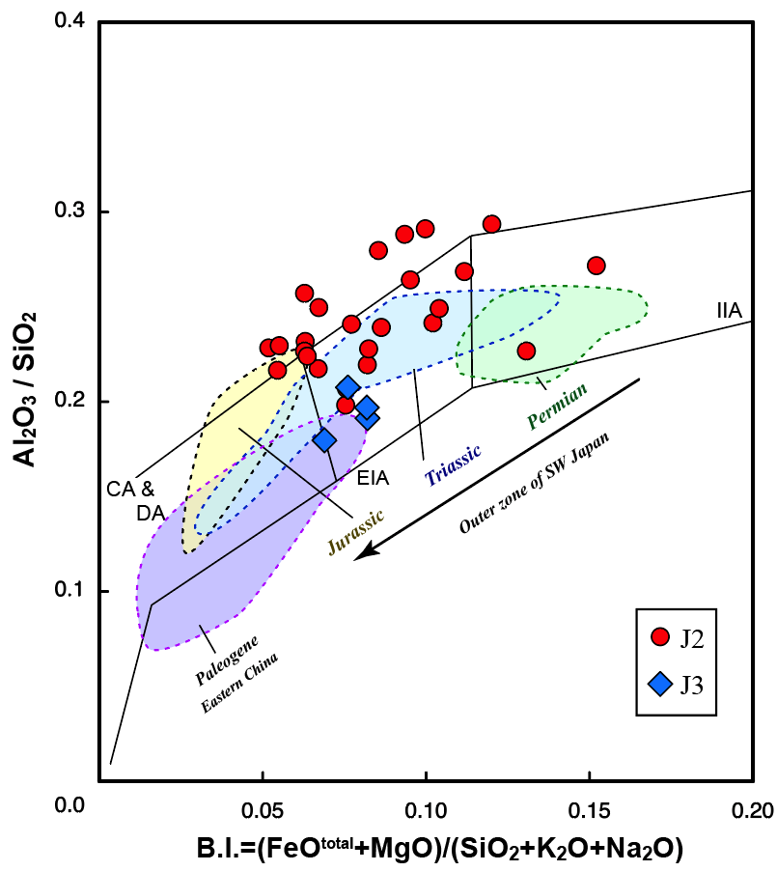
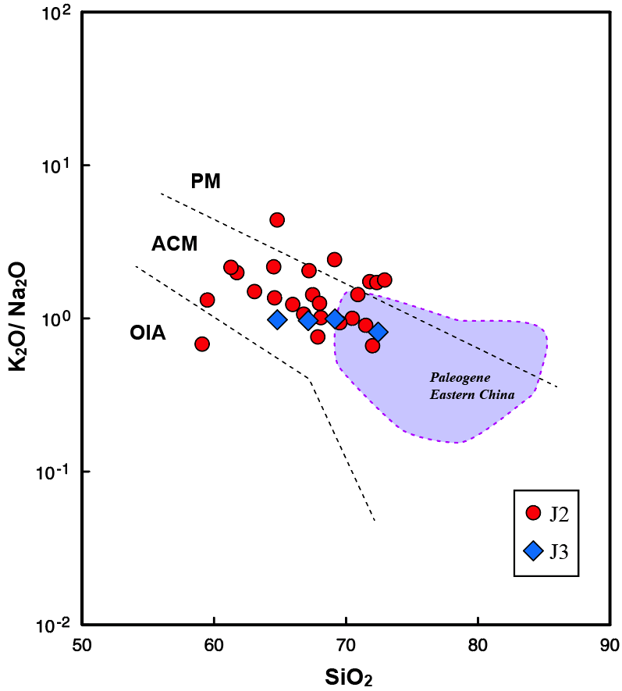
Geochemistry of sedimentary rocks from the Nariin Sukhat deposit
Fig. Al₂O₃/SiO₂ vs B.I. diagram for sedimentary rocks. Fields IIA (immature island arc), EIA (evolved island arc) and CA & DA (Continental island and Dissected arc) from Kumon & Kiminami (1994). Data from Dozen & Ishiga (2000) and Zhang et al. (2013).
Fig. K₂O/Na₂O relations SiO₂ in sedimentary rocks from this study area. Fields OIA (Oceanic island arc), ACM (Active continental margin) and PM (Passive Continetal margin from Roser and Korsch (1986). Geochemical data of Paleogene sedimentary rocks from Zhang et al. (2013).

Slide 7
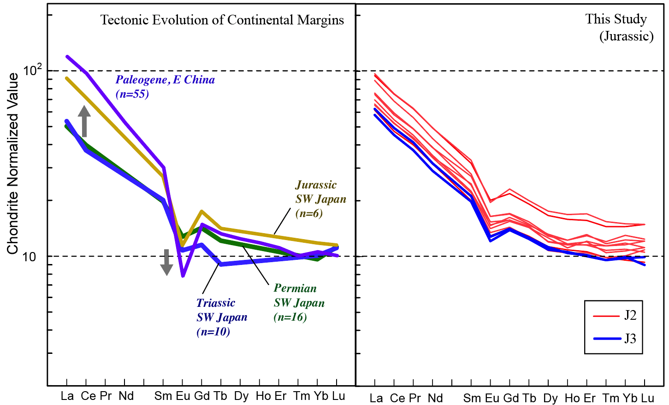
Geochemistry of sedimentary rocks from the Nariin Sukhat deposit
Fig. Chondrite-normalized REE patterns of sedimentary rocks from the East Asian continental margin and the studied area. Chondrite value from Taylor and MacLeanan (1985). Data from Dozen & Ishiga (2000) and Zhang et al. (2013).

Slide 8
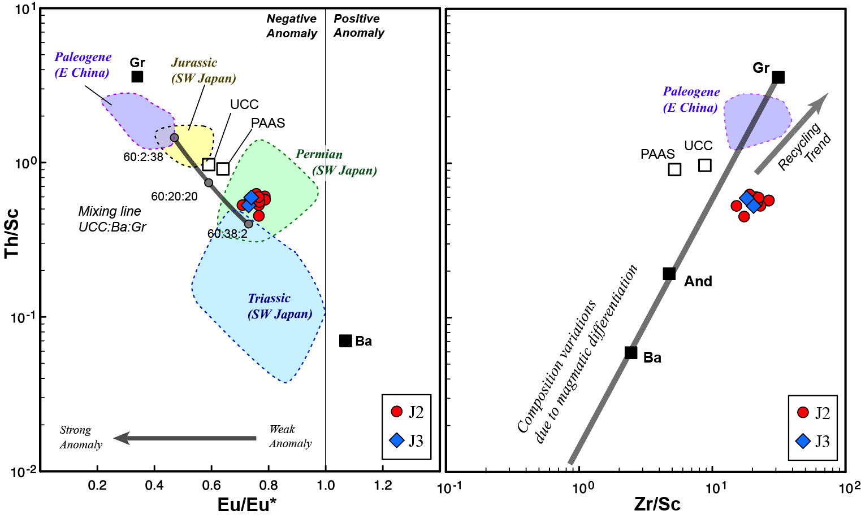
Geochemistry of sedimentary rocks from the Nariin Sukhat deposit
(a)
(b)
Fig. Estimation of original rocks of sedimentary rocks from this studied area using mixing model. (a) Eu anomaly vs Th/Sc diagram. (b) Zr/Sc vs Th/Sc diagram (after McLeannan et al., 1993). Data of UCC (Upper Continental crust), PAAS (post-Archaean sedimentary rocks), Gr (Phanerozoic Granite), And ((Phanerozoic Andesite) Ba (Phanerozoic Basalt) and mixing line from Dozen and Ishiga (2000) and Zhang et al. (2013).

Slide 9
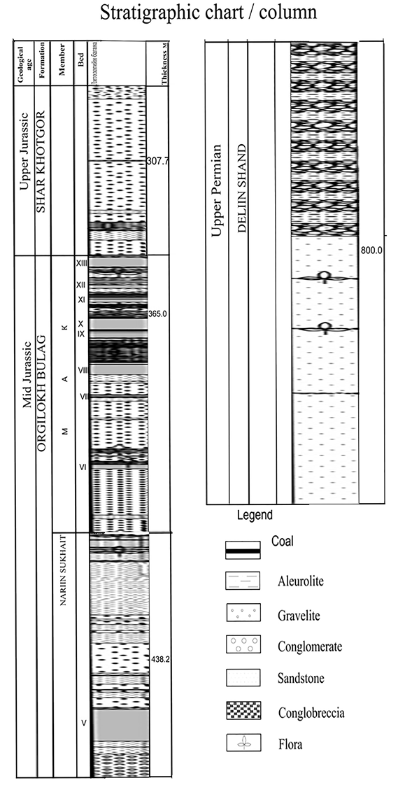
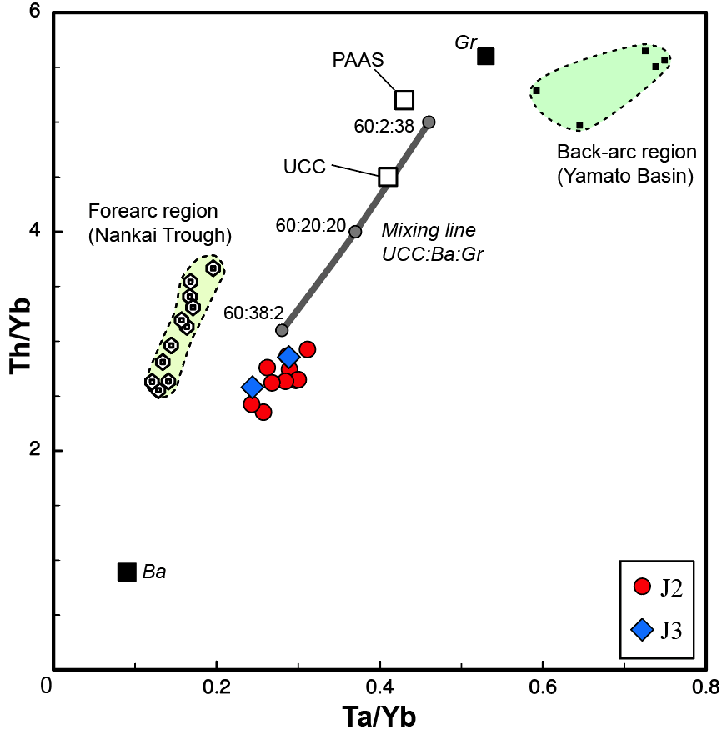
Fig. Estimation of sedimentary environments from this studied area using . Ta/Yb vs Th/Yb diagram. Data of Foreaec and Back-arc region of quarternary sediments from Dozen and Ishiga (2000).
The chemical composition of whole indicates (variable composition, values of the ratio Th/U > 3.8-4.2, values Th/Sc 0.3-0.8, values La_{N}/Yb_{N} > 5 and values Eu/Eu* (0.6-0.9)
The low CIA values (50–60) and Zr/Sc vs Th/Sc diagram indicate the absence or poor chemical weathering in the source area which is consist of andesitic to acidic rocks.
Analysis on tectonic setting of the source area suggests an active continental margin, which is similar to forearc sediment environments.

Slide 10
SEM-CL imaging study on quarts of sedimentary rocks from the Nariin Sukhat deposit
SEM-CL-imaging of sand stone quartz from Nariin sukhait show three types of quartz:
early Q1 cementation has gray to slightly grey luminescences, postdated compaction, and reduced intergranular porosity associated with illite formed during eogenesis.
Q2 is characterized by dark luminescence overgrowths and is more voluminous in the thinly bedded sandstones than in the thickly bedded sandstones filling most of the remaining pore space during mesogenesis.
Q3 was formed during the early telogenesis stage fully cementing the sandstones and the fractures were filled by hydrothermal chlorite and sulfides.

Slide 11
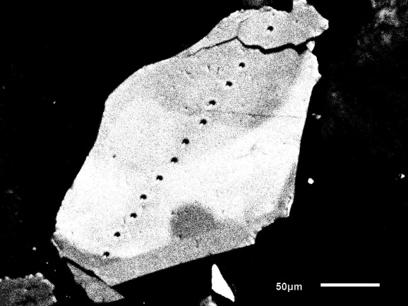
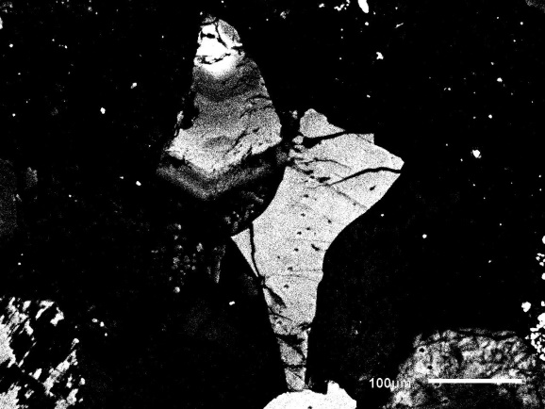
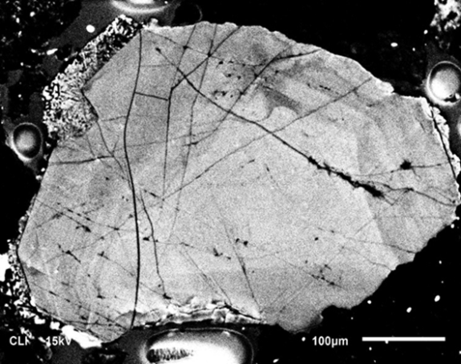
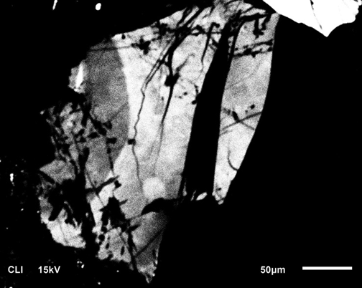
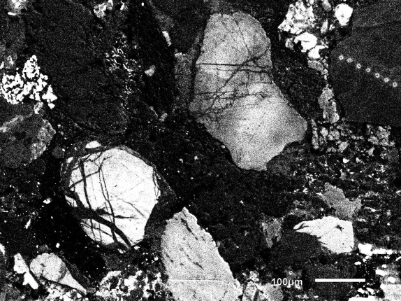
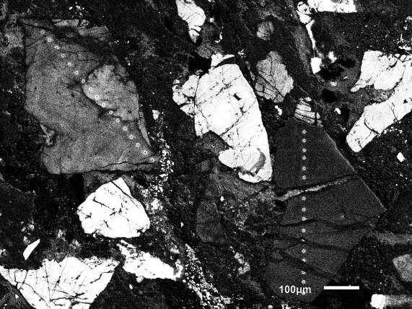
Paragenetic Models
Eogenesis
Q1
Q1
Mesogenesis
Q2
Q2
Telogenesis
Q3
Q3

Slide 12
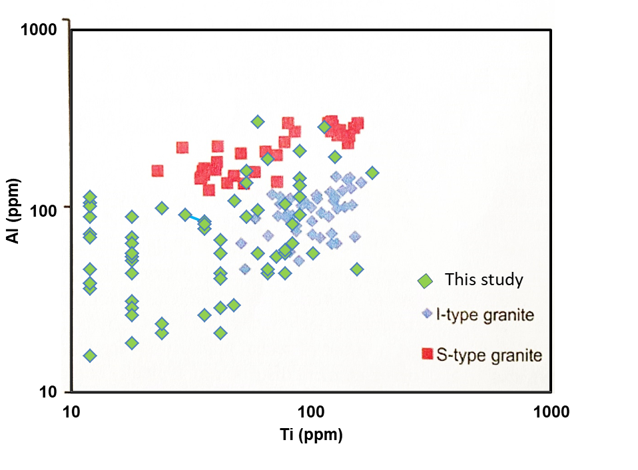
Aluminum and titanium concentrations in quartz from the Nariin sukhait sedimentary rocks
Rusk 2014.
Sedimentary rocks samples were collected drill hole N 52 of the Nariin sukhait coal deposit. Ti and Al values indicate almost all of the quartz in this sample was derived from I type granitoids, with little evidence of peraluminous quartz.

Slide 13
Conclusions
The chemical composition of whole indicates indicates components derived from the active continental margin type. Trace and Rare earth elements diagram indicate the absence or poor chemical weathering in the source area which is consist of andesitic to acidic rocks.
Analysis on tectonic setting of the source area suggests an active continental margin, which is similar to forearc sediment environments.
The geochemical, SEM-CL imaging and EPMA data results suggest a relatively homogeneous source, whit felsic composition similar to igneous rocks. The sedimentary environment of these sedimentary rocks was the poor chemical weathering in the source area.
Quartz CL textures and trace element compositions can be understanding the magmatic processes and also provide unique new insights into provenance determination in sedimentary rocks.

Slide 14
Thank you for your attention

