Slide 1


Front related model evaluation of multi-year simulations from hydrostatic to convection-permitting scales in the greater Alpine region
Heimo Truhetz¹, Dom Heinzeller², Robert Ritter³, Laurin Herbsthofer³
¹ University of Graz, Wegener Center for Climate and Global Global Change, Graz, Austria
² University of Colorado Boulder & NOAA/ESRL Global Systems Division, Cooperative Institute
for Research in Environmental Sciences, Boulder, CO, USA
³ University of Graz, Wegener Center for Climate and Global Global Change, Graz, Austria
email: heimo.truhetz@uni-graz.at
Tel.: ++43 316 380 8442
EGU 2020, Session CL2.44 @ Display, May 8, 2020

Slide 2




Acknowledgements
“Research for Climate Protection: Value-adding
Convection-Permitting Climate Simulations Austria”
(reclip:convex)
funded by the Klima- und Energiefonds through the Austrian Climate
Research Programme (ACRP) (ID: B769999)
Klaus Görgen (Institute of Bio- and Geosciences, Agrosphere, Research Centre Jülich)

Slide 3
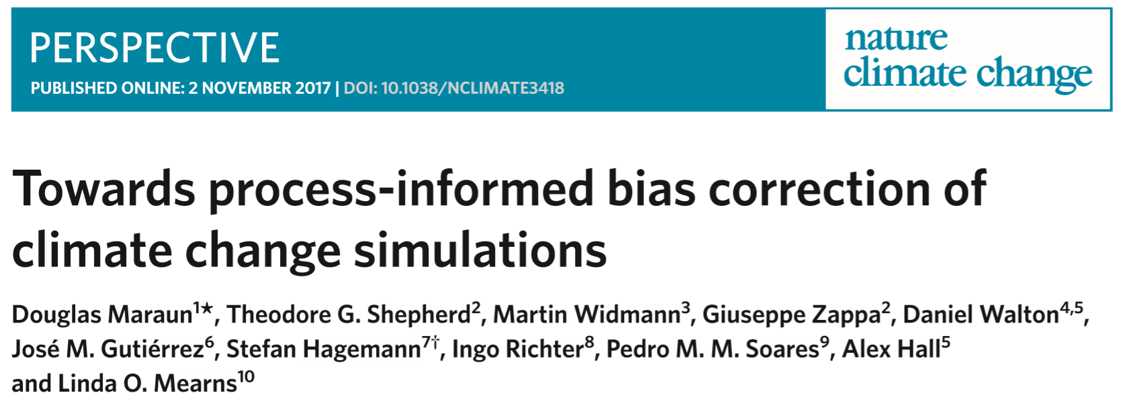
Motivation
Process-related investigations ask for algorithms that are able to isolate such processes in climate model data (across various model types and model grids)
➔ Detect the same front as the “same” in different models.
➔ Deviations among models should not be artificial results of
the algorithm.
➔ What are the criteria for a front detection algorithm to
give comparable results among different models and
resolutions?

Slide 4
Problem set, methodology, and goals
overview: Thomas & Schultz, Mon Wea Rev, 2019
Thomas & Schultz, BAMS, 2019
Components of front detection algorithms
Thermodynamic
field
Smoothing
Filtering
Detection algorithm
temperature
potential temperature,
equiv. potential temp.,
wet-bulb temperature,
wind, et al.
very coarsely resolved grid
(e.g. Catto et al. 2015),
moving weighted averages
(e.g. Jenkner et al. 2009;
Hewson & Titley 2010),
spectral decomposition
(e.g. Piazza et al. 2019)
horizontal gradient (G),
Thermal Front Parameter (TFP),
frontogenesis function (F),
asymptotic contraction rate (C),
et al.
Influence of smoothing vs spectral filtering by means of an idealised test function
Influence of different model resolutions by means of idealised baroclinic wave simulations
1. + 2. ➔ criteria for comparability
Application: (comparable) front statistics from multi-year simulations in the Alpine region
from CORDEX-FPS (real case)

Slide 5
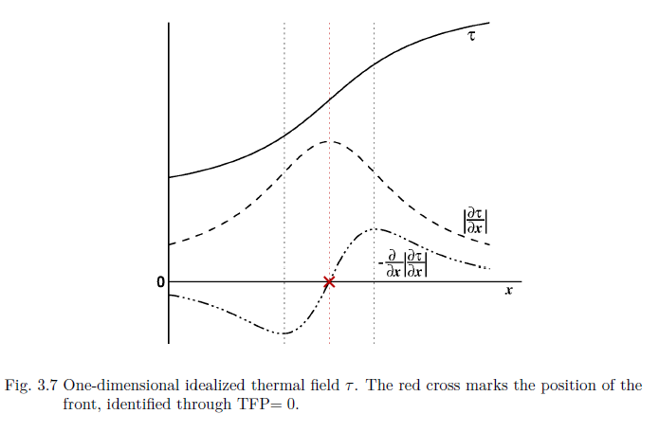




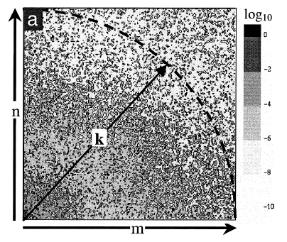
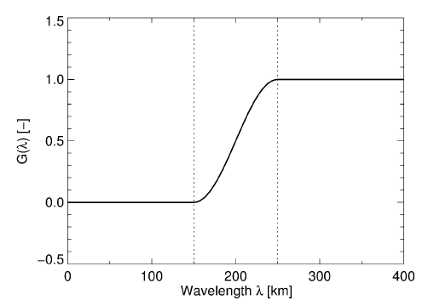

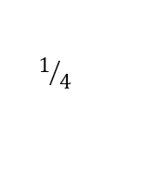


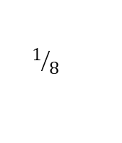


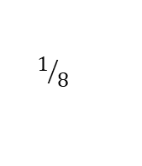
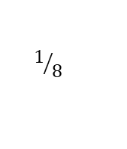

Front detection algorithm
Ritter (2014)
TFP … Thermal Front Parameter:
… thermal field
(temp., pot. temp., equiv. pot. temp., wet-bulb temp.)
masking condition for baroclinic zones:
Condition to avoid local minima:
1-2-1 smoother,
applied in n iterations
Discrete Cosine Transform (DCT)
(Denis et al., 2002)
$$1/{16}$$
$$1/8$$
$$1/{16}$$
$$λ_{L}$$
$$λ_{H}$$
$$1/8$$
$$1/4$$
$$1/8$$
$$1/{16}$$
$$1/8$$
$$1/{16}$$
Ritter (2014)

Slide 6
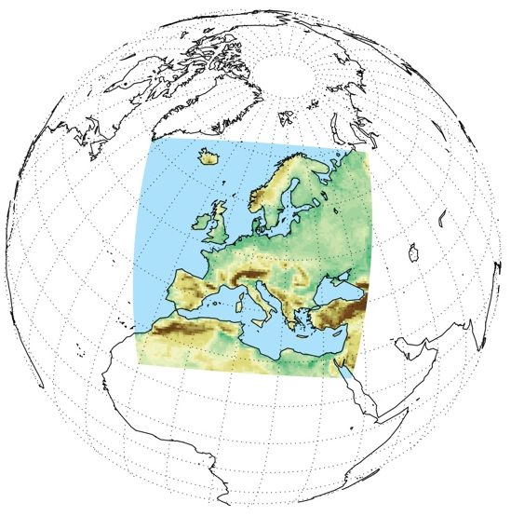
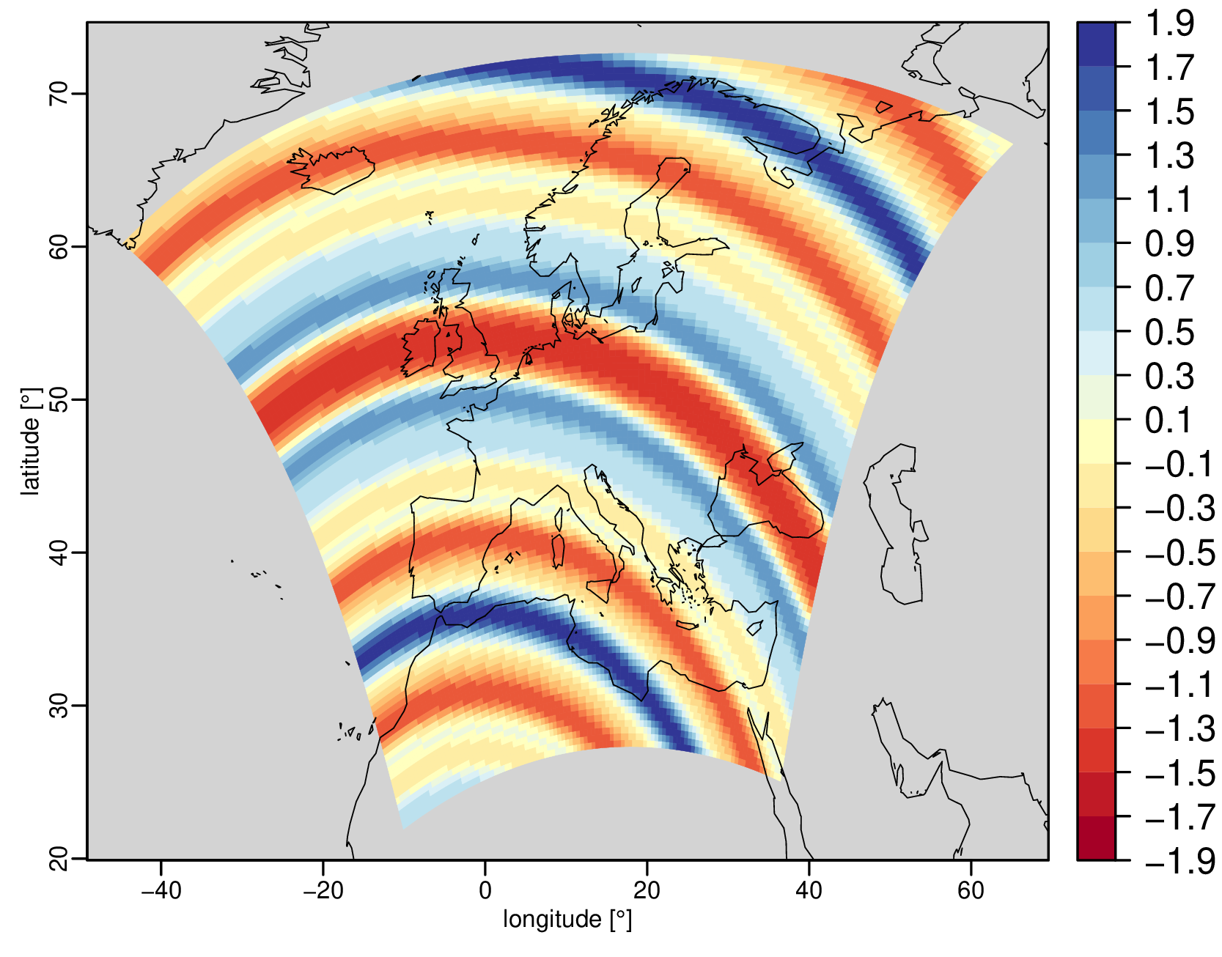
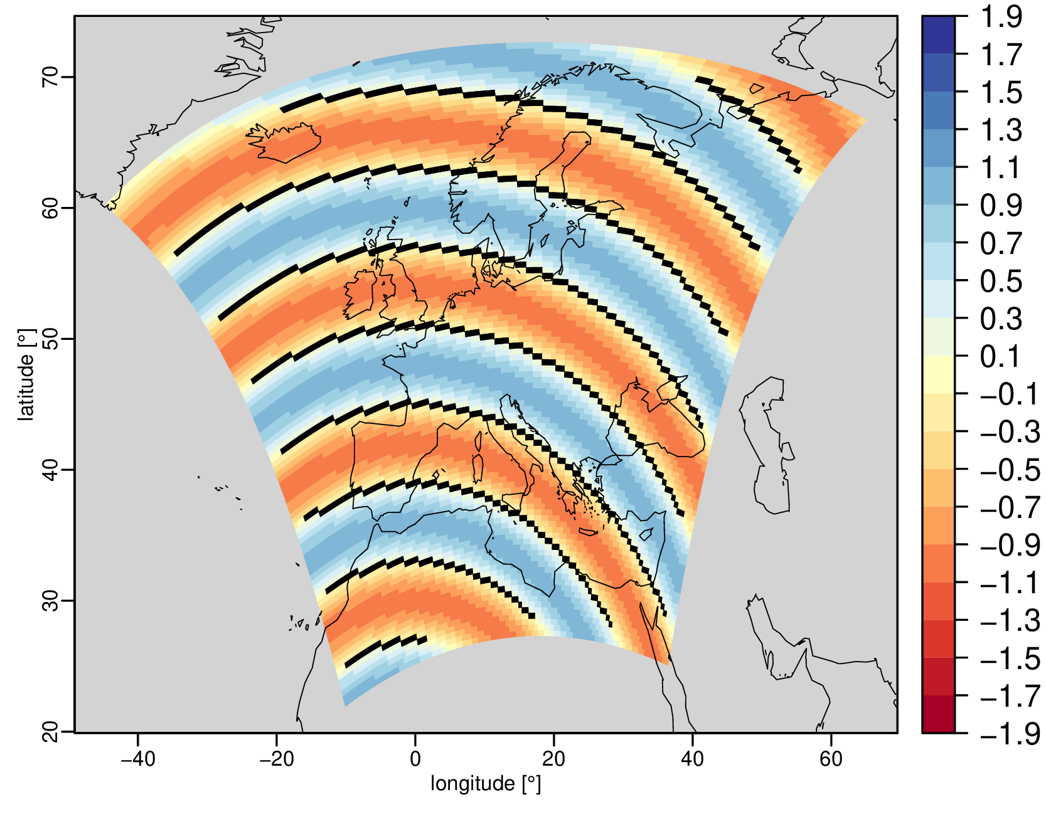




1. Idealised testing function
Function = Cosine + 2 disturbance terms
extracted on EURO-CORDEX (Jacob et al., 2014) domains
0.44° and 0.11° grid spacing
$$ψ\left(λ, φ\right)=r_{1} \cos{(k_{1} s\left(λ,φ\right))} {+ r}_{2} \cos{(k_{2} s\left(λ,φ\right))} + r_{3} \cos{(k_{3} s\left(λ,φ\right))}$$
Cosine
wrapped around the globe
r₁ = 1 ; k₁ = 30
disturbance
k₂ = 50
additional disturbance
k₃ = 100
$$r_{2}= r_{1}\sqrt{{10}^{−2 \left[\log\left({k_{2}}/{k_{1}}\right)\right]} }$$
$$r_{3}= r_{1}\sqrt{{10}^{−2 \left[\log\left({k_{3}}/{k_{1}}\right)\right]} }$$
$$ψ\left(λ, φ\right)$$
$$r_{1} \cos{(k_{1} s\left(λ,φ\right))}$$
Smoothing/
Filtering
dominant Cosine
k₁ = 30
should remain

Slide 7
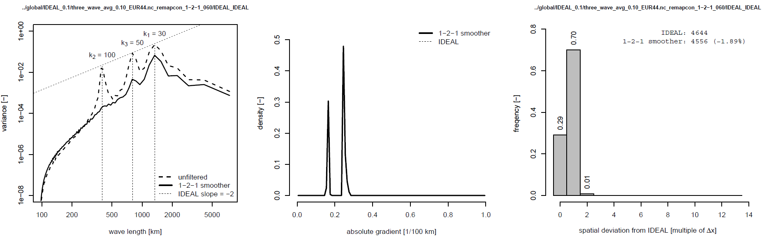
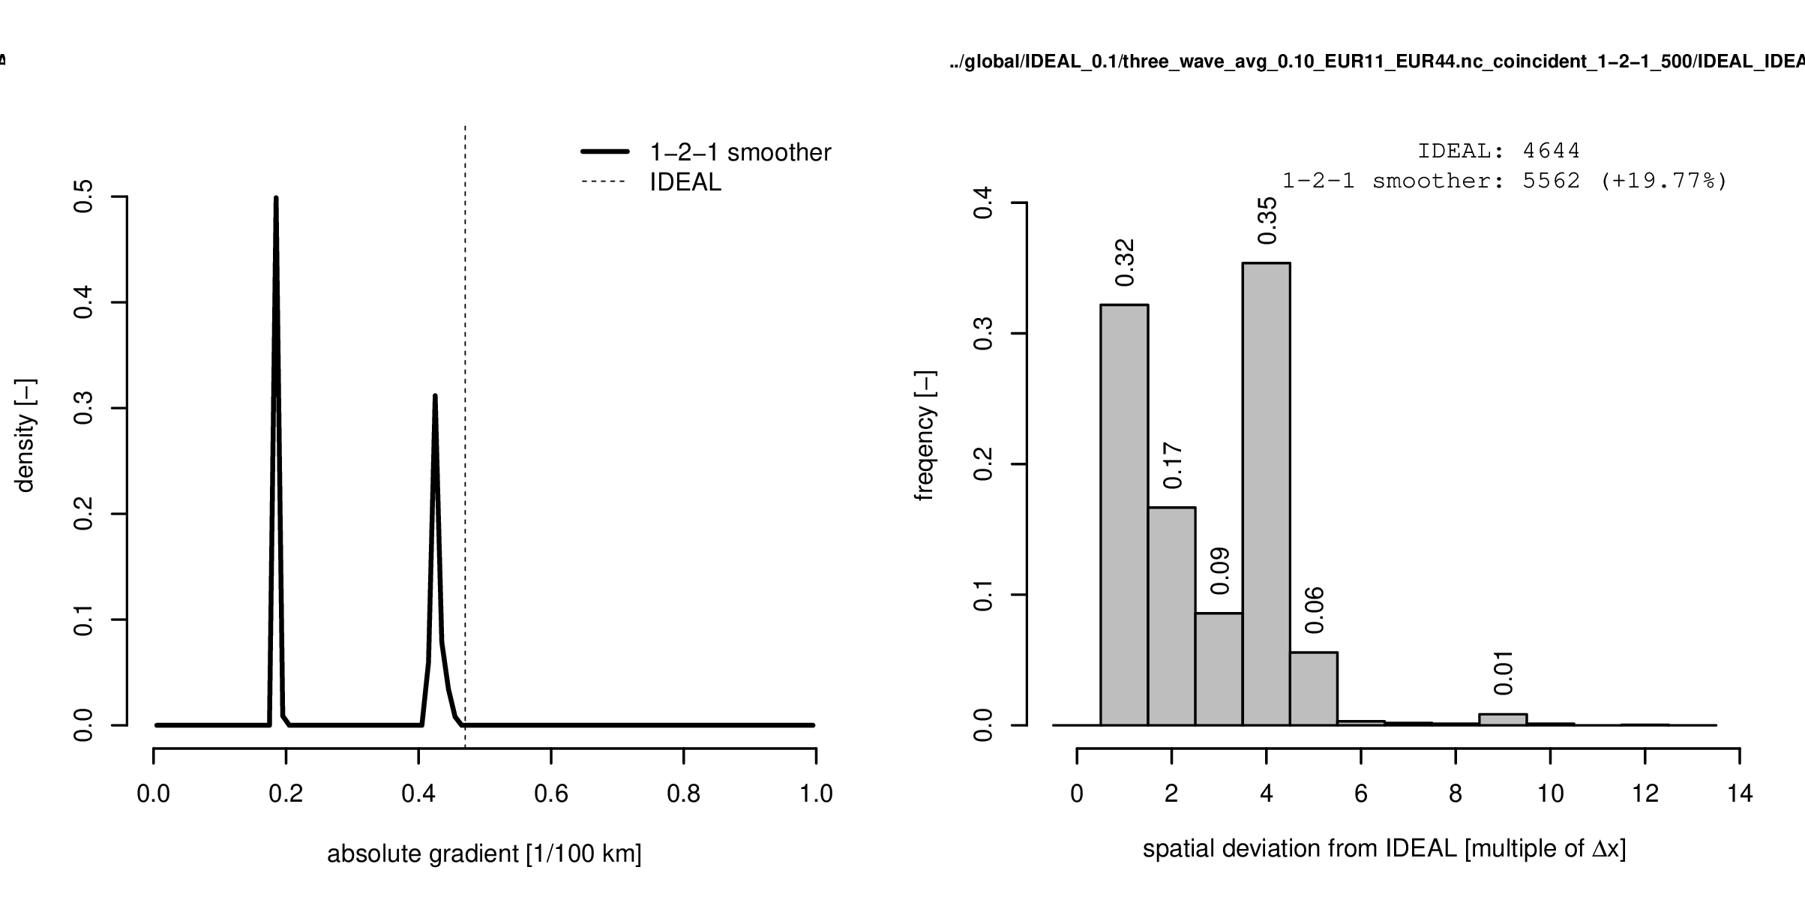
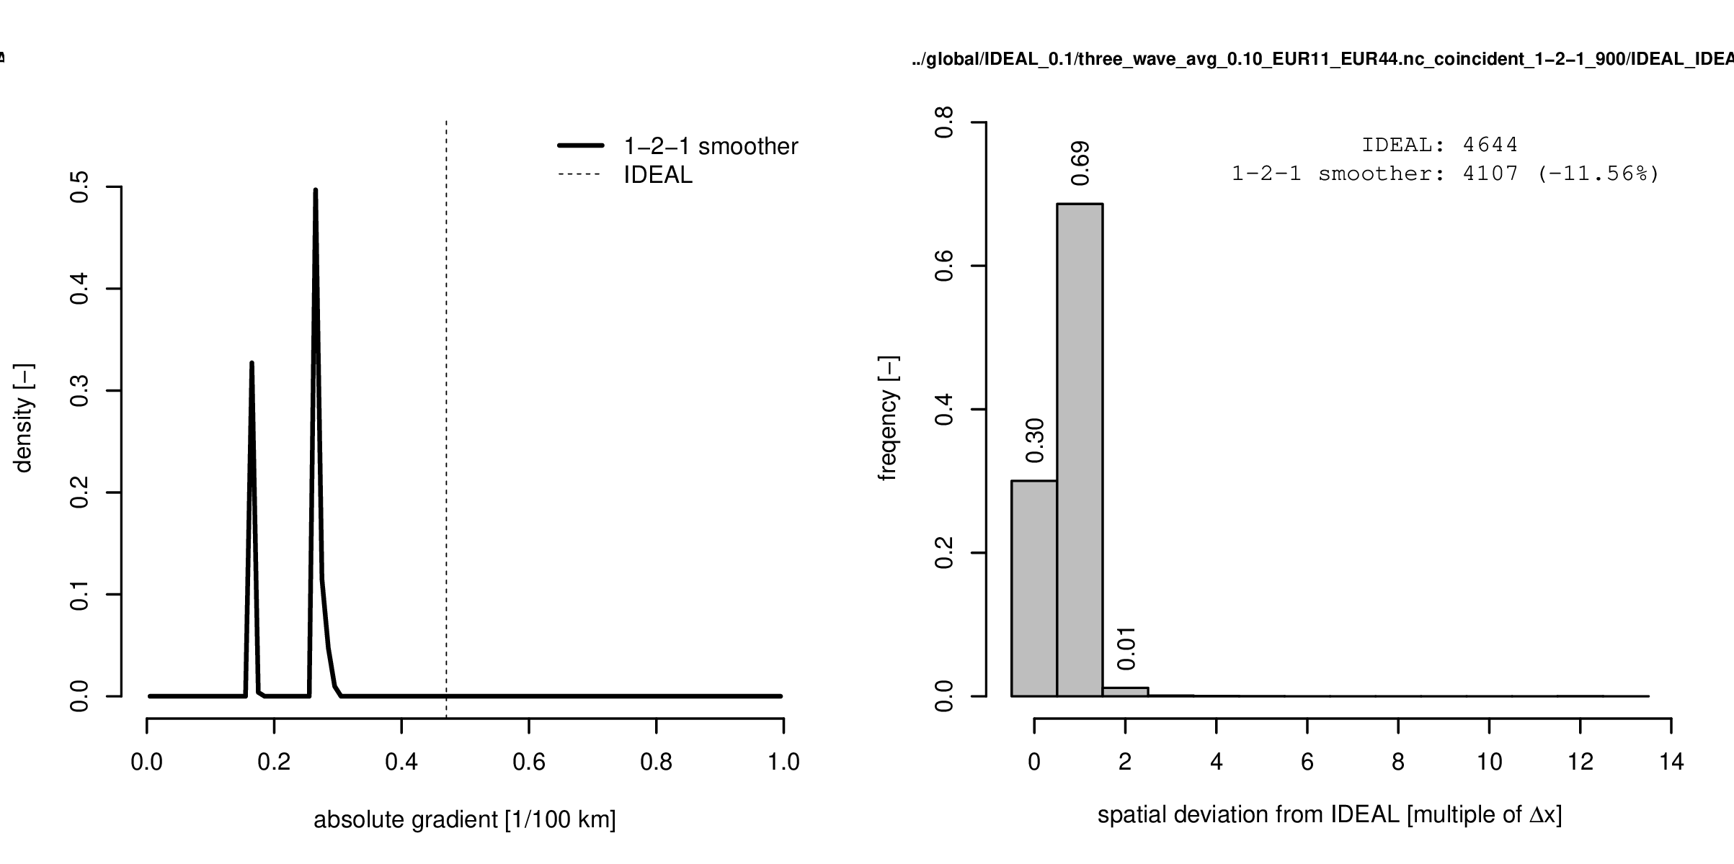
1. Idealised testing function
0.99
EUR-44
n = 60 iterations
selective dampening of certain
wavelengths is not possible
underestimation of front strengths
n depends on the grid spacing
but n is a priori not known
EUR-11
n = 500 iterations
EUR-11
n = 900 iterations

Slide 8
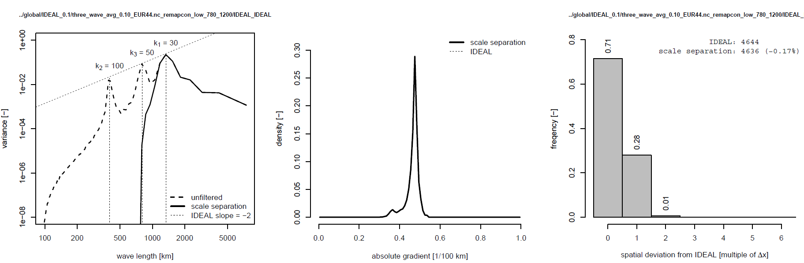
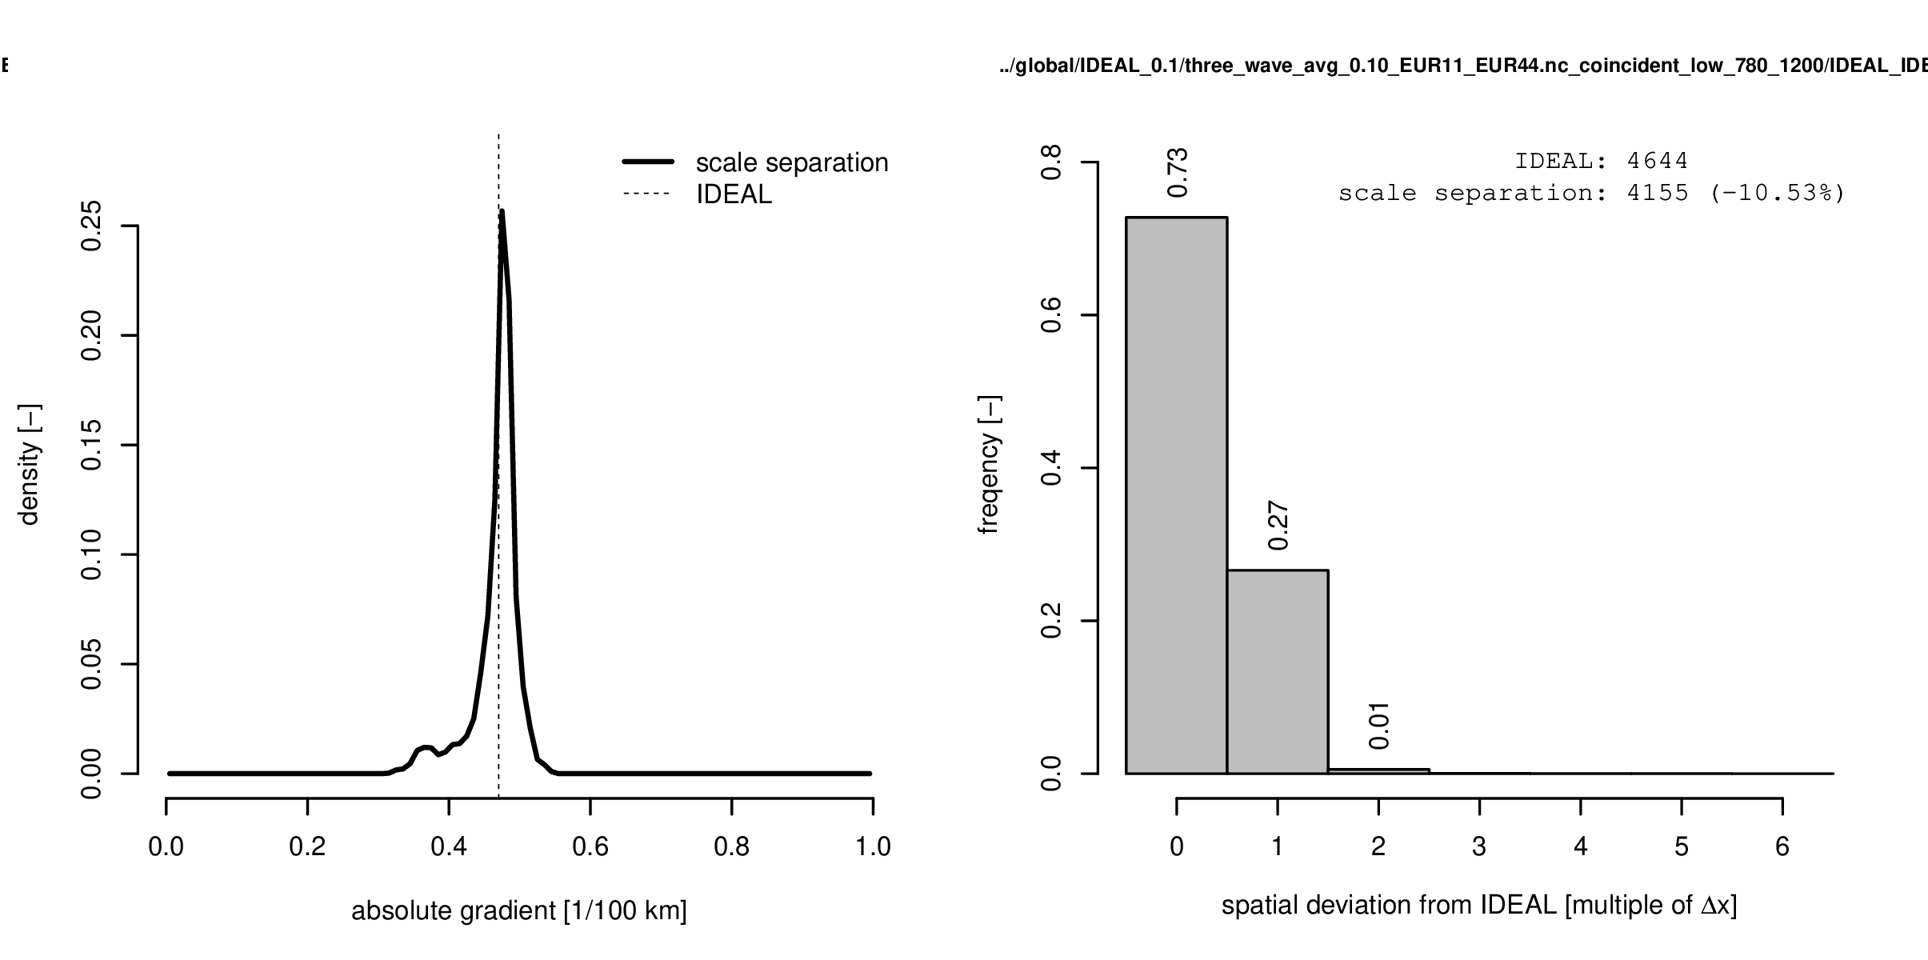
1. Idealised testing function
0.99
EUR-44
λ_{L} = 780 km
λ_{H} = 1200 km
selective dampening is possible
also front strengths are well
represented
λ_{L}, λ_{H} do not depend on
the grid spacing and
can be derived from
variance spectra
EUR-11
λ_{L} = 780 km
λ_{H} = 1200 km

Slide 9
2. Idealised baroclinic instability
Idealised simulation of baroclinic instability (Jablonowski and Williamson, 2006)
Linear dynamics
Non-linear dynamics
(wave breaking
sets in on day 9)

Slide 10
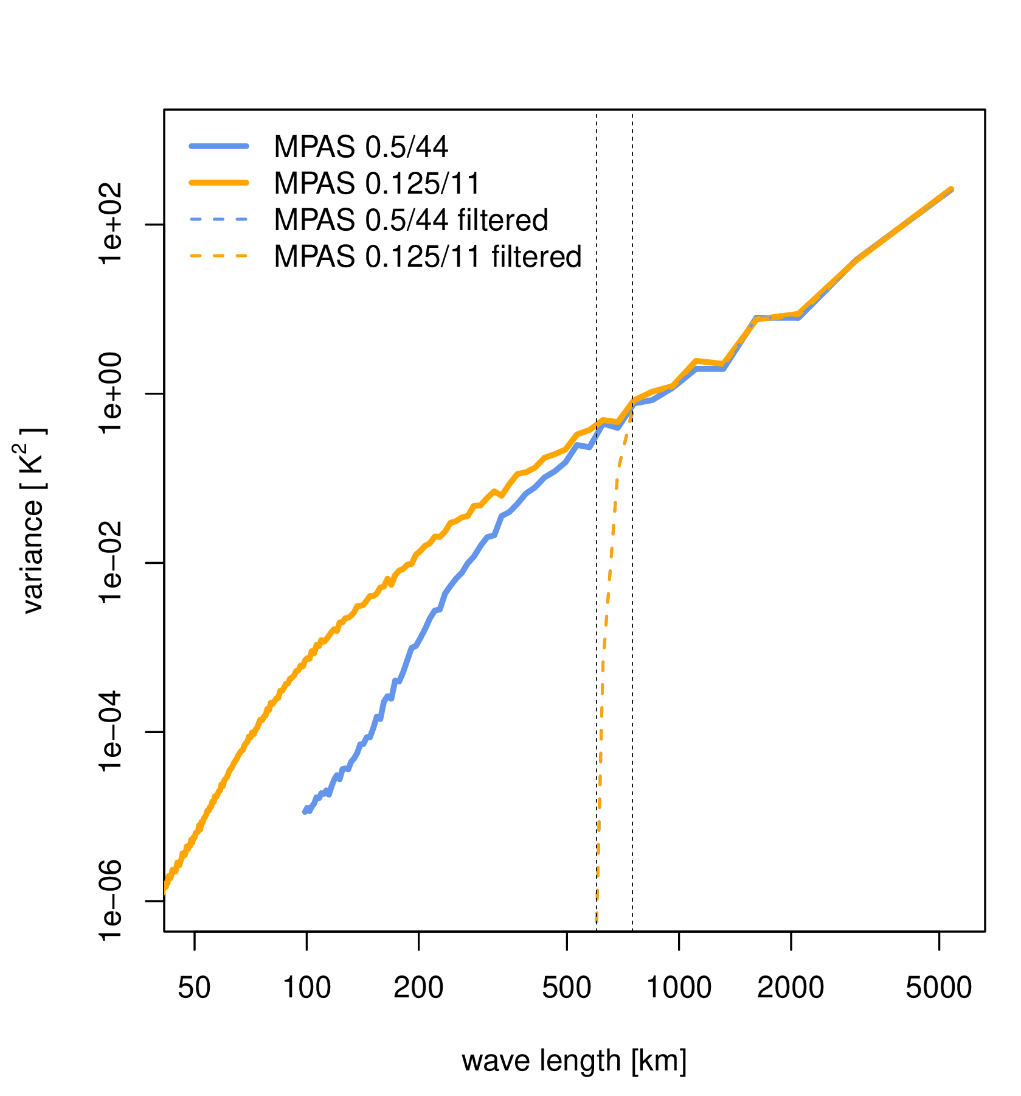
2. Idealised baroclinic instability
Model for Prediction Across Scales (MPAS v7.0) (Skamarock et al., 2012)
Dry adiabatic simulation
Resolutions: 0.5° and 0.125° grid spacing
Data extracted in EURO-CORDEX domains (moving along with the center of instability)
MPAS 0.5° → EUR 0.44
MPAS 0.125° → EUR 0.11°
Spectral filter based on DCT
(λ_{L} = 630 km, λ_{H} = 750 km)
➔ achieve equality among variance spectra
➔ Can the same front be detected as the “same” in
different models?
➔ Shall models be remapped onto a common grid, first?
Or shall coincident grid cells be compared?
λ_{L} = 630 km
λ_{H} = 750 km

Slide 11
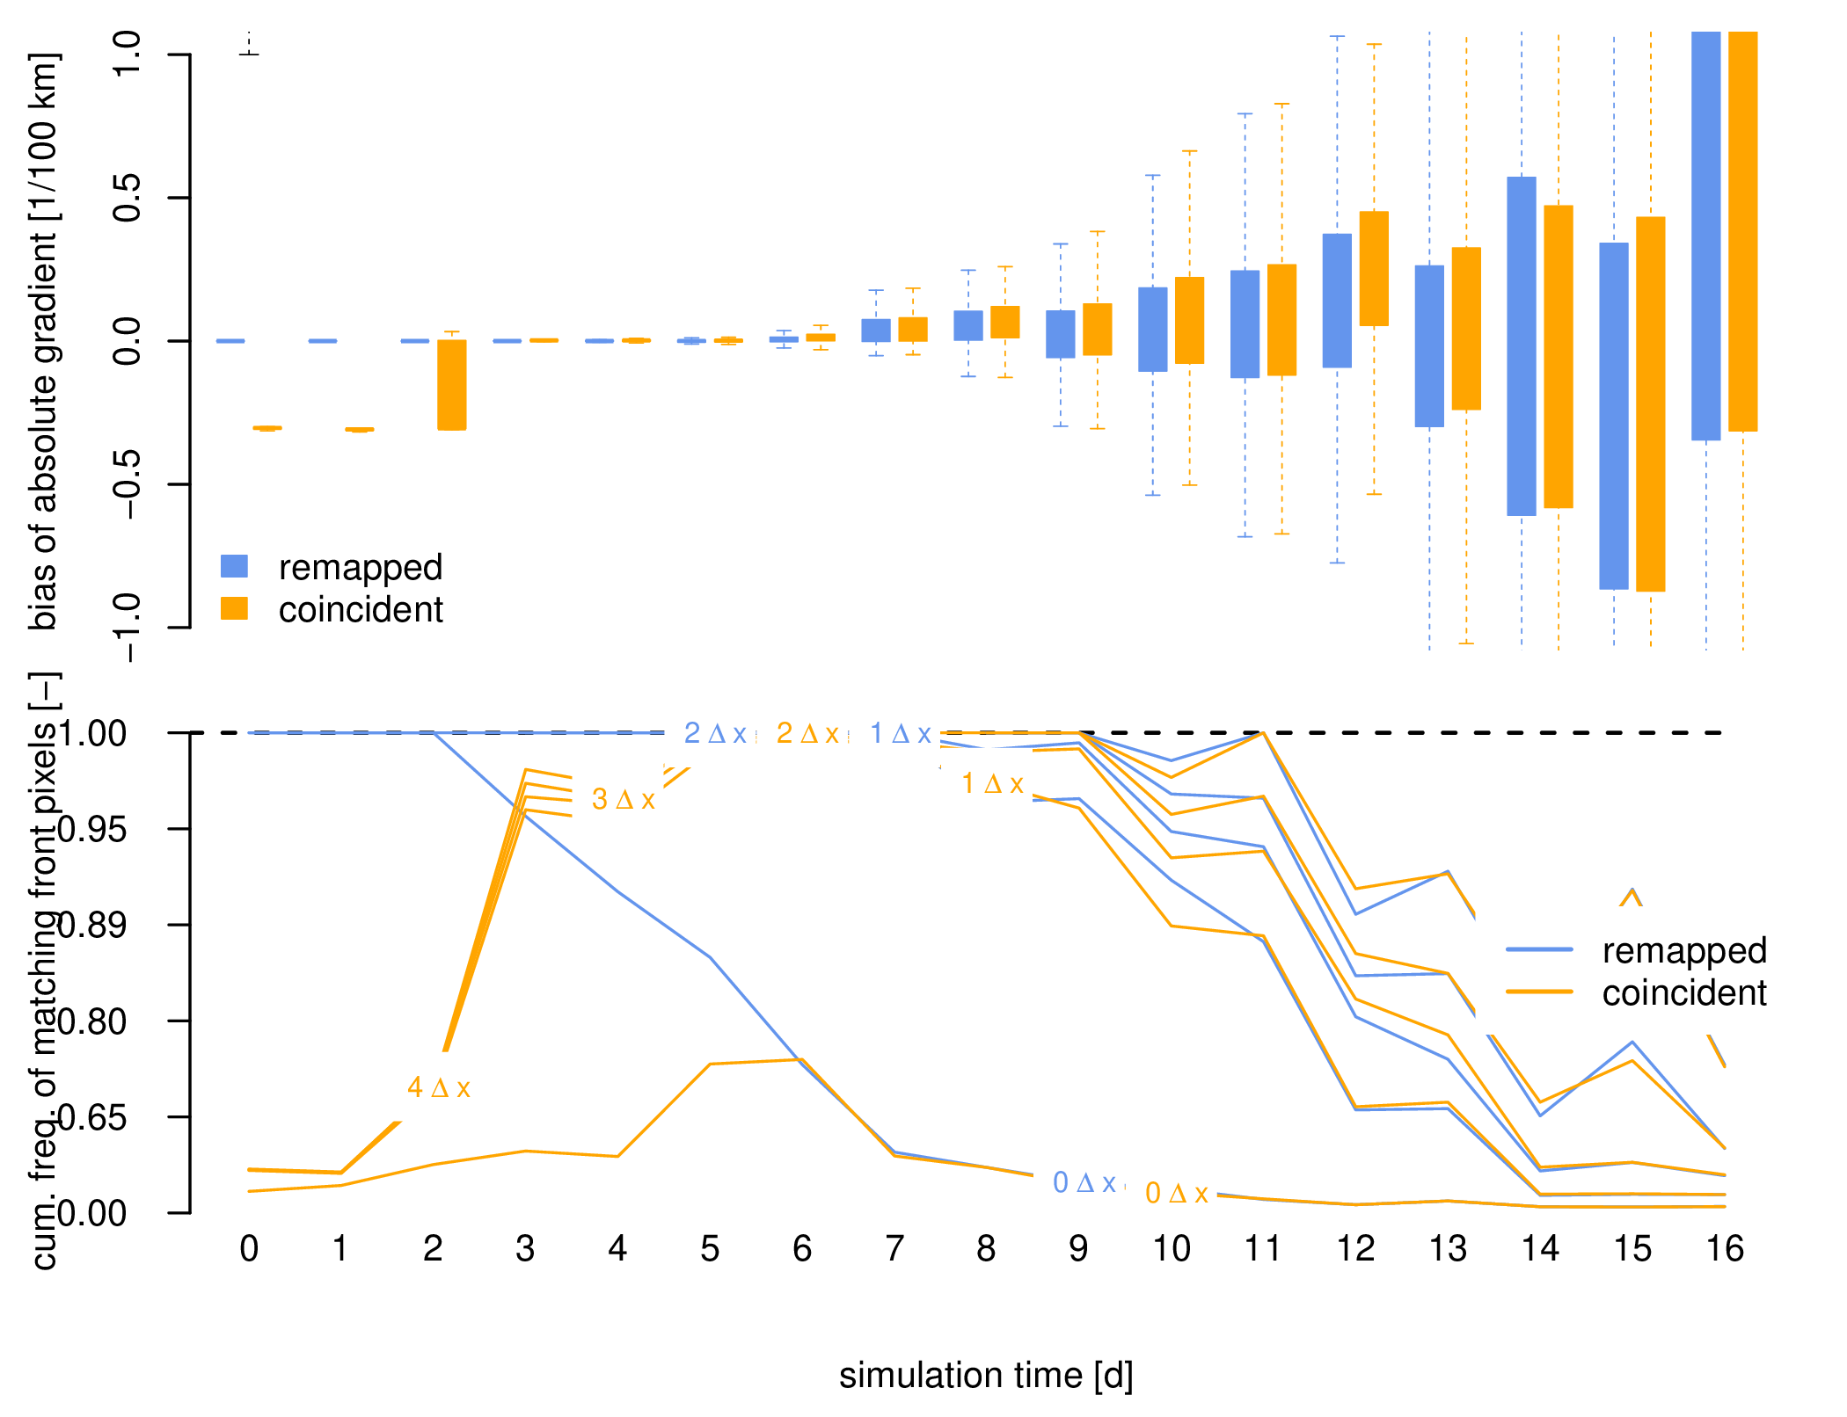
2. Idealised baroclinic instability
linear dynamics
non-linear dynamics
EUR-44 vs.
EUR-11 on
EUR-44
When linear dynamics dominate (until day 8), front strength and location are “quite” consistent among model resolution (deviations are mainly within 1 Δx).
When non-linearity progresses (day 9 and beyond), inconsistencies rapidly evolve and introduce incomparability due to internal variability.
Spectral filtering preserves consistency among model resolution farther into the regime of non-linearity (90% of all deviations remain in 1 Δx range until day 11).
Remapping on a common grid gives further improvements

Slide 12
➔ Criteria for comparability
Achieve equality in variance spectra
➔ spectral methods do have advantages
➔ remapping on a common (coarser resolved) grid gives further improvements
Same fronts can be detected as the “same” only when linear dynamics dominate
When non-linearity dominates, internal variability hampers comparability
(especially model errors cannot be distinguished from internal variability)
➔ a one-by-one comparability for fronts is not guaranteed!
➔ possible solution:
front statistics over longer time periods (or enough events)
?

Slide 13
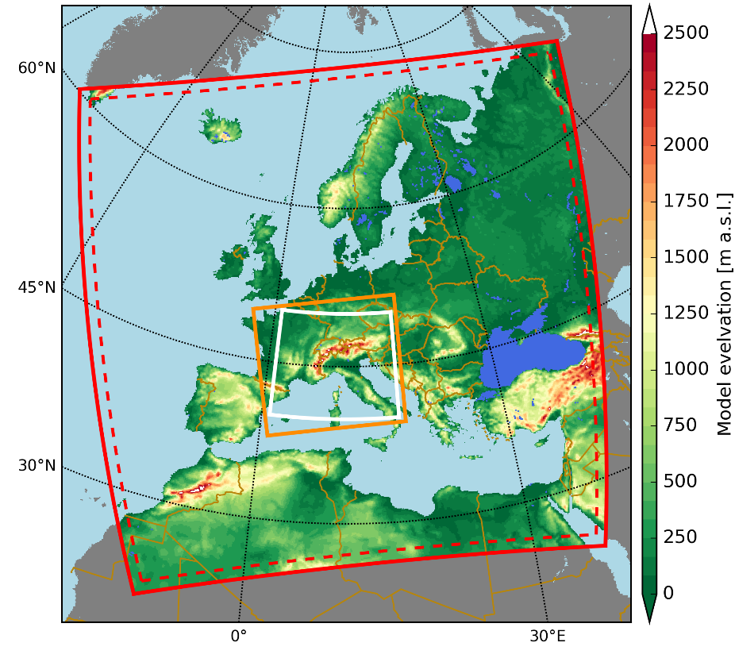
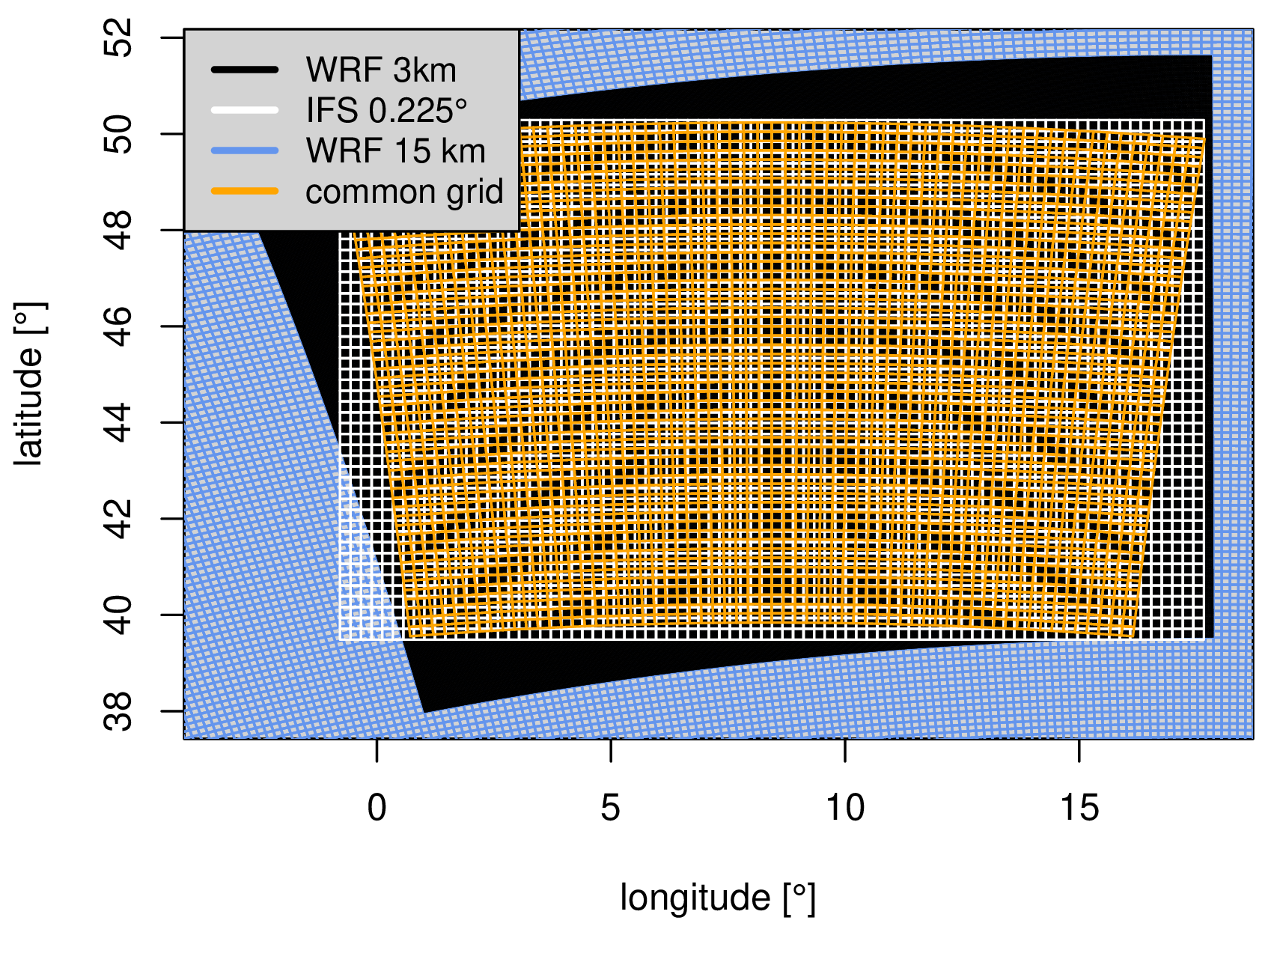
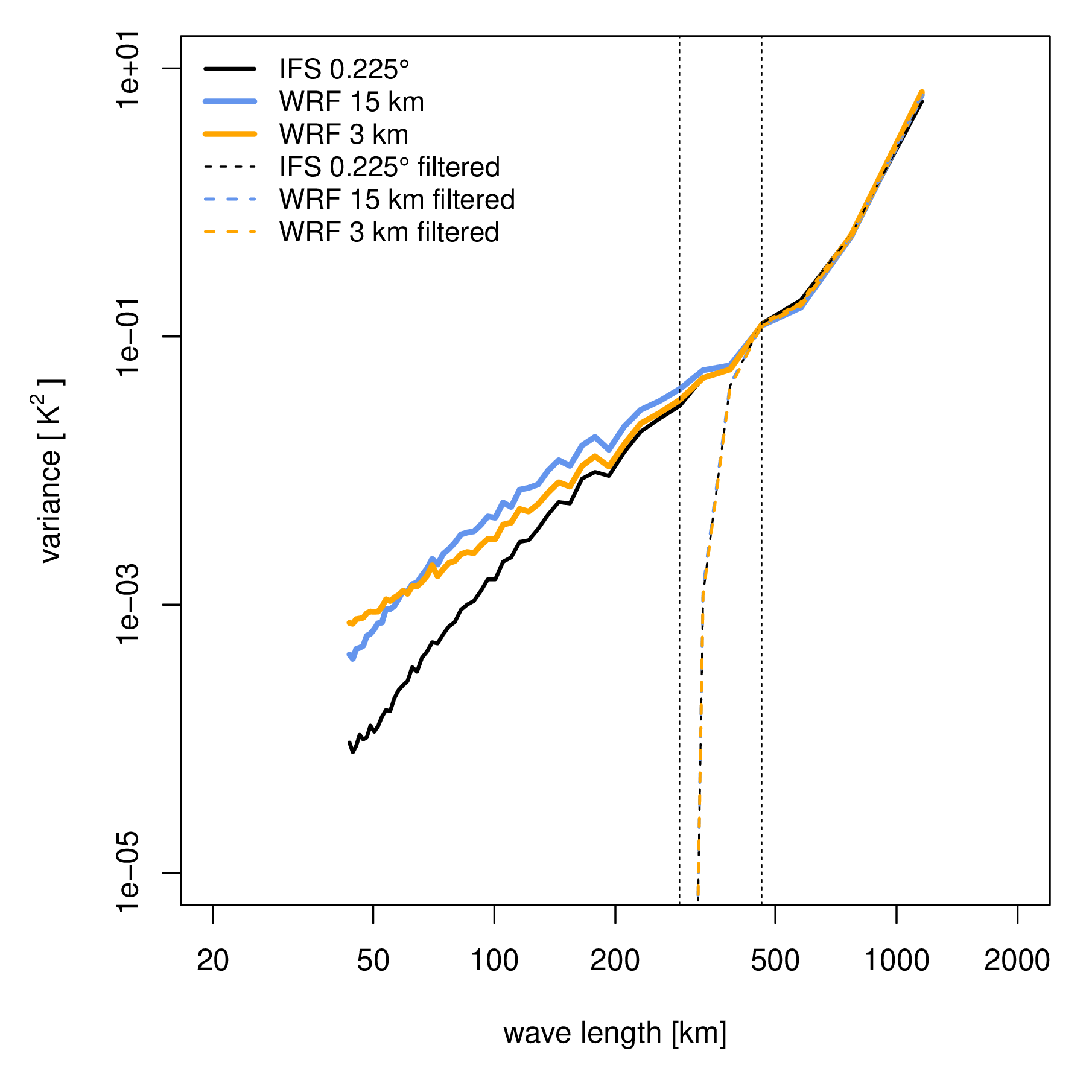
3. Application: CORDEX-WRF simulations
CORDEX-FPS WRF twin simulations (supported by Klaus Görgen, Jülich Research Centre)
WRF 3.8.1
15 km (WRF15) → 3 km (WRF3) online nesting
WRF15: deep/shallow conv. are parameterized
2 x WRF3: with sh. conv. ; w/o sh. conv. scheme
period: 1999 to 2009
Driving data: ERA-Interim
(Coppola et al. 2018)
Front detection
period: DJF/JJA 2006 to 2009 (3h time step)
level: 2600 m altitude
equiv. pot. temperature
reference data: IFS 0.225° grid spacing
common grid (25 km grid spacing)
Spectral filter based on DCT
(λ_{L} = 330 km, λ_{H} = 460 km)
➔ front statistics (rel. freq. of fronts DJF/JJA)

Slide 14
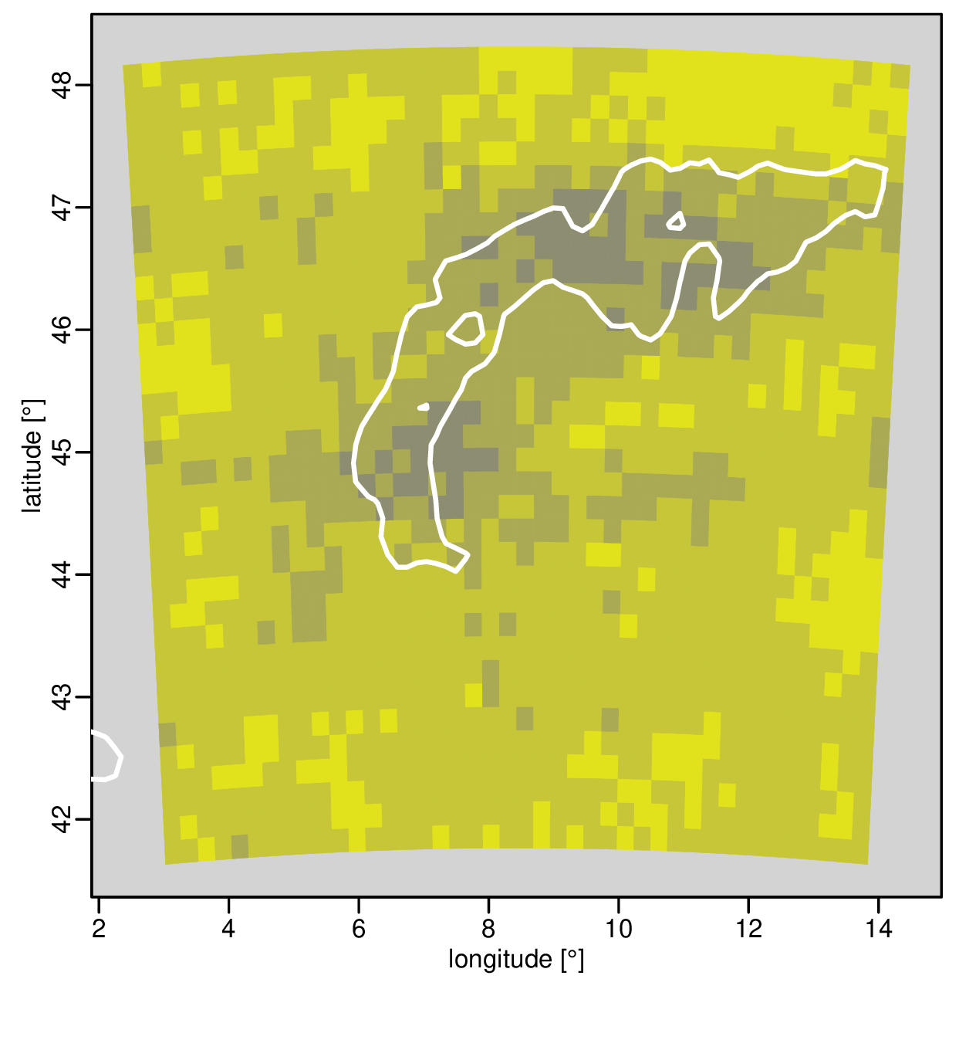
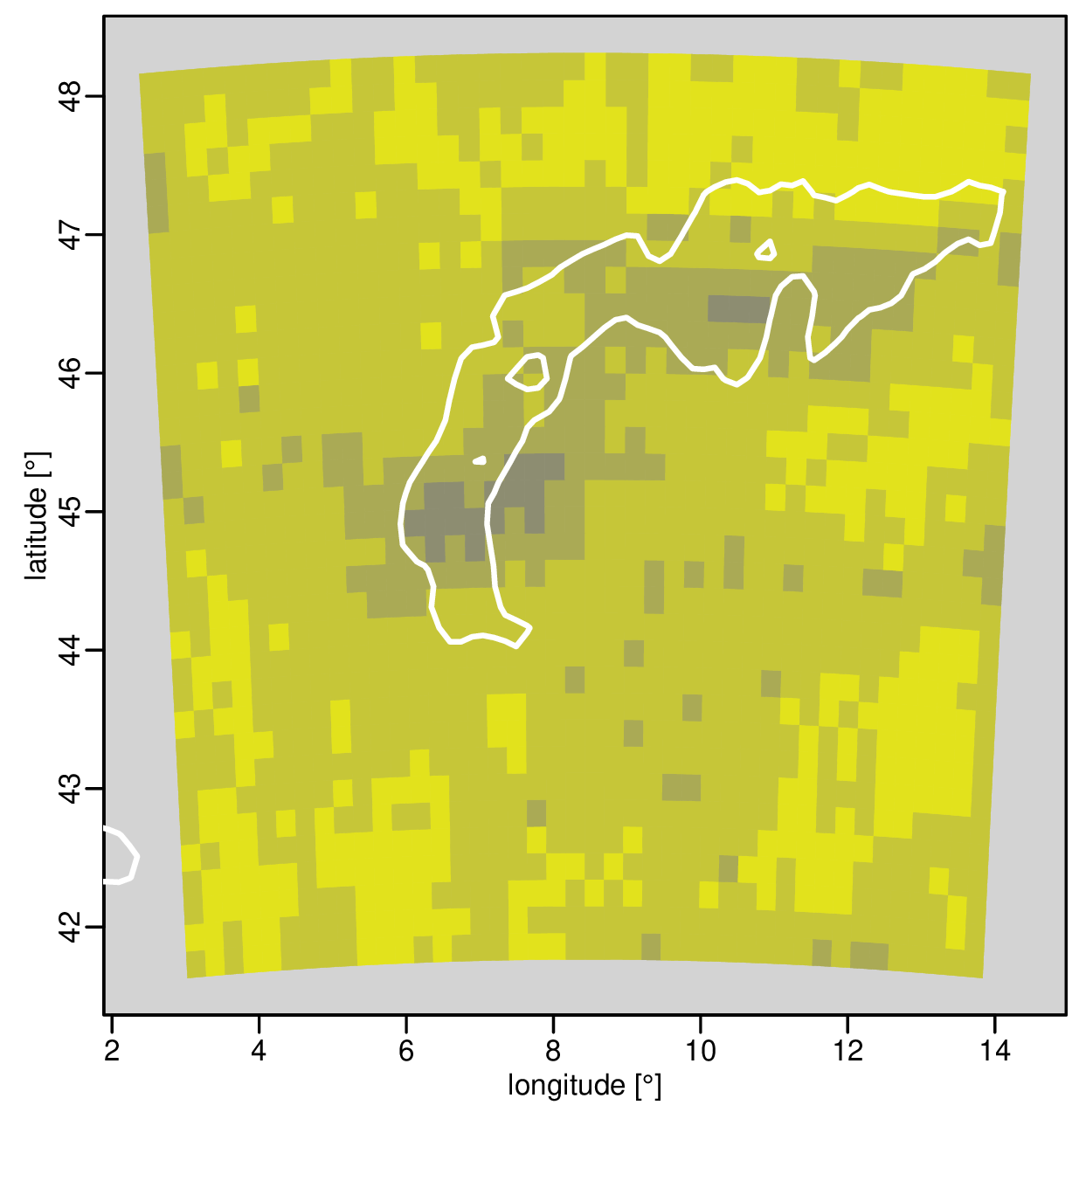
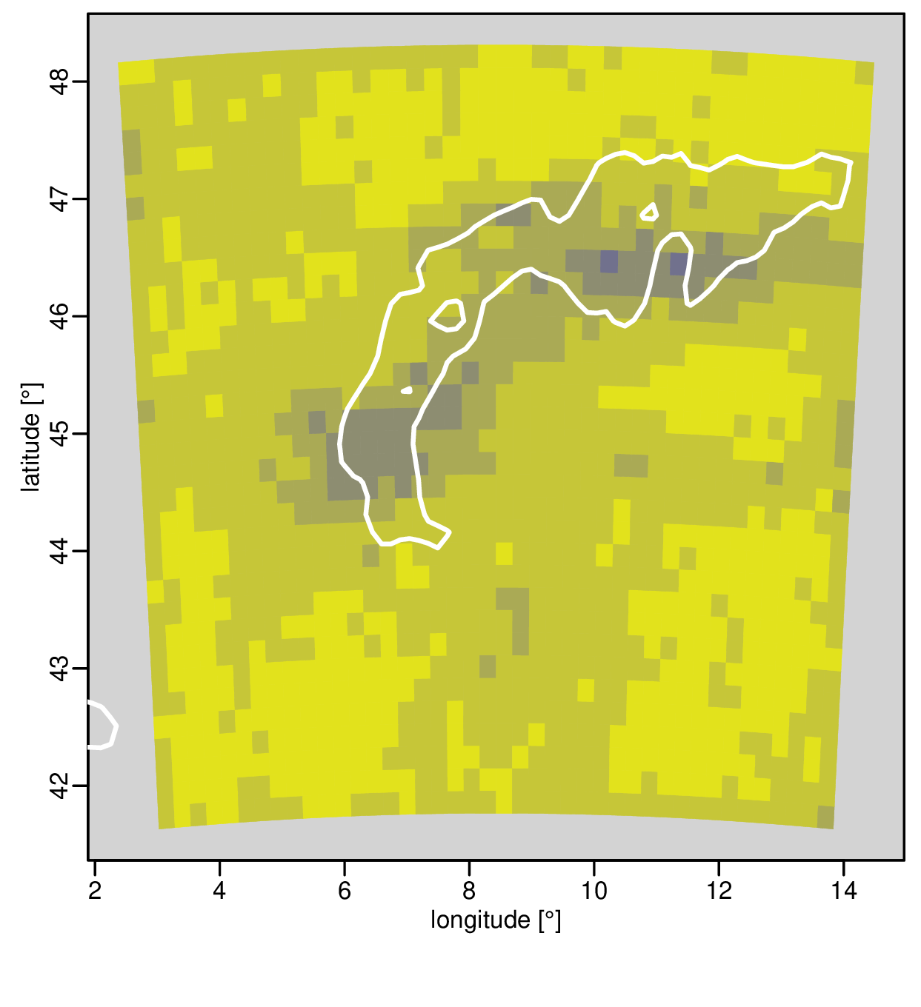
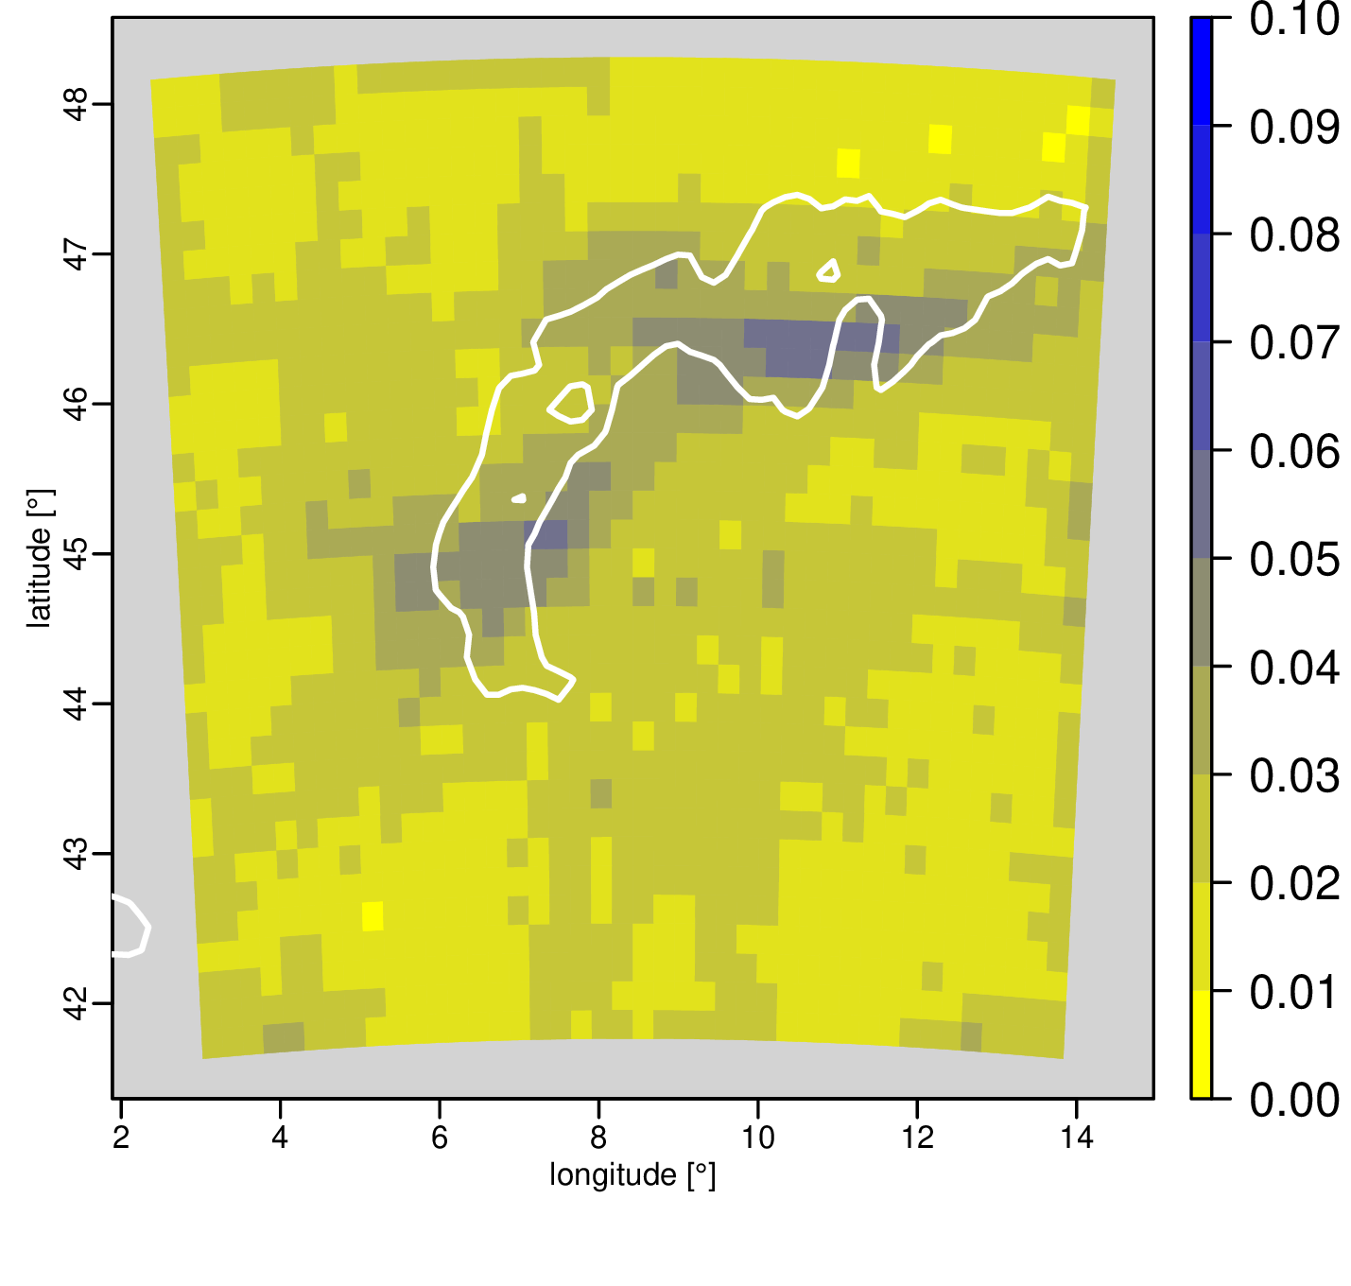
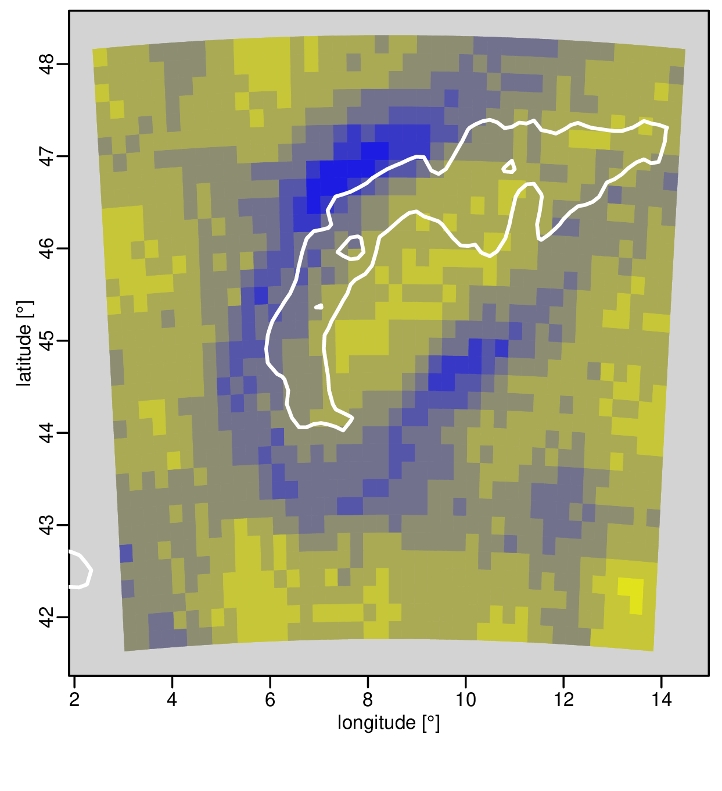
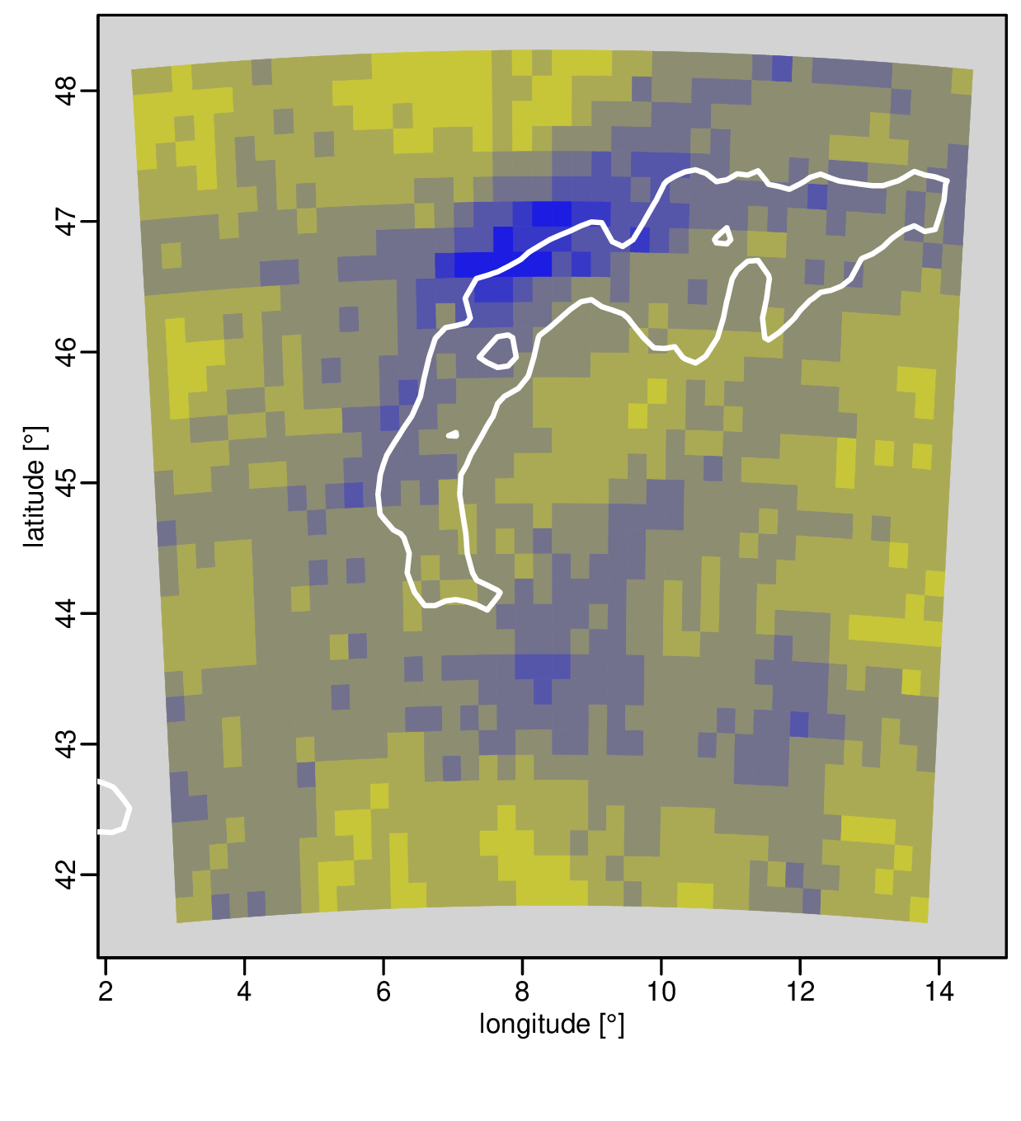
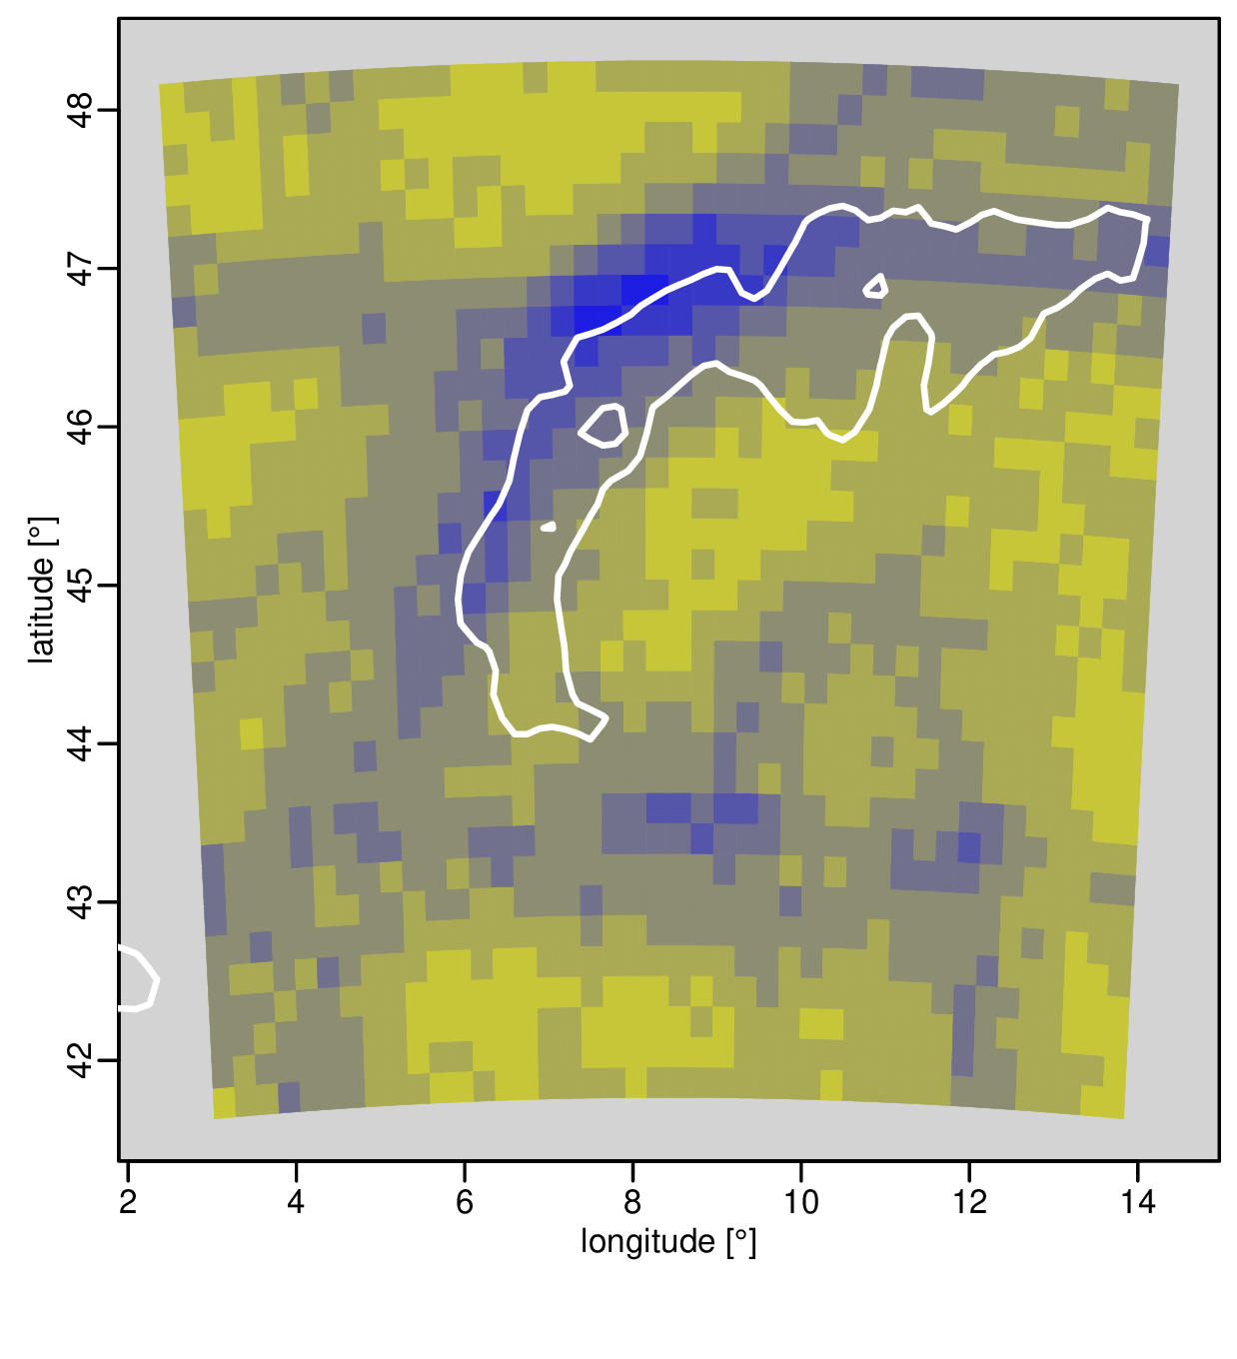
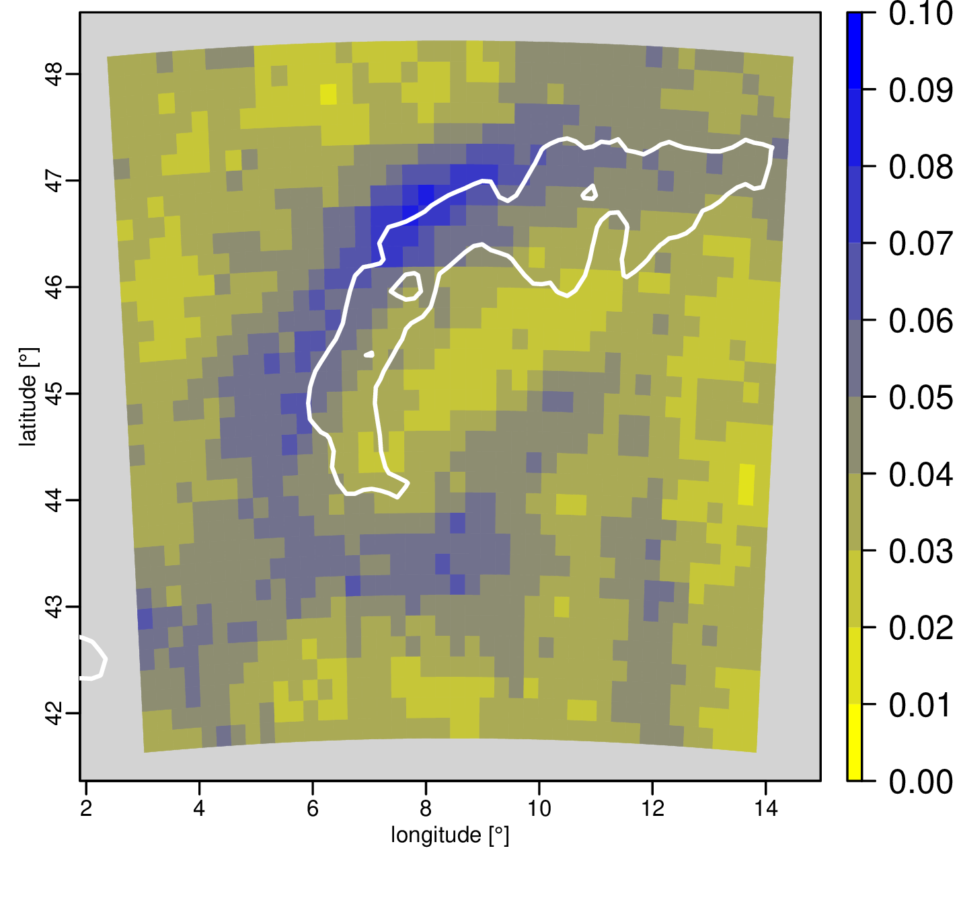
3. Application: CORDEX-WRF simulations
DJF
IFS
WRF15
WRF3 w/o sh
WRF3 sh
JJA
IFS
WRF15
WRF3 w/o sh
WRF3 sh
Much more fronts in JJA detected (also seen by Jenkner et al. 2009, Hénin et al. 2019)
WRF has less fronts in northern Italy ➔ indicator for underestimation of lee cyclogenesis?

Slide 16
Literature
Catto, J. L., Jakob, C., & Nicholls, N. (2015). Can the CMIP5 models represent winter frontal precipitation?: CMIP5 FRONTAL PRECIPITATION. Geophysical Research Letters, 42(20), 8596–8604. https://doi.org/10.1002/2015GL066015
Earl, N., Dorling, S., Starks, M., & Finch, R. (2017). Subsynoptic-scale features associated with extreme surface gusts in UK extratropical cyclone events: Extreme Wind Features in UK Cyclones. Geophysical Research Letters, 44(8), 3932–3940. https://doi.org/10.1002/2017GL073124
Hénin, R., Ramos, A. M., Schemm, S., Gouveia, C. M., & Liberato, M. L. R. (2019). Assigning precipitation to mid-latitudes fronts on sub-daily scales in the North Atlantic and European sector: Climatology and trends. International Journal of Climatology, 39(1), 317–330. https://doi.org/10.1002/joc.5808
Hewson, T. D., & Titley, H. A. (2010). Objective identification, typing and tracking of the complete life-cycles of cyclonic features at high spatial resolution. Meteorological Applications, 17(3), 355–381. https://doi.org/10.1002/met.204
Hope, P., Keay, K., Pook, M., Catto, J., Simmonds, I., Mills, G., McIntosh, P., Risbey, J., & Berry, G. (2014). A Comparison of Automated Methods of Front Recognition for Climate Studies: A Case Study in Southwest Western Australia. Monthly Weather Review, 142(1), 343–363. https://doi.org/10.1175/MWR-D-12-00252.1
Jenkner, J., Sprenger, M., Schwenk, I., Schwierz, C., Dierer, S., & Leuenberger, D. (2010). Detection and climatology of fronts in a high-resolution over model reanalysis the Alps. Meteorological Applications, 17(1), 1–18. https://doi.org/10.1002/met.142
Schemm, S., Sprenger, M., Martius, O., Wernli, H., & Zimmer, M. (2017). Increase in the number of extremely strong fronts over Europe? A study based on ERA-Interim reanalysis (1979-2014): Extremely Strong Fronts Over Europe. Geophysical Research Letters, 44(1), 553–561. https://doi.org/10.1002/2016GL071451
Schemm, Sebastian, Nisi, L., Martinov, A., Leuenberger, D., & Martius, O. (2016). On the link between cold fronts and hail in Switzerland. Atmospheric Science Letters, 17(5), 315–325. https://doi.org/10.1002/asl.660
Steinacker, R., & Brönnimann, S. (2016). Stationary flow near fronts. Meteorologische Zeitschrift, 25(6), 805–809. https://doi.org/10.1127/metz/2016/0832
Thomas, C. M., & Schultz, D. M. (2019a). Global Climatologies of Fronts, Airmass Boundaries, and Airstream Boundaries: Why the Definition of “Front” Matters. Monthly Weather Review, 147(2), 691–717. https://doi.org/10.1175/MWR-D-18-0289.1
Thomas, C. M., & Schultz, D. M. (2019b). What are the Best Thermodynamic Quantity and Function to Define a Front in Gridded Model Output? Bulletin of the American Meteorological Society, 100(5), 873–895. https://doi.org/10.1175/BAMS-D-18-0137.1
Zagrodnik, J. P., McMurdie, L. A., Houze, R. A., & Tanelli, S. (2019). Vertical Structure and Microphysical Characteristics of Frontal Systems Passing over a Three-Dimensional Coastal Mountain Range. Journal of the Atmospheric Sciences, 76(6), 1521–1546. https://doi.org/10.1175/JAS-D-18-0279.1

