Slide 1


Mathematisch-Naturwissenschaftliche Fakultät
KET-02
an energetic particle instrument in
interstellar medium
Bernd Heber, Robert Wimmer-Schweingruber, Marlon Köberle, Patrick Kühl, and Stephan Böttcher
Goal: Bridge the measurement gap between Voyager and AMS-02

Slide 2
Mathematisch-Naturwissenschaftliche Fakultät
Zusammenfassung
Abstract / Motifation
Voyager 1and 2 particle instruments measured the Very Local Interstellar Spectra (VLIS) at energies below about 100 MeV/nuc.
Recent AMS 02 measurements show that the VLIS is altered by the heliosphere for energies below 40-60 GeV/nuc.
Goal of a potential GCR instrument is to measure the VLIS electron spectra between 100 MeV and a few GeV.

Slide 3
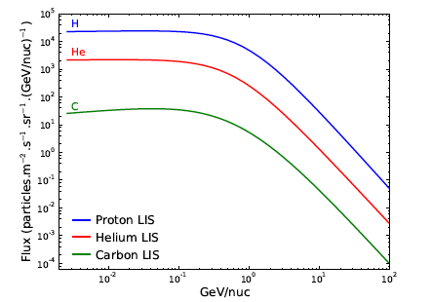
Mathematisch-Naturwissenschaftliche Fakultät
The Local Interstellar Spectra:
Protons, Helium and Carbon (Bishoff et al. 2016)
Derived from Voyager I measurements
Given by Pamela and/or AMS 02 measurements

Slide 4
Mathematisch-Naturwissenschaftliche Fakultät
Zusammenfassung
Abstract / Motivation
An instrument like the COsmic and Solar Particle INvestigation Kiel Electron Telescope (COSPIN/KET) is capable to gap major parts of the energy gap.
Measurement range of interest:
  Ions: 100 to above 2000 MeV/nuc
  Electrons up to 10 GeV in several energy channels.
Measurement principle: Energy loss-Cherenkov radiation

Slide 5
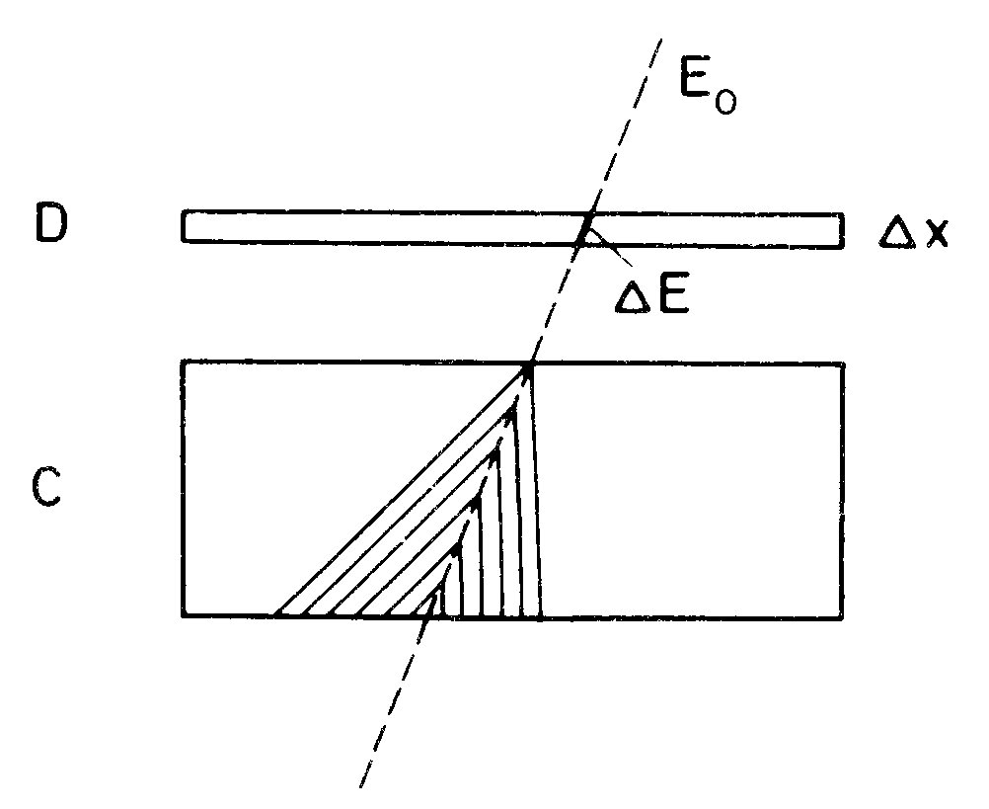
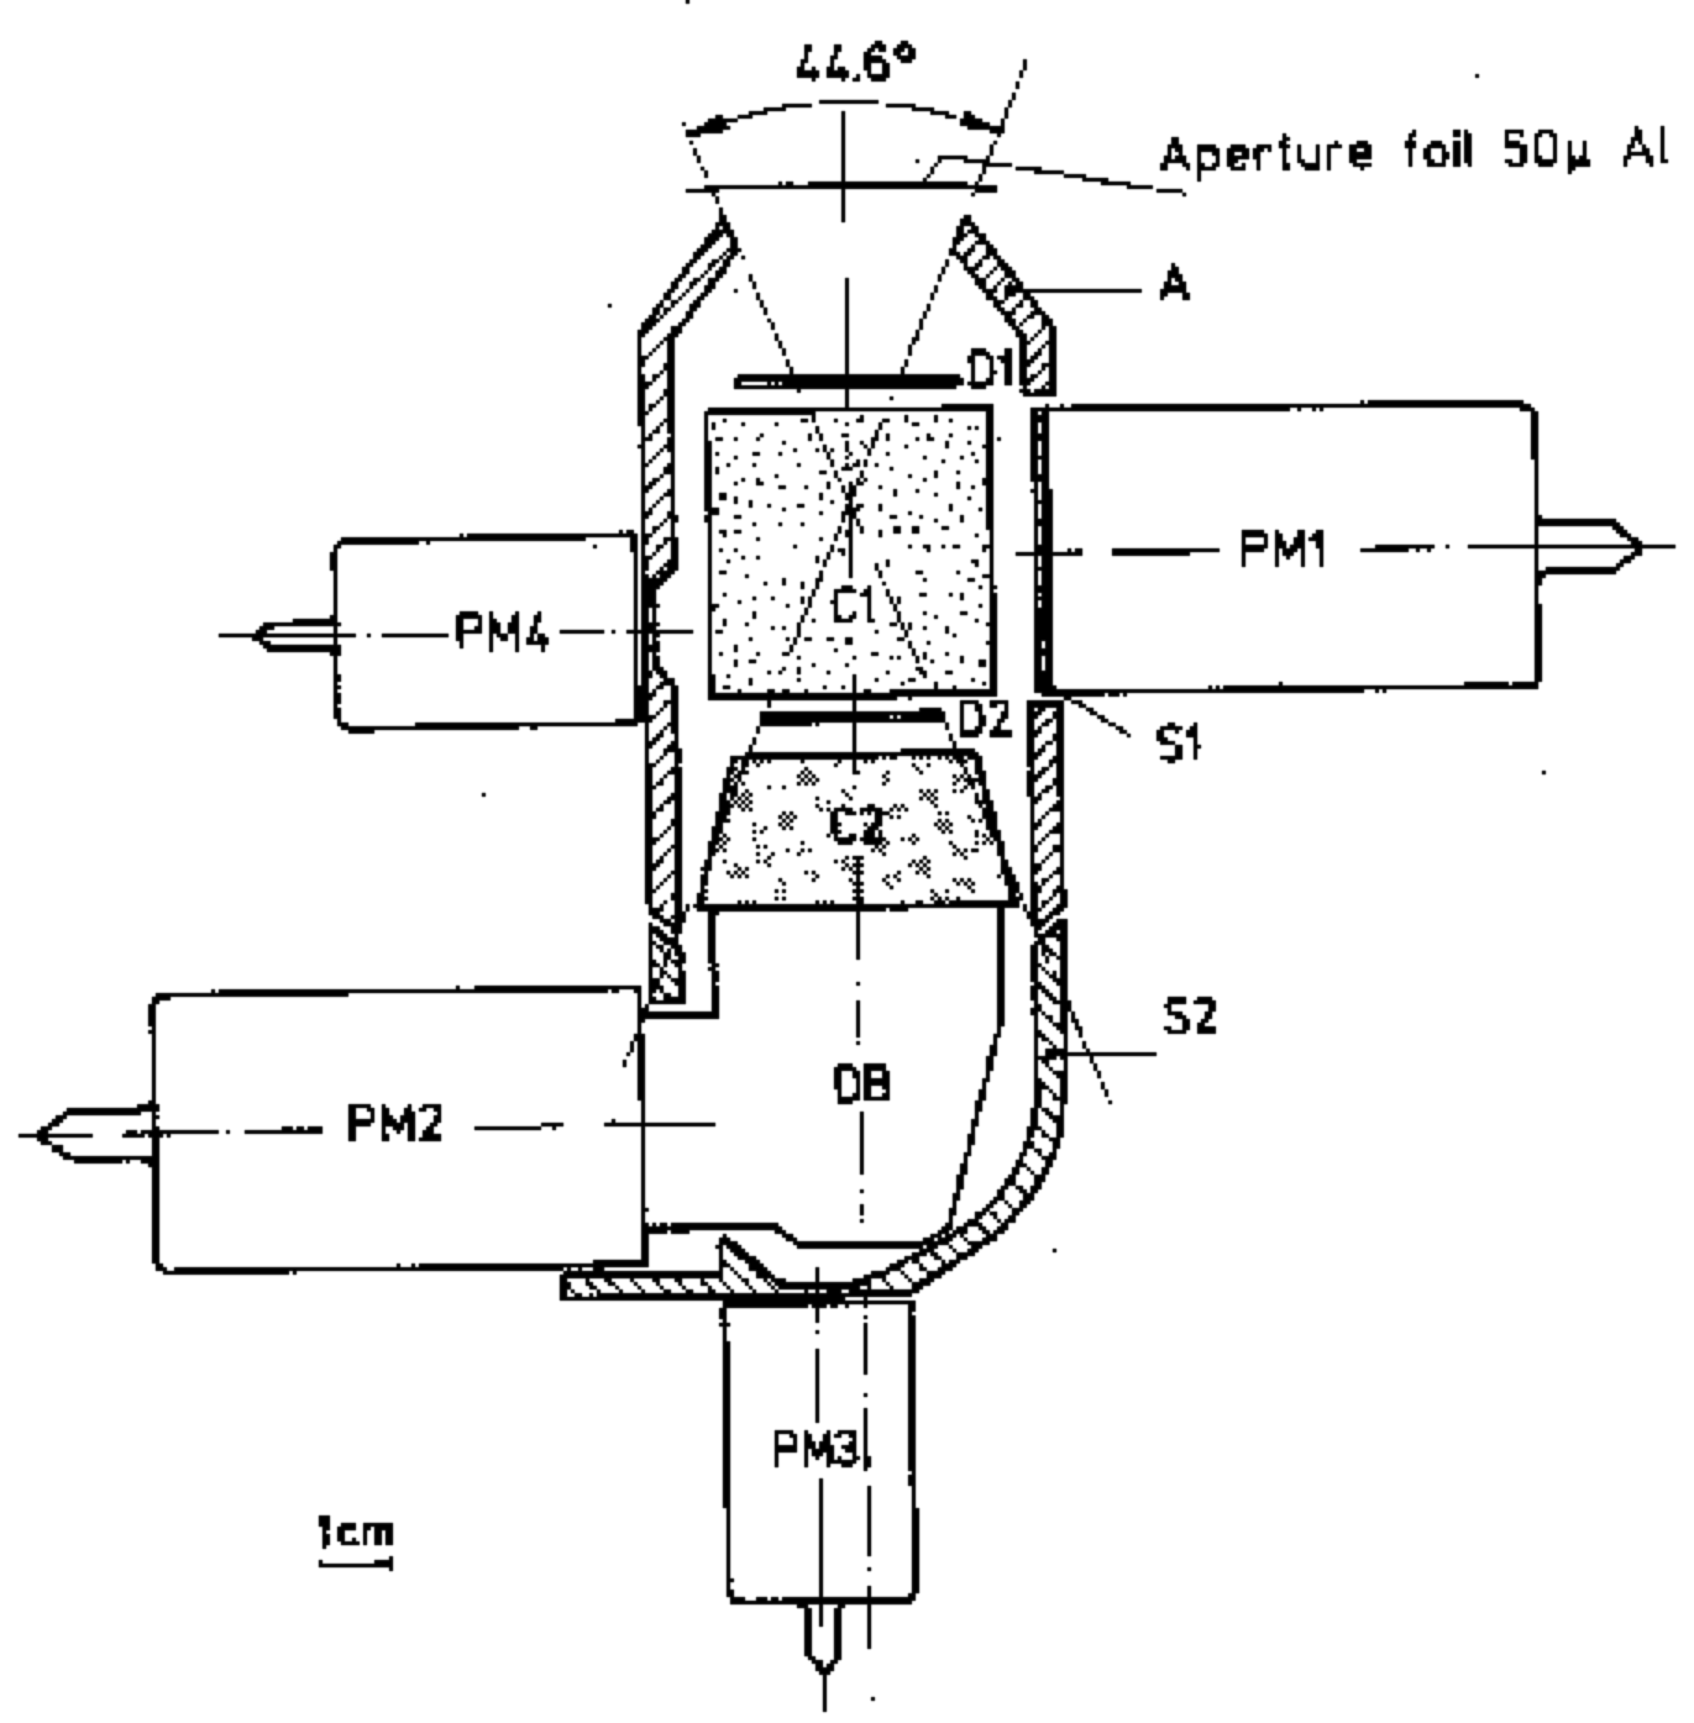
Mathematisch-Naturwissenschaftliche Fakultät
Zusammenfassung
Measurement Principle
Cherenkov Radiation can be used as:
  Threshold detector (page 6)
  ΔE – Cherenkov light method (page 7):
  ΔN = -A z² – B ΔE
  ΔN Number of photons
  ΔE Energy loss in Detector D
  z charge of the particle
  A and B constants

Slide 6
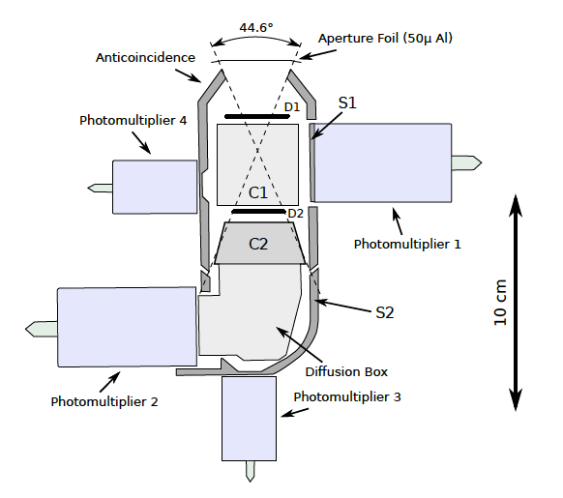
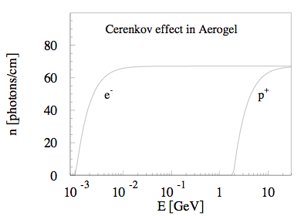
Mathematisch-Naturwissenschaftliche Fakultät
Zusammenfassung
Measurement Principle
C1 Cherenkov detector made from Aerogel (n=1.065)
Signal in C₁ is used to discriminate between e and p

Slide 7
Mathematisch-Naturwissenschaftliche Fakultät
Zusammenfassung
C2 Lead tri fluoride with (n=1.8) show a reasonable energy discrimination
Helium
protons

Slide 8
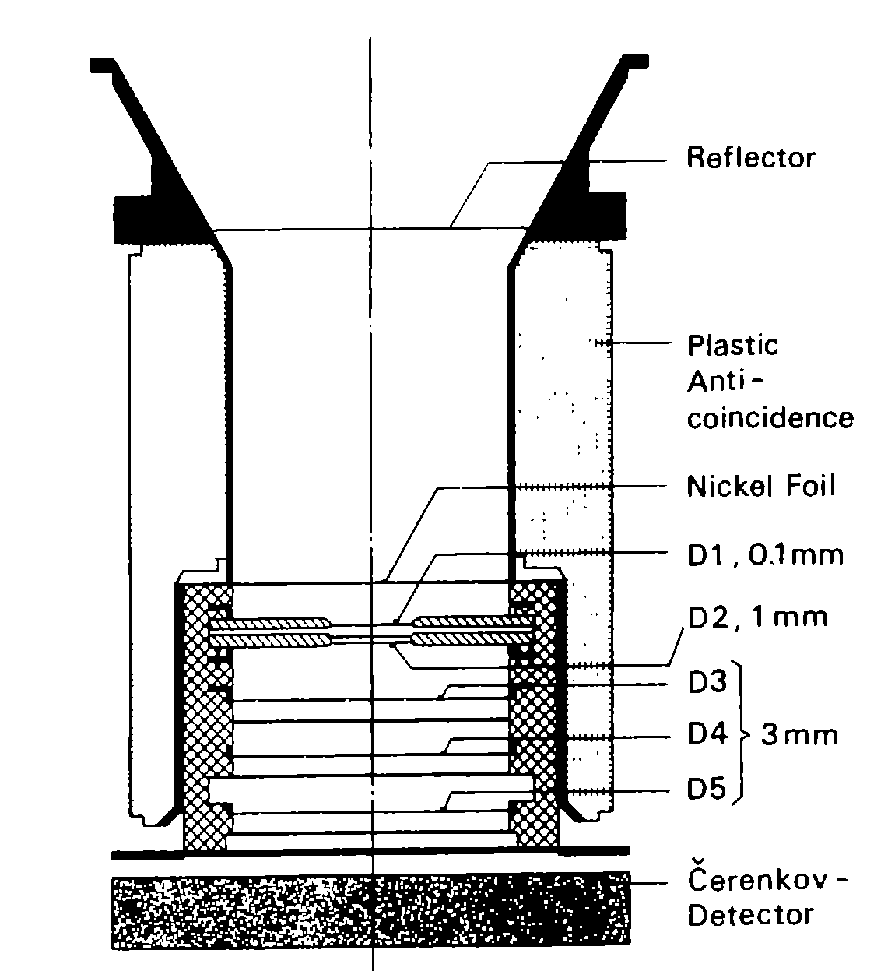
Mathematisch-Naturwissenschaftliche Fakultät
Zusammenfassung
The E6 Instrument aboard Helios
Sketch of the E6 sensor.
  5 semiconductor detectors
  anticoincidence cylinder (G).
  Cerenkov Detector separates stopping from penetrating particles (Sapphire)
  Instrument utilizes the dE/dx-E and the dE/dx-C-method

Slide 9
Mathematisch-Naturwissenschaftliche Fakultät
Zusammenfassung
Helios E6
Instrument should be capable to resolve High Z-particles. E.g.
Bottom to top:
Hydrogen
Helium
Carbon
Nitrogen
Oxygen

Slide 10
Mathematisch-Naturwissenschaftliche Fakultät
Zusammenfassung
Electron measurements from KET: Efficiencies and photon distribution measurements and GEANT4 simulations:
Energy spectra utilizing
inversion techniques
Measurements were performed at different accelerator.

Slide 11
Mathematisch-Naturwissenschaftliche Fakultät
Zusammenfassung
Summary
An improved Kiel Electron Telescope is capable to measure protons up to iron in the energy range from above 100 MeV/nuc to 2 GeV/nuc
Improvements is design and electronics are necessary to achieve these goals.

