Slide 1


Groundwater analysis of tropical urban aquifers in response of climate change (Shenzhen, southern China)
HS 8.2.1: How to assess climate change impacts on groundwater?
Huang Su, Michele Lancia, Chunmiao Zheng, Kevin Hiscock 7th May

Slide 2
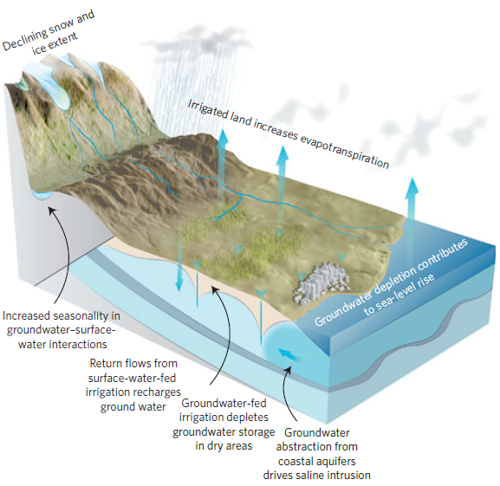
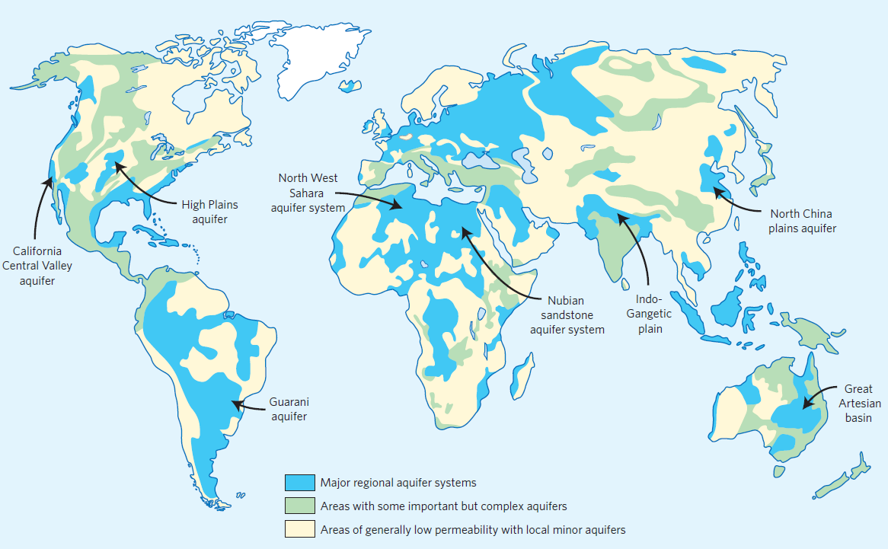
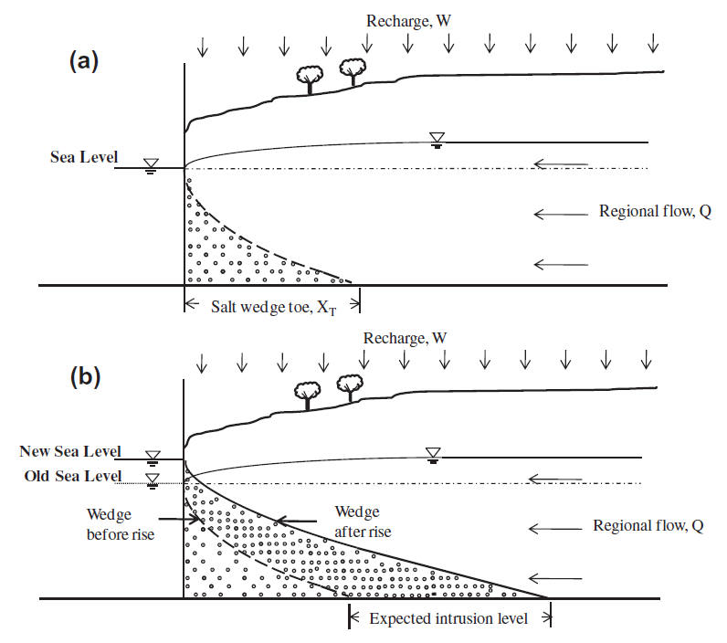
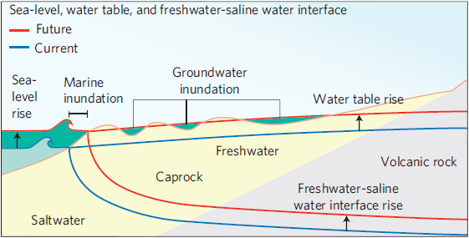
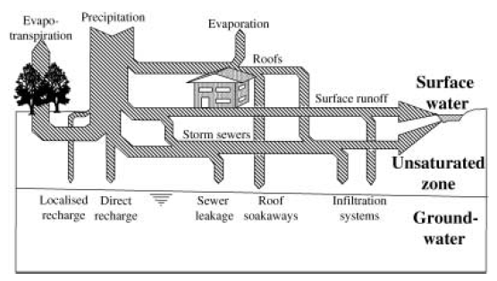
Introduction
(from Taylor et al. 2012)
( from Chang et al. 2011)
(from Lerner 2002)
(from Rotzoll and Fletcher 2012)
Notes:
Groundwater is the source of one third of all freshwater withdrawals, supplying an estimated 36%(domestic), 42%(agricultural) and 27%(industrial) (Taylor et al. 2012)
Climate Change & Climate Variability
Intensified climate change/variability cause more instability on precipitation, soil moisture and surface water
Tropical coastal urban aquifer
A great amount of natural replenishment delayed through pipe leakage instead diffuse rain fed due to urban impervious surface(Lerner 2002)
Even anthropogenic pumping activities dominantly causing saline intrusion, the changing climate can be last straw that breaks the groundwater system(Chang et al. 2011; Ferguson and Gleeson 2012).
In the meantime, coastal aquifer are more sensitive to sea-level rise as the risk of saline intrusion/inundation which may contaminate adjacent aquifer resource (Rotzoll and Fletcher 2012)

Slide 3
Research Purpose
Assess the climate change impact on groundwater dynamics of a tropical megacity.
Shenzhen
“Instant” megacity born in 1979 from fishing villages;
High-tech and financial center of southern China with a sub-tropical climate;
14 million of inhabitants and a water demand of 2000x10⁶ m³/a satisfied
by a huge system of dams and reservoirs.
Subtropical climate – abundant rainfall around 1900mm per year (unevenly distributed)
Notes:
Tropical: a lot of water and waterlogging/inundation are likely; it`s a megacity: a lot of people
The rainiest period is from May to September, when the rainfall exceeds 200 mm per month, while the least rainy period is from November to January, when it drops below 40 mm per month

Slide 4
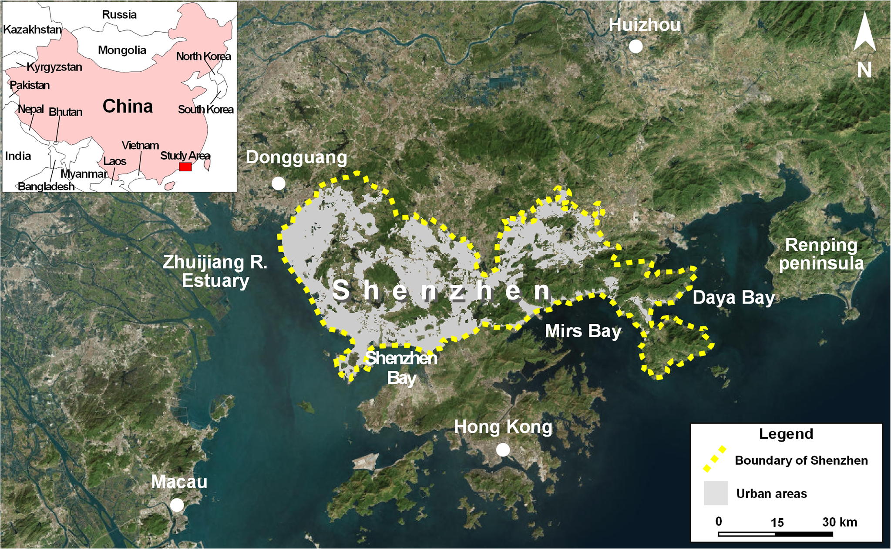
Study Area
from Lancia et al. 2019
Notes:
Shenzhen is located in Southern China at the boundary with Hong Kong. With 14 million of inhabitants, it is the major high tech and economic centre of Southern China. Thanks to the tropical rainfall of the summer season, the water demand (about 2000x10^6 m3/y), it is guaranteed by a sophisticated system of dams and reservoirs. Hilly Terrain-coastal plain and alluvial valleys are …urbanized….we detected from satellite image…

Slide 5
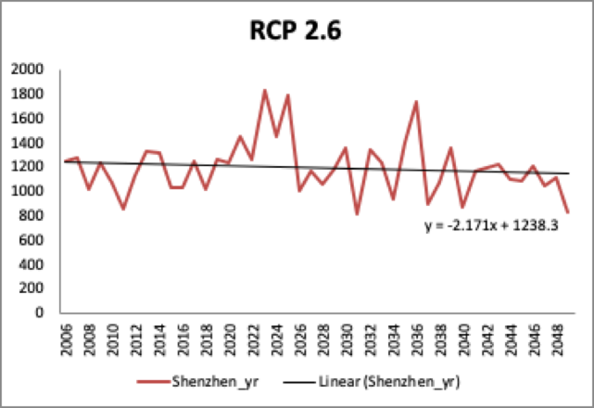
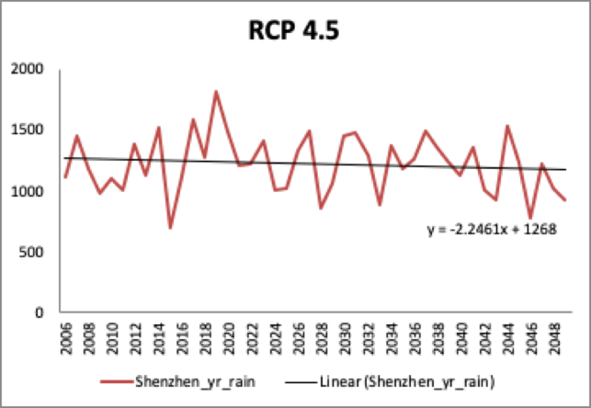
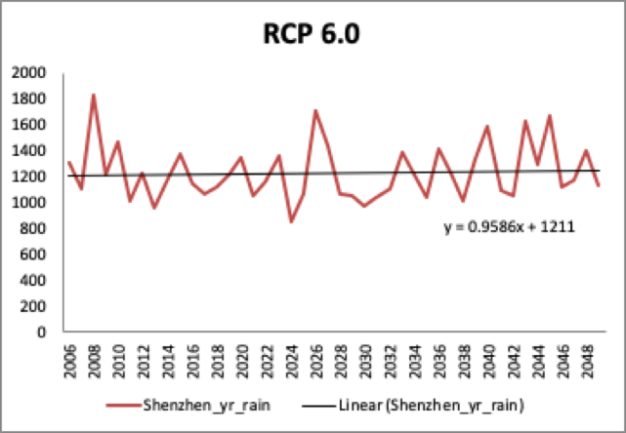
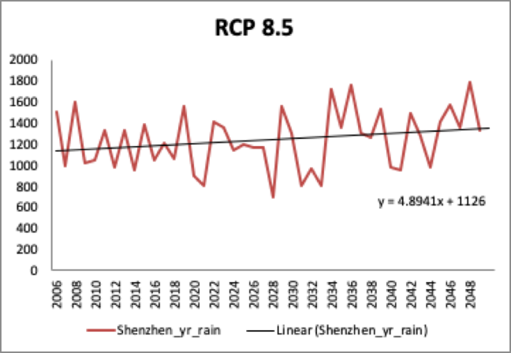
Climate Scenarios
Representative Concentration Pathway - Precipitation variation
Precipitation amount under different scenarios (from 2020-2050)
Decreasing trend under: RCP 2.6 (- 41.58%)& RCP 4.5(- 33.21%)
Increasing trend under: RCP 6.0(+ 2.58%) & RCP 8.5(+ 21.05%)
(IPCC 2007)

Slide 6
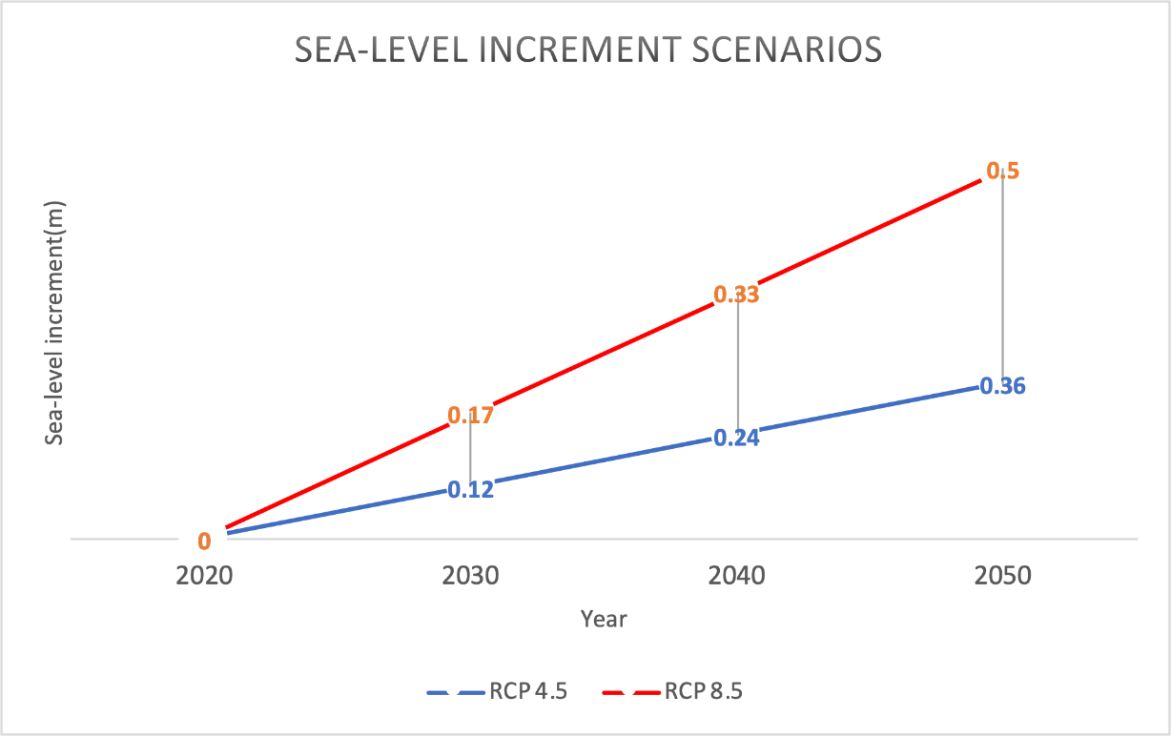
Climate Scenario
Representative Concentration Pathway - Sea-level rise
Global mean sea level may rise 0.18–0.48 m by mid-century and 0.5–1.4 m by the end of the century (Rotzoll and Fletcher 2012).
Sea-level increment projection (From 2020 to 2050)
RCP4.5 - 0.36m
RCP8.5 - 0.5m
(Jackson and Jevrejeva, 2016)

Slide 7
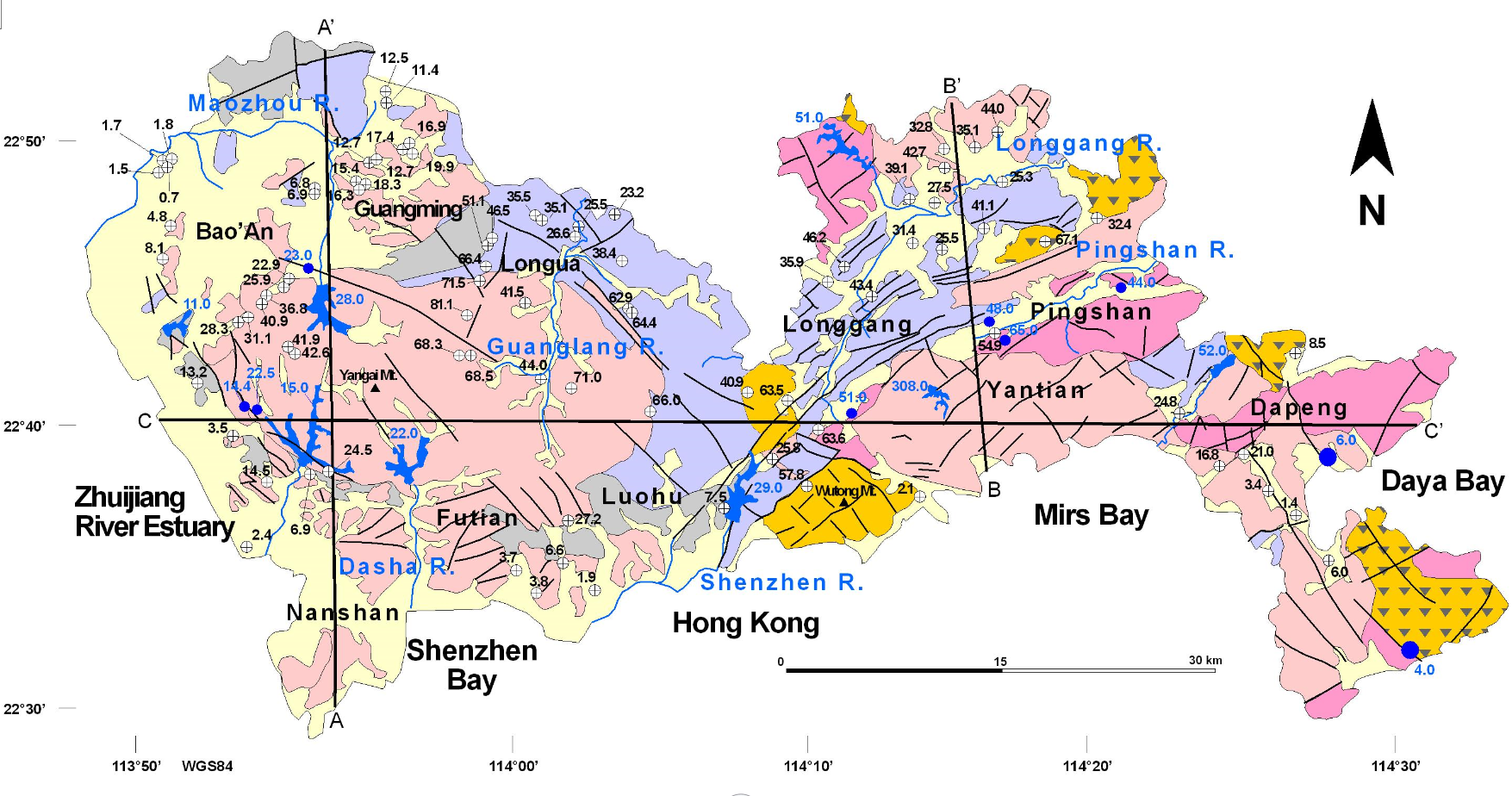
Hydrogeological Setting
Clastic-Quaternary
Tuff-Tertiary
Upp. Mes. Lava
Upp. Mes. Granite
Sedimentary I
Carbonate- Carbonif.
Sedimentary II
Basement
Fault
From Lancia et al. 2019
Notes:
Geology of Shenzhen is characterized by Paleozoic and Lower Mesozoic sedimentary terrigenous sequence (often metamorphosed) interrupted by upper Mesozoic granite intrusions and lava sequences. Fault are mainly distributed as NE-SW and NW-SE and connected to a Eocence strike-slip event that accumulated reworked material in the main depressions. Alluvial to cosastal Quaternary sequences encompasse the main valleys and coastal plains.

Slide 8
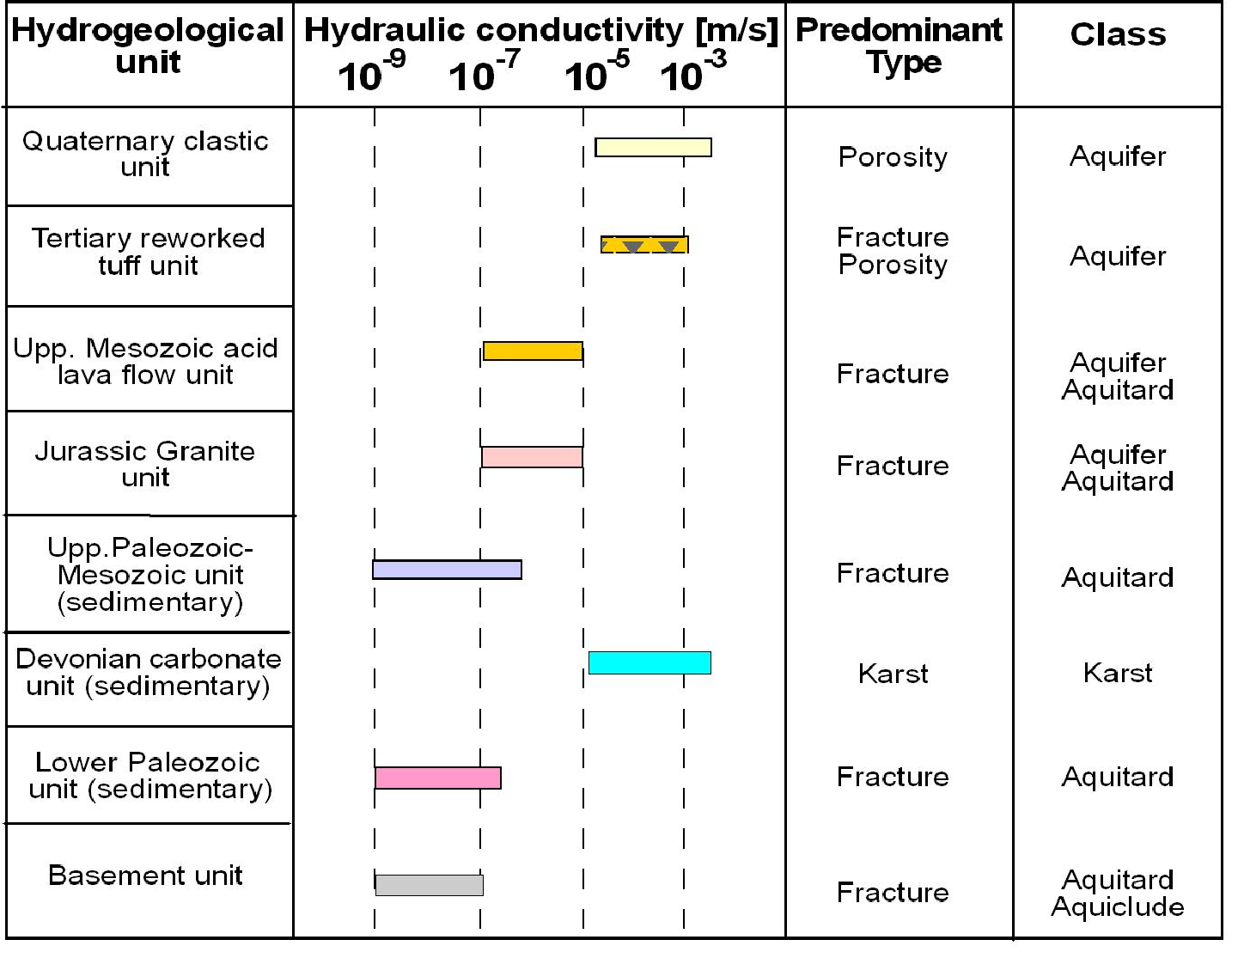
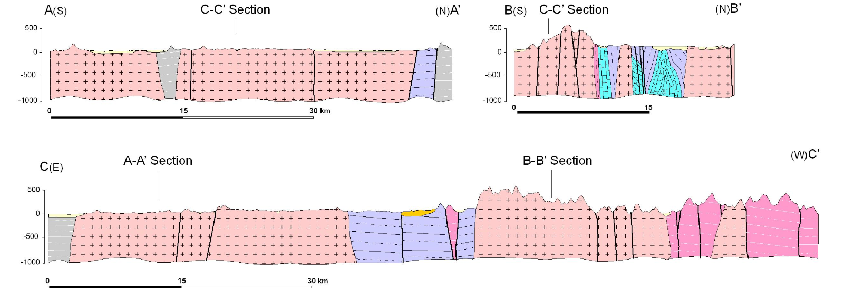
Hydrogeological Setting II
From Lancia et al. 2019
Notes:
Granite intrusion elaborated by strike-slip tectonics is responsible for the dissection in blocks. Based on literature analysis a description of the hydrogeological unit is presented: Quaternary, Tertiary are permeable by prosity as bedrock is generally impervious, unless it is locally fractured. Carbonate basin have a good hy. cond. but usually located on the bottom of the valley due to the accelerated karst processes.

Slide 9
Groundwater Conceptual Sections
From Lancia et al. 2019
Notes:
Therefore, groundwater circulation is shallow and developed along the weathered blanket (about 30 m thick) typical of the tropical region. Impervious bedrock guarantees a coincidence between the groundwater and shallow water basin.

Slide 10
Groundwater Conceptual Sections
From Lancia et al. 2019
Notes:
Karstified carbonate sequence are located below the base level of rivers and streams. In rural areas recharge comes from rainfall as well as in urban areas recharge derives from pipe leackage, flowerbeds and garden irrigation as well as other water amenities, accaroding to Lerner 2002.

Slide 11
Groundwater Conceptual Sections
From Lancia et al. 2019

Slide 12
Conceptual Model - Current Scenario
Notes:
In accordance with the current scenario….

Slide 13
Conceptual Model (2050) R.C.P. 8.5
Conceptual Model (2050) R.C.P. 4.5
Notes:
With RCP 8.5 happens that…with 4.5 happens that

Slide 14

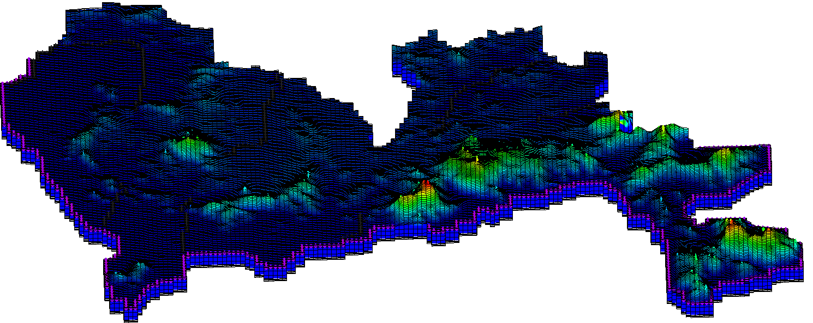
Groundwater model-MODFLOW
Top Elevation
(m a.s.l.)
N
30 km

Slide 15
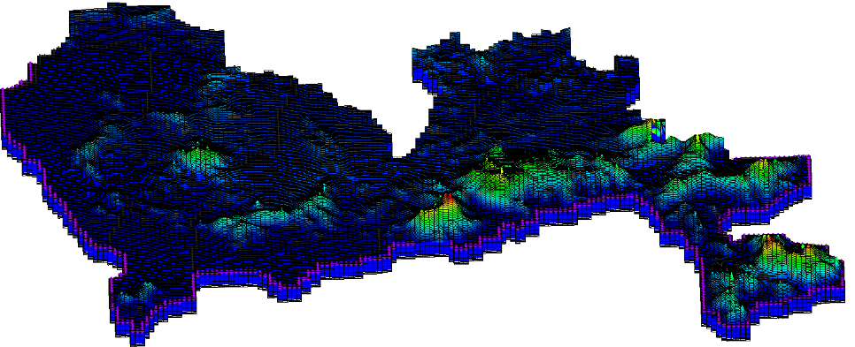
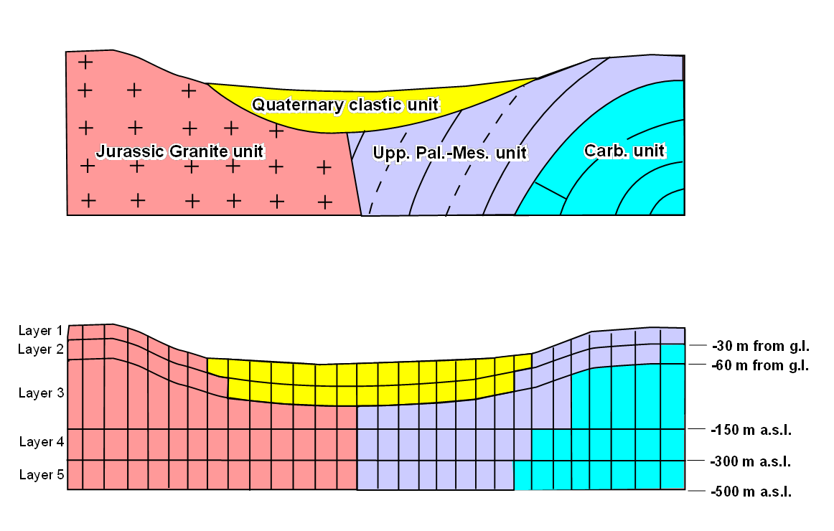
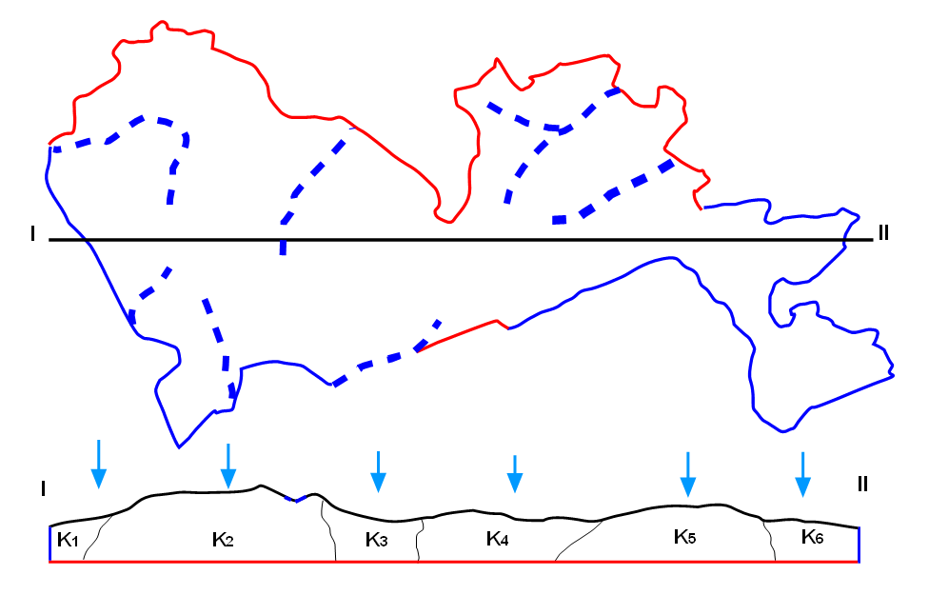
Groundwater model-MODFLOW
Cell dimension: 200x500 m
Solver: NWT-UPW
5 layers:
Boundary Conditions I
From Lancia et al. 2019
No Flow
River Package
From Lancia et al. 2019

Slide 16
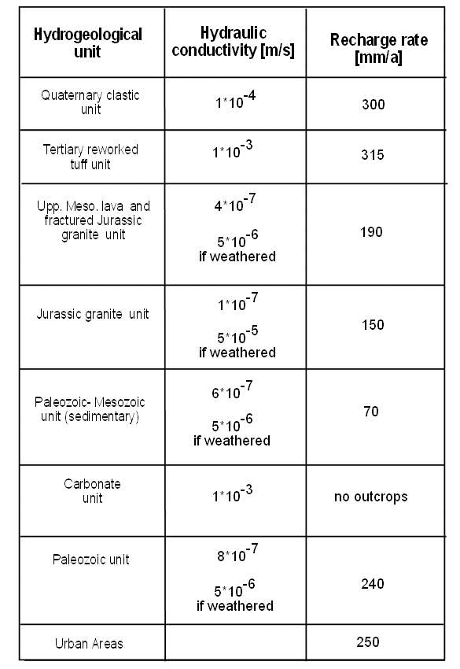
Groundwater model-MODFLOW
Lancia et al. 2019 Dataset
Time Steps*:
t(0)=2020
t(1)=2030
t(2)=2040
t(3)=2050
RCP 4.5
h(t0)=0 m a.s.l.
h(t3)=+0.36 m a.s.l
UZF_Inf (t0)= Lancia et al. 2019
calibrated dataset
UZF_Inf (t3)= -25% of Lancia et al.
(2019) calibrated dataset
RCP 8.5
h(t0)=0 m a.s.l.
h(t3)=0.5 m a.s.l
UZF_Inf (t0)= Lancia et al. 2019
calibrated dataset
UZF_Inf (t3)= +7.8% of Lancia et al.
(2019) calibrated dataset
All increments/decrements are set linear

Slide 17
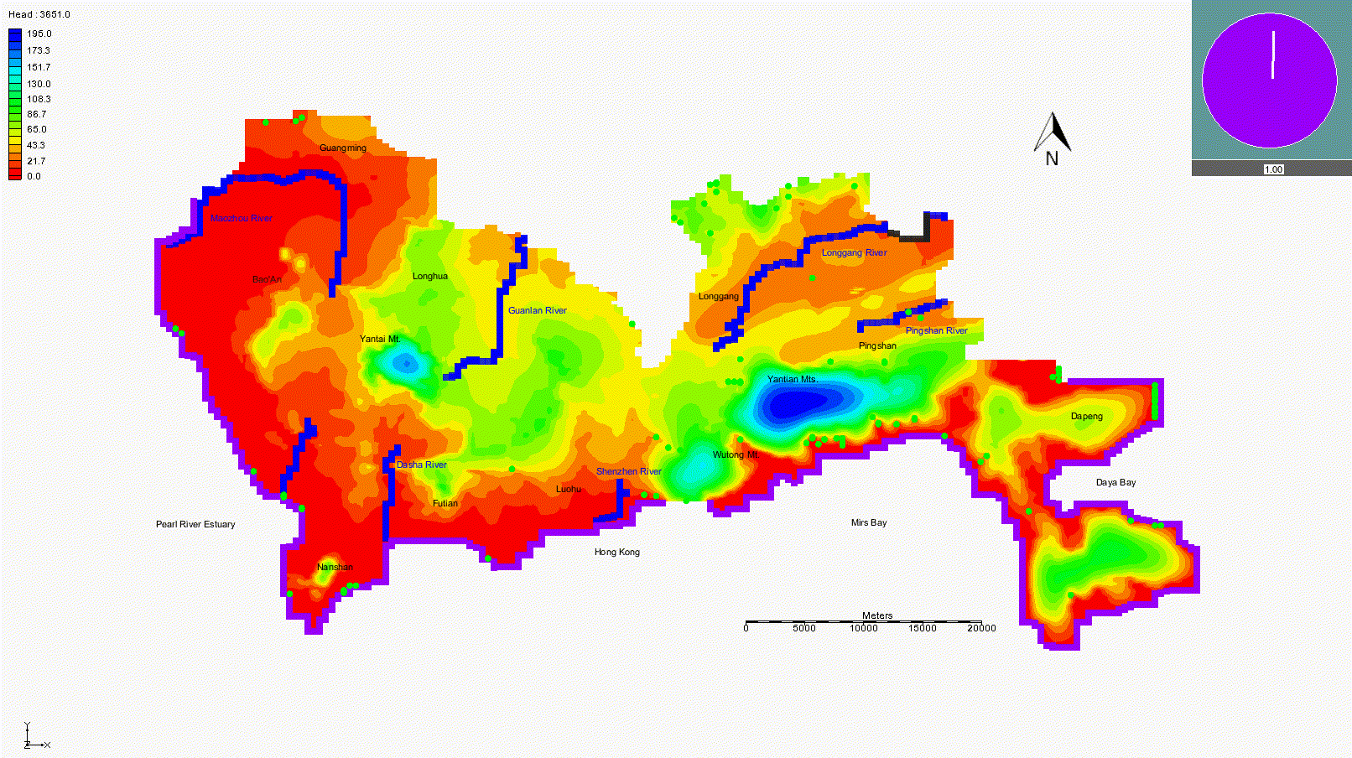
Simulated Groundwater Head (RCP 4.5): 2020-2050
days

Slide 18
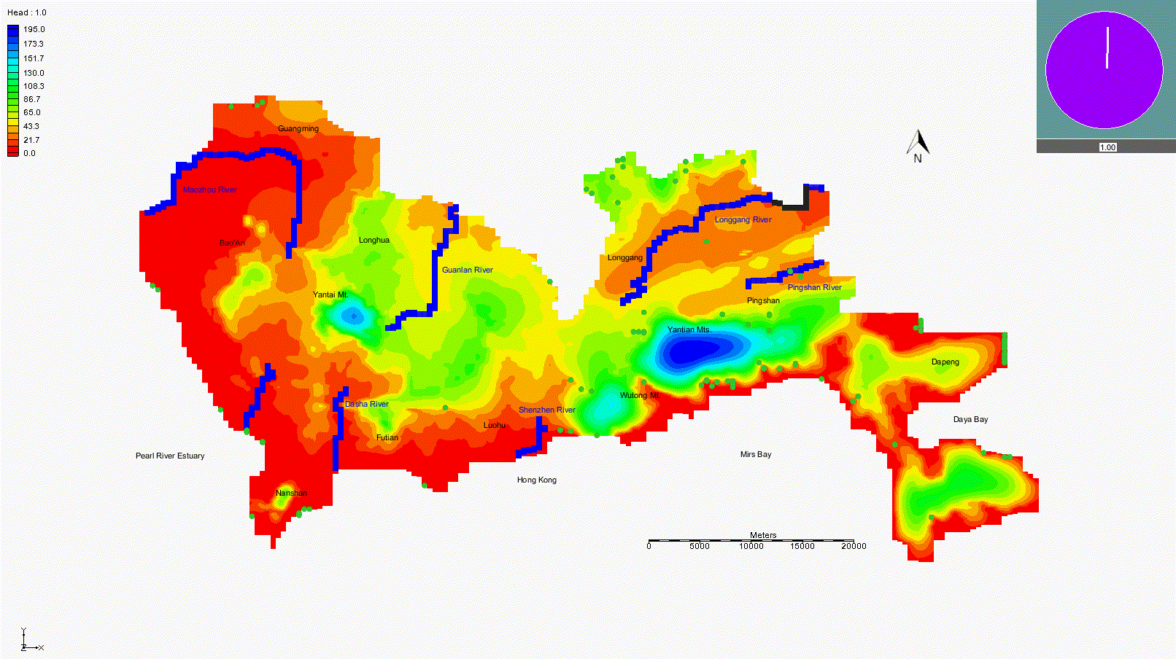
Simulated Groundwater Head (RCP 8.5): 2020-2050
days

Slide 19
Groundwater storage variation
RCP 4.5 (- 26%) groundwater table decreases from 1 to 26 m
RCP 8.5 (+ 15.48%) water level averagely rises from 0.5 to 8 m
In RCP 4.5, rainfall decreasing scenario, Dry cell almost tripled in 30 years, with the depletion of groundwater storage correspond with sea-level rise, the interface between saline water and fresh groundwater has been pushed inward(Saline intrusion).
In RCP 8.5, rainfall decreasing scenario, Wet cell doubled at the end of 2050, with the replenishment of groundwater storage, even sea-level rise occured, the interface between salt water and fresh groundwater has been pushed outward(Saline intrusion).

Slide 20
Water table variation
Water table change
RCP 4.5 | i | j | k | 2020 | 2030 | 2040 | 2050 | Increment(m)
Cell 1 | 279 | 32 | 1 | 5.69 | 5.45 | 5.17 | 4.86 | -0.83
Cell 2 | 255 | 56 | 1 | 162.18 | 159.28 | 155.12 | 147.92 | -14.26
Cell 3 | 290 | 120 | 1 | 195.37 | 190.39 | 182.81 | 169.66 | -25.71
Cell 4 | 357 | 113 | 1 | 2.43 | 2.36 | 2.28 | 2.18 | -0.25
Cell 5 | 423 | 49 | 1 | 1.03 | 0.9 | 0.76 | 0.59 | -0.44
Water table change
RCP 8.5 | i | j | k | 2020 | 2030 | 2040 | 2050 | Increment(m)
Cell 6 | 255 | 56 | 1 | 162.18 | 163.11 | 164.72 | 166.83 | 4.65
Cell 7 | 343 | 39 | 1 | 5.05 | 5.11 | 5.17 | 5.23 | 0.18
Cell 8 | 288 | 121 | 1 | 195.31 | 196.93 | 199.9 | 203.71 | 8.4
Cell 9 | 357 | 115 | 1 | 1.09 | 1.15 | 1.21 | 1.28 | 0.19
Cell 10 | 395 | 84 | 1 | 0.58 | 0.74 | 0.91 | 1.07 | 0.49
Cell 6
Cell 2
Cell 8
Cell 1
Cell 3
Cell 9
Cell 7
Cell 10
Cell 4
Cell 5

Slide 21
Discussion
Shenzhen presents a significant variability for future climate scenario;
By see the contrast water storage scenarios between RCP 4.5 and RCP 8.5 - even in highly urbanized setting - climate change can largely vary the storage of aquifer
Low-concentration scenario(RCP 4.5) demonstrates a large increase in risk of saline intrusion;
High-concentration scenario(RCP 8.5) demonstrates a large increase in risk of flood
Mitigation plans can be more integrated for dealing with the problem of saline intrusion in advance (e.g. the construction of a dam on Pearl River Delta)

Slide 22
Conclusion
Climate change varied area precipitation - infiltration which induced changing natural replenishment
Sea-level rise affects more low gradient area (elevation =<0.5m) through Intrusion/inundation
The interface in-between freshwater and salt water reacts rely on the condition of climate change
Sensitivity of groundwater to Climate change should be measured to try to avoid the emission extreme (risks of saltwater intrusion or flooding)

Slide 23
Thank you!
Questions are welcomed.

Slide 24
Reference
Chang, S. W., Clement, T. P., Simpson, M. J., & Lee, K. K. (2011). Does sea-level rise have an impact on saltwater intrusion?. Advances in water resources, 34(10), 1283-1291.
Ferguson, G., & Gleeson, T. (2012). Vulnerability of coastal aquifers to groundwater use and climate change. Nature Climate Change, 2(5), 342-345.
IPCC (2007) Report of the 26th session of the IPCC. Bangkok. April 30–May 4 2007. Intergovernmental Panel on Climate Change, Geneva, Switzerland
Lancia, M., Zheng, C., Yi, S., Lerner, D. N., & Andrews, C. (2019). Analysis of groundwater resources in densely populated urban watersheds with a complex tectonic setting: Shenzhen, southern China. Hydrogeology journal, 27(1), 183-194.
Luke P. Jackson and Svetlana Jevrejeva. (2016), “A probabilistic approach to 21st century regional sea-level projections using RCP and high-end scenarios.”, Global and Planetary Change. doi: 10.1111/joes.12148
Lerner DN (2002) Identifying and quantifying urban recharge: A review. Hydrogeology Journal, 10(1), 143-152
Svetlana Jevrejeva, Luke P. Jackson, Riccardo E. M. Riva, Aslak Grinsted, and John C. Moore (2016), “Coastal sea level rise with warming above 2 °C”, Proceedings of the National Academy of Sciences. doi: 10.1073/pnas.1605312113
Taylor, R. G., Scanlon, B., Döll, P., Rodell, M., Van Beek, R., Wada, Y., ... & Konikow, L. (2013). Ground water and climate change. Nature climate change, 3(4), 322-329.

