Slide 1
Stress and deformation analysis
in the Barents Sea in relation to
Paleogene transpression
along the Greenland-Eurasia plate boundary
S. Gac¹, A. Minakov², G. Shephard², J.I. Faleide^{1,2} & Sverre Planke^{2,3}
¹ Institutt for Geofag
Universitetet i Oslo
² CEED
Universitetet i Oslo
³ VBPR
Oslo

Slide 2
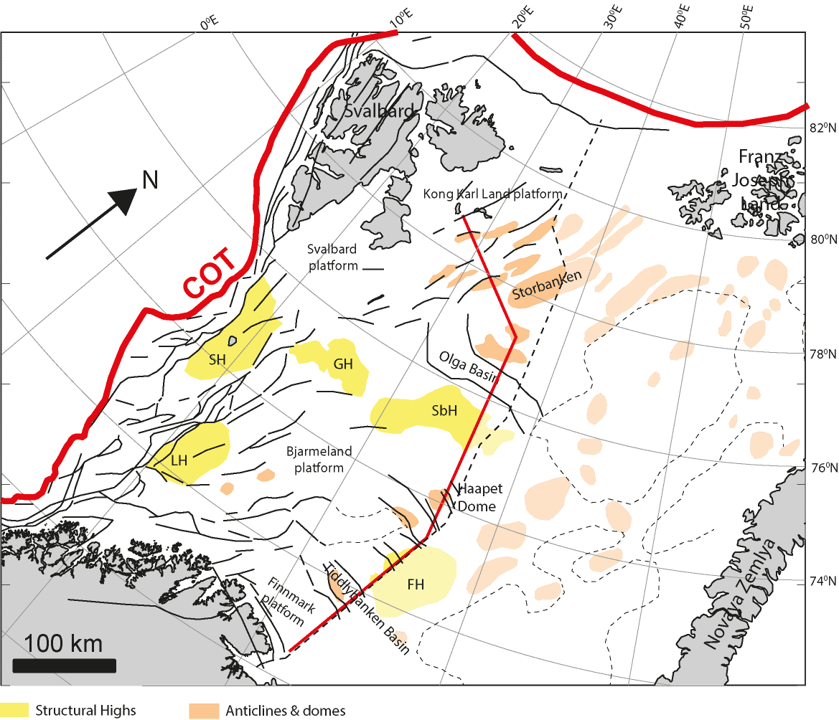
Domes and traps in the Barents Sea
Located above basement faults
Possible causes:
Contraction?
Salt?
Often several deformation phases
Triassic-Jurassic
Jurassic
Younger than early Cretaceous…
However, age is uncertain!! because of lack of data (due to Cenozoic regional erosion or missing wells)

Slide 3
Domes and traps in the Barents Sea
Located above basement faults
Possible causes:
Contraction?
Salt?
Often several deformation phases
Triassic-Jurassic
Jurassic
Younger than early Cretaceous…
However, age is uncertain!! because of lack of data (due to Cenozoic regional erosion or missing wells)

Slide 4
Episodes of compression
1,2
Carboniferous-Permian: Uralian Orogeny
Mid. late Triassic-mid. Jurassic: “Up-thrusting” of Novaya Zemlya
Late Jurassic-early Cretaceous: “Wrenching” due to the interaction between North-Atlantic and Arctic rift systems
Late Paleocene – Eocene: transpression along the western margin of Svalbard and along the Senja Fracture Zone
Miocene-Present: “ridge push” after the onset of the Knipovich ridge (Gabrielsen et al., 1997; Doré e al., 2008).
1,2
4,5
3
1

Slide 5
Question
Can these known and dated geodynamic events cause the deformation phases of the observed inverted structures?
Solution
Numerical modelling of those compressional mechanisms!
Comparison of modelled deformation with observations
Here we test the Paleogene transpression of Greenland vs. Svalbard

Slide 6
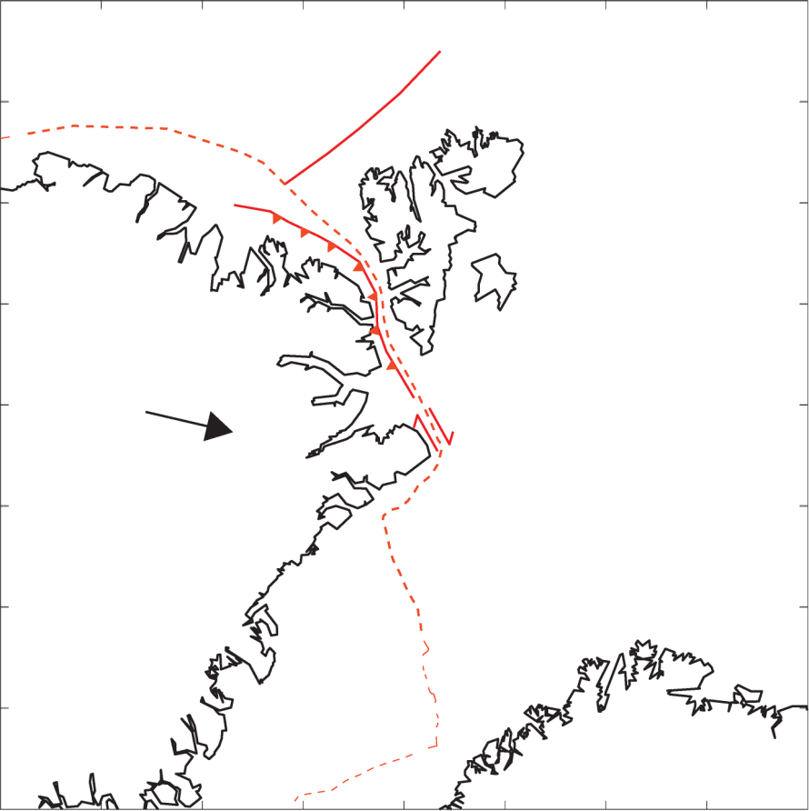
Paleogene Greenland-Eurasia transpression
Mid Paleocene plate kinematics
Mid-Paleocene (Eocene?)
Fold and thrust belt and Central Basin start to form at Svalbard (Jones et al., 2016)
?
Central Basin

Slide 7
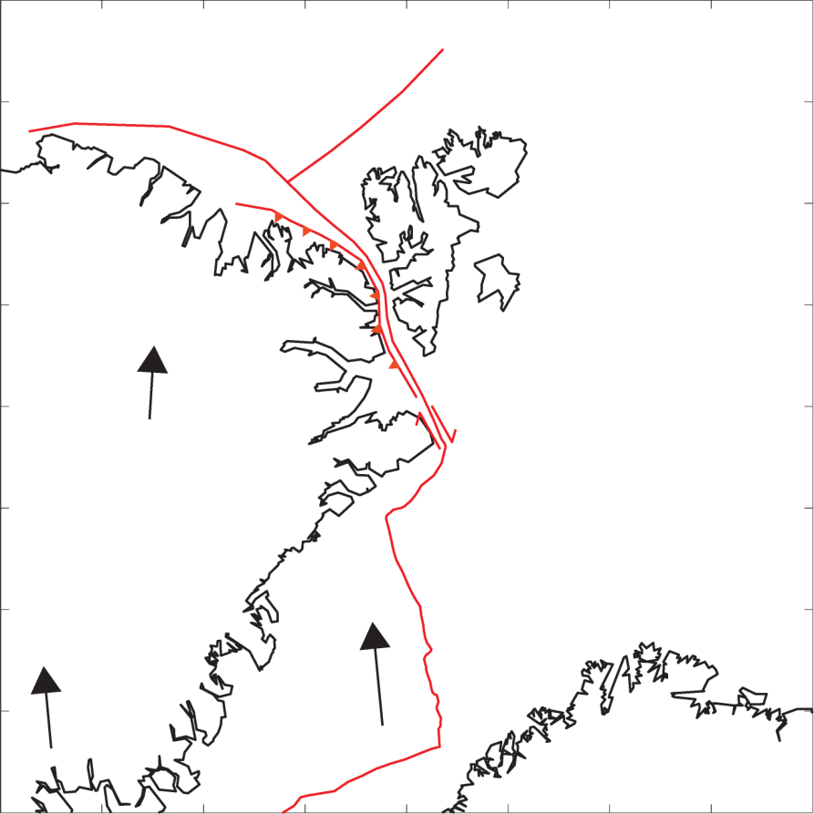
Eocene plate kinematics
Mid-Paleocene (Eocene?)
Fold and thrust belt and Central Basin start to form at Svalbard (Jones et al., 2016)
Eocene (C24)
Breakup in the North-Atlantic & Eurasian basin
Start of transpression west of Svalbard
Pull-apart basin at Vestbakken
?
Central Basin
Vestbakken Volcanic Province

Slide 8
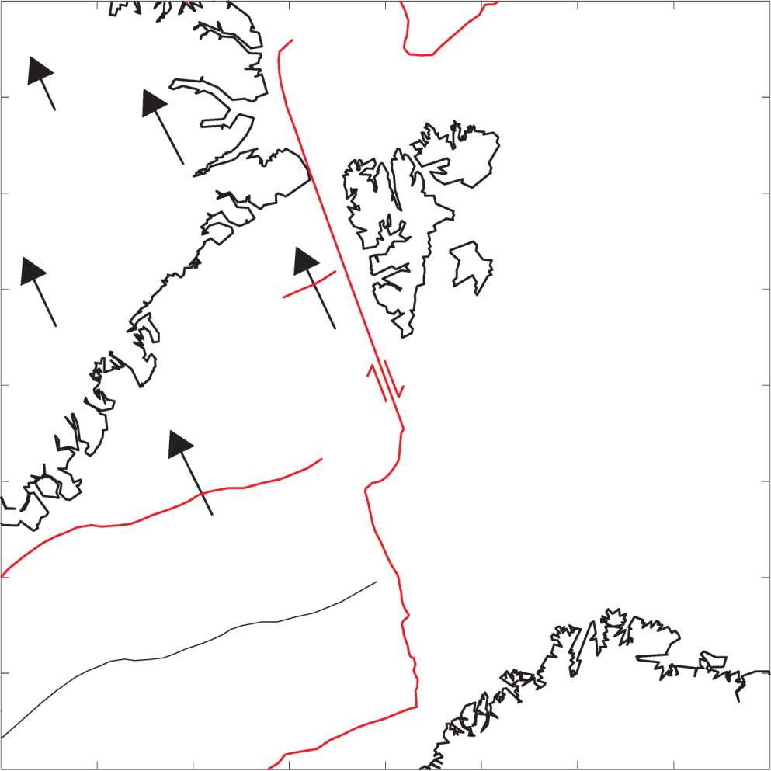
Oligocene plate kinematics
Mid-Paleocene (Eocene?)
Fold and thrust belt and Central Basin start to form at Svalbard (Jones et al., 2016)
Eocene (C24)
Breakup in the North-Atlantic & Eurasian basin
Start of transpression west of Svalbard
Pull-apart basin at Vestbakken
Oligocene (C13)
Greenland plate changes direction
End of transpression
Central Basin
Vestbakken Volcanic Province

Slide 9
Modelling set up - Workflow
Paleogene Greenland-Eurasia plate kinematic modelling

Slide 10
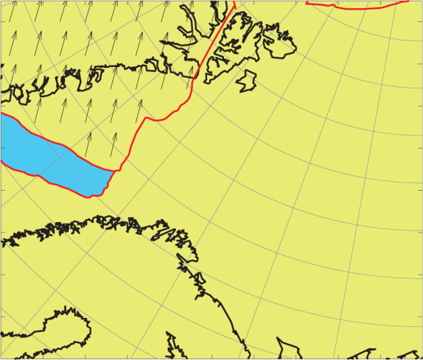
Modelling set up - Workflow
Paleogene Greenland-Eurasia plate kinematic modelling
2D FEM viscous stress and strain rate modelling

Slide 11
Modelling set up - Workflow
Paleogene Greenland-Eurasia plate kinematic modelling
2D FEM Viscous stress and strain rate modelling
Analytical prediction of 3D folding (Fletcher, 1991)

Slide 12
Model set up – alternate plate kinematic model
Kinematic Greenland plate modelling (M2)
Gaina et al. (2009)
GPlates plate tectonic software
Eurasia is fixed
Fewer Euler poles
Outputs
Plate velocities each Ma from Mid-Paleocene to Oligocene
Plate configurations each Ma

Slide 13
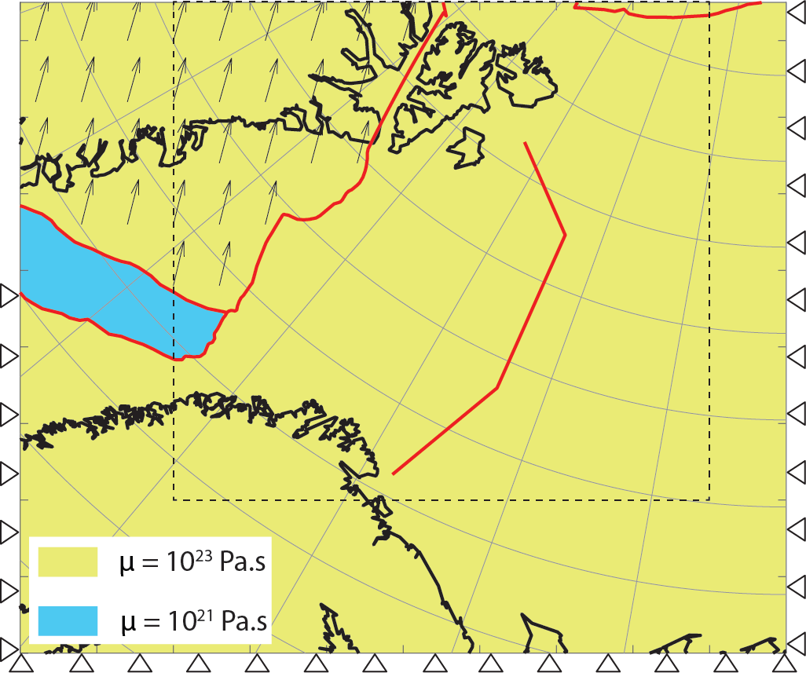
Modelling set up – viscous model
2D FEM Numerical stress and strain rate modelling
Thin-sheet approximation (σ_{zz}=0)
Assumptions
Stresses are conveyed in the lithosphere
Mid-ocean ridges do not convey stresses
Weak oceanic domain
Strong continental shelf
Free BC in the northern Barents Sea to simulate weakness zone caused by rifting
Outputs
Horizontal stresses & strain rate each Ma from Mid-Paleocene to Oligocene

Slide 14
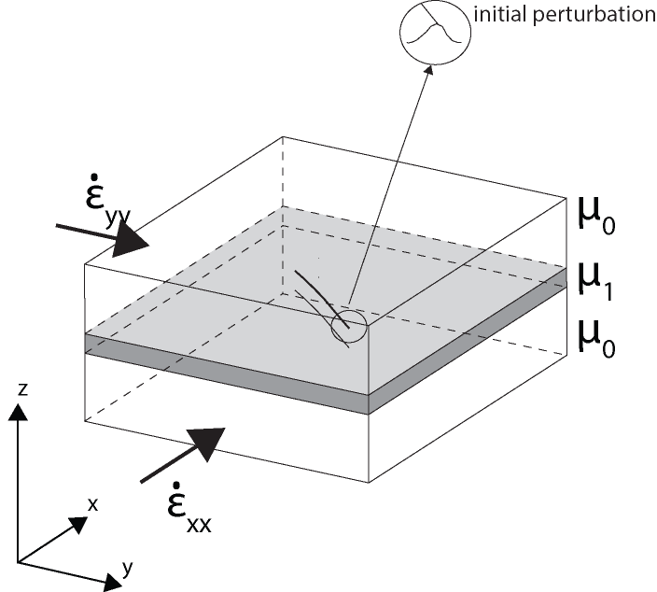
Analytical solution for 3D folding
Analytical solution – 3D folding (Fletcher, 1991)
3D embedded viscous layers
Disturbed by initial perturbations (caused by faults…)
Predicts the growth rate of the perturbation as a function of local strain rate amplitude and direction
Folding rate maximum when perturbation is perpendicular to contraction

Slide 15
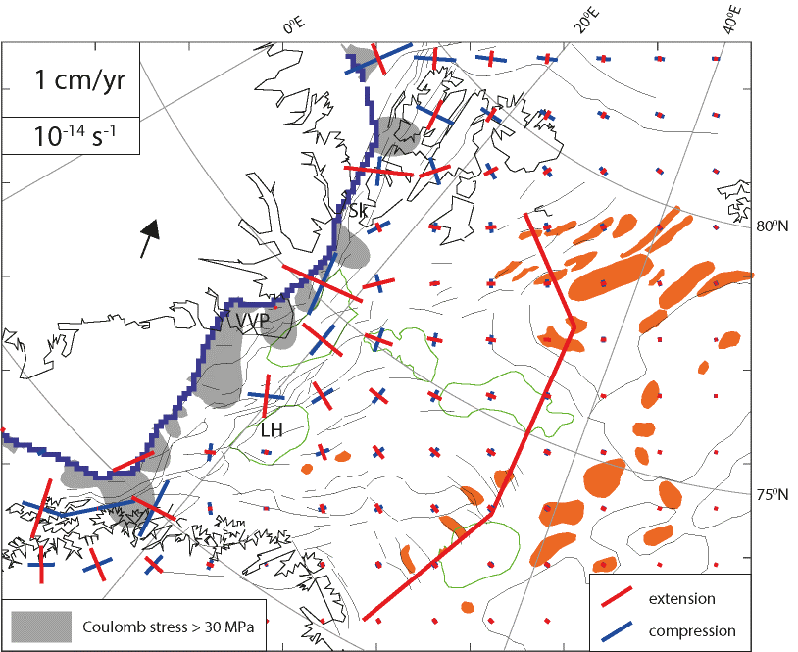
late Cretaceous before breakup (-65 Ma)
Principal strain rates

Slide 16
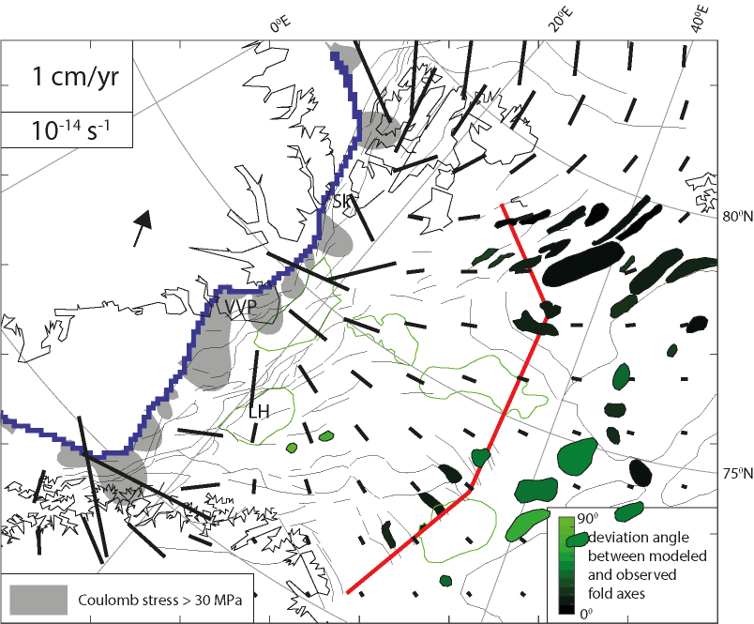
late Cretaceous before breakup (-65 Ma)
Principal strain rates
Favourite anticlines

Slide 17
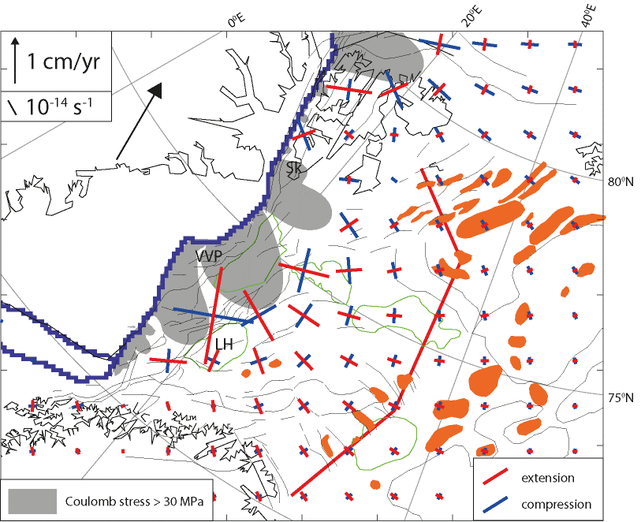
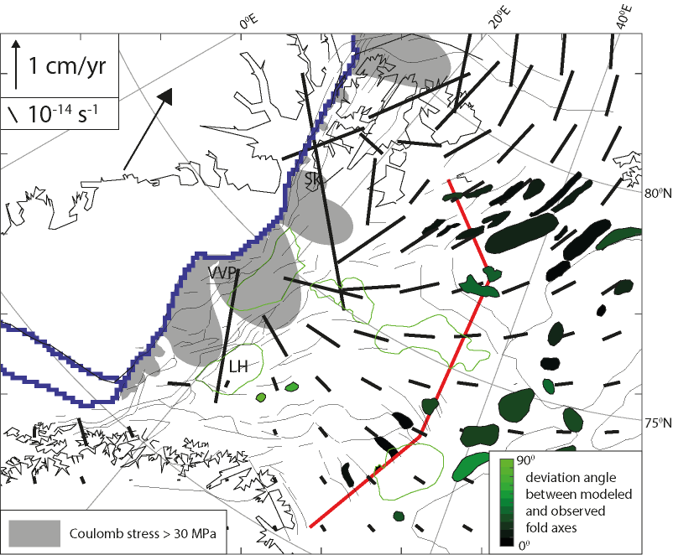
Eocene after breakup (-52 Ma)
Principal strain rates
Favourite anticlines
Gac. S., A. Minakov, G. Shephard, J.I. Faleide, and S. Planke. Stress and deformation analysis of the Eocene transpression in the Barents Sea, under review

Slide 18
Conclusions
Paleogene Greenland motion can promotes folding within the Barents Shelf
The modelling predicts that the preferential direction of fold axes is generally SSW-NNE in the northern Barents Sea progressively rotating to NW-SE in the southern Barents Sea in good accordance with the observed contraction east of Svalbard and in the SE Barents Sea.
Modelling predicts folding culminates in the Eocene: fist in the SE Barents Sea (early Eocene) then in the northern Barents Sea (middle Eocene)
Gac. S., A. Minakov, G. Shephard, J.I. Faleide, and S. Planke. Stress and deformation analysis of the Eocene transpression in the Barents Sea, in prep.

Slide 19
Supplementary material

Slide 20
Model set up – Paleogene plate kinematic model
Kinematic Greenland plate modelling (M1)
Barnett-Moore et al. (2016) before 49 Ma
Gaina et al. (2009) after 49 Ma
GPlates plate tectonic software
Eurasia is fixed
Outputs
Plate velocities each Ma from Mid-Paleocene to Oligocene
Plate configurations each Ma

Slide 21
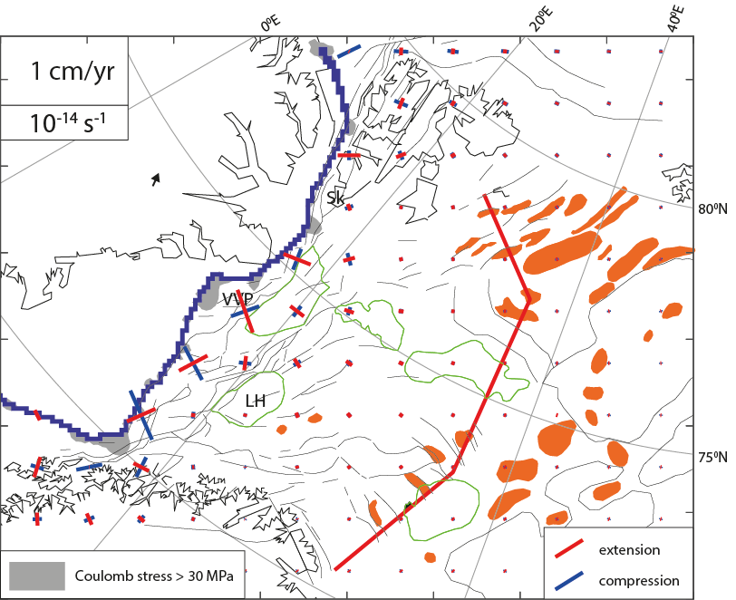
late Cretaceous before breakup (-65 Ma)
Principal strain rates

Slide 22
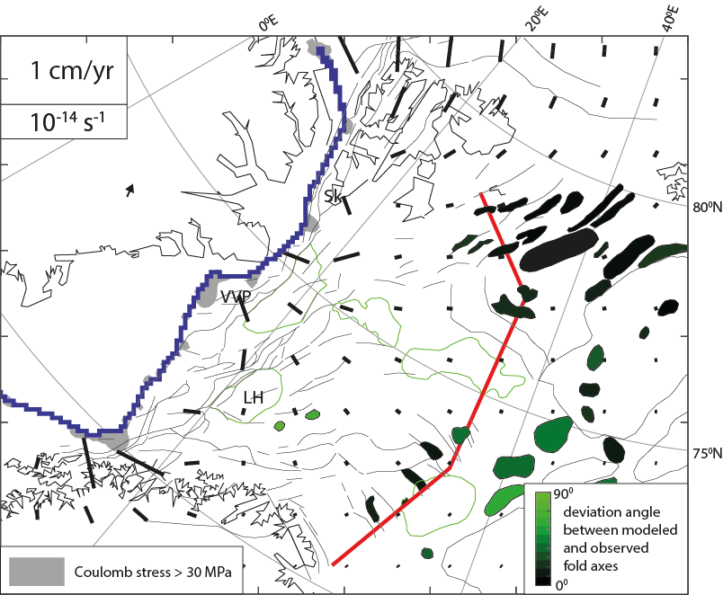
late Cretaceous before breakup (-65 Ma)
Principal strain rates
Favourite anticlines

Slide 23
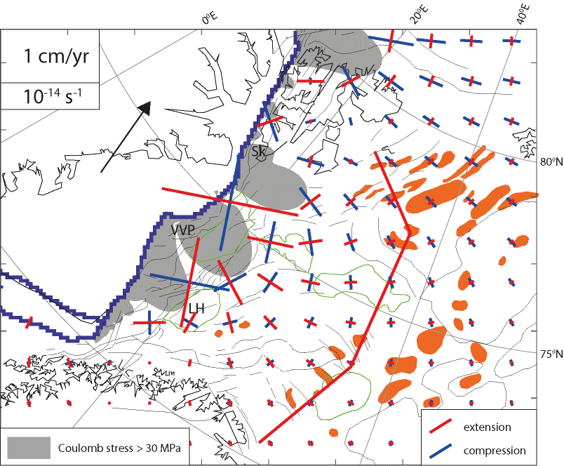
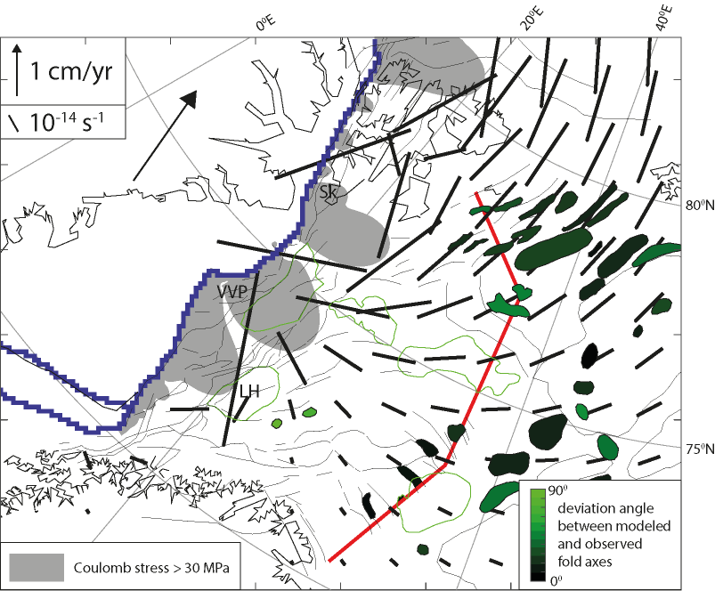
Eocene after breakup (-52 Ma)
Principal strain rates
Favourite anticlines

