Slide 1
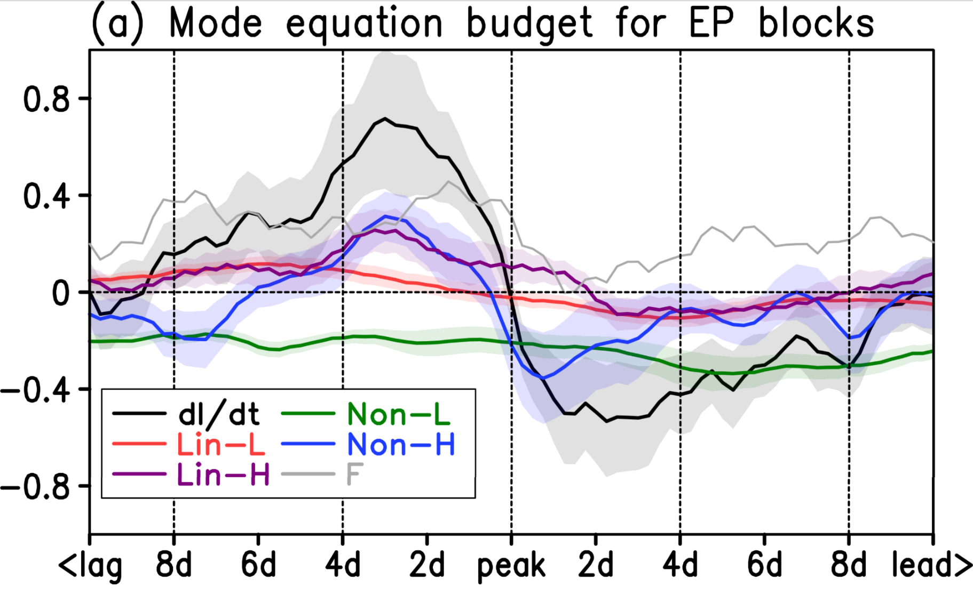
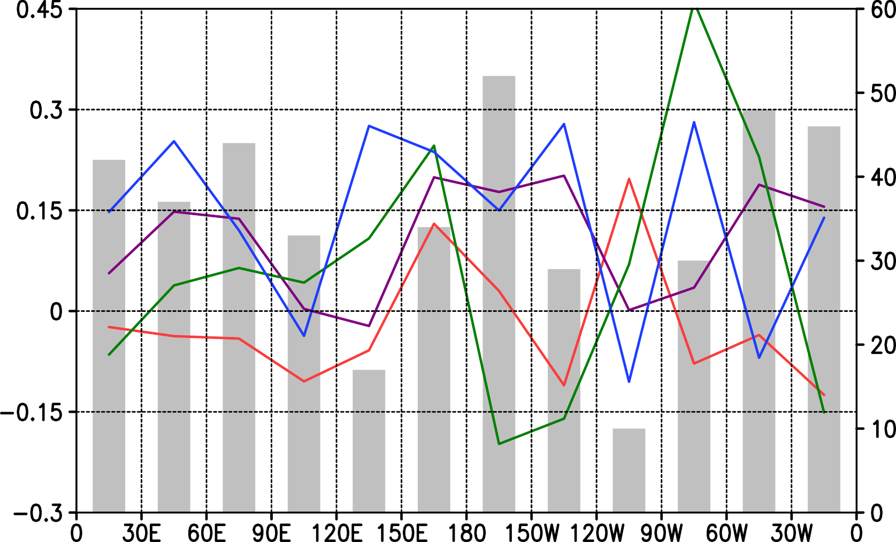
Mode-Decomposed Equation Diagnosis for Atmospheric Blocking Development
Masaru Inatsu (Hokkaido Univ), Takuya Aikawa (Japan Met Agency), and Naoto Nakano (Kyoto Univ)
[POINT of this study]
Mode-decomposed equation is derived from vorticity equation, using orthogonality of PC timeseries.
Atmospheric blocking is dynamically diagnosed with the equation without any time filtering to data.
Basis of PC analysis
Projection to blocking events
Any tempo-spatial function can be decomposed into EOF spatial patterns that are orthogonal each other with their coefficient of PC timeseries as
$$Z\left(x,t\right)=Z_{0}\left(x\right)+\sum_{n=1}^{∞}{Z_{n}\left(x\right)}A_{n}\left(t\right).$$
Each mode is sequentially chosen to maximise the variance and to be orthogonal to the lower modes.
$$\left(Z_{m},Z_{n}\right)=\int_{Ω}{Z_{m}\left(x\right)Z_{n}\left(x\right) dx}=δ_{mn}S_{n},$$
where $S_{n}$ is eigenvalues. In fact, the PC timeseries is also orthogonal each other (now they are normalized):
$$\frac{1}{T}\int_{T}{A_{m}\left(t\right)A_{n}(t) dt}=δ_{mn}.$$
Another tempo-spatial function is then decomposed with this set of PC timeseries as
$$Y\left(x,t\right)=Y_{0}\left(x\right)+\sum_{n=1}^{∞}{Y_{n}\left(x\right)}A_{n}\left(t\right).$$
Here the expansion coefficients $Y_{n}\left(x\right)$ is regressed onto PCs:
$$Y_{n}\left(x\right)=\frac{1}{T}\int_{T}{\left[Y\left(x,t\right)−Y_{0}\left(x\right)\right] A_{n}\left(t\right) dt}.$$
Note that $\left\{Y_{1}, Y_{2},…, Y_{n},…\right\}$ are not generally orthogonal each other.
Fig. 1. PC1 and PC2 of Z500 in the cold season between Nov and Mar based on data from 1960/61 to 2016/17.
Fig. 2. Z500 composite of Eastern Pacific blocking events.
The atmospheric blocking is defined by the meridional reversal of geopotential contours (Tibalti and Molteni 1990, Tellus) or by a high pressure anomaly (Dole and Gordon 1983, CD). This study used the hybrid method with Barriopedro et al. (2010, CD).
We identified 52 Eastern Pacific blocking events in 57 winters, which was identified as the central longitude of their peak in 180-150W. It was found that the Z500 composite of Eastern Pacific blocking events’ peak had large projection onto EOF2 (Figs. 1 and 2). We then define the blocking index as the linear combination of 10 modes composited for the events’ peak:
$$I_{}^{EP}=−0.081 A_{1}+0.747 A_{2}−0.003 A_{3}−0.089 A_{4}+0.023 A_{5}+0.207 A_{6}−0.209 A_{7}+0.196 A_{8}−0.053 A_{9}+0.262 A_{10}$$
Decomposition of vorticity equation
Diagnosis with blocking index equation
Wind vector expansion with PC timeseries
$$u\left(x,t\right)=u_{0}\left(x\right)+\sum_{n=1}^{∞}{u_{n}\left(x\right)}A_{n}\left(t\right)$$
is substituted into the isobaric vorticity equation
$$\frac{∂ζ}{∂t}=−∇⋅\left[u\left(f+ζ\right)\right],$$
and we obtain
$$\sum_{n}{ζ_{n}\left(x\right)\frac{dA_{n}}{dt}}=−\sum_{n}{\{∇⋅\left[u_{0}ζ_{n}+u_{n}\left(f+ζ_{0}\right)\right]\} A_{n}}−\sum_{m}{\sum_{n}{∇⋅\left(u_{m} ζ_{n}\right) A_{m} A_{n}}},$$
after the relative vorticity is computed from horizontal wind vector:
$$ζ_{n}=\frac{∂v_{n}}{∂x}−\frac{∂u_{n}}{∂y} \left(n=0,1,2,…\right).$$
Taking the inner product with $l$-mode relative vorticity,
$$\sum_{n}{C_{ln}A_{n}^{′}}=−\sum_{n}{L_{ln}A_{n}}−\sum_{m}{\sum_{n}{N_{lmn} A_{m} A_{n}}},$$
$$C_{ln}=\int_{Ω}{ζ_{l}\left(x\right) ζ_{n}\left(x\right) dx}≡\left(ζ_{l},ζ_{n}\right),$$
$$L_{ln}=\int_{Ω}{ζ_{l}\left(x\right) \{∇⋅\left[u_{0}ζ_{n}+u_{n}\left(f+ζ_{0}\right)\right]\} dx}, and$$
$$N_{lmn}=\int_{Ω}{ζ_{l}\left(x\right) ∇⋅\left(u_{m} ζ_{n}\right) dx}.$$
Operating the inverse matrix of $C_{ln}$, the nonlinear dynamic system is obtained.
$$A_{k}^{′}=−\sum_{l,n}{C_{kl}^{−1}L_{ln}A_{n}}−\sum_{l,m,n}{C_{kl}^{−1}N_{lmn} A_{m} A_{n}}$$
Blocking index equation with the truncation at 50 modes is
$$\frac{dI_{}^{EP}}{dt}=\sum_{n=1}^{50}{ℒ_{n}^{} A_{n}}+\sum_{m=1}^{50}{\sum_{n=1}^{50}{ℳ_{mn}^{} A_{m} A_{n}}}.$$
Separating low modes 1-10 into high modes 11-50,
$$\frac{dI^{EP}}{dt}=\sum_{n=1}^{10}{ℒ_{n} A_{n}}+\sum_{n=11}^{50}{ℒ_{n} A_{n}}+\sum_{m=1}^{10}{\sum_{n=1}^{10}{ℳ_{mn} A_{m} A_{n}}}$$
$$+\sum_{m=1}^{10}{\sum_{n=11}^{50}{ℳ_{mn} A_{m} A_{n}}}+\sum_{m=11}^{50}{\sum_{n=1}^{10}{ℳ_{mn} A_{m} A_{n}}}+\sum_{m=11}^{50}{\sum_{n=11}^{50}{ℳ_{mn} A_{m} A_{n}}},$$
the vorticity flux convergence can be divided into low-mode linear term, high-mode linear term, low-mode nonlinear term, and high-mode nonlinear term. Whereas the low modes were not effective to blocking formation, the high-mode nonlinear term played an important role in blocking formation over Eastern Pacific (Figs. 3 and 4).
Fig. 3. Lag composite of Eastern Pacific blocking events. (Red) low-mode and (purple) high-mode linear terms, (green) low-mode and (blue) high-mode nonlinear terms, and (black) tendency (day⁻¹).
Fig. 4. Composite of each term for sectorial blockings averaged over 4 days before the peak. The bar graph shows the number of blocking episodes.
References: Aikawa, T., M. Inatsu, N. Nakano, and T. Iwano, 2019: Mode-decomposed equation diagnosis for atmospheric blocking development. Journal of the Atmospheric Sciences, 76, 3151-3167. This was funded by the Environment Research and Technology Development Fund 2-1905 of the Environmental Restoration and Conservation Agency of Japan. © Masaru Inatsu, 2020, All rights reserved.

