Slide 1
Retrieving tropospheric parameters using predicted multi-GNSS orbits and clocks
Zhiguo Deng^{1,3}, Florian Zus¹, Kyriakos Balidakis¹, Jens Wickert^{1,2} and Harald Schuh^{1,2,3}
deng@gfz-potsdam.de
(1) GFZ Potsdam, Germany
(2) Technical University Berlin, Germany
(3) GeoBM GmbH, Germany

Slide 2
Content
Rapid and ultra-rapid multi-GNSS products: GBM & GBU
Orbit & Clock prediction method
Validation of Orbit & Clock prediction
ZTD from predicted Orbit and Clock
Conclusion and Outlook

Slide 3
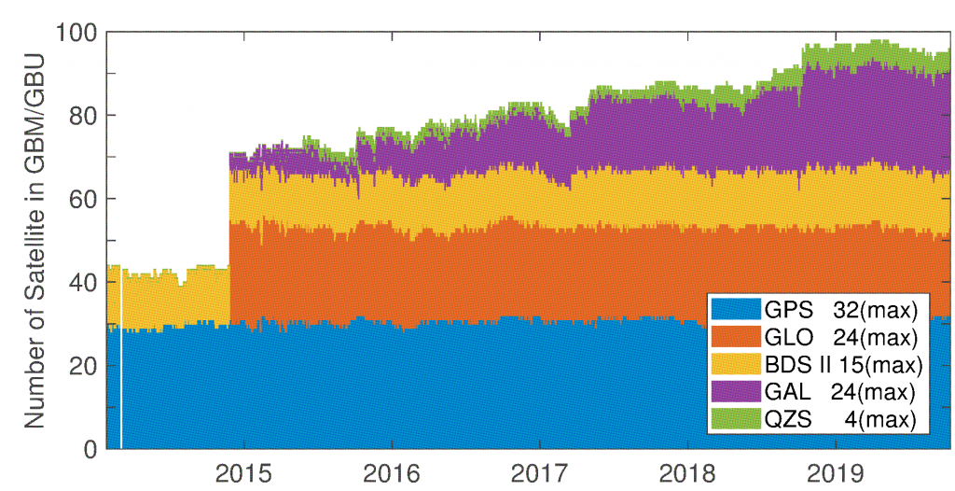
Rapid and ultra-rapid SP3: GBM & GBU
Product includes:
5 min. orbit & 30 sec. clock
Daily ERP parameters
Daily ISB for MGEX stations
Up to 129 satellites
Satellite system | Observation types
GPS | L1/L2
GLONASS | L1/L2
Galileo | E1/E5a
BeiDou II | B1/B2
BeiDou II+III | B1/B3
QZSS | L1/L2
(Up to 28 satellites of BDS III are added at the end of 2019.)
Start GBM
Start GBU

Slide 4
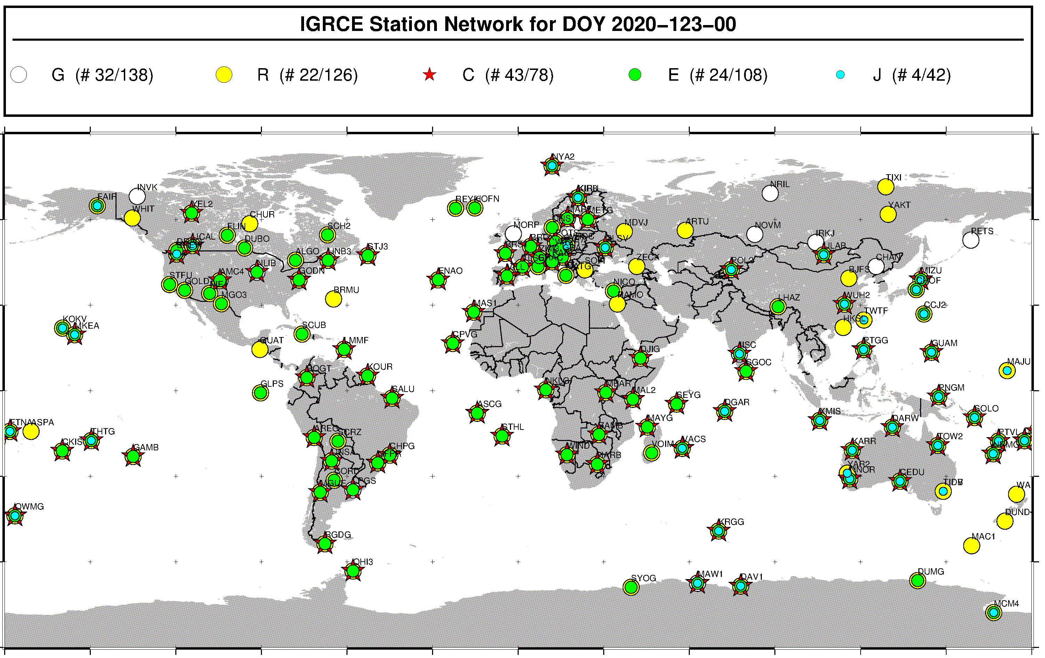
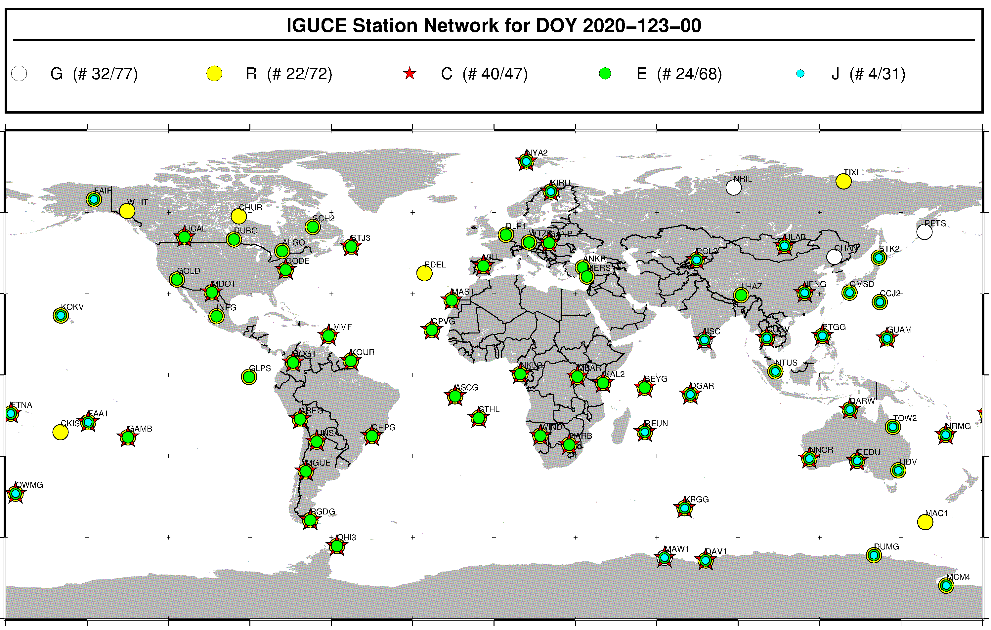
Multi-GNSS network for rapid & ultra rapid
(02-May-2020)
Rapid
Ultra rapid

Slide 5
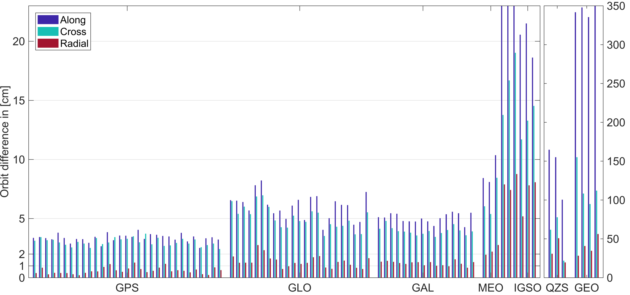
GBU Orbit prediction
GBU (09:00 job, 3 hours prediction part 12:00~15:00) vs. GBM
GBU
24 h SP3
24 h SP3
48h
GBM
24 h SP3__________
Sys. | T [cm] | N [cm] | R [cm]
G | 3.4 | 3.0 | 0.6
R | 6.0 | 5.1 | 1.4
E | 5.0 | 4.0 | 1.2
C(MEO) | 9.0 | 6.6 | 2.3
C(IGSO) | 23.8 | 14.8 | 7.5
C(GEO) | 373.5 | 117.5 | 39.9
J | 140.0 | 53.8 | 33.8

Slide 6
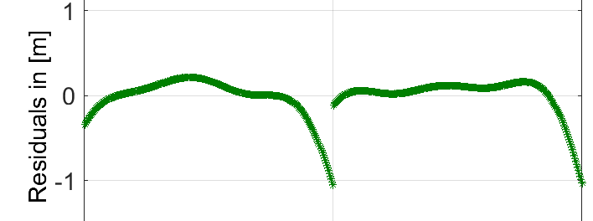
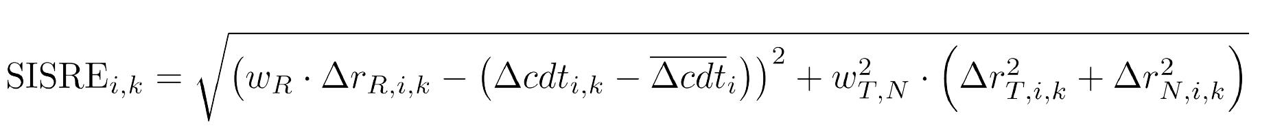
GBU Clock prediction
24 h ORB
24 h ORB
Correct clock using orbit fitting residuals before clock prediction.
24 h Clock
24 h Clock
24h
The quality of predicted orbit & clock is analysed with SISRE (Signal-In-Space Range Error):

Slide 7
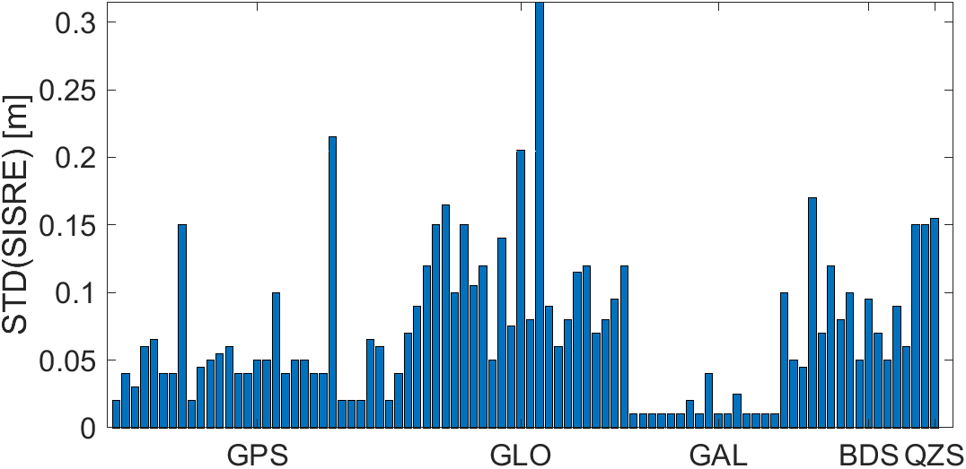
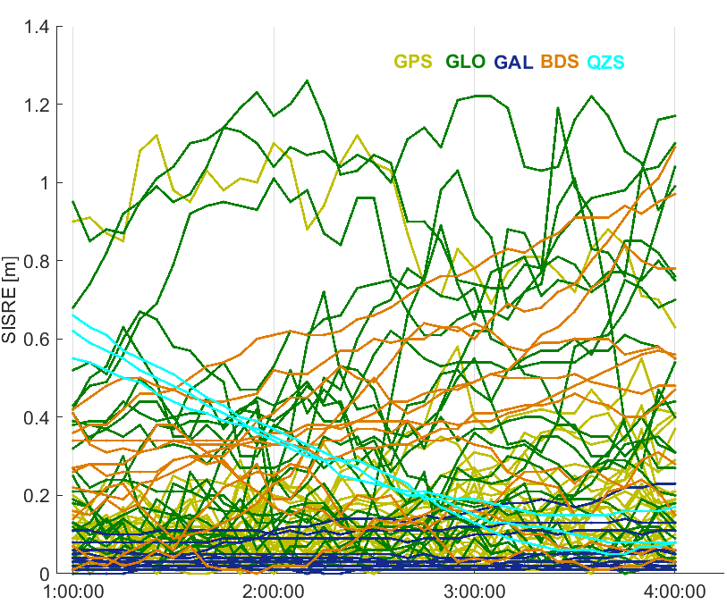
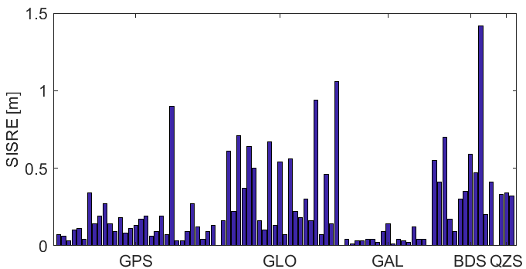
SISRE validation
3 hours predicted SP3 vs. GBM
After removing a clock bias over 3 hours for each satellite.
24 h calculated
24h predicted
GBM
24 h caculated
 | G | R | E | C | J
RMS[m] | 0.11 | 0.30 | 0.04 | 0.41 | 0.33
STD[m] | 0.04 | 0.11 | 0.01 | 0.07 | 0.15

Slide 8
ZTD from predicted SP3
Calculated part Predicted part
GBU SP3
24 h
24 h
In the predicted part only the satellites with STD(SISRE) < 2.5 cm are used. Clock bias can be absorbed by ambiguity.
24 hours static PPP
24 h observation
24 hours ZTD product
24 h ZTD
Parameters: 30 min. ZTD, 24 h. gradients and coordinates, receiver clock error.
Compare the last 2 hours ZTD product with:
1) ZTD from PPP using GBM SP3
2) ZTD from NWM (numeric weather model)

Slide 9
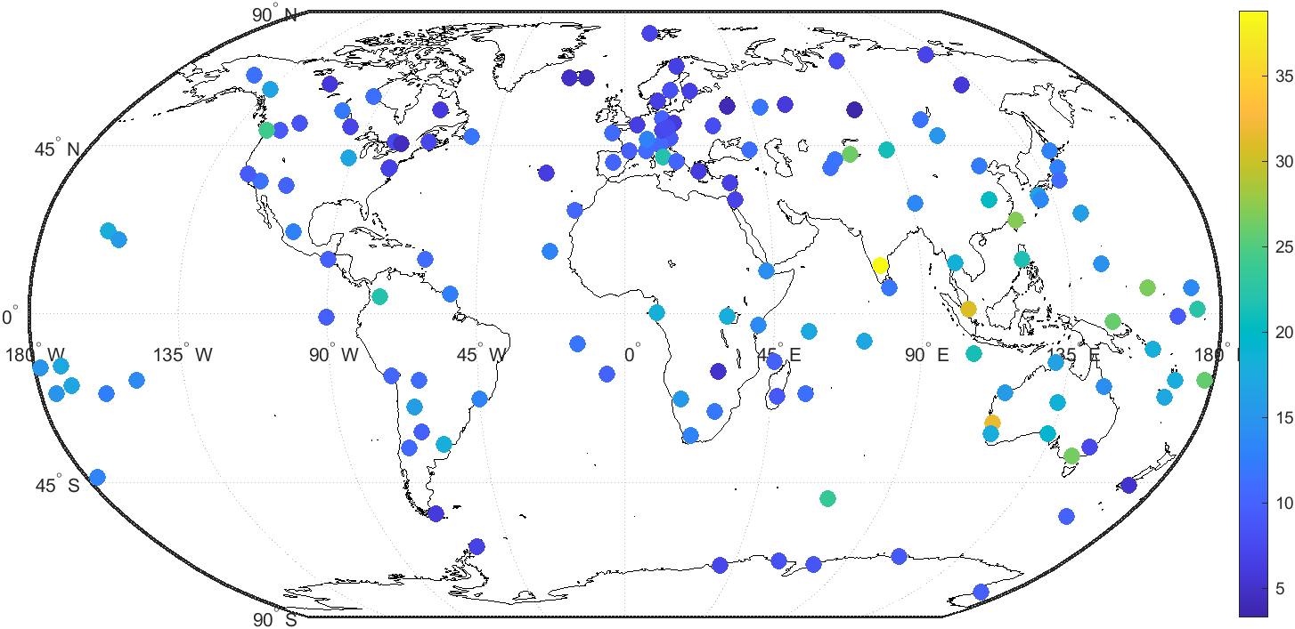
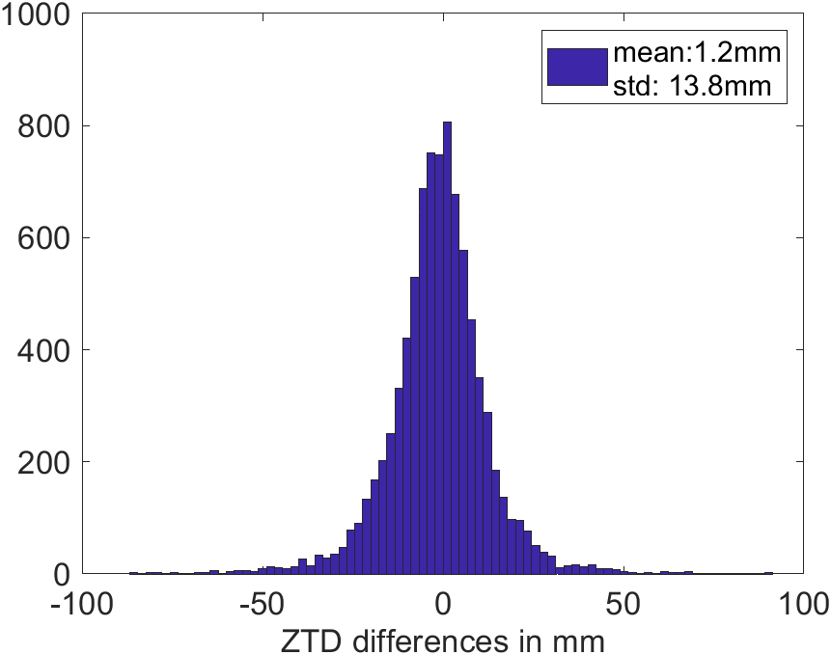
ZTD (predicted SP3) vs. ZTD (GBM SP3)
mm
The histogram of ZTD differences shows a mean of 1.2 mm and a STD of 13.8 mm. (outlier>100mm)
ZTDs from 146 stations (DOY 332-362 in 2019) are analyzed. The color indicates the RMS deviation for each station.

Slide 10
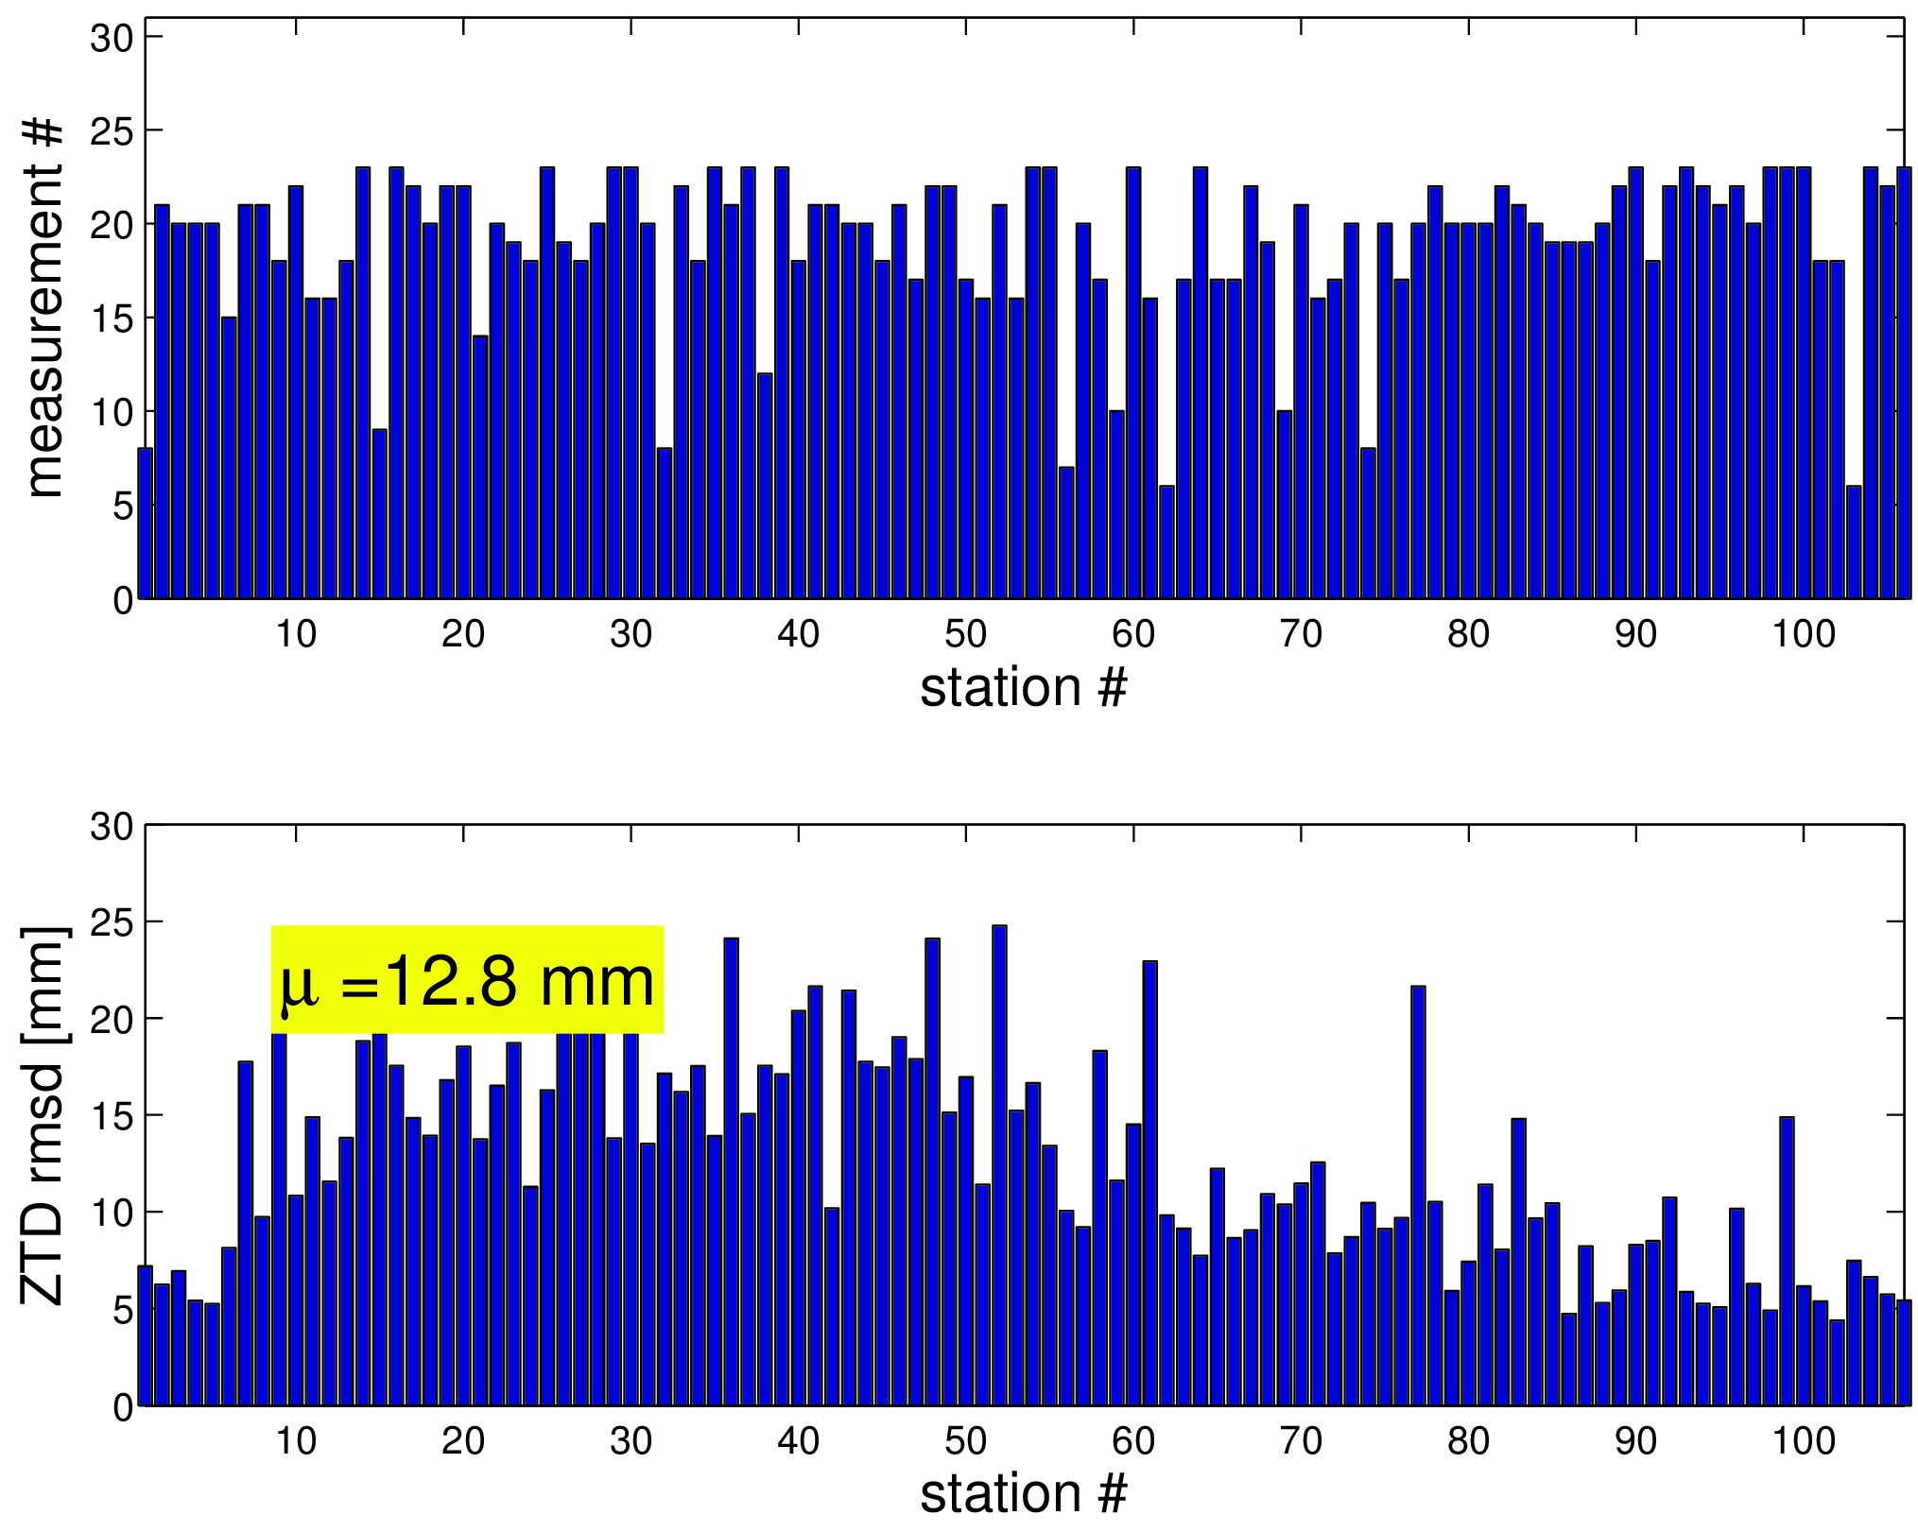
ZTD (predicted SP3) vs. NWM
NWM data comes from the atmospheric reanalysis
ERA5 (ECMWF)
Stations where RMS deviation exceeds 40 mm are removed from statistic (outliers)
Stations are sorted with respect to the latitude
The comparison with the weather model shows an average RMS deviation of about 13 mm.

Slide 11
Conclusion and Outlook
The GNSS orbit and clock determination and prediction benefits from the more stable clock.
SISRE for Galileo is the lowest.
ZTDs from 140 global stations using good* predicted satellite orbit and clocks are validated with a reference solution and a NWM. RMS deviations are about 13 mm.
ZTDs estimated from predicted orbit and clock products are sufficiently accurate for time critical meteorological applications.

Slide 12
Thank you for your attention

