Slide 1







SESSION: ITS4.5/GI1.4
New frontiers of multiscale monitoring, analysis, modeling and decisional support (DSS) of environmental systems
Chat time: Friday, 8 May 2020, 10:45–12:30
D2137 |EGU2020-17991
Self-potential (SP) soil monitoring tool by numbers and vectors characteristic
Vincenzo Di Fiore, Francesca Bianco, Giuseppe Cavuoto, Girolamo Milano, Nicola Pelosi, Michele Punzo, Daniela Tarallo, Pietro Tizzani, Michele Iavarone, Paolo Scotto di Vettimo, and Costantino Di Gregorio
Corresponding author: vincenzo.difiore@cnr.it

Slide 2
TOPIC
This work provides a new insight on electrical field monitoring of natural systems by considering the temporal variation of self potential (SP) of soils. To make this, we take into account some mathematical field features as so the matrix determinant and eigenvalues. Specifically, we highlight that the SP is linked to the soils electrical conductivity and chemical properties. In particular, soil electrical conductivity represent an indirect measurement that allows to correlate same physical and chemical properties of soil.
The performed analysis is based on synthetics and experimental case study that furnished a semi-quantitative
method to estimate the spatial and temporal variation of electrical field vector in the soil starting from the SP measurements. The experimental case study is referred to a site located in the Campania Region (Sothern Italy). We develop an effective system and a correlated methodology to monitor the elastic field in the soil by considering the variations of the determinant and eigenvalues of the Variable Time Matrix [TVM] that consists of a pairs of consecutive electric field vectors
Finally, we point out that, the acquisition system was entirely designed by the research and technical team by using the electronic components based on Arduino System Architecture

Slide 3
Summary
Data Processing Flow chart Algorithm
Mathematic framework
Synthetic data
Acquisition system
Experimental data
Conclusions

Slide 4
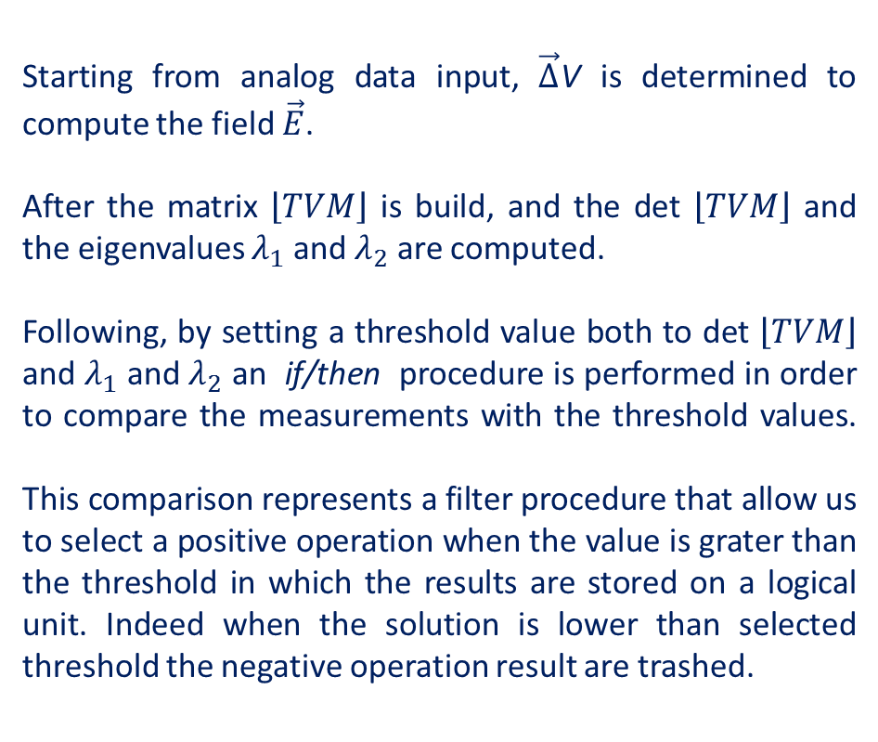
Data Processing Flow chart Algorithm
Starting from analog data input, $\vec{∆}$V is determined to compute the field $\vec{E}$.
After the matrix $\left\lfloor TVM\right\rfloor$ is build, and the det $\left\lfloor TVM\right\rfloor$ and the eigenvalues $λ_{1}$ and $λ_{2}$ are computed.
Following, by setting a threshold value both to det $\left\lfloor TVM\right\rfloor$ and $λ_{1}$ and $λ_{2}$ an if/then procedure is performed in order to compare the measurements with the threshold values.
This comparison represents a filter procedure that allow us to select a positive operation when the value is grater than the threshold in which the results are stored on a logical unit. Indeed when the solution is lower than selected threshold the negative operation result are trashed.

Slide 5
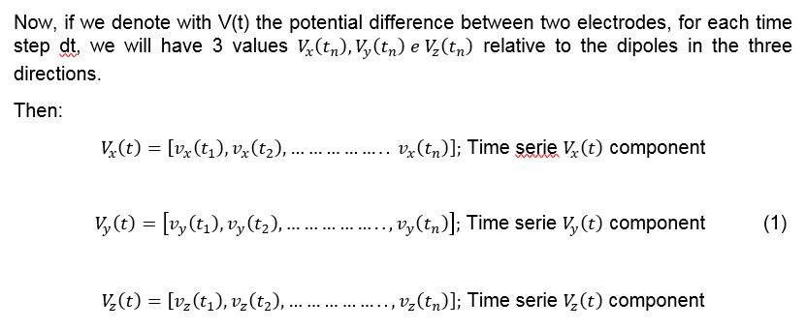
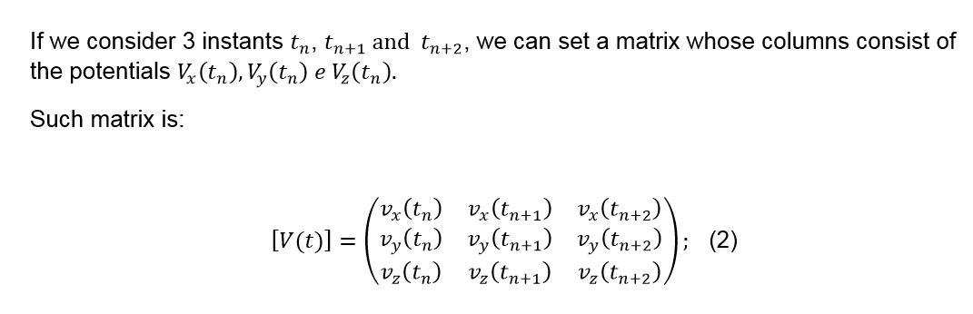
Mathematic framework

Slide 6
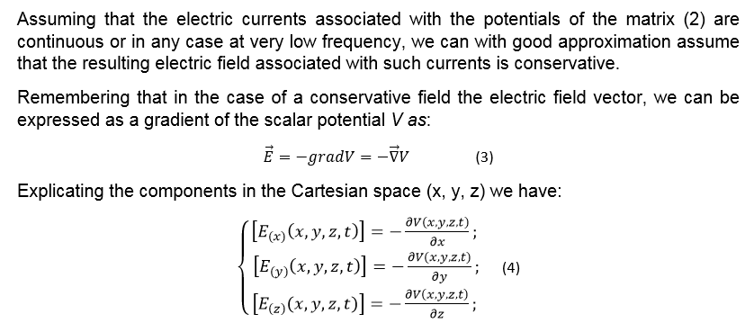
Mathematic framework

Slide 7
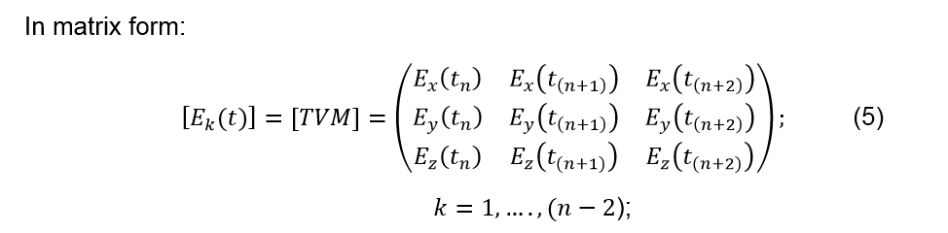
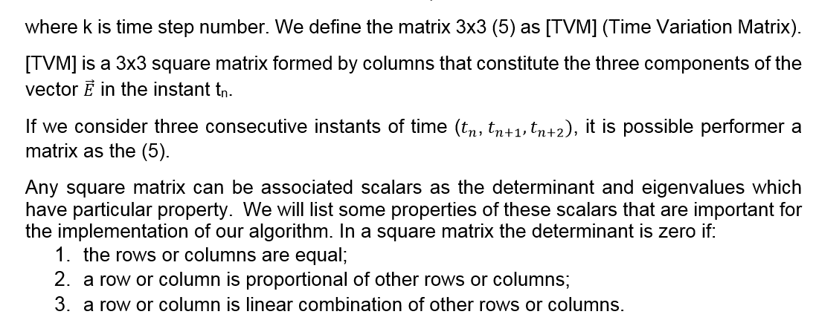
Mathematic framework

Slide 8
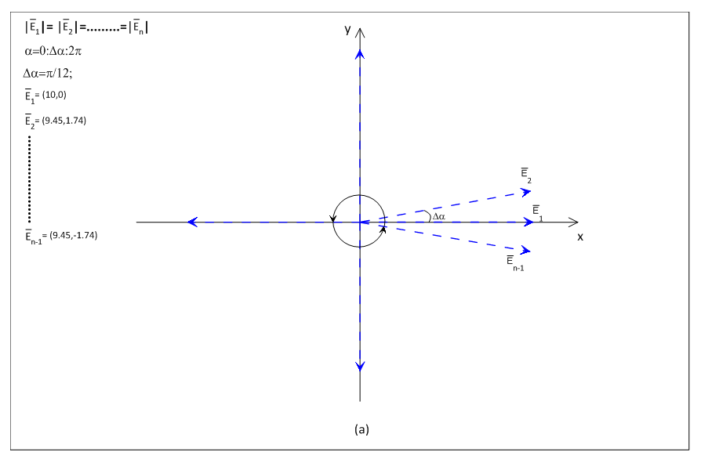


Synthetic data
Basic Assumption
First Case

Slide 9
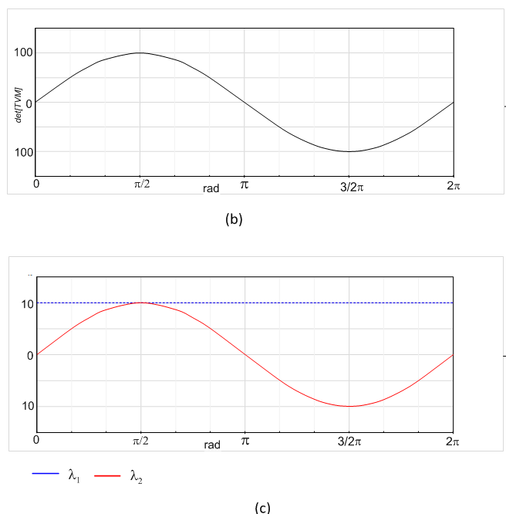
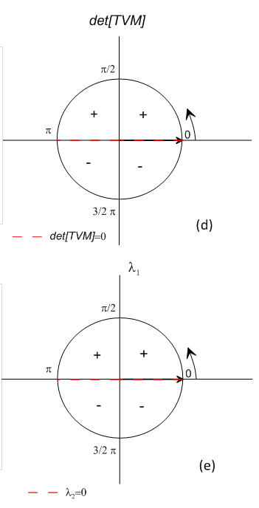
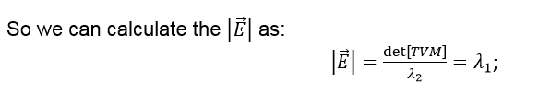

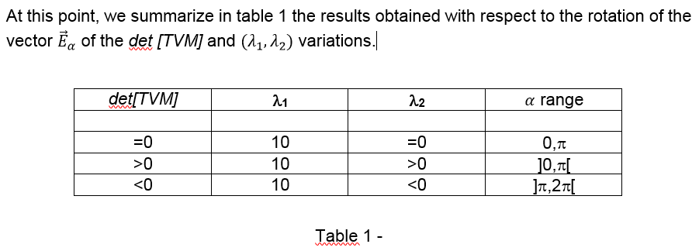


Synthetic data
Sign variation of the det[TVM] and of λ₁ , λ₂ and
the relative range rotation (α range)
(b) det[TVM] graph vs. 0,2π domain and (c) its sign variation on the goniometric circumference; (d) λ₁ and λ₂ eigenvalues vs.
0,2π domain and (e) their sign variation on the goniometric circumference.

Slide 10

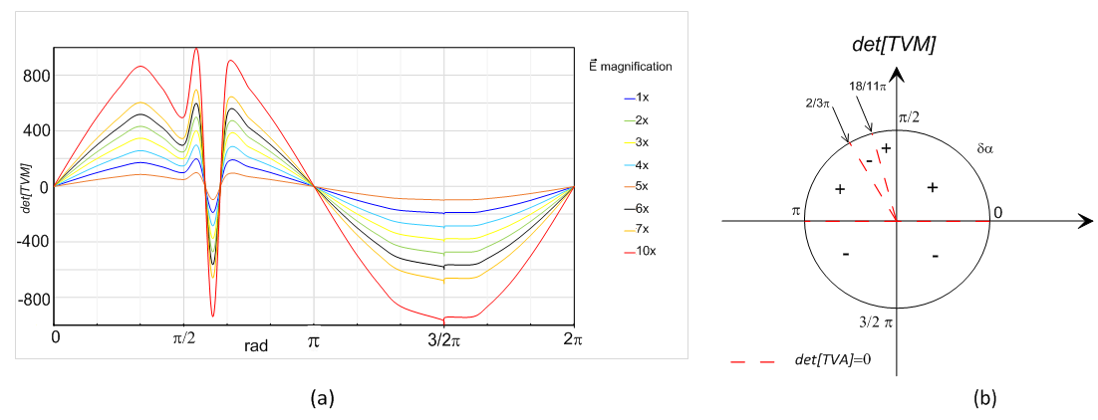
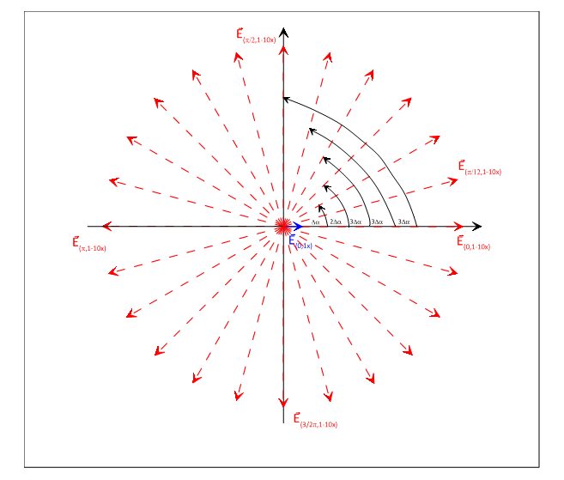
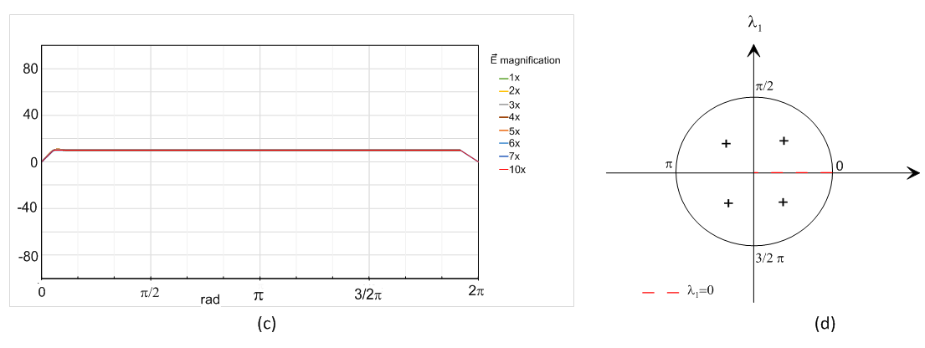
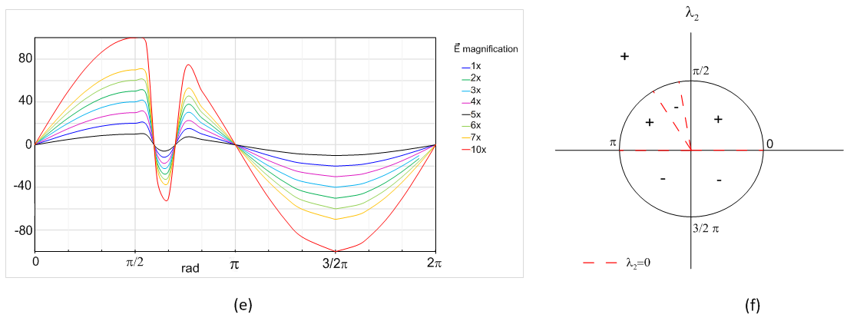

Synthetic data
Second Case:
and
variable

Slide 11

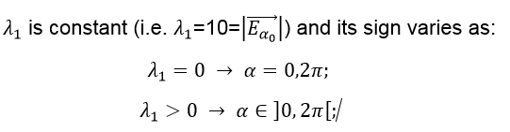
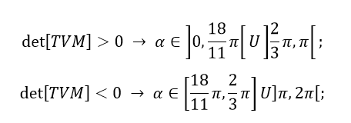
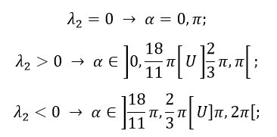
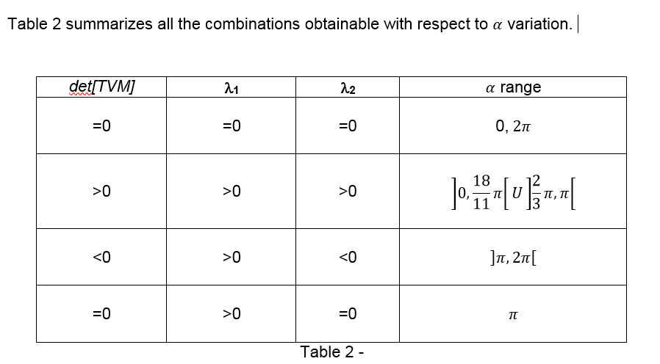
Synthetic data
II Case results

Slide 12
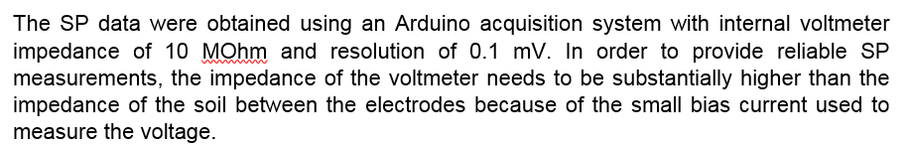
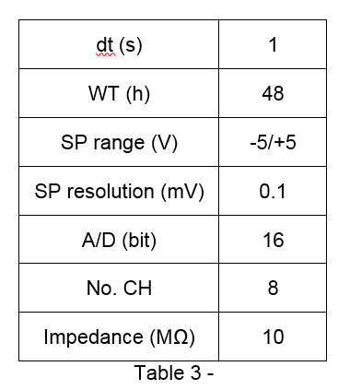
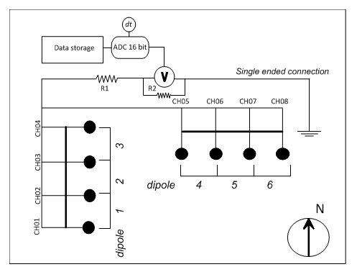

Acquisition system
Technical characteristic system and
acquisition parameters acquisition

Slide 13
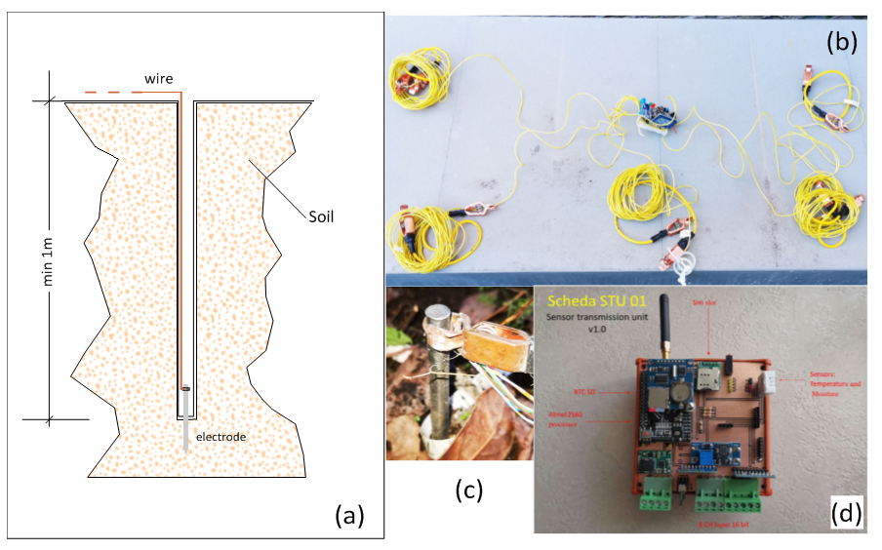
Acquisition system
Acquistion system: (a,c) detail electrodes installation in the ground; (b) connection cable system; (d) acquisition card

Slide 14
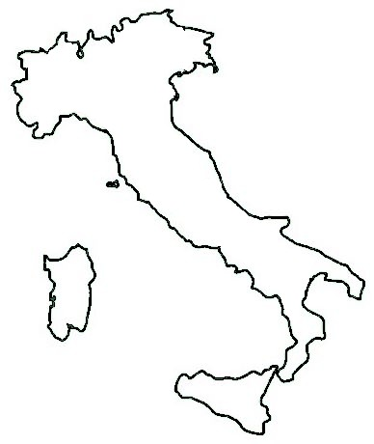
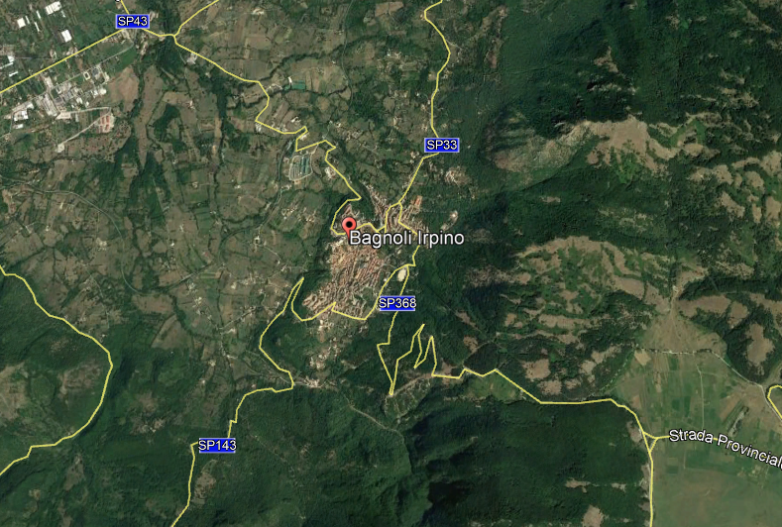
Test site: Bagnoli Irpino (AV)
I t a l y
Source: Google Earth Pro - 2020

Slide 15


Experimental data
(a) det[TVM] determinant vs. time;(b) eigenvalue vs. time; (c) eigenvalue vs. time; Initial modulus vs. time.

Slide 16
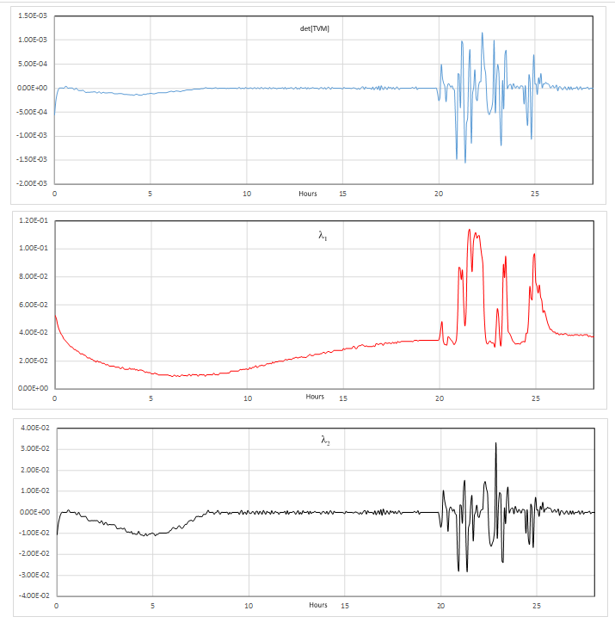
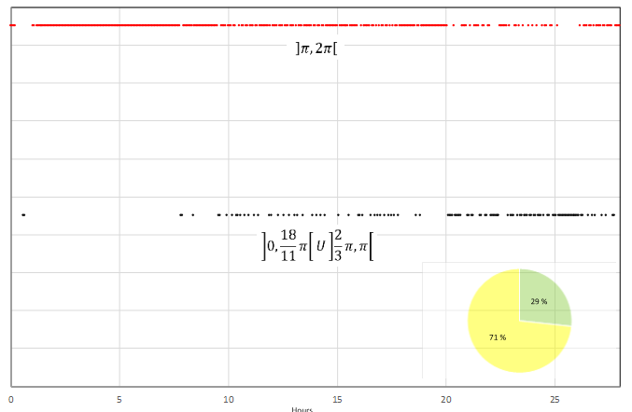
Experimental data
(b)
(c)
rotation distribution (in rad) vs. time and its absolute
percentage (lower right side); (b) det[TVM] determinant vs.
time; (c) eigenvalue vs. time; (d) eigenvalue vs. time.
(d)

Slide 17
Conclusion
  We apply the determinant and the eigenvalues of the [TVM] matrix approach to study the electrical field variation in the soil;
  The determinant and eigenvalues of the [TVM] describe good trend of the electrical field;
  - Experimental results show good quantitative agreement with synthetic results.
  Therefore, measuring the Self-potential (SP) on the soil, it is possible the environmental systems electric field monitoring by calculation of the determinant and the eigenvalues of the variable time matrix.

Slide 18
Thank You

