Slide 1
EGU2020 Virtually in Vienna Session SSS 8.2 8th June 2020
Exploring the potential for using hierarchical sediment fingerprinting as an urban management tool in monitoring changing sediment sources
Rory P. D. Walshª, Carla S. S. Ferreira^{b}, William H. Blake^{c}, Sam Higtonª & Antonio J. D. Ferreira^{b}
^{b} Department of Geography, College of Science, Swansea University, Swansea SA2 8PP, United Kingdom
ª Research Centre for Natural Resources, Environment and Society (CERNAS), College of Agriculture, Polytechnic Institute of Coimbra, Coimbra, Portugal
^{c} School of Geography, Earth and Environmental Sciences, Plymouth University, Plymouth, United Kingdom

Slide 2
Aims of the Presentation
Outline the potential of using a hierarchical (confluence-based) multi-proxy sediment fingerprinting approach for detecting and quantifying changing sediment sources (and soil erosion and degradation hotspots) in peri-urban and urban environments
First by summarizing its successful use in a Peri-urban catchment in Portugal
Second by presenting a step-by-step procedure for assessing its potential (or not) in other urban settings – and how to apply it
The importance of the spatial pattern of geology in relation to the drainage net and its confluences is emphasized - in relation to theory and messages from sediment fingerprinting in Borneo

Slide 3
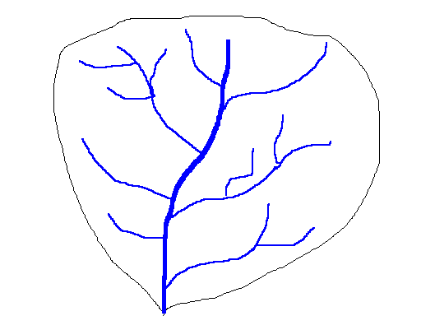




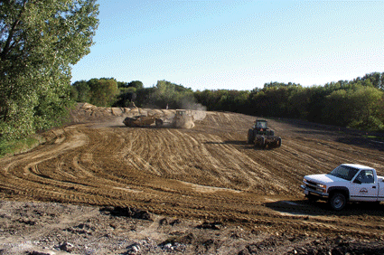
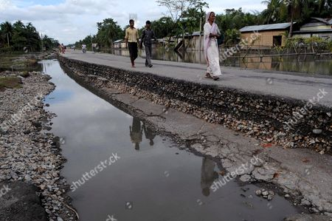

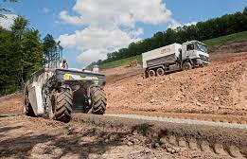

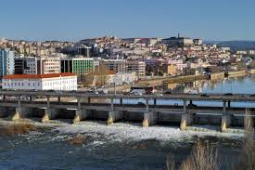
Peri-urban catchment
Sediment sources
Sediment transport
Sediment deposition
Impacts vary with landscape connectivity of the complex mosaic of urban and non-urban units!
Notes:
Information on the sources of sediment can help target best management practices at areas contributing disproportionately high amounts of sediment to streams. Management practices implemented in critical source areas have potential to be more effective at treating larger quantities of storm runoff.
The task to understanding the sediment transport processes at a catchment scale is complicated owing to high spatial and temporal variability of sediment erosion and deposition processes, within a catchment.

Slide 4
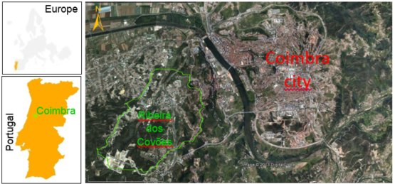
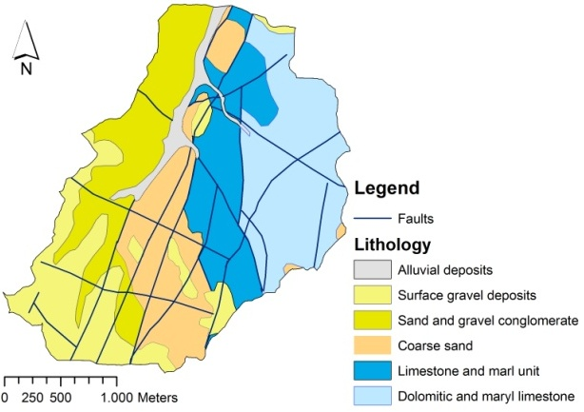
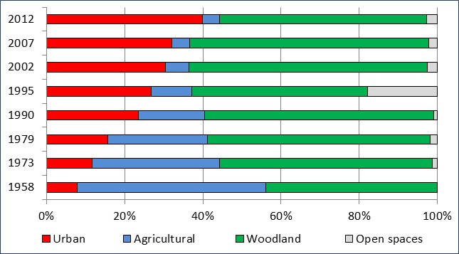
Study site: Ribeira dos Covões catchment
Size: 6.2 km²
Climate: Mediterranean (15°C, 979 mm)
Altitude: 35 m to 210 m
Slope: mean slope 9° (max. 46°)
Soils: Leptic Cambisols and Podsols
Fig. 1: Location of the study catchment.
Fig. 3: Land use change between 1958 and 2012.
Fig. 2: Lithology of the study catchment.
Notes:
Land use: 2012 - agricultural area 5%, urban 40% and woodland 55%
The catchment has contrasting lithology, including sandstone (56%) and limestone (41%) units, as well as alluvial deposits (3%) in the main valleys

Slide 5
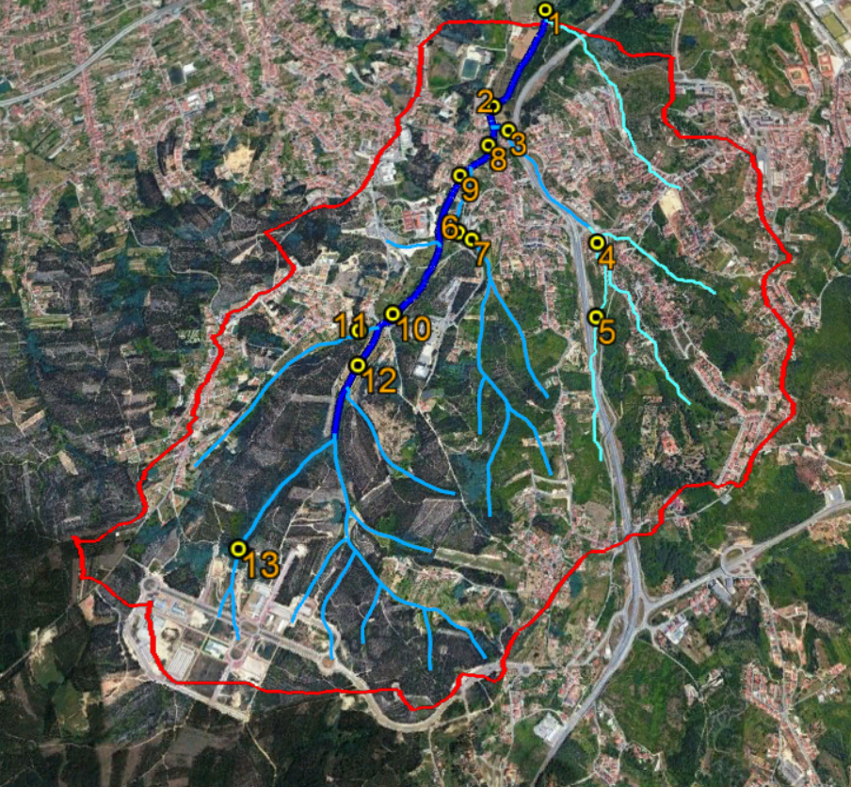
Methodology: Sediment Fingerprinting
Sampling/Analysis/Modelling
N
Surface bed sediments (of previous storms)
- 13 sites over the stream network
- Composite samples (0-2.5 cm)
Five sampling surveys 2012 – 2018
Sieving into < 63 micron, 63-125 micron and 125 micron – 2 mm fractions
XRF analysis
Unmixing modelling (Bayesian) on a catchment and step-by-step confluence basis
Legend
• Sampling sites
- Catchment
Water lines
- Perennial
- Ephemeral
- Intermittent
1000 m
Fig. 11: Location of bed sediment sampling sites.
Notes:
Relatively limited work has been done to identify sources of in-stream bed sediment in urban catchments using sediment fingerprinting
13 fluvial sediment sites were sampled. Each sample comprise a mixture of 10 surface samples.
Bed-sediments collected at the catchment outlet and in individual upstream sub-catchments
a long dry period (21/09/2012) (API₃₀= 3 mm); - construction of major road and enterprise park
a winter storm of relatively high rainfall intensity (23mm day⁻¹) (19/02/2015) (API₃₀= 39 mm); - consolidation of the enterprise park
after several storms in spring (22/04/2015) (API₃₀= 16 mm).
2018 – minor construction activities within the catchment

Slide 6
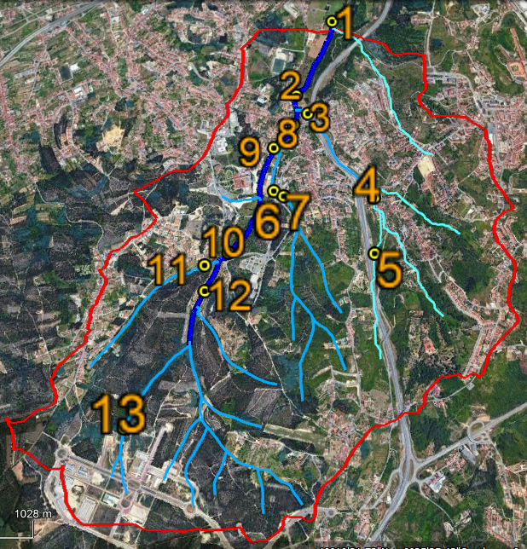
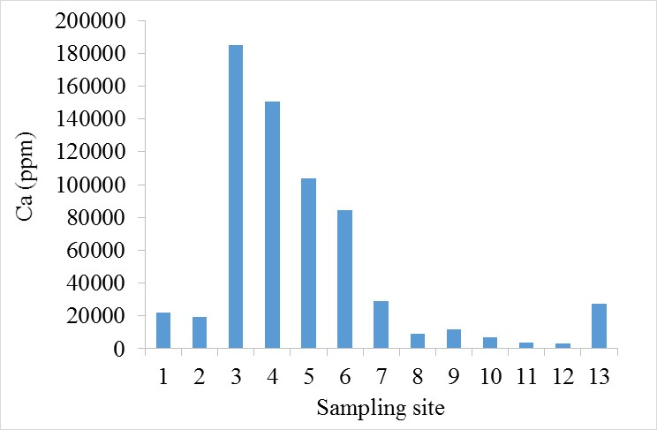
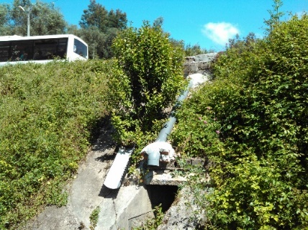
Spatial differences in geochemical properties of sediments
Major road
Limestone
Most urbanized
Road runoff
Construction
Limestone sites have greater concentrations of Ca, Sr and S (p<0.05);
Sandstone sites had greater concentrations of Zr and Si (p<0.05);
Metals are likely to be enhanced by urbanization and particularly road runoff inputs.
Notes:
Ca associated with construction
Sites receiving considerable road runoff displayed much greater concentrations of Cu than all the other sampling sites - comparison between 6 and 7; sites 3, 4, 5
Sr – strontium; S – sulfur
Si - silicon

Slide 7
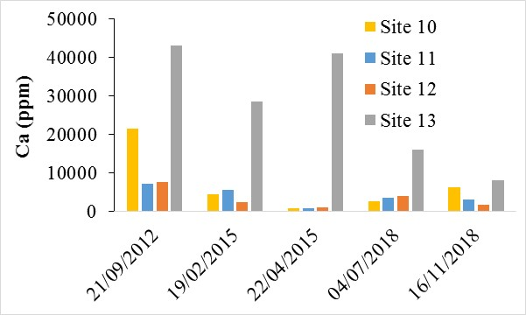
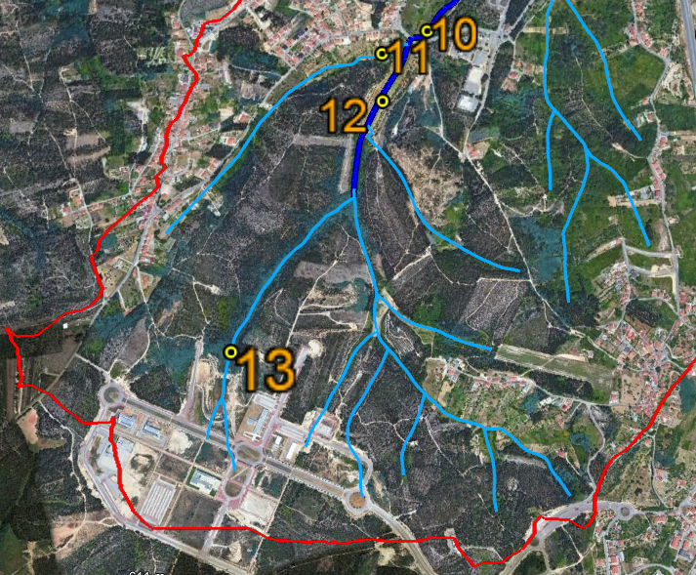
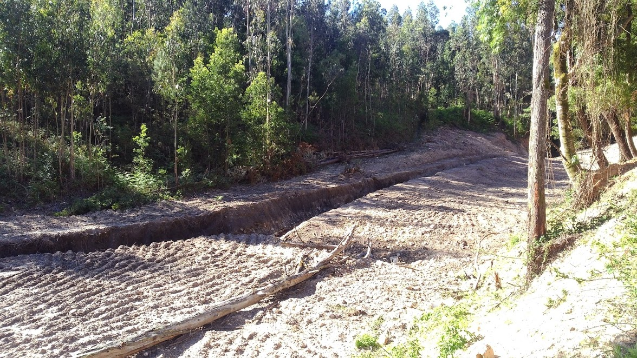
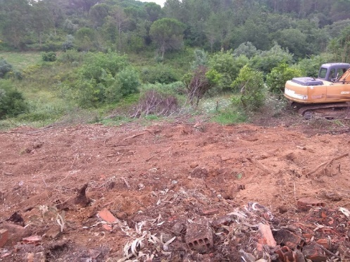
Temporal differences in geochemical properties of sediments
Enterprise Park
Kiwi plantation
Forest clear-felled
Fig. 15: Temporal differences in calcium concentrations between upstream sites 10 to 13.
There are significant temporal differences on sediment properties within individual sites (p<0.05);
E.g. Major differences driven by the stabilization of the enterprise park.
Notes:
Stabilization of the Enterprise park
Kiwi plantation in 2015
Deforestation in Site 12 in 04/07/2018

Slide 8
Wider application of the technique?
A Step-by-step procedure on whether and how to apply the hierarchical sediment fingerprinting approach in urban and peri-urban soil degradation management
Situational feasibility test
Fail ?
Give up or
Seek alternative strategy
Pass ?
Geochemical feasibility test
Fail ?
Fail ?
Pass ?
Initial sediment sampling survey, XRF analysis, discriminant analysis and modelling
Pass ?
Longer-term programme of post-storm bed-sediment sampling and monitoring
at a hierarchy of above/below confluence sites, the catchment outlet and soil sites
after storm events where all tributaries experienced fine bed-sediment movement
continuous discharge and turbidity monitoring at the catchment outlet
Subsequent XRF analysis of sieved fractions of samples from each storm survey
Unmixing modelling of successive geochemical results allows changes in sediment (and soil erosion) sources to be quantified - and inform urban soil management

Slide 9
Towards a Monitoring SystemA Step-by-Step Procedure – some notes
Assess situational feasibility for the urban or peri-urban area – focus on availability of usable drainage basins – these will usually be tributary systems, not the main river going through cities. Stream networks need to have bed-sediment sites (not gorges!!) and a reasonable number of urban confluences and sub-catchments
Geochemical feasibility test: tributary sediment in hierarchies need to be different from each other (or at least those of key interest) - THIS IS NOT ALWAYS POSSIBLE – see later slides for theory and examples
Carried out via a one-off detailed XRF sample survey, visual and (if promising), verified by discriminant analysis and Bayesian modelling
If successful establish a longer-term monitoring and post-storm sediment sampling programme
This ideally should comprise (1) a gauging station for either continuous or repeat-storm monitoring of suspended sediment and discharge at the catchment ‘outlet’ (either d/s of the target urban area or close to the confluence with a larger river) and (2) a network of sites for post-storm fine bed-sediment sampling strategically placed immediately above confluences (on each branch) and at the catchment outlet.
Periodic manual sampling (and subsequent XRF analysis) of fine bed-sediment after major storms, when all significant tributaries have experienced peak discharges and suspended sediment – and fresh sediment has been laid at the sites
Unmixing modelling of geochemical results inputted into an unchanging computer-based model, that is then run to indicate relative importance of sediment sources and any changes compared with previous occasions. Alternatively collected samples or analysed results could be sent to a commissioned university team!!
Monitoring of sediment source results and any changes to inform remedial actions by the municipal authority.

Slide 10
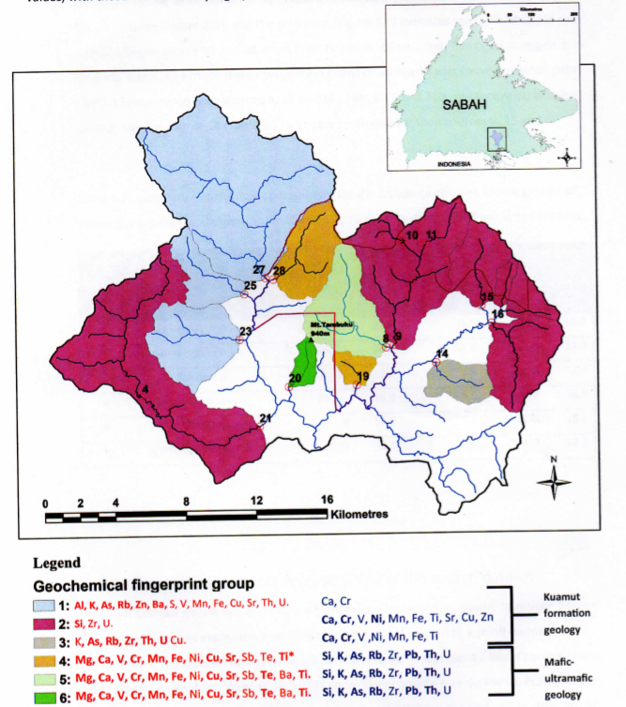
BRANTIAN CATCHMENT, SABAH (MALAYSIAN BORNEO): DYNAMICALLY CHANGING RAINFOREST AND OIL PALM LANDSCAPE
Distinctive Geochemical Fingerprint Groups in relation to the Sampling Hierarchy
Two major geological formations (Kuamut Formation and Mafic-Ultramafic Formation)
Six distinctive geochemical fingerprint groups (Red = high values of elements; blue = low values of elements)
Bed-sediment sampling sites: Black numbers = source tributary sub-catchments; Red circles = larger sub-catchments and entire Brantian catchment
Hierarchical (step-by-step confluence) approach allows sub-catchment sources with similar fingerprints, but spatially in different parts of the catchment, to be quantified
The same may apply in urban catchments, allowing quantification of different soil/sub-catchment sources
First, second and third rank
sampling (and historical core) sites

Slide 11
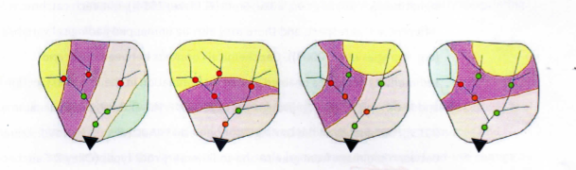
The role of patterns of geology in relation to the confluence pattern of drainage basins
Different colours represent geochemically contrasting geologies (and soils)
Different spatial arrangements of these geologies in relation to confluences either favour or prohibit successful sediment fingerprinting
Traffic light colours of circles downstream of confluences
indicate the likely success (green) or failure (red) of applying
the sub-catchment tracing technique at each site
….and hence the utility of the approach in a particular
urban/peri-urban soil degradation management setting

Slide 12
Conclusions
A hierarchical (step-by-step confluence-based) sediment fingerprinting approach using repeat sampling of bed-sediment geochemistry has been successfully applied in the Ribeira dos Covoes peri-urban setting to detect and quantify changing sources of sediment from soil erosion hotspots in the catchment.
The upstream Enterprise Park construction area, covering just 5% of the catchment area, was the main source of sediment in 2012, but somewhat less dominant in 2015 and 2018 with land stabilization – and an increase in erosion from a kiwi plantation was also successfully detected.
Although unable to be assessed and reported here (because of the Coronavirus Lockdown!! The technique may be enhanced by incorporating results using coarser fractions of bed-sediment.
A methodology for assessing its potential in a wider array of peri-urban and urban settings has been presented and explored, identifying some of the geological and drainage network settings where its use will be either favoured or precluded. Where settings are favourable, then the technique may prove an effective and relatively cheap management tool to detect and quantify new sources of soil erosion and degradation and target their mitigation;

